Slide 1
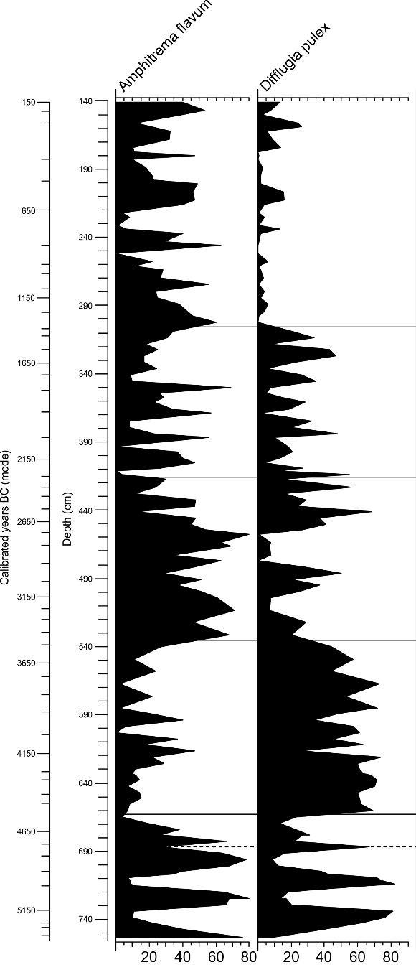
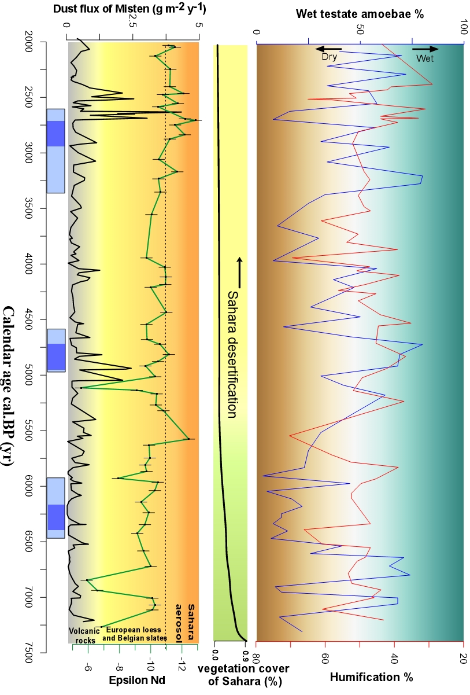
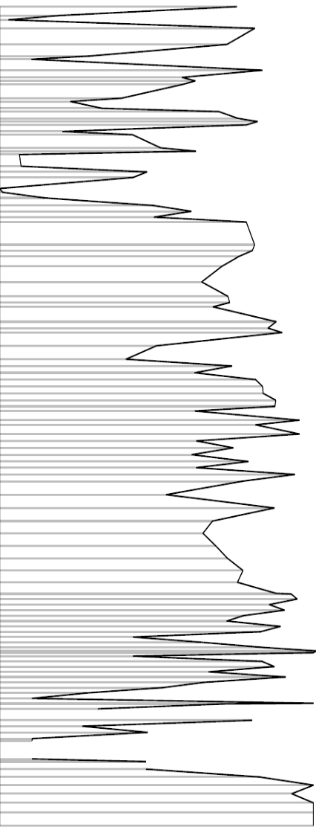
Calendar age BC (mode)
Calendar age BP (yr)
Wet Dry
2000
Tie-points
Time Intervals
E
D
C
B
A
3000
Base Fagus > 40%
XI
X QM/Fagus
3
8
97
6
5
4
3
2
1
5 6
X
3
Subboreal
4
5
4
Top Corylus CIV
6
Base Fagus >5%
4000
7 8
7
Top Corylus CIII
9 10 11
Years BP
8
9
Base Corylus CIII
IX
10
11
12
13
14
5000
12
13
Base Fagus
14
Base Tilia dom.
15
16
17
VIIIb VIIIa
15
A t l a n t I c
6000
16
17
Top Ulmus dom.
18
18
Ombrotrophic peat
Minerotrophic peat
7000
Cold events
−10
40
Top Corylus CI
Water table (cm)

