Slide 1
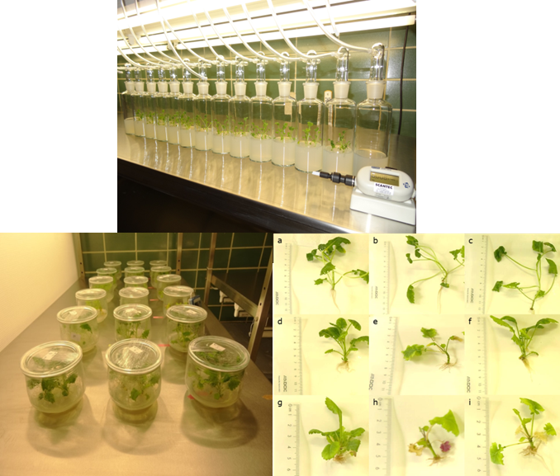
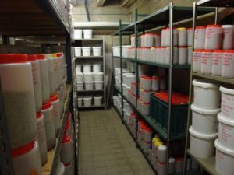
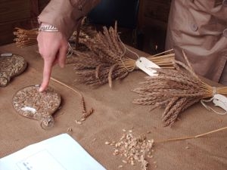
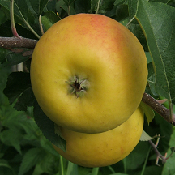
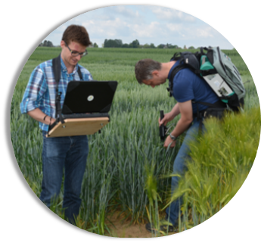
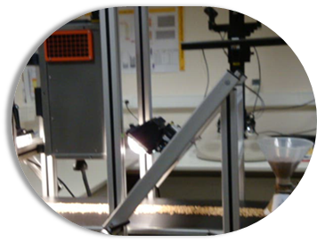
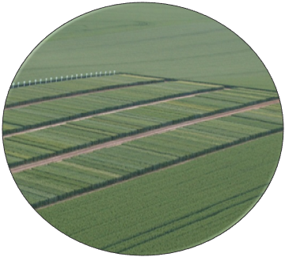
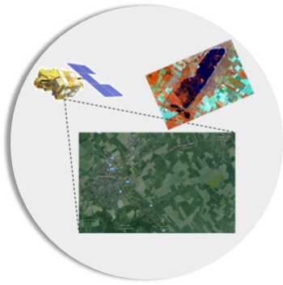
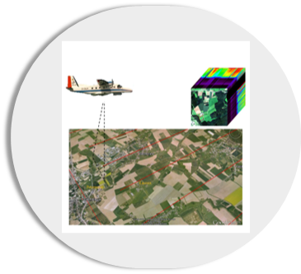
Plant phenotyping activities
at the Walloon Agricultural Research Centre
Damien Vincke⁵, Bastien Durenne¹, Dominique Mingeot¹, Emmanuelle Escarnot², Guillaume Jacquemin³, Feriel Ben Abdallah³, Yannick Curnel^{4,} Sergio Mauro¹, Pascal Geerts¹, Marc Lateur², Viviane Planchon⁴, Vincent Baeten⁵, Philippe Vermeulen⁵, Jean-Pierre Goffart³
Research Units: [1] Bioengineering [2] Breeding and biodiversity [3] Crops production systems [4] Farming systems, territory and information technologies, [5] Food and feed quality
Contacts: b.durenne@cra.wallonie.be & p.vermeulen@cra.wallonie.be
Molecular biology analysis
In vitro phenotyping
Collections
Field sensors
From controlled conditions …
Imaging sensors
Data science
… to field conditions
Network of trials
Satellite imaging
Aerial imaging
Walloon Agricultural Research Centre
To address today’s questions and to prepare tomorrow’s challenges
www.cra.wallonie.be
Bâtiment Léon Lacroix
Rue de Liroux, 9
- Gembloux
Belgium

