Slide 1
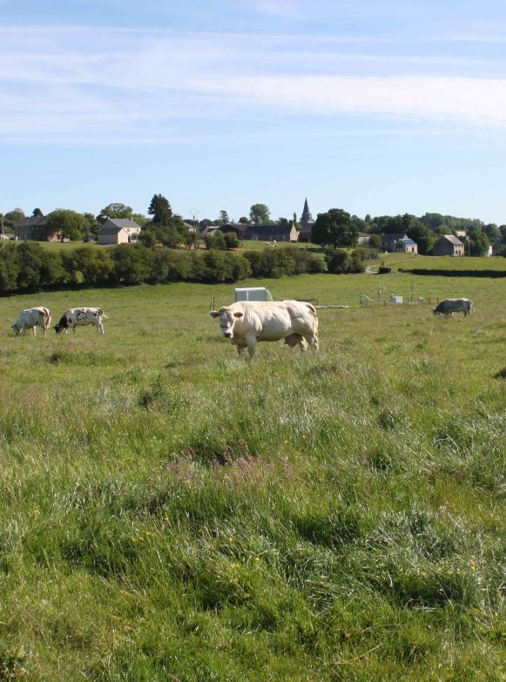



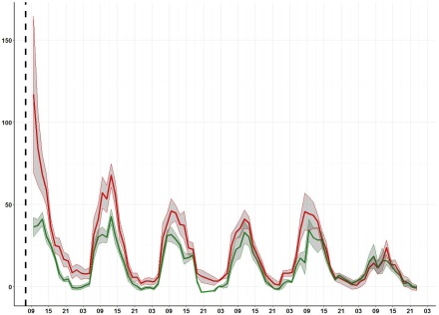


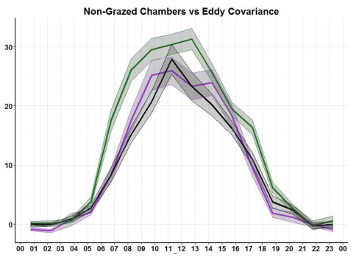
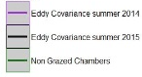
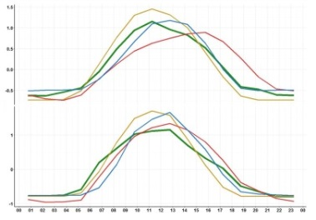
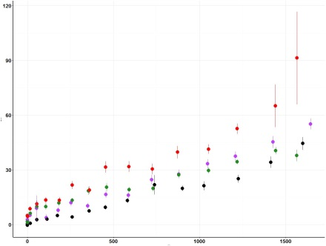
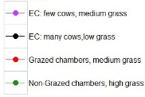
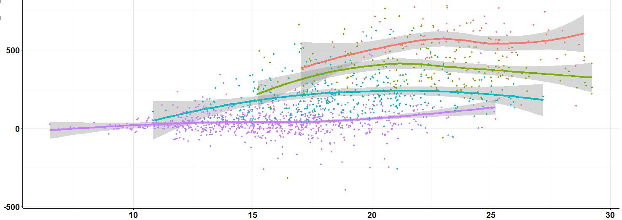
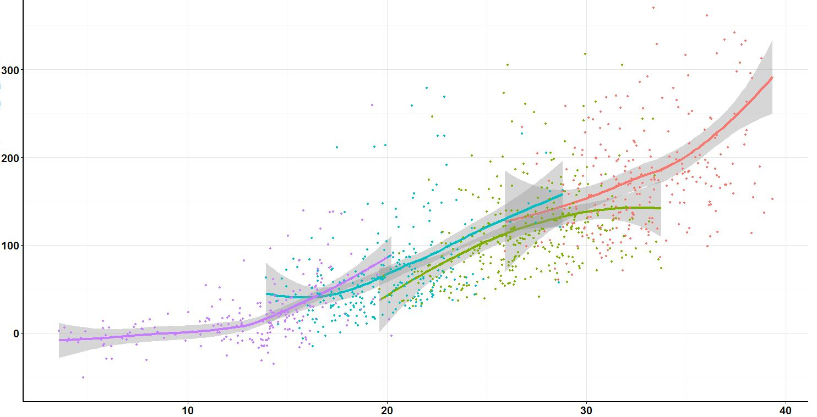
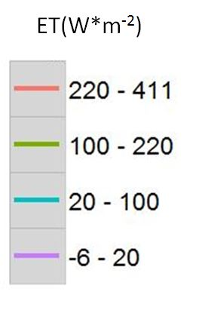
Environmental controls of methanol emissions from a grazed grassland in Dorinne, Belgium
Colin Michel¹, C. Amelynck³, M.Aubinet¹, A.Bachy¹, P. Delaplace², A.Digrado², P.Dujardin², M-l. Fauconnier², A.Mozaffar³, N. Schoon³, and B.Heinesch¹
Units of (1) TERRA Teaching and Research Center and (2) Agro-Bio-Chem , Gembloux Agro Bio-Tech , University of Liege and (3) Atmospheric Composition Division, Royal Belgian Institute for Space Aeronomy
Background & Objectives
VOCS have an important role in atmospheric chemistry
Few BVOC studies on grassland, none on grazed grassland so far
Poor understanding of the influence of (a)biotic stress on emissions
Methanol represents around 75% of the VOCs carbon cumulated flux of grasslands
Quantify methanol fluxes from a cow grazed grassland
Identify fluxes driving mechanisms and evaluate the impact of the grazing stress on methanol emissions
Material & Methods
Site characteristics:
Intensively grazed meadow (Average of 3.7 LSU.ha⁻¹ during the grazing season) located in Dorinne, Belgium (Condroz region). Mean annual air temperature of 10°C
66% graminaceous (mainly Perennial Ryegrass) and 16% legumes (mainly White Clover)
Measurement campaign:
Eddy covariance: May to November in 2014 and April to October in 2015 (with gaps)
Chambers: three two-week campaigns from August to September 2016
Instrumentation:
CO2, H2O concentration measured using a Infrared gas analyser
BVOC concentration measured using a conventional high sensitivity proton-transfer-reaction mass spectrometer (HS-PTR-QMS)
Meteorological, stocking density and biomass above ground (grass height) measurements
Eddy covariance : Methanol flux obtained per disjunct eddy covariance by mass scaning
Chambers : Methanol flux obtained with 3 non-grazed and 3 grazed automated dynamic flow-through chambers
Results: Impact of grazing and grass height
Chambers: Grazed vs Control
The first day, grazed grass emits 2.2 times as much as control grass (despite that no data can be collected for the first three hours)
The grazed/control emission ratio decreased every day after the grazing event and converge to one within 6 days.
ng(C)*m⁻² *s⁻¹
Results: Impact of stomatal conductance and climatic variables
hour
PPFD, ET and air temperature (AT) are the most correlated variables to the methanol flux but are strongly correlated to each other
Methanol fluxes for the 6 days just after grazing events in red (average for the 3 campaigns and 3 chambers) and non-grazed control in green
ng(C)*m⁻² *s⁻¹
EC data slightly lower than control chambers data, but grass height much lower( ~4cm vs ~14 cm)
In the same range of radiation, very stable EC data from one year to another
 |  | AT | PPFD | ET
EC | R | 0.57 | 0.82 | 0.80
 | Pcor_R | 0.18 | 0.47 | 0.28
Chambers | R | 0.84 | 0.83 | 0.83
 | Pcor_R | 0.31 | 0.31 | -0.04
hour
Correlation coefficient and partial correlation coefficient with the methanol flux for the EC data (summer 2014 and 2015) and the non grazed chamber data
No Units
Eddy Covariance
Air temperature dynamic different in a chamber than outside (greenhouse effect in the chambers)
Earlier methanol pic for the cuvette data
hour
Mean diurnal evolution of methanol fluxes for the eddy covariance method in the summer 2014 and 2015 and control chambers. For comparison, all periods have similar PPFD average.
Non-Grazed chambers
Relative impact of grazing and aerial biomass
Higher grass and higher stocking density normally lead to higher emissions
For the EC: the impact of the Grass Height (r=0.45,Pcor_r=0.234) is much more important than the stocking density (r=0.29, Pcor_r=0.003)
Clear contrast with the chambers: where the impact of grazing clearly is much more important than the impact of the grass height (r=-0.22!)
Hour
ng(C)*m⁻² *s⁻¹
Standardized one and a half-hourly mean of ET, PPFD, air T°,PPFD,ET and M33 flux for the Eddy Covariance Data (summer 2014 and summer 2015 together) and non Grazed chambers (last grazing more than 8 days ago)
Much higher correlation of the temperature with the methanol flux for the chambers data
The influence of the ET on the methanol flux seems negligible for the chambers data (clear contrast with the EC data)
PPFD (μmol/m²/s)
ng(C)*m⁻² *s⁻¹*dry_weight⁻¹
Eddy Covariance
Example of methanol flux response to PPFD of two contrasting periods for each method. EC: May 2014 (mean_H=6.3 cm, mean_SD=1.9 LSU.ha⁻¹), and August 2014 (mean_H=4 cm, mean_SD=5.6 LSU.ha⁻¹) Chambers: next 8 days after grazing event, grazed(mean_H=7.3cm) and control(mean_H=13.9cm) chambers
Non-Grazed chambers
Temperature(°C)
Conclusions & hypothesis
M33 flux per kg of dry grass response to temperature for different class of ET for the Eddy Covariance day data (summer 2014 and summer 2015 together) and non Grazed chambers day data (last grazing more than 8 days ago)
Grazing induces higher emissions of methanol but it is only detectable when measuring accurately with chambers
Light has a strong influence on the flux, both at the pasture and at the chamber scale
Temperature might have a stronger impact when the temperature range is higher and the temperature cycle is closer to the radiation and ET cycle (in the chambers)
Stomatal conductance might have an higher impact at the pasture scale that at the chamber scale (possible impact of a higher grass height in the chambers)
Acknowledgement
- This research is funded by the FNRS via the CROSTVOC project
- This research is only possible thanks to the Dorrine pasture owner: M^{r} Adrien Pacquet

