Slide 1
Continuing education with MOOCs
the case of children’s literature in French-speaking world
Björn-Olav Dozo¹, Jeff Van de Poel², Valérie Centi³,
Daniel Delbrassine ⁴, Vincianne D’Anna⁵, Éric Haubruge⁶
¹CIPL, University of Liège (bo.dozo@ulg.ac.be)
²IFRES, University of Liège (jfvandepoel@ulg.ac.be)
³Section pédagogique, Haute École Charlemagne (valcenti@hotmail.com)
⁴Department of French and Roman Literature, University of Liège (Daniel.Delbrassine@ulg.ac.be)
⁵University of Liège (vinciannedanna@gmail.com)
⁶ Prime Vice-Rector, University of Liège (e.haubruge@ulg.ac.be)

Slide 2
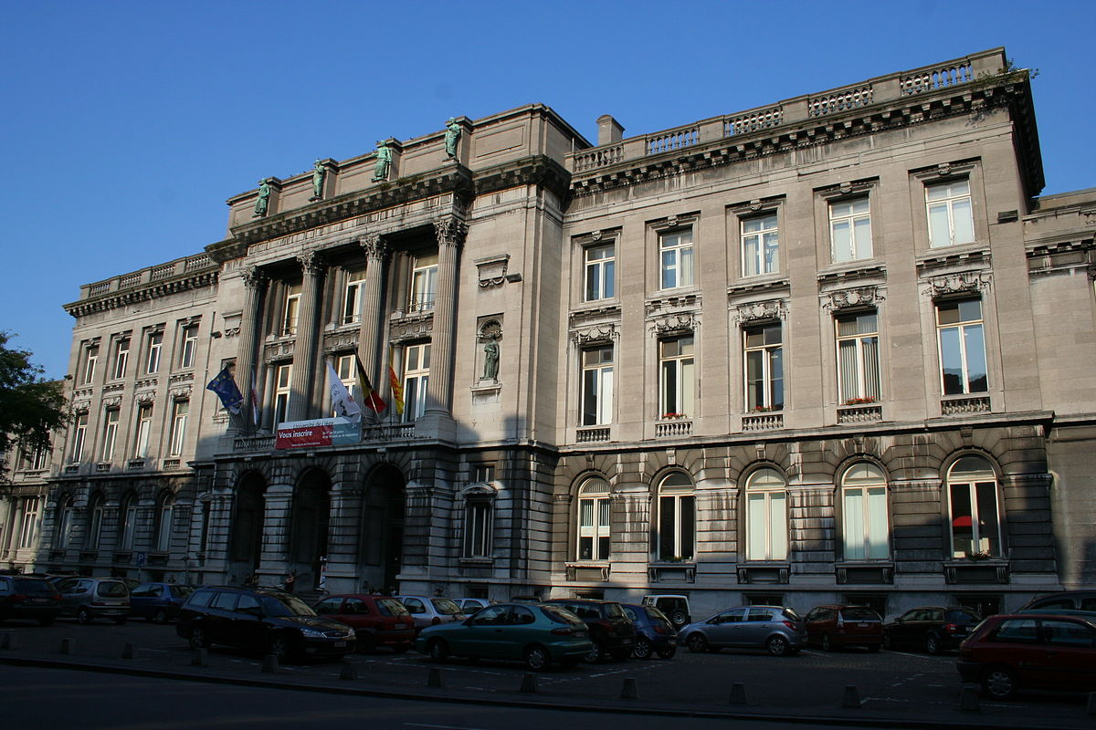
About Liège University
Public university of the French Community of Belgium
Established 1817
Rector : Prof. Albert Corhay
Academic staff: 2,800
Administrative staff: 4,300
Students : 22,000
Location : Liège, Wallonia, Belgium
Campus : Urban, suburban
Website : www.ulg.ac.be

Slide 3
The challenge of continuing and lifelong education
Objective : enhance competences of professionals
Adaptation of
Schedule
Contents
Teaching approaches
Notes:
Continuing education poses a challenge to the university: the objective is to allow professionals on the job market to enhance their competences through curricula adapted to their needs, both in terms of schedule and contents as well as teaching approaches applied.

Slide 4
Children’s literature
Pilot project for ULiège
Growing interest for the field in the civil society : teachers, librarians, members of cultural administrations… or simply parents …
Popular culture already in the Arts faculty program : long expertise in the field
Notes:
In its MOOCs policy, the University of Liège has identified this priority axis precisely to meet this requirement of schedule, contents and teaching approach. Already taught at the ULg, children's literature offered a perfect option for its pilot project. Popular culture studies are already one of the specificities of the Arts faculty program, and the University thought important to allow for a wider access to this teaching, responding to a growing interest from the civil society.

Slide 5
Problem description
Existent offer in chidren’s literature teaching : very few
One of the subject areas taught in secondary schools in French-speaking Belgium
Teachers are not trained !
Notes:
Up to now, there were, in French-speaking Belgium, only very few training opportunities on children's literature, based on cutting-edge scientific research, aimed at future or already established teachers. Although children's literature is one of the subject areas taught in secondary schools in French-speaking Belgium, it is not compulsory in the curriculum of aspiring French teachers at higher education institutions (whether universities or hautes écoles). Teaching children's literature thus depends on the teacher's good will !

Slide 6
Proposed Solution : MOOC
large-scale but cost controlled solution
open to anyone looking for this specific training
offering a certificate with a professional value
Notes:
Hence the importance of finding a way to train teachers in a subject area they have to teach to secondary school students by putting forward a large-scale but cost controlled solution, open to anyone looking for this specific training, and offering a certificate with a professional value

Slide 7
MOOC : pedagogical challenge
innovative teaching format distinct from the practices generally in force
especially adapted to the adult-learning in terms of pedagogical approach
Notes:
It was also important for the university to propose an innovative teaching format distinct from the practices generally in force and especially adapted to the adult-learning in terms of pedagogical approach (Thorpe,Edwards,Hanson, 1993)

Slide 8
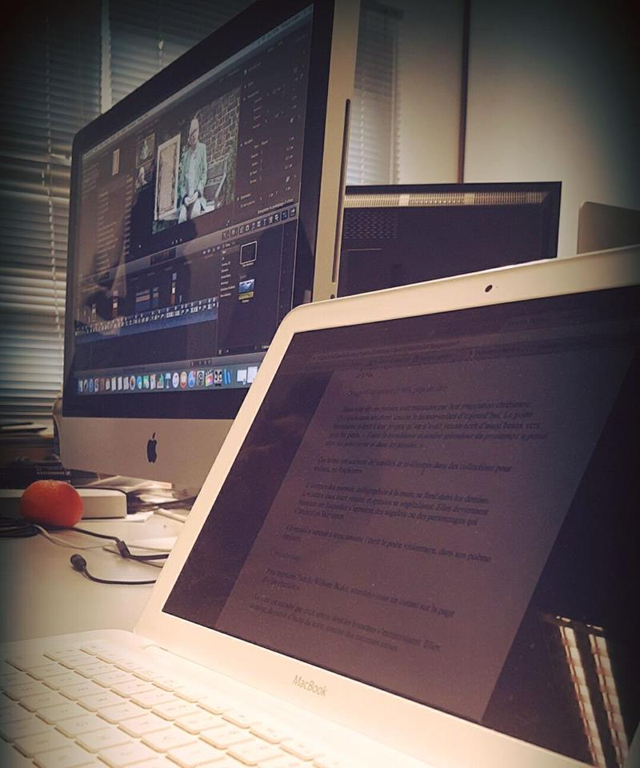
MOOC : production challenge
relative inexperience of the teaching staff in multimedia teaching
BUT :
supported by a team of instructional designers and a production staff with experience in the creation of online contents for the University's online education platform
Notes:
Choosing the MOOC format was an important challenge: on the production level, above all, given the relative inexperience of the teaching staff, supported by a team of instructional designers and a production staff with experience in the creation of online contents for the University's online education platform (but the scale was quite different)

Slide 9
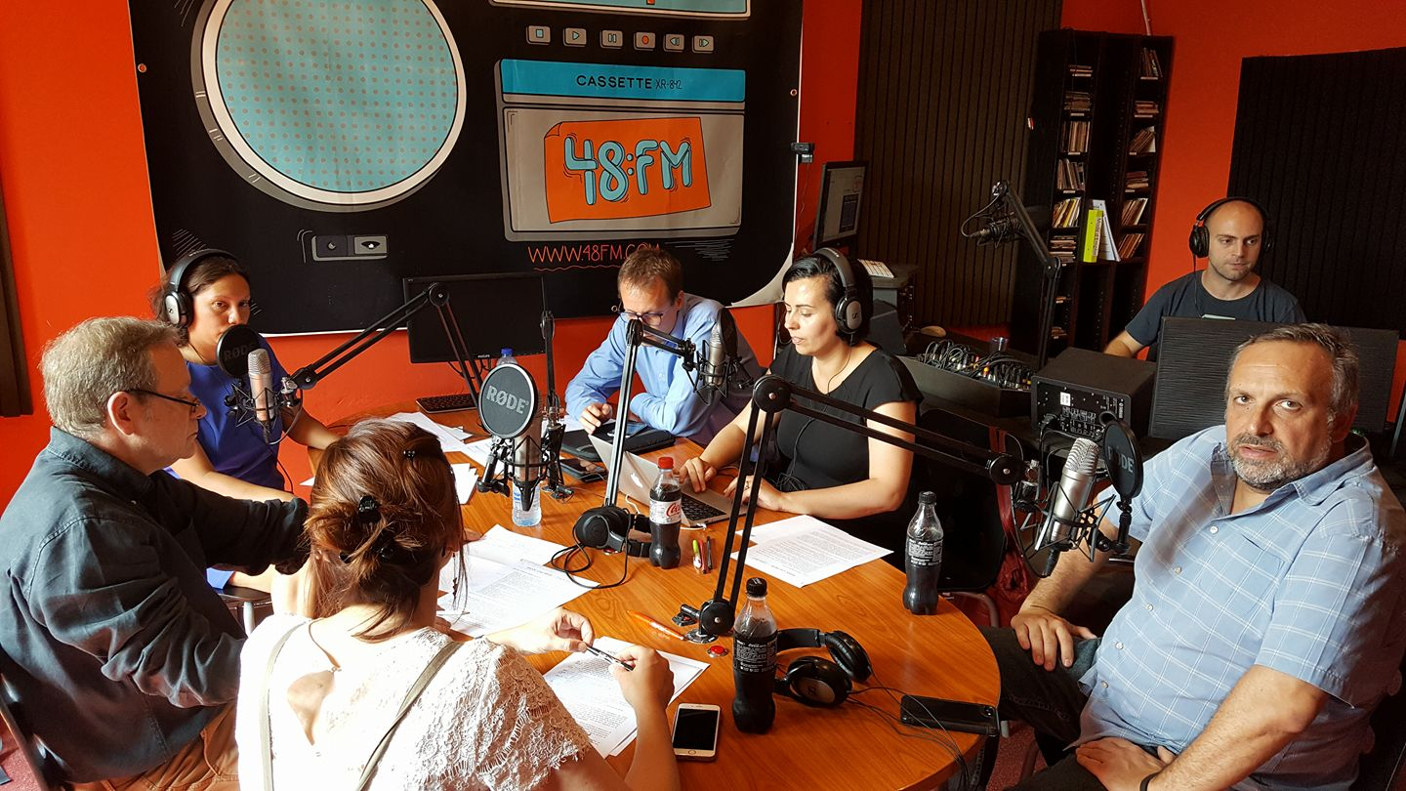
MOOC : reception challenge
expected audience is not particularly in line with digital technologies
bookish readers are not known to be new technology buffs
Notes:
On the reception level, it was also a challenge given that the expected audience is not particularly in line with digital technologies: MOOCs on literature are not the most common ones, and bookish readers are not known to be new technology buffs.

Slide 10
What’s in the MOOC ? (1)
Six weeks
Each week about a theme
Introduction about law, audience, specificities of children’s literature
Two main genres : the novel and the album
Publishing market
Digital literature
Fictions beyond the book
Notes:
The MOOC offers a selection of topics related to the field of children's literature, each under the responsibility of one team member, generally supported by experts. The MOOC tackles two main genres, the novel and the album, presents the publishing market, elaborates on digital literature and explores fictions beyond the book; it includes videos, quizzes, integrative activities, and feedback through forums.

Slide 11
What’s in the MOOC ? (2)
Videos
Quizzes
Integrative activities (writing skills)
Feedback through forums

Slide 12
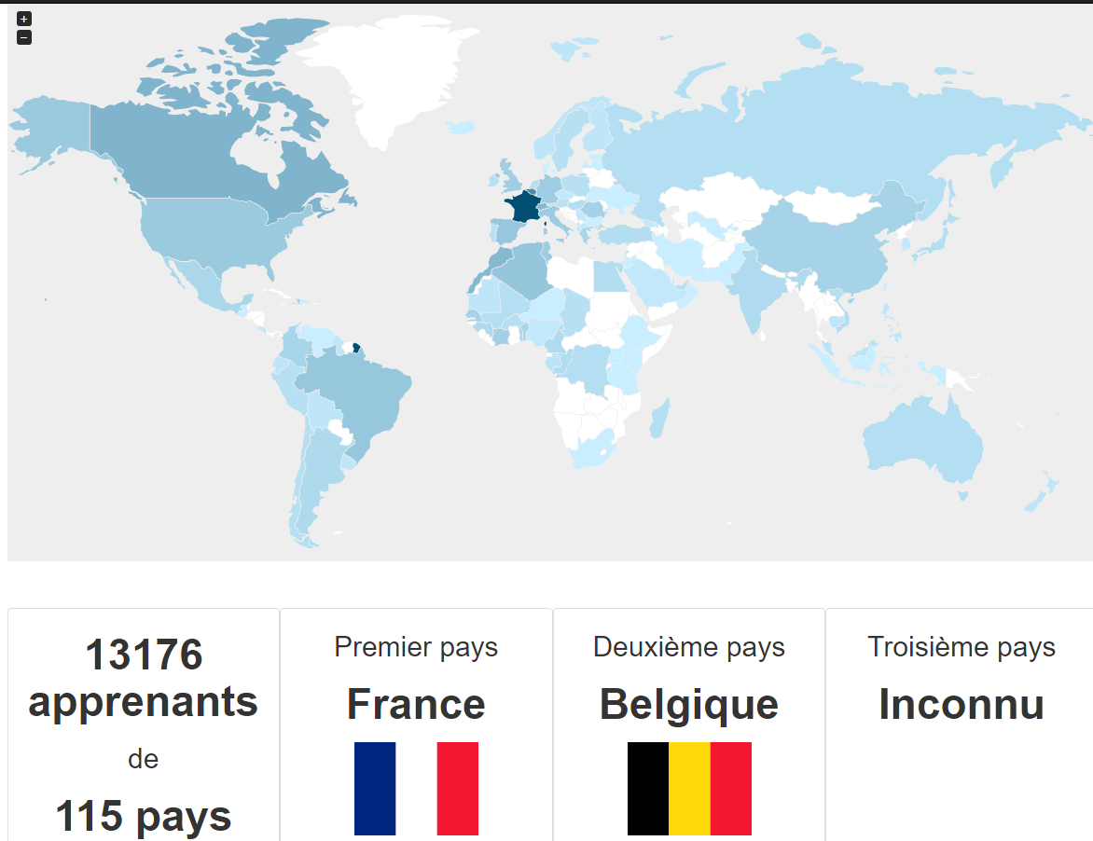
First audience
First session ended in May 2017
13400 subscribers (quite above the average for MOOCs in French)
For most subscribers : their first MOOC experience
Notes:
The first session, ended in May 2017, was a success, with more than 13400 subscribers, quite above the average for MOOCs in French. This is, for many subscribers, their first MOOC experience.

Slide 13
Feedback on forums
Very reactive
Quite a problem : we can’t answer to everyone
➔the learners answer to and help each other
general willingness to participate in the construction of collective knowledge useful for everyone
Notes:
the motivation and investment of the community is remarkable: the forums are very active, the learners answer to and help each other. The feedback is extremely positive, showing a general willingness to participate in the construction of collective knowledge useful for everyone. The information collected from participants is also an early success indicator in terms of population target.

Slide 14
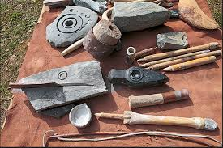
Next iteration of the MOOC
A dedicated community manager
Less experimentation with technical tools

Slide 15
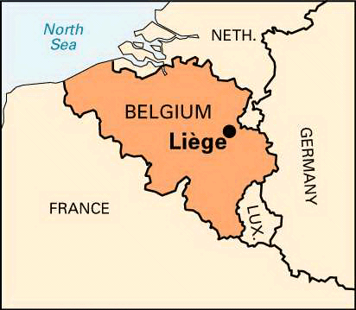
The future : a summer school
implement a blended learning element to our MOOC
After the MOOC, a selection of participants (based on applications) will take part to a course in person
Notes:
Given this initial success, and in order to enhance this in-depth continued training, the teaching staff is envisioning for next year to develop a summer school linked to the MOOC and implement a blended learning element to our MOOC. The participants would first have to follow the MOOC and complete the required activities, in order to be granted certification. Afterwards, a limited number of these participants (probably around fifty) will be selected based on applications to participate in person to a course that would expand on the introduction to the subject offered by the MOOC. This training would highly benefit from the exceptional resources that the city of Liège holds for children's literature: the Michel Defourny archive, holding more than 30000 pieces, is indeed a unique site in Europe which deserves a better valorization from the University.

Slide 16
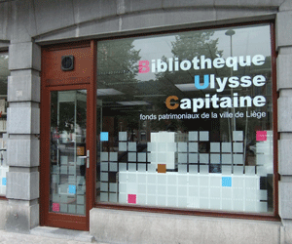
Resources in Liège
Teacher : Daniel Delbrassine
Michel Defourny archive, holding more than 30000 pieces, is a unique site in Europe

Slide 17
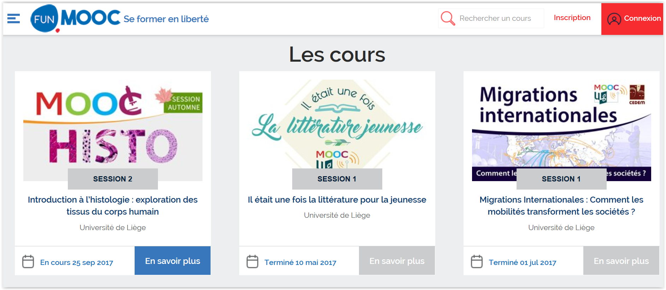
Our mooc is available on FUN
https://www.fun-mooc.fr/universities/universite-de-liege/

