Slide 1
Pathologies of reproduction
in beef cattle
Prof Ch. Hanzen, Dr A-S Rao
Université de Liège Faculté de Médecine Vétérinaire RUMEXPERT association
Courriel : Christian.hanzen@ulg.ac.be Publications : http://orbi.ulg.ac.be/
Facebook : https://www.facebook.com/Theriogenologie
Facebook : https://www.facebook.com/RumeXperts/
Warsaw october 2017

Slide 2
What I would like to tell you
Some characteristics on bovine meat production
What kind of reproduction performances for beef cattle
Some figures for first calving and calving interval in France and Belgium
Some specific factors affecting the reproduction performances in beef cattle
Uterine hypoplasia in Belgian Blue heifers
Dystocia and C section
Aseptic fibrinous parietal peritonitis
Pathologies of the postpartum
Postpartum anoestrus
Fertility
Hormonal management of reproduction : heat synchronisation

Slide 3
Some caracteristics on bovine meat production

Slide 4
European (28) livestock population in 2015
Bovine
< 1 y : 29,9 %
1 + 2 y : 20,4 %
> 2 y : 48,7 %
Dairy cows
23,56 millions
Non dairy cows
12,03 millions
http://ec.europa.eu/eurostat/statistics-explained/index.php/Agricultural_production_-_animals

Slide 5
European bovine population (millions) in some countries (2015)
http://ec.europa.eu/eurostat/statistics-explained/index.php/Agricultural_production_-_animals

Slide 6
European (28) meat production (2015)
http://ec.europa.eu/eurostat/statistics-explained/index.php/Agricultural_production_-_animals

Slide 7
European production of bovine meat (2015)
http://ec.europa.eu/eurostat/statistics-explained/index.php/Agricultural_production_-_animals

Slide 8
Some caracteristics of polish meat consumption and production
- 2.100.000 dairy cows
- 169.000 beef cows (50.000 pure breed : 75 % Limousine)
- 90 % of the produced meat is exported
Pig
Chicken
Evolution of the meat consumption
in Poland (Kg/people/year)
Beef

Slide 9
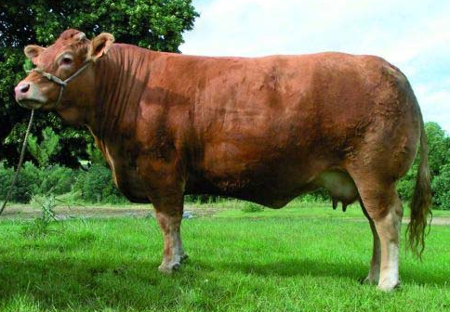
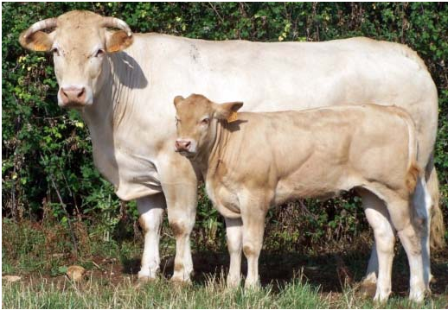
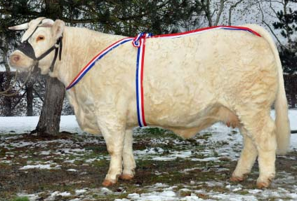
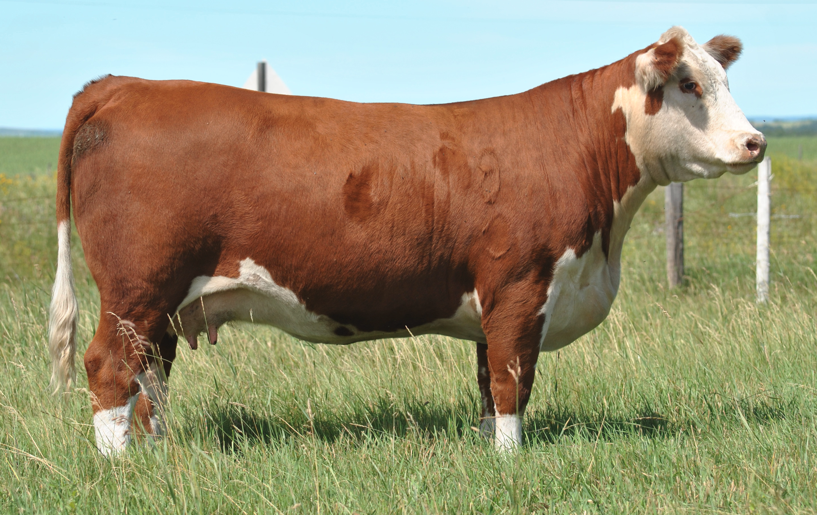
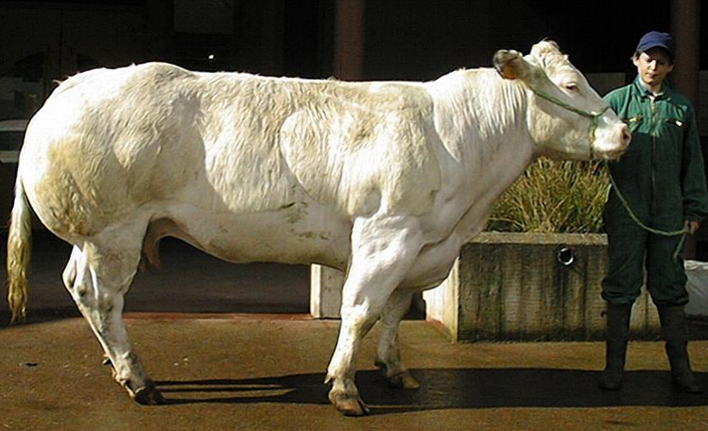
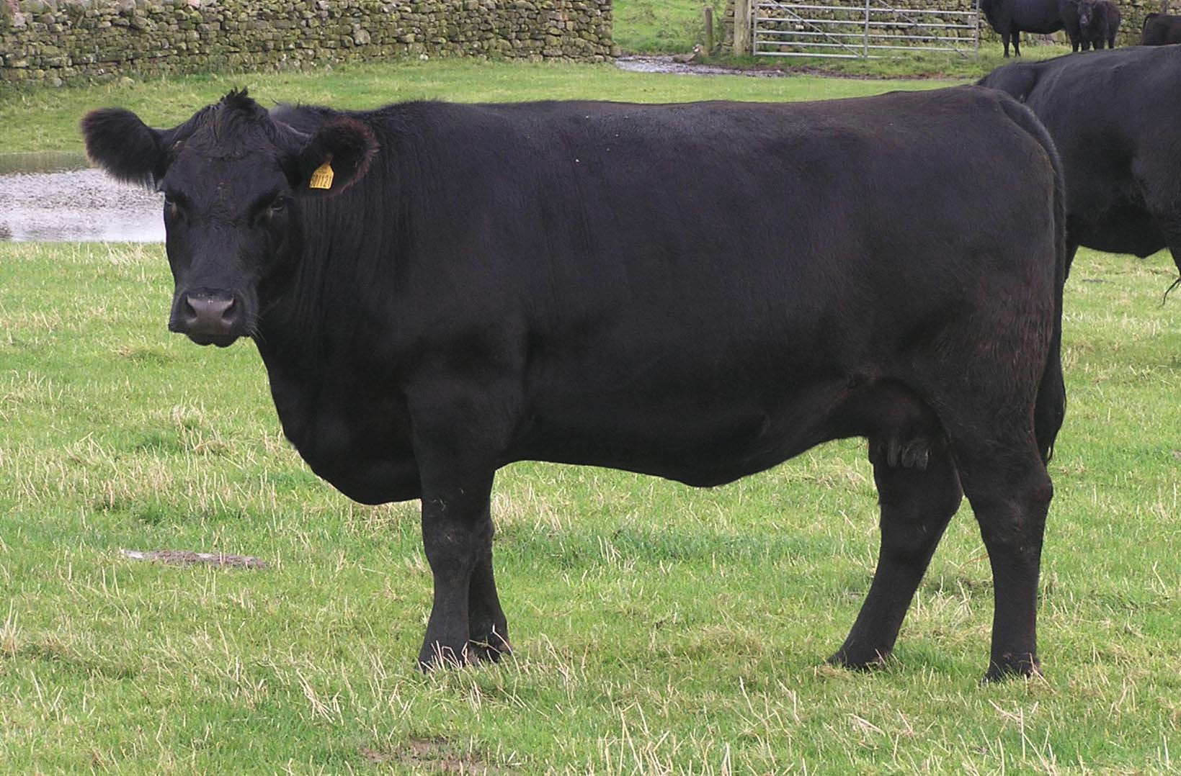
Limousin
Blonde d’Aquitaine
Charolais
late-maturing breeds
Some meat bovine breeds
early-maturing breeds
Hereford
Belgian Blue
Aberdeen Angus

Slide 10
How to define a reproduction problem in beef cattle ? Some data

Slide 11
Some targets for a beef herd (Diskin and Kenny Theriogenology 2016)
Calving interval : 365 days
Birth – first calving interval : 24 months
Less than 5% cows culled annually as barren
Greater than 95% of cows calving to wean a calf
Compact calving with 80% of cows calved in 42 to 60 days
Replacement rate 16% to 18%
Close alignment of calving date with onset of pasture availability in the spring

Slide 12
Some data observed in different european countries for different beef breeds

Slide 13
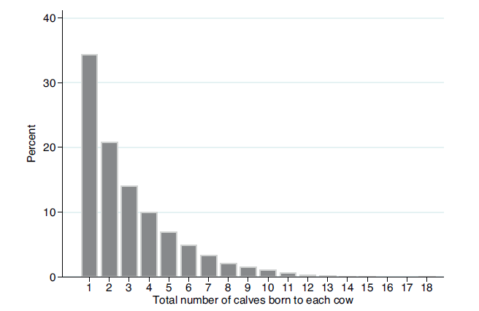
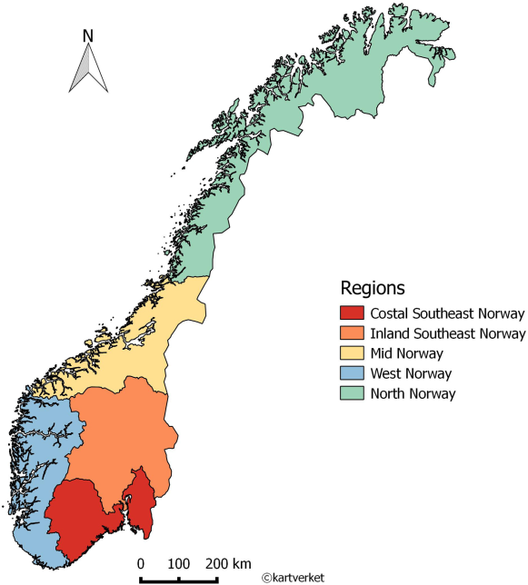
Number of calves of produced by 17,863
slaughtered beef norvegian cows
(Norwegian Red, Charolais, Aberdeen Angus, Limousin)
Holmoy et al. Preventive veterinary medicine 2017
The median age of cows
at slaughter was 3.8 years
Longevity
The average number
of calves per cow is 2 (1 to 18)

Slide 14
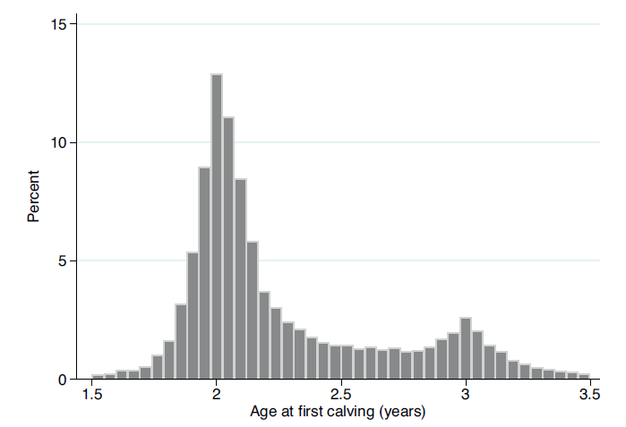
Age of first calving of 16,917 beef slaughtered norvegian cows (Norwegian Red, Charolais, Aberdeen Angus, Limousin)
Holmoy et al. Preventive veterinary medicine 2017
76 % < 2,5 years

Slide 15

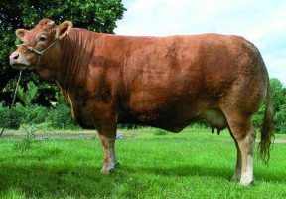

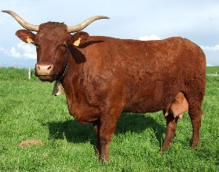
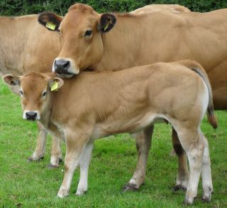
Some caracteristics of french beef breeds (2013)
(data from Référentiel Bovins croissance)
N cows
1.512.000
1.109.000
499.000
199.000
218.000
46.000
 | Charolais | Limousin | Blonde Aquit | Aubrac | Salers | Parthenais
N farms | 3623 | 2710 | 2112 | 829 | 597 | 256
N cows | 73 | 65 | 51 | 63 | 62 | 75
% AI | 33,4 | 20,0 | 20,0 | 21,0 | 21,6 | 35,8
CW | 438 | 409 | 493 | 365 | 379 | 470
Belgium 2016
457.000 beef cows
531.000 dairy cows
France 2017
4.042.000 beef cows (87.000 farms)
3.784.000 dairy cows (67.000 farms)
CW : carcass
weight (Kg)

Slide 16
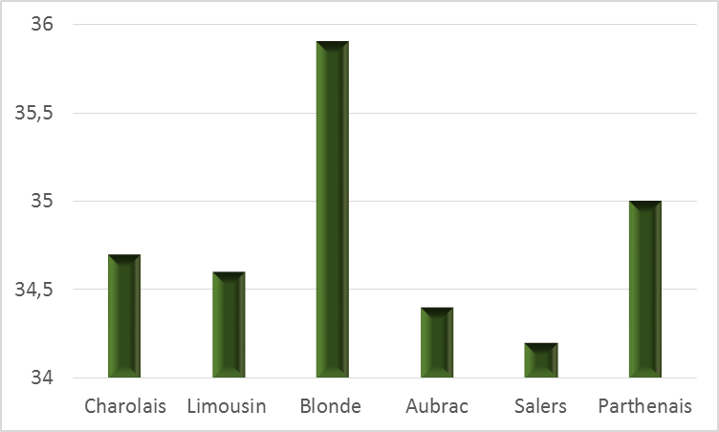
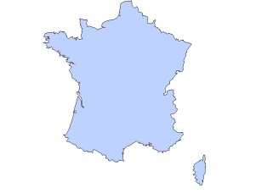
Age at first calving (months) of some french beef breeds (2013)
(data from Référentiel Bovins croissance)
34 to 36 months

Slide 17
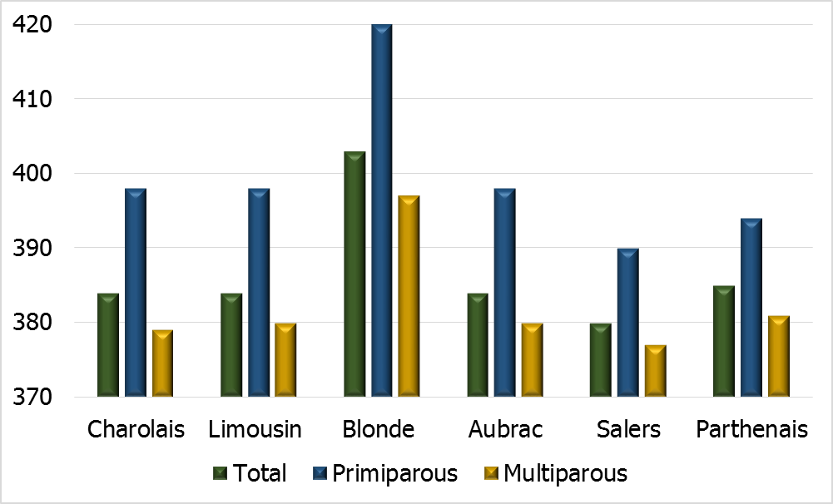
Calving interval of some french beef breeds (2013)
(data from Référentiel Bovins croissance)
Total : 380 to 405 days

Slide 18
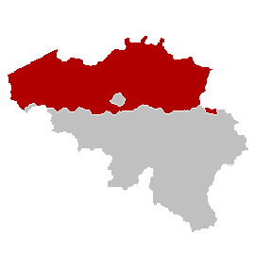
Average of age at first calving of different belgian
dairy and beef breeds
mths
BB Double
muscle
BB Double
purpose
Dairy
() = number of intervals during the period (2002 to 2009)
Top 10 % : average of the 10 % best farms (62 BBdm, 4 BBdp, 136 Dairy)

Slide 19
Average calving interval of different belgian
dairy and beef breeds
mths
BB Double
Muscle
Std : 65.8
BB Double
Purpose
Std : 58.5
Dairy
Std : 68.6
All farms
Top 10 % : average of the 10 % best farms

Slide 20
Some specific factors affecting the reproduction performances in beef cattle

Slide 21
Hypoplasia in Belgian Blue heifers

Slide 22
Uterine hypoplasia in Belgian Blue : a risk factor (Hanzen et al. 2003)
Retrospective study of 1000 clinical exams
Heifers aged between 14 and 24 months.
Manual determination of uterine diameter
Normal if diameter => 2 cm
Uterine hypoplasia if diameter < 2 cm
Manual palpation of ovaries
NO : Normal ovary if CL identification
RO : rough ovary with eventually a cavitary follicle
SO : small and smooth ovary

Slide 23
Prevalence of hypoplasia in 1000 BB heifers (14 to 24 th months) (Hanzen et al. 2011)
%
Normal uterus : 80 %
Hypoplasia : 20 %
Etiology ?????
Smooth, small ov
Rough ovaries
CL
Birth – C1 : 1 month longer

Slide 24
Dystocia and postpartum pathologies

Slide 25
Dystocia and C-section

Slide 26
Prevalence of dystocia in beef (Belgian Blue) and dairy cattle
(Hanzen 1994)

Slide 27
Prevalence of dystocia in beef and dairy cattle. A review
(Hanzen 2017)

Slide 28
Prevalence of dystocia according to the breed and NL (Hanzen 2017)
26,8 %
Beef cattle
3,2 %
13,8 %

Slide 29
11,7 %
4,8 %
Dairy cattle
14,2 %

Slide 30
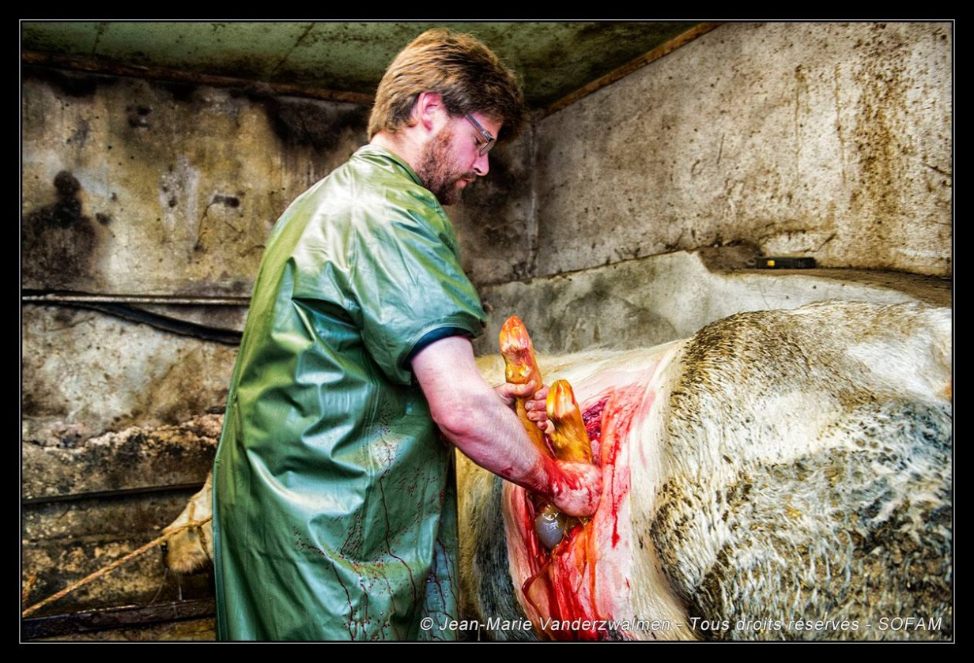
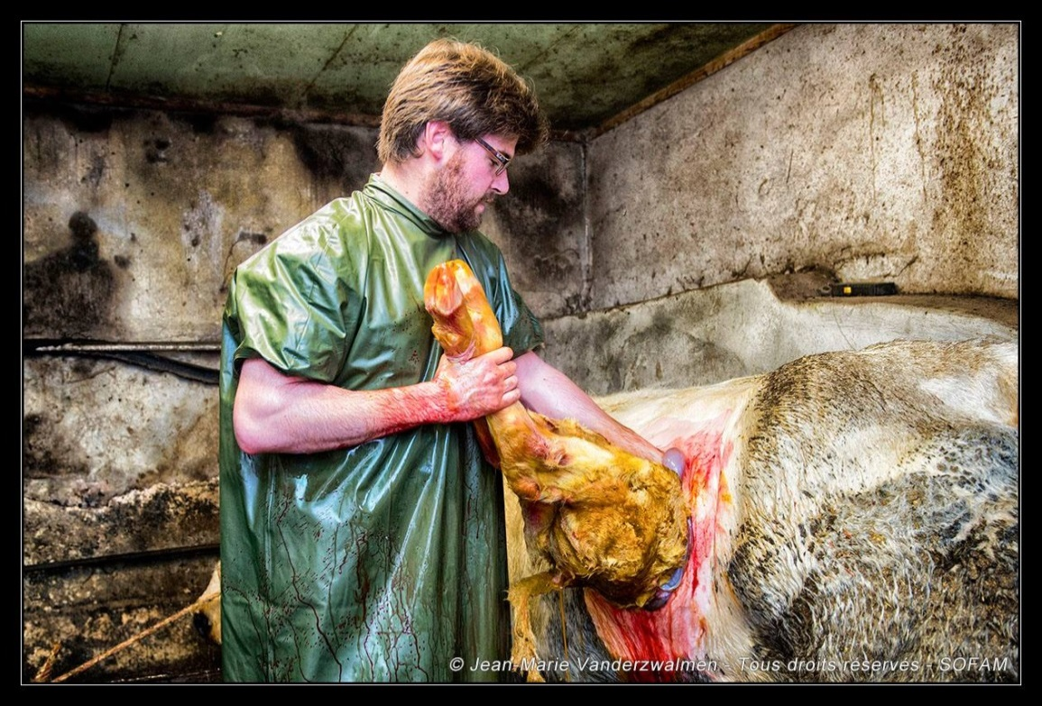
The C-section : an usual method of calving in Belgian Blue
87 % of C-Section in BB
Hanzen et al. 1994)
14 % of C-section in Charolais
(Zsuppán et al. 2015)

Slide 31
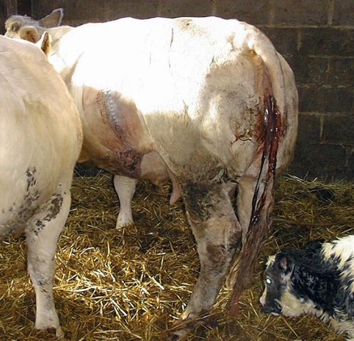
Effect of C-section on the frequency of placental retention
%
Elective CS has no effect on PR

Slide 32
Effect of Cesarean section on the frequency of clinical endometritis (vaginal diagnosis by speculum between 21 to 50 days pp)
Dairy cows (2740)
BB cows (3813)
P < 0.001
P < 0.02
%
%
Average frequency of uterine infections (6.600 vaginal exams) : 20 %
Less uterine infections in BB than in dairy cows
3. More effect of CS in dairy than in BB cows

Slide 33
Aseptic fibrinous parietal peritonitis (Peritoneal « hutch »

Slide 34
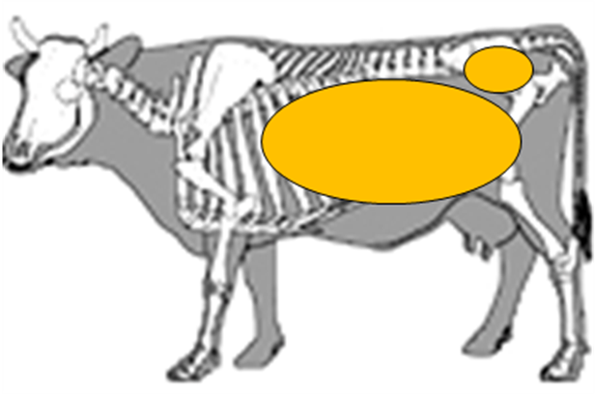
Some caracteristics (Hanzen et al. 2011)
Frequency : 0.7 %
Primiparous Belgian Blue cows are concerned
After C-section (mainly) or dystocia
Symptoms (10 to 30 days postpartum)
General : inappetence, decrease of the rumen motility, weight loss, hyperthermia
Local : left flank swelling, mettalic noise at percussion, reduction of the volume of the pelvic cavity
Etiopathogeny ??????????
34
Notes:
34
34

Slide 35
Skin
Rumen
Viscéral peritoneum
Parietal peritoneum
« hutch »
Fibrous wall
fibrin
Muscular wall
Liquids
35
Notes:
35
35

Slide 36
Skin
Rumen
Muscular wall
36
Notes:
36
36

Slide 37
Pelvic cavity
37

Slide 38

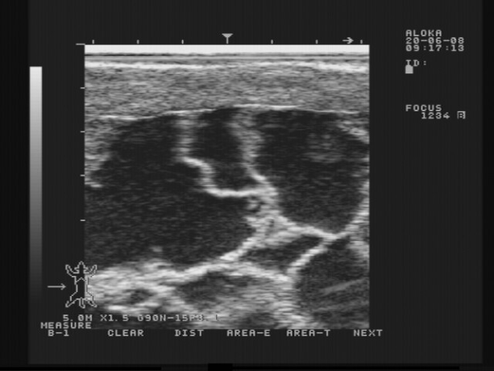
Muscular wall
Strips of fibrin
Liquids
38
38

Slide 39
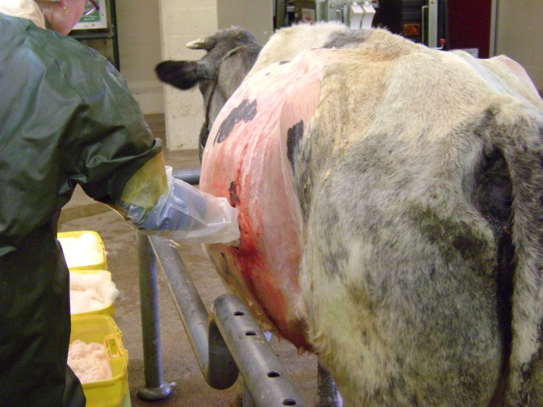
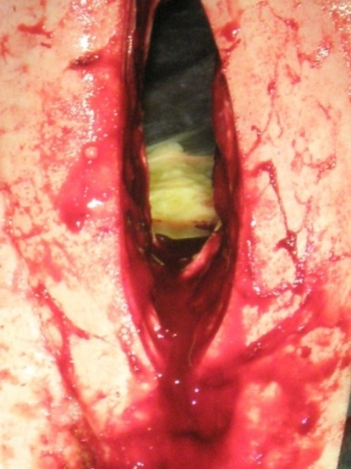
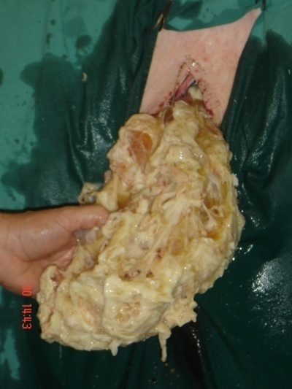
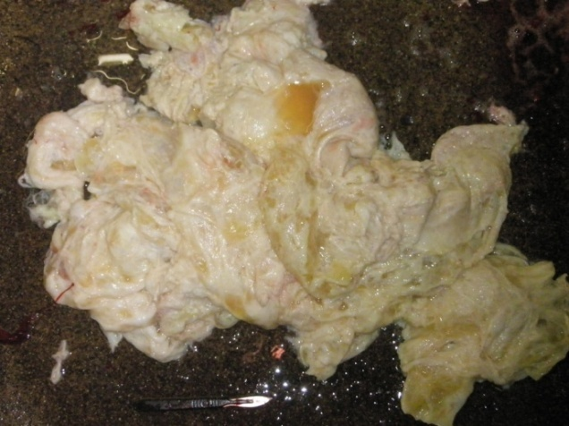
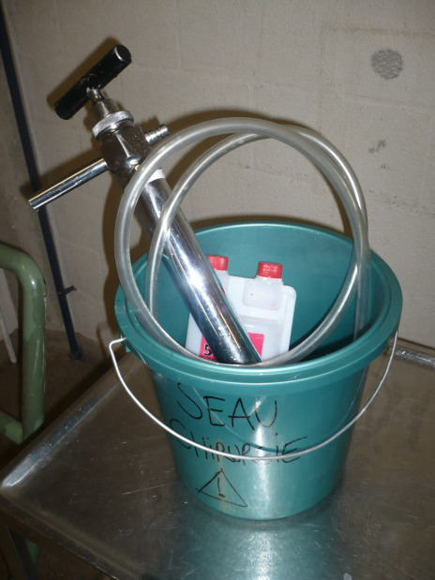
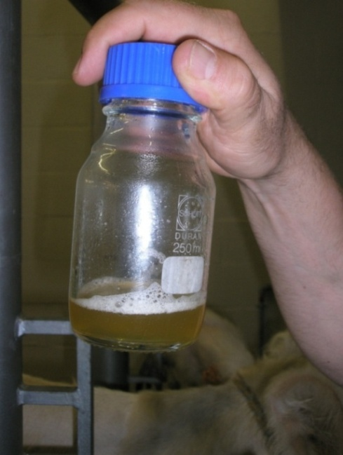
Treatment
39

Slide 40
Metabolic diseases, Uterine infections Ovarian cysts

Slide 41
Prevalence of some postpartum pathologies in beef (Belgian Blue) and dairy cattle (Hanzen 1994)

Slide 42
Postpartum anoestrus

Slide 43
Prevalence of the postpartum anoestrus in beef cattle
Evaluation by a P4 follow-up (Disenhaus et al. 2008)

Slide 44
Prevalence of the postpartum anoestrus in beef cattle
Evaluation by the % of beef cows not cycled before the beginning of the breeding period
44 % (Gasser et al. 2003)
46 % (Stevenson et al. 2003)
53 % (Lucy et al. 2001)

Slide 45
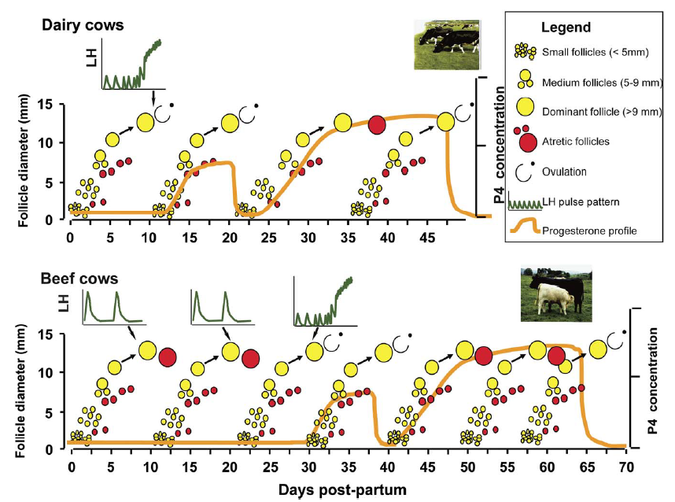
Resumption of dominant follicles and ovarian cycles during the postpartum period in dairy and beef suckler cows (Crowe et al. 2008)

Slide 46
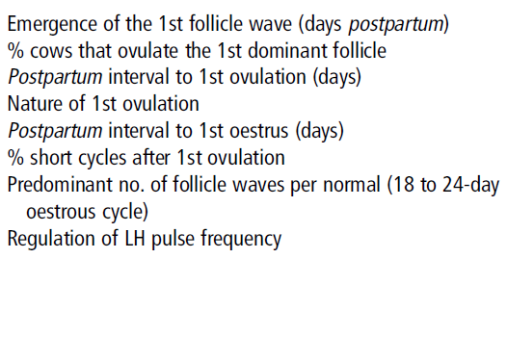
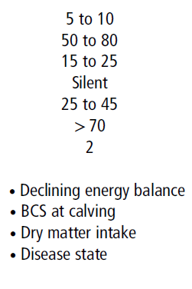
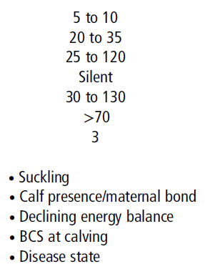
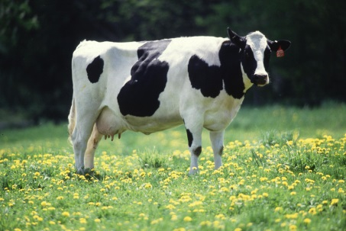
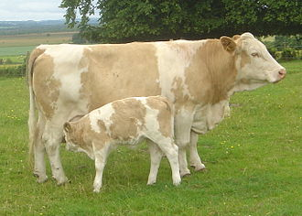
Reproductive parameters in the early postpartum period of dairy and beef suckler cows (Crowe et al. 2008)
Dairy cow
Suckler cow

Slide 47
4 main factors involved in postpartum anoestus
in beef cattle
1. Nutrition (energy)
>
Prepartum nutrition
(negative energy balance)
Postpartum nutrition
(negative energy balance)
BCS at calving
(Scale 1-9)
Primi : 6 to 7
Pluri 5 to 6
Negative correlation (0,75) between BCS at calving and length of anestrus
Negative correlation (0,47) between BCS change during PP or BCS at breeding (0,41) and length of anestrus
Effect on LH pulse frequency and insulin
Hess et al. JAS 2005

Slide 48
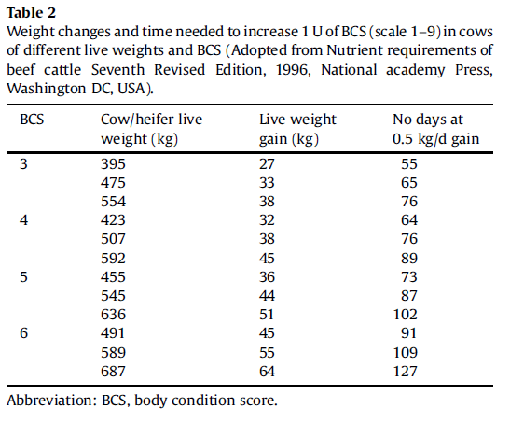
How to increase 1 Unit of BCS according to the weight of the cow (In Diskin et Kenny Theriogenology 2016 86 379)
30 to 60 days

Slide 49
% of ovulation by day 80 PP according
to the conditions of suckling
2. Suckling-maternal bond
15 % of cows don’t respond
= deep anoestrus (Hypoinsulinemia ?)
Stagg et al. Biol Reprod 1998

Slide 50
3. Biostimulation (bull exposure)
Necessity of a continuous stimulus
Accomodate the cows to an adjacent bull
Introduce a teaser bull into the herd
Begin one or two weeks after calving
4. Number of lactation
More anoestrus problem with primiparous cows

Slide 51
The fertility (reproduction period)

Slide 52
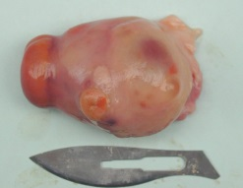
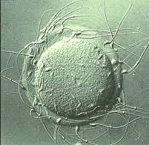
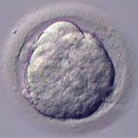
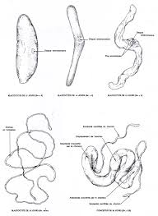
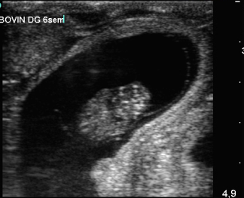
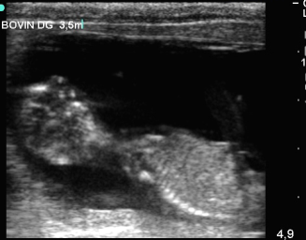
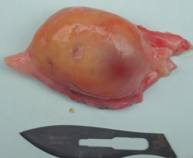
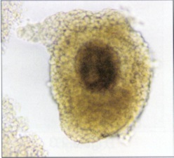
Losses during the first trimester of pregnancy in the cow (Wiltbank et al. 2016)
Embryo
Foetus
Before
Fertilization
D 1 to 7
D 8 to 27
D 28 to 60
D 61 to 90
No fertilization
10 (Cold) à 50 % (Heat)
Very early embryonic mortality
10 à 50 %
Early embryonic mortality
20 %
Late embryonic mortality
12 %
Early
abortion
< 2 %
Data collected in dairy cattle. Very few data in beef cattle

Slide 53
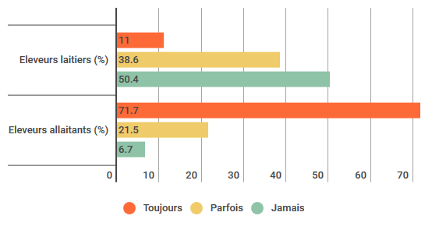
Use of natural service vs AI in dairy and in beef cattle in France
(Survey 2016 in 956 farms)
http://www.web-agri.fr/conduite-elevage
Dairy
Beef
Always
Some
Never
USA : AI concerns 7,6 % of beef cattle and 72,5 % of dairy cattle
See https://www.aphis.usda.gov/aphis/ourfocus/animalhealth/monitoring-and-surveillance/nahms/

Slide 54
Average number of AI by pregnancy (Total fertility index)
in different breeds in Belgium (Hanzen et al. 2011)
Notes:
2ème doc 2003-2004 Ch. Hanzen FMV Chapitre 24 L'insémination artificielle
54

Slide 55
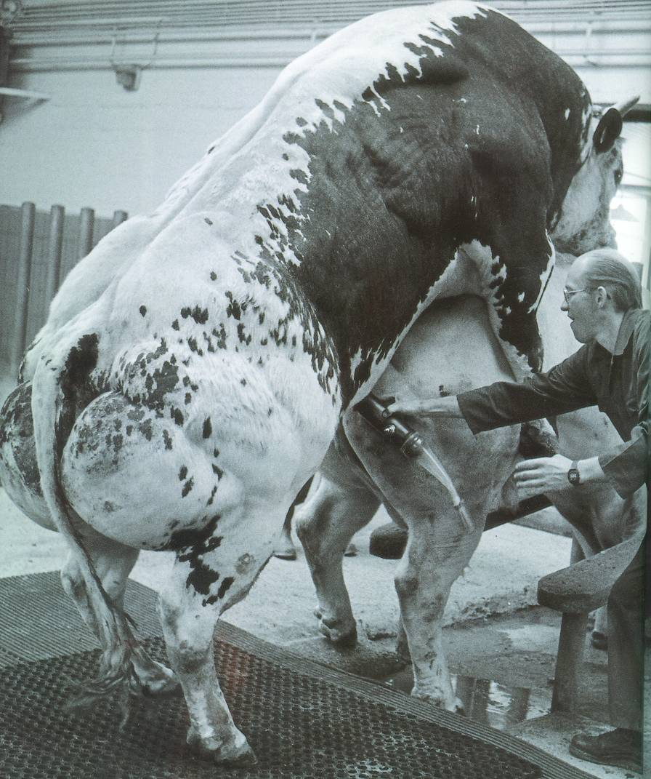
Fertility of beef cattle
Importance of a systematic breeding soundness evaluation of the bull
Notes:
2ème doc 2003-2004 Ch. Hanzen FMV Chapitre 24 L'insémination artificielle
55

Slide 56
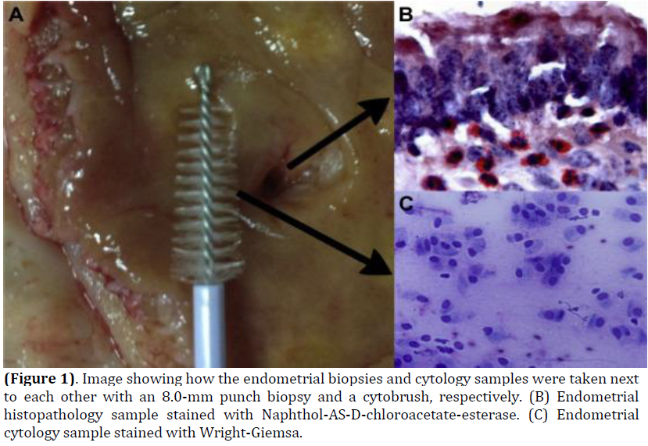
Subclinical endometritis : a new challenge in beef cattle ?
Pascottini 2016

Slide 57
Prevalence of subclinical endometritis during the waiting period in cows (244 herds and 13795 cows) (Saunier and Hanzen 2017)
Huge differences according to the stage of the PP, the method of diagnosis, the considered threshold and the history of the cow

Slide 58
If you want to use AI in beef cattle
The estrous synchronisation programs in beef cattle
Patterson et al. In Proc. Applied Reproductive Strategies in Beef Cattle – Des Moines, Iowa – 2016
http://www.appliedreprostrategies.com/2017/newsroom-archive.html

Slide 59
Why use an estrous synchronisation programs in beef cattle ?
Patterson et al. 2016 Congress Des Moines
To reduce the length of the breeding season
To have older and heavier calves at weaning
To reduce the time required for detection of estrus and so reduction of labor expense
To facilitate AI and embryo transfer (cows or heifers are in estrus at a predicted time)
To use more often genetically superior high accuracy sires
To reduce the length of the calving season

Slide 60
P
P
AI HD
TAI
Double P
0
11-14
65-72 h
G
P
G
TAI
Ov-Synch
0
7
9
16-20 h
Some basic hormonal protocols to syncrhronize heat in cycled cattle
TAI
G
P
G
Co-Synch
0
7
9
G
P
AI HD
Select-Synch
0
7
TAI : Timed artificial insemination; AI HD : insemination after detected heat P : PGF2a et G : GnRH
Notes:
POUR SE RAPPELER DE QUOI ON PARLE
On le sait l’injection d’une seule prostaglandine (P) est de nature à induire un oestrus. Cependant, ce traitement ne permet pas de réaliser une insémination systématique compte tenu de la disparité du délai de retour en chaleur.
Le degré de synchronisation augmente avec l’injection de deux P à 11 (génisses) ou 14 (vaches) jours d’intervalle. La méthode permet d’envisager une insémination systématique 65 h (génisses) ou 72 heures (vaches) après l’injection de la P ou d’inséminer sur chaleurs observées (si la capacité de l’éleveur à les détecter est suffisante).
Le protocole Ov-Synch et ses variantes C-Synch et Select-Synch. La première injection de GnRH aura pour but le cas échéant d’induire l’ovulation voire la lutéinisation du follicule dominnat éventuellement présent. Il en résultera la croissance d’un nouveau follicule plus apte à répondre à la deuxième injection de GnRH.
ATTENTION: ces protocoles sont à réserver aux VACHES laitières CYCLEES. Ils ne contribuent pas à augmenter la fertilité (lors d’insémination systématique, les % de gestation sont compris entre 32 et 45 %) mais contribuent à réduire la période d’attente du troupeau.
Se pose la question de leur utilisation dans les troupeaux laitiers européens dont la taille est relativement réduite. Se pose également la question du coût des traitements (plus élevés en Europe qu’aux USA).
PS Nous reviendrons bientôt sur les protocoles applicables aux vaches allaitantes.

Slide 61
Some hormonal protocols for beef heifers/ cows

Slide 62
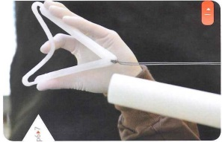
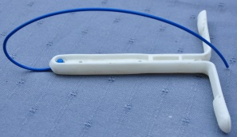
Hormonal protocols to inseminate cycled or not cycled beef heifers/ cows
to induce ovulation or luteinization of the follicle (> 10 mm diameter) and indirectly
the growth of a new follicle 2 to 3 days later
to induce luteolysis of
a corpus luteum and/or
a luteinized follicle
G and TAI
(if no
oestrus det)
AI HD
G and
TAI
G
P
0
CIDR/PRID 5 to 7 days
at the end of P4
54 to 72 h
84 h
Clean up bulls system
10 days after AI
to induce an artificial luteal phase or/and to inhibit the oestrus/ovulation or the final maturation of a preovulatory follicule
(P4 or MGA in heifers (USA only)
TAI : timed artificial insemination; AI HD insemination on heat detected; P : PGF2a ; G : GnRH

Slide 63
Some pregnancy rates (%) after hormonal synchronisation of heat and insemination in cycled or not cycled beef cattle
PR (pregnancy rate) : Proportion of females that become pregnant of the total number treated

Slide 64
Some protocols for AI in 2598 suckled beef cows (USA)
Effect of cyclicity and number of lactation on PR at AI
P<0.05
P<0.05
Larson et al. JAS 2014

Slide 65
Some protocols for AI in 2598 suckled beef cows (USA)
Effect of days postpartum and BCS (scale 1 to 9) on PR
Increase of 5,5 % of cycled cows for each 10 d increase of the breeding season
P<0.05
P<0.05
Increase of 11,5 % of cycled cows for each unit increase of BCS
Larson et al. JAS 2014

Slide 66
Effect of Reproductive Tract Score (RTS) on pregnancy rate
in beef heifers after fixed TAI (Locke et al. 2016)
1 : immature (< 20 mm diameter, no ovarian structures)
2 : 20 to 25 mm diameter, no tone, < 8 mm follicles
3 : 20 to 25 mm diameter, slight tone, 8 to 10 mm follicles
4 : 30 mm diameter, good tone > 10 mm follicle
5 : > 30 mm diameter, good tone, CL
(Odde et al. 1994)

Slide 67
Some recommandations
(From Larsson et al. 2014 and Patterson et al. 2016)
Assume a high percentage of cycling cows at the beginning of the breeding season by a high planned nutrition system
Manual palpation and or echography offer the possibility to detect the cycled cows and to adapt the hormonal protocol
Use such protocols later than 50 days postpartum
Protocols using progesterone provide an improved pregnancy rates
If Co-synch is used, respect an interval between PGF and TAI of 66 h (OR : 1,32 more chances to conceive after 66 than 54 h : Busch et al. 2008 in Patterson et al. 2016)

Slide 68
Avoid to treat cows with calving or postpartum problems
If AM-PM policy is choose for AI, observe three periods per day for oestrus detection
Take in mind that with Ovsynch and select synch protocols, 10 to 20 % of cows come in heat before or short time after PGF injection : such cows need to be inseminated
The introduction of bulls 10 days after AI contributes to increase the % of pregnant cow at the end of the breeding season

