Slide 1
L’open access et les plateformes francophones de publication en SHS
Ou « Quand le chercheur se pose des questions sur la diffusion de ses résultats »
Björn-Olav Dozo – ULiège

Slide 2
L’open access

Slide 3
A quick definition, to fix ideas
« By "open access" to [the scientific] literature, we mean its free availability on the public internet, permitting any users to read, download, copy, distribute, print, search, or link to the full texts of these articles, crawl them for indexing, pass them as data to software, or use them for any other lawful purpose, without financial, legal, or technical barriers other than those inseparable from gaining access to the internet itself. The only constraint on reproduction and distribution, and the only role for copyright in this domain, should be to give authors control over the integrity of their work and the right to be properly acknowledged and cited. »
Definition from the "Budapest Open Access Initiative" (BOAI, 2002).

Slide 4
Why do we, researchers, support such an initiative ?
Because it happens that some papers we would like to read are behind paywalls
Because we don’t want a research at two speeds : those for which libraries can afford suscriptions and others who can’t access to literature
Because scientifics do almost all the job : we produce papers, we peer-review them, and we will have to pay for them after ?
Because public funding research must be available for public, without paywalls
And so on, the reasons why open access spreads are numerous (look at http://iloveopenaccess.org/arguments-for-open-access/)

Slide 5
A very profitable industry
Merci à Paul Thirion pour les données
Serials cost for ULg more than 2.8 millions dollars a year…

Slide 6
Exemples of publishers’ profit
Elsevier: 36% of net profit (after taxes) on an income of €2.386 million/year
Springer Science: 33.9%
John Wiley & Sons: 42%
…
2002: £429m profit on £1295m revenue – 33.18%
2003: £467m profit on £1381m revenue – 33.82%
2004: £460m profit on £1363m revenue – 33.75%
2005: £449m profit on £1436m revenue – 31.25%
2006: £465m profit on £1521m revenue – 30.57%
2007: £477m profit on £1507m revenue – 31.65%
2008: £568m profit on £1700m revenue – 33.41%
2009: £693m profit on £1985m revenue – 34.91%
2010: £724m profit on £2026m revenue – 35.74%
2012: £768M on £2058M revenue – 37.3%
Source : http://svpow.com/2012/01/13/the-obscene-profits-of-commercial-scholarly-publishers/

Slide 7
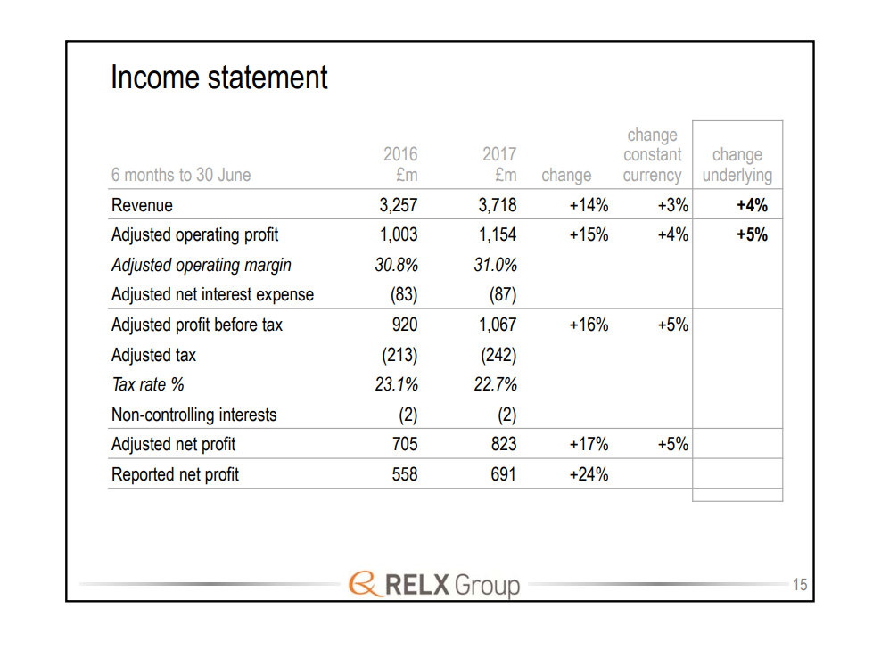

Slide 8
Open access : two « roads »
Green OA : authors self-archive their journal articles in an OA repository
  Example : Orbi, ULg’s repository (http://orbi.ulg.ac.be)
Gold OA : authors publish in an open access journal
  Example : OpenEdition Freemium, set of journals in humanities and social sciences available in open access with a business model founded on the freemium (the text is freely available, but if you want more services, you had to pay for them). http://www.openedition.org/8873?lang=en

Slide 9
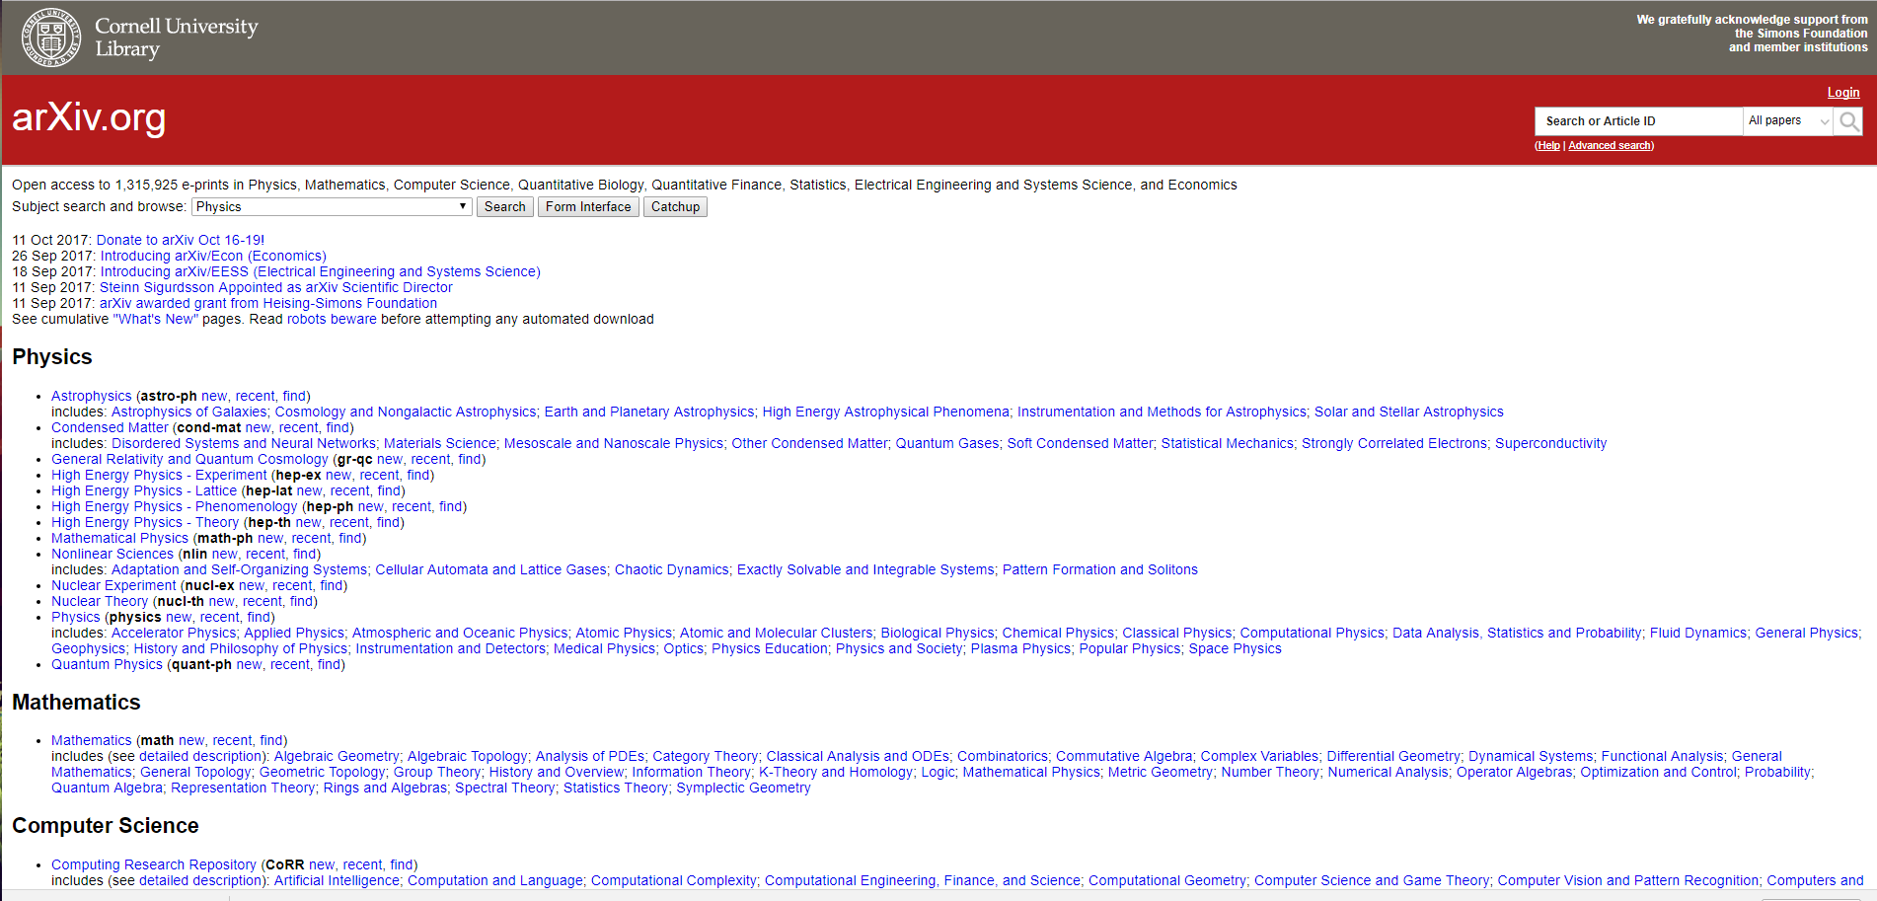
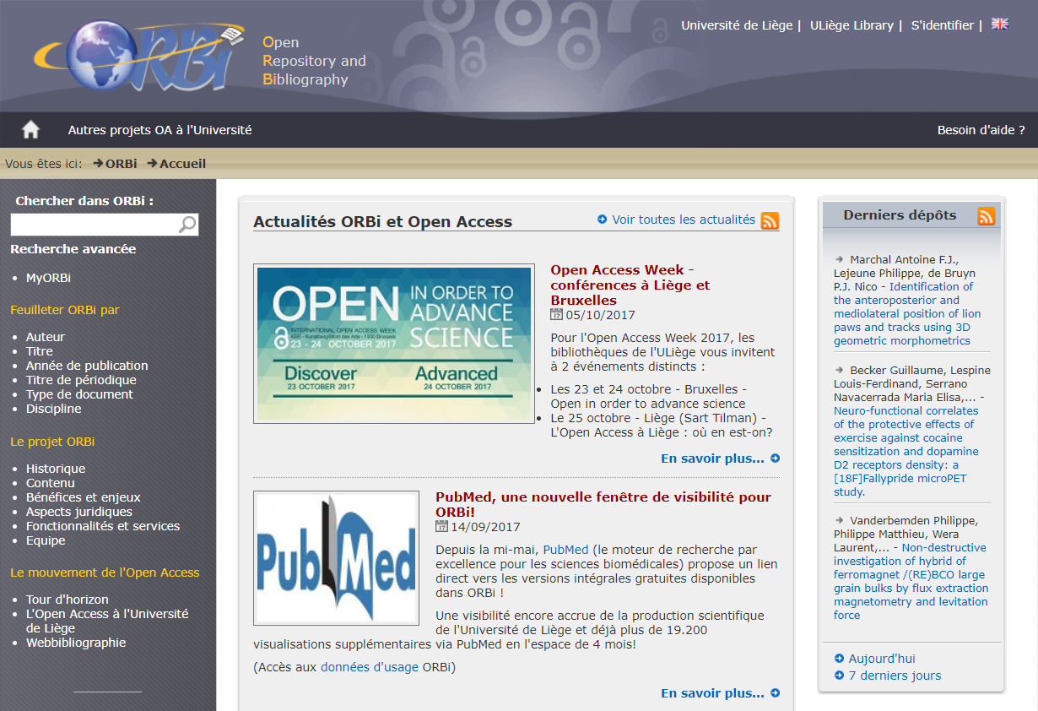
Créé par Paul Ginsparg en 1991

Slide 10
Voie dorée : trois modèles de financement
APC (article processing charges)
Financement public
Freemium (modèle d’OpenEdition)

Slide 11
Voie dorée : deux risques majeurs
Revues prédatrices : APC mais pas de peer review
« Double dipping » : payement deux fois, avec des APC et via abonnement

Slide 12
Le basculement complet vers la voie dorée vu par Elsevier
Extraits d’un article publié par Elsevier (26/9/2017)
  Advocates for a global transition to gold open access alone should be clear that an entirely gold open access system would cost more in some regions and for some institutions – especially those that are highly research intensive and therefore pay more in a “pay to publish” model – and that they consider this a price worth paying.
  In a “pay-to-publish model,” systemic costs would need to be borne by the academic research community rather than shared with industry. This is because the costs of publishing in a gold OA system are covered entirely by those who publish articles – the academic research community – and not spread among consumers including the commercial sector, which accesses large amounts of research but publishes comparatively little
https://www.elsevier.com/connect/working-towards-a-transition-to-open-access

Slide 13
Horizon 2020 expert group on Future of Scholarly Publishing and scholarly Communication
Composition du groupe d’experts pour "Horizon 2020 expert group on Future of Scholarly Publishing and scholarly Communication”
Individual experts:
• Jean-Claude Guédon, Canada
• Michael Jubb, United Kingdom
• Bianca Kramer, Netherlands
• Mikael Laakso, Finland
• Birgit Schmidt, Germany
• Elena Šimukovič, Lithuania
Organisations:
• Bill and Melinda Gates Foundation
• eLife
• Elsevier (RELX Group)
• Frontiers
• SpringerNature
• Wellcome Trust
Depuis https://blog.frontiersin.org/2017/10/05/frontiers-participating-in-european-commission-expert-group/

Slide 14
OpenEdition Freemium
Not a classical Article Processing-Charges gold model. It tries to be “fair gold”
hybrid economic model combining open-access to information and paid services generating income for the producers of its resources
place libraries at the heart of the development of open-access publication: sustainable alliance between producers and libraries to promote open-access in the humanities and social sciences

Slide 15
A link between research and libraries
Libraries care less for what is freely available. The aim is to introduce librairies into open access.
Since February 2011, the OpenEdition Freemium program has enabled libraries:
  to access six premium services specially designed to respond to their needs;
  to take part in the construction of an economic model for open access and find an alternative to restricted access platforms, which constrict users and diminish the impact of academic production;
  to create a dynamic which will incite more journals of quality to become open-access.

Slide 16
Les plateformes francophones de publication en SHS

Slide 17
Quatre grandes plateformes francophones
Cairn.info (http://www.cairn.info/)
Persee.fr (http://www.persee.fr/)
Erudit.org (https://www.erudit.org)
Openedition.org (https://www.openedition.org/)

Slide 18
Cœur de l’activité : les revues scientifiques
Mais chaque plateforme s’est spécialisée
  Cairn.info : magazines et encyclopédies de poche
  Persée : rétronumérisation
  Erudit : productions québécoise, + livres et littérature grise
  Openedition : livres, agenda et carnets de recherche

Slide 19
Financement
Cairn : abonnements
Persée : dotation publique
Erudit : public + abonnement
Openedition : public + freemium

Slide 20
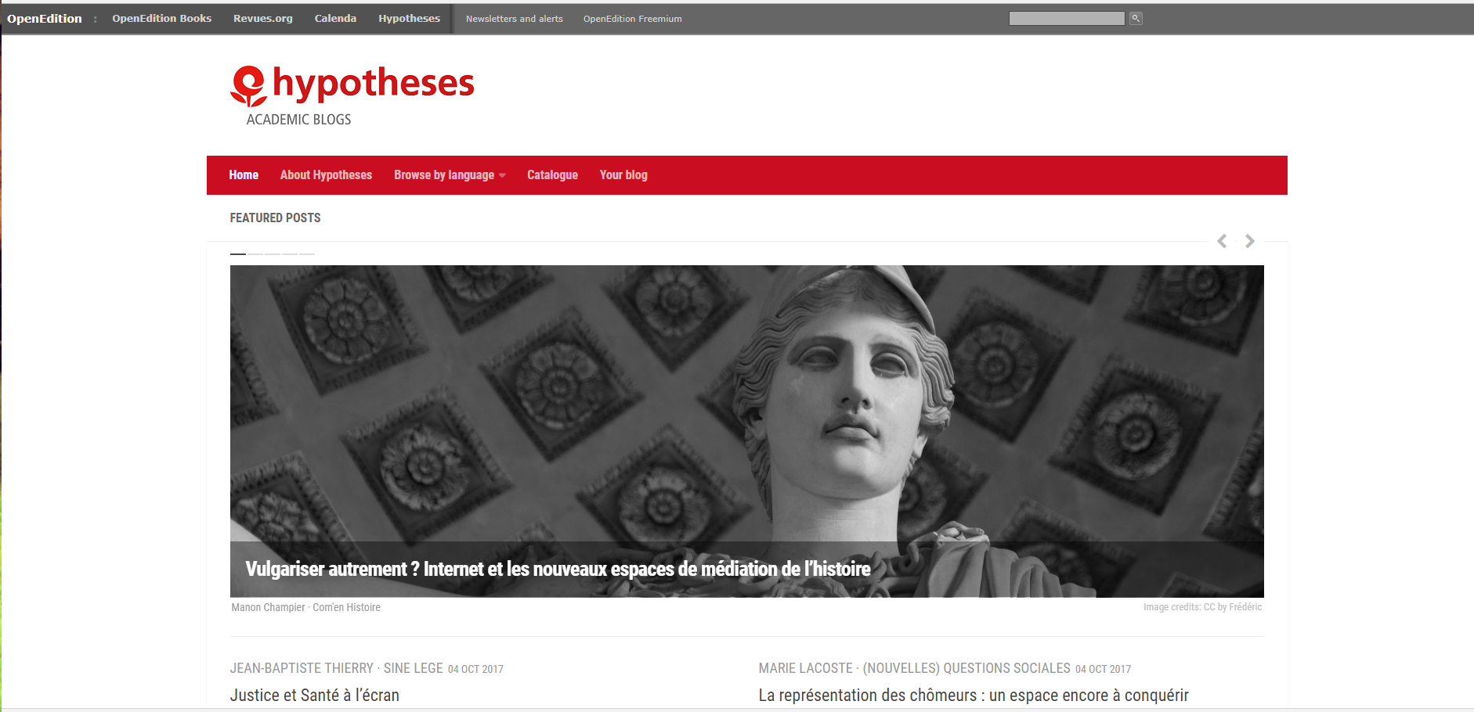
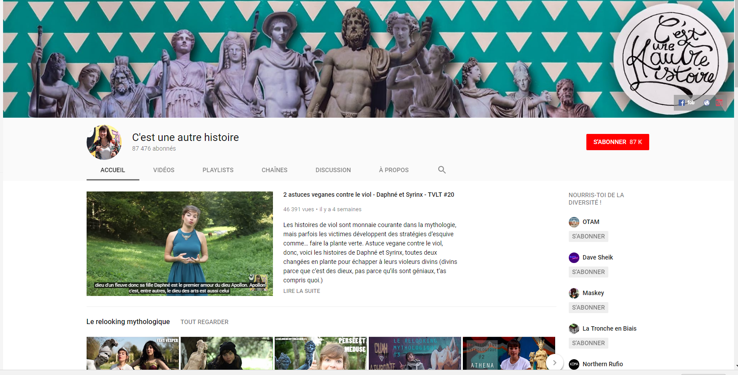
Vie scientifique : d’autres manières de faire exister sa recherche
Tenir un carnet de recherche (sur Hypotheses.org : blogging scientifique) ➔ participer à une communauté
Activités sur les réseaux sociaux (livetweets de conférence)
Vulgarisation scientifique (YouTube, ex. Manon Bril)
Participation à un comité de revue

Slide 21


