Slide 1
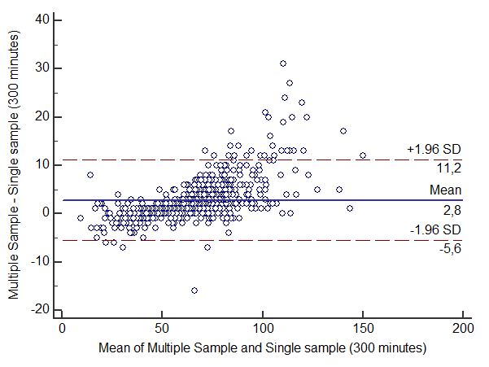
Measuring Plasma Clearance for Exact Assessment of GFR: Multi versus Single Sampling
Natalie Ebert¹*, Elke Schaeffner¹ , Hans Pottel², Etienne Cavalier³, Laurence Dubourg⁴, Martin Flamant⁵ and Pierre Delanaye³
¹Charité University Hospital, Berlin, Germany; ²KU-University Leuven, Belgium ³University Sart Tilman, Liège, Belgium; ⁴University Claude Bernard, Lyon, France ⁵Diderot University, Sorbonne, Paris, France.
INTRODUCTION
Measurement of plasma clearance (PC) of iohexol or 51Cr-EDTA are both recognized as gold
standard for exact GFR assessment. However, there are different protocols for PC measurement in terms of a varying number of plasma samples. We compare GFR results obtained from multi sample (MS) versus single sample (SS) PC measurement.
Figure 1: Bland Altman plot of absolute difference (ml/min/1.73m²)
of multi sample (MS) versus single sample (SS) after 300 min
Out of 5,106 indiv. 657 had GFR results based on a 300 min (or longer) sampling period. In total 43% were females, mean age (SD) was 54 (±17) yrs, BMI 25.9 (±5.5) kg/sqm, mean GFR 65±26 mL/min (4-195 mL/min).
Overall GFR results with SS at 120, 180 and 240 min had a concordance of ±10% with MS of 67, 84 and 91%, respectively. Detailed results in relation to GFR level can be found in table 1. In the 657 individuals, highest concordance was observed with the 300 min sample if GFR <50 ml/min and with 240 min sample if GFR ≥50 ml/min (concordance within 10% was 96%, within 5% was 85%).
Smallest concordance was found in individuals with very low GFR, at old age and with extreme BMI.
METHODS
We used data from 4 European cohorts including indiv. with PC of iohexol (Liège, Lyon, Berlin) or
51Cr-EDTA (Paris). MS clearance was calculated using a one compartment model with 3 or 4 samples at 120, 180, 240 and 300 min (or longer) after injection and Bröchner-Mortensen correction. The SS PC was calculated using the Jacobsson method based on the preexisting estimated GFR. We studied concordance between both methods within ±10%.
RESULTS
N=5,106 were included into the analysis with PC results based on 3 sampling points (120, 180 and
240 min) for slope calculation.
Table 1: Comparison of concordance within 10% between MS
and SS (at different time-points) according to GFR levels (n=5106)
GFR range (mL/min) | 120 min (%) | 180 min (%) | 240 min (%)
<30 (n=313) | 20.8 | 29.4 | 44.1
]30-45] (n=889) | 34.5 | 59.1 | 83.6
]45-60] (n=1205) | 56.5 | 85.5 | 96.9
]60-90] (n=1828) | 81.9 | 96.4 | 98.2
]90-130] (n=813) | 96.3 | 98.4 | 94.3
>130 (n=58) | 100 | 98.3 | 94.8
CONCLUSION
GFR results obtained from plasma clearance (PC) measurement with single sample (SS) showed a high concordance with values from multiple sample (MS) technique. This applies all the more if the timing for SS method was adjusted to estimated GFR. In conclusion, we found that in certain circumstances, i.e. epidemiological studies, SS iohexol PC measurement is an acceptable alternative to MS method.

