Slide 1


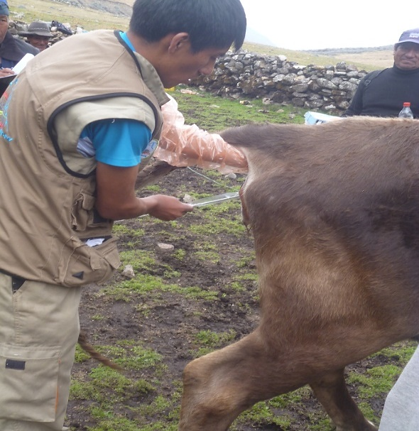
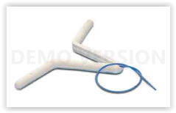
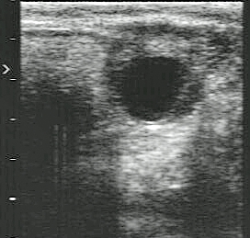
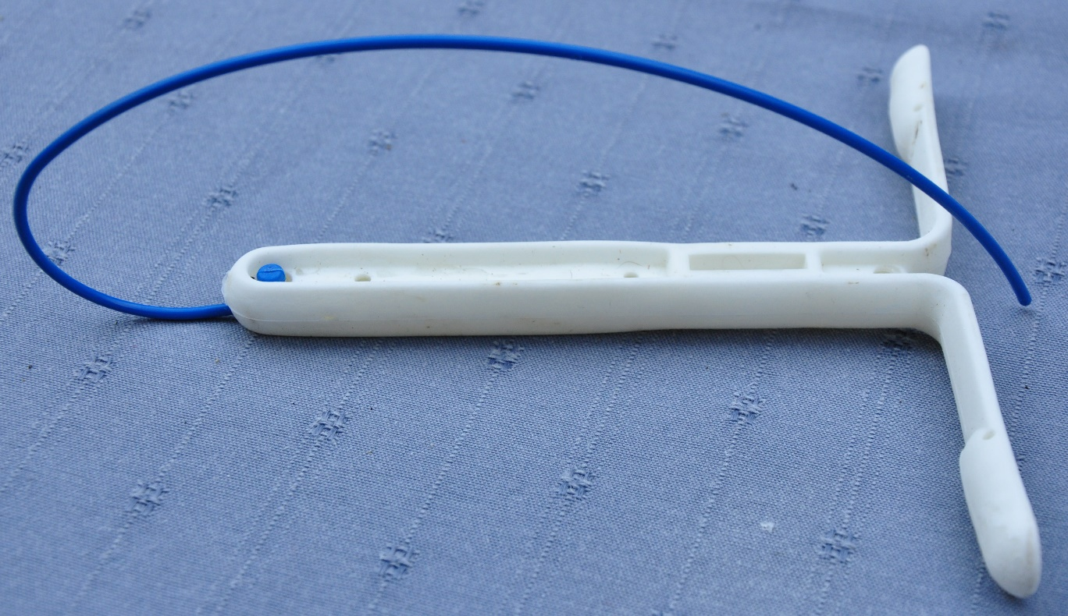
César Ordoñez¹, Enrique Ampuero¹, Nancy Huanca¹, Nélida Llocallasi¹, Hernán Cucho¹, Christian Hanzen²
¹Professional School of Animal Science, National University of San Antonio Abad of Cusco
²Faculty of Medicine Veterinary, Department of Theriogenology, University of Liege
Evaluation of two intravaginal implants for the synchronization of estrus in Criollo cattle in Peru
Goal
to compare the effect of two vaginal implants protocols on the follicular characteristics, the vaginal electrical resistance and the pregnancy rate of Criollo cattle reared in altitude (3100 m).
Protocol
N = 23
P4 : 1g
Oestr
Benzo
2 mg
Oestr
Benzo
1 mg
DIB system Agrihealth NZ
PGF2a
TAI
D1
CIDR Zoetis
D7
0 h
48 h
54 h
72h
D 45
P4 : 1,38g
Follicular
diameter
perimeter
Pregnancy
diagnosis
Results
N = 30
Vaginal
conductivity
Perimeter
Diameter
Treatment | n | Electrical resistance (ohm) | Follicle diameter (mm) | Follicle circumference (mm) | Pregnancy rate (%)
DIB ® | 30 | 240.3 ± 32.5 | 9.2 ± 1.9 | 24.8 ± 4.6 | 63.3
CIDR ® | 23 | 224.8 ± 39.8 | 9.0 ± 2.1 | 24.4 ± 4.9 | 69.6
Total/Average | 53 | 233.6 ± 36.3 | 9.1 ± 1.9 | 24.6 ± 4.7 | 66.0
Conclusion
The two vaginal implants protocols don’t have any significant differences (P>0,05) on the follicular characteristics, the vaginal electrical resistance and the pregnancy rate of Criollo cattle reared in altitude (3100 meters).
This research was sponsorised by the Canon fund UNSAAC

