Slide 1
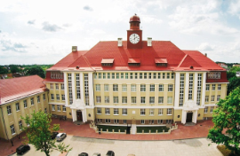

Thermal infrared and terahertz digital holography and their applications
Dr. Marc GEORGES
Lasers & Non Destructive Testing Laboratory
Centre Spatial de Liège – Liège Université, Belgium
XXX School of Holography, Coherent Optics and Photonics
Kaliningrad, October 2-6, 2017

Slide 2
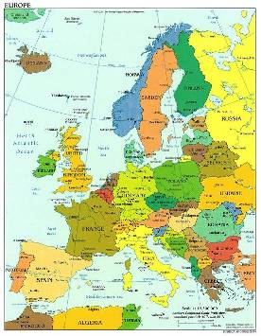
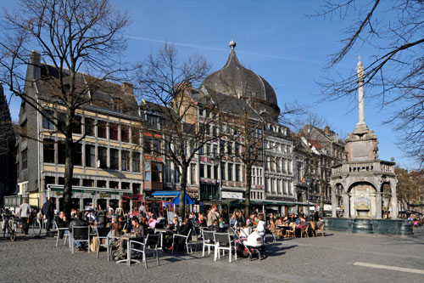
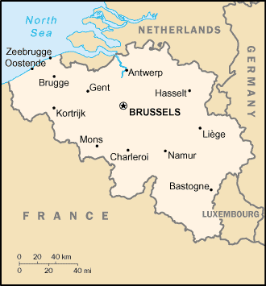
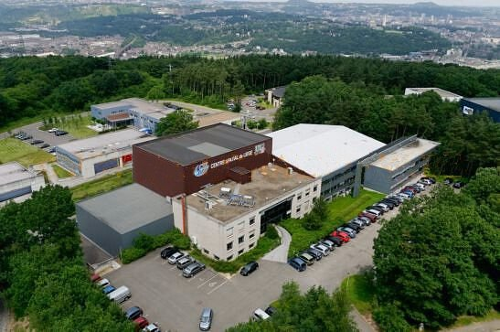
The Centre Spatial de Liège
Research Center of Liege University
100 people
  Engineers/Scientists (2/3)
  Technicians
  Administratives
Excellence Center of Optics of the European Space Agency (ESA)

Slide 3
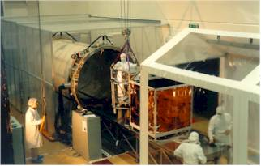
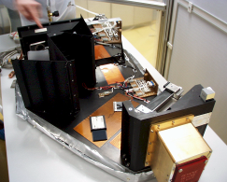
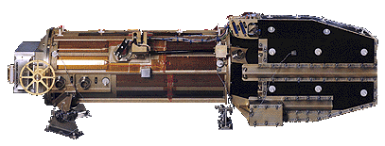
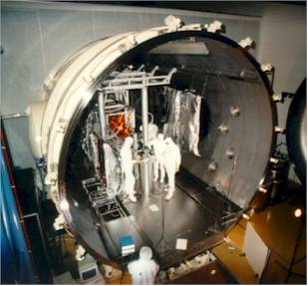
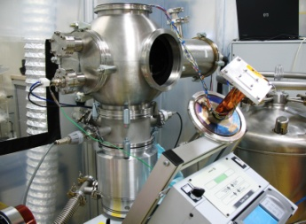



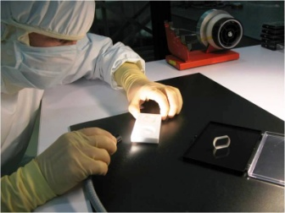


The Centre Spatial de Liège
Optics for Space
Simulated space environment testing
Large chambers with optical benches
Development of optical
Space instrumentation
Development of
Advanced Technologies
Vacuum-Cryogeny
Quality insurance
Thermal Design
Signal Processing
Spaceborne Electronics
Smart sensors
Surface processing
Optical Design
Laser Metrology
Non Destructive Testing

Slide 4
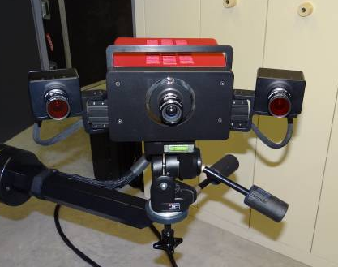
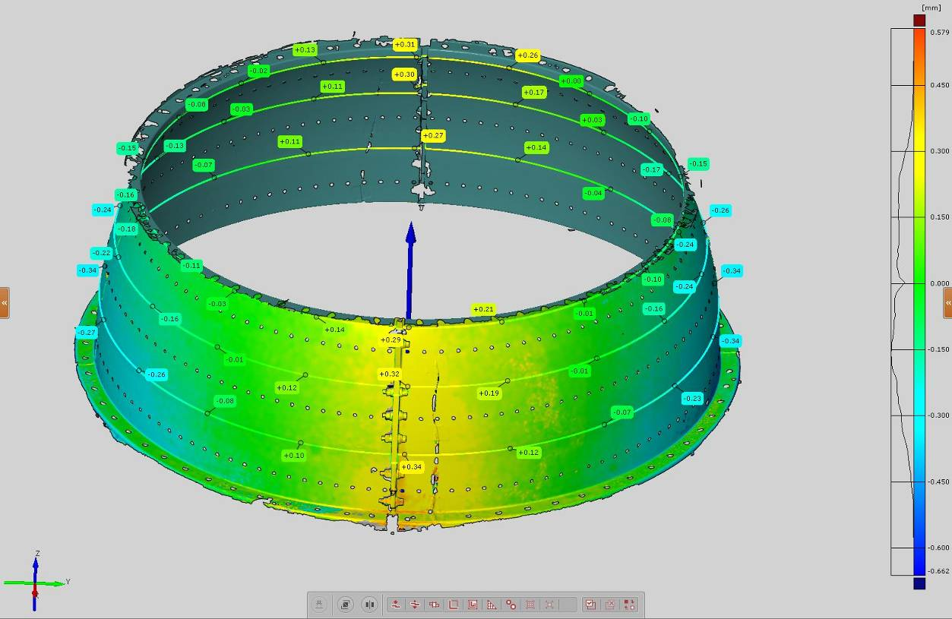
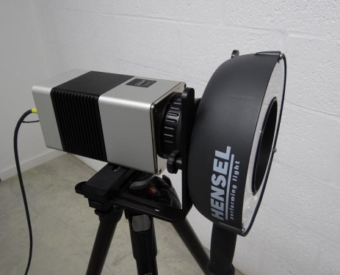
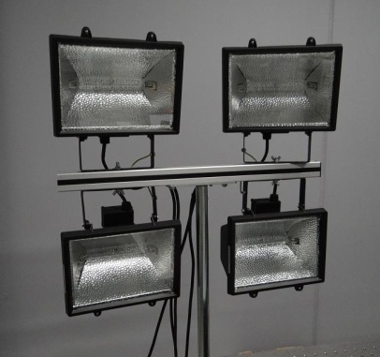
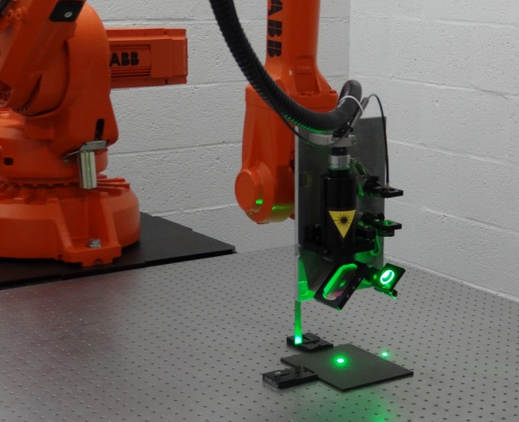
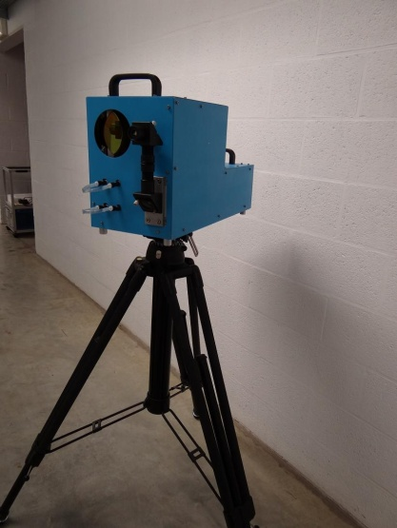
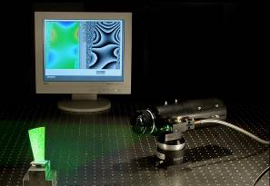
The Centre Spatial de Liège
Research in laser and optical metrology and NDT for aerospace
Dimensional measurement
Fringe projection
Digital Image Correlation
Thermography
Pulsed + Lock-in
Vibrothermography (ULg)
Full-Field Deformation measurement
Holography
Speckle interferometry
Shearography
Laser Ultrasonics

Slide 5
OUTLINE
Introduction
  Recall some basics
  Analog holography – Digital holography
  Holographic interferometry
  Wavelength is a key factor
Holography in the Long-Wave IR
  Analog holography
  Digital holography
  Digital holographic interferometry
Holography in Terahertz waves (far IR)

Slide 6





INTRODUCTION
Holography principle
LASER

Slide 7
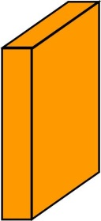
INTRODUCTION
Analog Holography : recording principle
Modification of holographic
medium properties
Illumination pattern
Absorption variation
Thickness variation
Refractive index variation
Amplitude hologram
Phase hologram

Slide 8
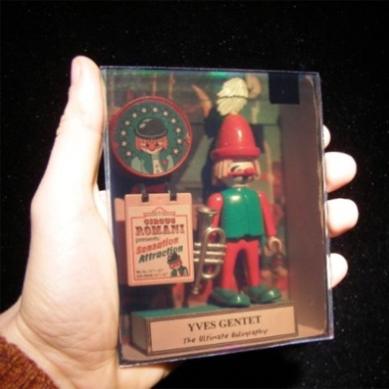
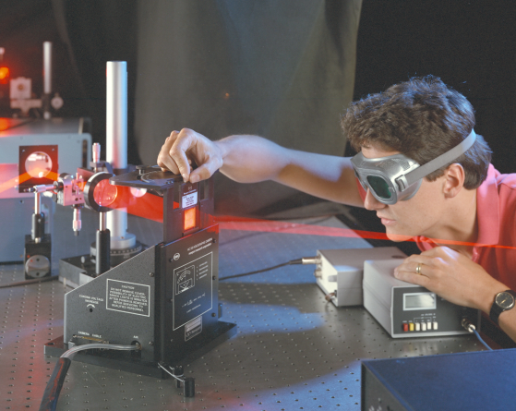
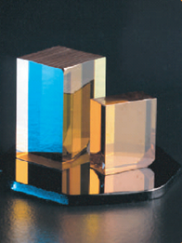
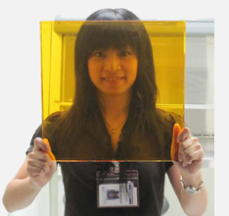
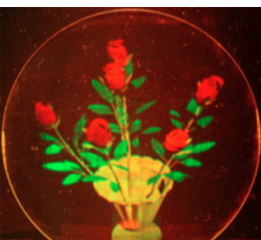
INTRODUCTION
Analog Holography : recording materials
Silver halides (AgBr)
Photo-thermoplastics
© Yves Gentet
© Newport
Photorefractive inorganics
Photorefractive polymers
© ICMCB, Bordeaux
© Opt. Science Center, Tucson AZ

Slide 9
Analog holography : Diffraction by grating
Recording of amplitude hologram
Amplitude hologram
Readout: diffraction process

Slide 10

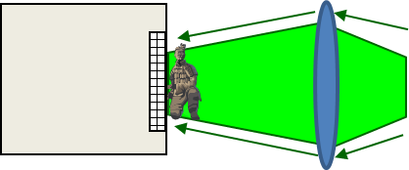
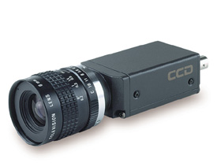
INTRODUCTION
Analog holography vs. Digital Holography
Digital Holography – Speckle Interferometry – TV Holography ….
LASER
lens
beam combiner
Recording holograms by digital array sensors
No need chemical processing
Fast
Holograms stored in computer memory
Can be transfered by internet
CCD - CMOS
Can be recorded at any wavelength, where sensors exist

Slide 11
INTRODUCTION
Digital Holography principle
Sensor (hologram) plane
Object plane
Fresnel diffraction integral (paraxial approximation)

Slide 12
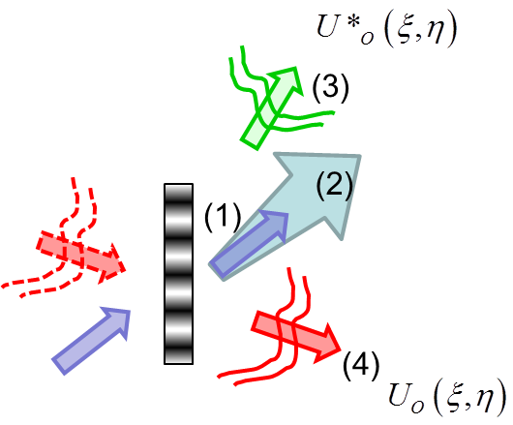
INTRODUCTION
Hologram recording (no lens between object and sensor)
Analytical expression representing the reference beam
d
Intensity of recorded hologram
Reconstruction (Fresnel principle)
Remind: Analog case

Slide 13
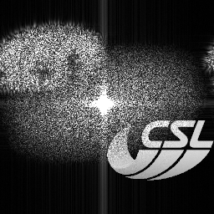
INTRODUCTION
Reconstruction – 2 : Discrete case
3
(3)
2
(2)
(1)
1
4
(4)
Digital
Analog

Slide 14
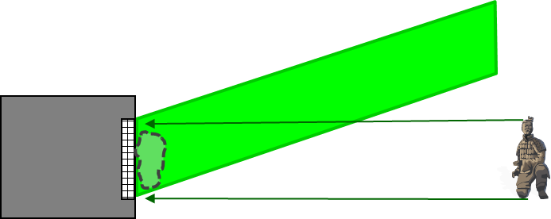
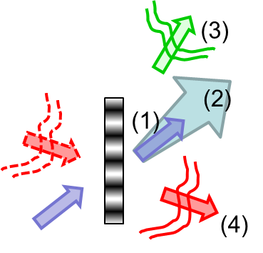
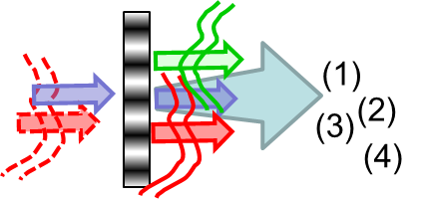
INTRODUCTION
Reconstruction – 3 : Some important points
Angle between object and reference beam – Dimension of objects
In order to resolve hologram, angle β must be correctly chosen
Angle too small not resolved (Shannon theorem)
λ: wavelength
Δpixel pitch
d
d: reconstruction distance
Separation between diffraction orders
Angle too small : All diffracted orders superimpose
Case of « in-line holography »

Slide 15
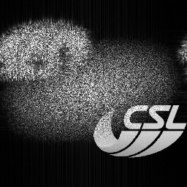
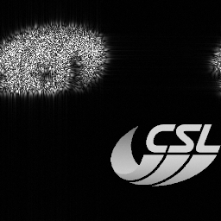
INTRODUCTION
Reconstruction – 4 : Filtering orders
Suppress low frequencies
(Kreis et Jüptner – 1997)
Suppress halo
(Skotheim – 2003)
Phase shifting (De Nicola, 2002)

Slide 16
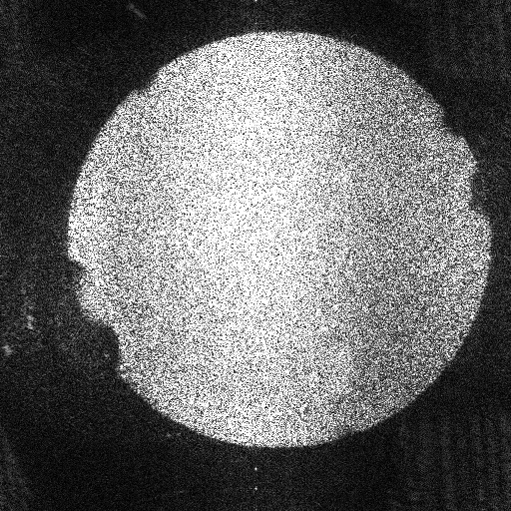
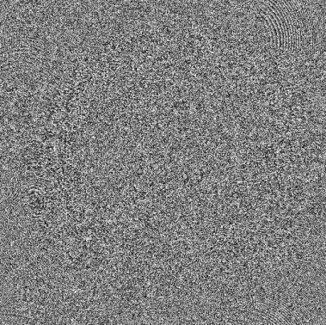
INTRODUCTION
Reconstruction – 5 : Retrieving Amplitude and Phase
Amplitude
Phase

Slide 17
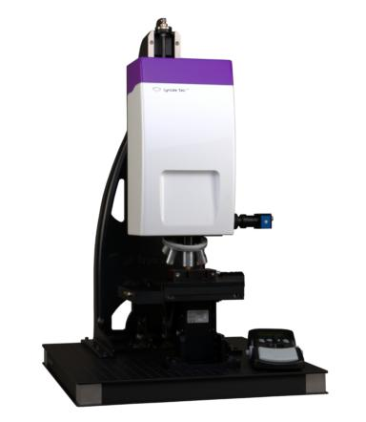
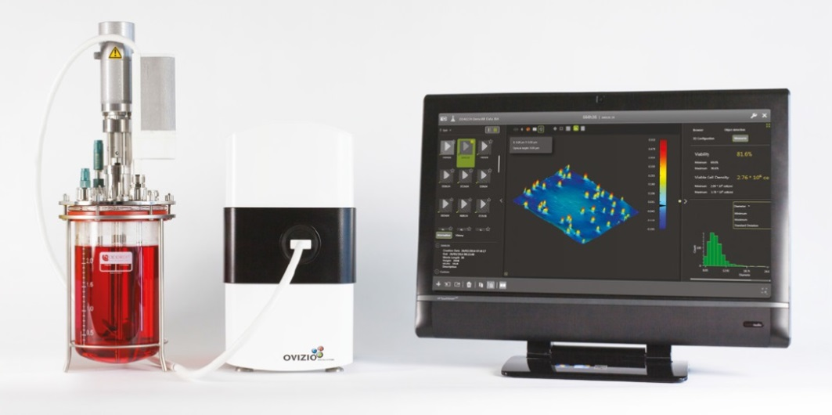
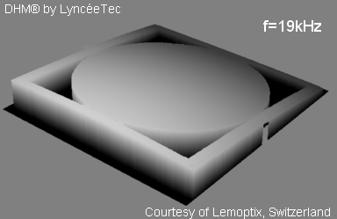
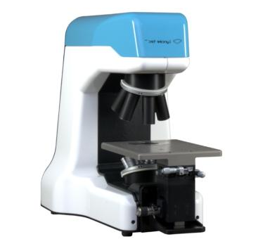
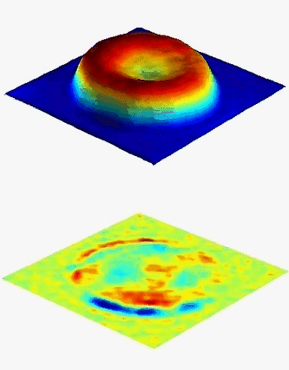
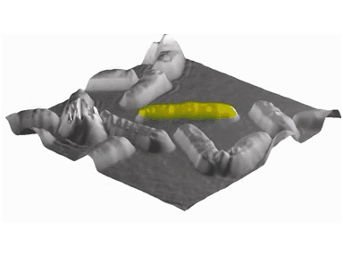
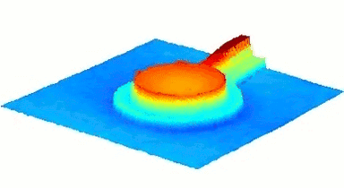
INTRODUCTION
Some digital holography applications in visible
Digital holographic microscope
Transparent objects/scenes
© Ovizio
Cell counting
© Lynceetec
Reflection
objects
© Lynceetec
Red blood cell
Membrane fluctuation
MEMS
movement
Cell division

Slide 18
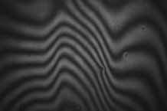
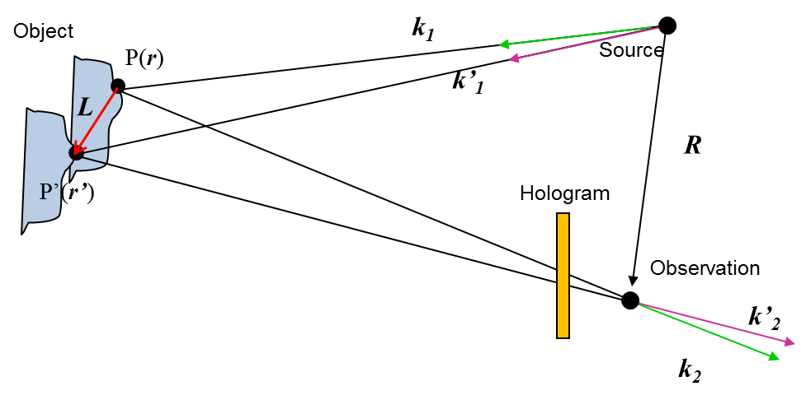
INTRODUCTION
Holographic interferometry
Scattering objects in motion or under deformation
Transparent objects undergoing phase change (e.g. refractive index changes)
Analog holography
Real-time
1 hologram stored + object visualised in real-time
Double-exposure
2 holograms stored
Digital holography
Double-exposure
2 holograms stored
Sequence of holograms
N holograms stored
Superposition of 2 holographic images
L << R, r, r’

Slide 19
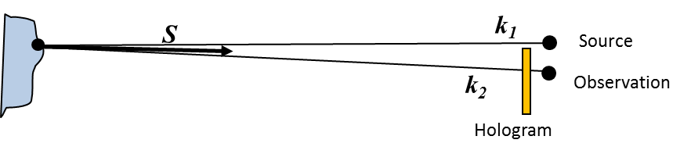
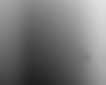
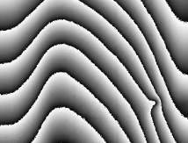
INTRODUCTION
Holographic interferometry
Interpretation of displacement/deformation
Out-of-plane configuration
Intensity is maximized for
Phase
unwrapping
Distance between two fringes
Phase extraction
Phase quantification

Slide 20
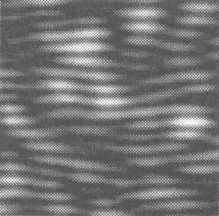
INTRODUCTION
Wavelength is a key factor for holography
Zoom of local interference pattern (hologram)
Phase map / displacement field
λ/2
λ/2
Pattern must be stable during recording
Measurement range Number of fringes
Set-up stability criterion : < λ/10
Visible lasers : stability better than 50 nm
Visible lasers : range = 50 nm – 10 µm
Only in laboratory conditions
CO2 laser
λ=10 µm
(LWIR range)
stability can be only 1 µm
range = 1 µm – 200 µm
Holography in the LWIR

Slide 21
Analog holography in the LWIR

Slide 22
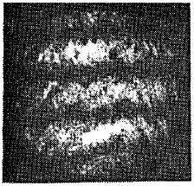
ANALOG HOLOGRAPHY IN LWIR
Photosensitive holographic recording media at 10 µm
Thermochromic materials
(Chivian et al, Appl. Phys. Lett. 1969)
Bismuth films
(Forman et al,
Appl. Phys. Lett. 1973)
Wax & Gelatin films
(Kobayashi et al, Appl. Phys. Lett. 1971)
Oil films
(Lewandowski et al,
Appl. Opt. 1986)
Plastics
(Rioux et al, Appl. Opt. 1977)
Disadvantages
  Recording at 10.6 µm, readout at 633 nm (HeNe laser)
  Typ. 10 lines/mm (low resolution)
Consider digital recording of hologram

Slide 23
Digital holography in the LWIR

Slide 24
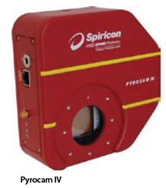




DIGITAL HOLOGRAPHY IN LWIR
Main components
Uncooled Pyroelectric Camera
CO2 laser
10.6 µm
Pitch 80 µm
124x124 pixels
1 µm – 3000 µm
Edinburgh Instruments
Uncooled Microbolometer Camera
A few Watt to few hundred Watts
Narrow linewidth
Hundred meters coherence lengths
Pitch 15-20 µm
1280x960 pixels
8-14 µm
Quantum Cascade Laser
Cooled MCT Camera
Tunable wavelength
100 mW
3 meter coherence length
15-20 µm
640x480 pixels
8-9 µm
Daylight Solutions

Slide 25
DIGITAL HOLOGRAPHY IN LWIR
Specificities of digital holography in LWIR - 1
Lensless Digital Holography
Off-axis configuration
Sampling criterium
Maximum size of recordable object
d_{o}: distance object - sensor
Δ: pixel pitch
Using state-of-art LWIR sensors
Observable objects
7 x larger at 10 µm

Slide 26

DIGITAL HOLOGRAPHY IN LWIR
Application : Large object capture
Capturing large objects hologram in LWIR – Display in visible
(M. Locatelli et al., Opt. Exp. 2012)
(M. Paturzo et al., Opt. Lett. 2010)
(A. Pellagoti et al., 3D Research 2010)

Slide 27
DIGITAL HOLOGRAPHY IN LWIR
Specificities of digital holography in LWIR - 2
Hologram sensor plane
3
2
In visible
1
3
4
1
4
In LWIR
Low frequency term
Uncoherent thermal background
Participes in
1
Filtered out

Slide 28




DIGITAL HOLOGRAPHY IN LWIR
Application : Lensless DH for looking through smoke/flames
Looking through smoke and flames
(M. Locatelli et al., Opt. Exp. 2012)
Classical
thermography
Lensless digital holography in LWIR

Slide 29

DIGITAL HOLOGRAPHY IN LWIR
Application : Lensless DH for looking through smoke/flames
Looking through smoke
(M. Locatelli et al., Opt. Exp. 2012)
Through smoke:
Lensless LWIR Digital Holography
same capability than Thermography
Smoke transparent in LWIR

Slide 30

DIGITAL HOLOGRAPHY IN LWIR
Application : Lensless DH for looking through smoke/flames
Detecting human being through flames
(M. Locatelli et al., Opt. Exp. 2012)
Also : Out-of-lab application !

Slide 31

DIGITAL HOLOGRAPHY IN LWIR
Vibration applications
Out-of-lab application
Remote monitoring of building oscillation modes
(P. Poggi, et al., Scientific Reports, 2016)

Slide 32
Digital holographic interferometry in the LWIR

Slide 33



DIGITAL HOLOGRAPHIC INTERFEROMETRY IN LWIR
Metrology for space structures - 1
Motivation
  Full-field deformations of reflectors in vacuum-thermal testing
  Large reflectors: up to 4 m diameter
  Range of deformations: 1 µm – 250 µm
  Reflectors cannot be equipped with cooperative targets
  nor sprayed with scattering powder !
Facility for Optical Calibration at the CSL
Herschel mission
Planck mission

Slide 34



DIGITAL HOLOGRAPHIC INTERFEROMETRY IN LWIR
Metrology for space structures - 1
  Reduce sensitivity to displacement to measure
  Reduce sensitivity to external perturbations
  Increase size of observable objects
  Objects reflects more specularly than in visible
Observable objects
7 x larger at 10 µm
Important when we use lenses: destruction of microbolometer pixels by CO2 laser

Slide 35




DIGITAL HOLOGRAPHIC INTERFEROMETRY IN LWIR
Metrology for space structures - 1
In-line Digital Holography : higher spatial resolution than off-axis
Phase-shifting for orders filtering
Scattering illumination
Diffuser
Uncooled µ-bolometer
640x480 pixels
Pixel Pitch : 25 µm
Frame rate 60 Hz
16 bits
LASER
To
reflector

Slide 36


DIGITAL HOLOGRAPHIC INTERFEROMETRY IN LWIR
Metrology for space structures - 1

Slide 37







DIGITAL HOLOGRAPHIC INTERFEROMETRY IN LWIR
Metrology for space structures - 1
Filtered and masked phase difference
Acquisitions (x4)
Amplitude
Mask
unwrapping
Phase #1
Phase diff.
Displacement map
Phase #2
37
slide 37

Slide 38





DIGITAL HOLOGRAPHIC INTERFEROMETRY IN LWIR
Metrology for space structures - 2
Study dark energy
Launch planned 2020

Slide 39


DIGITAL HOLOGRAPHIC INTERFEROMETRY IN LWIR
Metrology for space structures - 2
NISP Detection System (NI-DS)
  Matrix of 4×4 detectors
  Teledyne TIS H2RG detectors
  FPA dimensions: 170 × 170 mm²
  Range: 1000 nm – 2000 nm
STM | STM | STM | STM
STM | STM | STM | STM
STM | STM | MUX | FM
STM | STM | FM | MUX

Slide 40


DIGITAL HOLOGRAPHIC INTERFEROMETRY IN LWIR
Metrology for space structures - 2
Displacement field of the focal plane array (4x4 detectors)
  Cryogenic test (under vacuum)
  Determine deformation with 1 µm accuracy
  Determine piston and tilt of each detector from one another within +/- 10 µm
Temporal phase unwrapping
Allows following disconnected zones
Specular object (no scattering powder sprayed on specimen)

Slide 41






DIGITAL HOLOGRAPHIC INTERFEROMETRY IN LWIR
Metrology for space structures - 2
Implementation in vacuum chamber
Setup with scattering illumination
Temperature variation
Vandenrijt, J., et al., Opt. Eng 55(12), 121723 (2016)
Deformation between
293 K and 90 K

Slide 42

DIGITAL HOLOGRAPHIC INTERFEROMETRY IN LWIR
Metrology for space structures - 2

Slide 43
Speckle interferometry (ESPI) in the LWIR

Slide 44
SPECKLE INTERFEROMETRY IN LWIR
Speckle interferometry
LASER
lens
beam combiner
In speckle interferometry :
The image of the object is formed by
a lens on the image sensor
The interference with reference is
often called « specklegram »

Slide 45


SPECKLE INTERFEROMETRY IN LWIR
Speckle interferometry principle
t=t₁ :
t=t₂ :
Speckle pattern subtraction
Phase-shifting
Multiple specklegram capture with controlled phase steps
t=t₁ :
t=t₂ :

Slide 46






SPECKLE INTERFEROMETRY IN LWIR
Concept: LWIR Speckle Interferometry
Single sensor
Simultaneous measurement of
Temperature variation
Deformation
Laser OFF
Laser ON
Thermal background
Hologram/Specklegram

Slide 47






SPECKLE INTERFEROMETRY IN LWIR
Motivation: Measurement of deformation AND temperature
Thermo-mechanical deformation of space composite structures
Holographic camera
Thermographic camera
Defect detection in aeronautics composite structures
Thermography :
Local Temperature change
Shearography :
Local deformation

Slide 48













Grant : ACP7-GA-2008-213457
FANTOM : Full-Field Advanced Non-Destructive Technique for Online Thermo-Mechanical Measurement on Aeronautical Structures
Partner | Country | Profile
Centre Spatial de Liège Université de Liège |  | Coordinator – University Research Centre Development/application of non destructive testing techniques
Institut für Technische Optik Universität Stuttgart |  | University Research Centre Specialist of Holography
InfraTec GmbH |  | SME – Development of Thermography system and applications
Centro de Tecnologias Aeronauticas |  | Research Centre Specialist of Non Destructive Testing – Structural Tests
Optrion S.A. |  | SME – Development of Holography system and applications
Innov Support |  | SME – Servicing partner
Prof. Wolfgang Osten
Dr. Giancarlo Pedrini
Dr. Igor Alexeenko, now at

Slide 49






SPECKLE INTERFEROMETRY IN LWIR
Demonstration of principle
Wrapped phase
Unwrapped phase
3D plot of deformation
Temperature variation
Helicopter panel
Georges, M., et al., “Combined holography and thermography in a single sensor through image-plane holography at thermal infrared wavelengths,” Opt. Exp. 22, 25517-25529 (2014)

Slide 50



SPECKLE INTERFEROMETRY IN LWIR
Application
Laboratory set-up
Laboratory compact prototype
Mobile system
Vandenrijt , JF., et al. “Mobile speckle interferometer in the long-wave
infrared for aeronautical nondestructive testing in field conditions,”
Opt. Eng. 52(10), 101903 (2013)
Alexeenko, I., et al. “Nondestructive testing by using long-wave infrared interferometric techniques with CO2 lasers and microbolometer arrays,”
Appl. Opt. 52(1), A56-A67 (2013)

Slide 51




SPECKLE INTERFEROMETRY IN LWIR
Application: holographic non destructive testing in
industrial environment (Airbus plant, Toulouse, France)
Airbus D41 « Tear Down »
« All Composite Aircraft » A350 Fuselage
FANTOM industrial prototype

Slide 52
SPECKLE INTERFEROMETRY IN LWIR
Application
Δφ
ΔT
After 2 seconds
After 30 seconds
After 6 minutes
Lamp start
time

Slide 53
Digital holography in THz

Slide 54
DIGITAL HOLOGRAPHY IN THZ WAVES
The « Terahertz Gap »
Terahertz wave range (1 THz=10¹² Hz)
Sandwiched between the microwave and infrared
Frequency: 0.3-10 THz
Wavelength: 30-1000 µm
1 THz ↔ 33.3 cm⁻¹ ↔ 300 µm ↔ 4.1 meV
Electronics
Photonics
THz Gap
IR
Visible
“THz gap”
Least explored EM bands
Lack of sources/ detectors
300 MHz
1 m
3 GHz
10 cm
30 GHz
1 cm
300 GHz
1 mm
3 THz
100 µm
30 THz
10 µm
300 THz
1 µm

Slide 55





DIGITAL HOLOGRAPHY IN THZ WAVES
Terahertz imaging
Unique properties
  Low photon energies
  Non ionizing
  Dielectric material penetration
  Spectroscopic features (interaction with matter)
  Various potential applications
Security and Defense
Biomedical Applications
Source: “Molecular imaging with terahertz waves” by SJ Oh et al. , 2011
Nondestructive Inspection
Source: “THz scanner imagery”,
www.dailymail.co.uk
Identification of drugs and explosives
Source: “Non-destructive terahertz imaging of illicit drugs using spectral fingerprints” by Kawase et al. ,2003
Source: “Damage and defect inspection with terahertz waves” by Redo-Sanchez et al., 2006

Slide 56







DIGITAL HOLOGRAPHY IN THZ WAVES
Terahertz continuous emitters
Optical/laser based
Electrical
Optical pumped Far-IR Gas Lasers
Molecular gases (CH₃OH, CHOOH…)
Quantum Cascade Lasers (QCL)
Microwave Frequency Multipliers, Gunn diodes, IMPATT diodes
Source: https://www.edinst.com/products/far-infrared-terahertz-gas-lasers/
Source: http://www.rap.riken.jp/en/labs/twrg/tqdrt/index.html
Free Electron Lasers (FEL)
p-Germanium (p-Ge) laser
Source: http://terasense.com/products/terahertz-sources/
Backward wave oscillator (BWO)
Source: http://www.lightsources.org/what-free-electron-laser
Source: http://www.lightsources.org/what-free-electron-laser
Source: https://en.wikipedia.org/wiki/Backward-wave_oscillator

Slide 57



DIGITAL HOLOGRAPHY IN THZ WAVES
Terahertz broadband pulse emitters
Photoconductive Antennae
Photoinduced transient current generation
Optical rectification
Difference frequency generation
(ZnTe, GaP, GaSe, LiNbO_{3…})
Source: http://qcmd.mpsd.mpg.de/index.php/Broadband-Time-resolved-terahertz-spectroscopy.html
Air plasma
Optical nonlinear effects in air plasmas
Source: http://qcmd.mpsd.mpg.de/index.php/Broadband-Time-resolved-terahertz-spectroscopy.html
Source: “Intense terahertz generation in two-color laser filamentation: energy scaling with terawatt laser systems” by Oh et al., 2013

Slide 58


DIGITAL HOLOGRAPHY IN THZ WAVES
Terahertz pulse detectors
Inverse principle than pulse emission (probe pulse is mandatory)
Photoconductive Antennae sampling
Detecting the transient current formed by photoinduced carrier driven by Terahertz electric field
Electro-optic sampling
1st order EO effect produced by an EO crystal
ZnTe
Source: “Highly precise and accurate terahertz polarization measurements based on electro-optic sampling with polarization modulation of probe pulses” by Nemoto et al., 2014
Source: “Terahertz Applications by THz Time Domain Spectroscopy” by Iwasa, 2002

Slide 59









DIGITAL HOLOGRAPHY IN THZ WAVES
Terahertz detectors
Focal plane arrays (FPA) Uncooled thermal detectors
Microbolometers
Pyroelectric
VOx
384x288
Pitch 35 μm
NEP < 25pW @ 2.55 THz
SiN
320x240
Pitch 23.5 μm
NEP < 100pW @ 3 THz
VOx
320x240
Pitch 50 μm
NEP < 30pW @ 2.5 THz
LiTaO₃
160x160
Pitch 80 μm
NEP < 30pW @ 2.5 THz
Hack, E., et al., Comparison of Thermal Detector Arrays for Off-Axis THz Holography and Real-Time THz Imaging. Sensors (Basel), 2016. 16(2): p. 221.
Other detectors
Golay cells
Diode detectors
Most recent publications of THz
Digital Holography use FPA
Source: https://en.wikipedia.org/wiki

Slide 60







DIGITAL HOLOGRAPHY IN THZ WAVES
Terahertz optical components
Lens, windows and beam splitters
Silicon
Polymers: PTFE, HDPE, TPX
Key factors: loss and dispersion at operating wavelength
Off-axis parabolic mirrors
Free from spherical aberrations
Beam manipulation: focus, collimation…
Polarizers
Wire grid
main
manufacturers

Slide 61


DIGITAL HOLOGRAPHY IN THZ WAVES
Terahertz 2D imaging by scanning
B. B. Hu and M. C. Nuss, "Imaging with terahertz waves," Opt. Lett. 20, 1716-1718 (1995)

Slide 62


DIGITAL HOLOGRAPHY IN THZ WAVES
Digital Holography - 1
Off-axis digital holography
Point-by-point recording
Scanning detector
Metallic object
Mask in transmission
Heimbeck M., et al., Terahertz digital holography using angular spectrum and dual wavelength reconstruction methods., Optics Express, 2011. 9192-9200

Slide 63

DIGITAL HOLOGRAPHY IN THZ WAVES
Digital Holography - 2
Two-wavelength holography
Lens in THz transparent material
Variation of refractive index
Heimbeck M., et al., Terahertz digital holography using angular spectrum and dual wavelength reconstruction methods., Optics Express, 2011. 9192-9200

Slide 64


DIGITAL HOLOGRAPHY IN THZ WAVES
Digital Holography - 3
In-line (Gabor) digital holography
Metallic object
Concealed in THz transparent material
Gas laser
Xue, K, et al., Continuous-wave terahertz in-line digital holography., Optics Letters2012. 3228-3230

Slide 65

DIGITAL HOLOGRAPHY IN THZ WAVES
Digital Holography - 4
Locatelli, M., et al., Real-time terahertz digital holography with a quantum cascade laser., Scientific Reports, 2015. 5: p. 13566.

Slide 66

DIGITAL HOLOGRAPHY IN THZ WAVES
Digital Holography - 5
Locatelli, M., et al., Real-time terahertz digital holography with a quantum cascade laser., Scientific Reports, 2015. 5: p. 13566.

Slide 67


DIGITAL HOLOGRAPHY IN THZ WAVES
Digital Holography - 5
Experimental set-up
Sample
Huang, H., et al., Continuous-wave terahertz multi-plane in-line digital holography. Optics and Lasers in Engineering, 2017. 94: p. 76-81.

Slide 68

DIGITAL HOLOGRAPHY IN THZ WAVES
Digital Holography - 5
Phase retrieval
Synthetic aperture
Before
Improves resolution
After
Final 3D reconstruction
Auto-focusing
Huang, H., et al., Continuous-wave terahertz multi-plane in-line digital holography. Optics and Lasers in Engineering, 2017. 94: p. 76-81.

Slide 69
CONCLUSION
Long-wave IR holography-speckle interferometry
  Insensitive/Low sensitivity to external perturbations
  Some specific features give nice applications
    Looking through flames/smokes
    Large displacements measurements
    Combined thermography-interferometry for NDT
THz holography
  New field
  Benefit from fast growing of components improvement
  Applications
    Can reveal concealed object (e.g. NDT)
    Many new exciting applications (biomedical)

Slide 70
Большое спасибо !
mgeorges@ulg.ac.be
www.csl.ulg.ac.be

