Slide 1
THE RETURN OF MIGRANTS
Case study Van Thang commune, Nong Cong district, Thanh Hoa province,
Vietnam
Ngo Trung Thanh*, Philippe Lebailly*, Nguyen Thi Dien**
(*)University of Liege, Gembloux Agro Bio Tech, Belgium
(**)Vietnam National University of Agriculture
Notes:
Given a presentation today I would like to say thanks to donor, organizer and specially to Prof. P. Burny who invited me.
Here I would like to deliver a topic of the RETURN OF MIGRANTS

Slide 2
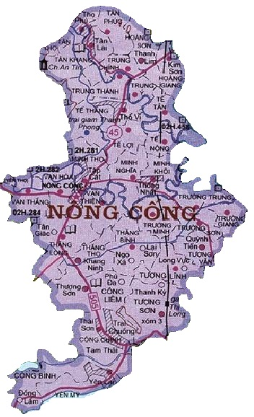
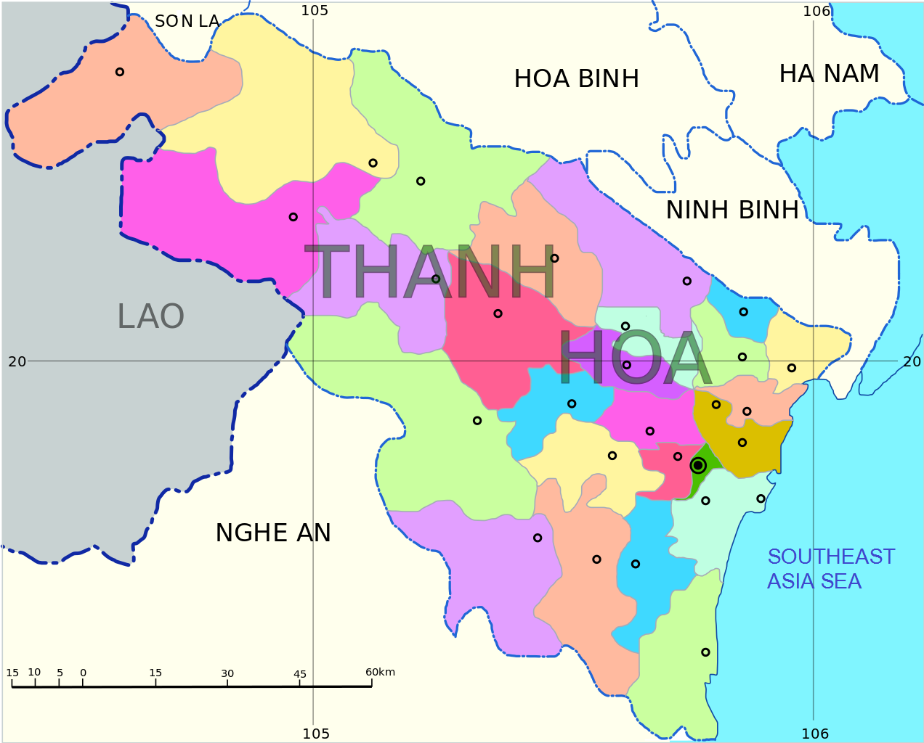
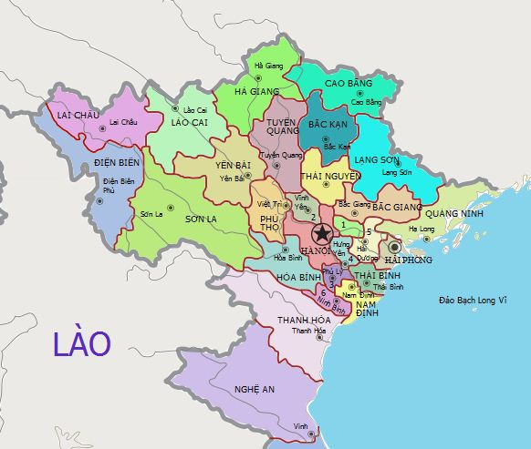
Study site

Slide 3
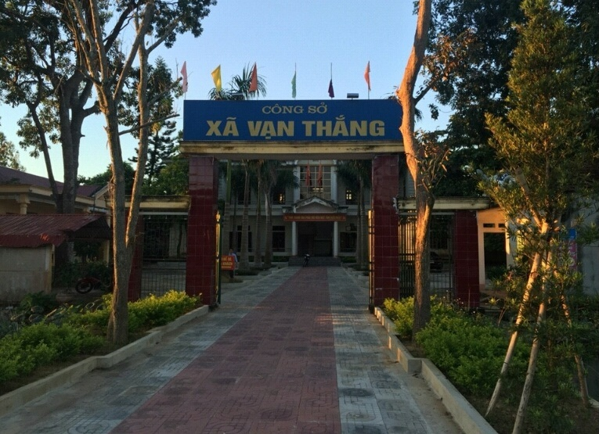
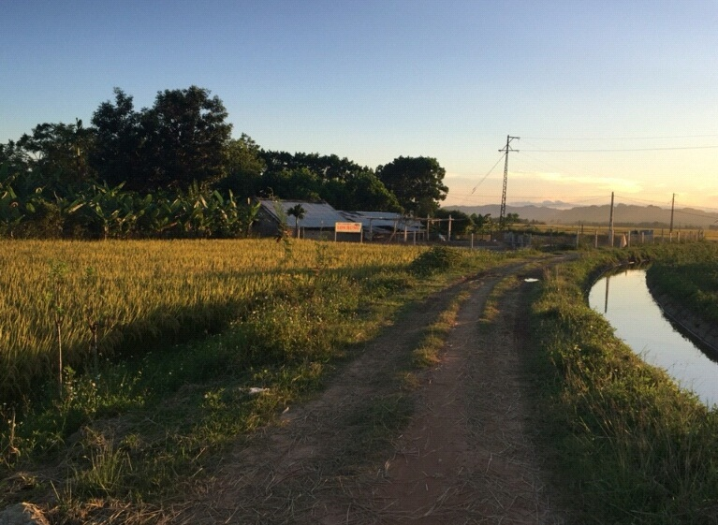
Data collection in Van Thang
Van Thang commune:
Main Livelihood: Agriculture
Poor of the district
Data collection:
68 return migrants (08/2016)

Slide 4
What are going to present?
What are the characteristics of the return migrants?
How was the living and employment before the return?
How the migrants do after the return?
In Industrial zones
Outside Industrial zones

Slide 5
Why return migrants?
Return migration as reviewing in literatures on international return migration is lacking in depth
Success and failure dichotomy which is shaped by many literatures has been criticized too narrow
Huge study has been conducted on migration, but not many in the return of migration, especially in Vietnam.

Slide 6
Where did migrants go?
First destination | In industrial zones | Outside industrial zones | Total
Binh Duong | 22 | 8 | 30
Da Nang | 0 | 2 | 2
Hanoi | 0 | 1 | 1
Ho Chi Minh City | 15 | 20 | 35
Total | 37 | 31 | 68

Slide 7
Characteristics of return migrants
 | N | Minimum | Maximum | Mean | Median
Age of return migrant | 68 | 20 | 55 | 29.86765 | 28.00000
Migrant in industrial zones | 37 | 20 | 40 | 26.64865 | 26.00000
Migrant outside industrial zones | 31 | 20 | 55 | 33.70968 | 34.00000
Number of migration | 68 | 1 | 4 | 1.514706 | 1.00000
Migrant in industrial zones | 37 | 1 | 4 | 1.432432 | 1.00000
Migrant outside industrial zones | 31 | 1 | 4 | 1.612903 | 1.00000
Duration of migration | 68 | 1 | 21 | 7.294118 | 7.00000
Migrant in industrial zones | 37 | 1 | 12 | 5.945946 | 6.00000
Migrant outside industrial zones | 31 | 1 | 21 | 8.903226 | 8.00000

Slide 8
Characteristics of return migrants
 |  | Marriage Distance
First destination of migration | Time of migration | Other districts | District | Commune | Other provinces | Total
In industrial zone | Not marriage |  |  |  |  | 4
 | Before migration | 3 | 2 | 1 | 0 | 6
 | During migration period | 7 | 2 | 6 | 5 | 20
 | After migration | 2 | 0 | 5 | 0 | 7
Total |  | 12 | 4 | 12 | 5 | 37
Outside industrial zones | Not marriage |  |  |  |  | 4
 | Before migration | 0 | 2 | 4 | 0 | 6
 | During migration period | 2 | 2 | 1 | 9 | 14
 | After migration | 1 | 1 | 4 | 1 | 7
Total |  | 3 | 5 | 9 | 10 | 31
^{[1]} Within Thanh Hoa province

Slide 9
Living before the return
Last destination of migration |  |  | Social environment |  |  | Total
 |  |  | Worse | Unchanged | Better
In industrial zone | Facilities for living condition | Worse | 3 | 4 | 0 | 7
 |  | Unchanged | 2 | 0 | 2 | 4
 |  | Better | 8 | 3 | 12 | 23
 | Total |  | 13 | 7 | 14 | 34
Outside industrial zone | Facilities for living condition | Worse | 1 | 2 | 3 | 6
 |  | Unchanged | 0 | 2 | 1 | 3
 |  | Better | 8 | 4 | 13 | 25
 | Total |  | 9 | 8 | 17 | 34

Slide 10
Employment before return
Last destination of migration |  |  | Working environment |  | Total
 |  |  | Satisfy | Not satisfy
In industrial zone | Income | Satisfy | 16 | 5 | 21
 |  | Not satisfy | 6 | 7 | 13
 | Total |  | 22 | 12 | 34
Outside industrial zone | Income | Satisfy | 17 | 5 | 22
 |  | Not satisfy | 6 | 6 | 12
 | Total |  | 23 | 11 | 34

Slide 11
Employment of returnees
Last destination of migration |  |  | Current employment |  |  |  | Total
 |  |  | No employment | Agriculture | None Agriculture | Mix
In industrial zone | Employment at early time of return | No employment | 0 | 0 | 7 | 0 | 7
 |  | Agriculture | 1 | 13 | 3 | 1 | 18
 |  | None Agriculture | 0 | 2 | 5 | 0 | 7
 |  | Mix | 0 | 0 | 0 | 2 | 2
 | Total |  | 1 | 15 | 15 | 3 | 34

Slide 12
Employment of returnees
Last destination of migration |  |  | Current employment |  |  |  | Total
 |  |  | No employment | Agriculture | None Agriculture | Mix
Outside industrial zone | Employment at early time of return | No employment | 3 | 0 | 2 | 0 | 5
 |  | Agriculture | 0 | 7 | 5 | 1 | 13
 |  | None Agriculture | 0 | 2 | 11 | 0 | 13
 |  | Mix | 0 | 0 | 0 | 3 | 3
 | Total |  | 3 | 9 | 18 | 4 | 34

Slide 13
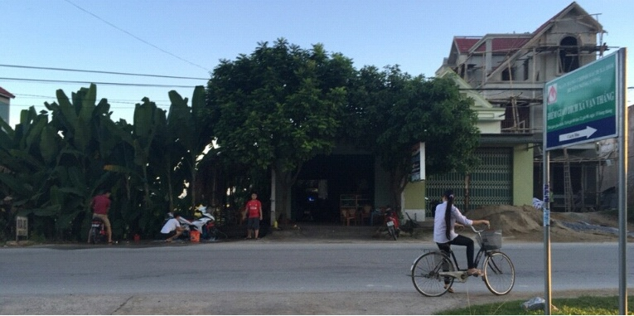
Employment of returnees
None farm employment of returnees

Slide 14
Renting agricultural land
Last destination of migration |  | Renting area (sao = 500m2) | Current employment |  |  |  | Total
 |  |  | No employment | Agriculture | None Agriculture | Mix
In industrial zone |  | 0 | 1 | 6 | 9 | 1 | 17
 |  | 1 | 0 | 2 | 1 | 0 | 3
 |  | 1.4 | 0 | 0 | 0 | 2 | 2
 |  | 2 | 0 | 2 | 2 | 0 | 4
 |  | 4 | 0 | 1 | 2 | 0 | 3
 |  | 6 | 0 | 1 | 1 | 0 | 2
 |  | 7 | 0 | 1 | 0 | 0 | 1
 |  | 19 | 0 | 2 | 0 | 0 | 2
 | Total |  | 1 | 15 | 15 | 3 | 34
Outside industrial zone |  | 0 | 3 | 7 | 17 | 4 | 31
 |  | 1 | 0 | 0 | 1 | 0 | 1
 |  | 4 | 0 | 2 | 0 | 0 | 2
 | Total |  | 3 | 9 | 18 | 4 | 34

Slide 15
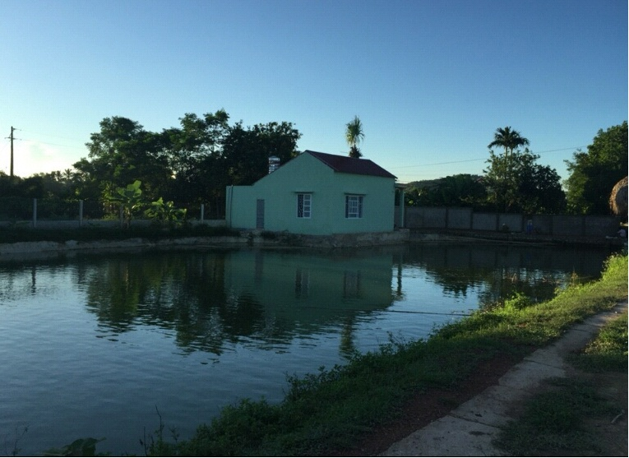
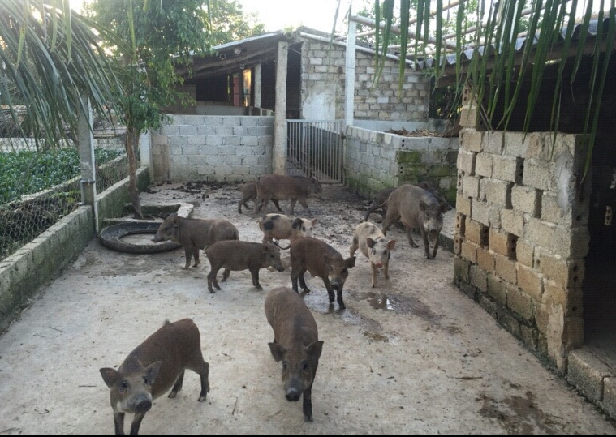
5ha farm

Slide 16
Conclusion
The return of migrants in Van Thang is not really associated with the unsuccessful of migration. In fact almost of returnees have satisfied with the life and employment at the destination.
Agriculture plays as a buffer for the returnees during seeking other none farm employments in home village

Slide 17
Thank you for your attention!

