Slide 1
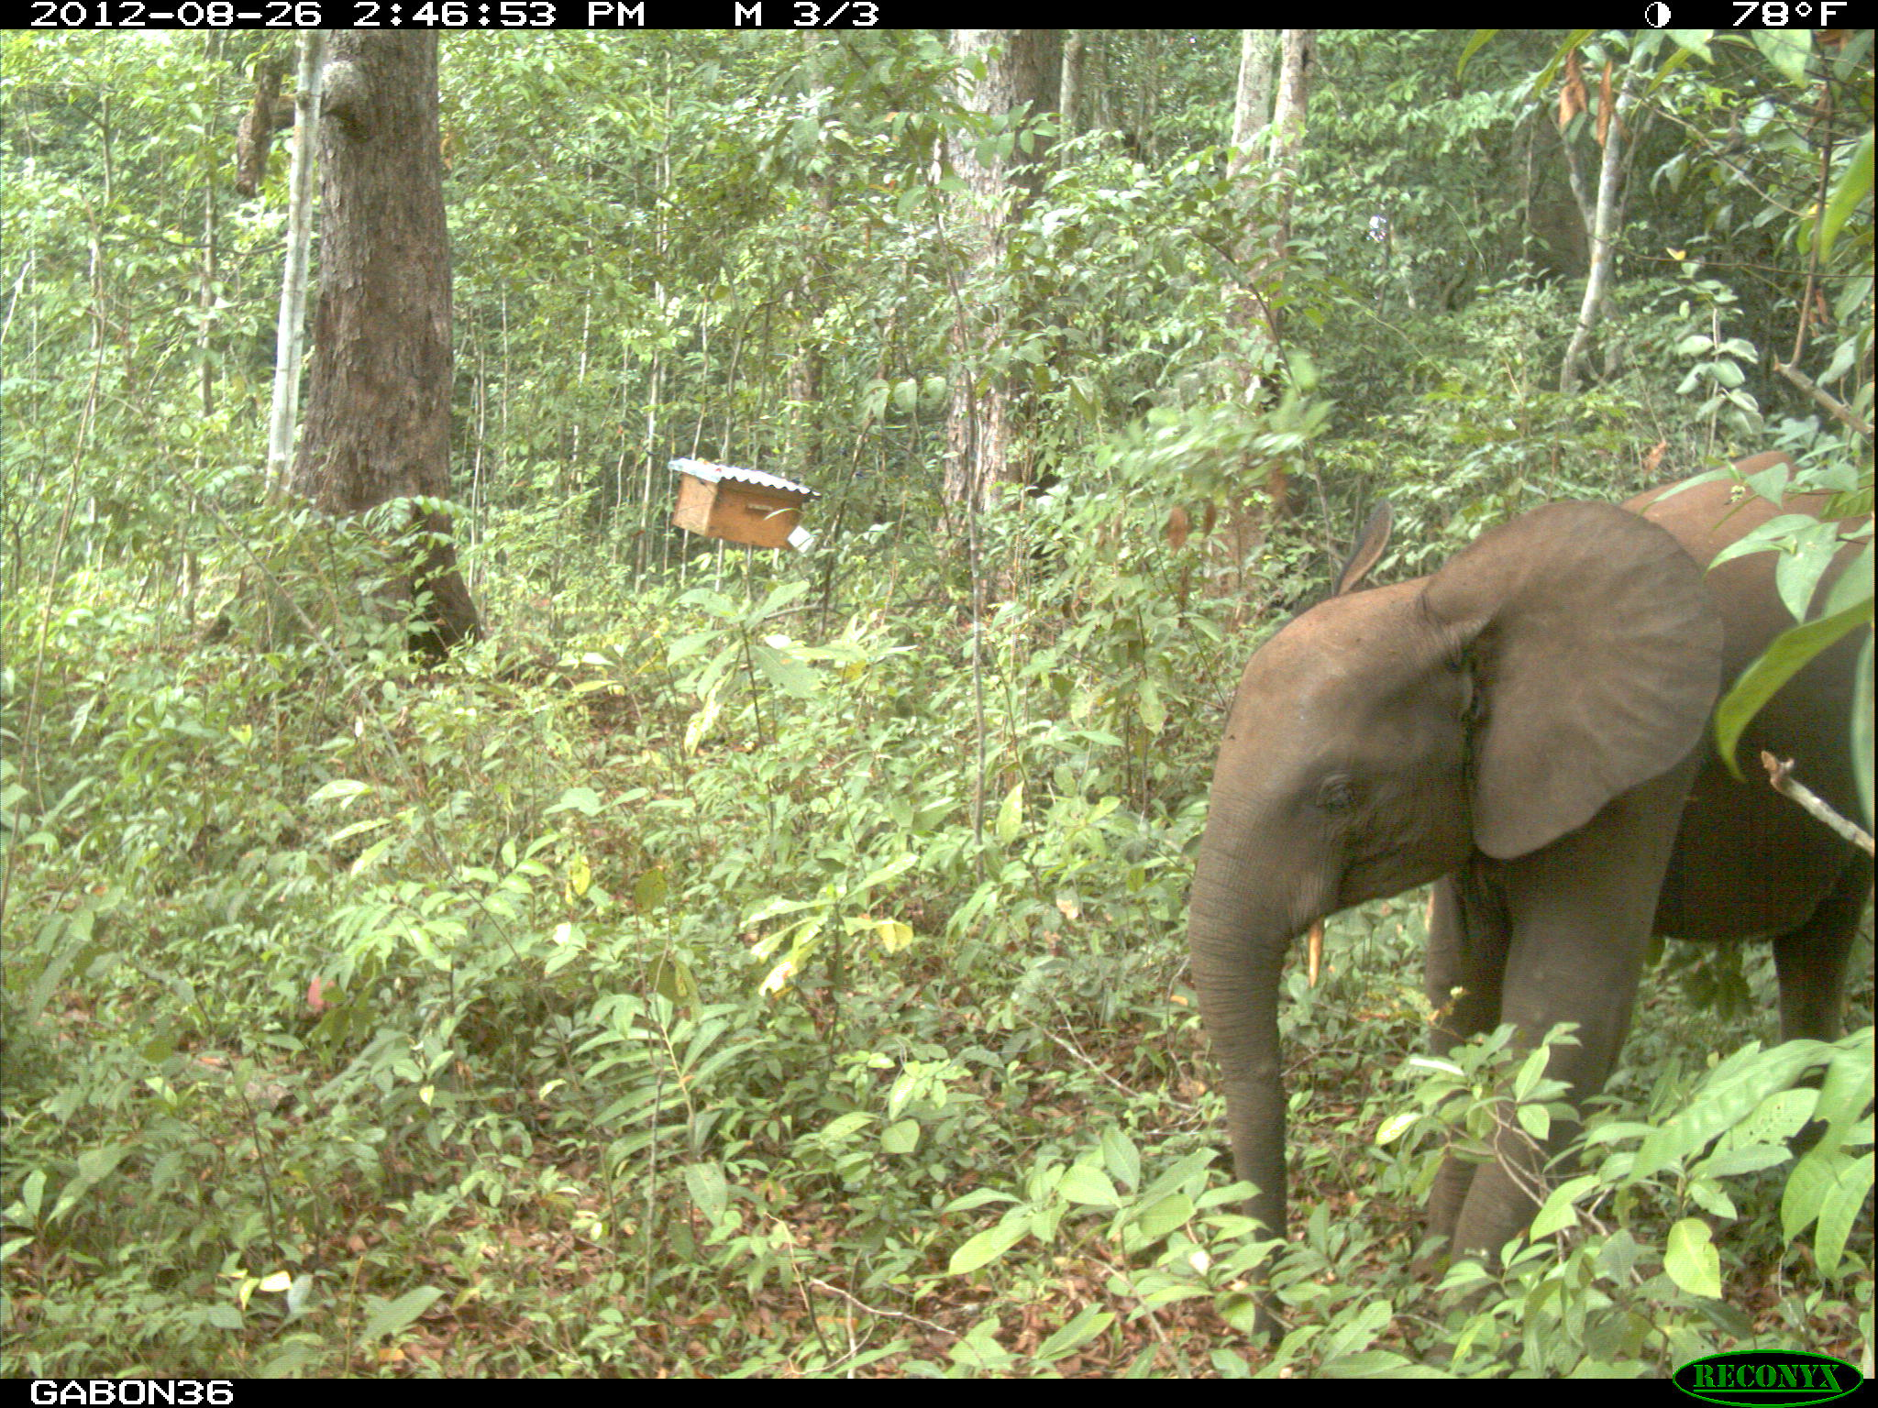







Video and camera traps to investigate animal ecophysiology and enhance wildlife management:
case study on bees and elephant interactions in Gabon
---------------------
Ref: Ngama S, Korte L, Bindelle J, Vermeulen C, Poulsen JR (2016) How Bees Deter Elephants: Beehive Trials with Forest Elephants (Loxodonta africana cyclotis) in Gabon (C Wicker-Thomas, Ed). PLoS ONE 11: e0155690.
Presenter:
Steeve Ngama
PhD Candidate, Central African Forests, TERRA Research Centre, Gembloux ABT, University of Liège, Belgium.
Research Fellow, IRAF-CENAREST, Gabon.
---------------------
Co-authors: Pr. Cédric Vermeulen and Pr. Jerôme Bindelle, Gembloux ABT, University of Liège, Belgium

Slide 2
Experiment design
Results
Going further
of 10
Content
Experiment design
Results
Going further

Slide 3
Experiment design
Trial conclusions
Going further
of 10
Context
Elephant species :
Elephant species : vulnerable or endangered (IUCN red list)
Habitat loss
Poaching for ivory
Human-elephant conflicts
Elephant damages on crops:
(1) human-elephant conflicts
(Walker 2012; Abernethy et al. 2013)
(2) less conservation action support
(3) 25-90% poverty increase with up to 100% income decrease
Bees: promising low tech, eco-friend elephant deterrent, income increaser ; (King 2010)
(1) How bees deter elephants? (2) Do bees deter forest elephant as savanna ones?
Ecophysiology:
  investigate how physiology matters on others animal life processes;
  suitable to investigate mechanisms behind population declines and achieve tangible conservation outcomes. (Bradshaw 2003)
Purpose
Using ecophysiology to:
know how bee physiology matters on its defensive behavior;
better understand bees and elephants interactions.

Slide 4
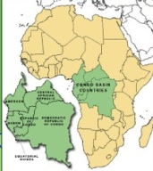
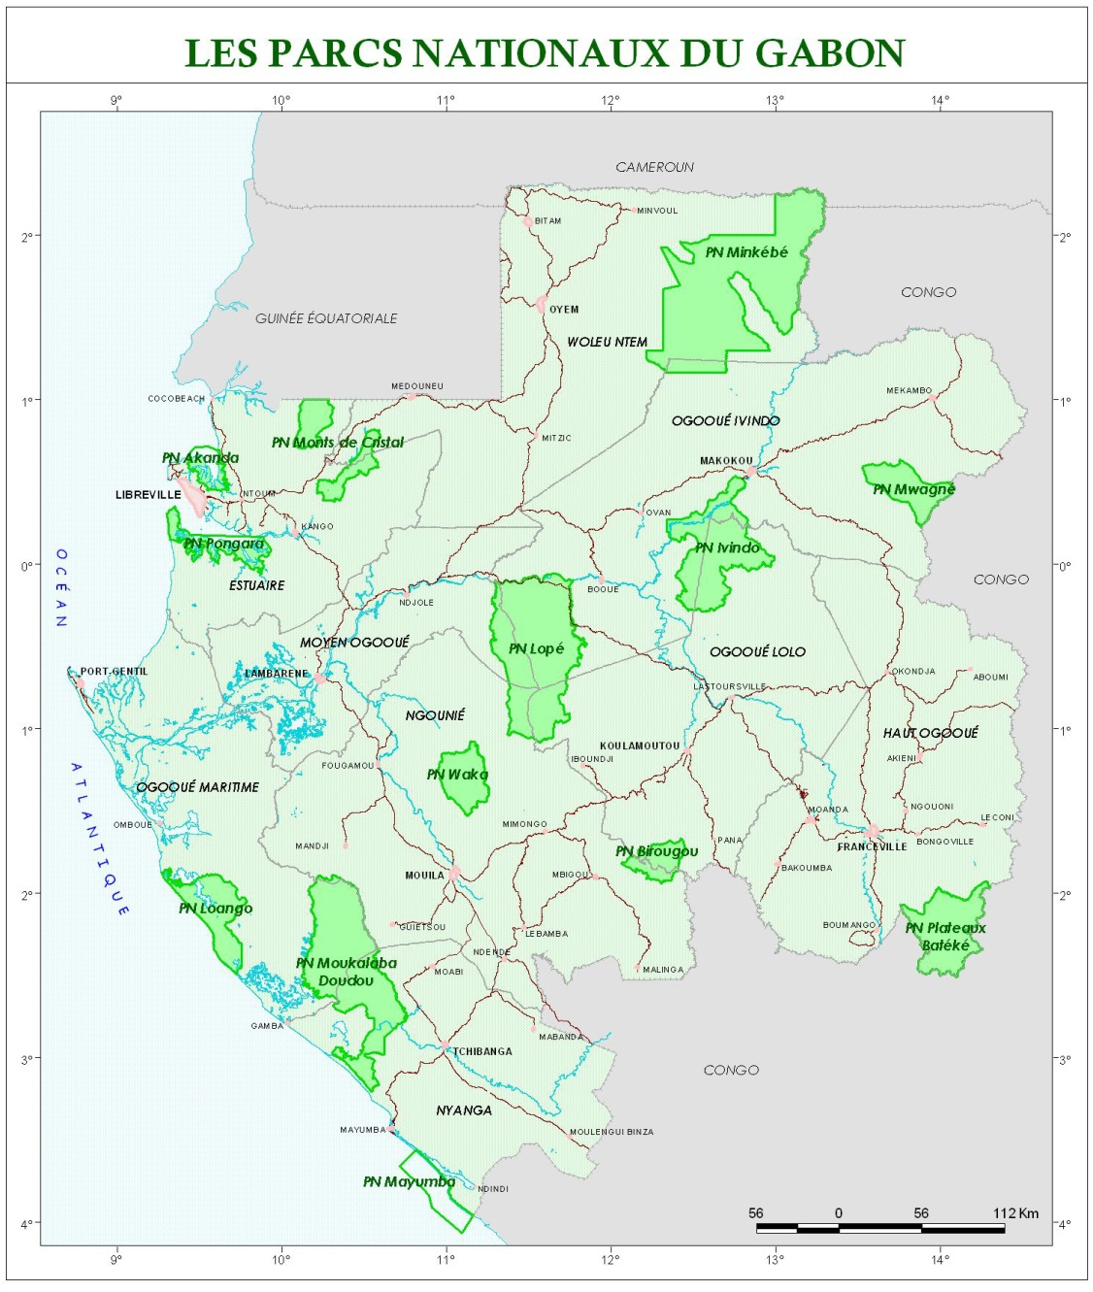
Experiment design
Trial conclusions
Going further
of 10
Study site

Slide 5
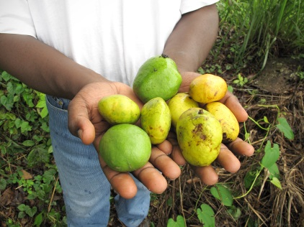
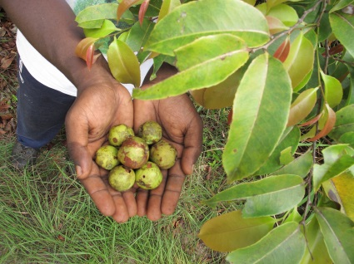
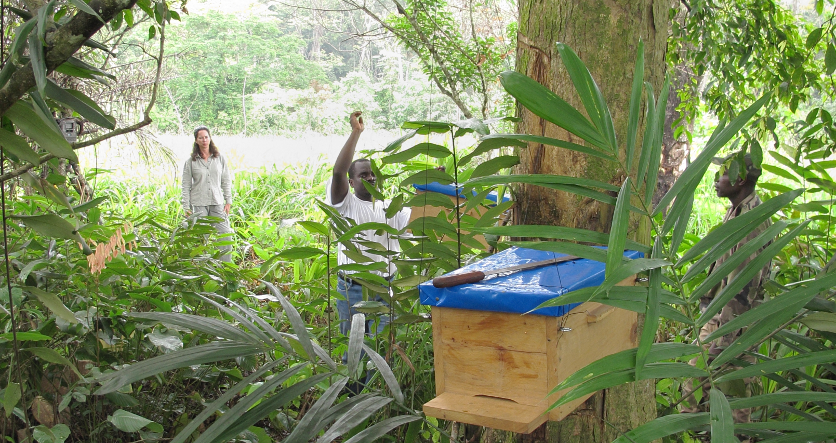
Experiment design
Trial conclusions
Going further
of 10
To see if beehives could deter elephant:
6 trees of Irvingia gabonensis and 4 trees of Sacoglottis gabonensis (whose fruits are consumed by forest elephants).
14 beehives were hung on 7 experimental trees (2beehives/tree), 3 trees served as controls (without beehives) and all were equipped with a camera trap.

Slide 6
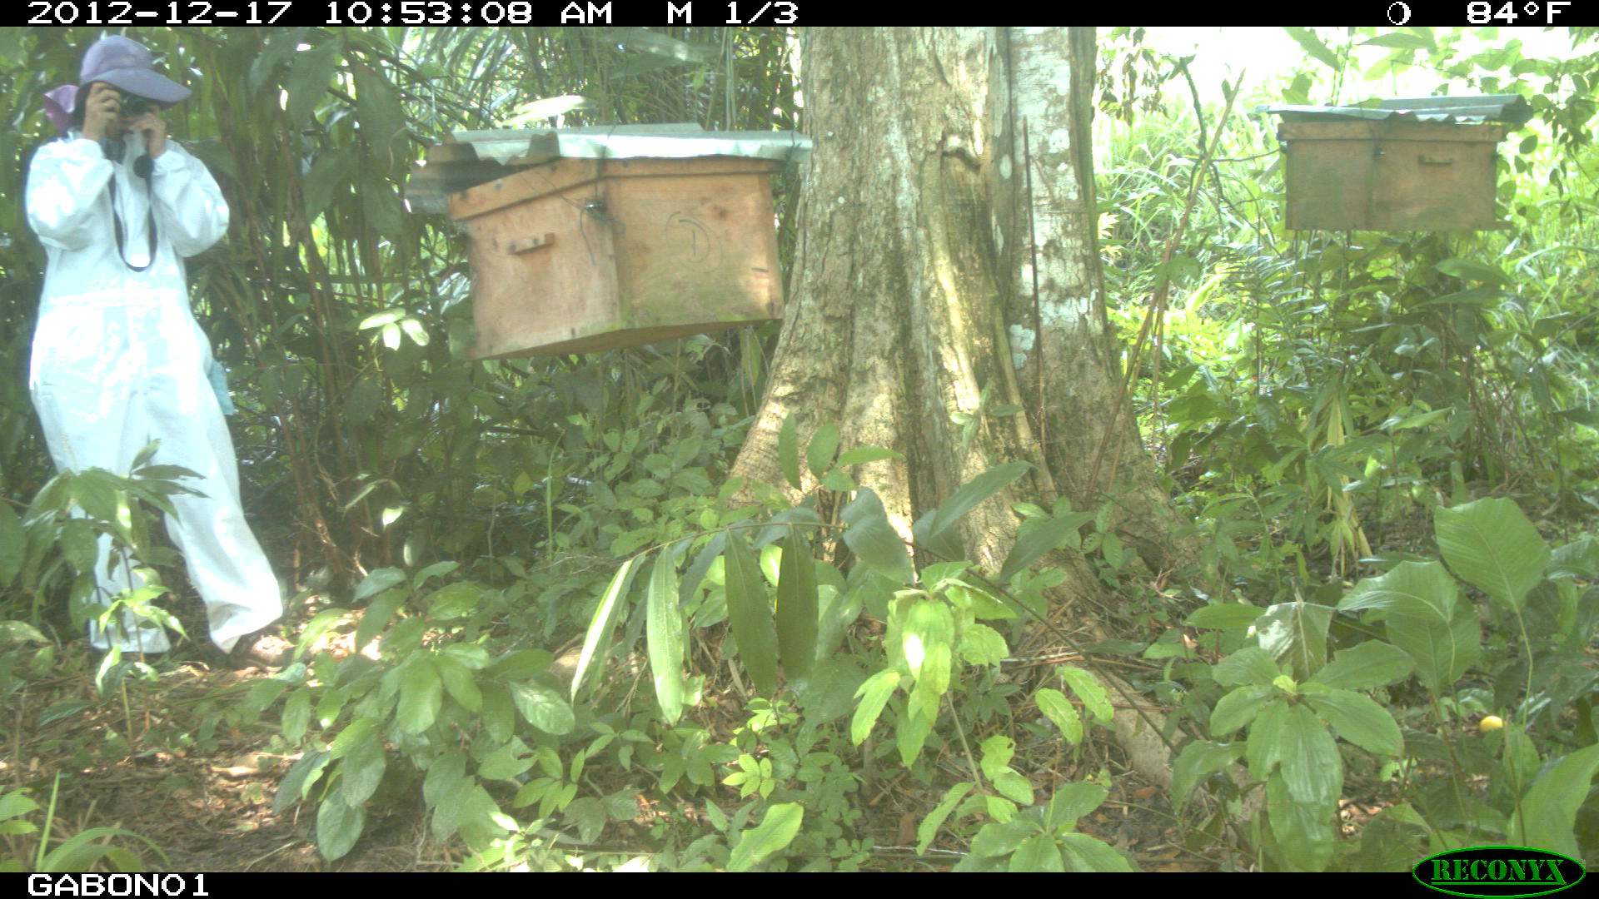
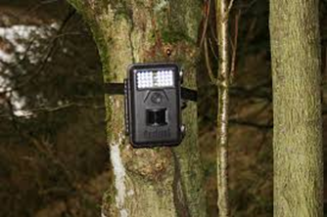

Experiment design
Trial conclusions
Going further
of 10
Photos from Camera traps:
to monitor elephant feeding behavior and reactions
Videos from a Canon PowerShot S3IBee camera:
To monitor bee physiology (reproduction and population growth) and defensive behavior  bee activities (b.mvt/min)
(Woyke 1992, Smith et al. 2015)
Experimental sites were monitored weekly during 70 weeks

Slide 7
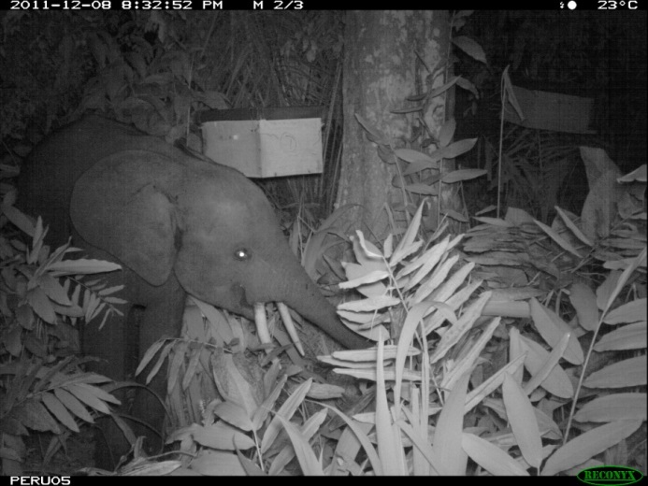
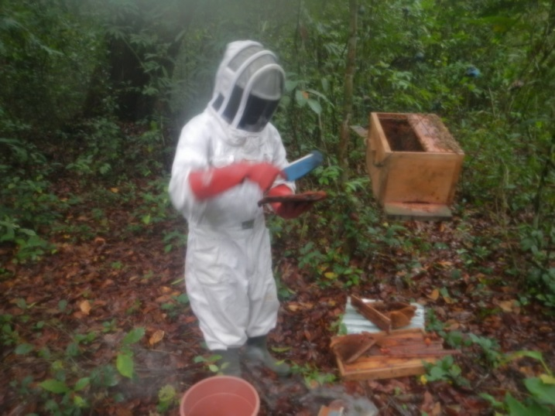
Experimental design
Results
Going further
of 10
8151 photos of elephants, representing 4h31min42s of time spent by elephants at experimental sites, which was mostly at night.
255 elephant visits.
17.7 kg of honey harvested (4.1±2.1 kg per productive beehive)

Slide 8
Experimental design
Results
Going further
of 10
Figue.2: Elephants behavior on sites and honey collected according to bee activity.
Simple bee or beehive presence do not deter forest elephants as their savanna congeners
To both deter forest elephants and produce honey local honey bees have to be well monitored and maintained at the level of 50-70 b.mvt/min

Slide 9
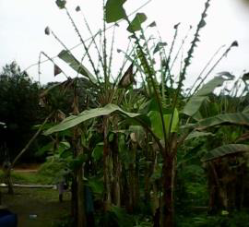
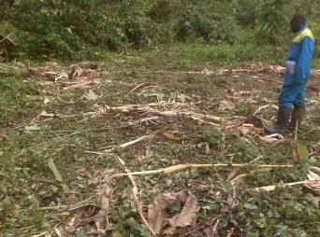
Trial conclusions
Going further
Trial design
of 10
- What lead elephant to face threats such as bees ?
- What could explain nutritional behaviour and crop selection of elephants?
Banana leaves eaten by elephants in Monts de Cristal NP.
Banana farm completly destroyed by elephants in Monts de Cristal NP.
Reproduction statuses and parasitism suspected as drivers !
For details missing in this presentation, see:
Ngama S, Korte L, Bindelle J, Vermeulen C, Poulsen JR (2016) How Bees Deter Elephants: Beehive Trials with Forest Elephants (Loxodonta africana cyclotis) in Gabon (C Wicker-Thomas, Ed). PLoS ONE 11: e0155690.

Slide 10

Thank you !
Experimental design
Results
Going further
of 10

