Slide 1


Robotix Academy Conference for Industrial Robotics (RACIR)
June 6 & 7, 2017
Robot control based on human motion analysis with IMU measurements
R. Pellois, L. Joris, and O. Brüls
Department of Aerospace and Mechanical Engineering, University of Liège, Belgium {robin.pellois,ljoris,o.bruls}@ulg.ac.be
Notes:
Me : Ingineering school (Ensam Lille) + master degree in montréal + started PhD in last december
Continue the work of Laura .

Slide 2
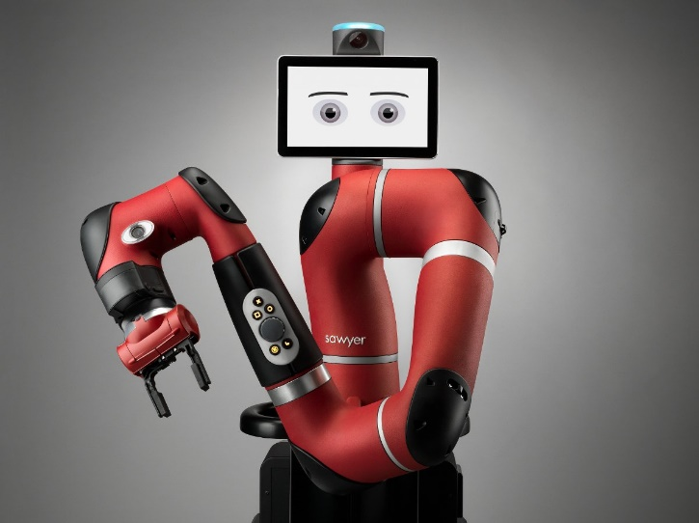
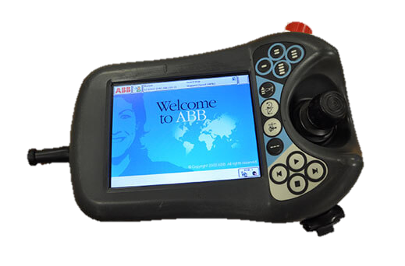
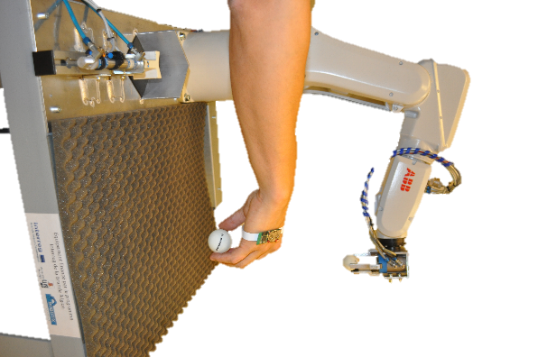
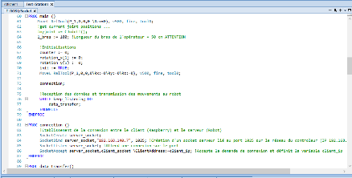
How to program a robot nowadays ?
Human-Robot Collaboratives methods
Classical methods
By moving the robot
Via teach-pendant (joint moving or end effector moving)
Voice controlled robot
Via computer : graphic solution or programming language
By Demonstration
to the robot
Notes:
- Classical programming method (teachpendant, code line ...) : tedious, slow
- vs new HRC method :
- moving the robot (example Sawyer at the lab) : no need to use joystick, really faster and easier
- Higher level : voice controled and by Demonstration to the robot : Try to recognize the attention of the human by extracting pattern in the voice or in the gesture

Slide 3
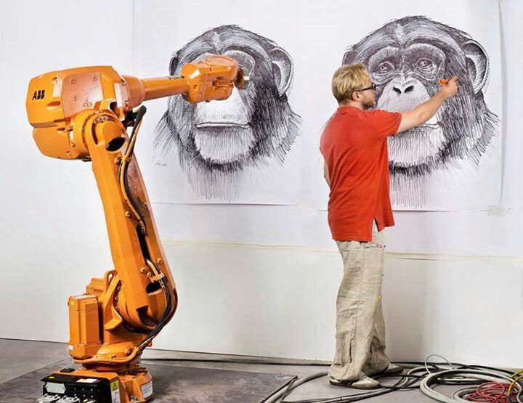
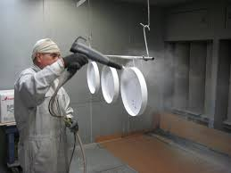
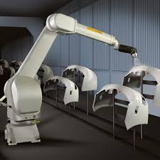
Why programming robot by demonstration based on human gesture measurement would be needed ?
short series
- Faster programing
More intuitive
No skills required
Programming new tasks
Specials skils
Notes:
- faster programming
- more intuitive
- Adapted to a new field of tasks (more artistic) : Exemple of citius
1 : Short series (20 to 30 pieces); Painting required technical skills and experience to know if the piece is well painted. But it would be exactly 20 or 30 time the same gesture.
2 : Or this kind of work requir precise, smooth motion a robot is able to do so it would be great to automated this work. But really not easy to programm because no precise position. It's more about programming a motion than programming position/tasks. So in this case, the idea is to mesure the mouvement of the painter for the firsts pieces and then let the robot complete the series.
3 : The robot just have to imitate the human.

Slide 4
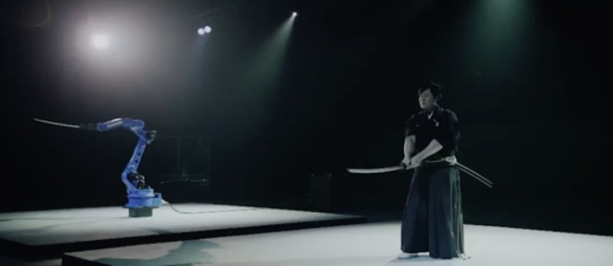
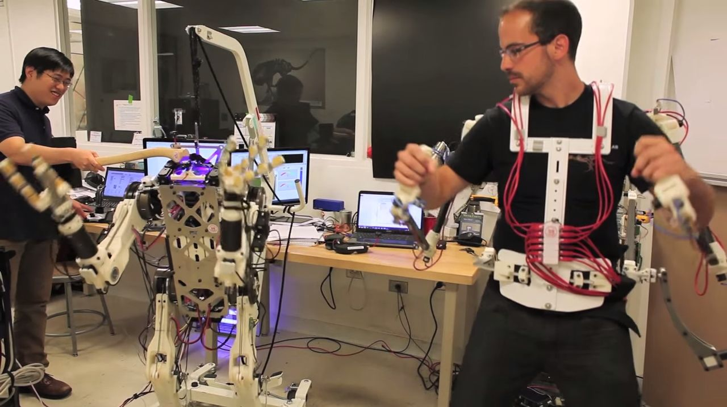
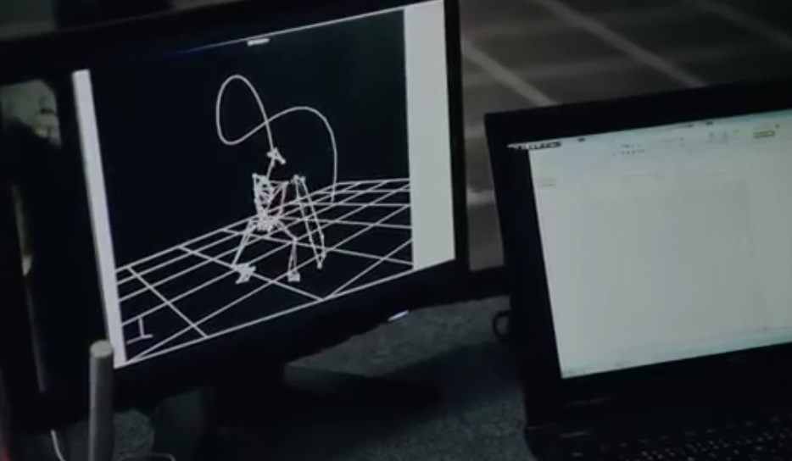
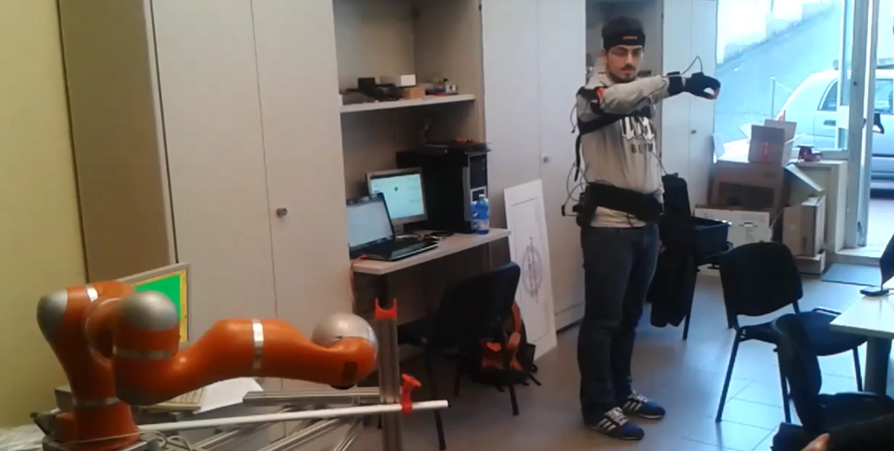
How to measure human motion ?
Opto-electronique
Vision
Exoskeleton
IMUs
Notes:
- Exoskeleton : mecanical, measure joint angle. Big, heavy, intrusif, but precise and sur
- Vision : Really sensitive to the environnement.
- IMUs : Can measure 6 degrees of freedom

Slide 5
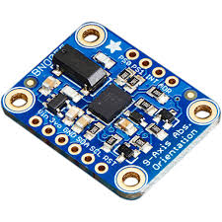
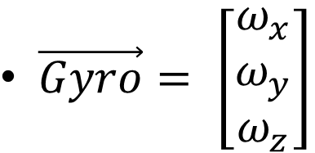
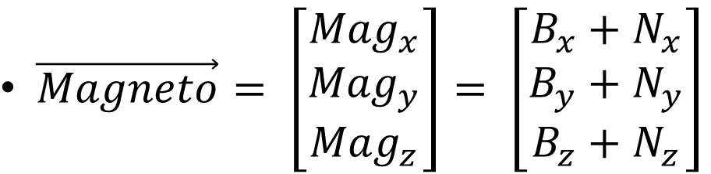
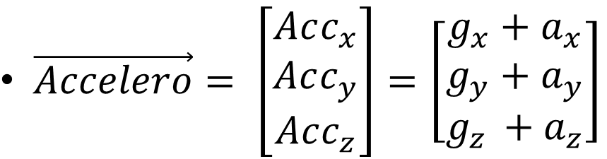
Why choosing IMUs ?
Accelerometer
Magnetometer
Gyroscope
$\vec{Accelero}= \left[\begin{matrix}Acc_{x} \\ Acc_{y} \\ Acc_{z}\end{matrix}\right]=\left[\begin{matrix}g_{x}+a_{x} \\ g_{y}+a_{y} \\ g_{z }+a_{z}\end{matrix}\right]$
$\vec{Magneto}= \left[\begin{matrix}{Mag}_{x} \\ {Mag}_{y} \\ {Mag}_{z}\end{matrix}\right]= \left[\begin{matrix}B_{x}+N_{x} \\ B_{y}+N_{y} \\ B_{z}+N_{z}\end{matrix}\right]$
$\vec{Gyro}= \left[\begin{matrix}ω_{x} \\ ω_{y} \\ ω_{z}\end{matrix}\right]$
Notes:
Cheap, wirelesse, light, easy to use, non invasiv, doesn't required special environnment (opposit to vision)
1 : Provide enough information

Slide 6
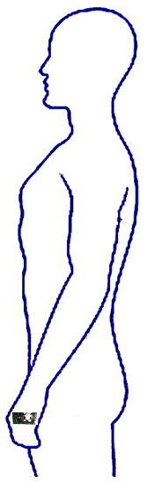
The objectif and the global strategy
Make a robot follow the wrist trajectory
Method 1
1 sensor module on hand
Require a first known position
Double integration of the
accelerometer signal
=> drift over time
Method 2
Several sensor modules on arm
Compensate the drifting over time.
Notes:
Objectif : make a robot follow the wrist trajectory

Slide 7
IMU
Acquisition & Processing part
Robot
How and What to transmit to the robot ?
Receiving IMU data wirelessly
Data Processing : Motion estimation
Transmitting command to robot
Notes:
What is interesting is to send proper information to Robot. So something to do the link between IMU and robot is necessary
1 : Start from IMU, attached to the human arm
2 : intermidiate part :
receiving data
main part : processing data to estimate wrist trajectory (first goal)
Transmiting command to the robot

Slide 8
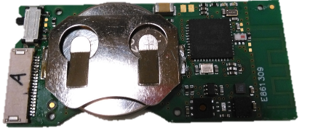
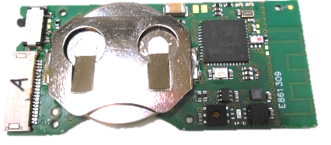
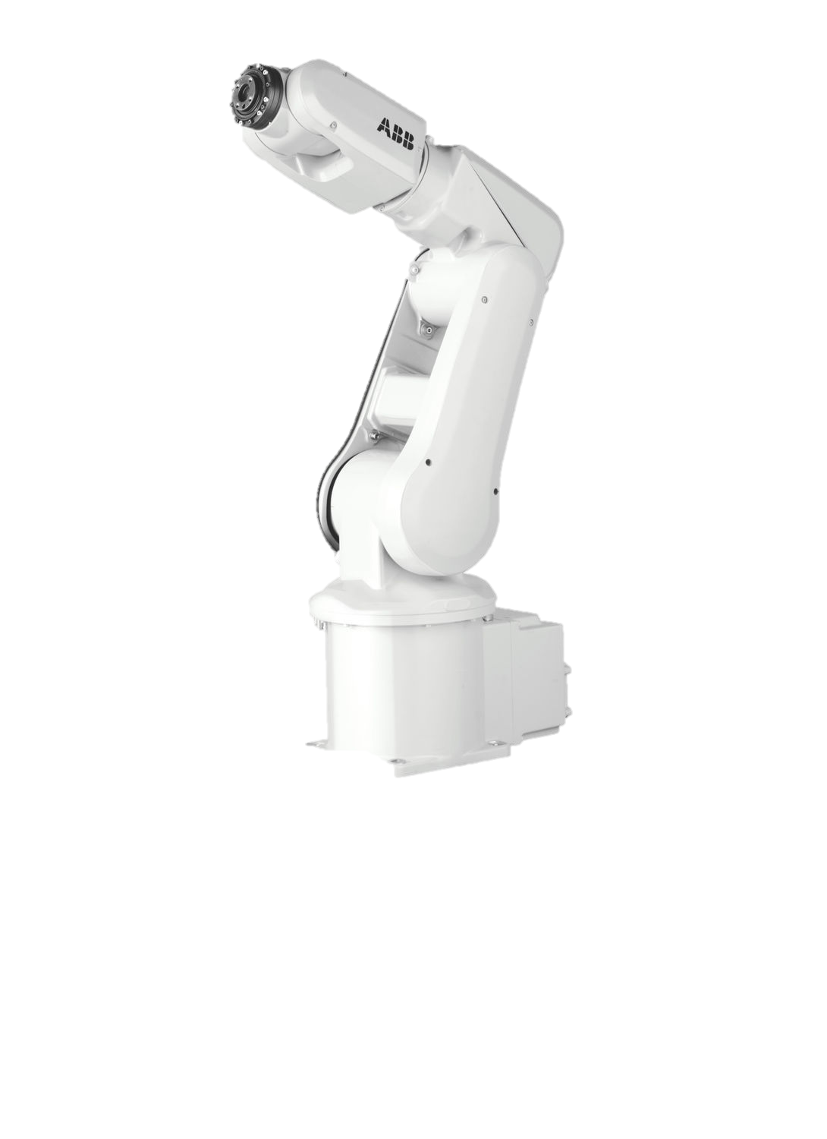
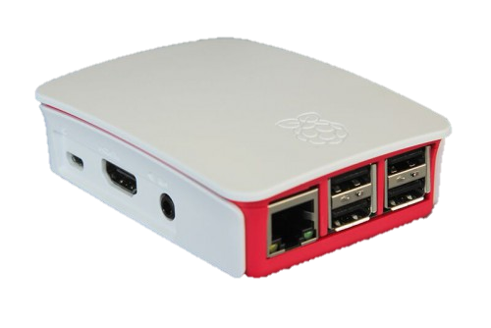
What the setup is composed of ?
Data transmition by Radio Frequency at 10 hz
IMU made by Micro-sys lab at ULg
microcontrôleur
Magnetometer
Easy programming ( C )
Well documented
RF antenna
The Acquisition & Processing part : Raspberry Pi
battery
Accelerometer & Gyroscope
Robot
Data transmition by ethernet wire in a client-servor socket environnement
Notes:
- sensors : MicroSys, Small : To show
- raspberry pi : RF atenna added
- robot : IRB120 ABB, RAPID

Slide 9

How to process the wrist trajectory ? - References Frames
Inertial Frame {E} :
Local Sensor Frame {Sn} at the step time n:
g
North pole
Z
Z
Y
Y
X
g
g
X
g
Notes:
-1 : inertial frame : Z = -g ; X = N projected on the perpendicular plan to g
-2 : Local sensor frame : reference frame = Accelerometer. Magnetormeter frame tranformed to fit with the accelerometer frame.

Slide 10
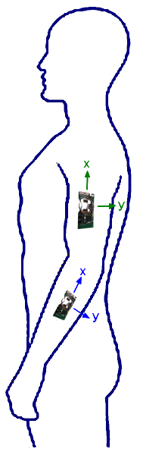
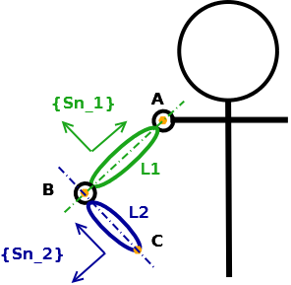
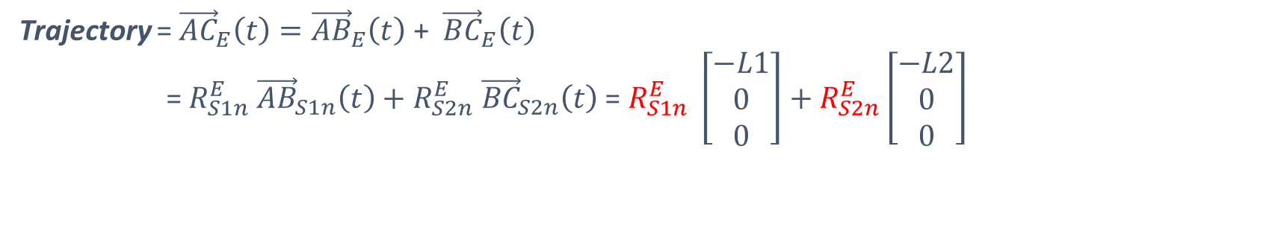
How to process the wrist trajectory ? - The strategy
1 : A simple arm model
Shoulder = 3 rotative DOF
Elbow = 3 rotative DOF
L1 = 30 cm & L2 = 25 cm
2 : The trajectory of the point C
Trajectory = ${\vec{AC}}_{E}\left(t\right)={\vec{AB}}_{E}\left(t\right)$ + ${\vec{BC}}_{E}\left(t\right)$
= $R_{S1n}^{E}$ ${\vec{AB}}_{S1n}\left(t\right)+R_{S2n}^{E} {\vec{BC}}_{S2n}\left(t\right) \text{= }R_{S1n}^{E} \left[\begin{matrix}−L1 \\ 0 \\ 0\end{matrix}\right]+R_{S2n}^{E}\left[\begin{matrix}−L2 \\ 0 \\ 0\end{matrix}\right]$
Notes:
- 1 : a simple model of the human arm. The operator is supposed to be unmoving.
- 2 : With this model , the trajectory of the wrist can be express as displayed , relative to the shoulder of the operator.
- 3 : This strategy involved to set 2 sensors on each segment of the arm of the operator. Just need to be sur that the X-Axes of the local frame S is paralle to the axes of each segment.

Slide 11
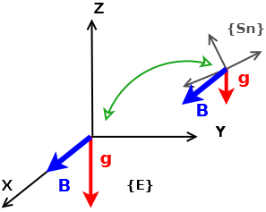

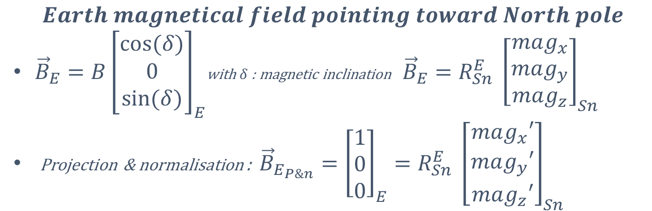
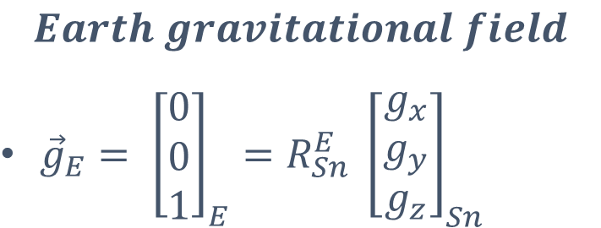
How to process the wrist trajectory ? - Rotational matrix from Acc & Mag
$$Earth gravitational field$$
${\vec{g}}_{E}= {\left[\begin{matrix}0 \\ 0 \\ 1\end{matrix}\right]}_{E}=R_{Sn}^{E} {\left[\begin{matrix}g_{x} \\ g_{y} \\ g_{z}\end{matrix}\right]}_{Sn}$
$$R_{Sn}^{E}$$
$$Earth magnetical field pointing toward North pole$$
${\vec{B}}_{E}=B{\left[\begin{matrix}cos⁡(δ) \\ 0 \\ sin⁡(δ)\end{matrix}\right]}_{E}$with $δ$ : magnetic inclination ${\vec{B}}_{E}=R_{Sn}^{E} {\left[\begin{matrix}mag_{x} \\ mag_{y} \\ mag_{z}\end{matrix}\right]}_{Sn}$
Projection & normalisation : ${\vec{B}}_{E_{P\&n}}={\left[\begin{matrix}1 \\ 0 \\ 0\end{matrix}\right]}_{E}=R_{Sn}^{E} {\left[\begin{matrix}mag_{x}′ \\ mag_{y}′ \\ mag_{z}′\end{matrix}\right]}_{Sn}$
$R_{S}^{E} is an orthogonal matrix : Line2(R_{Sn}^{E}$) = $Line3(R_{Sn}^{E}$) $˄ Line1(R_{Sn}^{E}\text{)}$
Notes:
- Acc give the gravity vector in the local sensors frame / g in earth fram = (0,0,1)
- Magneto give the magnetic north vector in the local frame ( need to be projected in the perpendicular plan to gravity). Magnetic vec in earth frame = (1,0,0)
- the third axes is deduced from the two others.
- at each time step the orientation matrix between inertial and local frame is computed.

Slide 12
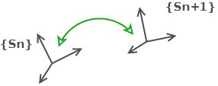
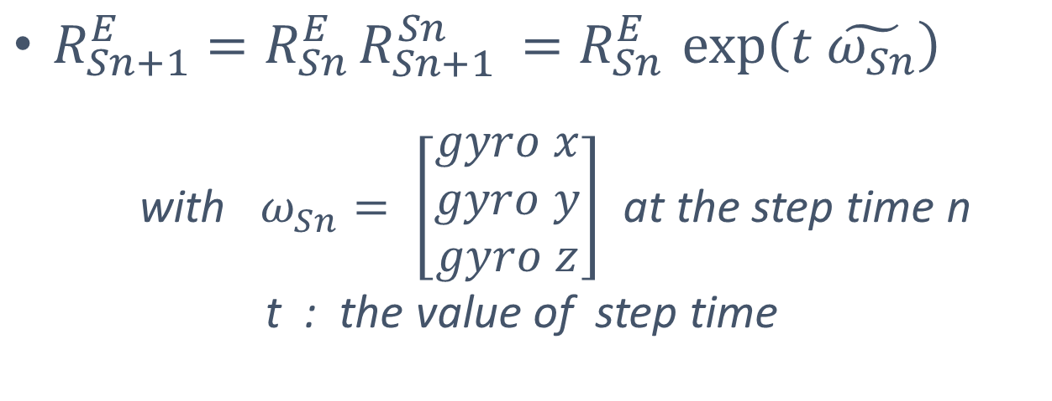
How to process the wrist trajectory ? - Rotational matrix from Gyro
$R_{Sn+1}^{E}=R_{Sn }^{E}R_{Sn+1 }^{Sn}=R_{Sn }^{E}\exp\left(t \tilde{ω_{Sn}}\right)$
with $ω_{Sn}= \left[\begin{matrix}gyro x \\ gyro y \\ gyro z\end{matrix}\right]$ at the step time n
t : the value of step time
Initialisation by the accelerometer and magnetometer data
Notes:
- the gyro give the angular displacement of the between to time step.
- With an initilisation by the acc+magneto method, the orientation of the sensors can be computed all allong the demonstration.

Slide 13

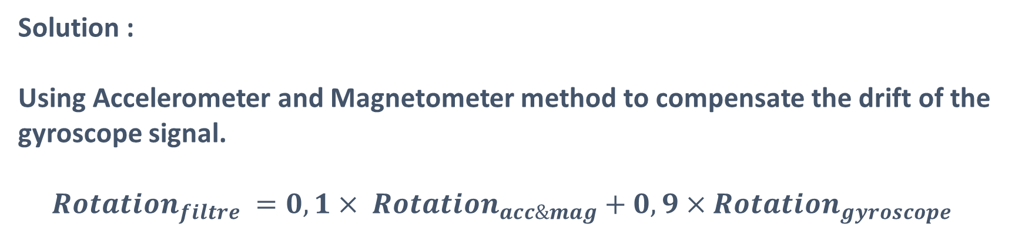
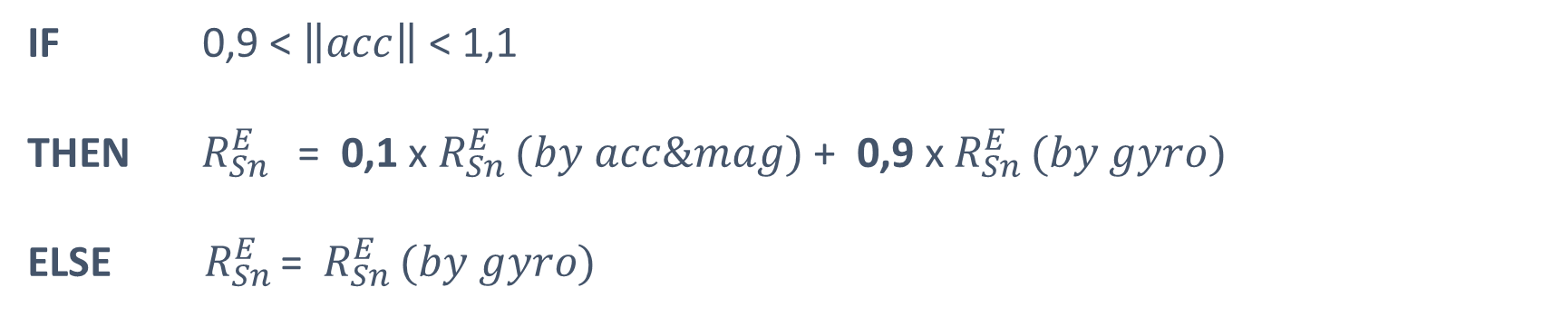
How to process the wrist trajectory ? - a mix of each part
Datas from accelerometer are disturbed by linear acceleration of the sensor and magnetometer data can be disturbed by the environnement
Due to signal integration between 2 steps time, results from gyroscope measurement drift over time.
Solution :
Using Accelerometer and Magnetometer method to compensate the drift of the gyroscope signal.
$$Rotation_{filtre} =0,1× Rotation_{acc\&mag}+0,9×Rotation_{gyroscope}$$
IF 0,9 < $\left\|acc\right\|$ < 1,1
THEN $R_{Sn }^{E}$ = 0,1 x $R_{Sn }^{E}(by acc\&mag)$ + 0,9 x $R_{Sn }^{E}(by gyro)$
ELSE $R_{Sn }^{E}$= $R_{Sn }^{E}(by gyro)$
Notes:
- PB : Magneto is disturbed by the magnetic fiel of the environnement and Accelero is disturbed by linear acceleration.
- PB : Gyro drift over time.
- mix of both : most of the time we used the gyroscope data but sometimes, if the linear accelaration is not too high, the orientation is a combination of the gyro data and acc+magneto data. This new matrix is used later as reference for the next rotationnal matrix computed by gyro. So basically, the acc an mag method is used only to initiate the gyro method and to compensate drifting.

Slide 14
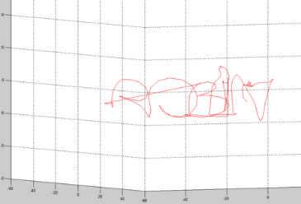
First Results - Name

Slide 15
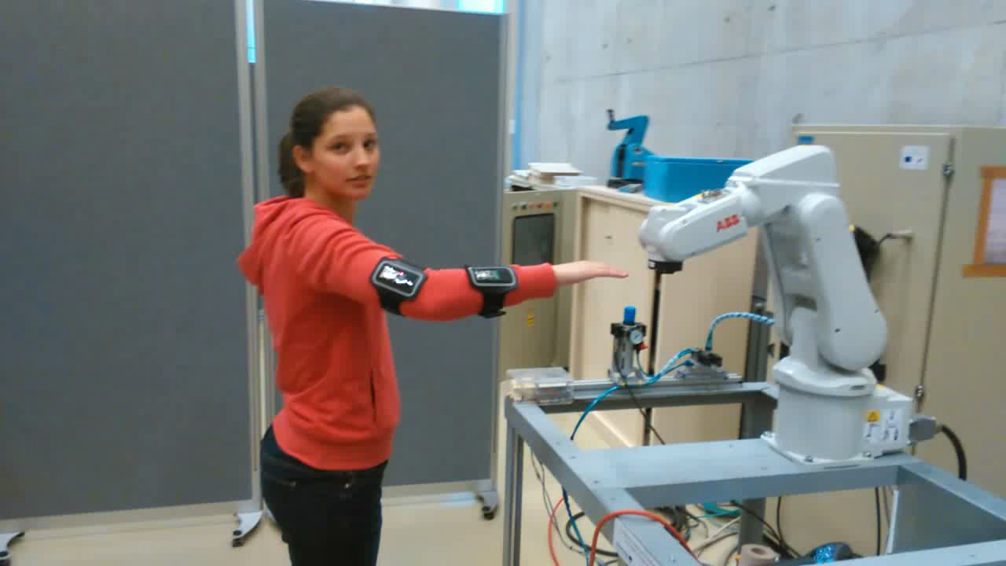
First Results - Robot

Slide 16
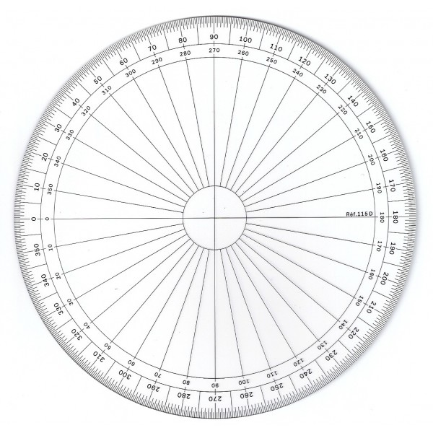

Error measurement : Magnetometer
$$\vec{B}$$
IMU module
Notes:
- objectif : measured the error from component,( from algorithm, from arm model) and comparison between them
- Magnetometer : Every 20 degrees, in a non magnetic environnement (outside), the protactor was oriented according to north pole ( measured by a compass).

Slide 17
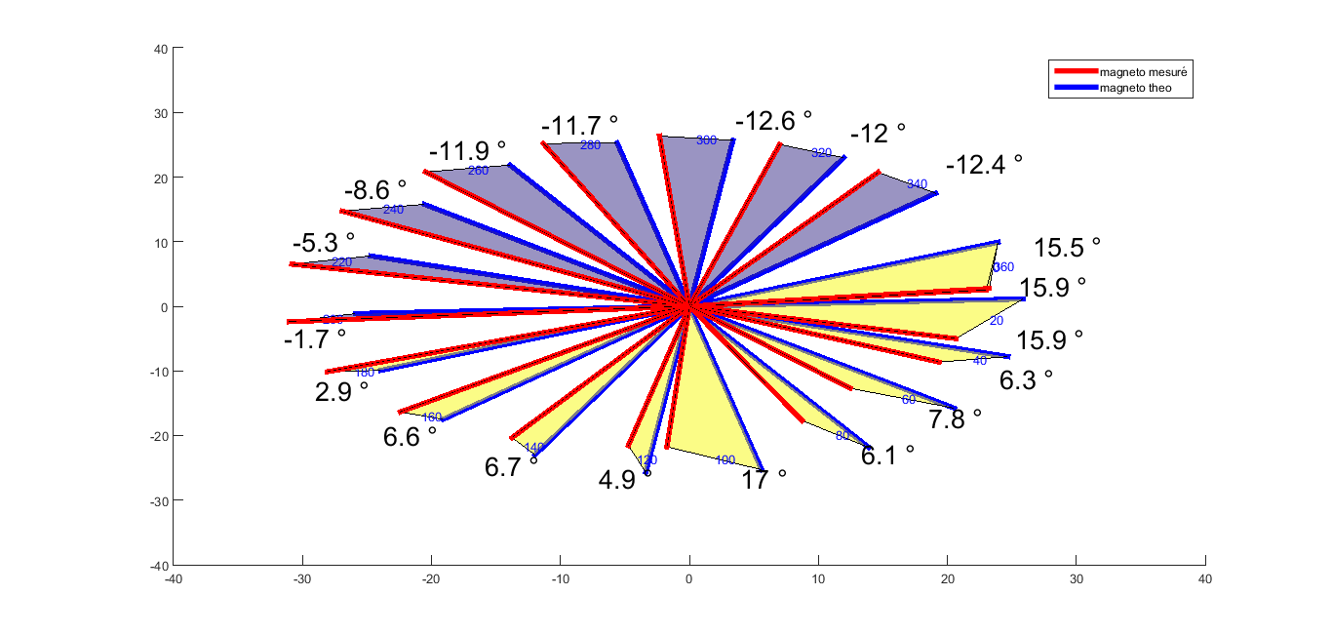
Error Measurement : Magnetometer
Error of the magnetometer compared to the magnetic north :
Between -13° and 17°
Notes:
- We can't be really precise because every experiment was different. The magnetometer is really sensitive to noise and the earth magnetic field is not enouh powerful to compensate the noise.
- This figure show one of the less disturbed experiment. We can see that there is still a discrepancies between -13° and +17°.

Slide 18
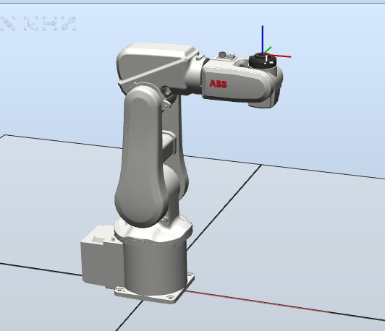

Error measurement : Accelerometer
$$\vec{g}$$
Notes:
- Accelerometer : Sensor set on the robot. The robot is supposed to have its Z axis parallele with g. The robot move its last axis.

Slide 19
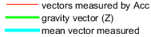
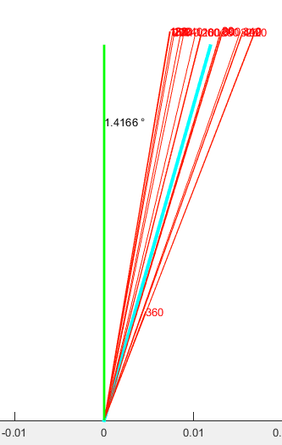
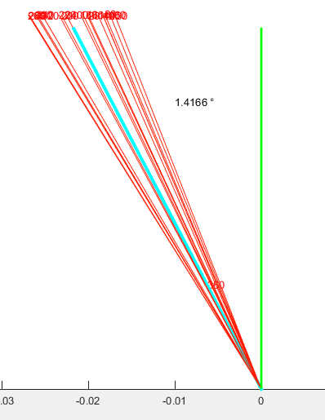
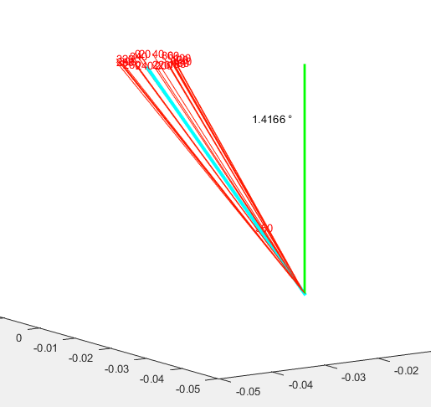
Error measurement : Accelerometer
Gravity vector measured by the accelerometer:
1,42 ° between the mean vector and the gravity
[0,36° ; 0,17°] between vectors measured and mean vector
Notes:
- error might come from a bad positioning of the sensors on the robot. But it's still pretty accurate.

Slide 20
Conclusion
- Quantify the global error by CodaMotion
- Is it possible to use the linear acceleration?
- Add orientation ( not only trajectory)
- Calibration

Slide 21
Questions ?

