Slide 1
Low Cost Concentrator
Solar Array
IAC-16.C2.8.9x33920
Collette J.P.
Walopt, Belgium, jpcollette@walopt.com
Rochus P., Hodgetts P., Nutal N., Larnicol M., Crahay J., Kloos T., Nols Ph.

Slide 2
Presentation overview
Introduction
V-Trough concept
Improved temperature management
Reflector wrinkles measurement
Measurement of optical performance with wrinkles
Numerical simulation of optical performance
Conclusions
Acknowledgment

Slide 3
Introduction
Primary target of concentration = surface gain for the solar cells.
First interest of a high concentration ratio (70’s and 80’s). But pointing and thermal design issues !
Some Fresnel concentrator still survive with a moderate concentration ratio of C < 10.
In the 90’s, low concentration appeared (C < 2.5), easily adapted to classical panels. Commercial spacecrafts in early 2000: gradual loss of power due to various causes.

Slide 4
Attention was paid to the contamination of the reflectors and operational temperature. A Multi-V design has been developed by the author.
Recently, JAXA launched its small REIMEI scientific spacecraft, with two solar arrays equipped with a single lateral reflector.

Slide 5
Reimei satellite with two wings and half concentrators
Fukuda, S. & et al. (2006)

Slide 6
V trough design limits
NRL, 1998

Slide 7
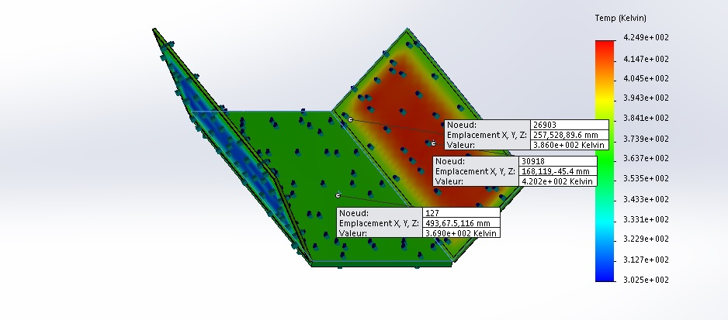
Improved Temperature Management
Development of an improved low cost reflector
Temperature field of a full solar panel with reflectors

Slide 8
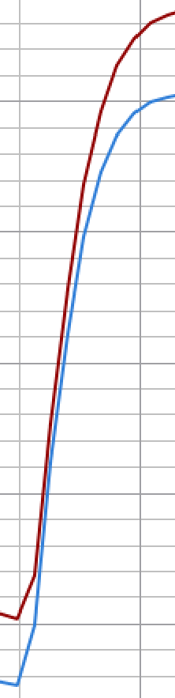
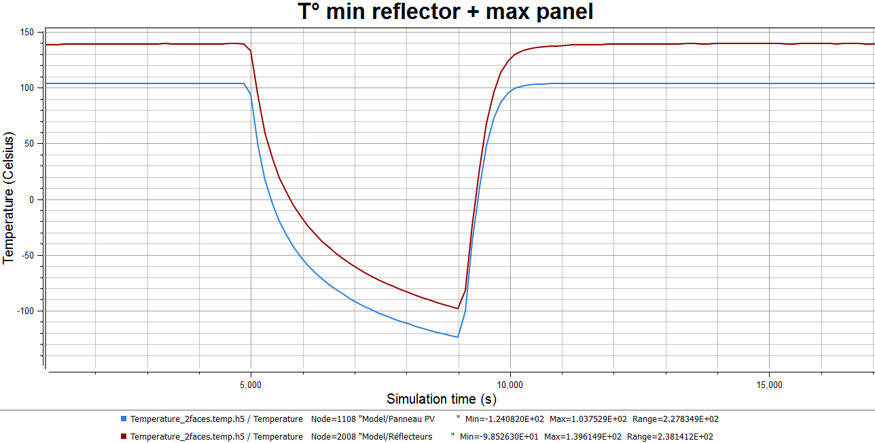
Eclipse on the solar panel and reflector
T reflector always > T panel

Slide 9
Reflectors wrinkles
Wrinkles by shear stress

Slide 10
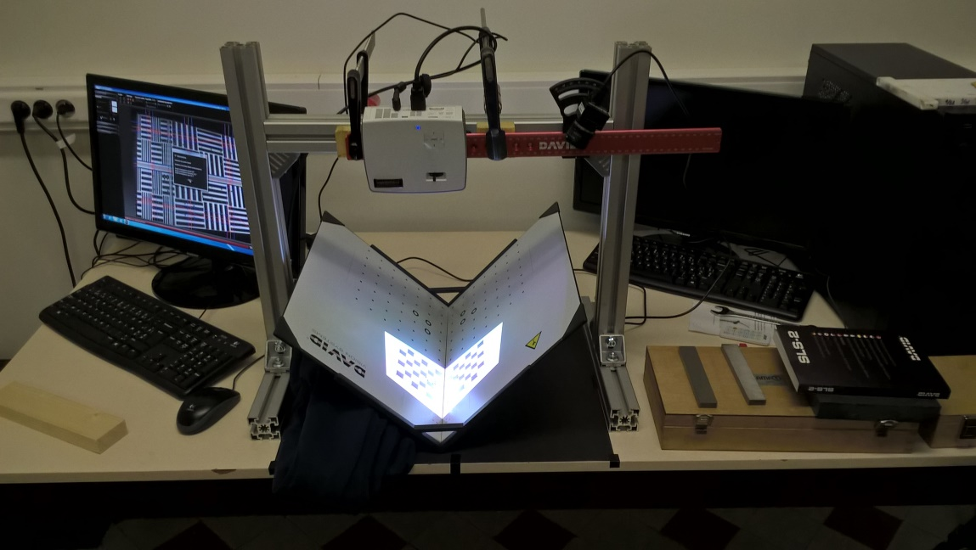
Measurement of wrinkles
3D scanner calibration set-up

Slide 11
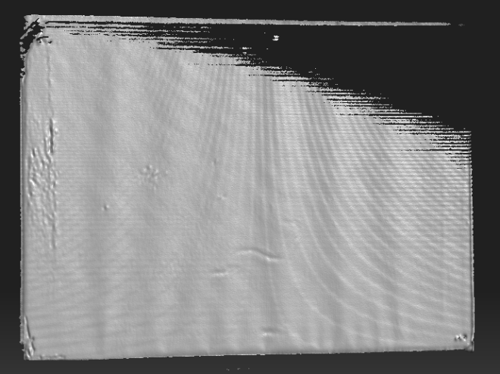
3D scanner view of wrinkles

Slide 12
Color scan uni-axial tension

Slide 13
Color scan bi-axial tension state

Slide 14
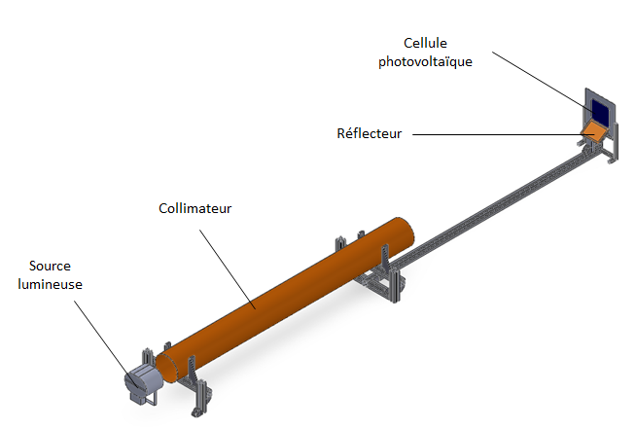
Measurement of optical performance
Optical bench

Slide 15
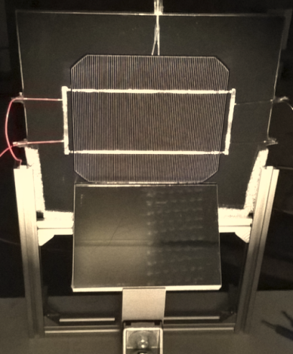
Solar cell with flat rigid mirror

Slide 16
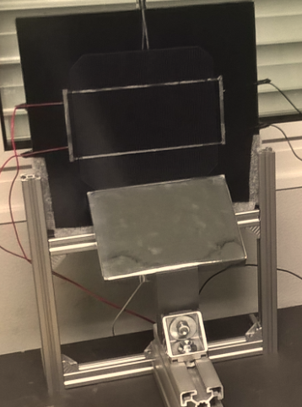
Solar cell with wrinkles on the mirror

Slide 17
measurement of the reflected light (wrinkles) with a photodiode

Slide 18

Simulation of wrinkles effects
Numerical model of wrinkles

Slide 19
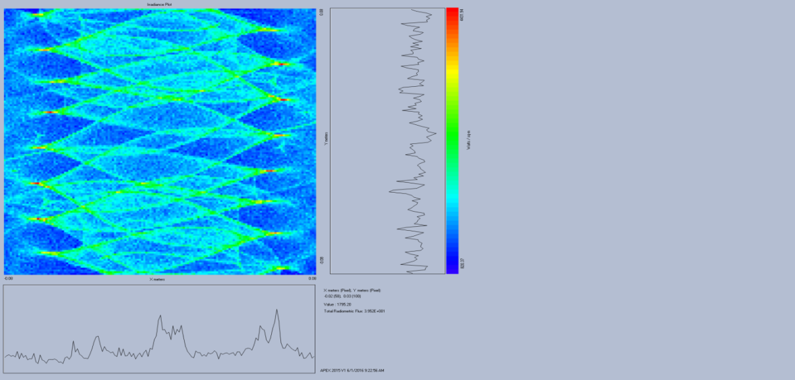
Simulation of solar irradiance on the panel with wrinkles
Simulation Measurements

Slide 20
Conclusions
The effects of wrinkles on the reflector are well understood and a simulation tool has been developed and qualified to extrapolate the results to a full scale.
The thermal behavior of the solar generator has been improved.
The developments of a low cost concentrator are still going on at the time being. A laboratory model will be manufactured at a reduced scale (about A4).

Slide 21


Acknowledgment
This work has been founded by the European Space Agency ESA-ESTEC under contract number 4000111611/14/NL/EM.
The authors wish to thank their colleagues who have made this work possible.

