Slide 1
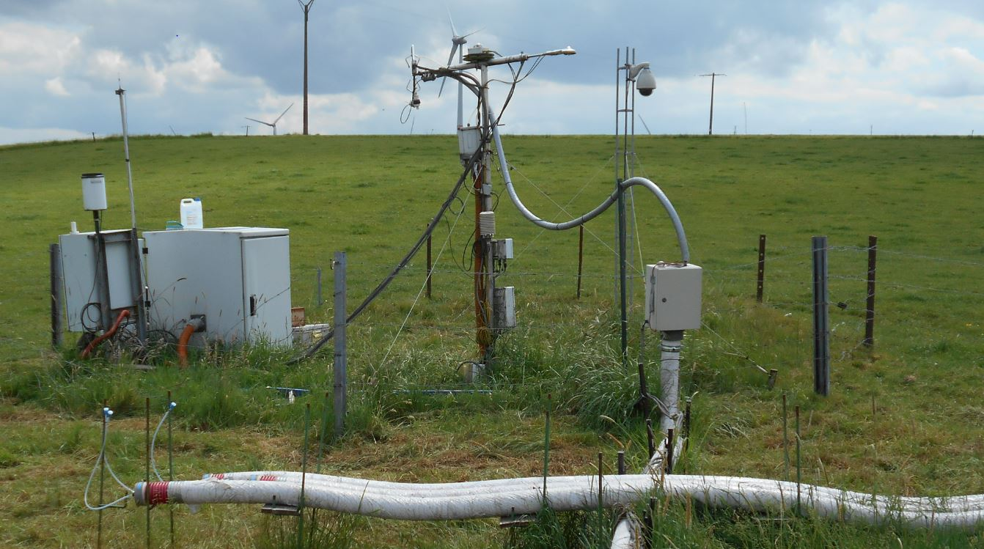
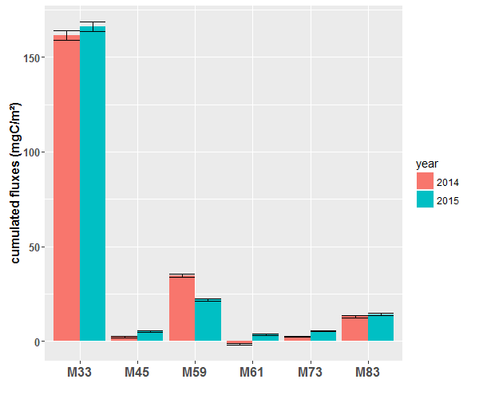
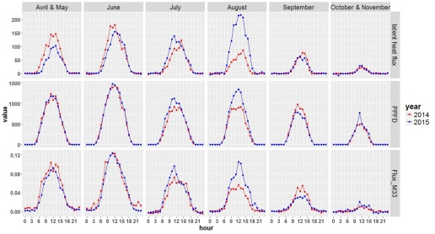
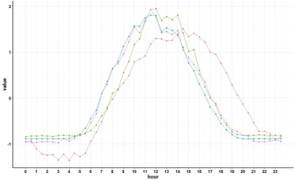
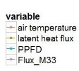
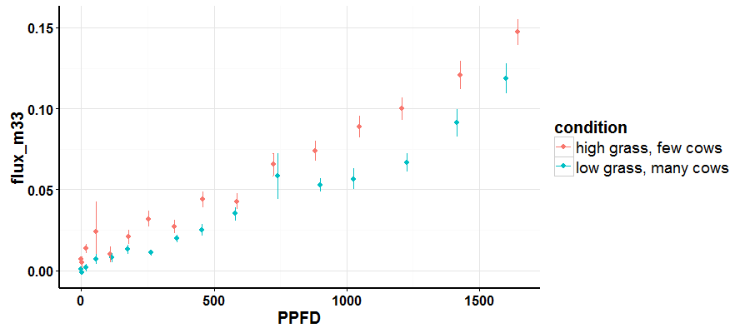
Environmental controls of biogenic volatile organic compound emissions from a grazed grassland in Dorinne, Belgium
Colin Michel¹, B.Heinesch¹, A.Bachy¹, M.Aubinet¹, A.Digrado², P. Delaplace², P.Dujardin², M-l. Fauconnier², C. Amelynck³, N. Schoon³, and A.Mozaffar³
Units of (1) TERRA Teaching and Research Center and (2) Agro-Bio-Chem , Gembloux Agro Bio-Tech , University of Liege and (3) Department of Mass Spectrometry, Royal Belgian Institute for Space Aeronomy
Background & Objectives
VOCS have an important role in atmospheric chemistry
Few BVOC studies on grassland, none on grazed grassland so far
Poor understanding of the influence of (a)biotic stress on emissions
Qualify and quantify BVOC fluxes from a grazed grassland
Identify fluxes driving mechanisms and evaluate the impact of the grazing stress on emissions
Results
Comparison with other studies
Methanol emission from the 15th of June to the 9th of August: Bamberger et al. (2010) 0.030 μgC.m⁻²s⁻¹ ; our study (2014) : 0.012μgC.m⁻²s⁻¹ (similar mean temperature)
Methanol emission from the 10th of June to the 28th of August: Amman et al. 0.029 μgC.m⁻²s⁻¹ ; our study (2015) : 0.013 μgC.m⁻²s⁻¹
Low value for our study could be due to different plant composition (more graminoïdes), lower LAI, different management practices,…
Fluxes of different VOCs
Conclusions on methanol controls
Cumulated VOCS fluxes of 210 mgC.m⁻² during the whole grazing period (April-November)
Methanol represents 75 % of the whole carbon cumulated flux
Carbon cumulated flux from VOCS represents 0.3% of the Net Ecosystem Exchange
Methanol flux very stable from one year to another
Strong correlation to the PPFD at different time scales confirmation that PPFD is a main driver on methanol production
Much higher correlation of half-hourly data to the ET than the daily data likely influence of the stomatal conductance in non-stable condition (confirmation that stomatal conductance is an important driver on methanol emission).
Poor influence of the SD likely linked to the fact that unlike the hay meadows, the cut biomass is directly ingested by the cows
In contrast to Brunner et al. (2007), biomass quantity positively correlated to the methanol flux likely linked to the low height of the grass in a grazed grassland compared to a hay
meadow
Environmental controls of methanol flux
Intra-daily scale : half-hourly data: PPFD (r=0.83 pcor_r=0.27) and evapotranspiration (r=0.83, pcor_r=0.34) main factors
Material & Methods
Site characteristics:
Intensively grazed meadow (Average of 3.7 LSU.ha⁻¹ during the grazing season) located in Dorinne, Belgium : 50° 18′ 44″ N; 4° 58′ 07″ E in the Condroz region. Elevation between 240 and 272 m
Mean annual air temperature of 10°C
66% graminaceous (mainly Perennial Ryegrass) and 16% legumes (mainly White Clover)
Measurement campaign:
May to November in 2014 and April to October in 2015 (with gaps)
Instrumentation:
CO2, H2O fluxes per eddy covariance
BVOC concentration measured using a conventional high sensitivity proton-transfer-reaction mass spectrometer (HS-PTR-QMS)
BVOC fluxes per disjunct eddy covariance
Meteorological, stocking density and biomass above ground (grass height) measurements
Investigated BVOC:
Methanol ($m/z$ 33), acetaldehyde ( $m/z$ 45), acetone ($m/z$ 59), acetic acid ($m/z$ 61), methyl ethyl ketone ($m/z$73), hexenols, hexenyl acetates and hexanal ($m/z$83)
Clear diurnal dynamic with close to zero flux at night
Strong seasonal variation
Very strong correlation to PPFD and ET
Methanol cycle very close to PPFD cycle (r=0.99), though lower at night and at the beginning of the day and higher at the end of the day (probable influence of the air temperature)
Perspectives
Comparison with data from dynamic chambers also available for this grassland (grazed and non grazed chambers)
Measurement of the impact of ozone stress by calculating the ozone flux (with the eddy co-variance method)
In depth analysis of the soil moisture factor by taking into account the fact that our hilly field in not homogenous in terms of soil humidity
Hourly mean for different months of ET, PPFD and M33 flux
Standardized half-hourly mean of ET, PPFD, air T° and M33 flux
Inter-daily scale daily data : PPFD main factor (r=0.82, pcor_r=0.25)
Grass Height, important factor(r=0.45,Pcor_r=0.234)
Much more important than the stocking density (r=0.29, Pcor_r=0.003)
Acknowledgement
This research is funded by the Federation Wallonia-Brussels via the CROSTVOC project
Example of two contrasting periods: May 2014 (H=6.3 cm, SD=1.9 LSU.ha⁻¹), and August 2014 (H=4 cm, SD=5.62 LSU.ha⁻¹)

