Slide 1
First retrievals of methane isotopologue
CH₃D from FTIR ground-based observations in the High Arctic (eureka)
Whitney Bader
CANDAC/PAHA workshop

Slide 2
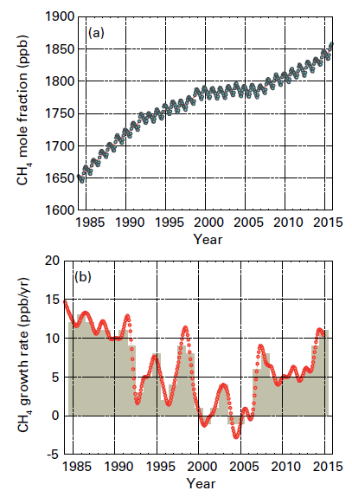
Introduction and motivation
Atmospheric methane CH₄
  Lifetime of 8-10 years
  2nd most important anthropogenic GHG
  1/5th of radiative forcing since 1750
  New high of 1845 ± 2 ppb
  + 256 % since pre-industrial times
  + ~0.3%/year since mid-2000s
  Changes remain unexplained
  Bloom et al., 2010; Dlugokencky et al., 2009; Frankenberg et al., 2011; Hausmann et al., 2016; Helmig et al., 2016; Montzka et al., 2011; Rigby et al., 2008; Schaefer et al., 2016; Spahni et al., 2011; Sussmann et al., 2012; van der Werf et al., 2010; Tuner et al., 2017; Rigby et al., 2017
WMO, Greenhouse gas bulletin N°12, 2016

Slide 3
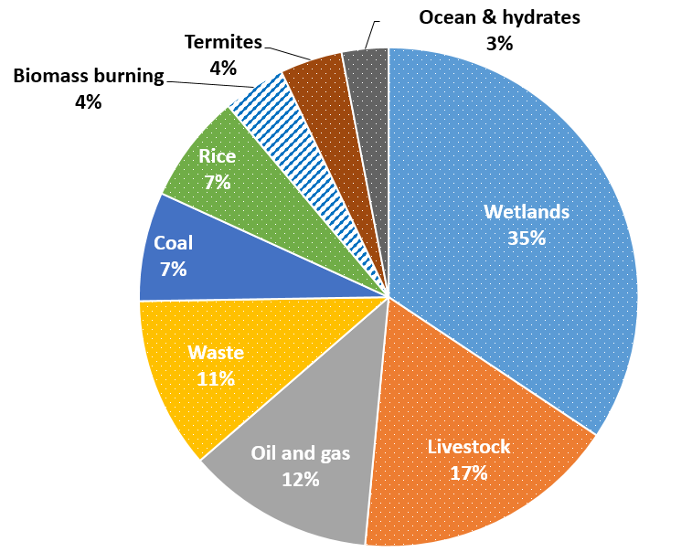
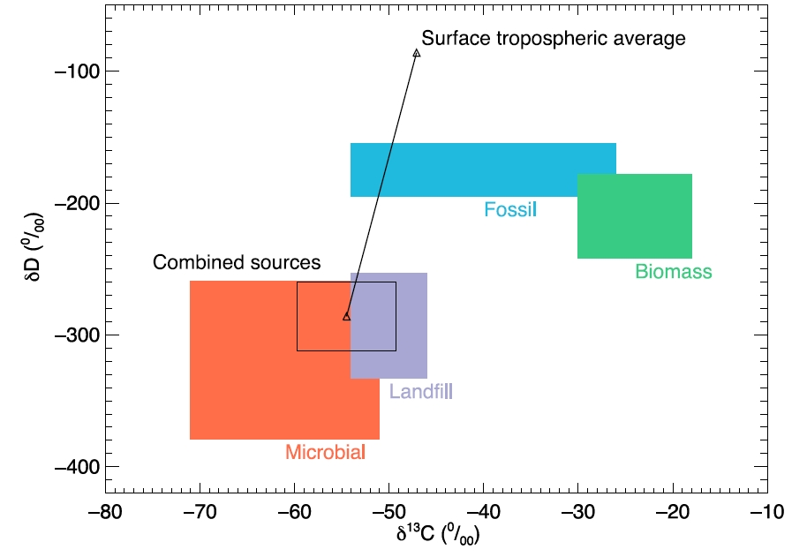
introduction and motivation
2 main isotopologues : CH₃D, ¹³CH₄
  CH₃D : 6.158 x 10⁻⁴ rel. abundance
  ¹³CH₄ : 1.11 x 10⁻² rel. abundance
  Specific emission ratio
    Process type
  Kinetic Isotope Effect
    Removal pathway
  Fig. 2 from Rigby et al., 2012
  CH₃D and ¹³CH₄ are good tracers of the methane budget.

Slide 4
Instrumentation & dataset
Development and optimization of the retrieval strategy for CH₃D from ground-based FTIR (Fourier Transform infrared) solar observations with the SFIT-4 algorithm
Toronto, ON, Canada
  Bomem DA8 Fourier Transform Spectrometer
~1430 days of observations since May 2002
Eureka, NU, Canada
  Bruker IFS-125 HR Fourier Transform Spectrometer
~760 days of observations since July 2006
  Portable Atmospheric Research Interferometric Spectrometer for the InfraRed
~240 days of spring observations at Eureka since 2004
Jungfraujoch, Switzerland
Bruker 120-HR : ~2590 days of observations since 1990

Slide 5
Instrumentation & dataset
Development and optimization of the retrieval strategy for CH₃D from ground-based FTIR (Fourier Transform infrared) solar observations with the SFIT-4 algorithm
Toronto, ON, Canada
  Bomem DA8 Fourier Transform Spectrometer
~1430 days of observations since May 2002
Eureka, NU, Canada
  Bruker IFS-125 HR Fourier Transform Spectrometer
~760 days of observations since July 2006
  Portable Atmospheric Research Interferometric Spectrometer for the InfraRed
~240 days of spring observations at Eureka since 2004
Jungfraujoch, Switzerland
Bruker 120-HR : ~2590 days of observations since 1990

Slide 6
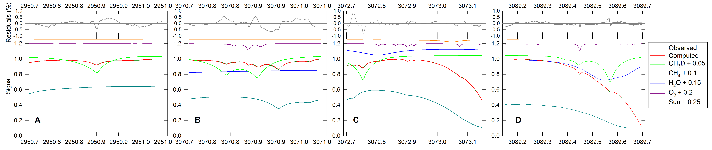
Retrieval strategy - windows
Target gas
CH₃D
Interfering gases
CH₄
H₂O
O₃
Solar lines

Slide 7
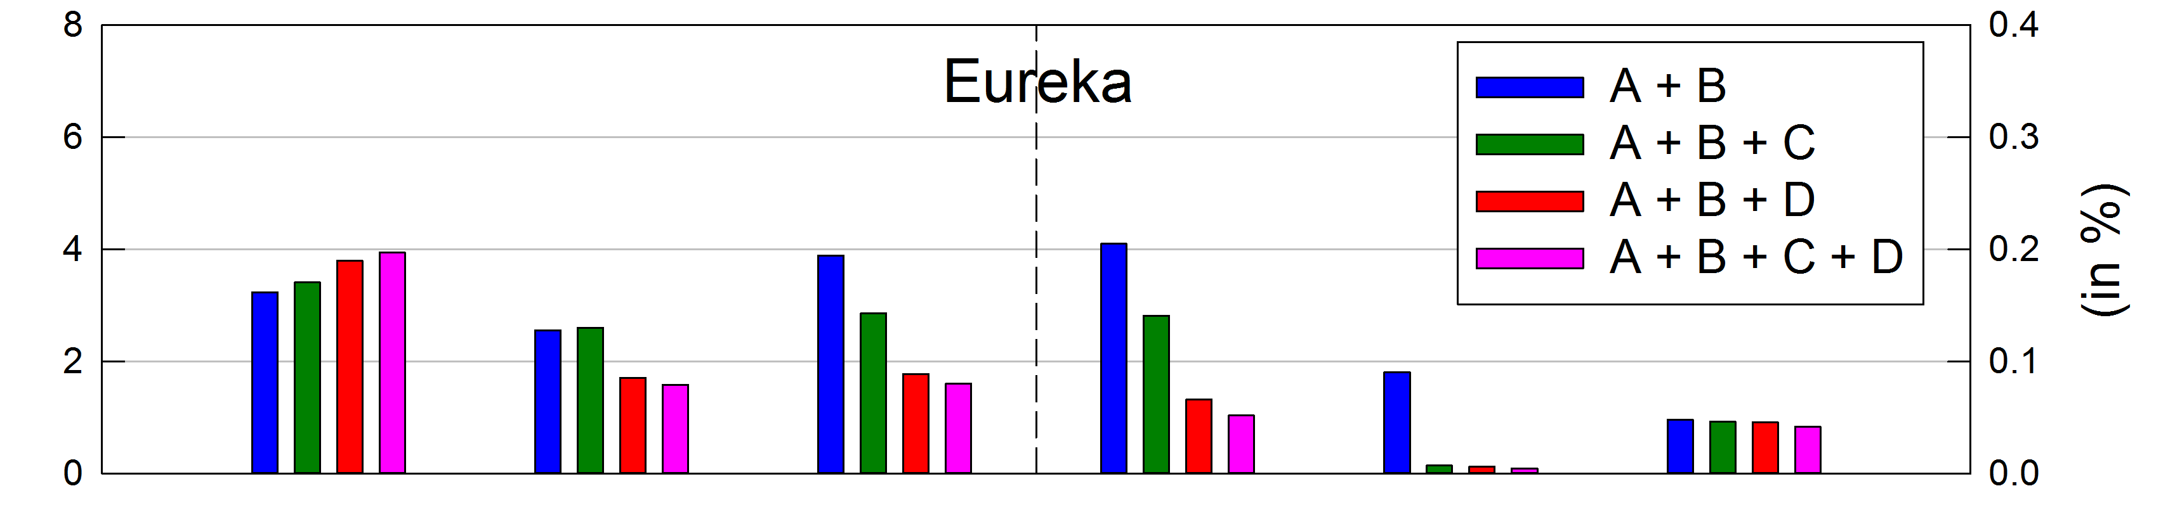
The benefit of 4 windows
Evaluate our retrieval strategy objectively through analysis of error budget and information content
Impact of the combination of the 4 available windows on the error budget and information content

Slide 8
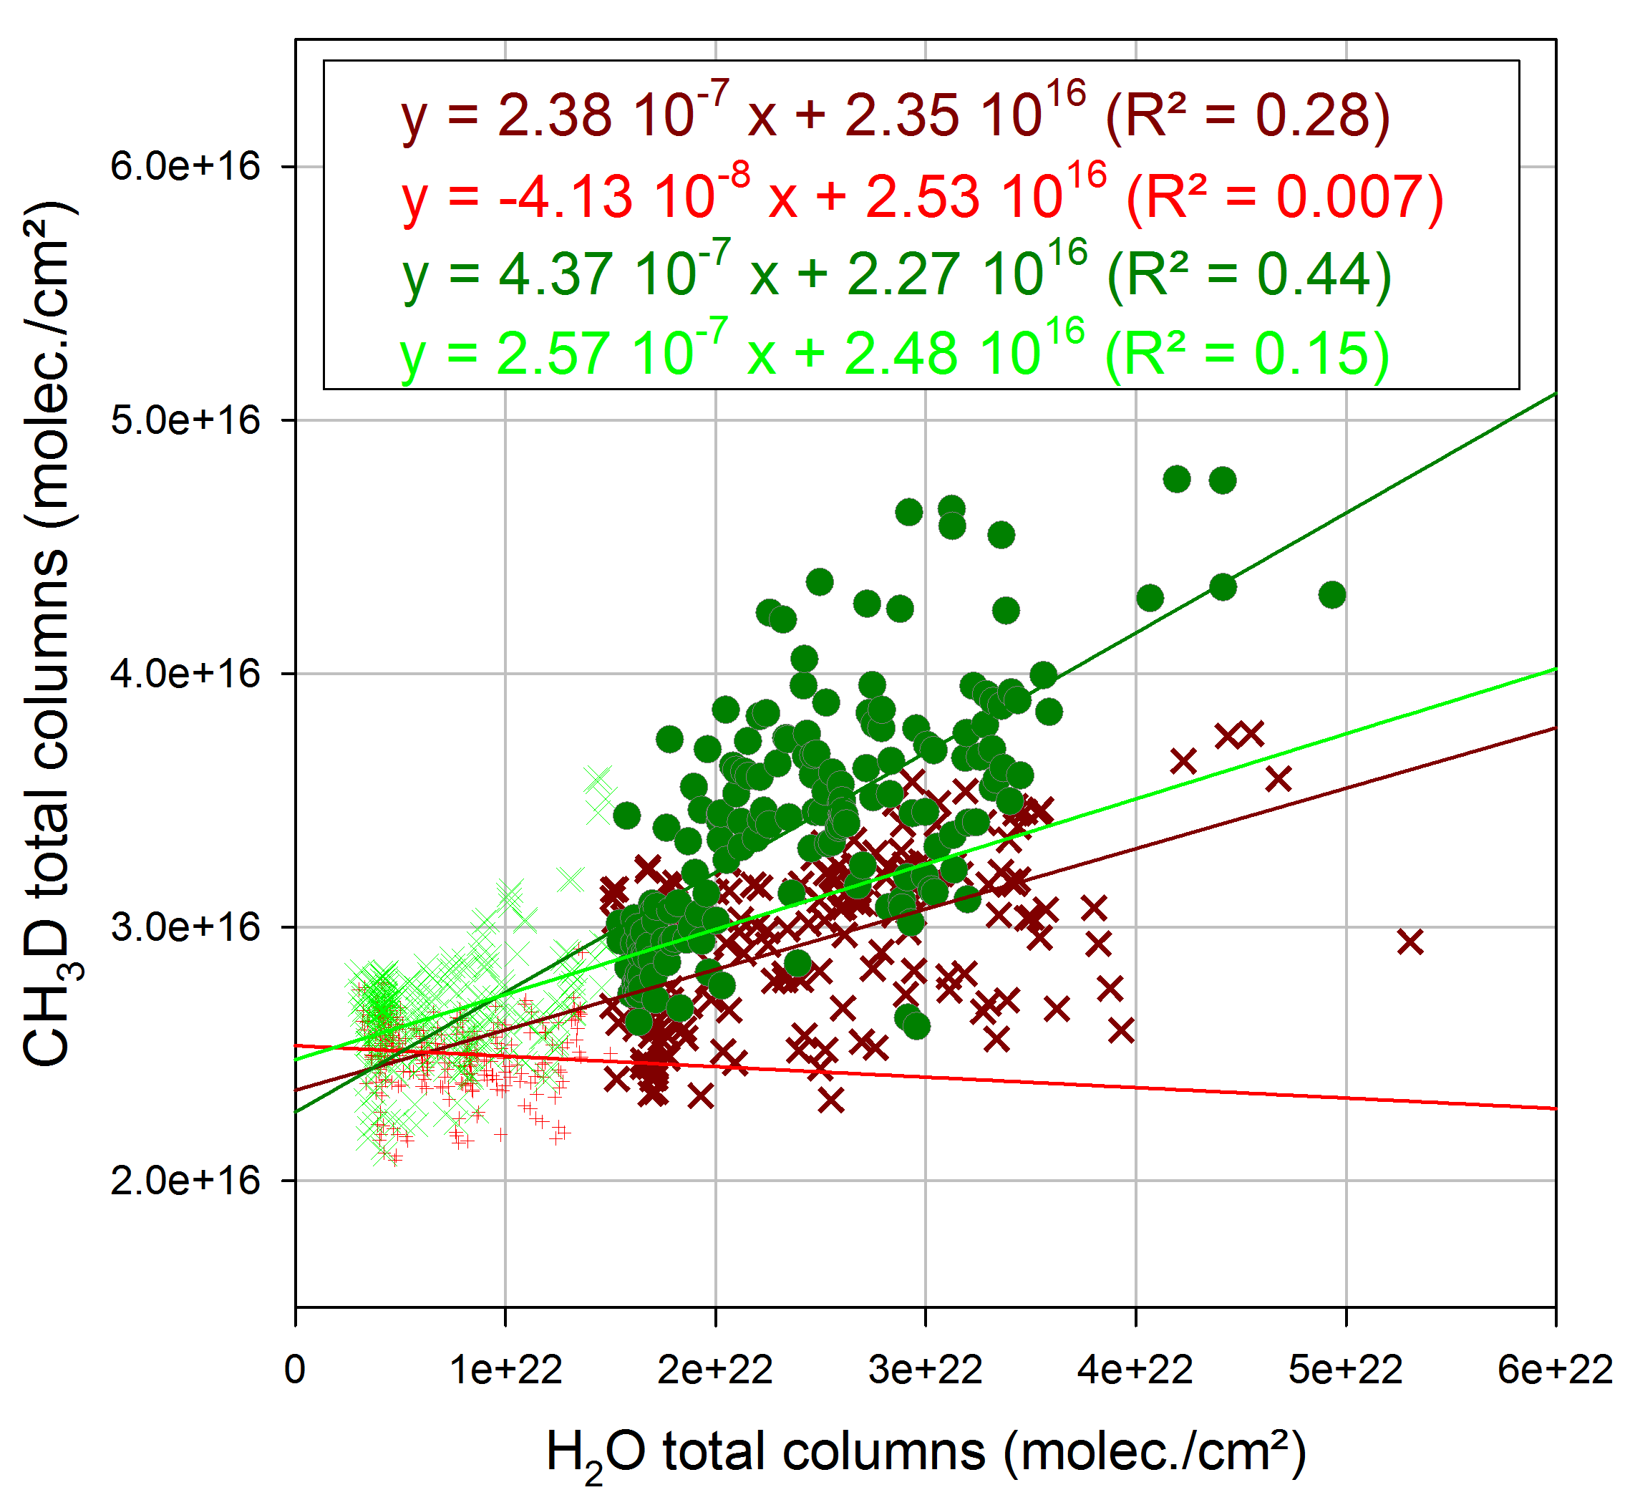
Water vapor
Use of a water vapor specific window as 5th window ?
(2941.65 –2941.89 cm⁻¹)
4 windows
+ water vapor window
4 windows

Slide 9
Water vapor
4 windows ?

Slide 10
Water vapor
4 windows ?

Slide 11
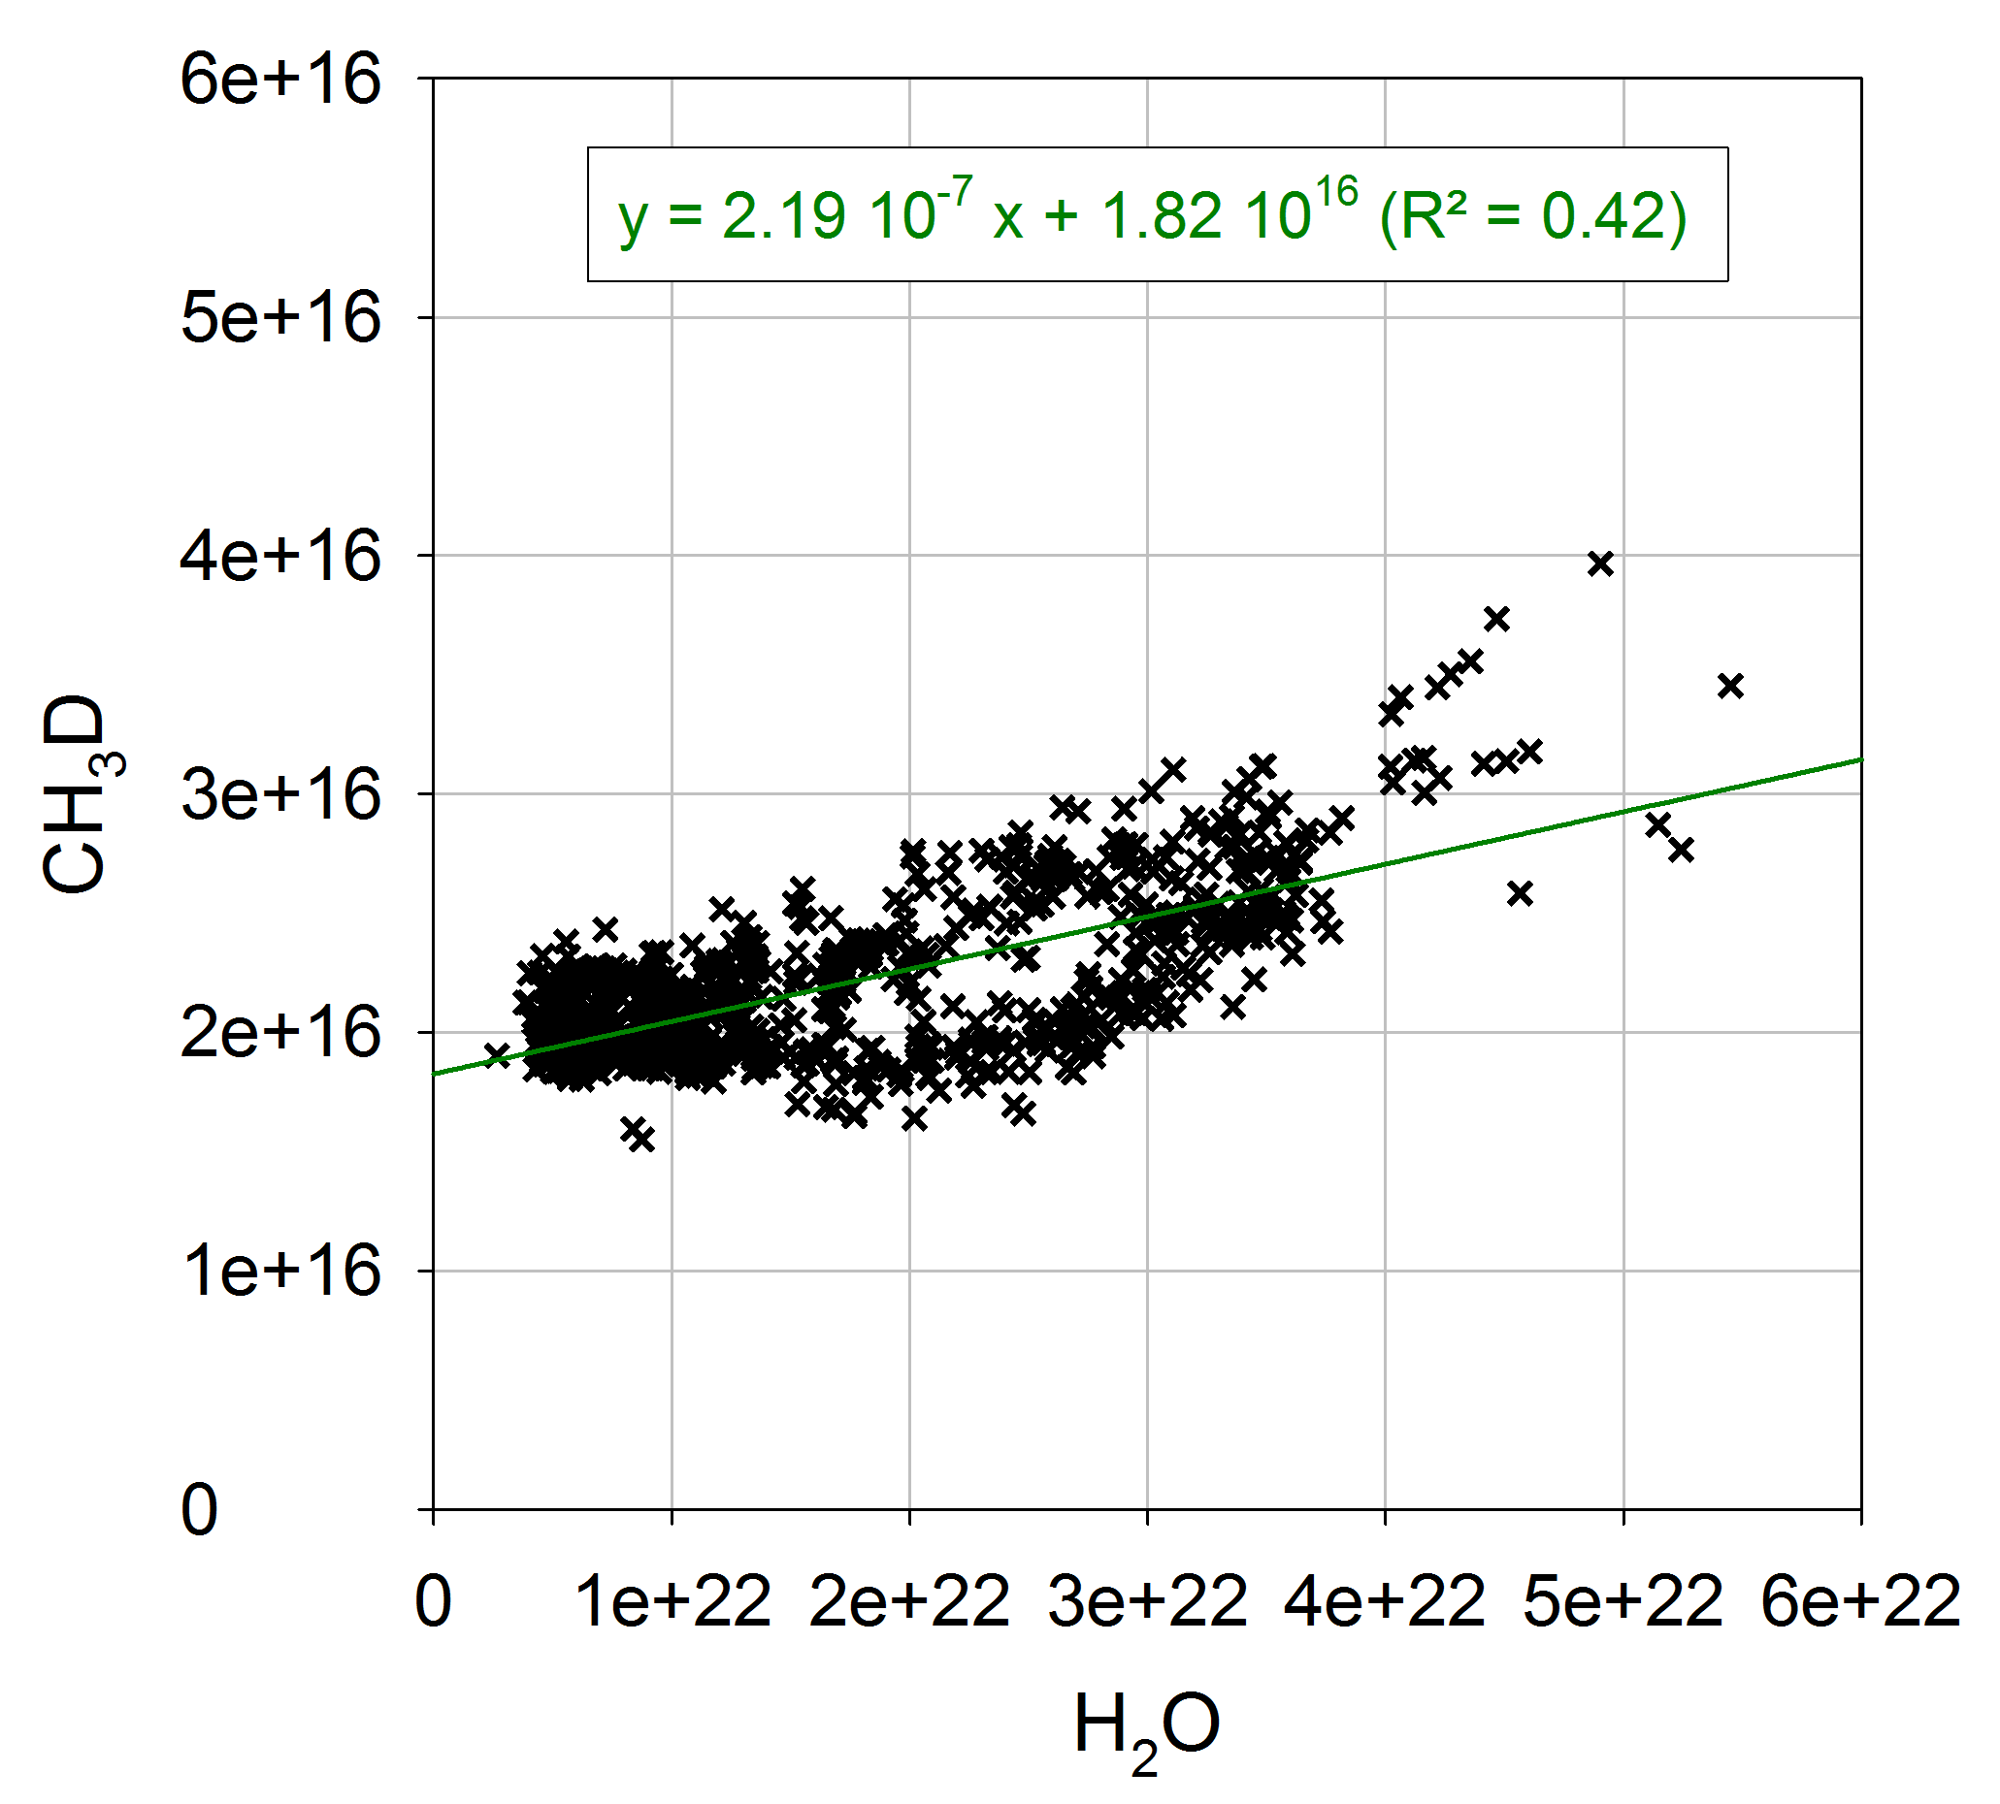
Water vapor
3 windows

Slide 12
Water vapor
4 windows ?

Slide 13
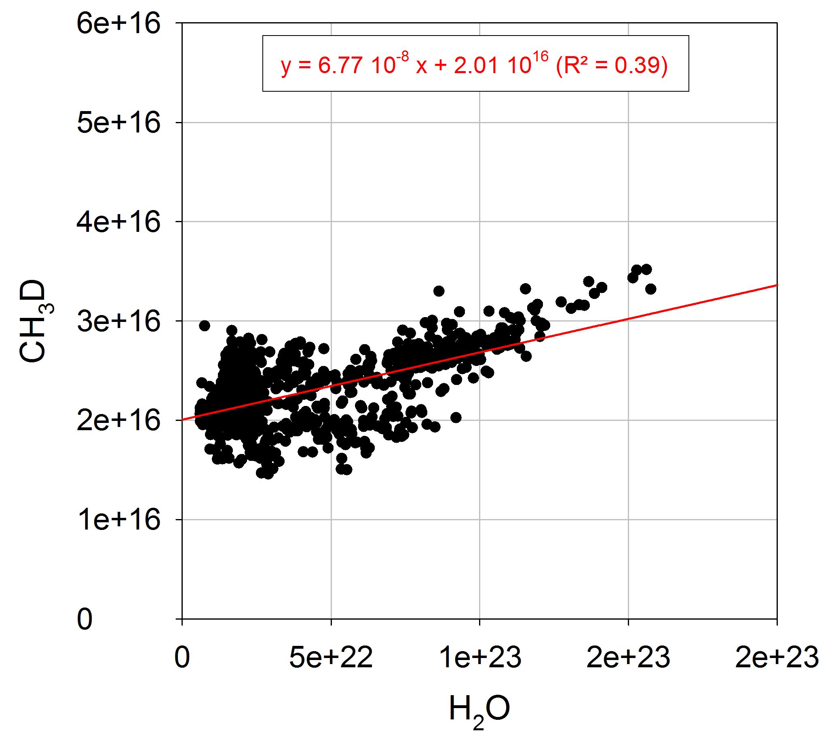
Water vapor
2 windows

Slide 14
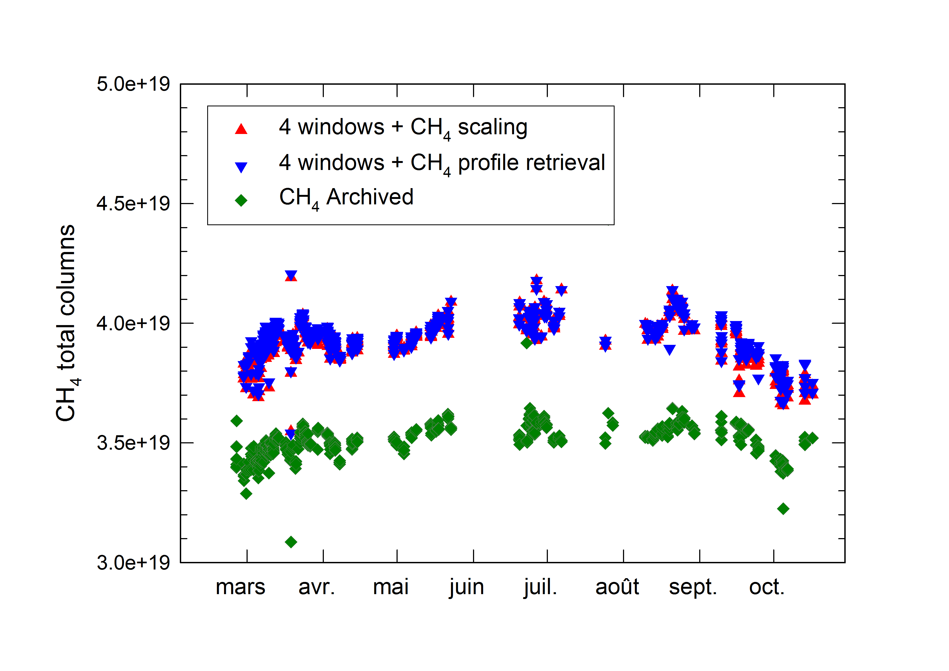
Methane CH₄
?

Slide 15
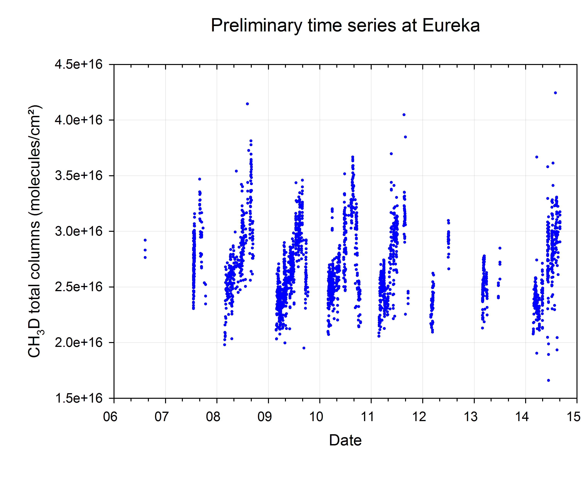
CH₃D Time series at Eureka
(Unfiltered individual measurements)

Slide 16
Next steps…
Water vapor approach
Methane approach
Any suggestions are welcome !
CH₃D time series : Valuable dataset for validation
  Next steps of the project
¹³CH₄ retrieval strategy
Development of a GEOS-Chem isotopic simulation

