Slide 1
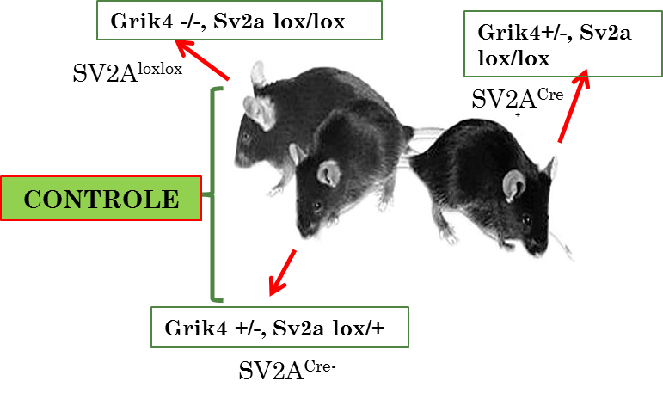
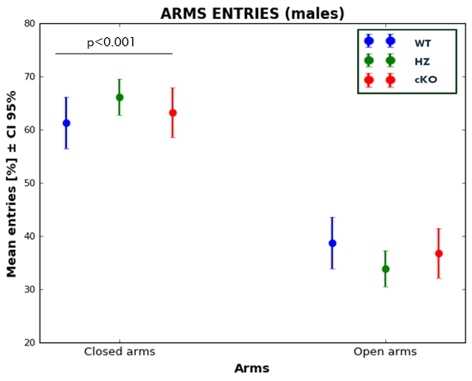
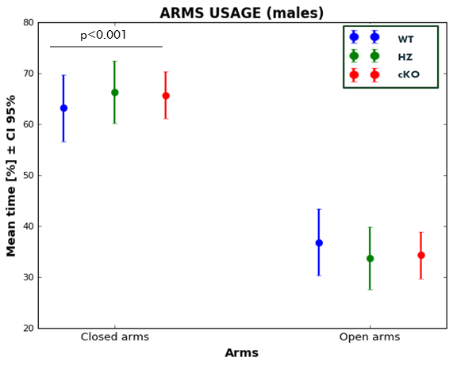
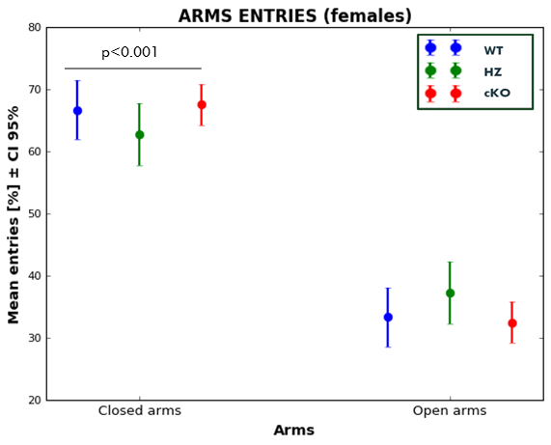
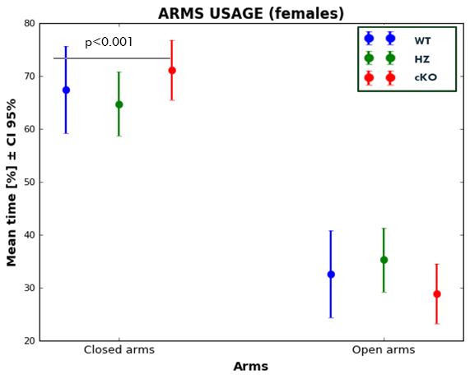
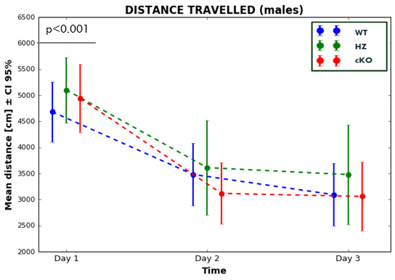
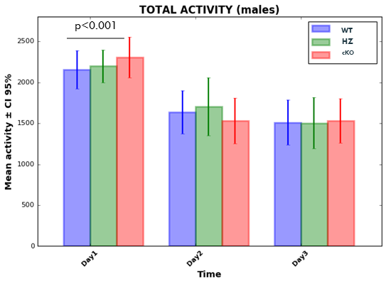
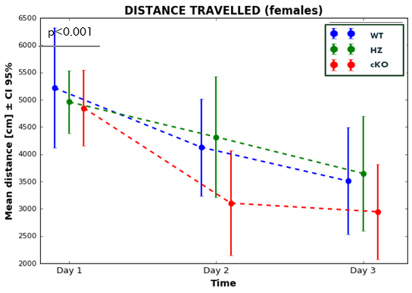
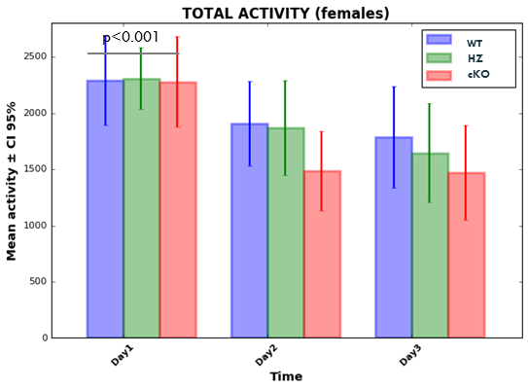
Behavioural phenotyping of SV2A lox/lox mice: Motor and anxiety-like features
Serrano, ME^{1,2}, Bartholomé, O.³, VanDenAckerveken, P³, Rogister, B³, Plenevaux, A¹., Tirelli, E²
¹GIGA-CRC In vivo Imaging, Ulg
²GIGA-Research, Département des sciences biomédicales et précliniques, Ulg
³ Neuroscience comportementale et psychopharmacologie expér., Ulg
Introduction
Methods
New antiepileptic drugs mainly target the SV2A protein [1] but its role is still unknown.
Knockout mice have been created to clarify the question [2,3], but only heterozygous SV2A (+/-) are viable, revealing anxiety-like features and a pro-epileptic phenotype [4,5]. Recently, a floxed SV2A mouse model has been produced to slightly deeper the link between the protein and the epilepsy [6].
The present study was undertaken to perform a first behavioural phenotyping of this SV2A lox/lox mice.
Evaluation of the effect of 3 genotypes in the mice’s phenotype: WT (Grik4-/-, SV2A lox/lox), HZ (Grik4 +/-, SV2A lox/+) and cKO (Grik4 +/-, SV2A lox/lox) in two parallel experiments: Male (n=42) and female (n=33)
Results
EPM
MALES
FEMALES
1
Preference for the closed arms
2
No differences between groups
PARTIAL ETA SQUARED = 0,738
PARTIAL ETA SQUARED = 0,805
ACTOM.
MALES
FEMALES
1
Habituation along the days to the environment
2
Same habituation in all the groups
3
No differences in activity between the groups
PARTIAL ETA SQUARED = 0,711
PARTIAL ETA SQUARED = 0,716
PARTIAL ETA SQUARED = 0,636
PARTIAL ETA SQUARED = 0,663
Conclusion
Results indicate that only a decrease in the hippocampal expression of SV2A protein does not lead to major behavioral changes at least in the model tested. However, a 50%- lack of SV2A in the whole brain triggers the appearance of anxiety-like features [3].
Since the power of the present design is lower than 60%, tests with a power of 80% are being conducted (larger sample size), such that any existing small effect size will be detected.
This research was supported by FRS FNRS, Walloon Region and UCB Pharma. Alain Plenevaux is research director of the FRS-FNRS Belgium.
Contact : meserrano@ulg.ac.be
[1] Hamann et al., Eur J Pharmacol, 2008 [2] Crowder et al., Proc Natl Acad Sci U S A., 1999 [3] Lamberty et al., Behav Brain Res., 2009 [5] Kaminski et al., Neuropharmacology, 2008 [6] Menten-Dedoyart et al., PLoS One, 2016

