Slide 1

Absent, yet Present? Tracing “Responsible Innovation” in Radiation Protection Research
Michiel van Oudheusden
Ricomet Conference – Vienna – 27-29 June 2017

Slide 2



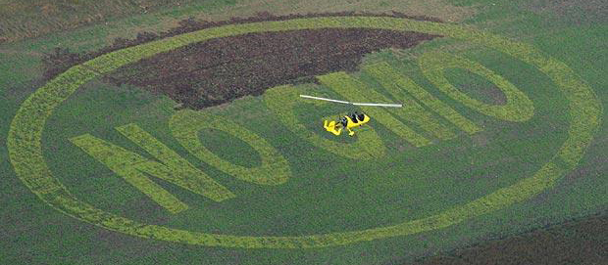

GMOs

Slide 3
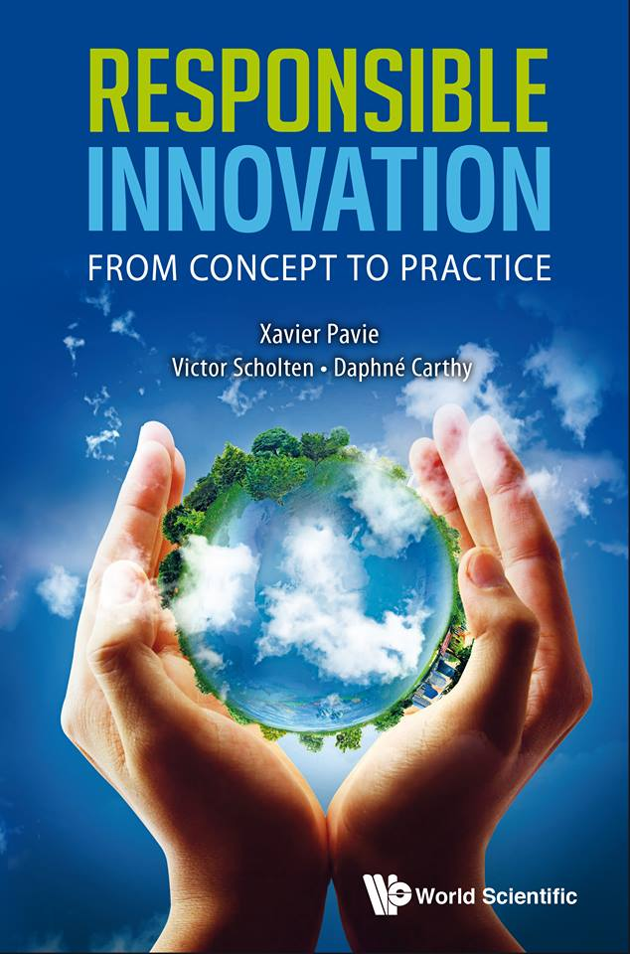
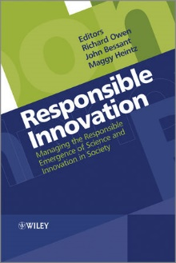

Enter Responsible Innovation (RI)
European Research Agenda & Horizon 2020 initiative:
“Research and innovation must respond to the needs and ambitions of society, reflect its values and be responsible” (E.U. Commissioner M. Gheoghegan–Quinn)
“We need to involve civil society very upstream”
(O. Quintana, Director European Research Area)
Explore and prioritise social, ethical and
environmental issues now and in the future
Ongoing involvement of society
Openness and transparency in the research
process

Slide 4

Where is RI in radiation protection research?
Long tradition of responsibility in nuclear S&T
Principles and Codes of Conduct
e.g. Precautionary principle
Participatory approaches
e.g. “Partnership approach” for siting LILW
Ethics, risk communication included in Euratom FP6-7 calls
…
Strong focus in Euratom on meeting societal challenges, inclusion and societal uptake… but no mention of RI
This presentation:
Not why or should?
But how?
Entering sideways?

Slide 5

Examples
Conversations between nuclear R&D directors, scientists and technologists, and (other) SSH researchers.
e.g. Drafting of 2015 Ricomet Declaration:
“Appeal to implement Responsible Research and Innovation in Euratom nuclear research, development and activities”
Recurrent concerns and opportunities:
But we are responsible (RI is patronizing).
RI can help to make ethical reflection an integral part of R&D.
Does RI involve industry? If not, it should.
It is not clear to me what RI means.
How do you people define RI?

Slide 6
Tasks and roles for SSH researchers
Carefully consider how RI is received and how we “move with” RI in/through radiation protection research.
Implement RI? Or: Ask how innovation is made responsible?
How to involve industry?
Define RI? Constitutive ambiguity?
How to do interdisciplinary work?
SSH:
Plurality of SSH disciplines, agendas, instruments
RI hybridizes SSH into specialist subfields (e.g. risk communication, technology assessment, public engagement)
Work is fleeting, fragmented, diffused: Cannot speak with one voice
RI draws us together and pulls us apart

Slide 7

Moving with RI
RI “sits around on the sidelines”:
Our awareness of its absence, or our practical efforts to include/exclude it, render it present, and that presence is disruptive, perturbing the processes of ordermaking (Horst & Michael 2011).
Its “imagined presence” facilitates or constrains our moves as SSH researchers.
Implications for SHINE?
Listen to voices in the field
Consider implications of mobilizing RI
Build reflexive capacity into platform

Slide 8
Copyright © 2017 - SCK•CEN
PLEASE NOTE!
This presentation contains data, information and formats for dedicated use only and may not be communicated, copied, reproduced, distributed or cited without the explicit written permission of SCK•CEN. If this explicit written permission has been obtained, please reference the author, followed by ‘by courtesy of SCK•CEN’.
Any infringement to this rule is illegal and entitles to claim damages from the infringer, without prejudice to any other right in case of granting a patent or registration in the field of intellectual property.
SCK•CEN
Studiecentrum voor Kernenergie
Centre d'Etude de l'Energie Nucléaire
Belgian Nuclear Research Centre
Stichting van Openbaar Nut
Fondation d'Utilité Publique
Foundation of Public Utility
Registered Office: Avenue Herrmann-Debrouxlaan 40 – BE-1160 BRUSSELS
Operational Office: Boeretang 200 – BE-2400 MOL

