Slide 1
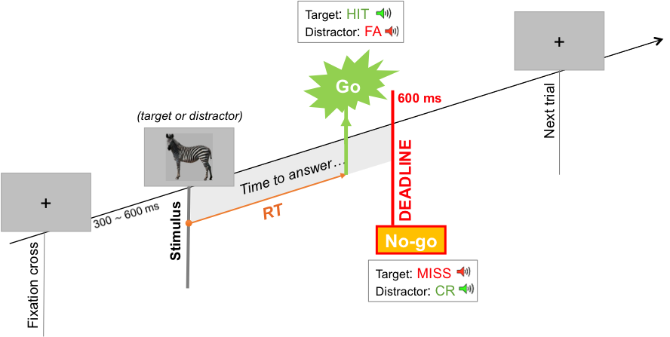
Evolution of fast familiarity and novelty decisions in aging
Emma Delhayeª, Christine Bastinª, Christopher Moulin^{c}, Gabriel Bessonª, & Emmanuel Barbeau^{b}
ª Brain and Cognition Research Center, University of Toulouse, CNRS CERCO UMR 5549, France
^{b} GIGA-CRC In-Vivo Imaging, University of Liège, Belgium
^{c} Laboratory of Psychology & NeuroCognition (CNRS UMR 5105), University of Grenoble Alpes, France
INTRODUCTION
Memory and novelty detection are thoroughly intertwined since novelty detection relies on the capacity to distinguish what is already known from what is not. However, several questions remain unclear.
(1) What is the nature of the relationship between familiarity and novelty detection?
Single continuum, two-step mechanism, or dual-route with convergence (Kafkas & Montaldi, 2014, 2015)?
(2) How does this relationship evolve through aging?
Familiarity is relatively preserved in aging. What about novelty?
METHODS
RESULTS
Participants:
Experiment 1:
Experiment 2:
Procedure: 10 blocks of a recognition memory task
Study: 30 items/block
Test:
30 targets & 30 distractors/block
2 conditions: familiarity versus novelty detection
5 blocks/condition
Speed and Accuracy Boosting procedure (SAB): speeded go/no-go recognition memory task that constraints subjects to use their fastest strategy
Experiment 1:
4
Accuracy (d')
0.6
Bias (c’) [1]
600
Minimal RT (ms)
 | Participants
 | N = 31
Age | 23.8 ± 2.8 (20–32)
M/F | 12/19
3
***
0.4
***
500
*
Familiarity
0.2
vs.
2
0
400
Novelty
-0.2
1
-0.4
300
Participants | Middle-age | Older
 | N = 20 | N = 20
Age | 51 ± 2.7 (46-55) | 69,1 ± 3.1 (65-75)
M/F | 7/13 | 9/11
Education | 15 ± 2.48 | 14 ± 2.62
0
-0.6
200
-0.8
8
390
410
494
Correlations:
6
499
3
Accuracy (d')
Bias (c’)
r = .5
p < .01
0.6
% go-responses
0.4
4
2
0.2
Novelty
0
Novelty
2
1
-0.2
r = -.49
p < .01
-0.4
0
0
200
400
600
0
0
1
2
3
-0.6
-0.6
-0.4
-0.2
0
0.2
0.4
0.6
Experiment 2:
RT (ms)
Familiarity
Familiarity
Accuracy (d')
Bias (c’)
Minimal RT (ms)
Middle-age
**
***
3
p = .06
600
***
*
vs.
3
2
*
Older
2
1
500
Correlations:
Accuracy (d')
0
2
1
-1
400
r = .5
p < .05
-2
Novelty
0
Familiarity
Novelty
-3
Familiarity
Novelty
300
Familiarity
Novelty
1
r = .45
p < .05
10
Familiarity
Novelty
440
0
1
2
3
Besson et al., 2012
440
10
480
Familiarity
8
420
8
3
r = .39
p = 0.089
Bias (c')
6
6
2
% go-responses
1
4
4
Novelty
0
Minimal reaction time: time at which the proportion of hits significantly outnumbers the proportion of false alarms
2
2
-1
r = .64
p < 0.01
0
0
-2
0
200
400
600
0
200
400
600
-3
-3
-2
-1
0
1
2
3
RT (ms)
RT (ms)
Familiarity
DISCUSSION
(1) Single continuum, two-step mechanism, or dual-route with convergence?
Familiarity ≠ novelty across all measures suggests two distinct mechanisms
But could also be explained by processing fluency
Correlated biases suggests one single decision criterion
(2) Age-related dissociations between familiarity and novelty
We show decreased familiarity with age
Greater difficulty in older participants to reach novelty decisions within the allocated time
Due to the age-related slowing of processing speed
Limitation inherent to the speeded design of the task
REFERENCES
[1] Macmillan, N. A., & Creelman, C. D. (2004). Detection theory: A user’s guide. Psychology Press.
ACKNOWLEDGMENTS
This work was supported by the Leonardo Da Vinci Program, the University of Liege, the Léon Frédéricq Foundation, SAO-FRA, and the Inter-University Attraction Pole P7/11
Cyclotron Research Centre | Brain and Cognition Research Centre | Emma Delhaye | Emma.Delhaye@ulg.ac.be

