Slide 1


The game for urban regeneration?
Perrine Dethier

Slide 2
SimsCity ValueCap
Joint Programming Initiative Urban Europe
4 countries:
Netherlands
Norway
United Kingdom
Belgium
Doctoral thesis

Slide 3
Urban regeneration
Urban regeneration is complex and faces many obstacles
Parcels fragmented
Significant costs for public infrastructure
Many actors involved
Innovative strategies
Self-organizing urban governance mechanisms

Slide 4
Innovative strategies
Land readjustment
Transfer to a co-ownership structure of property rights. This co-ownership structure manage the development of the perimeter. The owners are paid in proportion to the value of their property contributions.
Business improvement district (BID)
All land owners within the BID-defined perimeter are legally required to pay a levy towards the BID organization. The organization conducts programmes to improve the attractiveness of the area (security, cleaning, entertainment, decoration, marketing...)
Tax increment financing (TIF)
Using anticipated future increases in tax revenues to finance current improvements (such as new or improved infrastructure).

Slide 5
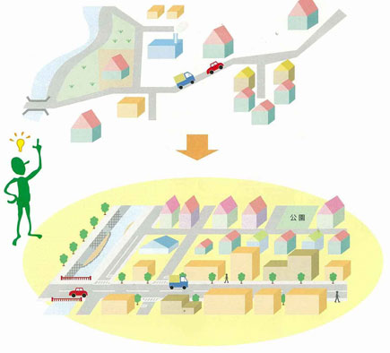
Land readjustment

Slide 6
Innovative strategies
Land readjustment
Transfer to a co-ownership structure of property rights . This co-ownership structure manage the development of the perimeter. The owners are paid in proportion to the value of their property contributions.
Business improvement district (BID)
All land owners within the BID-defined perimeter are legally required to pay a levy towards the BID organization. The organization conducts programmes to improve the attractiveness of the area (security, cleaning, entertainment, decoration, marketing...)
Tax increment financing (TIF)
Using anticipated future increases in tax revenues to finance current improvements (such as new or improved infrastructure).

Slide 7
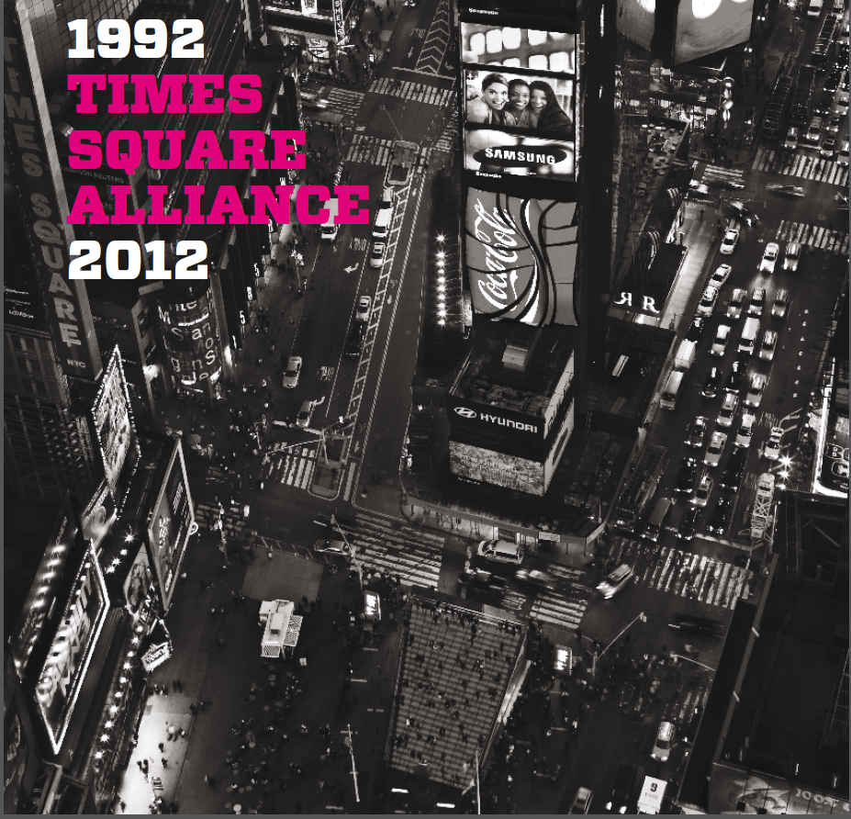
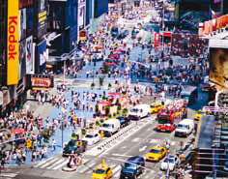
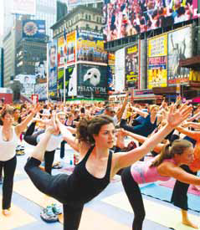
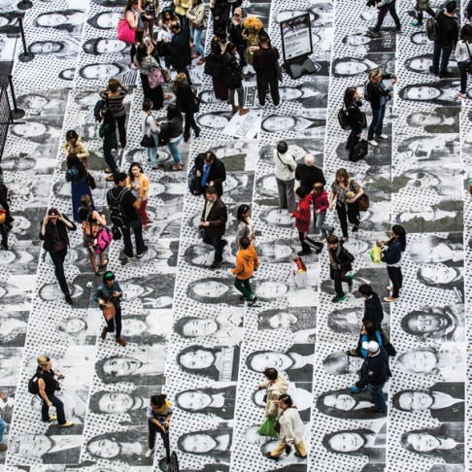
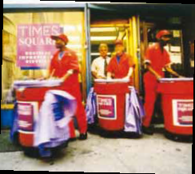
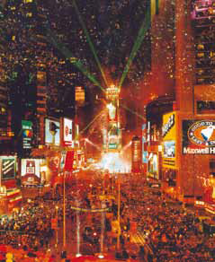
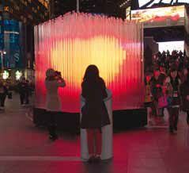
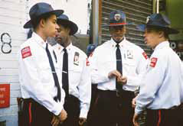

Slide 8
Innovative strategies
Land readjustment
Transfer to a co-ownership structure of property rights . This co-ownership structure manage the development of the perimeter. The owners are paid in proportion to the value of their property contributions.
Business improvement district (BID)
All land owners within the BID-defined perimeter are legally required to pay a levy towards the BID organization. The organization conducts programmes to improve the attractiveness of the area (security, cleaning, entertainment, decoration, marketing...)
Tax increment financing (TIF)
Using anticipated future increases in tax revenues to finance current improvements (such as new or improved infrastructure).

Slide 9
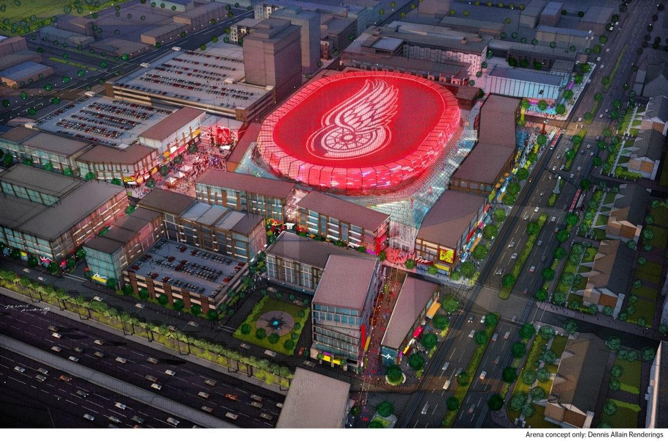
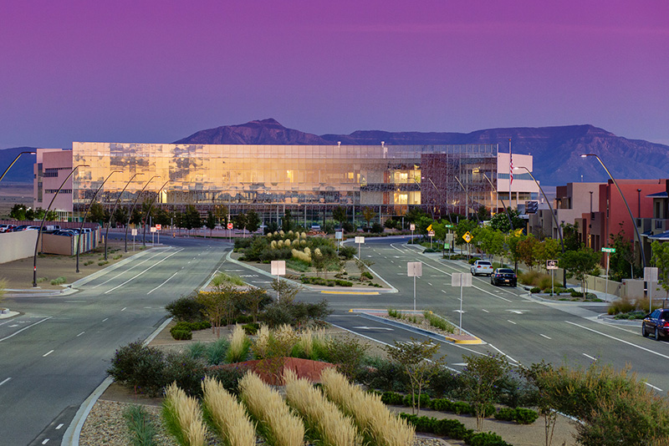
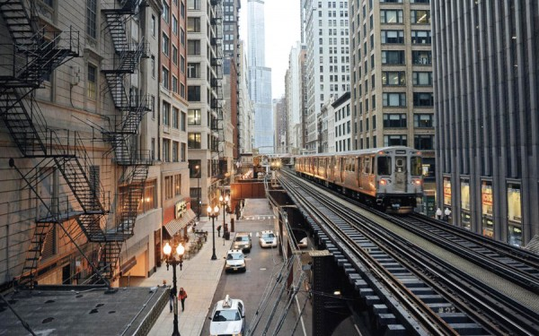
Red Wings hockey stadium, Detroit, Michigan
Mesa del Sol, Albuquerque , New Mexico
Chicago 'L', Chicago, Illinois
Notes:
In July 2014, Detroit's Downtown Development Authority announced TIF financing for the new Red Wings hockey stadium. The total project cost, including additional private investments in retail and housing, is estimated at $650 million, of which $250 million will be financed using TIF capture to repay 30-year tax exempt bonds purchased by the Michigan Strategic Fund, the state's economic development arm.

Slide 10
Planning culture
Innovative strategies are developed in a specific country.
Each national or region context is characterised by cultural particularities (history, beliefs, values, political and legal traditions, socio- economic patterns...)
The transferability of planning successes => need to take into account contextual obstacles => planning culture

Slide 11
Planning culture
Unclear concept and difficult to define
« the collective ethos and dominant attitudes of planners regarding the appropriate role of the state, market forces, and civil society in influencing social outcomes »
(Sanyal, 2005)
Driving forces (de Vries, 2015)
Realize international comparative studies
Understand contextual conditions that provide planning
Difficult to distinguish cultural influences with other influences (institutional)
Example
Distrust to planning in Flanders and a principal trust in planning in the Netherlands
(de Vries, 2015)
Notes:
Comportement pas uniquement rationnel mais culturellement déterminé
Attitude hostile envers le gouvernement et attitude d’hyper-individualisme vs meilleur acceptation des interventions du gouvernement et attitude plus collective
Revolution indu: Limiter croissance des villes (dvp reseau dense et promouvoir acces à la propriété) vsindustrialisation tardive
Apres-guerre: Nl detruit et forte pression demo
Système de l’AT fort similaire

Slide 12
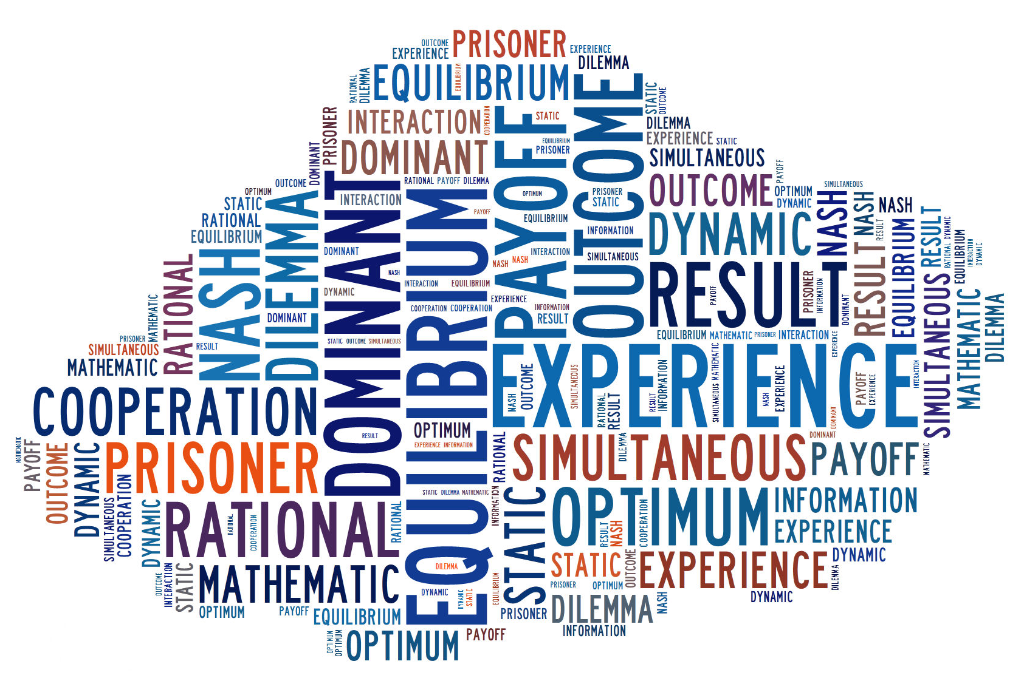
Planning culture
How?
Methodology => Game theory
Variables:
Risk
Trust
Cooperation

Slide 13


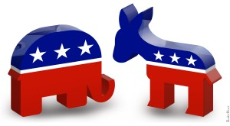
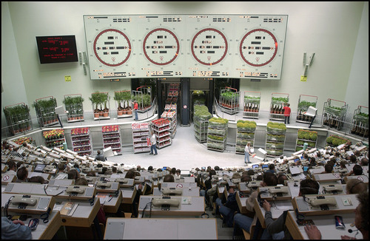
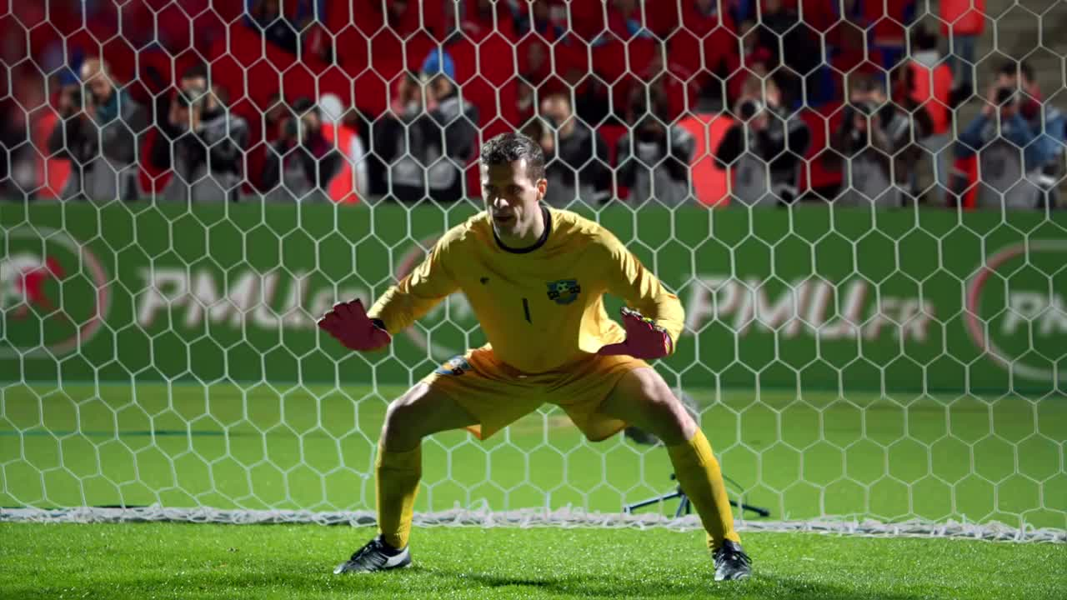
Game theory

Slide 14

Prisoner dilemma
Cooperates
Defects
Cooperates
5 years
0 year
10 years
Defects
10 years
0 year
1 year

Slide 15
Prisoner dilemma
Cooperates
Defects
Cooperates
5 years
0 year
10 years
Defects
10 years
0 year
1 year

Slide 16
Prisoner dilemma
Cooperates
Defects
Cooperates
5 years
0 year
10 years
Defects
10 years
0 year
1 year

Slide 17
Game theory
Wide variety of games (static, dynamic, complete or incomplete information, 2 to a great number of players... )
Postulate : rationality of players
At the same time as its development, experimental economics emerged
Components
Monetary incentive
Anonymity
Experimental economics

Slide 18

Trust game
E
3E
Y-E+R
Y+3E-R
R
R

Slide 19
Research question
Does game theory help identify planning culture difference to adapt innovative strategies?

Slide 20
SimsCity ValueCap
Organize games for stakeholders
Games:
To evaluate
Risk
Trust
Cooperation
To test innovative strategies

Slide 21
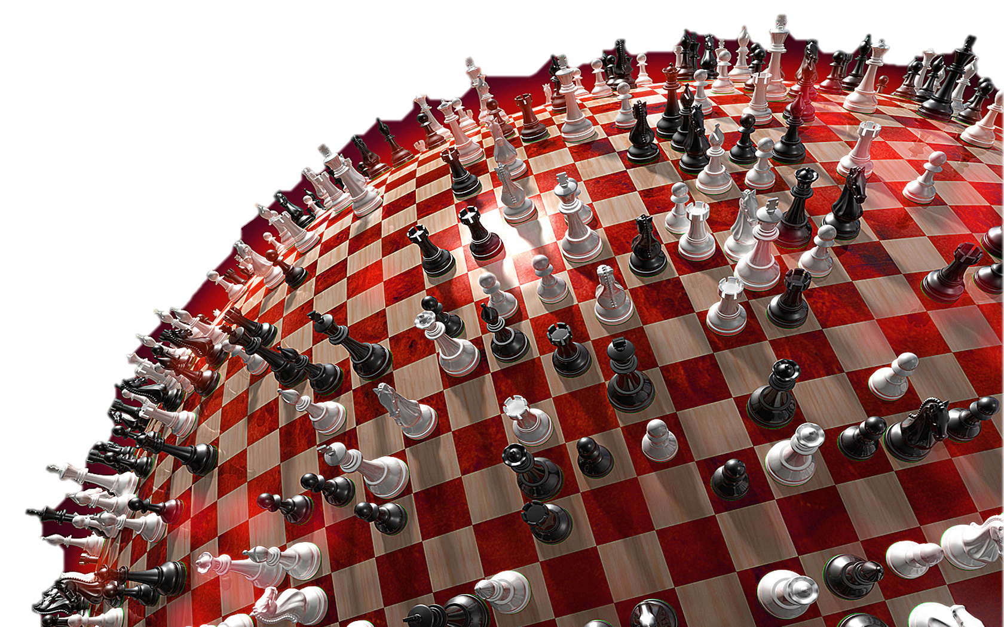
Thank you for your attention

Slide 22
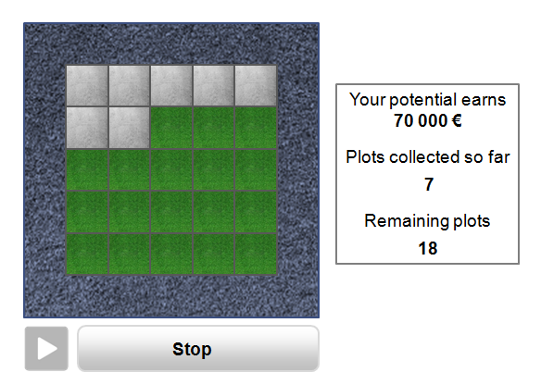
Bomb task

Slide 23

Public good game
Y-G₂+T/4
T/4
G₂
G₁
T/4
T=α*(G₁+ G₂+ G₃+ G₄)
T/4
G₃
Y-G₃+T/4
Y-G₁+T/4
G₄
T/4
Y-G₄+T/4

