Slide 2
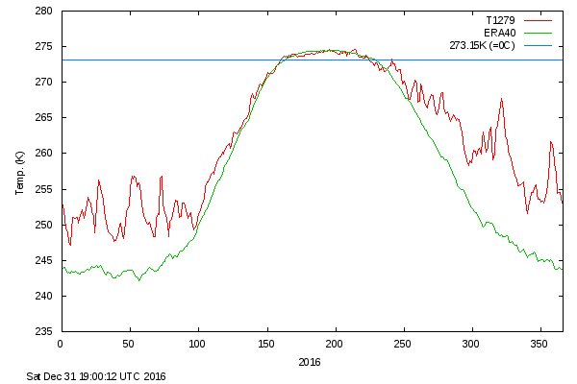
Red curve: temperature in the Artic in 2016. Green curve: Average temperature in the Artic over the period 1958-2002.

Slide 4
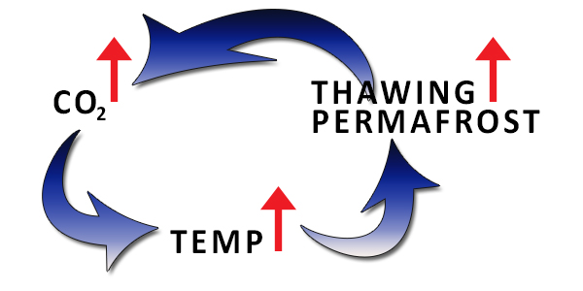
The fear of climate tipping points
Example 1: When sea ice shrinks it leaves areas of dark ocean that absorb more heat, which in turn causes further shrinkage, and so on in a spiral.
Example 2:

Slide 5
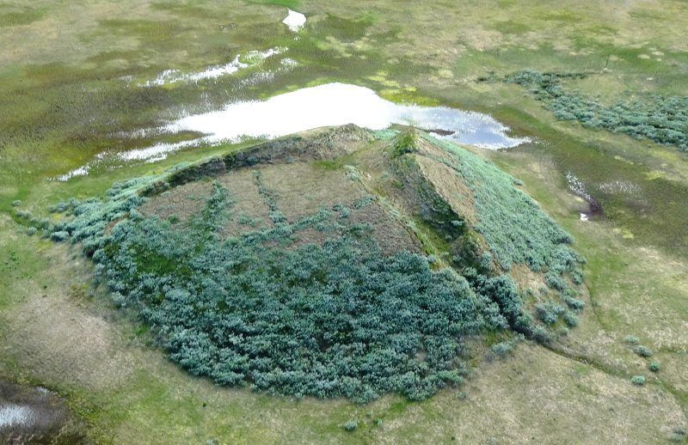
Methane bubble in Siberia.

Slide 6
Example 3: Growth of finger-width cryoconite cones holding black microbial gunk that accelerates melting if the Greenland ice sheet.

Slide 7
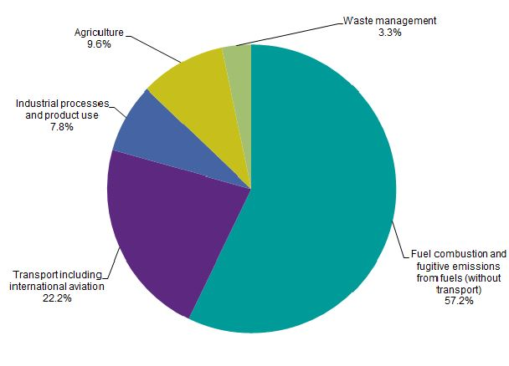
Greenhouse gas emissions, by source sector, EU-28, 2013 (% of total)

Slide 8
Nuclear power. Costs in 2016: 60€/MWh-120€/MWh.
Wind energy. Cost in 2016: 25 €/MWh-140€/MWh.
Solar energy. Cost in 2016: 26 €/MWh-130€/MWh.

Slide 9
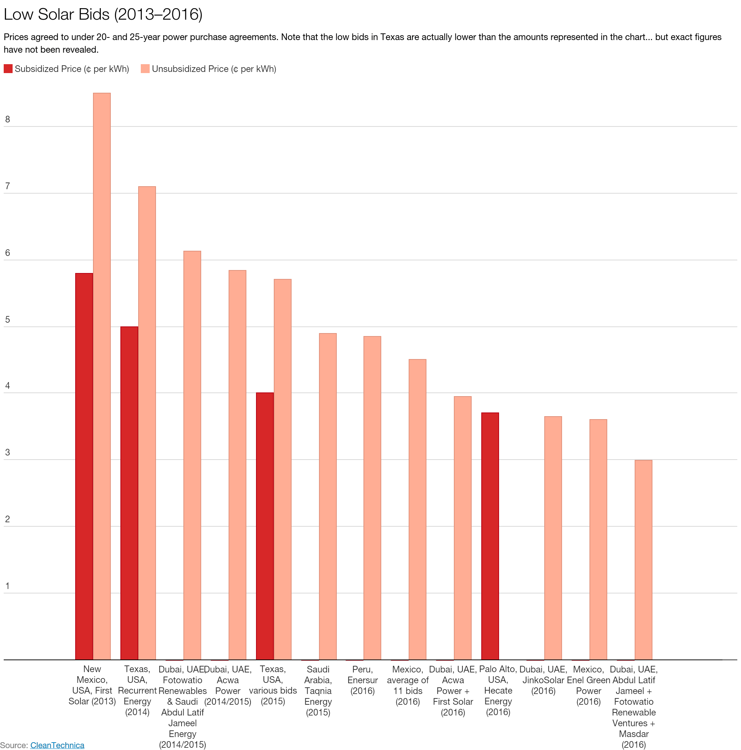

Slide 10
Final energy consumption in Belgium: 150 kWh/person/day
Yearly energy consumption : 150 x 365 x 11 x 10⁶ ≃ 600 TWh
Electricity consumption : 80 TWh

Slide 11
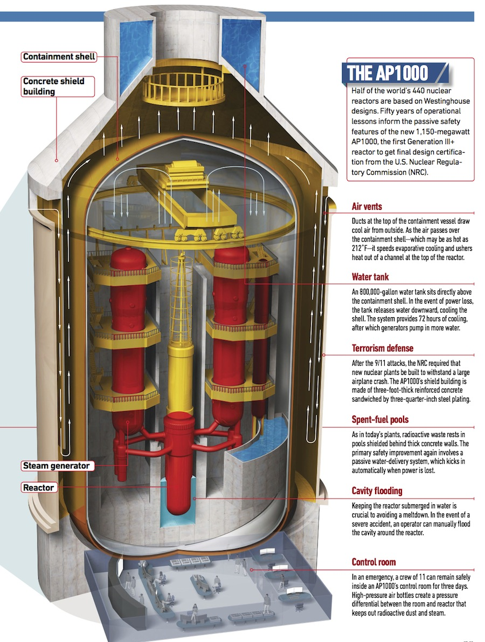
69 AP1000 nuclear reactors (designed and sold by Westinghouse/Toshiba). Price tag: in the range of €200 billion. Note: GDP Belgium in 2015 : €400 billion
How to generate 600 TWh of energy every year ?

Slide 12
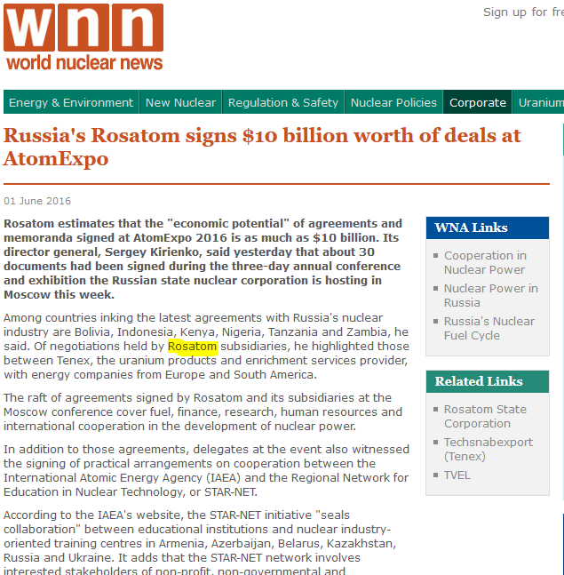

Slide 13
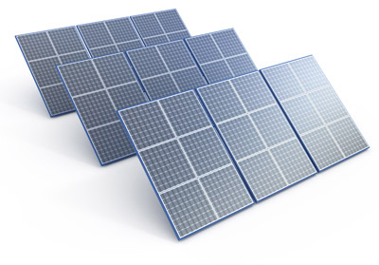
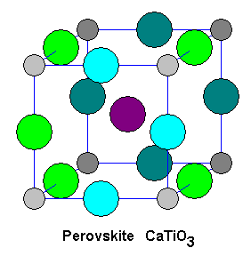
3424 km² of PV panels. This corresponds to an installed capacity of 685 GW or around 200 times the installed PV capacity in Belgium in 2016.
Price tag: in the range of €600 billion.

Slide 14
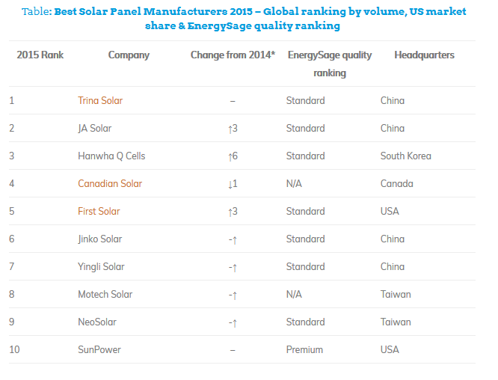

Slide 15
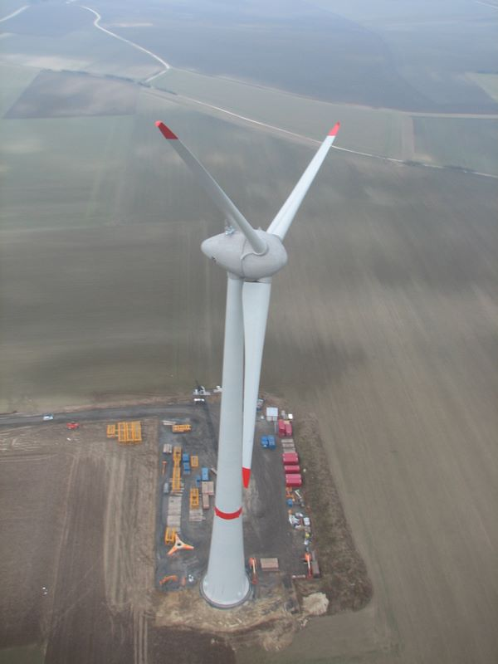
30220 Enercon-126 wind turbines = 229,071 MW of installed wind capacity, around 100 times more than the wind capacity currently operational in Belgium in 2016. This would correspond to wind farms covering 17,180 km² of land.
Price tag: in the range of €300 billion.

Slide 16
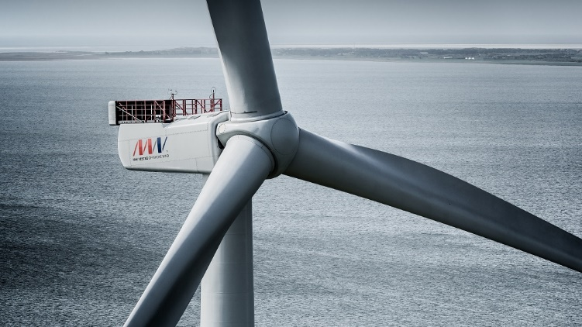
World’s most powerful wind turbine selected for Belgium’s largest offshore wind park. The V-164-8.4 MW

Slide 17
What about storage needs?
Power Produced = Power Consumed
+ Power Stored
+ Power Wasted
Storage needs for daily fluctuations : Computation of storage under the following assumptions: (i) all the energy (600 TWh/year) is generated by PV panels (ii) the load will be constant (iii) PV sources generate a constant power from 7 am till 7 pm and no power outside those hours. (iv) Efficiency of 1 for storage.

Slide 18
Storage capacity needed: 600÷365÷2= 0.82 TWh = 820,000,000 kWh
The Tesla Powerwall 2: capacity of 14 kWh => 58,571,428 Powerwalls would be needed.
Manufacturing price of around €200/kwh. Price tag in the range of €160 billion

Slide 19
Storage needs for interseasonal fluctuations: Solar irradiance during the six sunniest months of the year is three times higher than during the other months of the year => Storage needs: 150 TWh. Price tag: €3000 billion.
Other solutions: (i) Oversize the PV installations and throw power away during the sunny period (ii) Transform electricity into hydrogen that has a storage cost of around €2/kWh

Slide 20
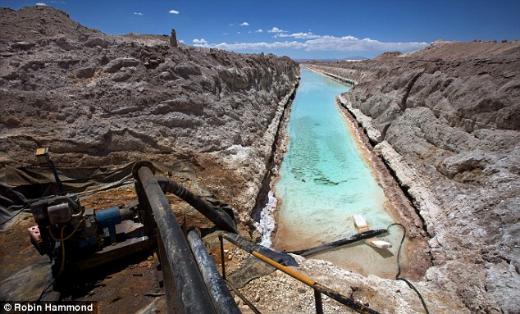
Lithium mine in the Atacama desert, Chile

Slide 21
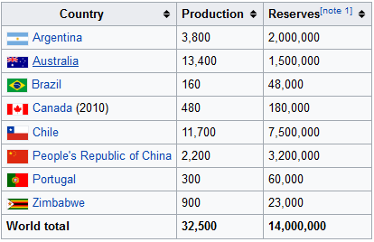
1 kg of Lithium needed for 10 kwh. 14 million tons of proven reserve. That corresponds to a potential storage capacity of 140 TWh.
Equivalent to 12h of worldwide energy consumption (155,000 TWh).
Equivalent to the storage capacity of 1.75 billion of Tesla cars.
Lithium: yearly production by countries and proven reserves.

Slide 22
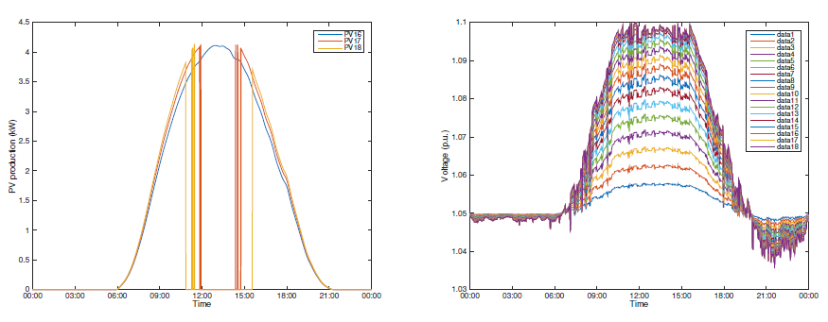
Distribution networks and renewables: challenges

Slide 23
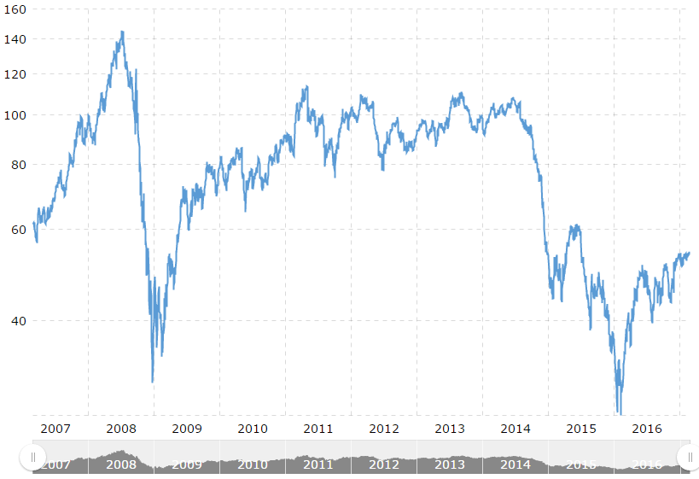
Forget the energy transition: let us go back to fossil fuels
Reason #1. Gas/oil is cheap and is poised to stay cheap with the shale revolution.
Price barrel of oil in $. 1 barrel of oil = 1.62 MWh. If price of oil is equal to $60, then 1 MWh of oil energy costs: 37 $/MWh.

Slide 24
Reason #2. With the rise of liquefied natural gas (LNG), we do not have to depend anymore on Russia for our gas supply.
The LNG terminal in Zeebrugge.

Slide 25
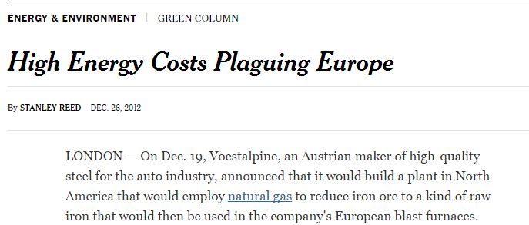
Reason #3. Renewable energy will kill the EU industry

Slide 26
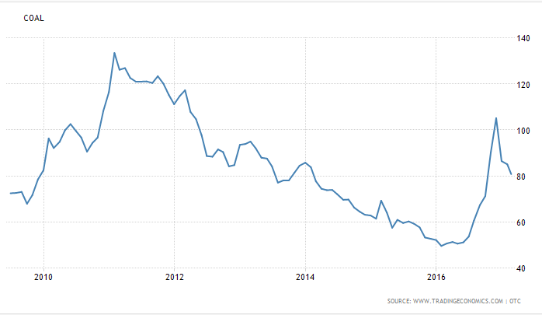
Reason #4. There is plentiful of coal. Let us burn it. Even if it generates lots of CO2, we are anyhow too late to avoid climate warming (except if it is an hoax ).
Proved recoverable coal reserves: 1000 billions of tons = 8,141,000 TWh
Worldwide energy consumption per year: 155,000 TWh
Coal could cover all our energy needs for more than 50 years.
Price per ton of coal in $. 1 ton of coal = 8.14 MWh. If price of coal is equal to 100$/ton, then 1 MWh of coal costs: 12 $/MWh.

Slide 27
Wait….
1. In good locations, renewable energy is becoming the cheapest way to produce electricity. In $/MWh of energy, it becomes also cheaper than oil.
2. Importing fossil fuels is also supporting terrorism, dictatures, while investing into renewables boosts the local economy.
3. Be carefull about shale oil/gas. Production prices may go up in a near future, once the best shale oil ressources have been exploited (the U-curve curse). Production may also brutally stop due to environmental constraints.

Slide 28
Shale oil field in the Permian bassin (Texas, USA)

Slide 29
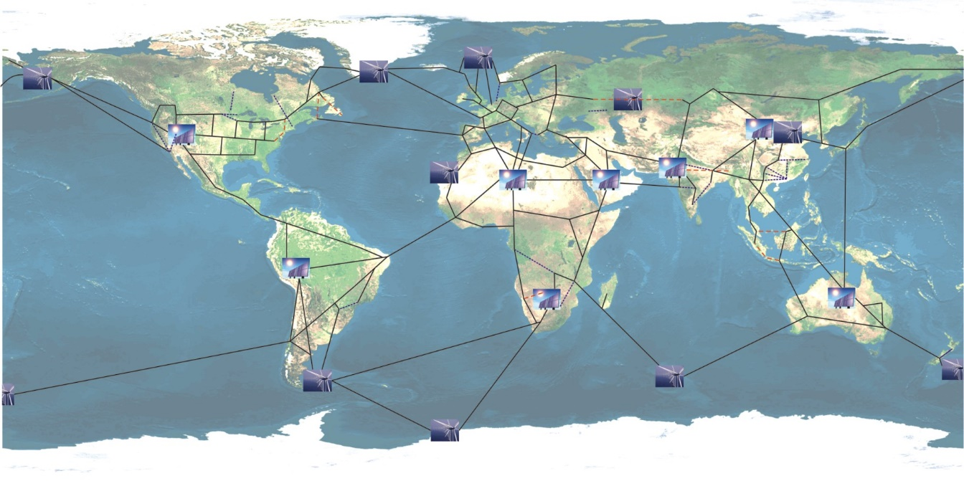
A global grid for the provision of cheap renewable energy
More at: http://blogs.ulg.ac.be/damien-ernst/tedx-talk-the-global-grid-for-empowering-renewable-energy/

Slide 30
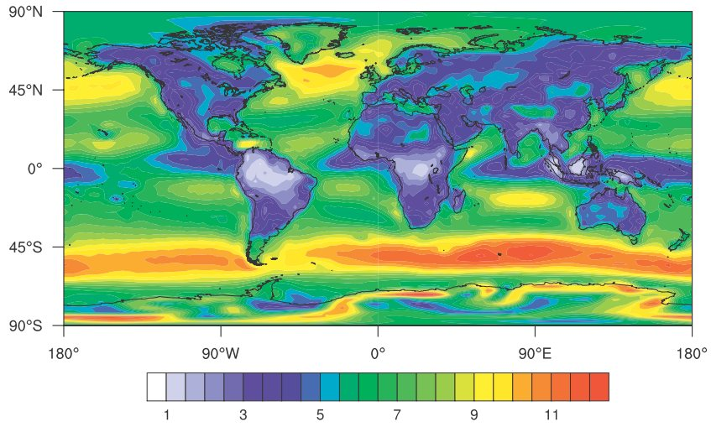
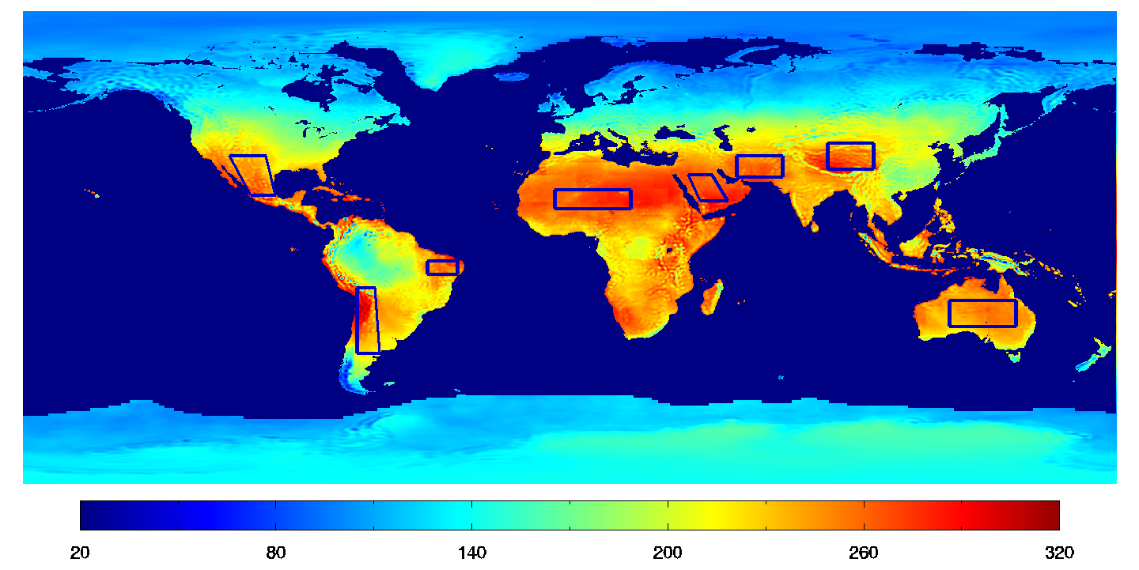
Why a global supergrid?
1. In many countries, you have only a limited number of prime locations for harvesting renewable energy
2. Intermittency of renewable energy sources
3. Tapping into rich veins of renewable energy sources

Slide 31
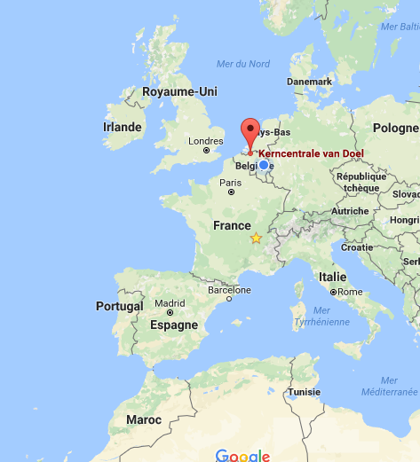
A future element of the global grid? An undersea cable between Morocco and Belgium. With such a project, Northern Europe would get access to cheap Moroccan PV energy, even during the winter.
The cable could be connected on the Belgium side at the Doel nuclear power plant, which is closing in 2025, and which is located near the coast. This would allow for the reusing of the existing electrical infrastructure in Belgium (very difficult to build new lines in Belgium due to NIMBY issues).
Around 3000 km
length of
undersea cable

Slide 32
Picture taken at the COP22 in Marrakech (November 2016), when exiting my airplane.

Slide 33
« Humans are not good at global negotiations. But humans are a species of builders. So let us build this Global electrical grid » Nicholas Dunlop, Chairman of the Climate Parliament, November 2016, COP22

Slide 34
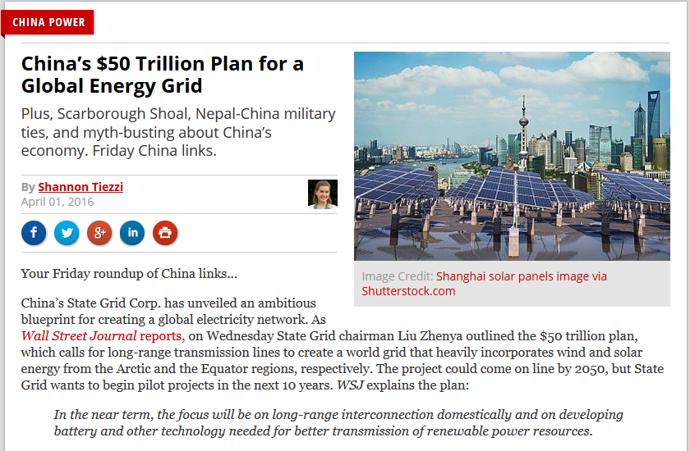

Slide 35
Electrical energy sales
Power
producer
Power
producer
Power
producer
Power
producer
Uber-like models for electricity: a definition
Wholesale market/grid
Electrical energy consumed by loads that does not go (only) through the electrical energy sale channels defined by
Large consumer
Large
prosumer
Retailer
Retailer
Retailer
Consumer
Consumer
Consumer
Prosumer

Slide 36
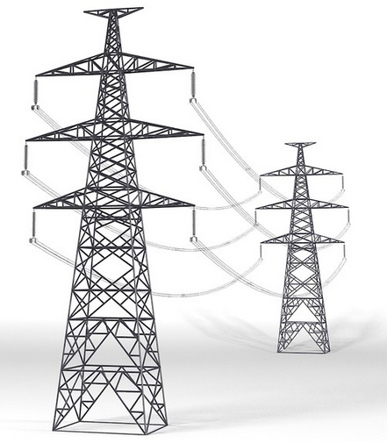
Microgrids: the most popular uber-like model
A microgrid is an electrical system that includes one or multiple loads, as well as one or several distributed energy sources, that are operated in parallel with the broader utility grid.
The single-user microgrid
Legal.
Popularised by PV panels and batteries.
Possibility to have a microgrid fully disconnected from the utility grid.
Electrical energy source(s) & load(s)
Utility grid
Meter
Single legal entity (e.g. a household, a company)

Slide 37
The multi-user microgrid
Regulatory framework may not allow for the creation of multi-user microgrids.
Often more cost-efficient than the single-user microgrid (e.g. economy of scale in generation and storage, easier to get higher self-consumption at the multi-user level).
Electrical energy source(s) and/or load(s)
Electrical energy source(s) and/or load(s)
Utility grid
Money paid for energy and transmission/
distribution and tariffs only based on this meter
Several legal entities. Submetering

Slide 38
Why microgrids?
1. Financial reasons: (i) Price paid for generating electricity locally is lower than price paid for buying electricity from the utility grid (ii) Hedging against high electricity prices.
2. Technical reasons: (i) Microgrids – especially multi-user ones – are a great way for integrating renewables into the grid and developing active network management schemes (ii) Security of supply, especially if the microgrids can be operated in an autonomous way.
3. Societal reasons: (i) Local jobs (ii) Energy that belongs to the people.

Slide 39
A taxonomy for uber-like models for electricity
Microgrid
Virtual microgrid
Mobile storage device
1. Single-user
2. Multi-user
Electric Vehicles (EVs)
No Electric Vehicle Battery
Single-user
Multi-user
3. Power generation and/or storage close to the user
4. Power generation and/or storage anywhere
5. Users close to each other
6. Users located anywhere
Not V2G
Vehicules to
Grid (V2G)
10. Delivery of electricity with storage devices
7. Car not always charged at home
8. Car discharging only at home
9. Car as a substitute for the utility grid
11. Storage devices
as a substitute for
the transmission grid

Slide 40
From the market point of view, the consumption of the ‘single user’ is equal to the sum of the consumption measured by the three meters, for every market period.
Model 3 and 4: The single-user virtual microgrid
If the user is located close to generation/storage (Model 3), it may have beneficial effects on the network to increase self-consumption in the virtual microgrid.
Model 3 tested in Belgium. Known as E-Cloud. Big storage generation/storage devices in an E-Cloud but they are divided up among several single users.
Standard regulations do not allow for the creation of virtual microgrids.
Σ
Battery
Generation
Single user

Slide 41
Model 5 and 6:The multi-user virtual microgrid
May be very helpful to integrate renewables if users are located close to each other (Model 5).
Difficult to have multi-user virtual microgrids that can operate in an autonomous way.
Easier to create a multi-user virtual microgrid in one area of a network than a multi-user microgrid. In a multi-user microgrid, one single potential user may block the creation of the microgrid.
Consumption in the virtual microgrid,
as seen from the market
=
Σ
user of
the virtual
microgrid
Electrical energy source(s) and/or load(s)
Electrical energy source(s) and/or load(s)
Electrical energy source(s) and/or load(s)

Slide 42
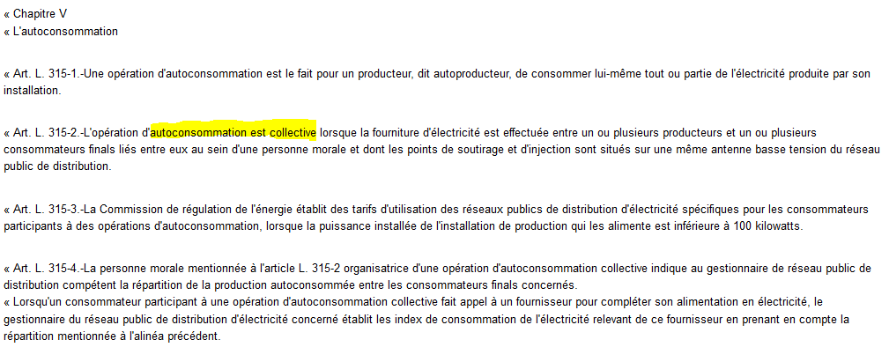
Model 5 (not 6) authorized in France?
A piece of French regulation « authorizing » the creation of multi-user virtual microgrids for which all the users are connected to the same low-voltage feeder (Model 5):
PS: Sorry for those of you who do not speak French

Slide 43
Model 7: EV – Car not always charged at home
A few comments on how this model could affect the electrical industry:
1. May help domestic microgrids with PV and batteries to go fully off grid. How? During a sunny period the owner of the (good-sized) domestic microgrid would charge its EV at home. Otherwise, he would charge it at another location. This would help the fully off-grid microgrid to handle the inter-seasonal fluctuations of PV energy.
2. The EVs could be charged immediately adjacent to renewable generation units where electricity costs may be much lower than retailing cost for electricity. Two numbers: retail price for electricity in Belgium: 250 €/MWh. Cost of PV energy in Belgium: less than 100 €/MWh.
May also help to avoid problems on distribution networks caused by renewables.

Slide 44
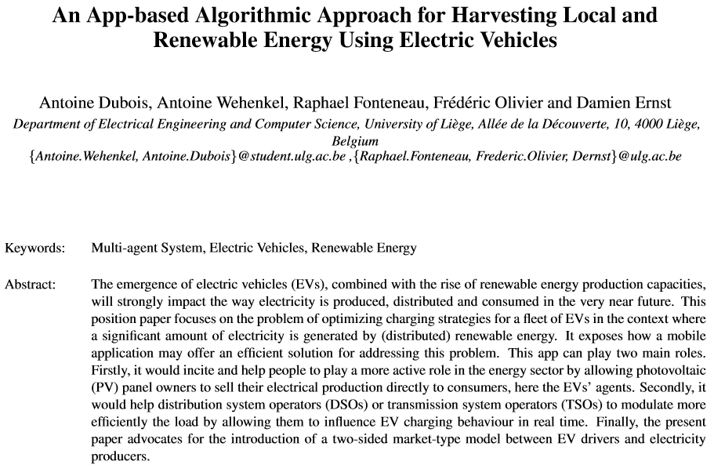
Download the reference: An App-based Algorithmic Approach for Harvesting Local and Renewable Energy Using Electric Vehicles.

Slide 45
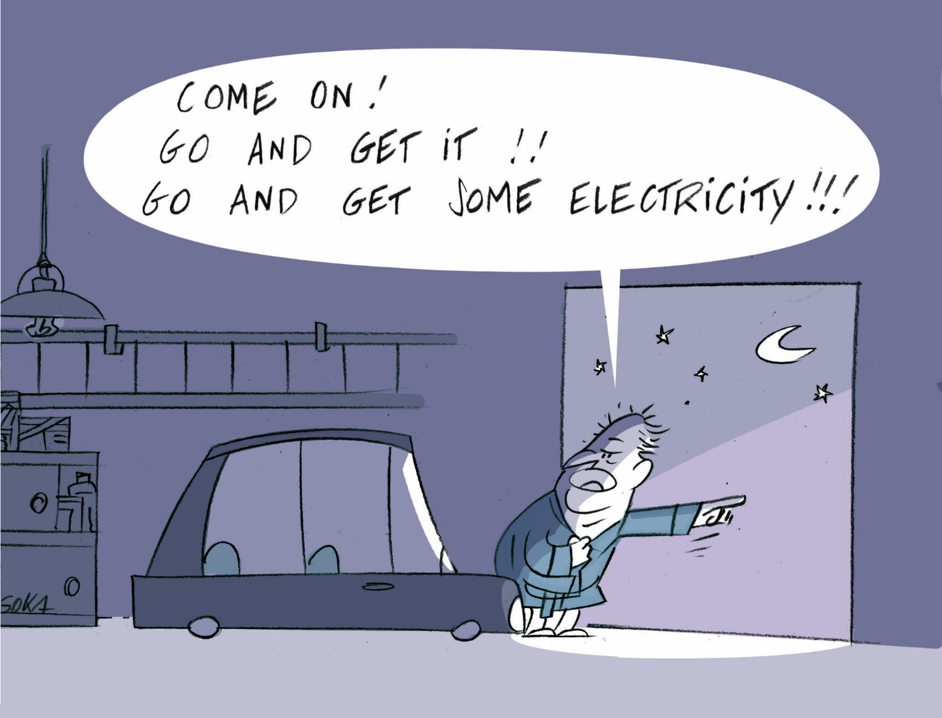
Model 8: V2G – Vehicle discharging only at home
1. Could allow for the creation of fully off-grid microgrids that do not have their own generation capacities.
2. Self-driving EVs could, during the night, autonomously bring back electricity to the house. This electricity could be stored in the batteries of the house.

Slide 46
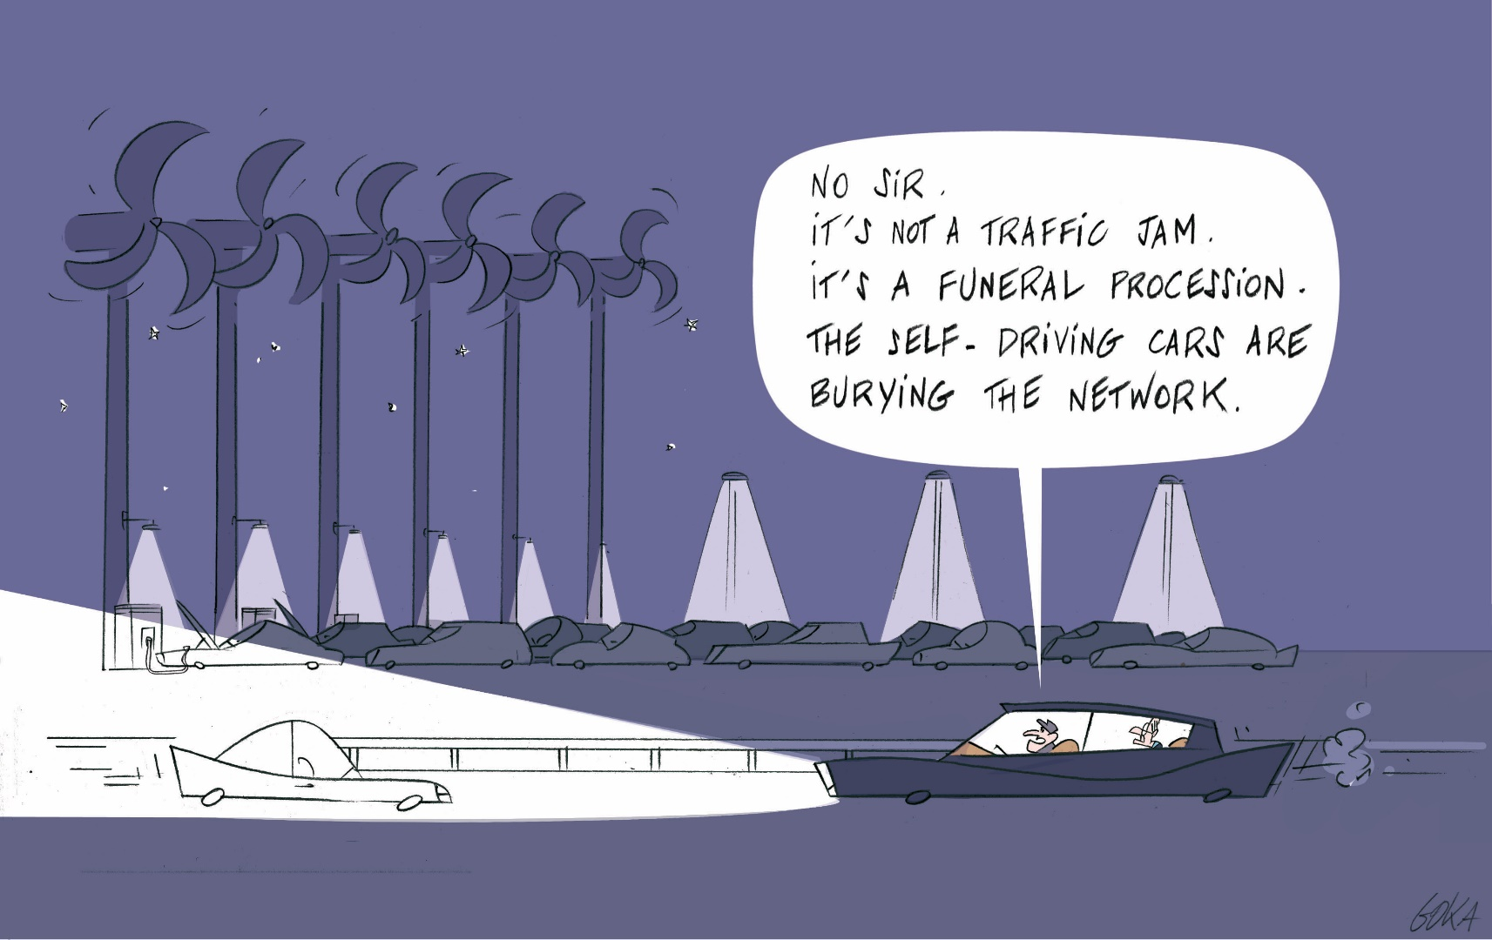
Model 9: V2G – Car as a substitute for the utility grid
EV charging could be carried out next to electricity sources at a cheap price. Afterwards, EVs could directly sell their electricity (without using the grid) to any electricity consumer at a higher price. As such, they will act as a true competitor for the utility grid.

Slide 47
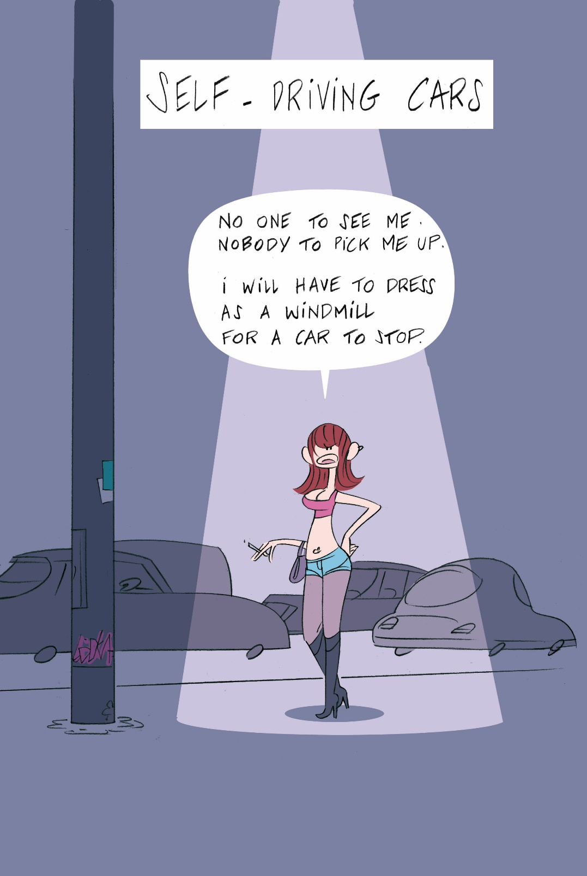
Model 9 may become very successful with the rise of self-driving cars for two main reasons:
1. No one will be needed to drive the car to collect electricity and deliver it to the electricity consumer.
2. Fleets of self-driving cars will not be used during the night to transport passengers. Using them during the night as a substitute for the electrical network will therefore accrue very little additional capital costs.

Slide 48
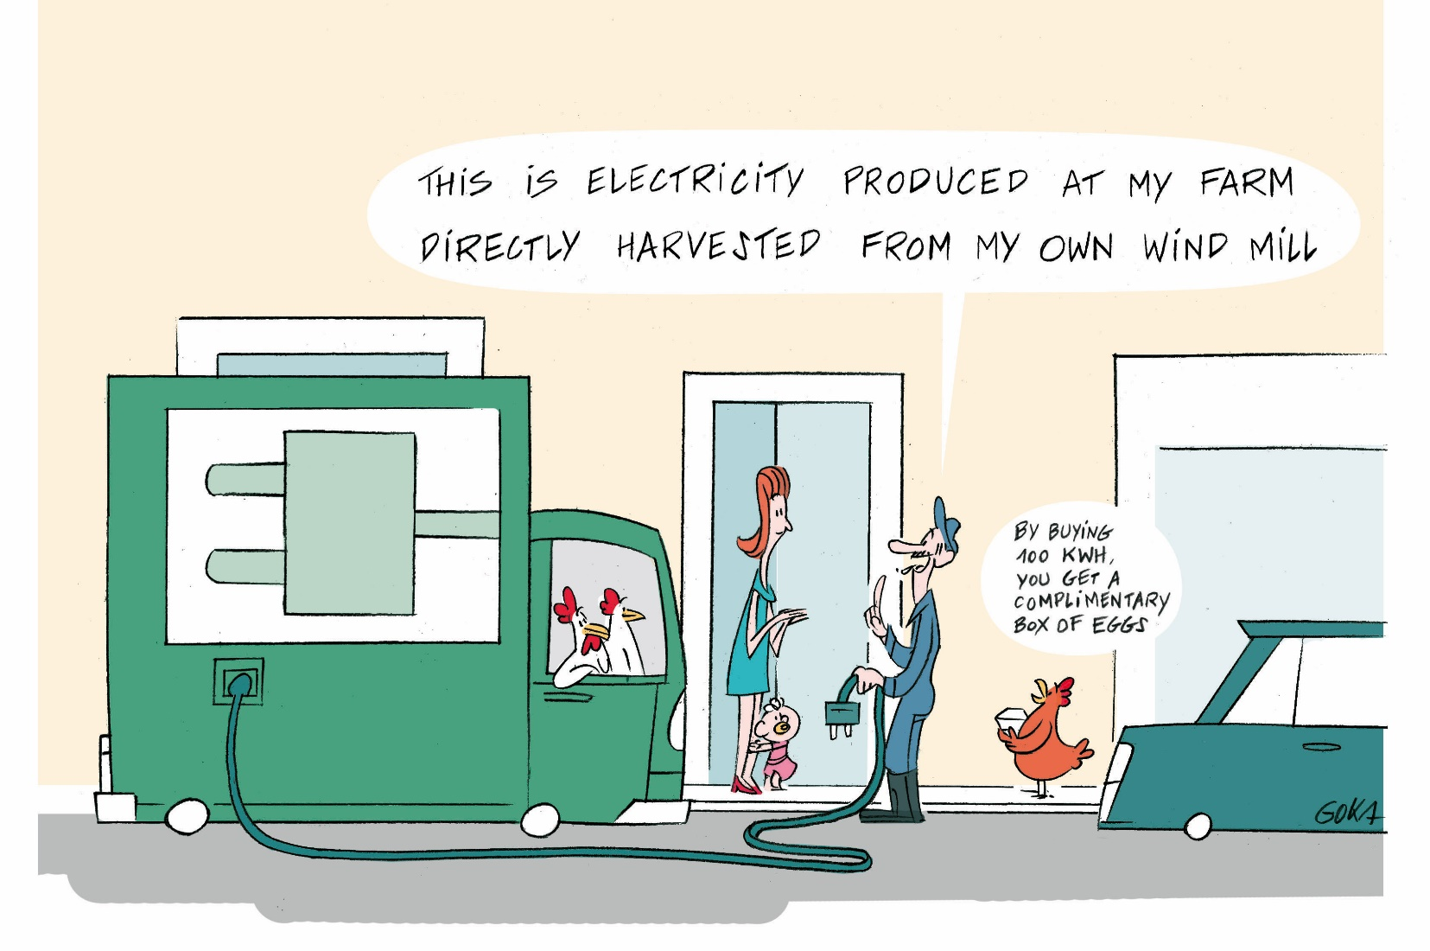
Model 10: No EV battery. Delivery of electricity using storage devices
1. Many producers of electrical energy could start delivering electricity directly to home batteries through the use of mobile batteries.
2. Delivery system may be significantly cheaper than the cost of running distribution networks in rural areas.
3. Biggest competitor of Model 10: Model 9.

Slide 49
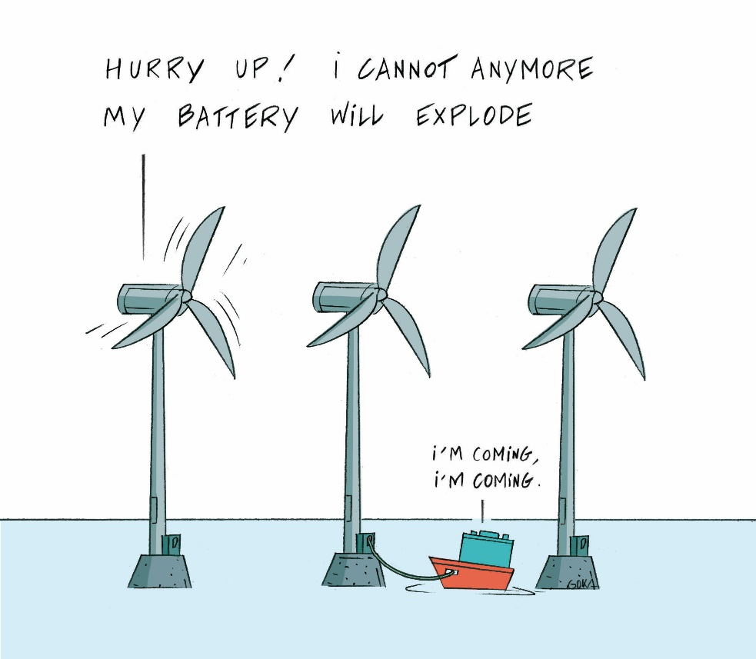
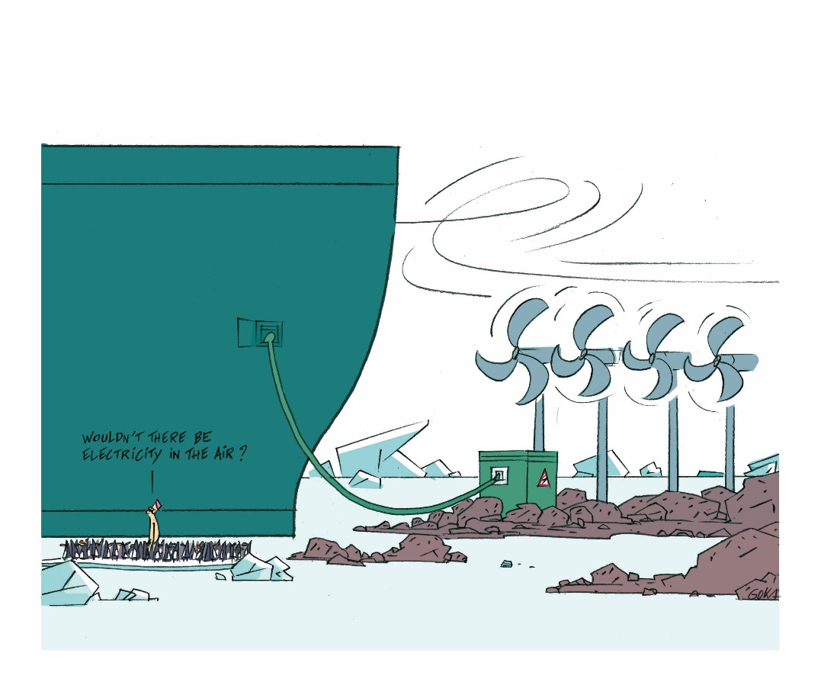
Model 11: No EV battery. Storage devices as a substitute for the transmission grid
1. The off-shore grid could be replaced by a system of boats with batteries.
2. Renewable energy collected at remote locations, such as the East coast of Greenland for example, where there is ample wind, could be brought back to consumption centres with using large ships full of batteries. Model is competitive with undersea cables once cost of batteries drops below 50 €/kWh.
3. Model 11 could be combined with a model based on electricity distribution with batteries.

Slide 51
Watch a French version of this conference :
https://www.youtube.com/watch?v=QP2230dhYbg

