Slide 1
Thermo-economic optimization during preliminary design phase of organic Rankine cycle systems for waste heat recovery from exhaust and recirculated gases of heavy duty trucks
L. Guillaume, A. Legros, R. Dickes , V. Lemort
VTMS, London May 18th 2017

Slide 2
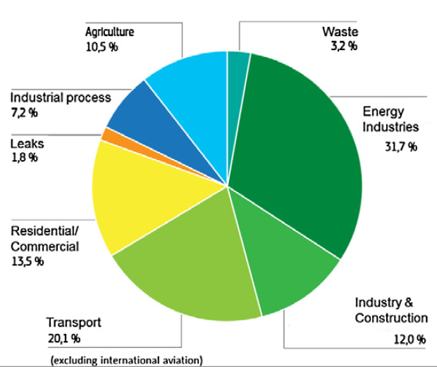
Introduction
Context
Reduce fuel consumption is necessary
to reduce GHG emissions (HD represents ¼ of EU road transport emissions)
to increase competitiveness of transportation by trucks (fuel=28% of the total operating cost of the truck)
How could we reduce fuel consumption?
Waste heat valorization is a promising solution
Even with a large engine efficiency, 50-60% of fuel energy is lost in waste heat
Typical energy distribution on a euro 5 engine

Slide 3
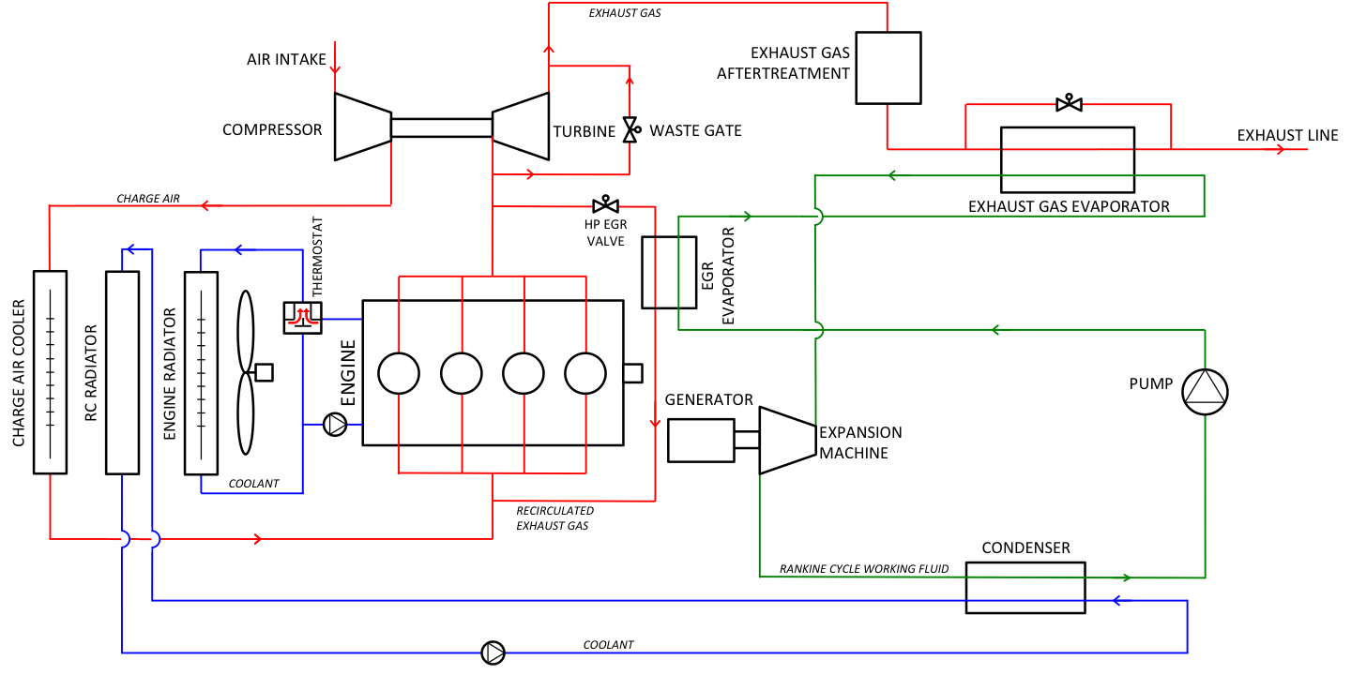
Introduction
Context
Among the WHR techniques, the Rankine cycle is one of the most promising ones.
However, R&D activities are still necessary to find the most appropriate architecture (working fluid, heat source/sink, expansion machine, etc.) in order to reach an acceptable economical profitability and to increase reliability
Many possible architectures for given boundary conditions

Slide 4
Introduction
Objectives of the work
To propose a thermo-economical optimization methodology for the design of (organic or not) Rankine cycle systems integrated into HD Trucks

Slide 5
Content of the presentation
Introduction
Definition of the case study
Simulation model of waste heat recovery systems
Selection of design conditions
Thermoeconomic optimization of the design
Optimization of off-design performance
Conclusions
Notes:
In a first step, the use case is defined in terms of investigated heat sources and heat sinks, working fluid candidates, technologies of the ORC components and engine operating conditions on which the system will be designed and its performance will be evaluated.

Slide 6
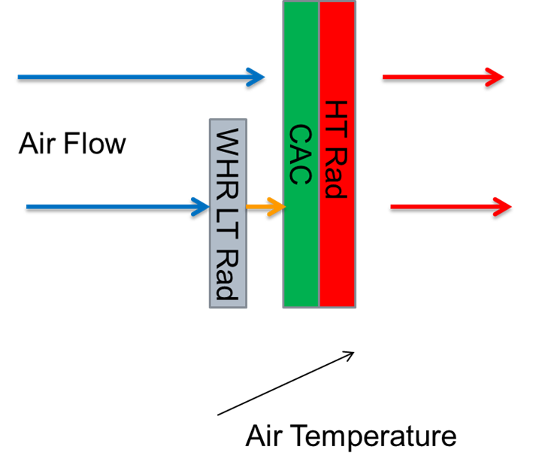
Definition of the case study
Heat sources and sink
Water cooled condenser + dedicated radtiator
Notes:
Peut-être parler des niveaux de températures.

Slide 7
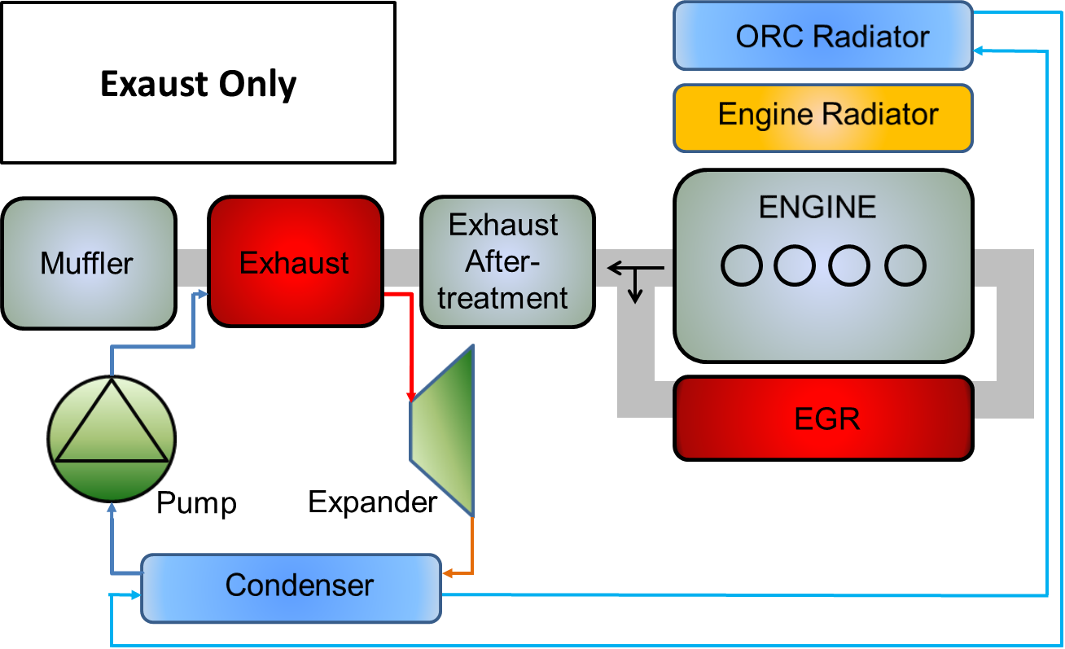
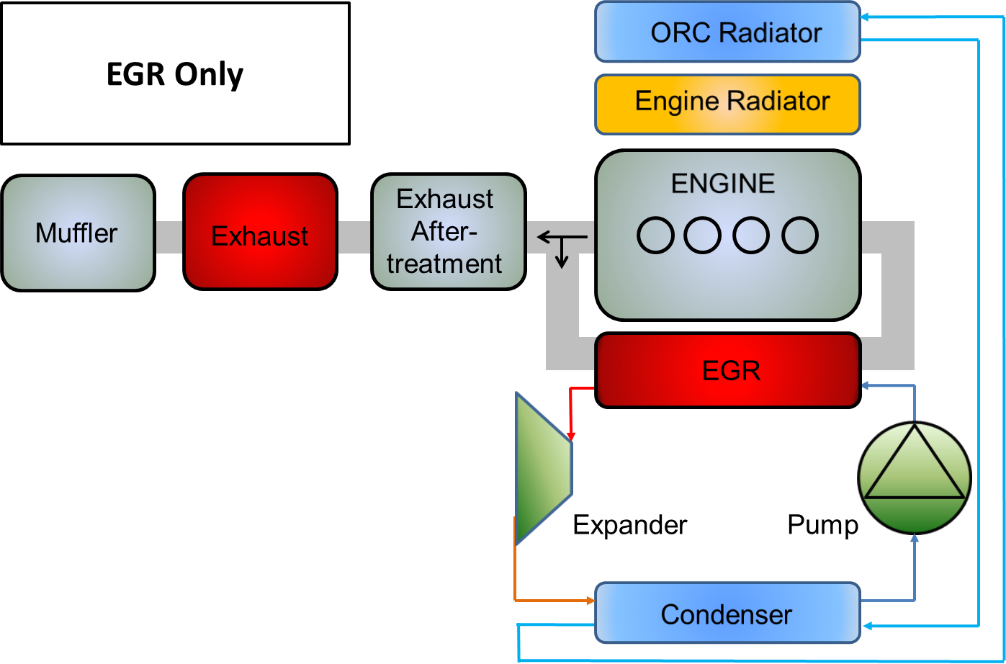
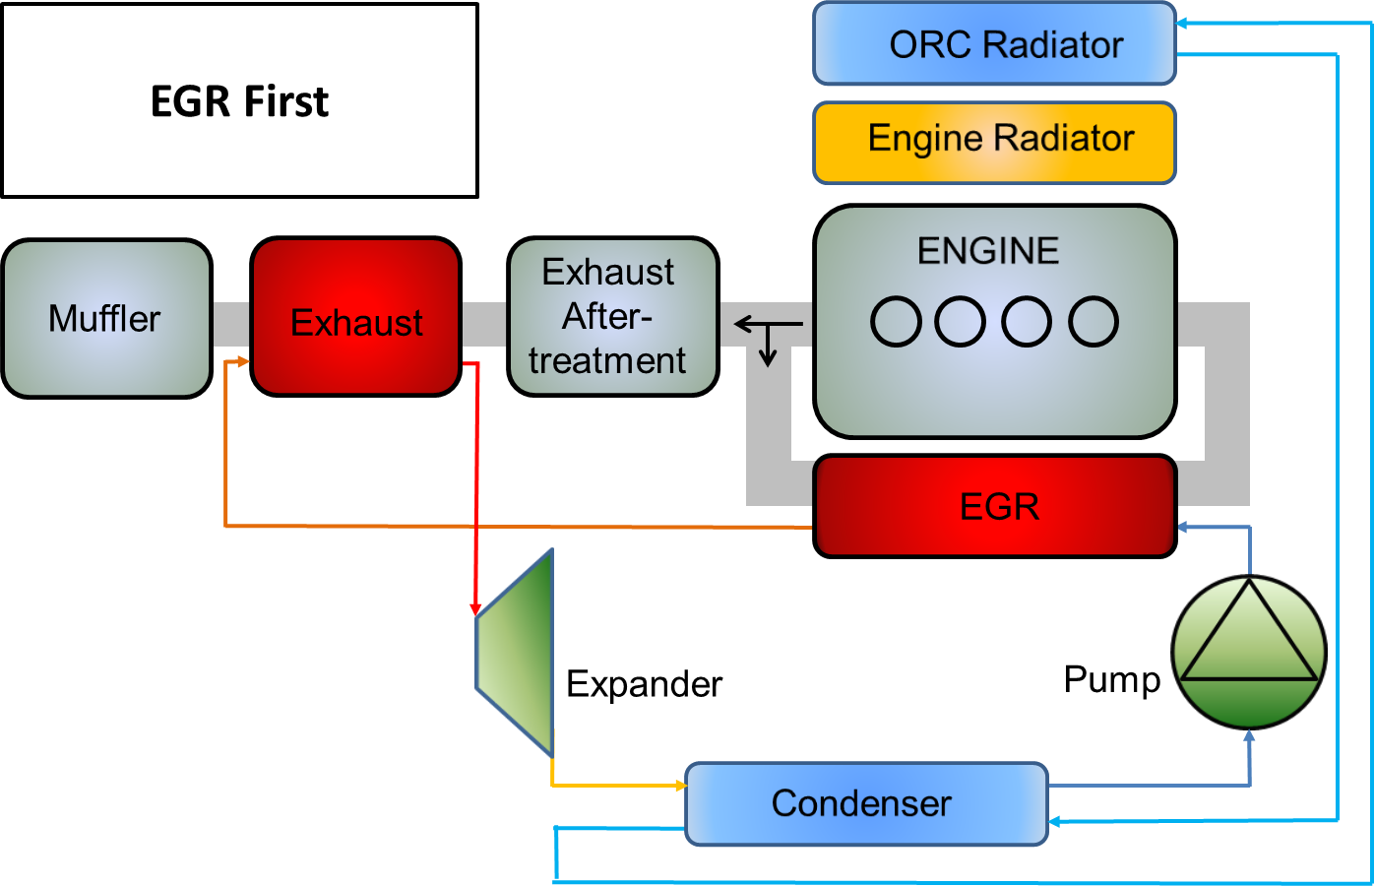
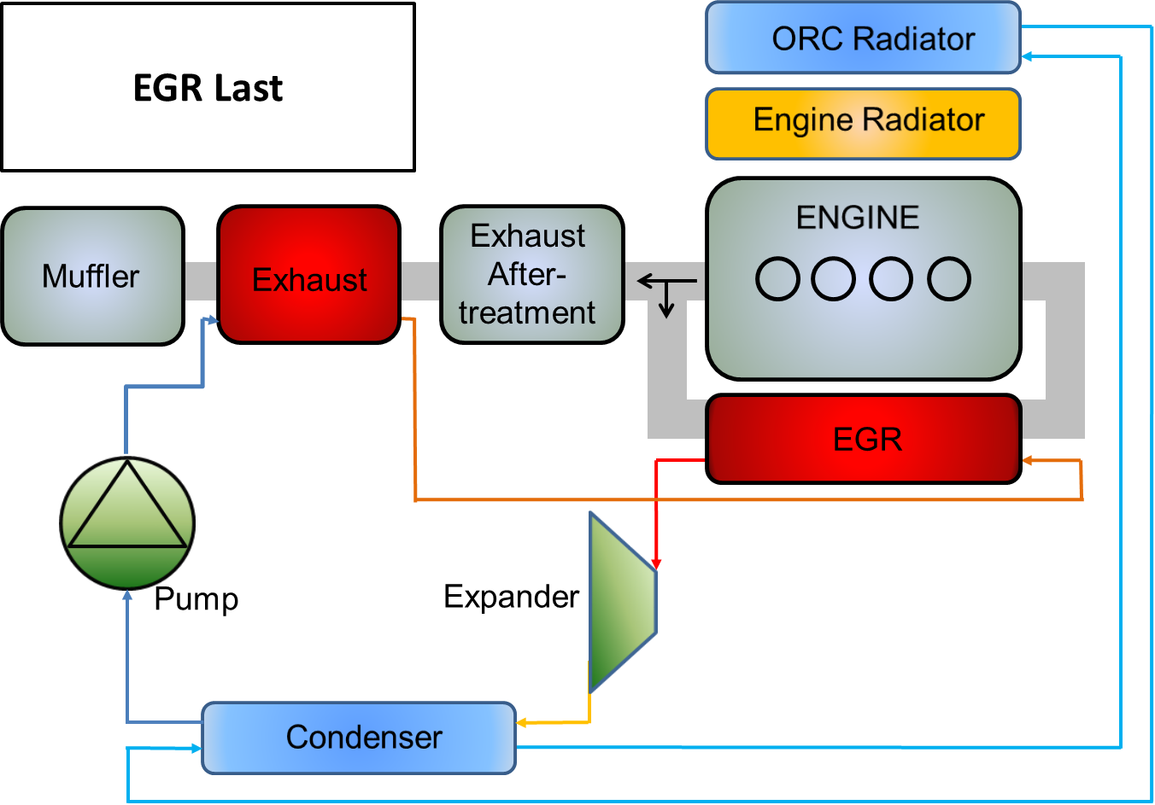
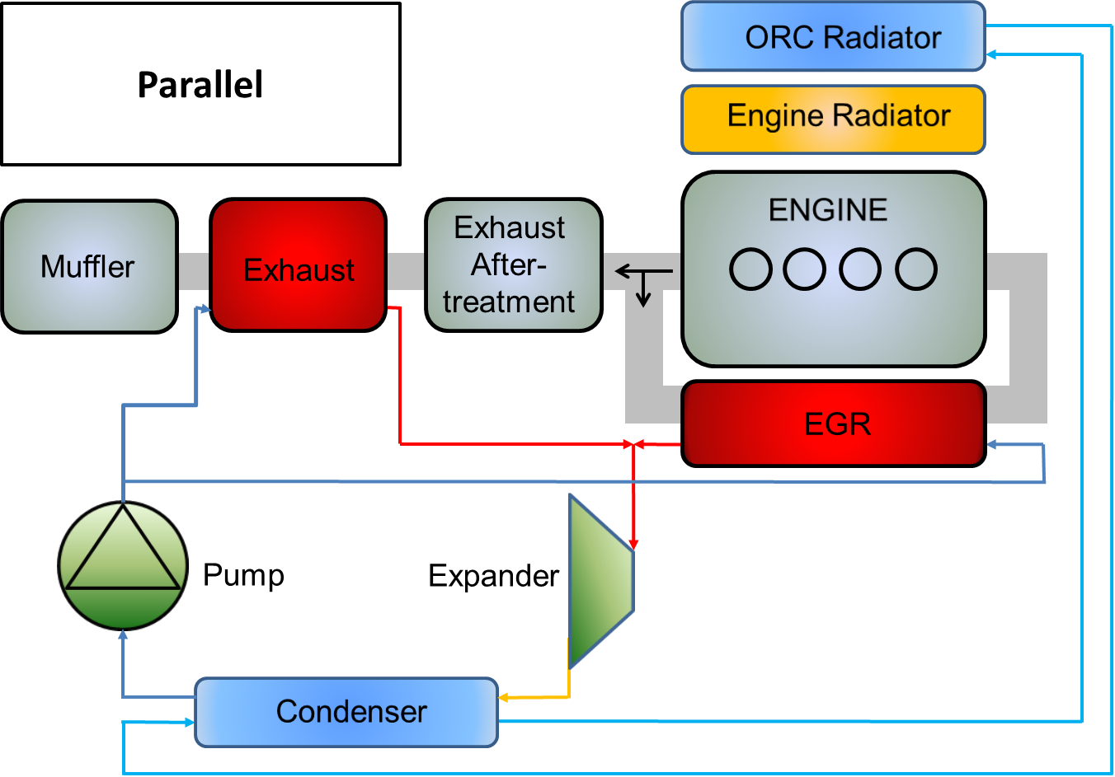
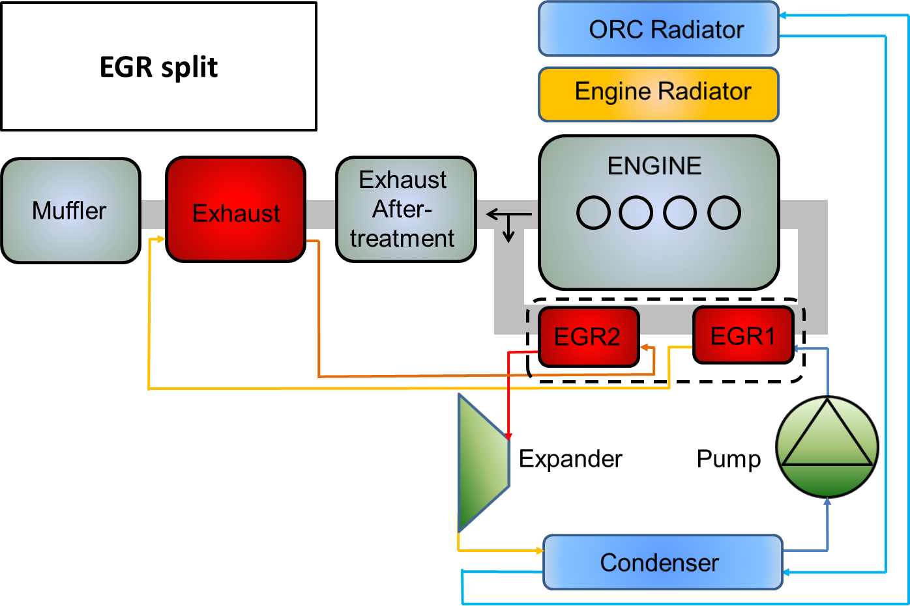
Definition of the case study
Heat sources and sinks
➔ 6 topologies

Slide 8
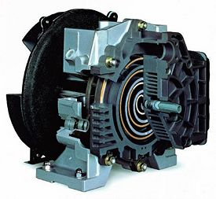
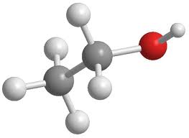
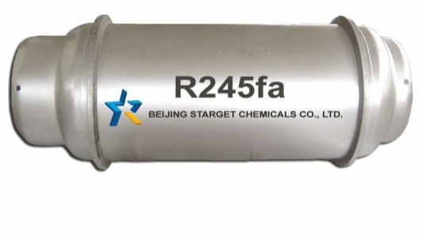
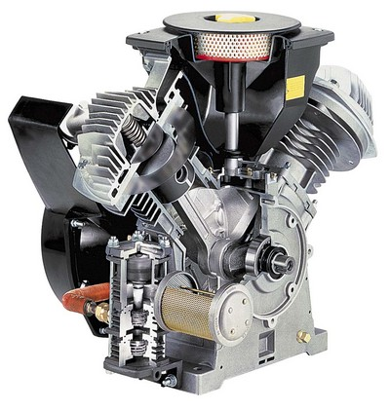
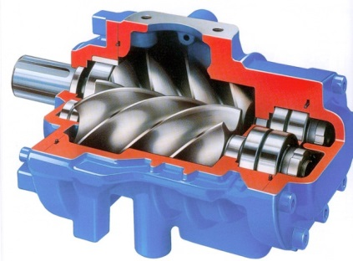
Definition of the case study
Expansion machines and working fluids
4 expansion machines: scroll, screw, piston, vane
3 working fluids: water, ethanol and R245fa

Slide 9
Content of the presentation
Introduction
Definition of the case study
Simulation model of waste heat recovery systems
Selection of design conditions
Thermoeconomic optimization of the design
Optimization of off-design performance
Conclusions

Slide 10
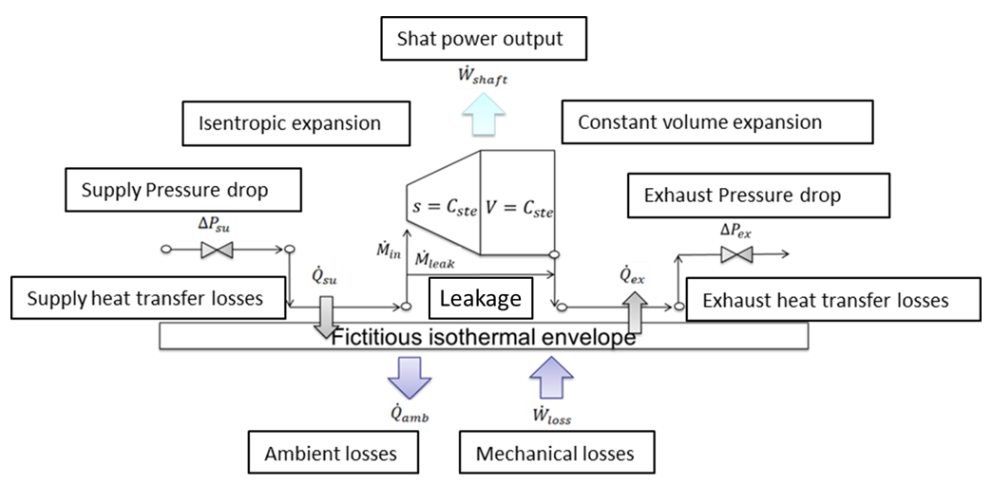
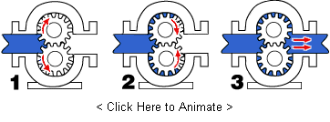
Simulation model
Component models
Pump Model
Semi empirical model
Fixed efficiencies
Expansion machine Model:
semi empirical model
Heat exchanger on the hot side
Tube and tube
Shell and tube
Plates
Heat exchanger on the cold side
Tube and tube
Shell and tube
Plates
Notes:
the systems being defined, the models of the components used for these systems are be briefly described. For the pump and the expansion machines, semi empirical models are developed. The semi empirical nature comes from the fact these models use a limited number of parameter to take the losses phenomena occurring during the expansion into account These parameters are generally calibrated based on experimental data and conserved to extrapolate the performance of the machine outside the validation domain.
Moving boundary models were built for plate, tube and tube and shell and tube technologies.
Model physcial (not simple effectiveness) validated! For hex and expanders. Correlations for hex, void fraction.

Slide 11
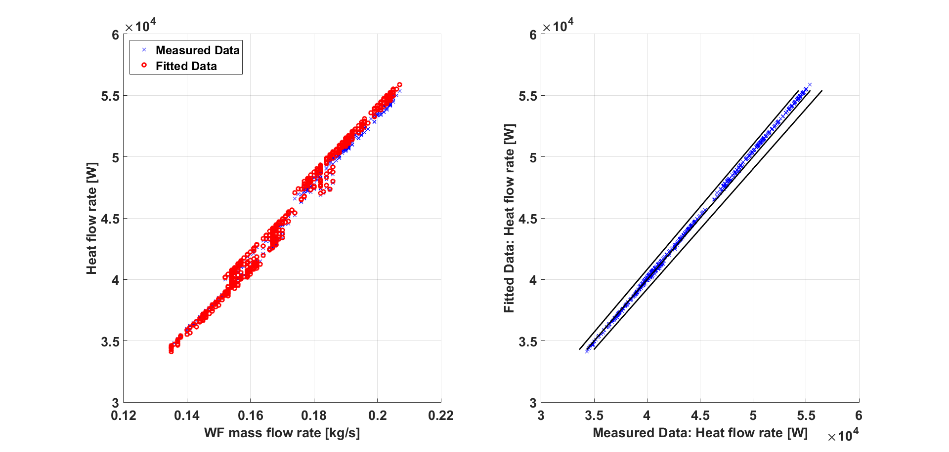
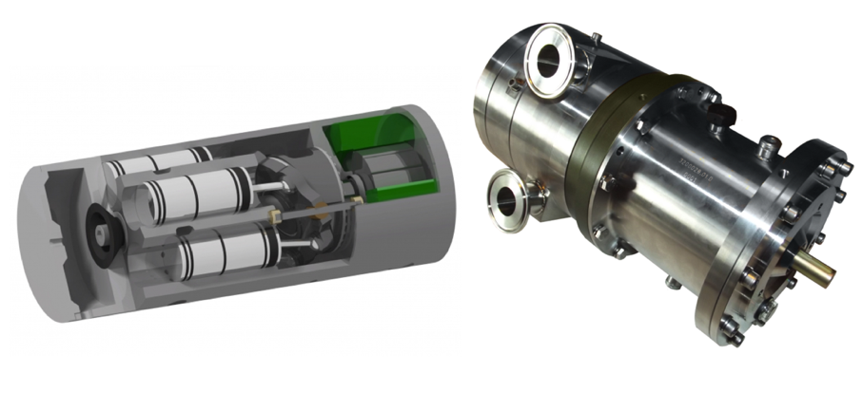
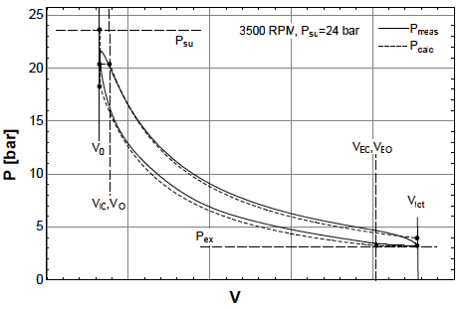
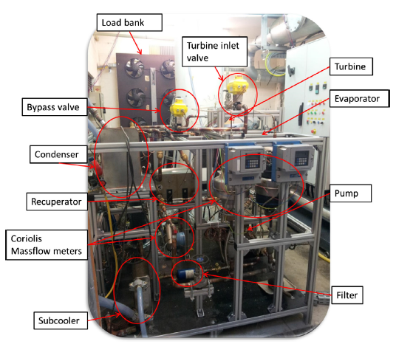
Simulation model
Models validation
Prototype of axial piston expander fed with R245fa
Indicator diagram (measured and predicted)
Notes:
Plate heat exchangers are considered here. Based on available measurements performed on an evaporator using exhaust gases as heat source, the model was calibrated and a correlation for the heat transfer coefficient was identified. This correlation is a simple dittus bolter type and is used for the sizing of the evaporator of the investigated ORC systems.

Slide 12
Content of the presentation
Introduction
Definition of the case study
Simulation model of waste heat recovery systems
Selection of design conditions
Thermoeconomic optimization of the design
Optimization of off-design performance
Conclusions

Slide 13
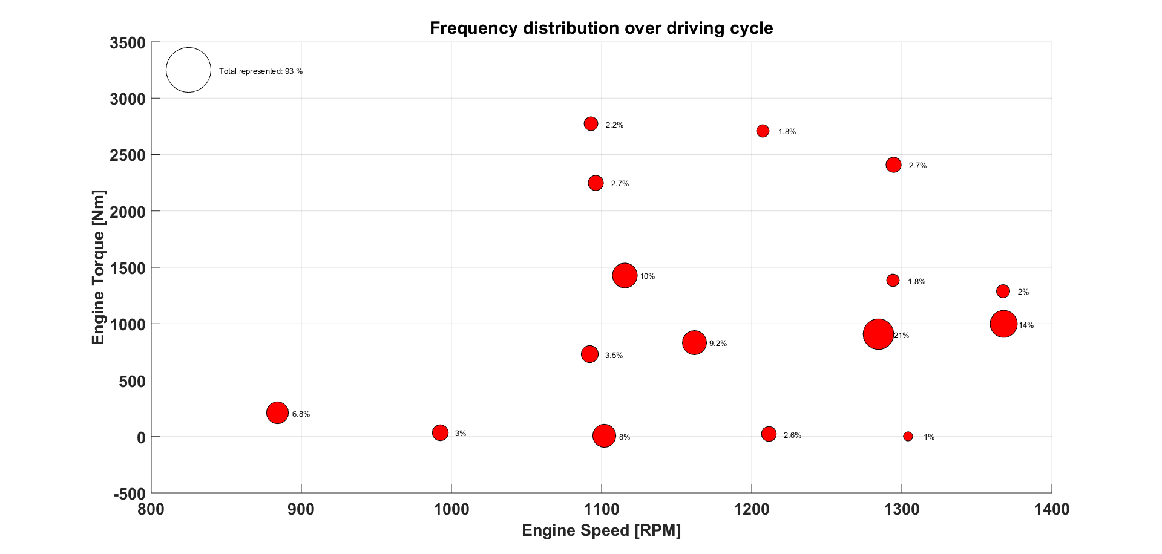
Selection of design conditions
Occurrence of representative operational points
Driving cycle is a combination of different reference driving cycles
Frequency distribution of the couples (engine torque, engine speed) over the driving cycle.
Notes:
The driving cycle is a combination (weighted) of 6 typcial cycles. Provided by a truck manufacturer. Flat, hilly parts.

Slide 14
Selection of design conditions
Selection procedure
For each point, optimization of the design in order to minimize the SIC (simplified model and cost relationship for the expander are used)
Imposing the design, evaluation of the performance on the 16 other points
Computation of the weighted average power on the 17 points
Selection of the design point
Notes:
The driving cycle is a combination (weighted) of 6 typcial cycles. Provided by a truck manufacturer. Flat, hilly parts.
Choisit-on le point sur base de la puissance moyenne ou du SIC moyen?

Slide 15
Content of the presentation
Introduction
Definition of the case study
Simulation model of waste heat recovery systems
Selection of design conditions
Thermoeconomic optimization of the design
Optimization of off-design performance
Conclusions
Notes:
Now we introduce more deatiled models of expanders
For hex, they are the same
Minimisation of the SIC

Slide 16
Thermoeconomic optimization
Constraints and optimization variables
Optimization variables | Economic constraints
Pinch of the heat exchangers | Mass of the heat exchangers
Evaporating pressure | Technical constraints
 | Temperature of the EGR
 | Heat rejection capacity
Built-in volume ratio | Limited expander speed
Expander speed | Limited expander inlet temperature
Overheating degree | Expander outlet vapor mass fraction
 | Gas temperature at the evaporator outlet
Selection of design point (simplified expander model)
Optimization of design
(more detailed expander model)
Notes:
Trois optimisation à la suite l’une de l’autre:
- identification du point de dimensionnement
Design thermoéconomique du design
Optimation des variables de contrôle en off-design
Si pinch trop faible, masse échangeur trop importante

Slide 17
Thermoeconomic optimization
Constraints and optimization variables
Expander technology | Scroll | Screw | Piston | Vane
Rotational speed [RPM] | <10000 | <25000 | 500-6000 | <4000
Max. Inlet temperature [°C] | 250 | 490 | >500 | <165
Built-in volume ratio [-] | 1.5-4.9 | 2.5-6 | 3-14 | 2-4.5
Pressure ratio [-] | 25 | 50 | Same as in ICE
Notes:
The NOx reduction strategy should not be impacted by the WHR system and the recirculated gases should be kept below a maximal temperature (around 120°C).
Pressure ratio: a limit is questionable

Slide 18
Thermoeconomic optimization
Scaling of expansion machines
Expander model must be scalable.
Calibration of the models on existing machines using experimental data (reference machines)
Scaling of the parameters to adapt the models to the machine being currently designed (efficiencies are maintained).
Scaling relations applied to the model parameters
Model calibrated on a existing machine (reference)
Model of the machine being designed for the truck application
Notes:
As for the heat exchanger, experimental data is used as starting point of the expander models. The models for all the four technologies are calibrated and validated using experimental data and are used as reference. During the design of the ORC systems, the parameters of the expander models are scaled to adapt the model to the machine currently deisgned.

Slide 19
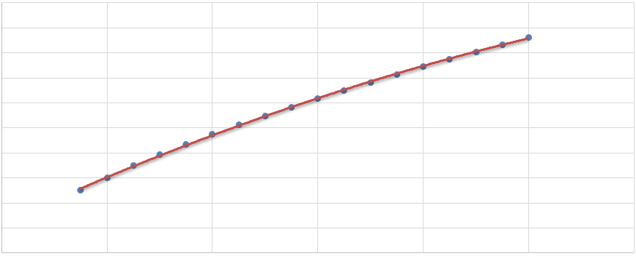
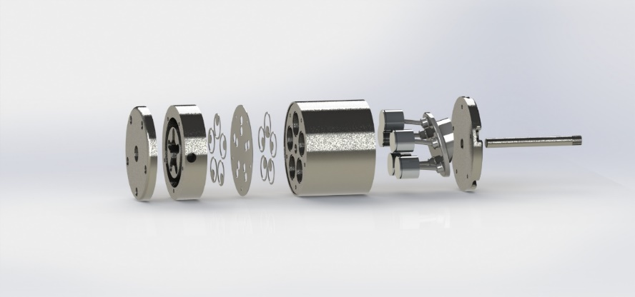
Thermoeconomic optimization
Cost of components
Optimization objective: minimize SIC (specific investment cost in [EUR/kW])
Indirect costs: engineering, contingency
Direct costs: components, fluid, piping, sensors, control
Heat exchangers: cost correlations established in previous project
Expander: use of CAD tool to estimate the cost of each piece
Example for a piston expander (assumptions: swash plate, 5 cylinders, Constant L/D ratio, stainless steel, 20000 units/y)
Notes:
All pieces are considered
Scaling laws of solidworks model
Mass and fabrication techniques. Stainless steel. Molding. 20000 piece production per year.
Finally remain the cost relations
Cout des échangeur: parti des échangeurs de NoWaste et des lois de corrélations
SystemCost = PP.Cost + EGR.Cost + EG.Cost + EGR2.Cost + EXP.Cost + CD.Cost + LTCost;
WFCost
InstallationCost = SystemCost*0.45;
PipingCost = SystemCost*0.35;
InstCtrlCost = SystemCost*0.2;
ServFacCost = 0;%SystemCost*0.5;
DirectCost = SystemCost + WFCost + InstallationCost + PipingCost + InstCtrlCost + ServFacCost;
%Indirect Costs
EngineeringCost = DirectCost*0.08;
ConstructionCost = 0;%DirectCost*0.15;
ContingencyCost = EngineeringCost*0.15 + ConstructionCost*0.15; (contégence = réserve en cas de problèem)
IndirectCost
Expansion machine: solidworks

Slide 20
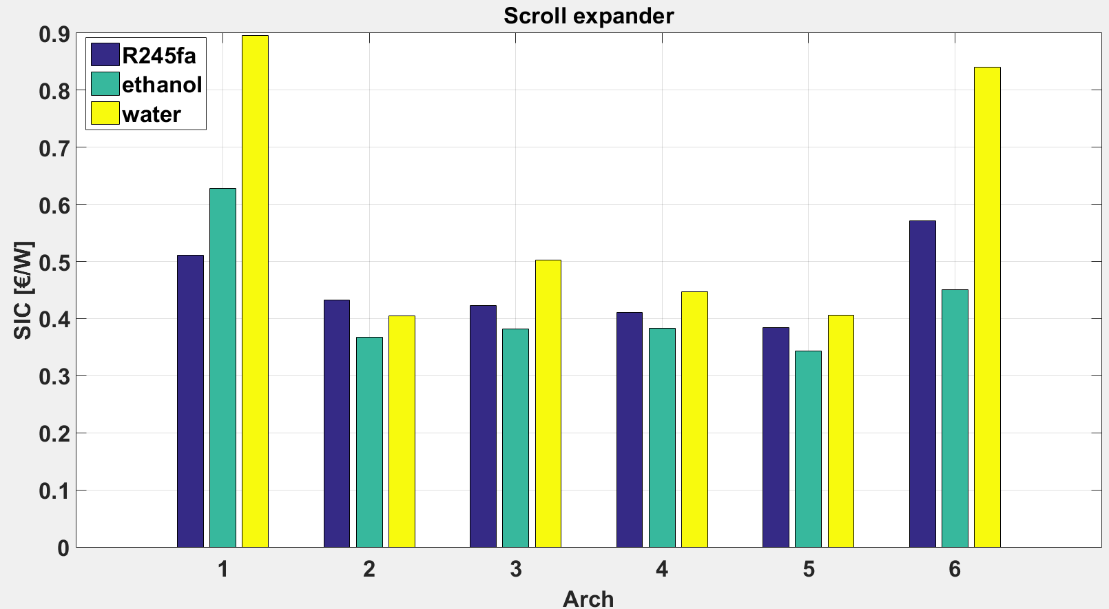
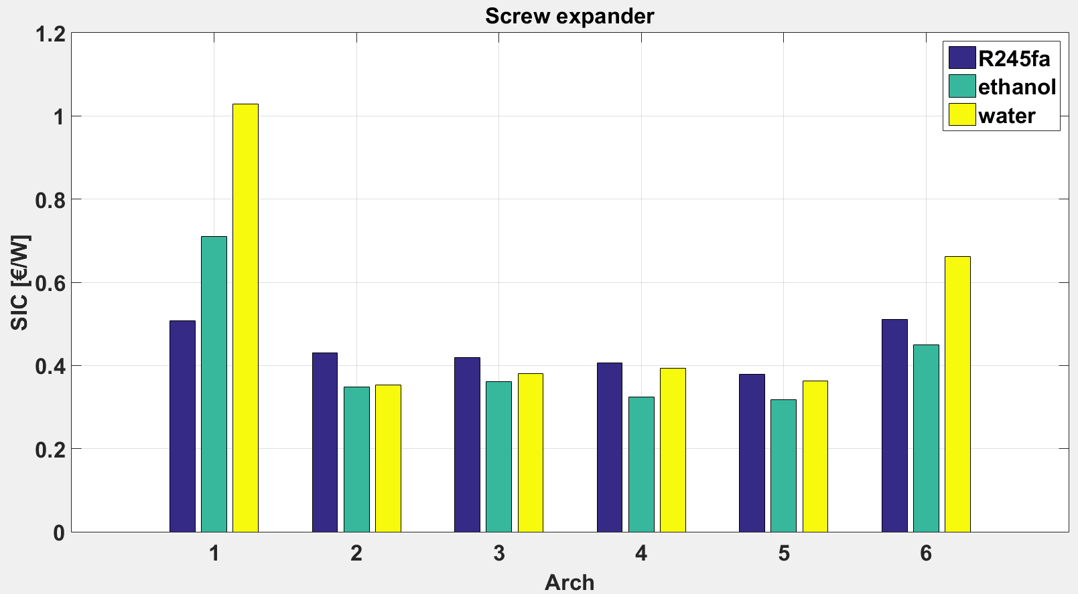
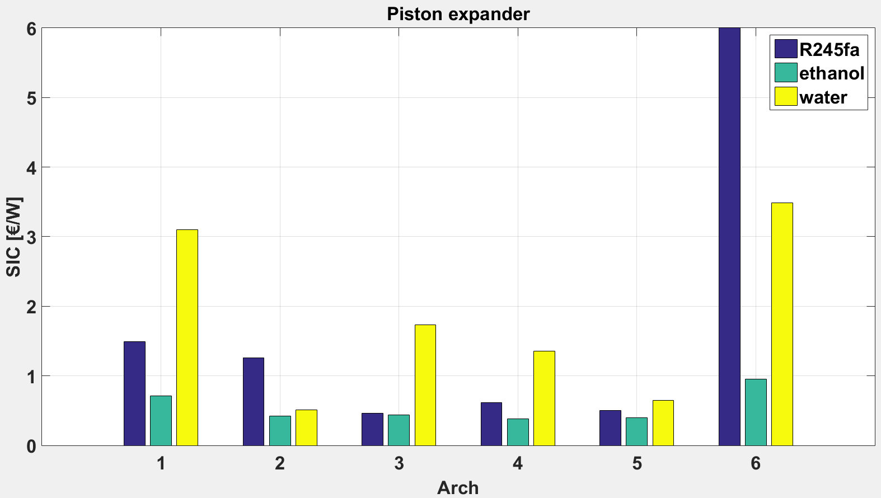
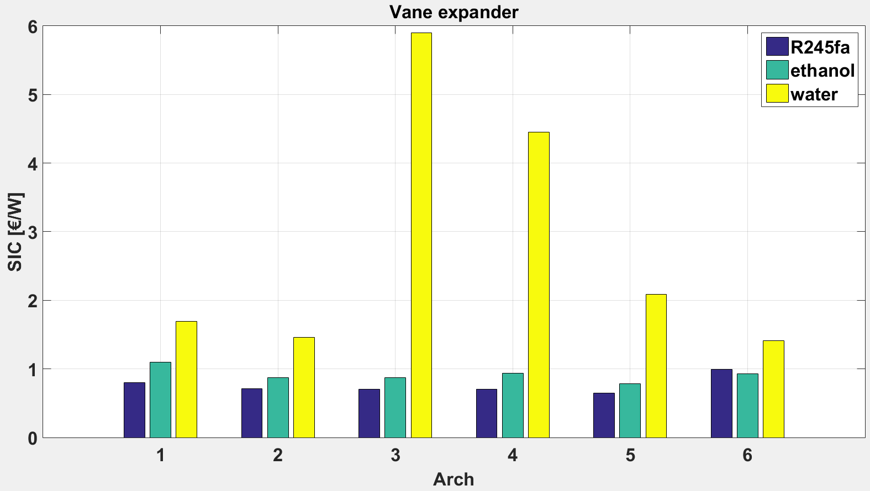
Thermoeconomic optimization
Results (nominal point, no upper limit on EGR temp)
Water should be avoid with topology 1
Inlet temperature constraint limits performance with water
Topologies 2-5 are the most promising
Notes:
Sizing Point!
No upper limit on EGR exhaust temperature
Toujours intéressant utiliser EGR, faibles SIC
SIC plu simportant avec vane car T_su limite plus faible, donc moins compact et perfo du cycle moins bonnes
Eau à éviter en exhaust only car plus faible températures de gaz donc + volumineux et – performant
Finally, the most appropriate solution, based on the assumptions made here is the use of the screw expander integrated in the parallel topology and using ethanol as working fluid

Slide 21
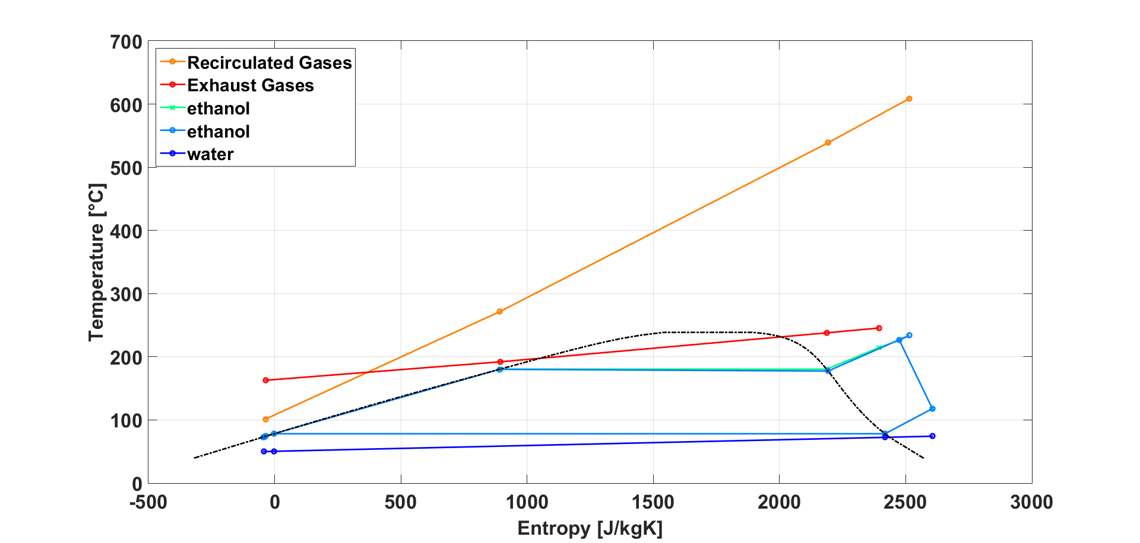
Thermoeconomic optimization
Results (nominal point, no upper limit in EGR temp)
Best case: Screw expander, topology 5 (parallel) and ethanol
Net power output:
10.9 kW
Evaporating pressure:
19 bar
Condensing pressure:
1 bar
Rotational speed:
25 krpm (6.25 cm³)
Overheating degree:
48 °C
Built-in volume ratio:
6
Notes:
Drawback: architecture 5 is the most difficult to control
Deux surchauffes différentes et remélange avant de rentrer dans turbine

Slide 22
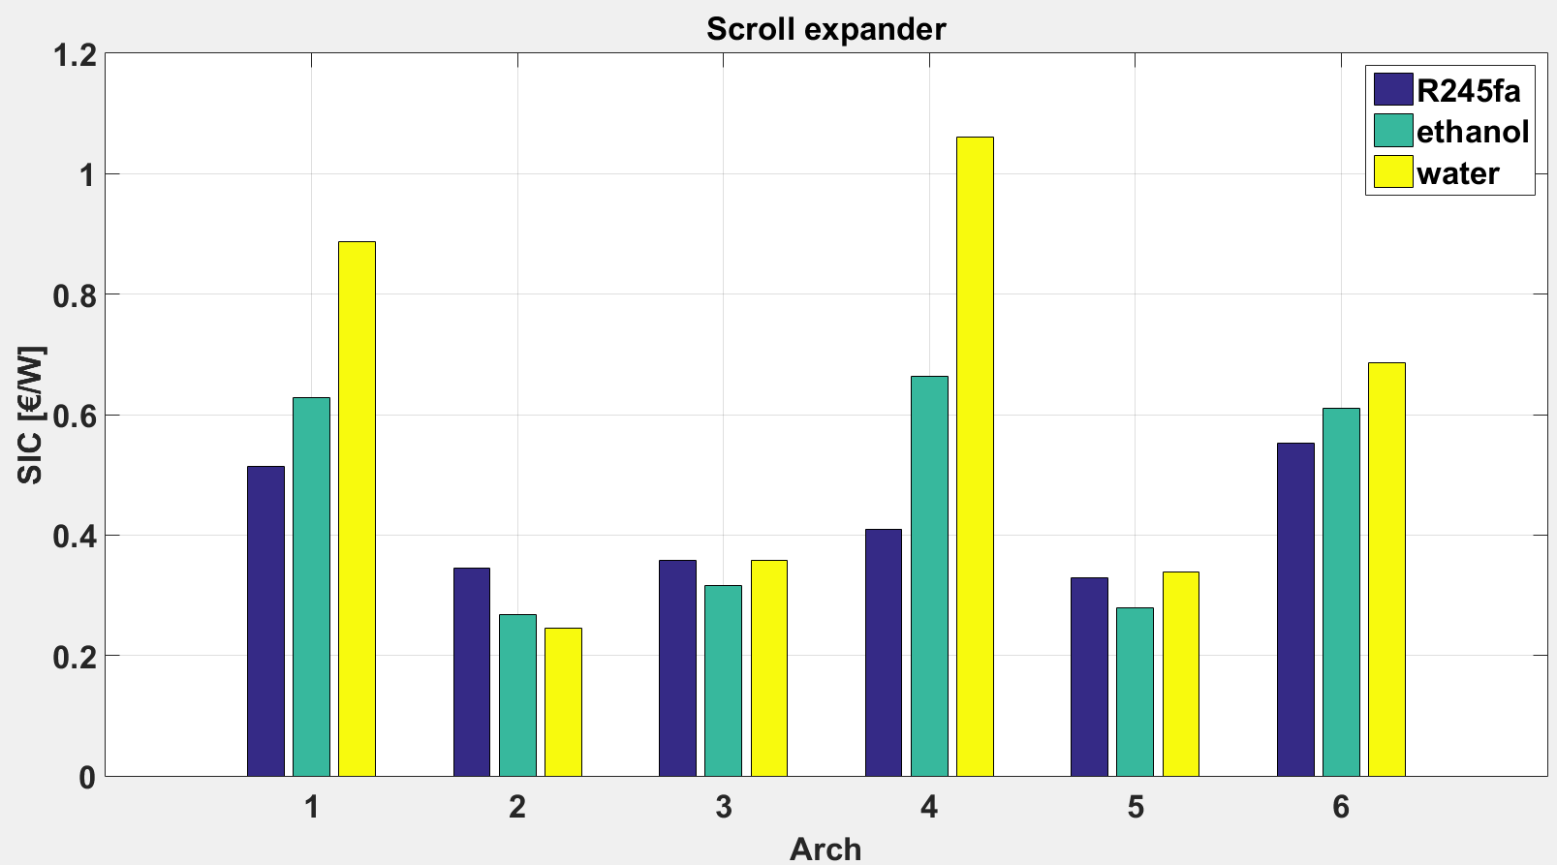
Thermoeconomic optimization
Results (nominal point, upper limit on EGR temp)
Topology 4 is impacted negatively by the temperature limit on the EGR
No upper limit on EGR temperature
Upper limit on EGR temperature (120°C)
Notes:
Ici, il y a la limite sur la température supérieure de l’EGR
La 4 devient plus cher car l’EGR étant en sortie, il faut abaisser Pev, du coup plus volumineux et cher

Slide 23
Content of the presentation
Introduction
Definition of the case study
Simulation model of waste heat recovery systems
Selection of design conditions
Thermoeconomic optimization of the design
Optimization of off-design performance
Conclusions

Slide 24
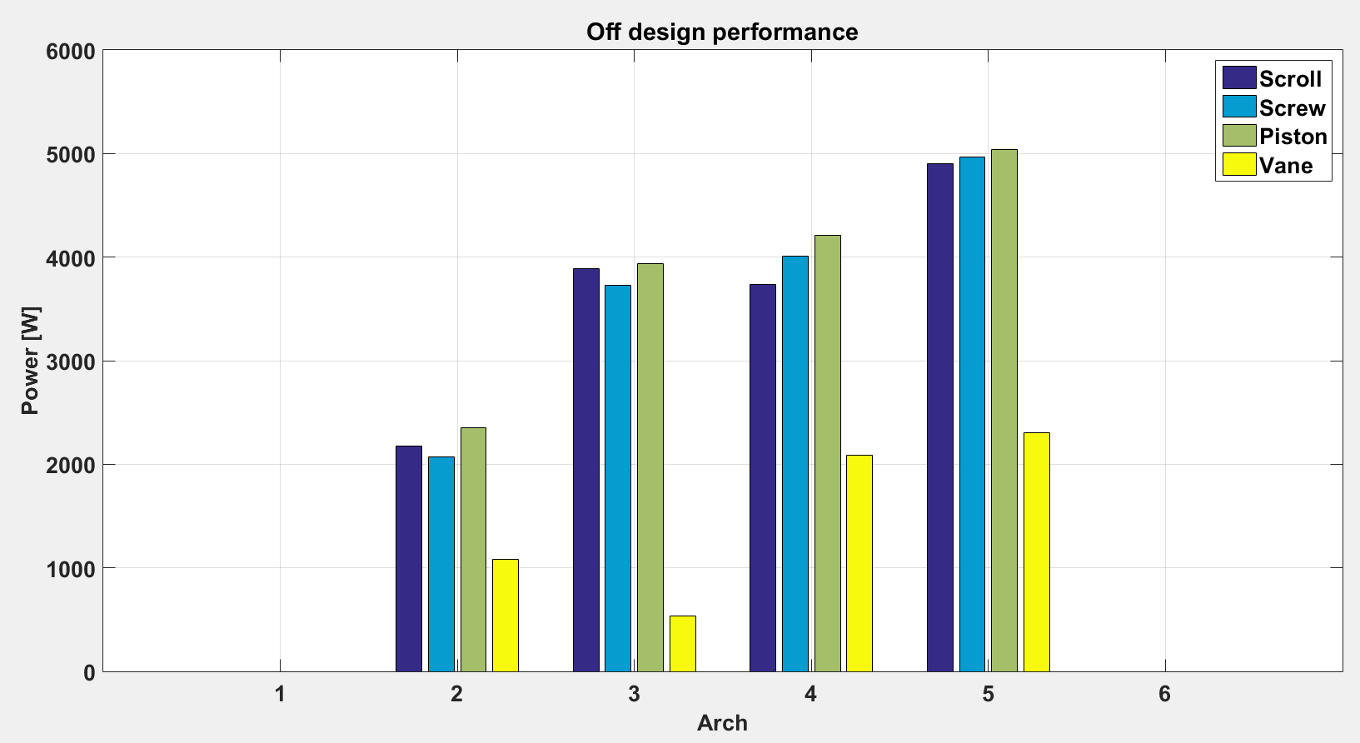
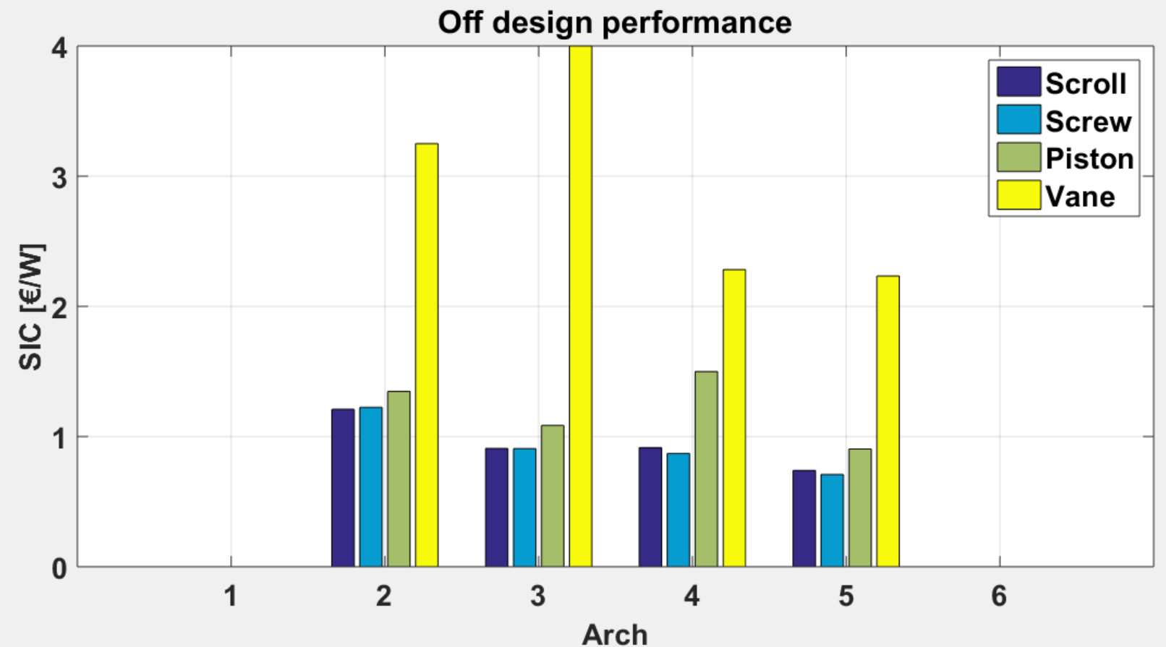
Off-design optimization
Results
Inlet temperature constraint limits performance with ethanol
Topology 5 with ethanol and the screw expander appears to be the best choice
Working fluid: ethanol
Design is fixed
Evaporating pressure and superheat are adjusted
Notes:
Weighted average on the 17 points with the 4 more interesting architectures
! Be careful color is the machine
LUDO: limite sur EGR?

Slide 25
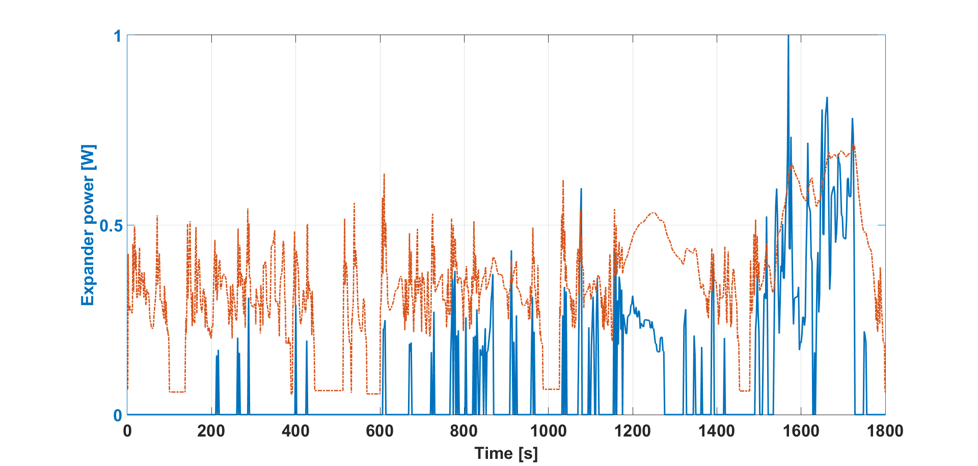
Conclusions
3-step methodology: help ORC designers to best select the topology, expansion machine and working fluid for truck applications.
Preliminary design: final design must be refined with more accurate tools
Performance and cost are not the only criteria (complexity, controllability, etc.)
Results are not general: they are specific to the investigated engine.
Future work
Mixtures water/ethanol
Simulation of driving cycles
Notes:
No pretentation to show exact figures: we shox the trends
Pour le moment, on regarde que la perfor et le coût: controlability…(par exemple l’architecture 5)
Sur le choix des fluides, il y a aussi la compatibilité.
Results are no general: here this is only one given ruck

