Slide 1
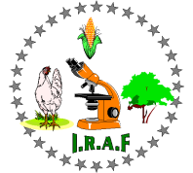
The wildlife day « sunstainable management and conservation of wildlife »
October, 13th 2015. Gembloux ABT, Ulg (Belgium)
Ecophysiology to understand elephants’ crop raiding behavior
Ngama S.^{1,2}, Vermeulen C.¹, Bindelle J.¹
1: Gembloux Agro Bio Tech, University of Liège.
2: Institut de Recherches Agronomiques et Forestières (IRAF) / Centre National de la Recherche Scientifique et Technologique (CENAREST), Gabon.

Slide 2
Content :  Introduction: conservation context  Ecophysiology : definition and conservation achievements  African elephant conservation status and basic biology  How to investigate elephant ecophysiology ? Three basic approaches:  Using hormones: Hormones, reproduction and crop raiding behavior in elephants  Using nutrition parameters: Reproduction and Nutrition are related to the crop raiding behavior in elephants  Using health and infection parameters: Parasitism is related to the crop raiding behavior in elephants  Conclusion

Slide 3
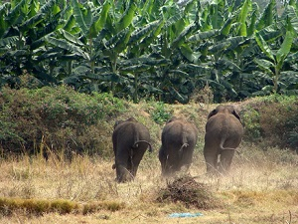
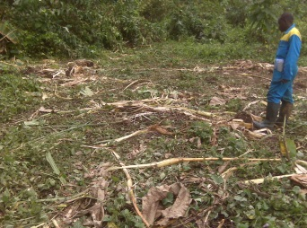
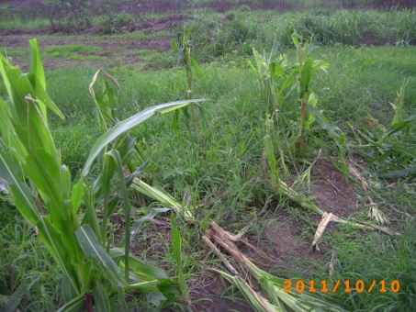
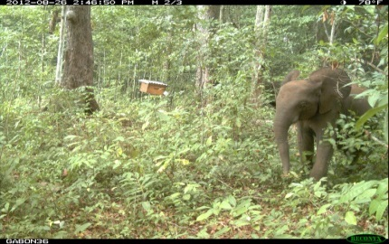
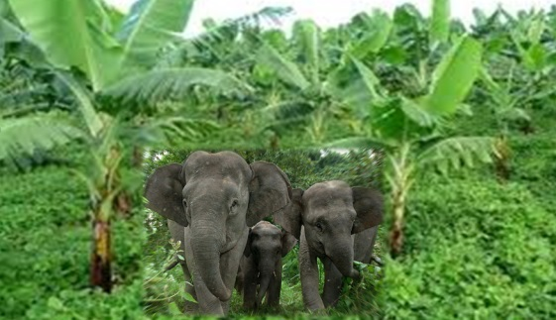
 The earth is facing its sixth mass extinction due to human-related activities (Leakey, 1996; Wilson, 2002).  Conservation science has emerged as a crisis discipline to stem that biodiversity loss (Soule´ 1985, Kareiva & Marvier 2012, Cooke et al. 2014).  To adress biodiversity loss conservation science requires interdisciplinary approaches which bring together experts across different fields , such as “Ecophysiology” (Soule´ 1986, Cooke et al. 2014).  Surprisingly few conservationists utilize ecophysiological methodology.  Here we discuss how ecophysiological explorations could help understand elephant crop raiding behaviour and identify related gaps in knowledge.
 Introduction :

Slide 4

 Introduction :
Biology
Conservation biology
Conservation physiology
Conservation ecology
Ecophysiology
Crop raiding behavior
Conservation behavior
Anthropology, etc…
- Elephants-

Slide 5
 Ecophysiology focuses on individual organisms in relation to their environments and is highly integrative embracing many aspects of others fields (Degen, 1997; Luttge and Scarano, 2004; Stevenson, 2006). For instance:  Small Desert Mammals survival in deserts is due mainly to behavioral adaptations and habitat selection, although physiological adaptations also contribute to their success (Degen, 1997).  Blaustein et al. (2012) reviewed amphibian population declines through understanding infections and disease consequences in the context of hosts’ ecophysiology.
☞ Ecophysiology : definition and conservation achievements :

Slide 6
 African elephants are listed as “vulnerable” on the International Union for the Conservation of Nature (IUCN) Red List (IUCN Red List 2009).  In Central Africa forest elephants’ population size declined by 62% between 2002–2011, the taxon lost 30% of its home range and this population is now less than 10% of its potential size (Maisels et al, 2013).  Elephants display distinct differences compared to other mammalian species (Hildebrandt et al. 2011, Brown 2014):  - The longest ovarian cycle of all mammals studied to date: 14-16 weeks in duration, with an 8-12 week luteal phase and a 4-6 week follicular phase  - The longest gestation: 20-22 months  - It’s a umbrella species  - The worst crop raider of its home range
☞ African elephant conservation status and basic biology :

Slide 7
 Hormones have a pivotal role in genotypes and environmental effects translations into morphological and/or behavioural phenotypes (Knapp et al., 2003; Rhen and Crews, 2002).  hormone analyses are essential to understand functions such as reproduction, metabolic activity, health, behaviour (Ganswindt et al. 2012, Brown 2014) and therefore ecophysiology in elephants.
☞ 1- Using hormones: Why ?

Slide 8
 The metabolic status of an organism, defined by the availability of energy and nutrients to the tissues, is a pivotal modulator of a myriad of biological functions (Tena-Sempere, 2007).  This is especially evident in females where pregnancy and lactation are linked to a considerable energetic drain, needed for the nurture of embryos and newborns (Casanueva et al, 1999).  But the physiologic basis for such a joint regulation of energy balance and reproduction has begun to be unveiled only recently, in a phenomenon that involves multiple common regulatory signals, acting at different levels of the reproductive system (Tena-Sempere, 2007).  Several studies have suggested that nutrition, and mineral consumption in particular, may be important in affecting elephant population densities (McNaughton et al. 1997, Milewski 2000, Vanleeuwe et al. 1997).  In browsers like elephants, relations between reproduction and diet quality are poorly studied.
☞ 2- Using nutrition parameters: Why ?

Slide 9
 In both wild and domesticated species, studies have found that host susceptibility to Gastro-intestinal (GI) parasite infection is strongly influenced by nutrition (Coop and Kyriazakis 2001, Ezenwa 2004).  Gastro-intestinal (GI) parasite load is the best predictor of crop raiding behaviour in elephants, with crop raiders having fewer parasites than non-crop raiders (Tabitha, 2013).  Thus, future studies that address this question could provide further insight into what might be occurring with the GI parasite load by identifying possible inter-species transmission between elephants and even with domestic hoof stock and humans.
☞  Using health and infection parameters: Why ?

Slide 10
 Ecophysiological investigations have already allowed great conservation outcomes in species like amphibians (Blaustein et al. 2012), terrestrial carnivores (Bryan 2013) and small desert mammals (Degen 1997).  In elephants, similar investigations are needed, and would have great potential in developing long-term strategies to mitigate elephants’ crop raiding behaviours (Tabitha 2013).  To that end, simultaneous evaluations of (i) excreted steroid metabolites, (ii) nutritional parameters of ingested food and (iii) parasite loads in dungs will give key data to understand, forecast and mitigate elephants’ crop raiding behaviours .
 Conclusions :

Slide 11
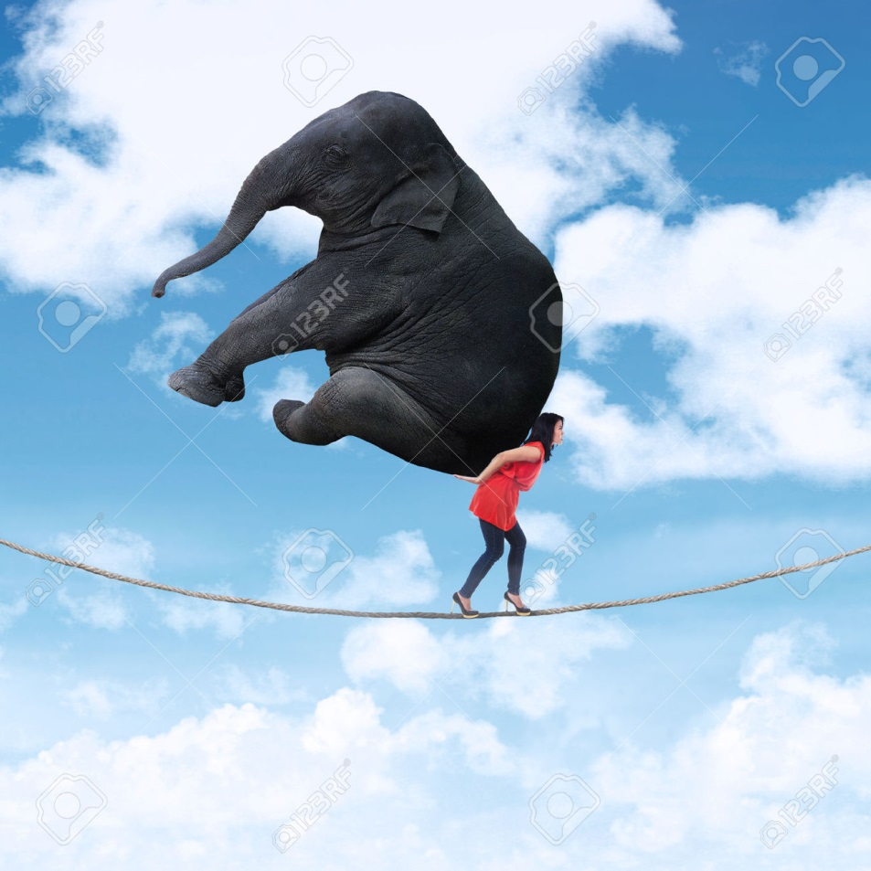
Thank you for attention !

