Slide 1
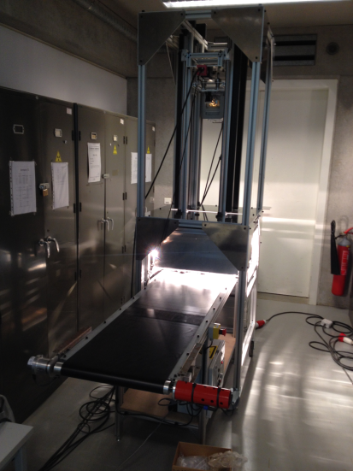
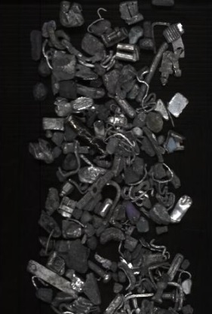


Design and calibration of a 2-cameras characterization prototype
Hyperspectral machine vision applied to recycling
Authors : Pierre Barnabé, Godefroid Dislaire, Sophie Leroy, Eric Pirard.
Funding :
Service public de Wallonie | WBGreen Program

Slide 2
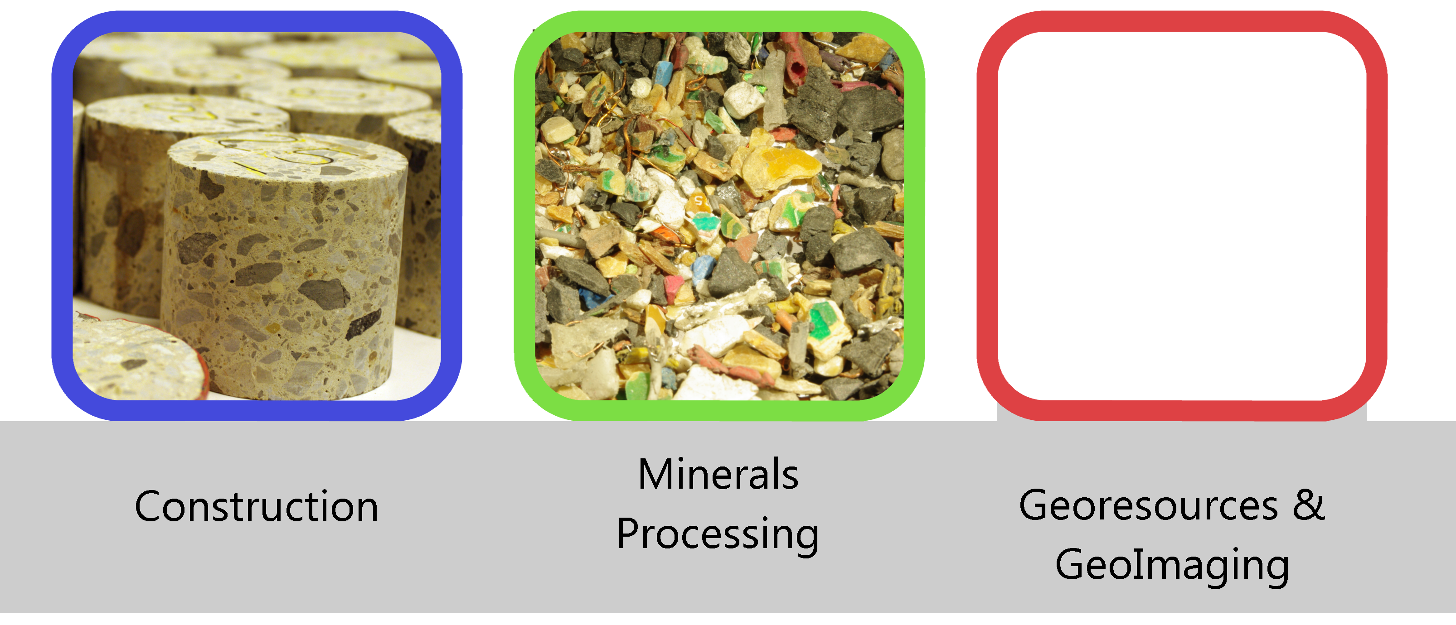
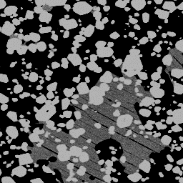
GeMMe Research Unit

Slide 3
Introduction
Prototype
Classification
Calibration
Conclusions & Perspectives

Slide 4
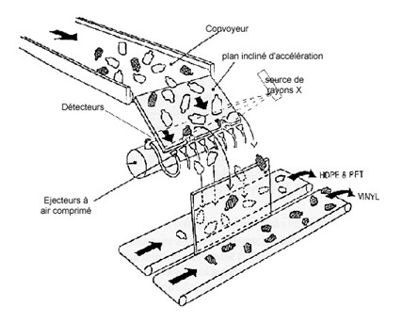
Introduction
Goals:
Classify metallic non ferrous scraps by hyperspectral imaging
Part of a global project dedicated to real-time sorting for industrial application
Context :
Recycling industry needs efficient characterization/sorting tools
European directives for January 2015 : >95% recycling of end-of-life vehicles
Different particle size flows => different approaches

Slide 5
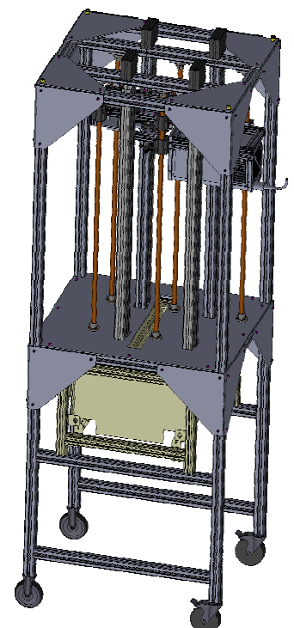
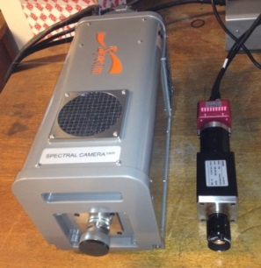
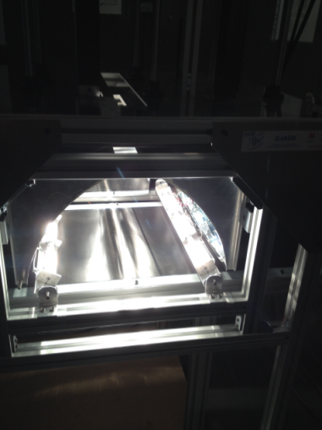
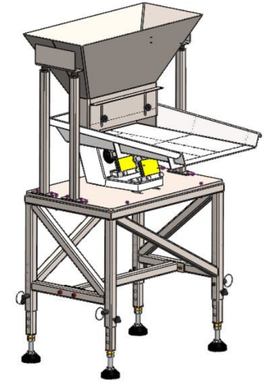
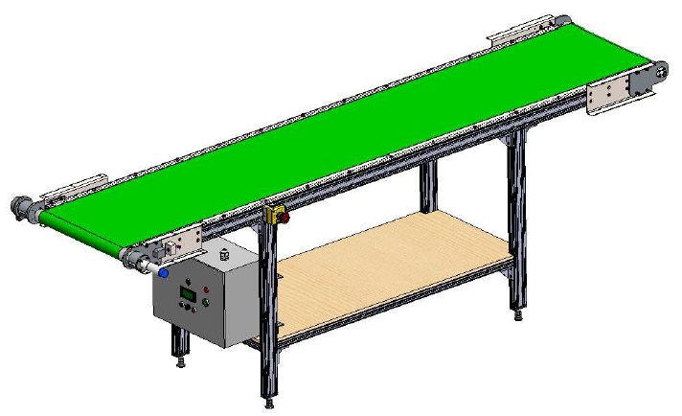
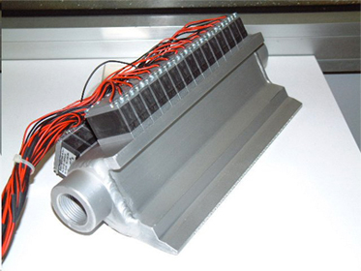
Prototype
Frame
Cameras
Illumination system
Specim SWIR Camera
Photonfocus CMOS
with Specim VNIR Spectrograph
Dispersion system
Conveyor belt
Sorting manifold
Notes:
Superimpose Australia

Slide 6
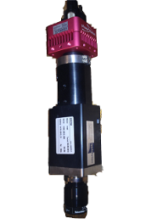
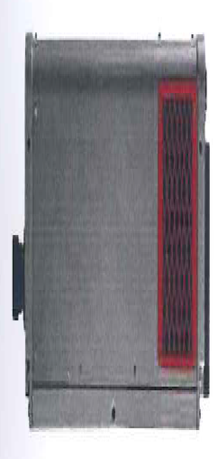
Prototype
Frame
Cameras
Illumination system
Specim SWIR Camera
Photonfous CMOS
with Specim VNIR Spectrograph
SWIR
Aluminium coated mirror
VNIR
Gold coated mirror
Translation
Notes:
Superimpose Australia

Slide 7

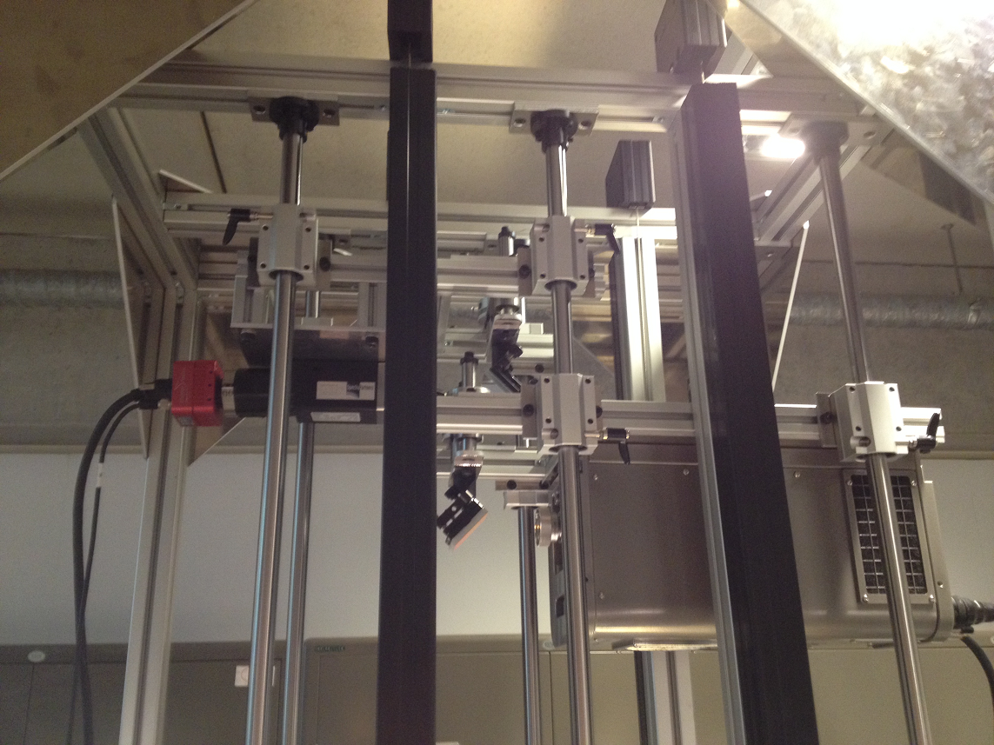
Prototype
Cameras & mirrors
Notes:
Superimpose Australia

Slide 8
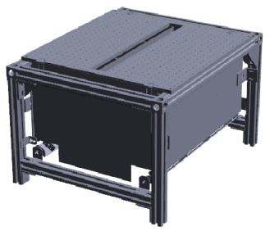

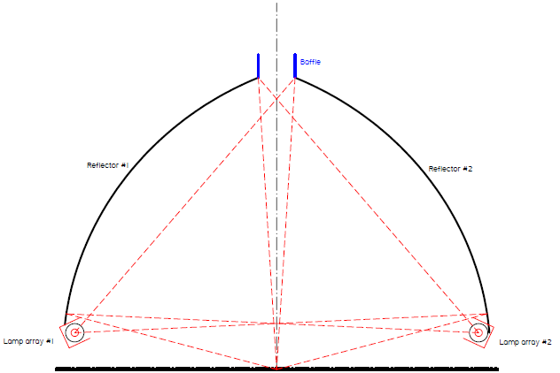
Prototype
Illumination system
Elliptical reflectors :
  Lamp array in one focus
  Measured line in the other focus
Allows to maximise angle of illumination and collected light
Notes:
Superimpose Australia

Slide 9
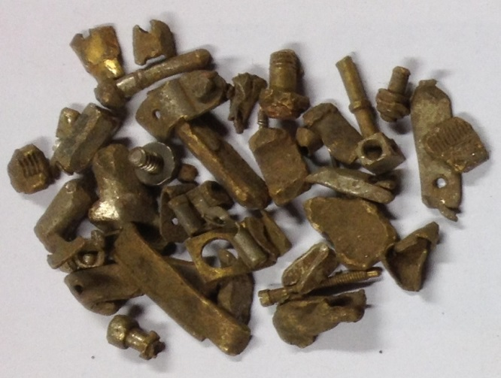
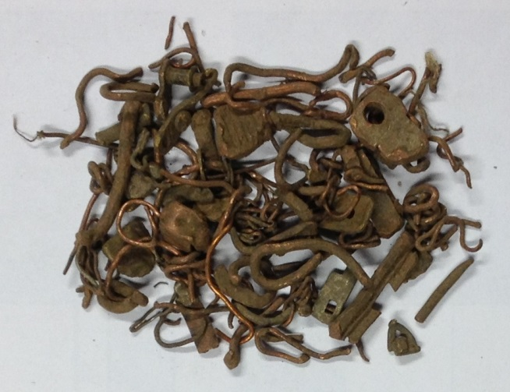
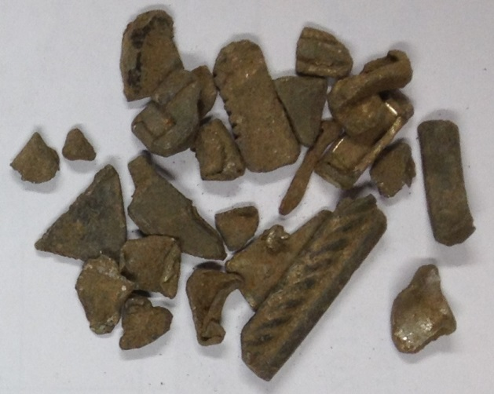
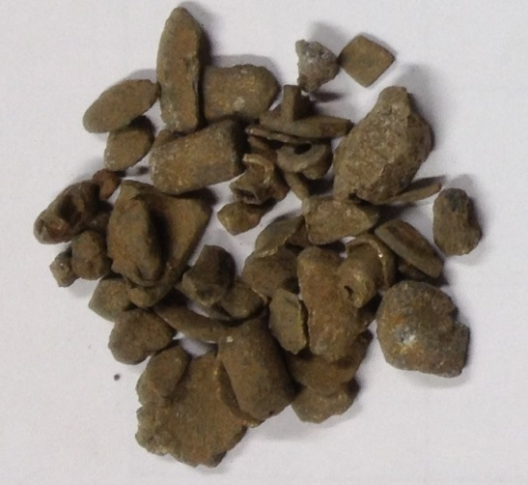
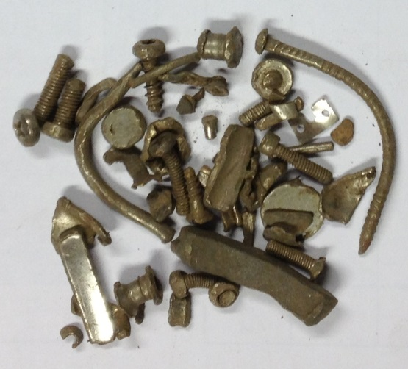
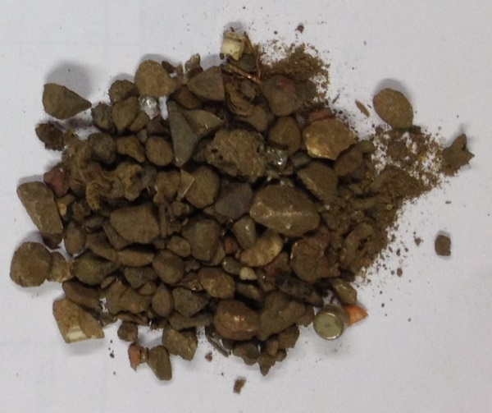
Classification
Hand sorted classes (3-15mm)
Brass
Copper
Zinc
Aluminium
Stainless steel
« Wastes »
+ Lead, magnesium, chromium, iron, cables, glass…

Slide 10
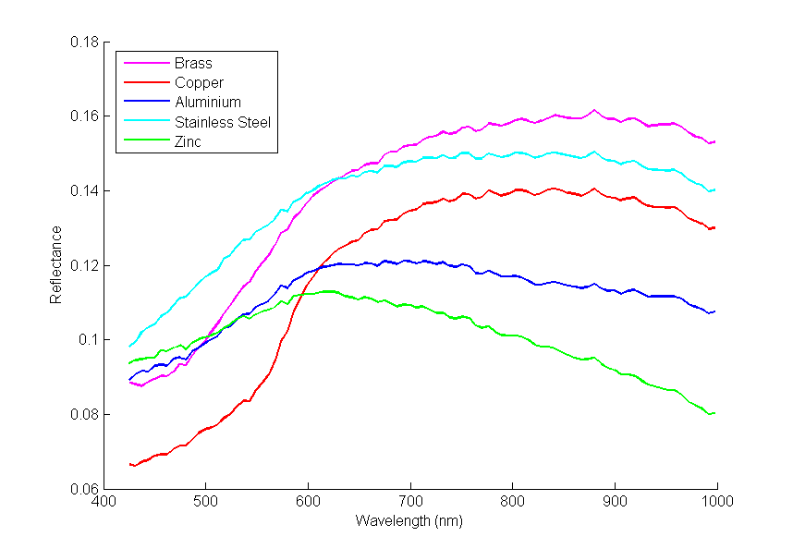
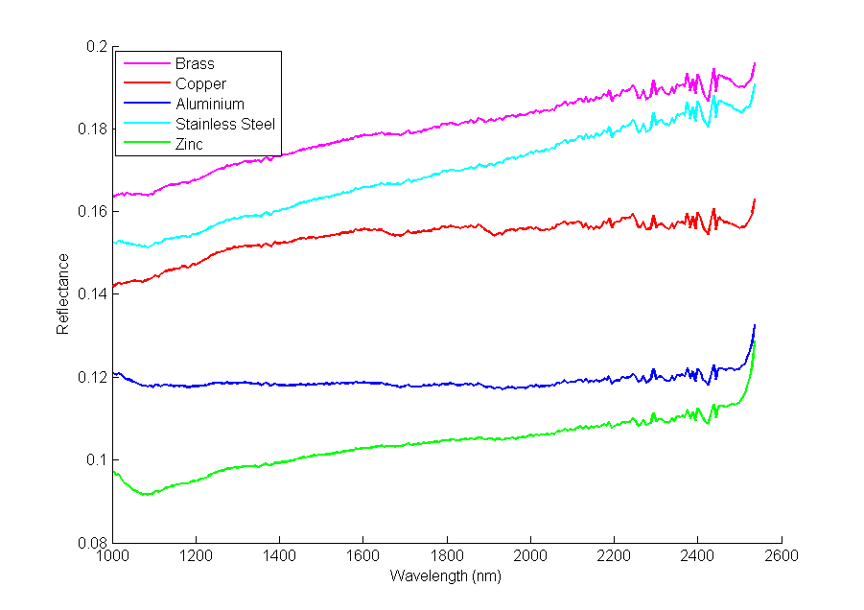
Classification
Average reflectance Spectra

Slide 11
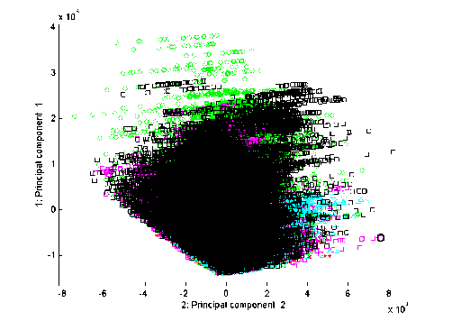
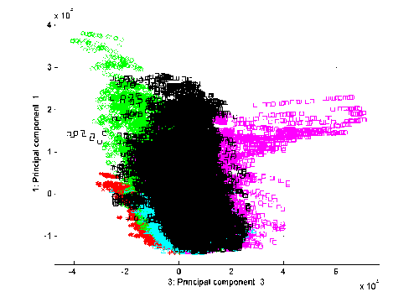
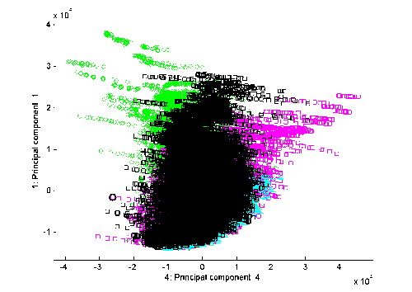
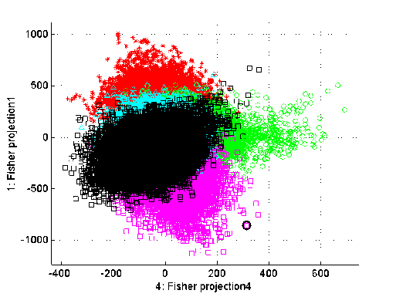
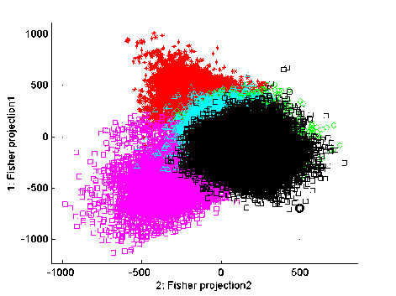
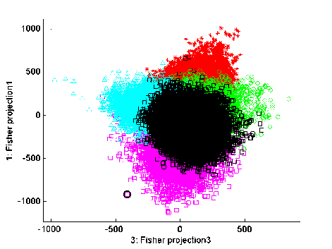
Classification
Feature extraction
    PCA
    LDA

Slide 12
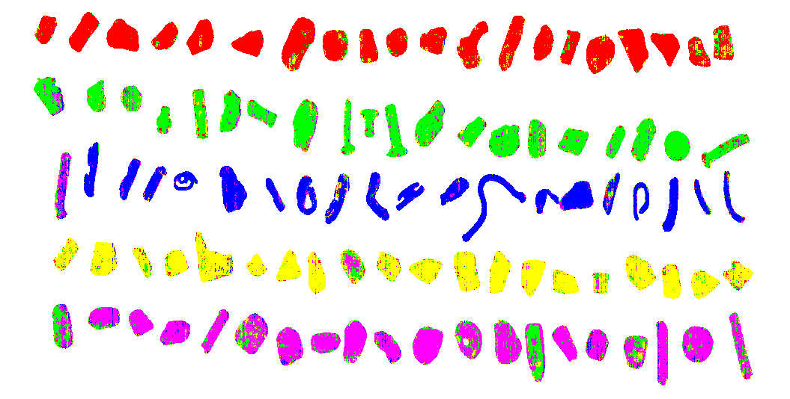
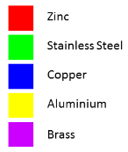
Classification
Results
Test set : 100 fragments (20 for each class)
Training set : subset of pixels from 5 random fragments by class
LDA + Random Forest classifier results :

Slide 13
Classification
Results : confusion matrix
Pixel level :
 |  | Decisions
 |  | Zinc | Stain. Steel | Copper | Aluminium | Brass
True labels | Zinc | 91.1% | 3.2% | 0.2% | 5.1% | 0.3% | 100%
 | St. Steel | 4.3% | 82.0% | 1.4% | 6.2% | 6.2% | 100%
 | Copper | 1.4% | 2.7% | 87.3% | 3.0% | 5.6% | 100%
 | Alu. | 3.0% | 6.1% | 1.0% | 86.6% | 3.2% | 100%
 | Brass | 1.1% | 17.0% | 4.7% | 4.7% | 72.4% | 100%
=> Error = 16.13%
Object level :
 |  | Decisions
 |  | Zinc | Stain. Steel | Copper | Aluminium | Brass
True labels | Zinc | 100.0% | 0% | 0% | 0% | 0% | 100%
 | St. Steel | 0% | 100.0% | 0% | 0% | 0% | 100%
 | Copper | 5.3% | 0% | 94.7% | 0% | 0% | 100%
 | Alu. | 0% | 5% | 0% | 95.0% | 0% | 100%
 | Brass | 0% | 9.52% | 0% | 0% | 90.5% | 100%
=> Error = 4%

Slide 14
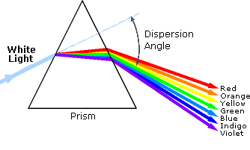
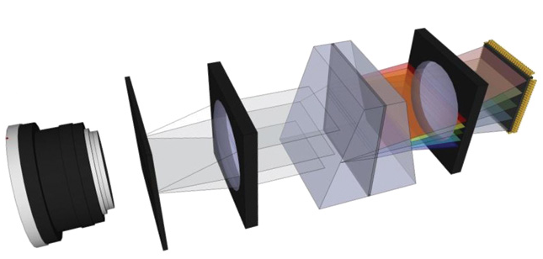
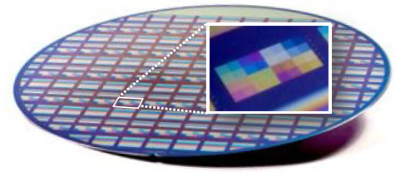

Calibration
Hyperspectral imaging
  Light Dispersion: transmission or reflective (Offner) diffraction gratings …or even small filters network
(Source : www.laserfocusworld.com)
(Imec hyperspectral filter structures)
  Sensor:
    CMOS/CCD for Visible-and-near-Infrared, 400-1000nm (VNIR)
    Indium gallium arsenide (InGaAs)/Mercury cadmium telluride (MCT) for Short-wavelength-Infrared, 1000-2500nm (SWIR)
Sensor
Spectral direction
  Lens
  Illumination system => Reflectance measurement
Spatial direction (line of pixels)
Notes:
Superimpose Australia

Slide 15
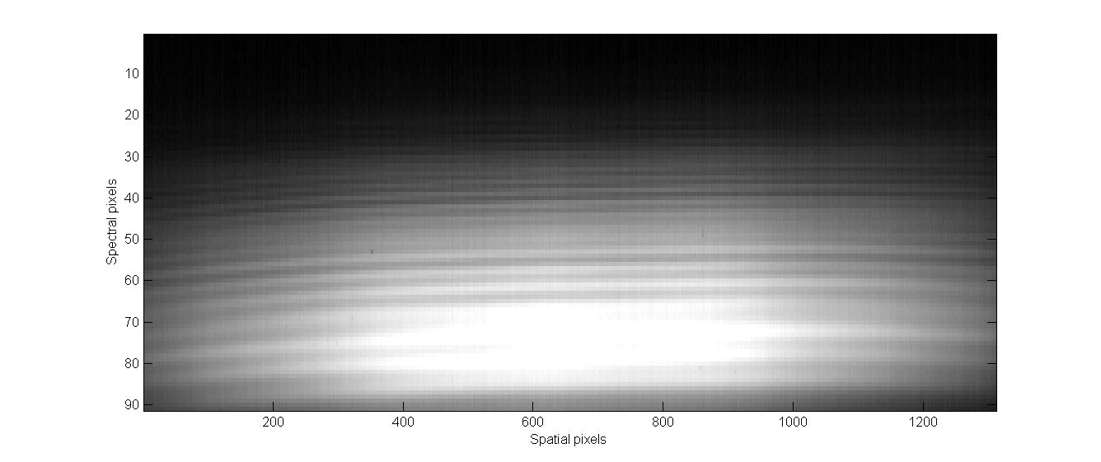
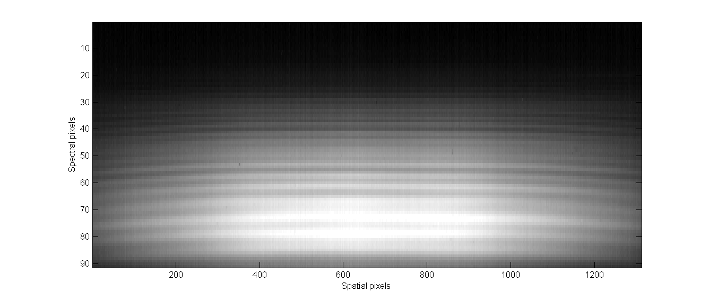
Calibration
Alignment : Camera & Spectrograph (VNIR)
Notes:
Superimpose Australia

Slide 16
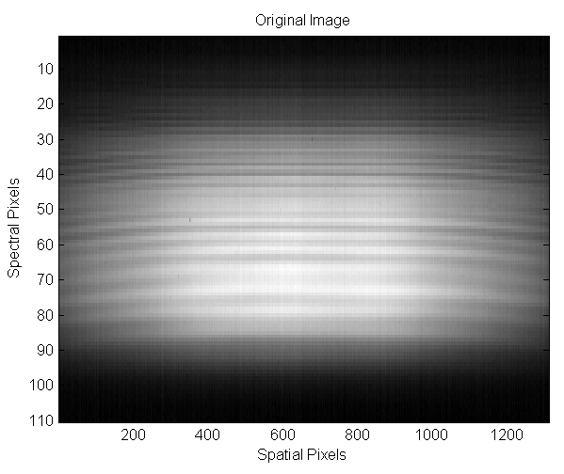
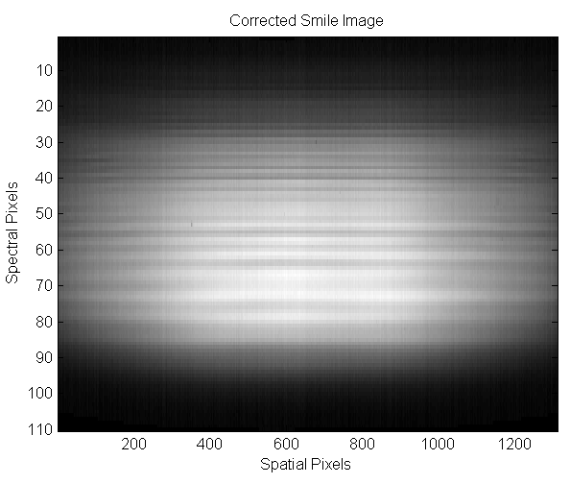
Calibration
Smile Effect (VNIR)
Notes:
Superimpose Australia

Slide 17
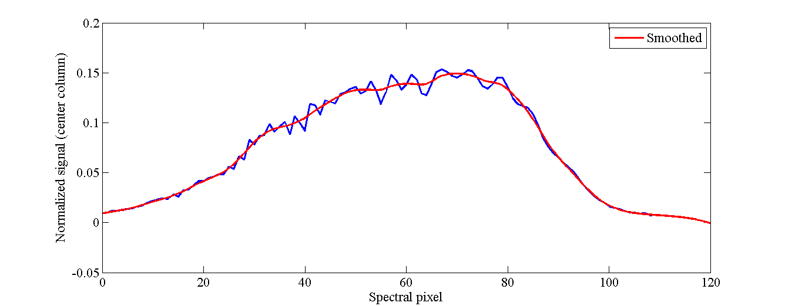
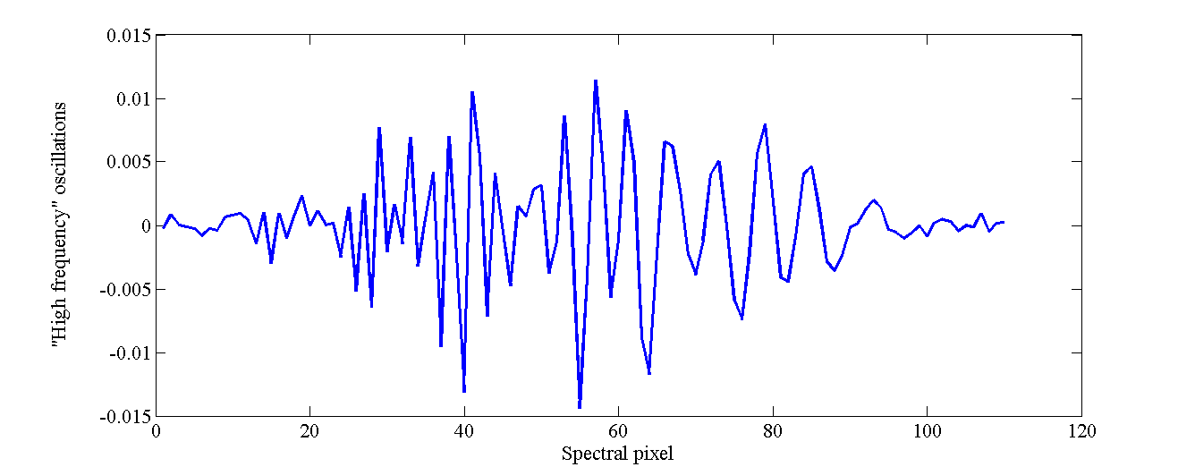
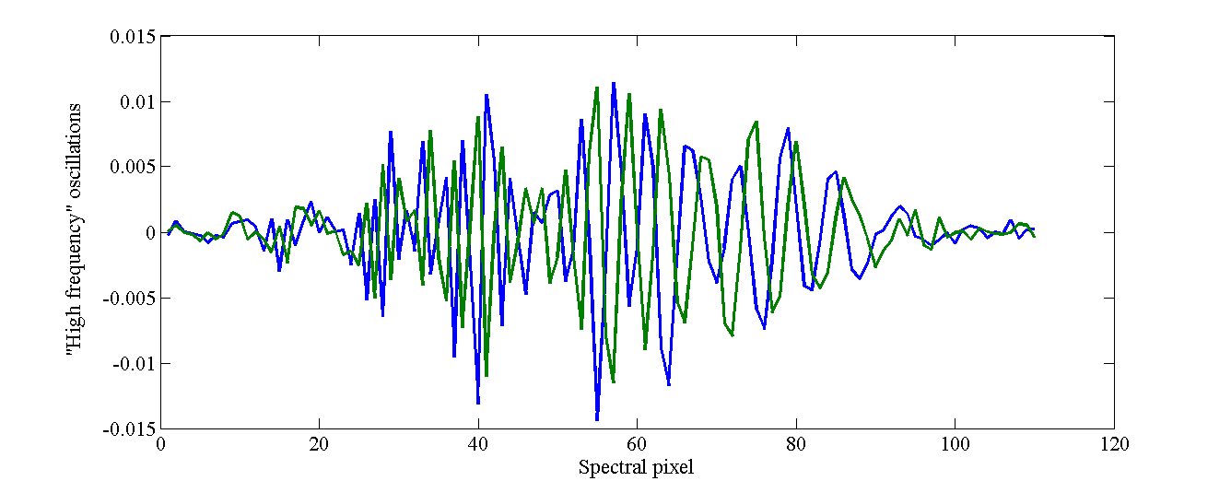
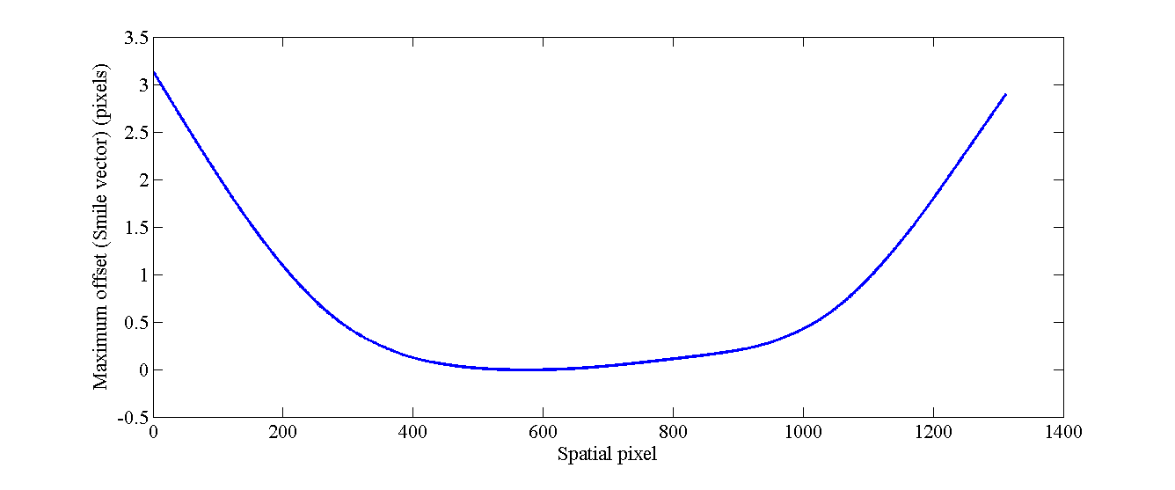
Calibration
Smile Effect (VNIR)
High pass filter (remove low frequency components)
Find offset between signals from each column and the central column, obtained with maximum of cross-correlation
=> Compute « Smile » vector with offset for each column of the sensor
Notes:
Superimpose Australia

Slide 18

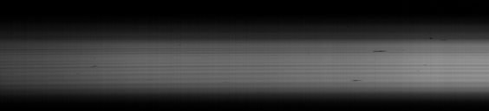
Calibration
Wavelength & Radiometric Calibration
Wavelength Calibration
Radiometric Calibration
Notes:
Superimpose Australia

Slide 19
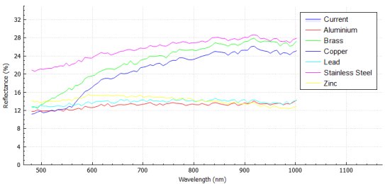
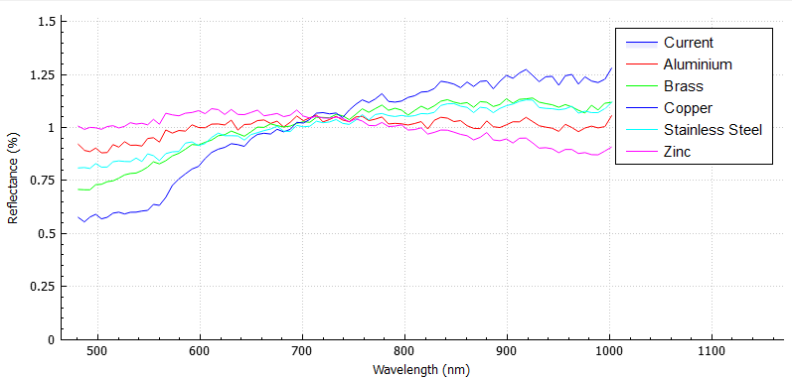

Calibration
Radiometric Calibration & Reflectance normalization
From signal to reflectance (for a pixel [x,y]):
      $$Reflectance\left(λ_{i}\right)=\frac{L\left(λ_{i}\right)−B\left(λ_{i}\right)}{W\left(λ_{i}\right)−B\left(λ_{i}\right)}$$
Where: B = Black reference, pixel x of the line, wavelength i
W= White reference, pixel x of the line, wavelength i
Reflectance presents variations depending of the position of the fragment, his orientation, etc. -> Normalisation to « signatures » (for k wavelengths)
    $$Norm. Reflectance \left(λ_{i}\right)=\frac{Reflectance\left(λ_{i}\right)}{\sum_{n=1}^{k}{Reflectance\left(λ_{n}\right)}}$$
Notes:
Superimpose Australia

Slide 20
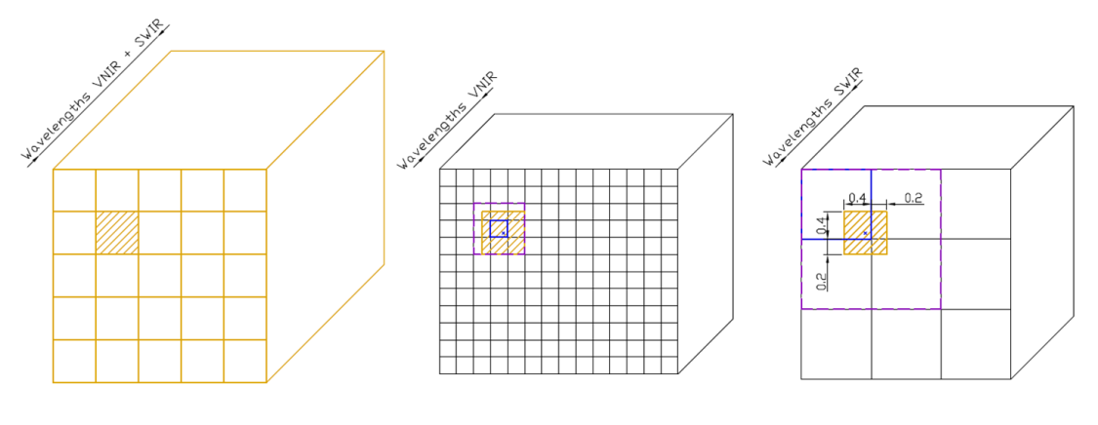
Calibration
Geometric calibration for registration
Cameras alignment
  Roll, to measure parallel lines (loose fitting screw)
  Pitch, to measure the same line (mirrors orientation)
=> Use of a fine reflectant string
Pixel merging
Notes:
Superimpose Australia

Slide 21
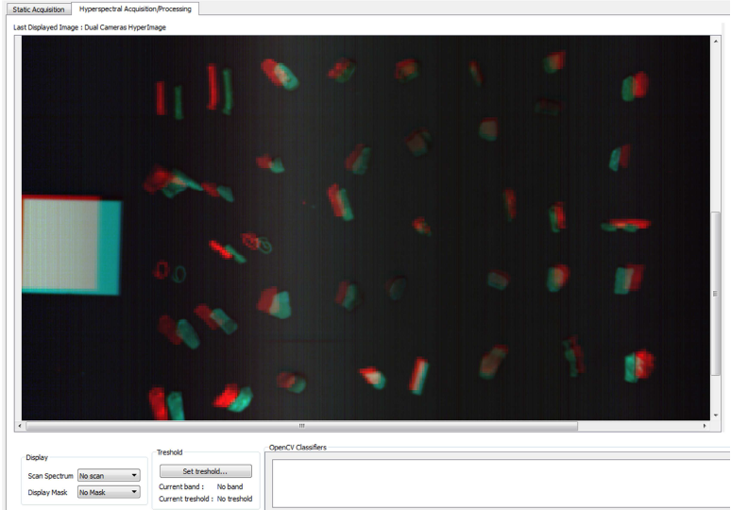
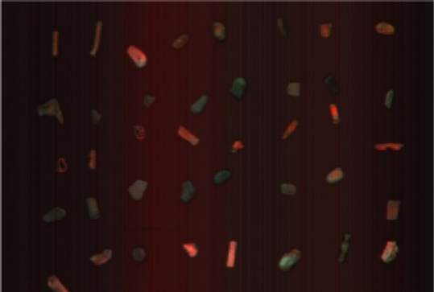
Calibration
Geometric calibration for registration
Pixel merging
  Offsets in spatial pixels and frame number between cameras
Notes:
Superimpose Australia

Slide 22





Calibration
Hyperspectral machine vision applied to mineral industry and recycling
Non linearity + Noisy signal
  Depending of the orientation of fragments and hence the actual response of the sensor, reflectance calculated in comparison of the 99% diffuse refl. Spectralon may be biased
  => “Steps” between corrected reflectance of the 2 cameras may appear for a lot of pixels (especially when signal-to-noise ratio decreases)
Sensivity of Photonfocus CMOS
(Source : http://www.olympusmicro.com)
Sensibilty of a MCT sensor
Combination of halogen light source spectrum
and CMOS response in VNIR
Notes:
Superimpose Australia

Slide 23


Calibration
Hyperspectral machine vision applied to mineral industry and recycling
Dynamic noise (moving pattern)
  Delta of subsequent “dark” frames (taken with shutter on) at:
25 FPS
100 FPS
Notes:
Superimpose Australia

Slide 24

Calibration
Hyperspectral machine vision applied to mineral industry and recycling
Dynamic noise (moving pattern)
  Effect visible in noisy bands, for low reflectance objects…
Notes:
Superimpose Australia

Slide 25
Conclusions
  Remarks :
  Monotonous reflectance curves, especially SWIR
  Variability in intensities (depending of orientation)
  Calibration requires attention => before tuning classifiers, optimizing data quality is crucial
+ :
Non destructive
Quick
VNIR is sufficient for most metals => Low cost characterisation tool
- :
Surface properties only!
=> Sample “preparation” (sanding, washing,…) to reduce error
  Limited speed for in-line measurement (need extremely powerful lighting system => problems of heat with halogen)
Lots of data to process

Slide 26
Thanks for your attention !

