Slide 1
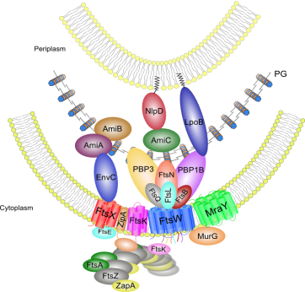
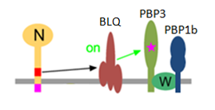
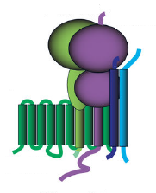
Introduction
Study of interactions within the enzymatic core of the divisome in Escherichia coli.
A. Boes, S. Olatunji, and M. Terrak
Centre for Protein Engineering, University of Liège, Sart Tilman, 4000 Liège, Belgium. adrien.boes@doct.ulg.ac.be
Peptidoglycan (PG) synthesis is controlled by specialized multiprotein machineries that are essential for bacterial growth and division. The divisome (figure 1A) controls septal PG synthesis and separation of daughter cells. In E. coli, PBP3, PBP1b and FtsW interact and collaborate to synthesized the new cell wall at the division site [1-6]. Nevertheless, the factors responsible for triggering the synthesis of the septal PG are largely unknown. A Recent in vivo study suggests that FtsN would collaborate with the complex FtsBLQ to activate the PG synthesis at the division site [7] (figure 1B). In this work we have investigated interactions between these proteins and we aim to characterize their biochemical activities.
A
B
Figure 1 :
A. Schematic representation of the divisome in E. coli.
B. Model for PG synthsesis activation by the collaboration of FtsN and FtsBLQ.
Anti-Q
B
Results
A
Anti-L
Anti-B
C
Figure 2 :
A. Coexpression and purification of FtsBLQ complex on IMAC.
B. Western blot performed on FtsBLQ. C. After gel filtration.
1) Purification of the FtsBLQ complex
The full-length form of the three proteins FtsB, FtsL and FtsQ were co-expressed in E. coli followed by affinity co-purification with FtsB containing an N-terminal His-tag (bait) and the others proteins untagged (prey) (figure 2).
FtsQ
FtsB
FtsL
2) FtsBLQ complex interacts with the FtsW-PBP3 complex
3) FtsBLQ complex interacts with FtsN
We performed co-expression of strep-FtsB, FtsL, FtsQ, with His-FtsW-PBP3 in E. coli followed by affinity purification on a Ni-NTA column (figure 3). These results suggest that the proteins FtsW-PBP3 and FtsBLQ form a larger complex.
We performed co-expression of His-FtsB, FtsL, FtsQ, with FtsN in E. coli followed by affinity purification on a Ni-NTA column (figure 4). These results suggest that the FtsBLQ complex interacts with FtsN.
E
A
A
B
C
D
Anti-Q
Anti-L
Anti-B
Figure 3 :
A. Coexpression and purification of HisFtsBLQ/FtsW/PBP3 on IMAC.
B. FtsW-PBP3 complex (control).
C and D. PBP3 labelled with fluorescent ampicillin.
E. Western blot performed on HisFtsBLQ/FtsW/PBP3 complex.
FtsW* = degradation of FtsW.
Anti-N
B
Figure 4 :
A. Western blot performed on HisFtsBLQ/FtsN complex.
B. Coexpression and purification of HisFtsBLQ/FtsN on IMAC.
PBP3
FtsW
FtsN
FtsQ
FtsQ
FtsW*
FtsB
FtsB
FtsL
FtsL
Conclusions and Perspectives
PBP3
FtsQ
FtsN
FtsQ
Using co-expression and co-purification experiments, we reconstituted the FtsBLQ complex and we showed that FtsBLQ interacts strongly with the complex FtsW-PBP3 to form a larger sub-complex. We also demonstrated that FtsBLQ interacts with FtsN. Reconstitution of larger complex are in progress with the aim to study the effect of both FtsBLQ and FtsN on PBP3 and/or PBP1b activities using labelled lipid II.
FtsW
FtsL
FtsL
FtsB
FtsB
References
1- Egan AJ and Vollmer W. Ann N Y Acad Sci. 2013 1277, 8-28; 2-Bertsche et al., Mol Microbiol 2006 61 675-90; 3- Mohammadi et al., EMBO J 2011 30,1425-32; 4- Müller et al., J Biol Chem 2007 282 36394-402; 5-Fraipont et al., Microbiology 2011 157, 251-9;6; 6-Leclercq et al, Scientific Report, 2017-
7- Bing Liu et al., Mol Microbiol 2015 95(6), 945–970.
Acknowledgement to

