Slide 1
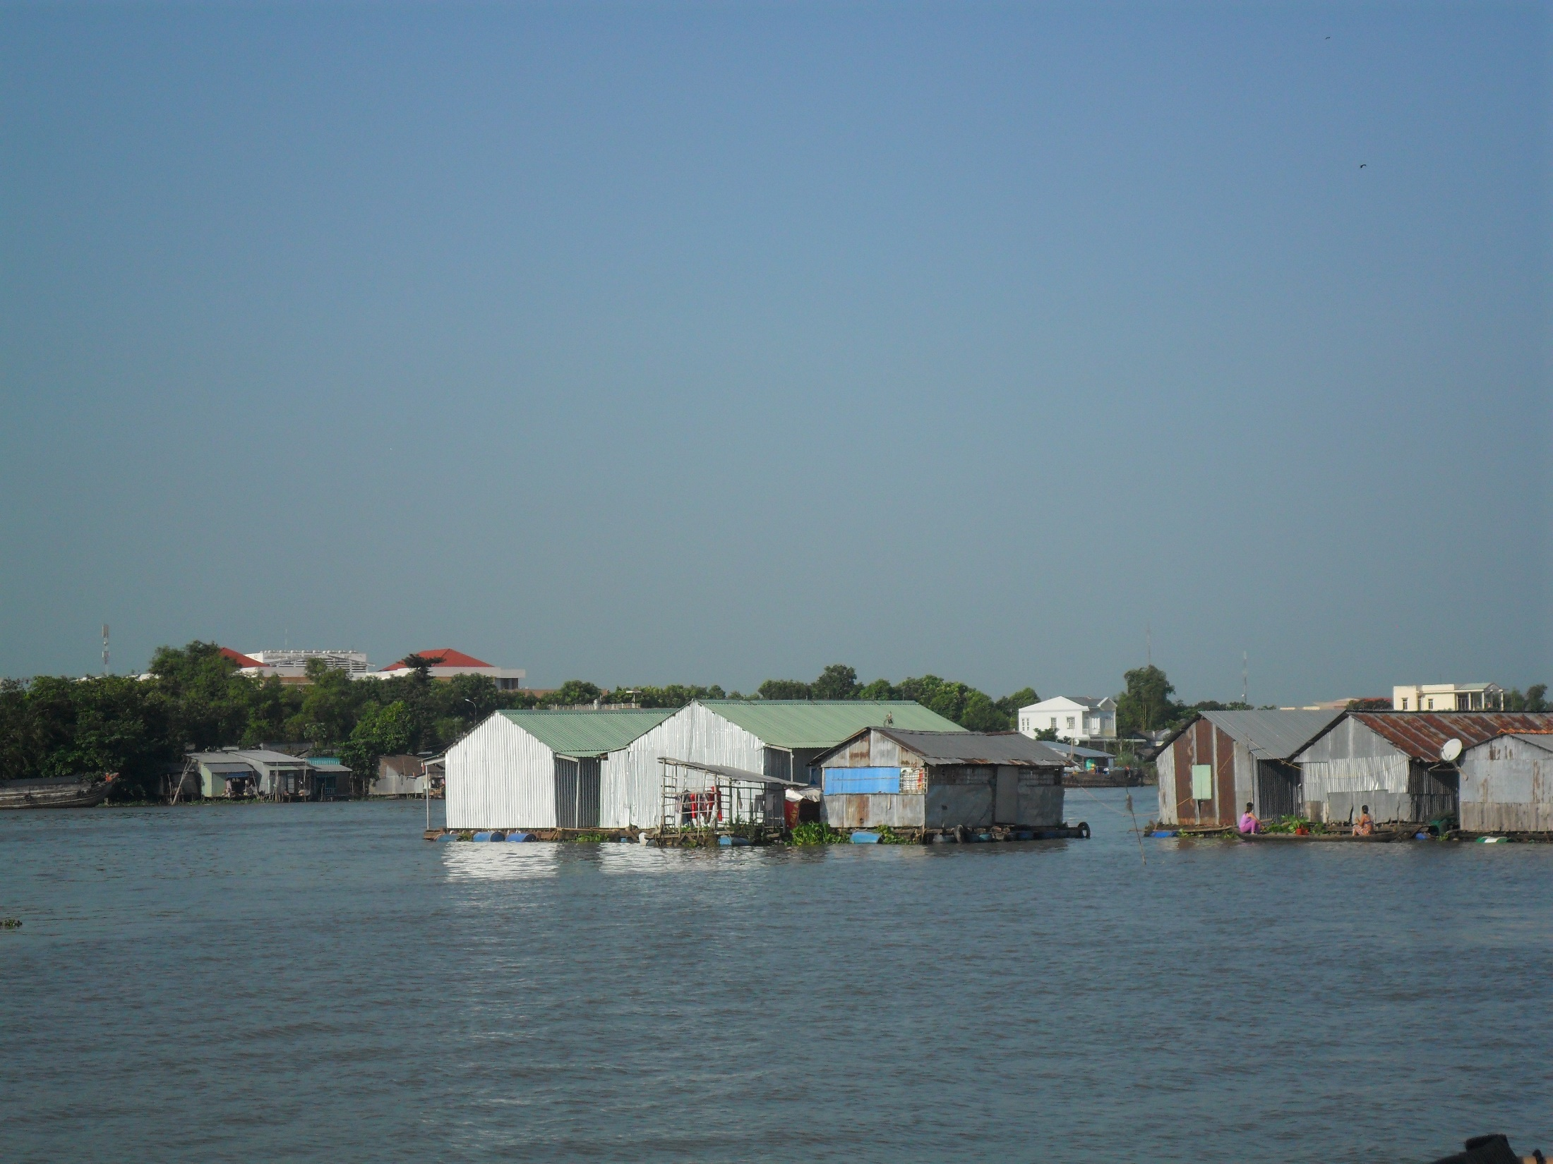
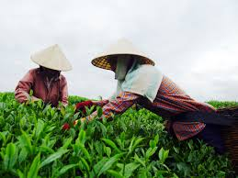
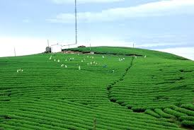
Improving Farmer’s Water Quality Management for Sustainable Aquaculture Production in Mekong Delta: A Case Study in Thot Not District, Can Tho Province of Vietnam
Improving Farmer’s Water Quality Management
for Sustainable Aquaculture Production in Mekong Delta:
A Case Study in Thot Not District, Can Tho Province of Vietnam
Prepared by:
Nguyen Thi Hai Ninh
Nguyen Mau Dung
Ho Ngoc Cuong
Faculty of Economics and Rural Development
Vietnam National University of Agriculture

Slide 2
INTRODUCTION
Aquaculture production is a thriving industry in the Mekong Delta of Vietnam with total aquaculture areas of 746 thousand hectares and the production of around 2 million tons (MARD, 2009).
Production intensification of semi-intensive and intensive culture system has become a trend in the delta, especially for Tra fish (Pangasius hypoththalmus) and Basa fish (Pangasius bocourti sauvage) - two popular catfish species bred in the Mekong Delta.
The practice of these systems by small farm households usually results in pollution of culture water from uneaten food and waste products of cultured organism, thus placing negative consequences on aquaculture yield and quality.
Farm households can apply various kind of measures for WQM in aquaculture production such as pond bottom treatment, water exchange, aeration, feed controls, chemical treatment for water, etc.,.

Slide 3
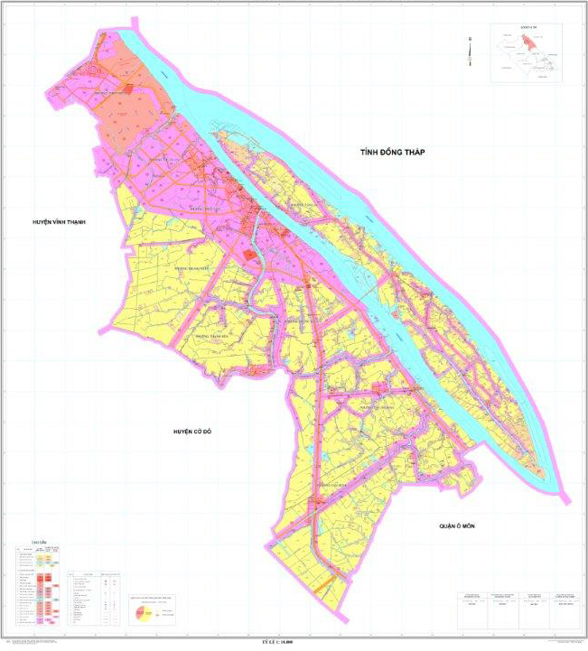
STUDY AREA
Thot Not district locates in Can Tho province and close to Hau River – one branch of Mekong river.
Being bounded by Ô Môn, Cờ Đỏ, Vĩnh Thạnh districts and Đồng Tháp province
Having 8 district level units with 11780.74 ha and a population of 158225 inhabitants
Thot Not had the biggest area under aquaculture farming with 318 hectares of Tra and Basa fish out of a total of 671 hectares under catfish farming in the whole province.

Slide 4
METHODOLOGY
Secondary data: Scientific reports by specialized agencies and departments
Primary data: Survey on 32 aqua-farms
A FGD with wife and woman who are employed in the fish farms is held in order to learn about the participation of genders in WQM
Key informant interview with local authorities: staff of district and extension station of Thot Not district
Data
collection
Descriptive statistics to describe the general pictures of aquaculture production
Comparative analyses will be applied to investigate the difference in WQM between communes and farm household groups
SWOT analysis will be used to identify the strengths, weaknesses, opportunities and threatens for current WQM for aquaculture production in the households
Research
method

Slide 5
RESEARCH FINDINGS
Overview of aquaculture production in Thot Not district
2008 is the time of catfish growing to reach the highest peak with the total feeding area as 621 ha.
The area decrease to 550 ha in 2012, 443.7 ha in 2013 and 435 in 2014.
Over 3 year from 2012 to 2014 average decreased by 11.1% due to catfish raw material price falling big disadvantage for those farms.
Figure 1. Pangasius catfish situation in Thot Not district

Slide 6
RESEARCH FINDINGS (cont)
General information about catfish farming households in Thot Not
Table 1. General information about Pangasius catfish farming households in Thot Not
Content | Unit | Average/HH
Total average production | Ton | 383.11
Average production of pond | Ton | 233.51
Cycle/year | Rank | 1.69
Average number of pond | Pond | 2.68
Average water surface area | m² | 14,058
Depth of the pond | m | 3.98
The average area of aquaculture per household is 1.4 hectares with the number of ponds in the range of 2 to 3 ones.
The average number of cycle of each pond is 1.69 (each cycle lasts about 8 months).
Educational
levSource: Survey data, 2015
el
Gender
Location

Slide 7
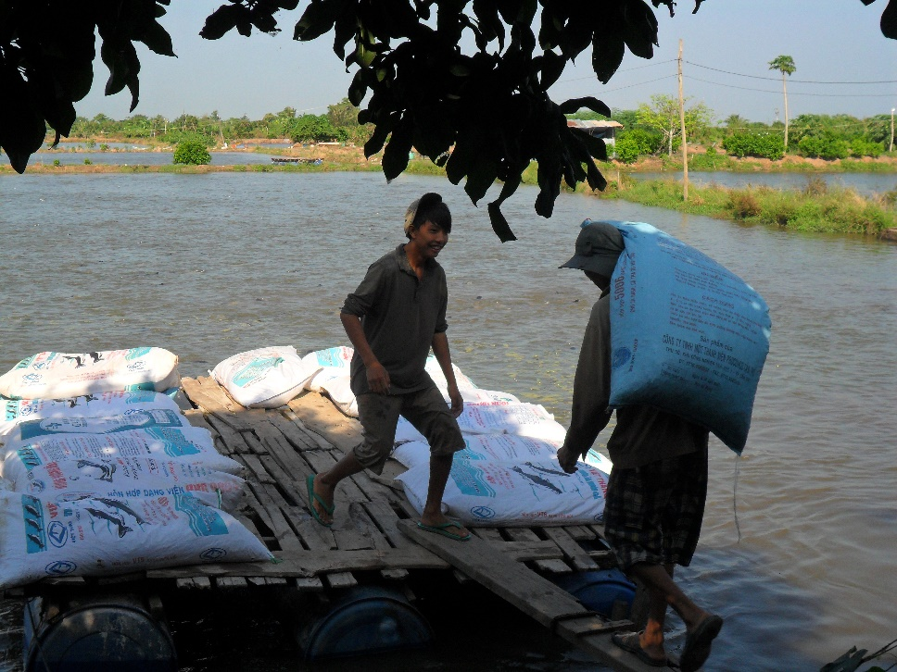
RESEARCH FINDINGS (cont)
General information about catfish farming households in Thot Not
In terms of labor, approximately 90% of aquaculture households in Thot Not hire workers, of which more than 42% of the households regularly hire employers for 12 months with a salary of 3.5 to 4 million dongs per month.
28.5% of the Tra catfish raising households hire seasonal workers with the number of 6 to 10 workers who are employed on harvest time with a salary of 200,000 dongs/day.
Gender
Location
Picture 1. Labor for catfish farming in the surveyed households

Slide 8
RESEARCH FINDINGS (cont)
Situation of water pollution in aquaculture pond in Thot Not district
Table 2. The main reasons causing water pollution
as assessed by the households
Reasons | Ratio (%)
Due to contaminated water supplies | 59.38
Because of residue food | 62.50
Due to the used chemical residues and antibiotic | 43.75
Because the density is too large (number of fish/m2 ) | 40.63
Because there is no fair sewerage system | 31.25
Other | 25.00
Gender
Figure 2. Households’ assessment of water quality
Source: Survey data, 2015
Location
Compared to 3 years ago, there are 46.88 % households think that it is more pollution
Farmers acknowledge that environment in the catfish ponds is polluted because water in ponds is stagnant, while the fish food is felt down every day, therefore, it is unavoidable for water to discolor and stink because fish do not eat all the food (62.50%)

Slide 9
RESEARCH FINDINGS (cont)
Disease of Pangasius catfish in Thot Not district
The disease of catfish quite diverse as: Purulent liver – kidney, cephaledema, icterus, haemorrhage, parasitic
Percentage of Pangasius catfish households with purulent liver – kidney is the highest with 62.5 %
These diseases usually occur in small period of less than 500 grams of fish
Gender
Location
Figure 3. Disease of Pangasius catfish
in Thot Not

Slide 10
RESEARCH FINDINGS (cont)
Water quality management in aquaculture Households
1. Selection of pond location
Table 3. Interests of the pond selection of surveyed households
Criteria | Evaluation rate (%)
 | Important | Very important | Extremely important
Area | 18.75 | 9.38 | 15.63
Rent cost | 12.50 | 6.25 | 0.00
Water supply | 28.13 | 15.63 | 43.75
Sewage disposal system | 18.75 | 34.38 | 12.50
Far from residential areas | 21.88 | 25.00 | 15.63
Less flooded areas | 25.00 | 3.13 | 9.38
Gender
Educational
level
Location
Source: Survey data, 2015
When selecting the pond, the following criteria are assessed: area, rent cost, water supply, sewage disposal system, ensuring far from residential areas, less flooded area
Totally, 90.63 % of surveyed households reported their concern most about water supplies; and 43.75% of them think that pond location near by water supply is extremely important

Slide 11
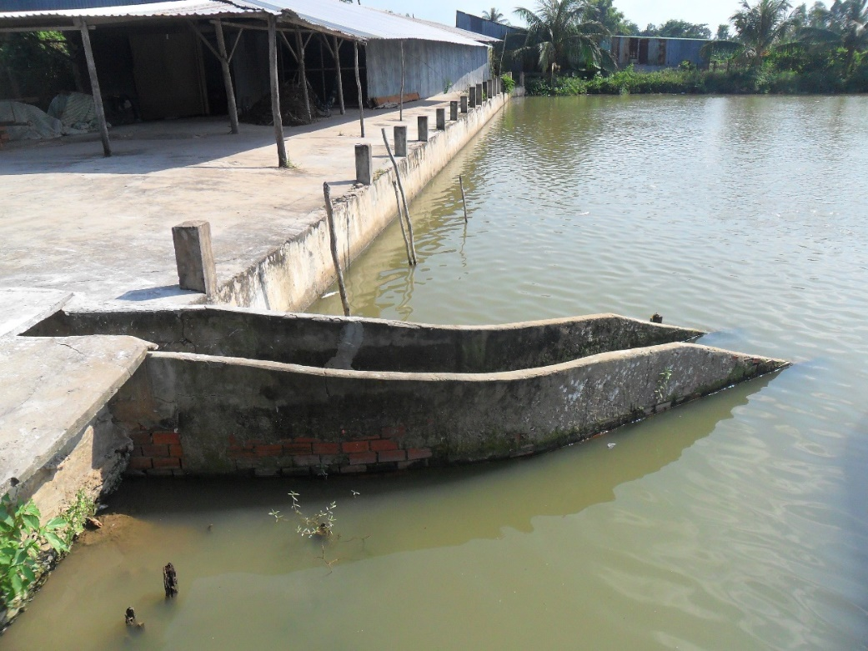
RESEARCH FINDINGS (cont)
Water quality management in aquaculture Households
2. Selection of pond shore structure
Table 4. Structure of pond shore
of the surveyed HHs
Criteria | Value
Pond depth (m) | 3.98
Pond shore structure (%)
- Brick and cement shoreline | 3.10
- Pond shoreline with plants | 78.10
- Pond shoreline with plants | 15.60
- Others | 3.10
Gender
Educational
level
Location
Source: Survey data, 2015
Picture 2. Pond shoreline with brick and cement
To reduce the contamination from the water, building pond shore is one of the water management measures in aquaculture.
78.1% have pond shoreline with plants and 3.1% having brick and cement shoreline. Pond shoreline built with brick and cement is stable, preventing from soil erosion but costly.

Slide 12
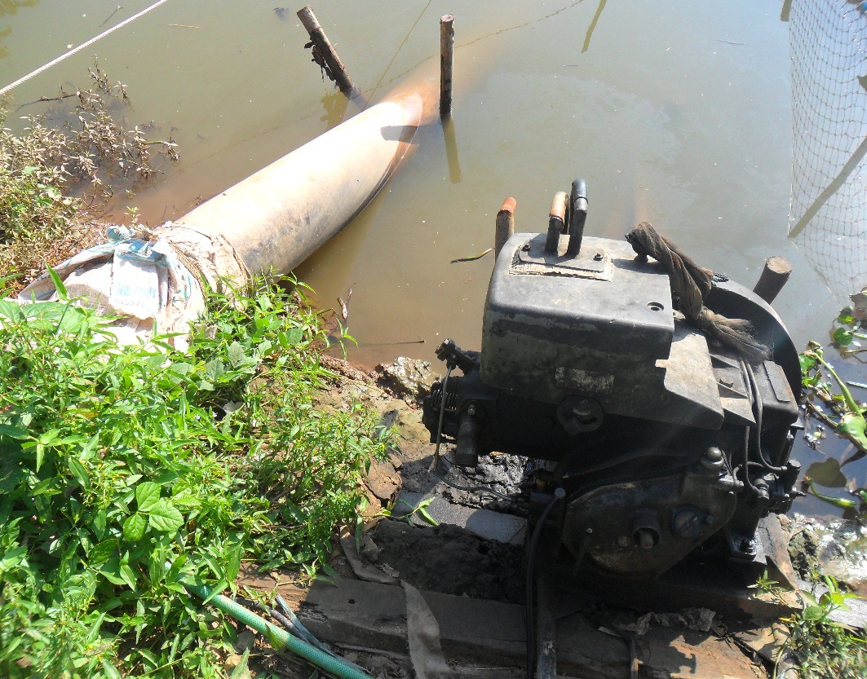
RESEARCH FINDINGS (cont)
Water quality management in aquaculture Households
3. Treatment for the bottom layer of pond
Table 5. Treatment for the bottom layer
of fishpond
Criteria | HHs applied the measures (%)
Pond drying | 62.5
Absorbing mud at the bottom layer | 96.9
Spreading lime powder | 93.8
Other | 71.9
Gender
Educational
level
Location
Source: Survey data, 2015
Picture 3. Absorbing mud at the bottom layer
HHs apply the treatment for the bottom layer of pond post-harvesting and before a new culture.
Absorbing mud at the bottom layer is an important and almost compulsory measure with 96.9% of households practice
Due to different shore structure, there is only 62.5% of households applied pond drying after harvesting.

Slide 13
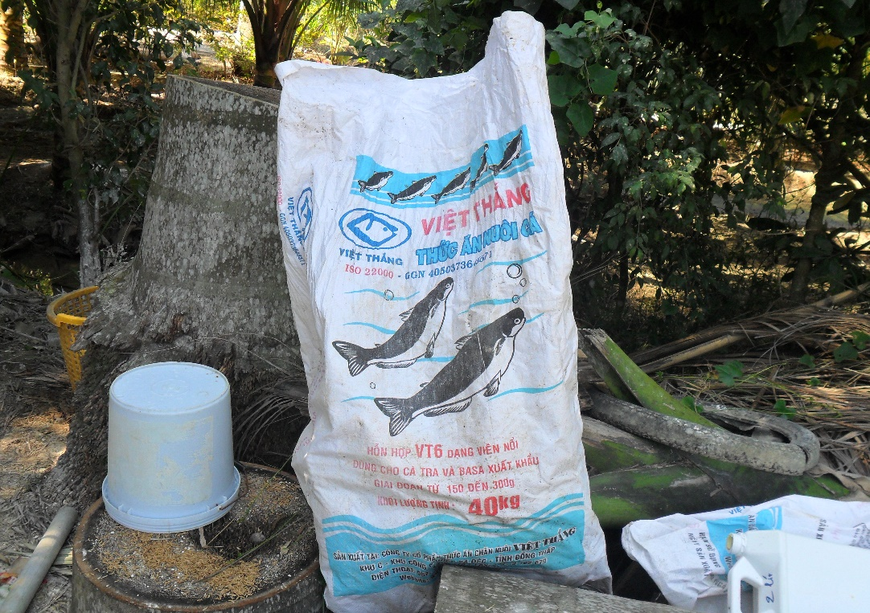
RESEARCH FINDINGS (cont)
Water quality management in aquaculture Households
4. Selection of fish density and feed style
Gender
Educational
level
Location
Figure 4. Selection of feed style
Picture 4. A type of fish food
HHs are concerned much about the fish density. 84.4% of households are interested in pond water quality; 81.3% of surveyed households believe that risk of disease is a determinant factor for considering the fish density.
Measures used by households that show high efficiency in water management are the selection of foods, food intake, times per day, and feed schedule.
Households use commercial foods in pellet form, floating on the pond surface in a short time that are originated from company's shares, Stork, South Vietnam, Vietnam Thang, GreenFeed.

Slide 14
RESEARCH FINDINGS (cont)
Water quality management in aquaculture Households
5. Selection of water supply for fishpond
Table 6. Active preparation for supply water for the pond
Criteria | HHs rate (%)
Check the quality of intake water
- Yes | 65.6
- No | 34.4
Checking measures
- Visual observation | 43.8
- Testing machines | 6.3
- Other | 15.6
Schedule of water change
- Recurrently | 81.3
- Strange smell | 28.1
- Water supply source is clean | 21.9
- Strange color | 37.5
- Dead fish in the pond | 28.1
- Other | 3.1
Average proportion of pond water change | 47.0
Farmers check pond and decide to change the water from 1 to 2 times a day, depending on the quality of water in the pond.
The proportion of changed water varies from 40-50% of total water volume of the pond
81.3% of HHs practice recurring, 28.1% change the water as strange smell presents in the pond water, 21.9% HHs change in clean water supplies; 37.5 % will change based on the strange water color, and 28.1% do it when fish in the pond die.
Gender
Educational
level
Location
Source: Survey data, 2015

Slide 15
RESEARCH FINDINGS (cont)
Water quality management in aquaculture Households
6. Selection for pond water treatment measures
Table 7. Active preparation for supply water for the pond
Criteria | Rate of HHs (%)
Surface aeration
- Yes | 3.1
- No | 96.9
Use of chemical and bio-product in the treatment
- Potassium permanganate | 56.3
- Probiotics | 37.5
Some measures are showing their efficacy in water treatment in fishponds that include: surface aeration, use of chemical and bio-products.
The surface aeration is practiced in only 3.1% of households
Source: Survey data, 2015
Gender
Location
The use of chemical and bio-products such as potassium permanganate for antiseptic, antibacterial, anti-algae, and other aquatic disease prevention, was found in 56.3% of households

Slide 16
RESEARCH FINDINGS (cont)
Gender participation in water quality management
Table 8. Selection of water quality management measures by gender
Selected measures | Husband (%) | Wife (%)
Pond location | 100 | 0.0
Pond shore structure | 100 | 0.0
Pond bottom layer treatment | 84.4 | 15.6
Fry and fish density | 87.5 | 12.5
Feed style | 96.9 | 3.1
Water supply source for fishpond | 100 | 0.0
Pond water treatment | 93.8 | 6.2
Source: Survey data, 2015
The decision to use the way to manage water quality is given mainly by husbands; wives only decide a very small number of choices.
Pond location selection, pond shore structure and pond water supply are at the discretion of husbands since these are important factors determining the success or failure of the culture.
Wives consult the selection of other measures such as pond bottom layer treatment, and pond water treatment with 15.6% and 6.2%, respectively
Gender

Slide 17
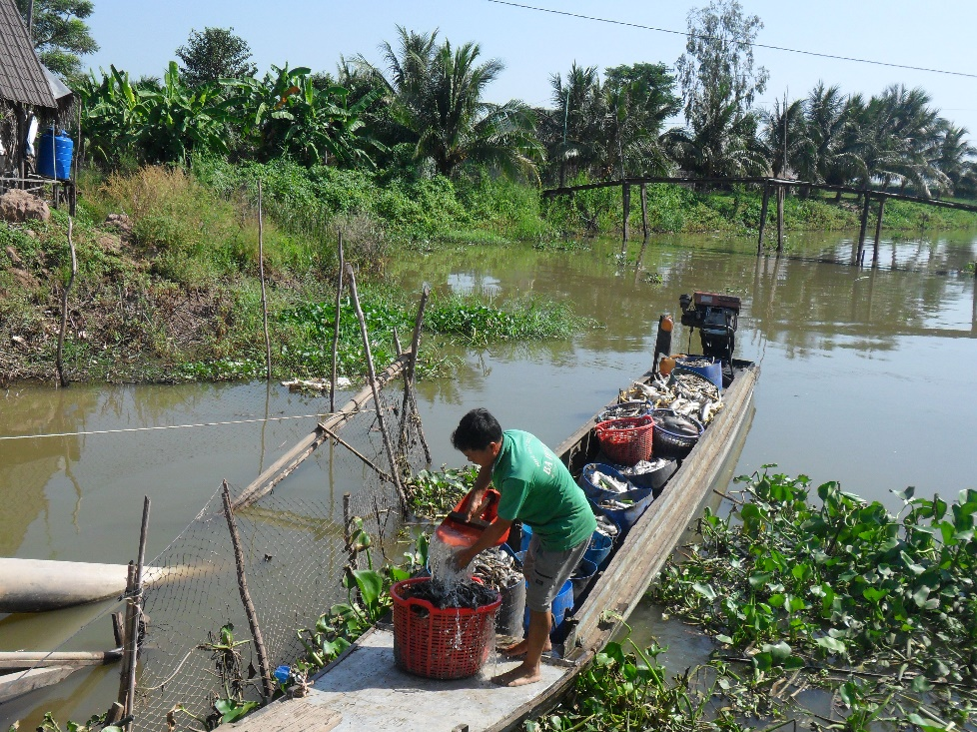
RESEARCH FINDINGS (cont)
Gender participation in water quality management
Table 9. Implementation of WQM measures by gender
Water management measures | Husband (%) | Wife (%)
Pond bottom layer treatment | 96.9 | 3.1
Feed style | 78.1 | 21.9
Water supply source for fishpond | 100 | 0.0
Pond water treatment | 93.8 | 6.2
The highest percentage women participation is (21.9%) in fish feeding since this is a small work, and easy to implement.
Source: Survey data, 2015
Meanwhile female participation in sprinkling lime to the pond bottom accounts only 3.1%.
The main reasons of women rarely participate in implementing activities of water management in aquaculture production comes from the division of labor in the family
Gender
Location

Slide 18
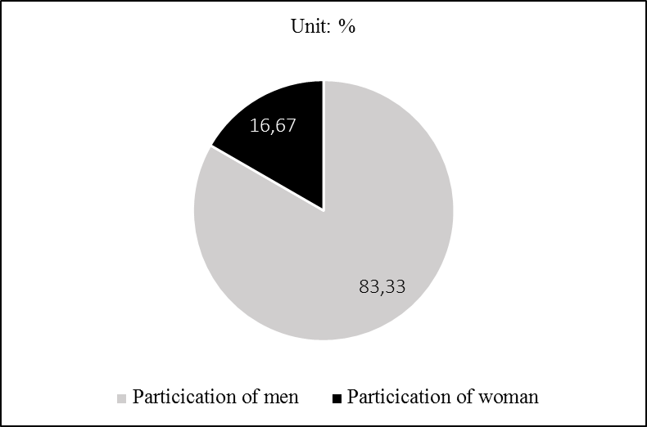
RESEARCH FINDINGS (cont)
Gender participation in water quality management
Not only that limit participation in aquaculture activities at household level, but the majority of women in our study rarely participate in extension training which organized by local government to improve farmers’ awareness of WQM in aquaculture production
Figure 5. Gender discrimination in extension
training participation
Gender
Location
Households have both male and female employees, of which 80% of engineers and technicians and technical advisors are men. The rest of the staff is women.
Figure 6. The rate by gender in hired labor

Slide 19
RESEARCH FINDINGS (cont)
Factors affecting farmer’s WQM for aquaculture production
Pond location
Pond shore structure
Pond bottom layer treatment
Fry and fish density
Feed style
Water supply source for fishpond
Pond water treatment
Age
Educational level
Income proportion
Aquaculture area
Extension training courses
Neighbors’ experience and TV programs
Seasonality
Inside HHs’ factors
Outside HHs’ factors
Gender
For the same method of WQM, applying percentage in 36-50 year-old group tends to be more than the other groups
People who have been trained for knowledge in aquacuture farming, tend to concern more about structure of pond bank, fish breed (76.92%) and method of pond water treatment (75%).
The trained households concern more about methods to treat polluted water because they understand serious impacts of pollution on water quality and fish productivity.

Slide 20
CONCLUSION
Most households in the Thot Not district raise Tra catfish, some households use the model of Tra catfish-frog and Tra catfish-catfish combinations16
1
A number of measures to manage pond water quality
78.13% of aquaculture households in ThotNot assessed pond water quality to be contaminated
2
3
A number of measures to manage pond water quality
75% of surveyed households asserted that the selection of pond location is the most important criterion.
75% of surveyed households asserted that the selection of pond location is the most important criterion.
Another common measure practiced in households with a rate of over 94% is the use of bio and chemical products for pond water treatment
Pond water replacement from 1 to 2 times per day is evaluated as effective for reducing immediately pond water contamination.
3
4

Slide 21
CONCLUSION (cont)
4
Very few women participate in the fishpond water quality management
The decisive role of the wives accounts a small percentage (3.1 % to 15.6%)
in some methods such as sprinkling lime on the bottom layer of pond,
feeding or using biological and chemical products for fishpond water treatment noted.
2
The husbands and male employees mostly realize these measures
3
4

Slide 22
RECOMENDATION
- Develop policies to protect the water environment for aquaculture households. These should improve the education and awareness of household responsibility to protect environmental water quality.
1
- Plan regional environment, and detailed environmental – protection
programs in areas planned for aquaculture.
- Encourage and create good conditions for HHs to intensively farm Tra fish.
It is important for households to apply methods to protect the environment,
especially in the context of pond farming.
2
- Increase training for farming households, particularly for long established farming households due to the increased risk of pond diseases from perennial pond water techniques. Training content should concentrate on the processing of water sources and pond water and on intensive farming methods.
3
4

