Slide 1



What is the importance of large trees to biomass productivity in heterogeneous forests?
Gauthier LIGOT
Dakis-Yaoba OUEDRAOGO, Sylvie GOURLET-FLEURY, Sébastien BAUWENS, Yves BROSTAUX, Xavier MORIN, Fidèle BAYA, Jean-Louis DOUCET, Adeline FAYOLLE
Gauthier LIGOT
gligot@ulg.ac.be
Notes:
C’est fin de journée, on est tous un peu fatigué, moi y compris, alors j’ai envie de commencer par un petit vote à main levée: Qui penses que les arbres de grandes dimensions ont un rôle prépondérant pour la production de biomasse en forêt irrégulière? Qui dit oui? Qui dit non? Qui pense que la réponse est évidente?
Bon maintenant vous allez devoir attendre la fin de l’exposé pour savoir si vous avez eu raison…

Slide 2
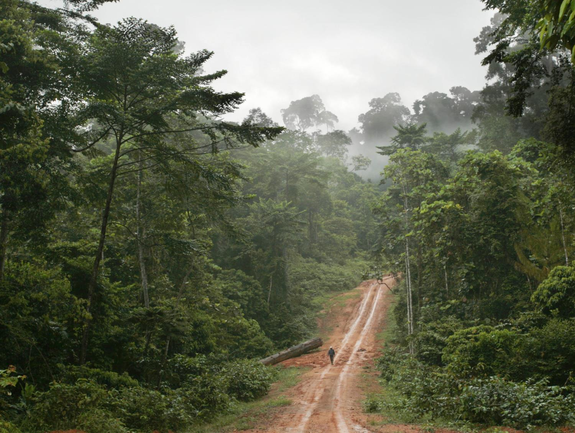
Notes:
Bienvenu en forêt tropicale d’afrique centrale… Comme ailleurs sur la planête, on préfère des systèmes d’exploitation sélectif, seul quelques arbres sont coupé par ha et plus de grandes surface en un coup. Contrairement à la gestion traditionnelle, il faut donc gérer des forêts très complexes dans lesquelles des arbres d’espèces, de taille, d’âge diversifiées coexistent.

Slide 3
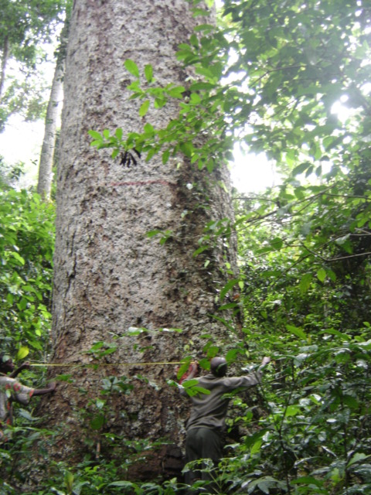
Large trees a key structural characteristic of complex forests
Notes:
Pilier de la structure de ces forêts autant en termes de biomasse qu’en termes d’habitat pour la biodiversité

Slide 4
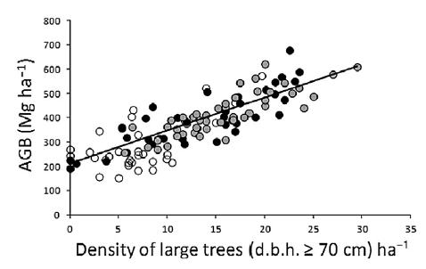
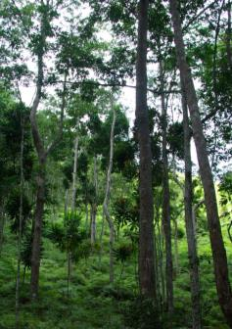
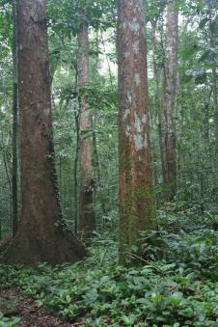
Large trees are scare but their abundance drives stand biomass and carbon stocks
Density of large trees explains 70% of above-ground biomass (AGB) variation across the tropics
Neotropics 287 Mg.ha⁻¹
Africa 418 Mg.ha⁻¹
Asia 393 Mg.ha⁻¹
Slik et al. 2013 GEB
Notes:
Aussi bien à une échelle régionnale que pan-tropicale,
The density of trees with a DBH ≥ 70 cm have been linearly related to plot AGB, with 70% of variation explained.
The density of large trees also explain the difference in AGB between the Neotropics (Southern and Central America), Africa and Asia

Slide 5
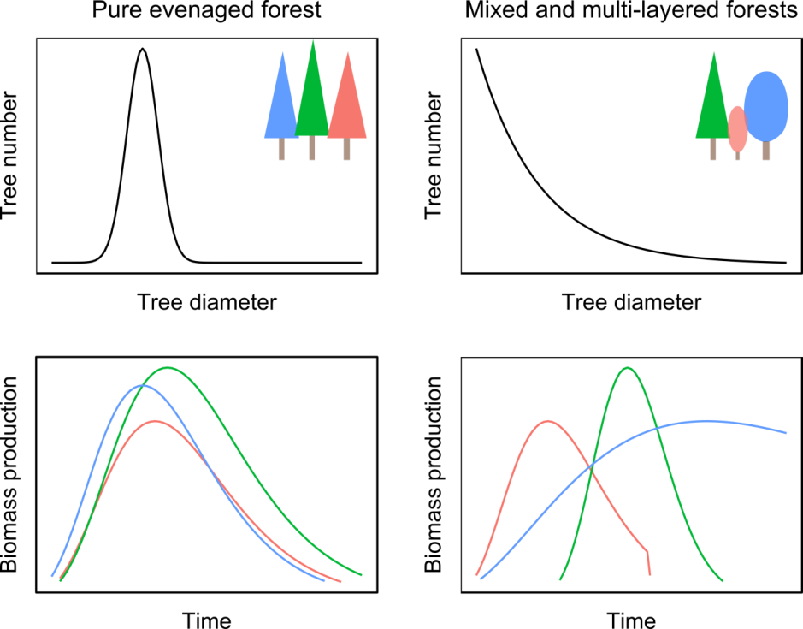
The role of large trees to annual biomass production

Slide 6
The role of large trees to annual biomass production
Size- or age
decline

Slide 7
The role of large trees to annual biomass production
Notes:
En peuplement irrégulier, il n’y a plus de lien entre le temps, la taille des arbres et la production

Slide 8
The role of large trees to annual biomass production
Long-living
species
Mortality
Recruitment

Slide 9
The role of large trees to annual biomass production
Few large trees
of varying size,
age, species
and life history

Slide 10
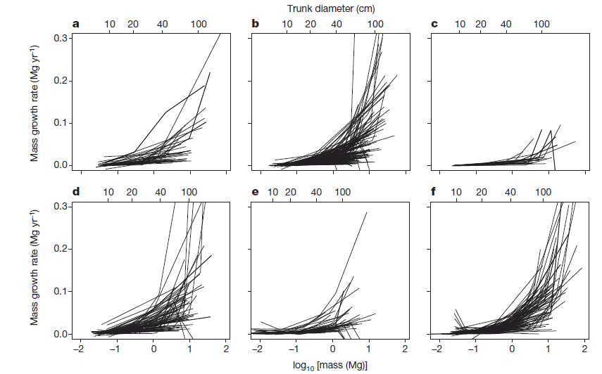
Large trees ≠ senescent biomass stock
Africa
(Cameroon + DRC)
Asia
Australia
Central and South America
Europe (Spain)
North America (USA)
Stephenson et al. 2014 Nature
Notes:
The important contribution of large trees to biomass and carbon accumulation has also been demonstrated.
A recent analysis demonstrated a continuous increasing mass growth rate with tree mass thus highlighting the huge contribution of large trees to carbon accumulation in forest ecosystems (Stephenson et al., 2014).
The pattern has been identified using a segmented regression and the log-transformation of the x-axis suggests an exponential relationship (and not a power relationship).

Slide 11
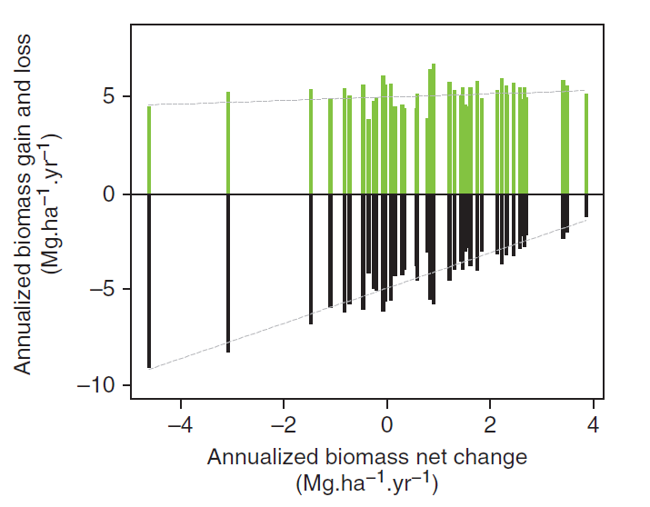
Large trees mortality could drive net biomass change
Biomass gains
Tree growth, recruitment
Biomass losses
Tree mortality
Rutishauser et al. 2010 J. Veg. Sci
Mainly due to mortality in large trees
Notes:
Dans ce graphique,
En x : l’évolution nette de biomasse, i.e. gains – pertes
En y : soit les gains en valeurs positives, soit les pertes en valeurs négative
l’auteur, Ervan Rutishauser a choisi d’utiliser des barres plutôt que des points, mais dans ce cas vous pouvez analyser ce graphique en regardant l’extrémité de chaque barre comme un point.
On y remarque que les pertes (donc la mortalité) est corrélée avec l’évolution net de biomasse alors que cette corrélation est très faible avec les gains. Dans certains cas, la mortalité influence donc plus l’évolution net de biomasse comparativement au gain. En d’autres termes, les gains sont assez constant aussi bien dans les forêt qui ont un bilan en biomasse positif ou négatif…

Slide 12
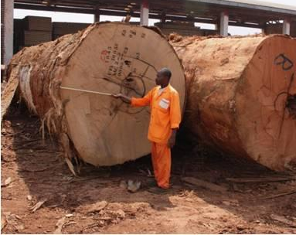
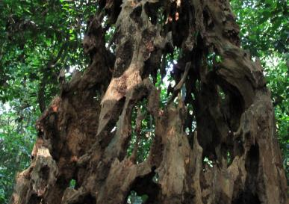
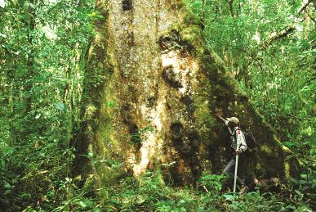
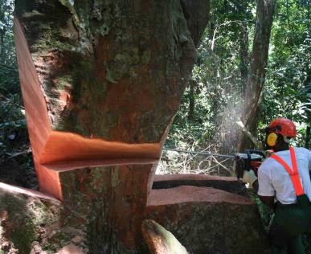
The productive role of large trees at the forest scale
A crucial question
Carbon cycle and climate mitigation
Forest management
Conservation
A large variety of point of views
Observation scale
Ecology and Forest Sciences
Interactions of processes operating at tree and stand levels

Slide 13
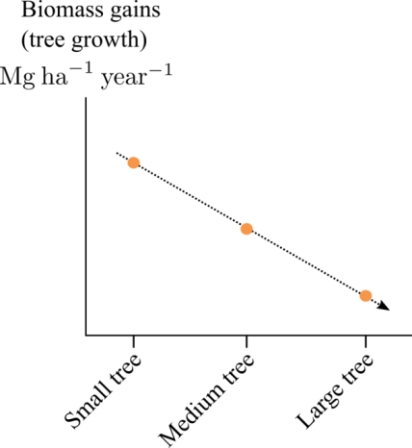
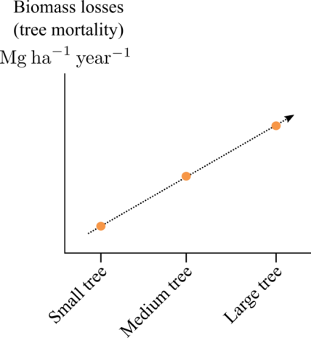
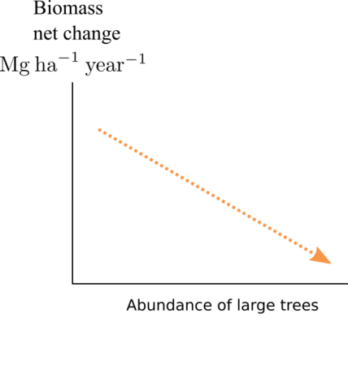
Research question and hypotheses
Clarify the relative role of large trees in biomass production at the stand level in complex forest
Sum of the biomass gains
of every small trees
per area unit

Slide 14
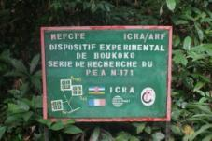
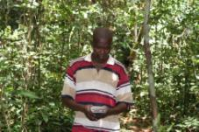
MATERIAL & METHODS
The M’baïki long-term silvicultural experiment Study species and plots Computing biomass gains and losses at the 4-ha plot scale
Notes:
To test these hypotheses, we used the data of the M’baiki long-term silvicultural experiment

Slide 15
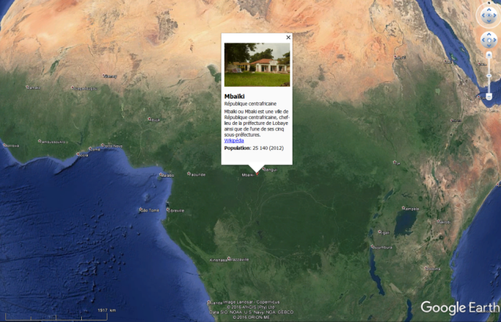
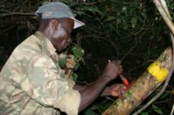
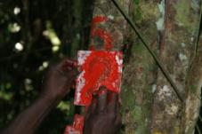
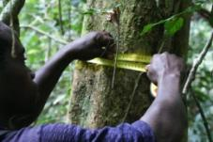
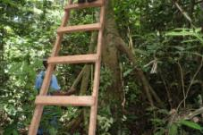
The M’baïki site
Location : Central African Republic
Permanent sampling plots
10 plots (4-ha) established in 1982
All trees (dbh≥10cm) marked, geo-referenced and identified
Silvicultural treatments Control plots (3×4 ha)
logged plots (3×4 ha) between 1984 and 1985
Logged and thinned plots (4×4 ha) between 1984 and 1987
Notes:
République centrafricaine. Average annual rainfall is 1739 mm (1981–2008) with a 3-months dry season. Annual average monthly temperature is 24.9°C (19.6–30.2 °C, 1981–1989). The site is located on a large plateau (500 to 600 m a.s.l.). Soils are deep ferralitic soils, classified as acrisols in the WRB system. The vegetation belongs to the semi-deciduous moist forest (and specifically to the moist Central African type).

Slide 16
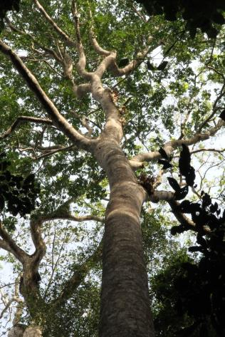
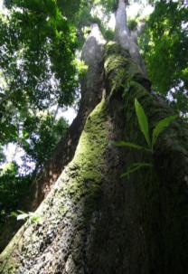
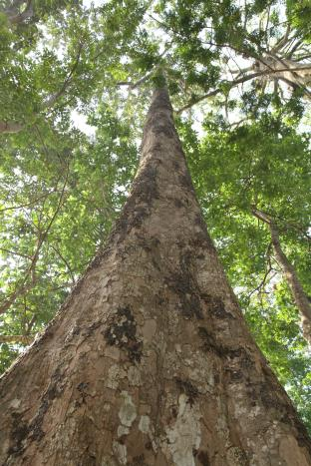
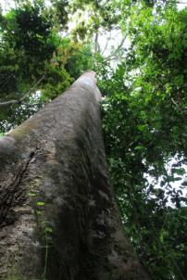
Data selection
1992 – 2012 period
A total of 29,729 trees of 225 taxa including 200 species, 151 genera and 54 families
Eg. Entandophragma cylindricum (12.4 % of AGB in large trees in 1992), Triplochiton scleroxylon (9.4%), Terminalia superba (7.3%), Manilkara mabokeensis (7.2%) and Petersianthus macrocarpus (5.0%).
Entandophragma cylindricum (Meliaceae)
Triplochiton scleroxylon (Sterculiaceae)
Terminalia superba (Combretaceae)
Khaya anthoteca (Meliaceae)
Notes:
Due to identification issues, we used the long term growth data over the 1992-2012 period
Sapelli, Ayous, Fraké, Acajou
En réalité, d’avantage d’espèce ont été identifiée depuis 1992.

Slide 17
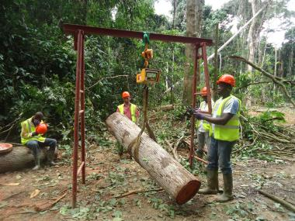
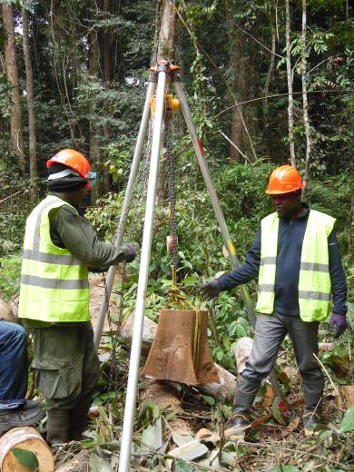
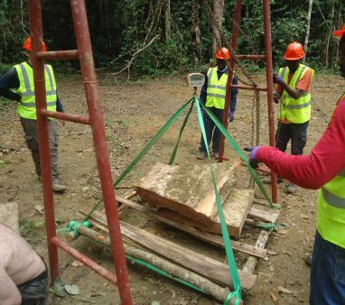
Biomass computation
Allometric relationship for moist tropical forests
(BIOMASS R Package)
AGB_{i} =
WD_{s} × exp[-1.499 + 2.148×ln(DBH) + 0.207×ln(DBH)² - 0.0281×ln(DBH)³]
biomass gain = the sum of the biomass growth of all surviving trees
recruitment = Biomass recruited is the sum of the biomass of all trees that attained 10-cm DBH
biomass loss = the sum of the biomass of all trees that died
Chave et al. 2005 Oecologia

Slide 18
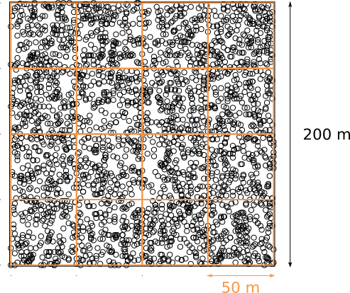
Statistical analyses
8 DBH classes of ≥ 20 cm
3 DBH classes:
small : 10-30 cm
medium : 30-70 cm
large trees : >70 cm
10 plots of 4 ha
Compute biomass gains and losses for each plot, subplot and size class
Compute confidence intervals of 4-ha plot
Biomass estimates bootstrapping over 0.25-ha subplots
160 subplots of ¼ ha

Slide 19





Results & Discussion
Biomass stock of large trees
Biomass gains and losses of large trees
Biomass net change versus abundance of large trees
Notes:
I will now show some results,
BUT I first wanted to give a special attention to our centrafrican colleagues of the Mbaiki experiment that have been living hard time since march 2013

Slide 20
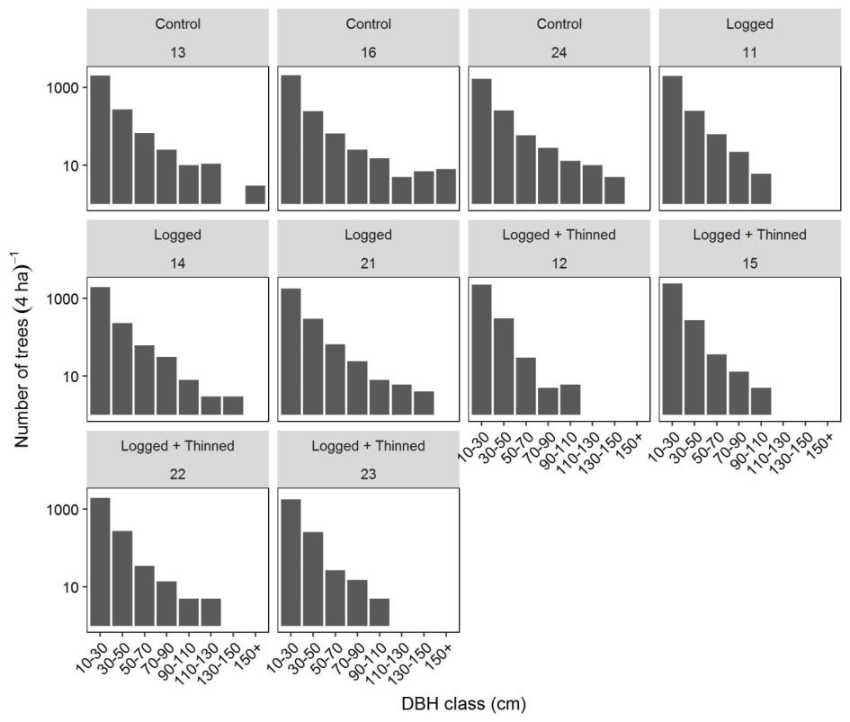
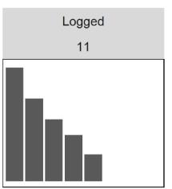
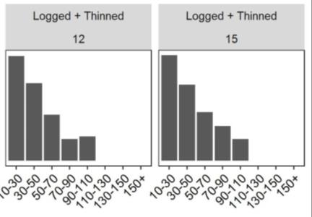
Stand structures along a gradient of forest perturbation
Basal area : 23 – 36 m²/ha
QSD : 24 – 28 cm
N : 523 – 603 trees/ha
%N large trees : 0.5 - 2.8%
%AGB large trees : 17 – 49%
Biomass net change :
1.1 – 9.2 Mg ha⁻¹ year⁻¹

Slide 21
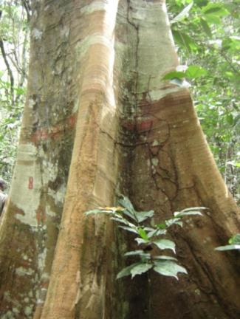
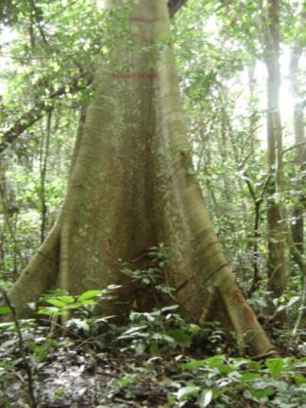

Stand structures along a gradient of forest perturbation
Large trees (DBH > 70 cm)
= very diverse trees!

Slide 22
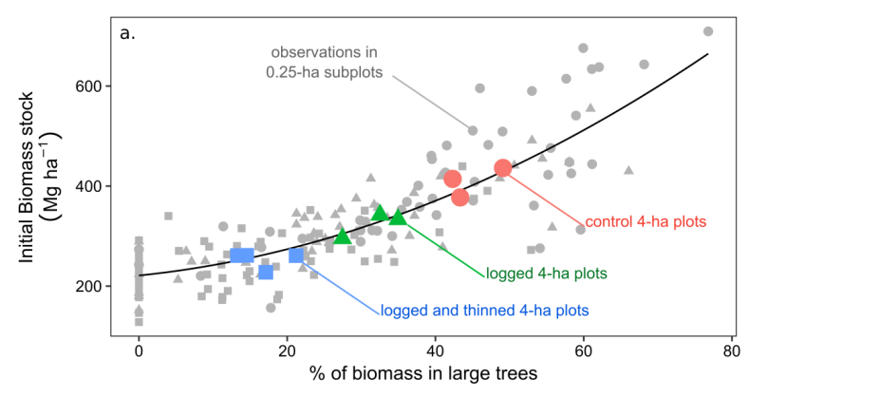
Biomass stock increased with the abundance of large trees
Abundance of large trees well predict total biomass stock (r=0.984, n=160)
Even at a very local scale
Neotr
Africa
Asia
Slik et al. 2013 GEB

Slide 23
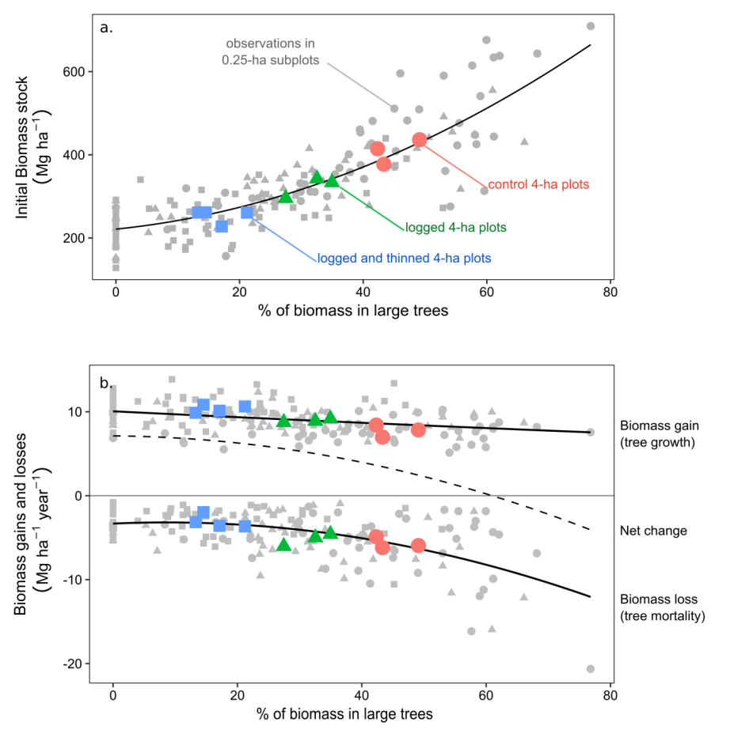
Biomass net change decreased with the abundance of large trees
Notes:
Plots with high abundance of large trees are then also plot with high initial stock of biomass
stand biomass loss increased with the abundance of large trees probably as a combined effect of higher tree mortality rates among all tree size classes and higher initial biomass stock

Slide 24
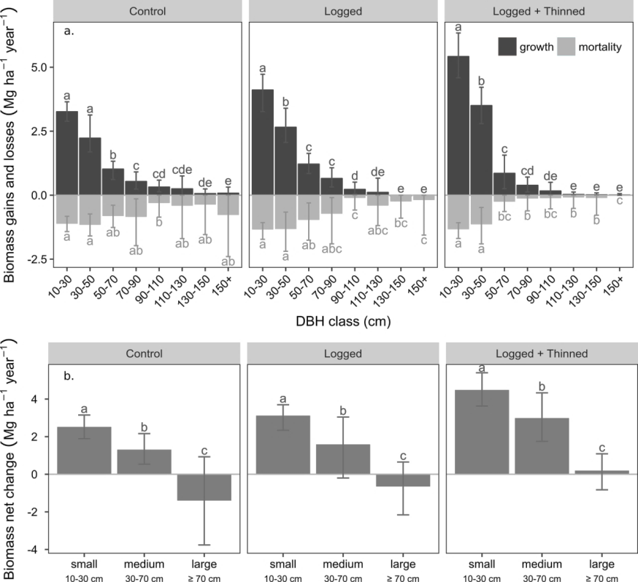
Contribution to plot biomass gains and losses
The few large trees produced substantially less biomass then the numerous small trees
Loss of biomass of large trees could be as important as that of small trees
Notes:
no clear trend was observed regarding the loss of biomass with tree size.
The loss of biomass in large trees depends logically on the initial stock of large trees and then also on the intensity and frequency of past perturbations

Slide 25
Contribution to plot biomass gains and losses
The few large trees produced substantially less biomass then the numerous small trees
Loss of biomass of large trees could be as important as that of small trees
=
Contribution to plot biomass net change decreased with tree size and that of large trees ≈ 0
Notes:
no clear trend was observed regarding the loss of biomass with tree size.
The loss of biomass in large trees depends logically on the initial stock of large trees and then also on the intensity and frequency of past perturbations

Slide 26
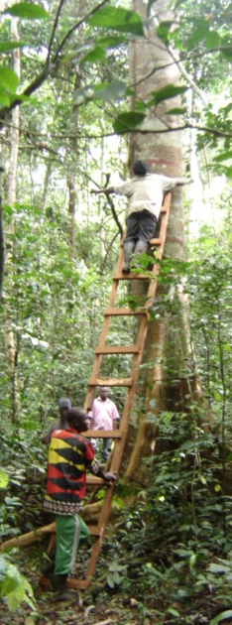
Conclusions

Slide 27
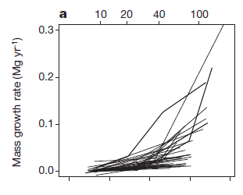
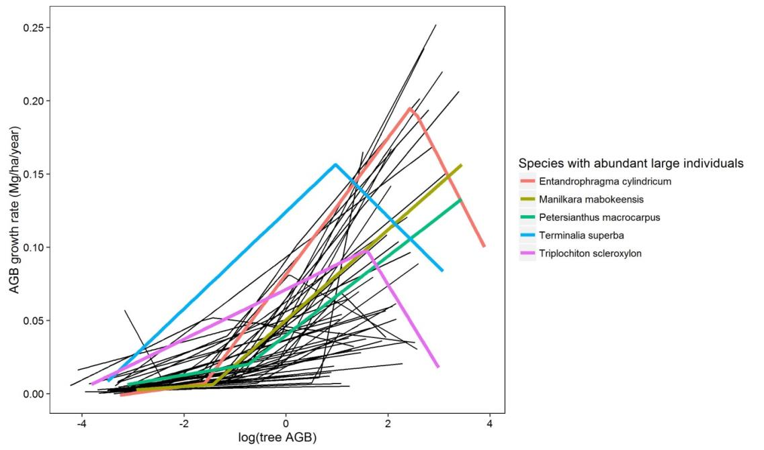
Not in contradiction with the results observed at the tree level
Africa
(Cameroon + DRC)
Stephenson et al. 2014 Nature
Notes:
Some large individuals may indeed show large and sustained biomass increment but such large increment does not reflect the production of biomass in large individuals at the plot level
As reviewed by Sheil et al. (2016), individual and aggregated trends in biomass production can be distinct, for example, because large trees experience during their life different competitive environment than most small trees.
Part of the novelty of our study is to clearly demonstrate that despites high growth rate of some large individuals, the contribution of large trees to stand biomass net change is likely limited in comparison to that in small trees.

Slide 28
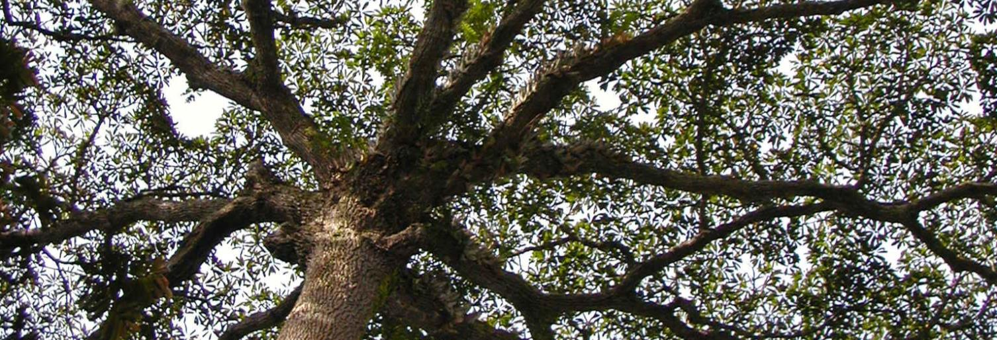
In terms of biomass or carbon only … Forest with abundant large trees = high capital investment high risk level low profitability rates

Slide 29
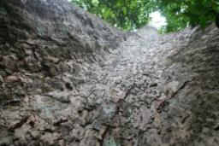
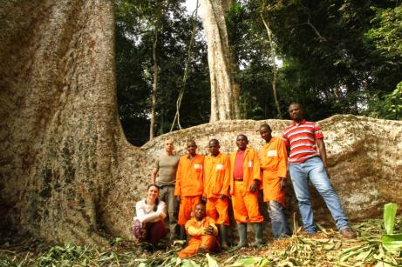
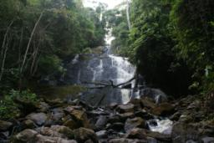
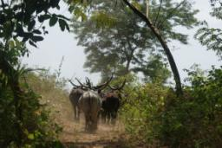
Photo credit :
© Jean-Louis Doucet, Jean-Yves de Vleeschouwer, Dakis-Yaoba Ouédraogo ,
Adeline Fayolle, Sebastien Bauwens
Gauthier Ligot
gligot@ulg.ac.be

Slide 30
Stand structure
Plot | Treatment | Tree density |  | Quadratic mean DBH | Basal area | Aboveground Biomass |  | basal area 1984-1987
 |  | (ha⁻¹) | %large trees | (cm) | (m² ha⁻¹) | (Mg ha⁻¹) | % large trees | (m² ha⁻¹)
16 | Control | 603.25 | 2.49 | 27.75 | 36.49 | 436.22 | 49.11 | 1.11
24 | Control | 506.50 | 2.81 | 28.41 | 32.12 | 377.35 | 43.33 | 0.47
13 | Control | 597.25 | 2.05 | 26.87 | 33.86 | 414.42 | 42.32 | 0.33
12 | Logged + Thinned | 649.75 | 0.50 | 22.55 | 25.95 | 261.05 | 13.28 | -2.86
11 | Logged | 584.50 | 1.33 | 24.59 | 27.76 | 295.30 | 27.45 | -3.12
21 | Logged | 548.50 | 1.91 | 26.73 | 30.79 | 342.23 | 32.53 | -3.88
15 | Logged + Thinned | 677.00 | 0.70 | 22.29 | 26.41 | 261.53 | 14.54 | -5.25
14 | Logged | 571.50 | 1.97 | 25.54 | 29.28 | 333.35 | 34.95 | -5.58
22 | Logged + Thinned | 574.50 | 1.09 | 23.97 | 25.93 | 260.94 | 21.20 | -6.44
23 | Logged + Thinned | 523.75 | 1.05 | 23.82 | 23.34 | 227.64 | 17.12 | -6.87

Slide 31
Biomass gains, losses and net changes
Id | traitement | site | Growth |  | Mortality |  | Recruitment |  | Net change
24 | Control | La Lolé | 6.97 | (6.44;7.48) | -6.19 | (-7.9;-4.77) | 0.34 | (0.3;0.38) | 1.13 | (-0.6;2.59)
16 | Control | Boukoko 2 | 7.83 | (7.27;8.44) | -5.94 | (-8.47;-3.96) | 0.46 | (0.42;0.52) | 2.36 | (-0.24;4.4)
11 | Logged | Boukoko 1 | 8.74 | (8.22;9.31) | -6.03 | (-7.36;-4.81) | 0.35 | (0.31;0.4) | 3.06 | (1.64;4.35)
13 | Control | Boukoko 1 | 8.42 | (7.9;8.96) | -4.89 | (-6.5;-3.51) | 0.27 | (0.24;0.31) | 3.80 | (2.31;5.11)
21 | Logged | La Lolé | 8.89 | (8.34;9.43) | -5.00 | (-6.95;-3.62) | 0.32 | (0.28;0.37) | 4.22 | (2.47;5.69)
14 | Logged | Boukoko 2 | 9.16 | (8.45;9.88) | -4.59 | (-6.27;-3.23) | 0.35 | (0.29;0.4) | 4.91 | (3.14;6.56)
23 | Logged + T. | La Lolé | 9.88 | (9.11;10.54) | -3.15 | (-3.85;-2.44) | 0.30 | (0.27;0.34) | 7.03 | (5.97;7.96)
12 | Logged + T. | Boukoko 1 | 10.12 | (9.35;10.79) | -3.59 | (-4.34;-2.85) | 0.53 | (0.46;0.6) | 7.06 | (5.9;8.1)
22 | Logged + T. | La Lolé | 10.64 | (9.77;11.49) | -3.66 | (-4.75;-2.78) | 0.43 | (0.38;0.47) | 7.41 | (6.38;8.35)
15 | Logged + T. | Boukoko 2 | 10.84 | (10.3;11.46) | -1.96 | (-2.22;-1.72) | 0.32 | (0.28;0.37) | 9.20 | (8.63;9.79)

Slide 32
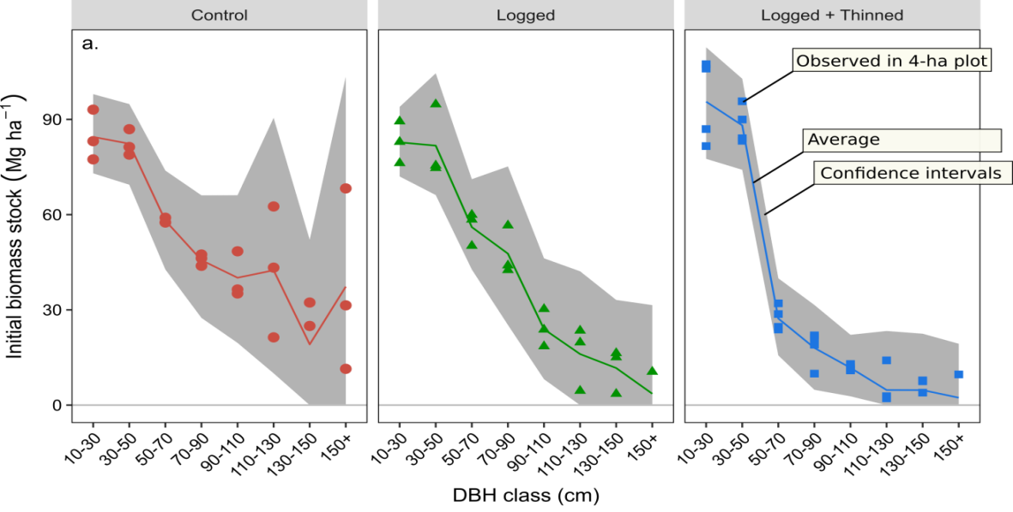
Importance of large trees along a gradient of forest perturbation
%AGB large trees : 17 – 49%
Large trees (DBH > 70 cm)
= very diverse trees!
Notes:
The definition of large trees is inevitably ecosystem-specific
large trees include trees of very different sizes, ages, shapes and species
large trees spaed trees of diameter ranging from 70 cm to 221 cm.

