Slide 1



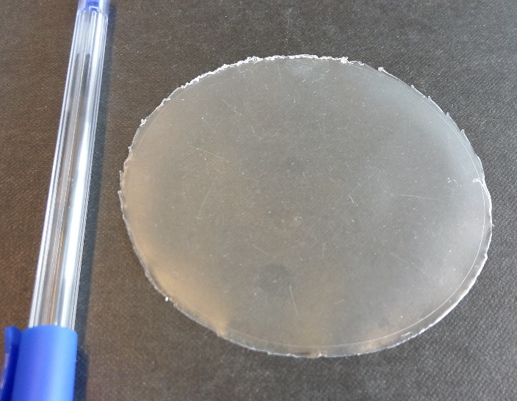
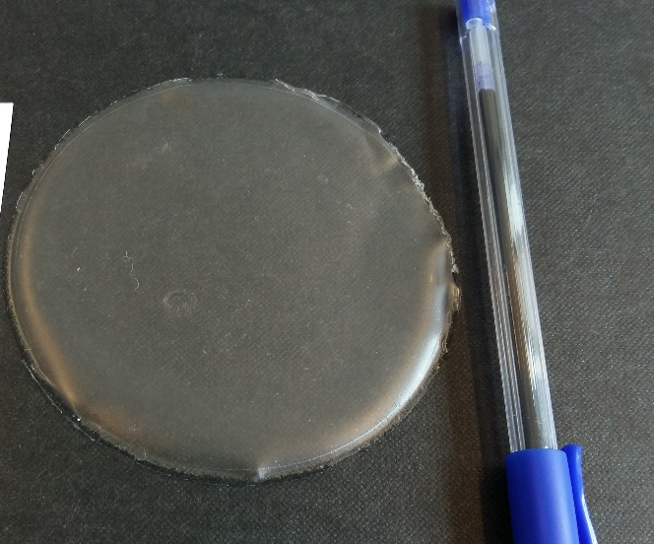
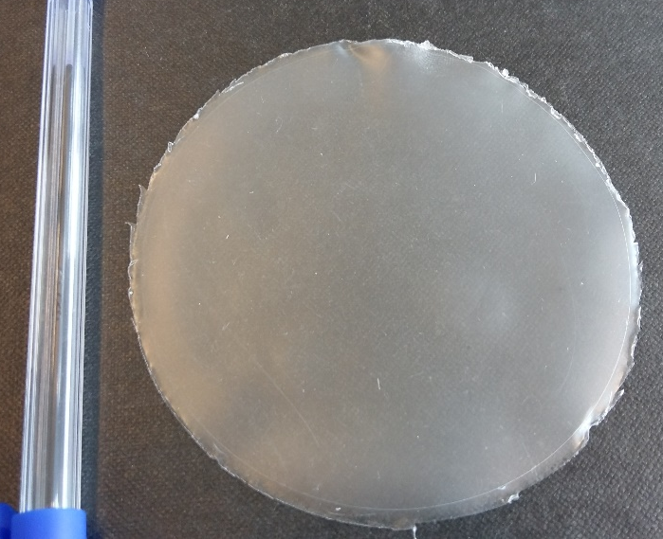
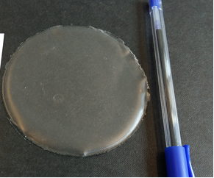
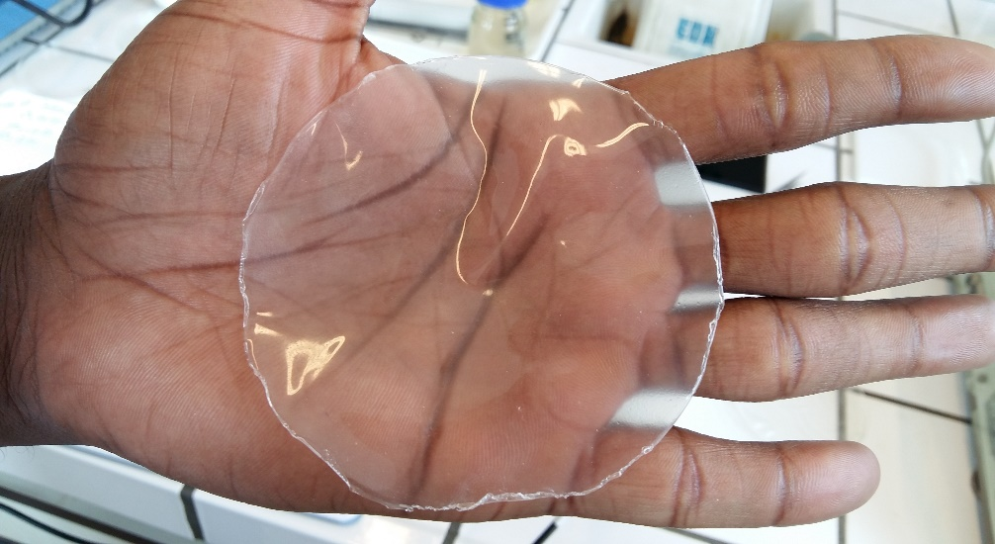
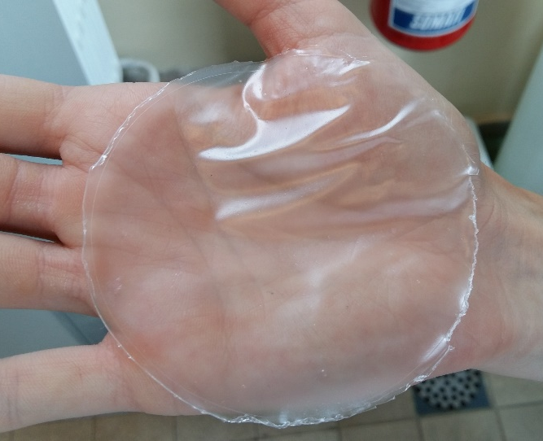
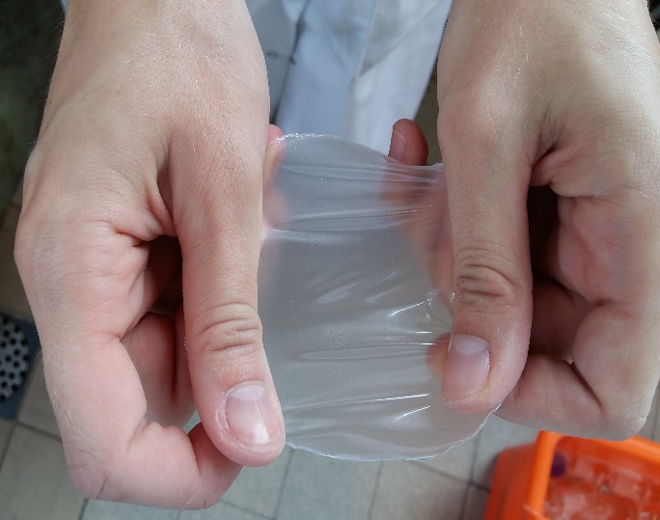

Water Vapor Permeability and mechanical properties of edible films on native starch from improved cassava variety in Côte d’Ivoire
Adjouman Y D ^{1,2,3 *}, Nindjin C ^{1,2} , Tetchi F A ¹, Amani N G ¹ and Sindic M ³
1 University Nangui Abrogoua, Food sciences Technologies Abidjan, Ivory Cost
2 Centre Suisse de Recherches Scientifiques in Côte d’Ivoire (CSRS)
3 University of Liège-Gembloux Agro-Bio Tech, Laboratory Security and Quality of Food Products
* Author adress: desyadjouman@gmail,com/ +32 465454054
Summary
Results
Films were prepared with 5 % oil, 25 and 30 % glycerol, 0 and 5 % soy lecithin and 0,2 g potassium sorbate. Mechanical (Tensile strength and Elongation at break) and water vapor properties of native improved cassava starch variety Olekanga films were determined. Increasing glycerol concentration and soy lecithin addition had no significant effect on water vapor permeability of the films. In opposite significant difference (p <0.05) of glycerol concentration was observed on tensile strength and elongation at break of films. Which was not the case when soy lecithin concentration is increased from 0 to 5 %. Tensile strength decreased with increase in glycerol concentration. Opposite behavior was observed for elongation at break. Films on native starch from improved cassava variety Olekanga in Côte d’Ivoire were less resistant, very elongable with acceptable water vapor permeability.
Films visual appearance
a
b
c
d
e
f
g
Introduction
A study in Côte d'Ivoire entitled "artisanal and industrial valorization of native cassava (Manihot esculenta Crantz) and yam (Dioscorea sp)" starches showed that the film produced with starch cassava and vegetable oil showed the most promising coatings capabilities. This film was designed without plasticizer and showed mechanical limits. So, the presence of plasticizer could overcome the fragility of the film, with a commonly used slurry of 15-40 g of glycerol in 100 g of starch. The properties of starch films can be further improved by producing composite films with incorporation of functional additives. Thus, in this present study, starch-based films have been strengthened with addition of a plasticizer (glycerol), an emulsifier (soy lecithin) and a preservative (potassium sorbate).
Figure 1: a) film from formulation F2; b) formulation F1
c) formulation F4; d) formulation F3 ;
e, f, g) emulsified film hand-held
Table 1: Values of films WVP
Formulations | WVP (x 10⁻¹¹ g Pa⁻¹ s⁻¹ m⁻¹) | Thickness (µm)
F1 | 2.13ª ± 0.00739 | 74.25 ± 4.60
F2 | 2.21ª ± 0.0198 | 79 ± 0.707
F3 | 2.8ª ± 0.332 | 73.65 ± 0.119
F4 | 2.64ª ± 0.116 | 70.75 ± 2.47
Material and Methods
Native starch used was obtained by cold water extraction from a cassava variety Olekanga belonging to the genotype collection of National Agricultural Research Center in Côte d'Ivoire.
Films preparation, mechanical properties and WVP determination
Step 1:
Cassava starch, glycerol and water mixture is heated at 30-75°C at 750 rpm / 20min
Oil and water or oil, water and soy lecithin is also heated at 30-75°C at 750 rpm / 20min
Step 2:
Oil and water or oil, water and soy lecithin mixture is homogenized at 24000 rpm / 2 min
Both mixtures were mixed together and heated at 75-95°C at 750 rpm / 25 min
Step 3: Final solution is poured into Petri dishes and dried at 35 °C / 24 hours. After drying, films are removed and stored at 25 °C and 62 % humidity / 48 hours.
Water Vapor Permeability was conducted according ASTM method E96, mechanical properties were studied using a TA.TX2 Stable Micro Systems Texture Analyzer by means of tensile test based on the ASTM D882-02, with some modifications and the differences between means were tested at p <0.05 level using Minitab17 software.
Figure 2: Tensile strength of film based on Olekanga cassava starch
Figure 3: Elongation at break of film based on Olekanga cassava starch
Conclusion
Acknowledgments
The authors would like to thank the Interprofessional Fund for Agricultural Research and Council (FIRCA) in Côte d’Ivoire who supported funding of this study. They would also like to thank Marjorie Servais and Thomas Bertrand for all technical support to the laboratory
Films generally appear uniforms, homogeneous, transparent and present no cracks
Method applied in the preparation of various starch based films with improved cassava Olekanga has produced films in which oil appeared scattered
Tensile strength decreased with increase in glycerol concentration. Opposite behavior was observed for elongation at break
For Water Vapor Permeability, values varied from 2,13.10⁻¹¹ to 2,8.10⁻¹¹ g/Pa·s·m. This results are nevertheless lower than those obtained by Phan The and al. (2009) which varied from 2,75 to 2,94.10⁻¹¹ g/Pa·s·m on emulsified films based on cassava starch
Films on native starch from improved cassava variety Olekanga in Côte d’Ivoire were less resistant, very elongable with acceptable water vapor permeability.
References
ASTM, American Society for Testing an Materials: Standard ASTM E96 for Cup Method Water Vapor Permeability Testing, Annual Book of ASTM, Philadelphia, PA.
Phan The D., Debeaufort F., Voilley A and Luu D. (2009). Influence of hydrocolloid nature on the structure and functional properties of emulsified edible films. Food hydrocolloids 23, 691-699
13-14 October 2016; Sophia Antipolis (France); 2nd EPNOE Junior Scientists Meeting

