Slide 1
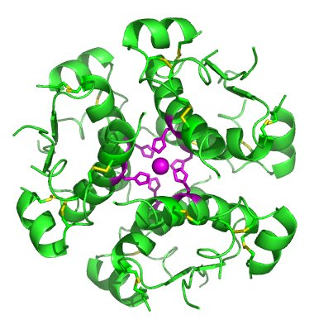
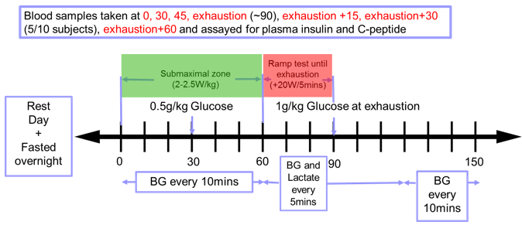
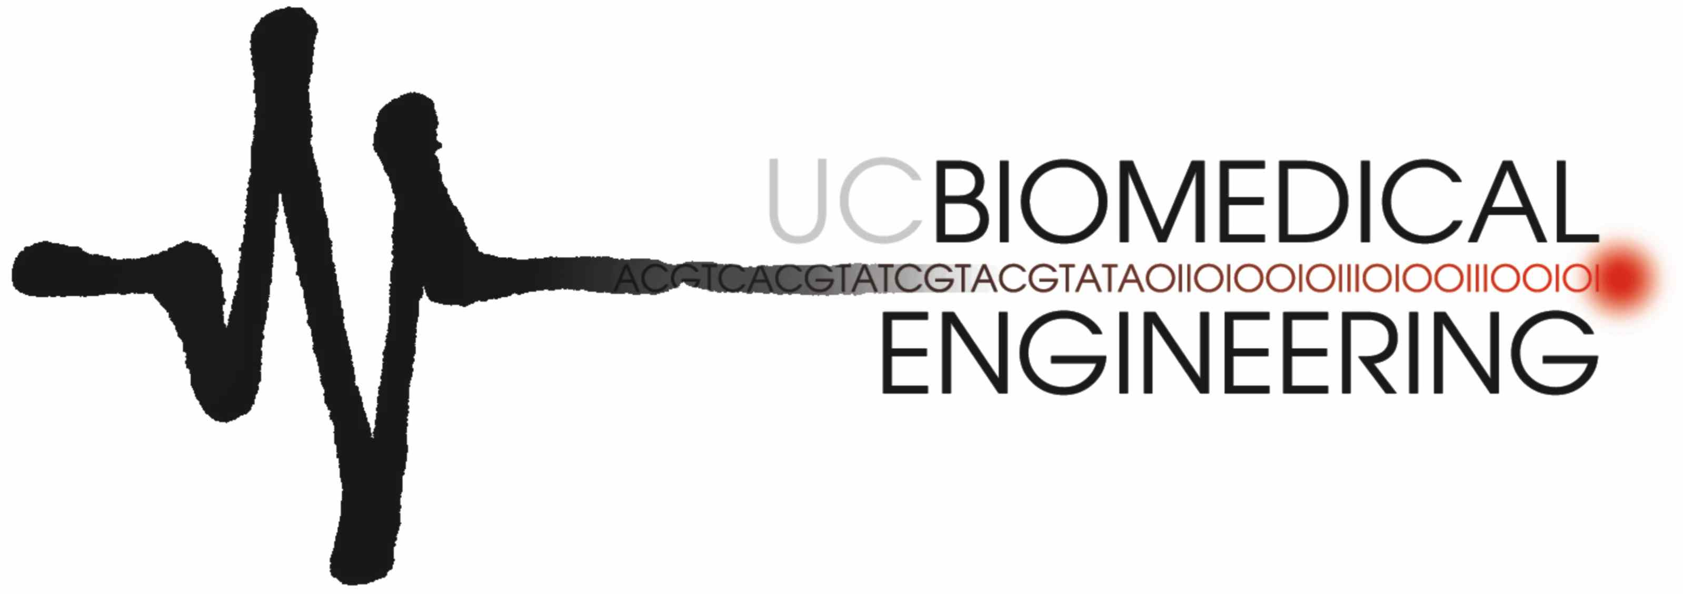



A Model of Endogenous Insulin Secretion During Exercise
Felicity Thomas, Chris G Pretty, Kent Stewart, Geoffrey M Shaw, Thomas Desaive, J Geoffrey Chase
INTRODUCTION
Modelling endogenous insulin secretion (Uen) can play a significant role in model-based glycaemic management. The accuracy of modelled endogenous insulin secretion can significantly impact other model-identified parameters, like insulin sensitivity (SI) and thus dosing. However, many models of endogenous secretion are based exclusively on sedentary individuals (healthy and diabetic), and are not appropriate during and immediately after exercise, due to the impact on secretion of post-exercise hyperglycaemia and increase of counter-regulatory hormones. This study develops an endogenous insulin secretion model for healthy individuals during exercise
METHODS
RESULTS
Patients and Protocol
10 trained subjects (resting heart rate<60bpm, training 6-15hrs/week) underwent a fasted continuous exercise test to exhaustion (EX). Oral glucose doses were given at 30mins (0.5g/kg) and exhaustion ~85mins (1g/kg). Reference capillary BG measurements were measured every 10mins. Venous blood samples were assayed for plasma insulin and C-peptide at 0, 30, 45min, EX, EX+15min, EX+30min (5/10 subjects), EX+60min. Insulin secretion was identified from C-Peptide and plasma insulin, and fitted as a function of BG.
Endogenous secretion was constrained between upper and lower bounds of 16000 mU/hr and 1000 mU/hr. The model fitting was applied across all values and then separately to the measurements collected during exercise and after exercise. The resulting model coefficients (a_{j}) and goodness of fit values are shown in Table 2.
Table 1. Cohort demographics of the participants. Data are presented as median [interquartile range] where appropriate
Number | 10
Age (yr) | 28 [23 37]
Gender (M/F) | 7/3
BMI (kg/m2) | 22 [21 24]
Resting HR (bpm) | 55 [53 56]
VO2max (mL/kg/min) | 46 [39 59]
Trained Cyclist (Y/N) | 7/3
Length of CGM data (hr) | 140 [105 141]
Table 11.2 Coefficients for endogenous insulin secretion models fitted with 1, 2 and 3 independent variables (dimensions) for all values measured, the values measured during exercise and the after exercise.
 | Model | Coefficients |  |  |  | Goodness of fit (R²)
 |  | Constant c (mU/hr) | BG a­₁ (mU.l/mmol.hr) | BG derivative a₂ (mU.l/mmol) | Plasma Insulin a₃ (l/hr)
All values | 1 dim. | -14140 | 2559 |  |  | 0.53
 | 2 dim. | -15973 | 2977 | -728 |  | 0.30
 | 3 dim. | -24954 | 4734 | -1161 | -185 | -0.15
During exercise | 1 dim. | -5325 | 1153 |  |  | -0.50
 | 2 dim. | -11717 | 2429 | -745 |  | -1.19
 | 3 dim. | -9859 | 2369 | -639 | -225 | -0.92
After exercise | 1 dim. | -18667 | 3049 |  |  | 0.04
 | 2 dim. | -27076 | 4142 | -845 |  | -0.71
 | 3 dim. | -45933 | 7107 | -1474 | -219 | -1.64
A simple 1-dimensional model, Fig 2, using all the measured values demonstrates the best fit. There was no benefit from additional complexity or splitting the model in to during and after exercise, most likely as there was then not enough values to generate an accurate model.
$Uen=2559×BG−14140$ Eq. 2
Figure 1. Schematic of exercise trial protocol
Modelling
The pharmacokinetic model and population kinetic parameters reported by Van Cauter et al. were used to deconvolve insulin secretion rates from measured C-peptide data. Age-based kinetic parameters were used for each subject.
As in previous studies models of the form shown in Equation 1 were fitted to the data. Where x_{j}­ denotes the independent variables (BG, BG derivative, plasma insulin) and c is a constant bias.
$f\left(x\right)=\sum_{j}{a_{j}x_{j}}+c$ Eq 1.
Model fitting was performed by minimising the sum of the geometric means of the squared deviations in each dimension. Goodness of fit was assessed using the coefficient of determination, R2, calculated for the constrained model.
Figure 2. Pre-hepatic insulin secretion data from the 10 subjects and the one dimensional model fit (R² = 0.53)
To validate the secretion model, comparisons were made to published data. No data was found in the literature concerning insulin secretion rates in athletes or healthy subjects while exercising. Reported results for the glucose coefficient are at the upper end of the range 2646 - 485mU.L/mmol.hr for healthy, sedentary subjects .
CONCLUSION
The proposed model of endogenous insulin secretion, based on physiological measurements, provides a simple estimate of insulin secretion with comparable physiological parameters to existing literature. Overall, the endogenous insulin secretion model provides a valuable addition to glucose-insulin modelling, specifically for healthy individuals during exercise.

