Slide 1
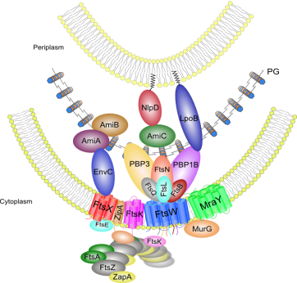
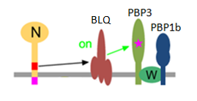
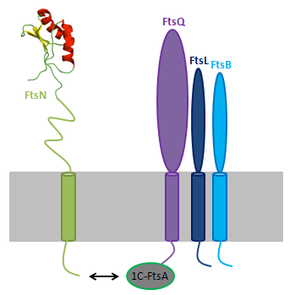
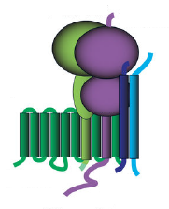
Introduction
Study of interactions and activities of the enzymatic core of the divisome in Escherichia coli.
A. Boes, S. Olatunji, and M. Terrak
Centre for Protein Engineering, University of Liège, Sart Tilman, 4000 Liège, Belgium. adrien.boes@doct.ulg.ac.be
Peptidoglycan (PG) synthesis is controlled by specialized multiprotein machineries that are essential for bacterial growth and division. The divisome (figure 1A) controls septal PG synthesis and separation of daughter cells. In E. coli, PBP3, PBP1b and FtsW interact and collaborate to synthesized the new cell wall at the division site [1-6]. Nevertheless, the factors responsible for triggering the synthesis of the septal PG are largely unknown. A Recent in vivo study suggests that FtsN would collaborate with the complex FtsBLQ to activate the PG synthesis at the division site [7] (figure 1B). In this work we have investigated interactions between these proteins and we aim to characterize their biochemical activities.
A
B
Figure 1 :
A. Schematic representation of the divisome in E. coli.
B. Model for PG synthsesis activation by the collaboration of FtsN and FtsBLQ.
Results
A
B
C
1) Purification of the FtsBLQ complex
FtsQ
The full-length form of the four proteins FtsN, FtsB, FtsL and FtsQ were co-expressed in E. coli followed by affinity co-purification with FtsB containing an N-terminal His-tag (bait) and the others proteins untagged (prey) (figure 2). Same experiment was carried out using a strep-tag (figure 3). Both experiments allowed us to co-purify FtsL and FtsQ with FtsB.
FtsB
FtsL
FtsL
FtsB
Figure 2 : A. Coexpression and purification of FtsBLQ complex on IMAC. B. Western blot with antibody anti-His₆ performed on His-FtsBLQ C. After gel filtration on superdex 200.
Figure 3 : Coexpression and purification of FtsBLQ complex on Strep-tactin column.
2) FtsBLQ complex interacts with the FtsW-PBP3 complex
We performed co-expression of strep-FtsB, FtsL, FtsQ, FtsN with His-FtsW-PBP3 in E. coli followed by affinity purification on a Ni-NTA column (figure 4). The non specific affinity of FtsBLQ for the Ni-NTA column has been invalidated. These results suggest that the proteins FtsW-PBP3 and FtsBLQ form a larger complex inside the divisome.
A
B
C
D
E
Figure 4 :
A. Coexpression and purification of HisFtsBLQ/FtsW/PBP3 on IMAC.
C. FtsW-PBP3 complex (control).
B and D. PBP3 labelled with fluorescent ampicillin.
E. Western blot with antibody anti-FtsQ performed on His-FtsBLQ (left) and on HisFtsBLQ/FtsW/PBP3 complex (right).
FtsW* = degradation of FtsW.
PBP3
D.
FtsW
FtsQ
FtsW*
FtsL
FtsB
Conclusions
Perspectives
Using co-expression and co-purification experiments, we showed that FtsBLQ interacts strongly with the complex FtsW-PBP3 to form a larger sub-complex inside the divisome.
Investigate if PBP1b could take part inside the penta-complex highlighted in this work.
Asses the effect of both FtsBLQ and FtsN on the transpeptidase activity of PBP3 using radioactive lipid II and the PBP1b mutant unable to cross-link the PG glycan.
Monitor the effect of both FtsBLQ and FtsN on the glycosyltransferase activity of PBP1b by fluorescence method using dansyl lipid II as substrate.
Trying to co-purify FtsN with the penta-complex using the 1C domain of FtsA which is known to interact directly with the N-terminus of FtsN [8] (figure on the right).
PBP3
FtsQ
FtsW
FtsL
FtsB
References
1- Egan AJ and Vollmer W. Ann N Y Acad Sci. 2013 1277, 8-28; 2-Bertsche et al., Mol Microbiol 2006 61 675-90; 3- Mohammadi et al., EMBO J 2011 30,1425-32; 4- Müller et al., J Biol Chem 2007 282 36394-402; 5-Fraipont et al., Microbiology 2011 157, 251-9;6; 6-Leclercq et al, Scientific Report, 2017-
7- Bing Liu et al., Mol Microbiol 2015 95(6), 945–970; 8- Busiek et al., J.Bacteriol 2012 94(8): 1989–2000.
Acknowledgement to

