Slide 1


Slide 2



02
The Belgian Electoral System Open list system, political parties and individual candidates
Frédéric Bouhon
Lecturer at the University of Liège (Belgium)

Slide 3
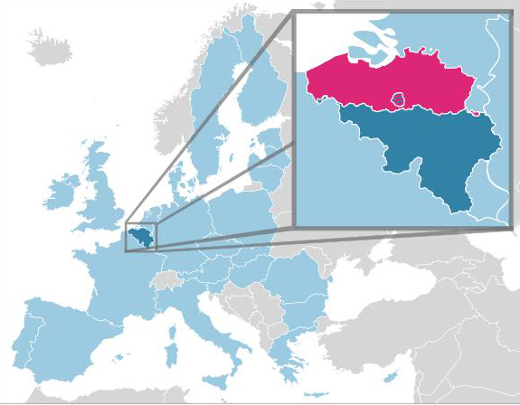
02
General introduction

Slide 4
02
I. General description of the Belgian electoral system
Federal and multi-level political system
Proportional system
Legal threshold and constituency magnitude
Open lists system

Slide 5
02
Federal and multi-level political system
3 Regions :
Flemish Region
Walloon Region
Brussels-Capital Region
3 Communities :
Flemish Community
French Community
German-speaking Community

Slide 6
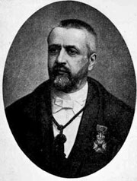
02
Proportional system (since 1899)
D’Hondt system
Victor d’Hondt
1841-1901

Slide 7
02
Legal threshold and constituency magnitude
Legal threshold : only parties which have obtained at least five percent of the total votes cast in a given constituency can be admitted to the process allocating seats in the said constituency.
Natural threshold : lack of constituency magnitude and disproportion.

Slide 8
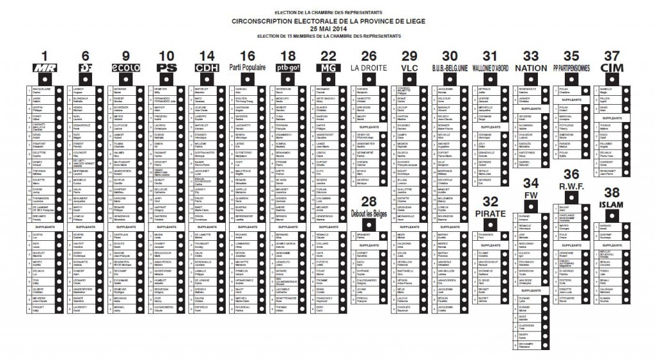
02
Open list system

Slide 9
02
II. Description of the open list system in Belgium
A. Origin and evolution
B. Constitution of the lists
C. Official registration of the lists
D. Options open to electors on election day
E. Consequences on the attribution of seats

Slide 10
02
Origin and evolution
1899 : introduction
1995 : first main modification : opportunity of voting for several individual candidates
2000 : second main modification (discussed later)

Slide 11
02
Constitution of the lists
Large freedom for the political parties, but…
- Nomination of full candidates and substitute candidates

Slide 12
02
FULL CANDIDATES
SUBSTITUTE CANDIDATES

Slide 13
02
Constitution of the lists
Large freedom for the political parties, but…
- Nomination of full candidates and substitute candidates
- Gender quota

Slide 14
02
Official registration of the lists
Sponsoring by a number of outgoing MPs or a (larger) number of electors

Slide 15
02
Options open to the electors on election day
Avoiding choosing (despite the fact that vote is compulsory)
Two other options :
voting for one (and only one) list as a whole or

Slide 16
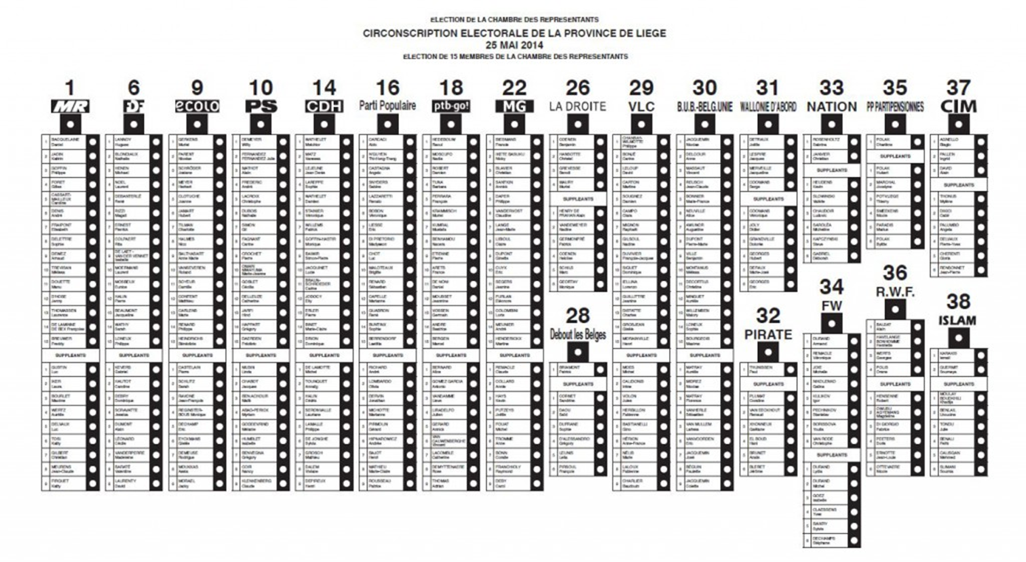
02

Slide 17
02
Options open to the electors on election day
Avoiding choosing (despite the fact that vote is compulsory)
Two other options :
voting for one (and only one) list as a whole or
voting for one or several candidates on the same list

Slide 18
02

Slide 19
02
Options open to the electors on election day
Avoiding choosing (despite the fact that vote is compulsory)
Two other options :
voting for one (and only one) list as a whole or
voting for one or several candidates on the same list
Both options are available for the lists of full candidates and the lists of substitute candidates.

Slide 20
02
Consequences on the attribution of seats
If the number of full candidates on a list equals the number of seats allocated to that list, all these candidates are elected.
If the number of full candidates on a list is larger than the number of seats allocated to that list, half of the votes cast in favour of the list as a whole are distributed to the full candidates according to their ranking on the list. The first candidate on the list benefits from these votes in priority. They are added to his or her own “preference votes” up to the number of votes required to obtain a seat. If the list as a whole obtains enough votes, then the remainder benefits the second candidate, then possibly the third, fourth, and so on.

Slide 21
02
Consequences on the attribution of seats
If the number of full candidates on a list equals the number of seats allocated to that list, all these candidates are elected.
If the number of full candidates on a list is larger than the number of seats allocated to that list, half of the votes cast in favour of the list as a whole are distributed to the full candidates according to their ranking on the list. The first candidate on the list benefits from these votes in priority. They are added to his or her own “preference votes” up to the number of votes required to obtain a seat. If the list as a whole obtains enough votes, then the remainder benefits the second candidate, then possibly the third, fourth, and so on.

Slide 22
02
III. Political effects of the electoral law
A. General tendencies
B. Concrete example

Slide 23
02
 |  | System in force before the 2000 reform |  |  | System in force today |  |  | Pure open list system
Names of the candidates | Prefe-rence votes | Added votes | Total | Elec-ted | Added votes | Total | Elec-ted | Added votes | Total | Elec-ted
1. Jambon | 61.100 | 0 | 61.100 |  | 0 | 61.100 |  | 0 | 61.100
2. De Wit | 29.918 | 10.486 | 37.404 |  | 10.486 | 37.404 |  | 0 | 29.918
3. Van Noppen | 21.635 | 15.769 | 37.404 |  | 15.769 | 37.404 |  | 0 | 21.635
4. Demir | 10.248 | 27.156 | 37.404 |  | 27.156 | 37.404 |  | 0 | 10.248
5. Van Moer | 8.956 | 28.448 | 37.404 |  | 28.448 | 37.404 |  | 0 | 8.956
6. V. Esbroeck | 6.527 | 30.877 | 37.404 |  | 23.247 | 29.774 |  | 0 | 6.527
7. Bellens | 8.648 | 28.756 | 37.404 |  | 0 | 8.648 |  | 0 | 8.648
8. De Ridder | 9.404 | 28.000 | 37.404 |  | 0 | 9.404 |  | 0 | 9.404
9. V. D. Voorde | 5.447 | 31.957 | 37.404 |  | 0 | 5.447 |  | 0 | 5.447
10. Broecks | 5.310 | 8.763 | 14.073 |  | 0 | 5.310 |  | 0 | 5.310
11. V. D. Vloet | 7.741 | 0 | 7.741 |  | 0 | 7.741 |  | 0 | 7.741
12. Frederickx | 6.497 | 0 | 6.497 |  | 0 | 6.497 |  | 0 | 6.497
13. Peeters | 6.890 | 0 | 6.890 |  | 0 | 6.890 |  | 0 | 6.890
14. Antonio | 4.677 | 0 | 4.677 |  | 0 | 4.677 |  | 0 | 4.677
15. Geets | 3.794 | 0 | 3.794 |  | 0 | 3.794 |  | 0 | 3.794
16. Choukri | 5.631 | 0 | 5.631 |  | 0 | 5.631 |  | 0 | 5.631
17. Guldentops | 6.837 | 0 | 6.837 |  | 0 | 6.837 |  | 0 | 6.837
18. Van Laer | 4.166 | 0 | 4.166 |  | 0 | 4.166 |  | 0 | 4.166
19. Anthonis | 4.025 | 0 | 4.025 |  | 0 | 4.025 |  | 0 | 4.025
20. Weets | 5.032 | 0 | 5.032 |  | 0 | 5.032 |  | 0 | 5.032
21. Vangheel | 3.908 | 0 | 3.908 |  | 0 | 3.908 |  | 0 | 3.908
22. Cottenie | 5.120 | 0 | 5.120 |  | 0 | 5.120 |  | 0 | 5.120
23. Celis | 6.542 | 0 | 6.542 |  | 0 | 6.542 |  | 0 | 6.542
24. Van Dijck | 15.607 | 0 | 15.607 |  | 0 | 15.607 |  | 0 | 15.607 | 4

Slide 24
02
 |  | System in force before the 2000 reform |  |  | System in force today |  |  | Pure open list system
Names of the candidates | Prefe-rence votes | Added votes | Total | Elec-ted | Added votes | Total | Elec-ted | Added votes | Total | Elec-ted
1. Jambon | 61.100 | 0 | 61.100 |  | 0 | 61.100 | 1 | 0 | 61.100
2. De Wit | 29.918 | 10.486 | 37.404 |  | 10.486 | 37.404 |  | 0 | 29.918
3. Van Noppen | 21.635 | 15.769 | 37.404 |  | 15.769 | 37.404 |  | 0 | 21.635
4. Demir | 10.248 | 27.156 | 37.404 |  | 27.156 | 37.404 |  | 0 | 10.248
5. Van Moer | 8.956 | 28.448 | 37.404 |  | 28.448 | 37.404 |  | 0 | 8.956
6. V. Esbroeck | 6.527 | 30.877 | 37.404 |  | 23.247 | 29.774 |  | 0 | 6.527
7. Bellens | 8.648 | 28.756 | 37.404 |  | 0 | 8.648 |  | 0 | 8.648
8. De Ridder | 9.404 | 28.000 | 37.404 |  | 0 | 9.404 |  | 0 | 9.404
9. V. D. Voorde | 5.447 | 31.957 | 37.404 |  | 0 | 5.447 |  | 0 | 5.447
10. Broecks | 5.310 | 8.763 | 14.073 |  | 0 | 5.310 |  | 0 | 5.310
11. V. D. Vloet | 7.741 | 0 | 7.741 |  | 0 | 7.741 |  | 0 | 7.741
12. Frederickx | 6.497 | 0 | 6.497 |  | 0 | 6.497 |  | 0 | 6.497
13. Peeters | 6.890 | 0 | 6.890 |  | 0 | 6.890 |  | 0 | 6.890
14. Antonio | 4.677 | 0 | 4.677 |  | 0 | 4.677 |  | 0 | 4.677
15. Geets | 3.794 | 0 | 3.794 |  | 0 | 3.794 |  | 0 | 3.794
16. Choukri | 5.631 | 0 | 5.631 |  | 0 | 5.631 |  | 0 | 5.631
17. Guldentops | 6.837 | 0 | 6.837 |  | 0 | 6.837 |  | 0 | 6.837
18. Van Laer | 4.166 | 0 | 4.166 |  | 0 | 4.166 |  | 0 | 4.166
19. Anthonis | 4.025 | 0 | 4.025 |  | 0 | 4.025 |  | 0 | 4.025
20. Weets | 5.032 | 0 | 5.032 |  | 0 | 5.032 |  | 0 | 5.032
21. Vangheel | 3.908 | 0 | 3.908 |  | 0 | 3.908 |  | 0 | 3.908
22. Cottenie | 5.120 | 0 | 5.120 |  | 0 | 5.120 |  | 0 | 5.120
23. Celis | 6.542 | 0 | 6.542 |  | 0 | 6.542 |  | 0 | 6.542
24. Van Dijck | 15.607 | 0 | 15.607 |  | 0 | 15.607 |  | 0 | 15.607 | 4

Slide 25
02
 |  | System in force before the 2000 reform |  |  | System in force today |  |  | Pure open list system
Names of the candidates | Prefe-rence votes | Added votes | Total | Elec-ted | Added votes | Total | Elec-ted | Added votes | Total | Elec-ted
1. Jambon | 61.100 | 0 | 61.100 |  | 0 | 61.100 | 1 | 0 | 61.100
2. De Wit | 29.918 | 10.486 | 37.404 |  | 10.486 | 37.404 | 2 | 0 | 29.918
3. Van Noppen | 21.635 | 15.769 | 37.404 |  | 15.769 | 37.404 | 3 | 0 | 21.635
4. Demir | 10.248 | 27.156 | 37.404 |  | 27.156 | 37.404 | 4 | 0 | 10.248
5. Van Moer | 8.956 | 28.448 | 37.404 |  | 28.448 | 37.404 | 5 | 0 | 8.956
6. V. Esbroeck | 6.527 | 30.877 | 37.404 |  | 23.247 | 29.774 |  | 0 | 6.527
7. Bellens | 8.648 | 28.756 | 37.404 |  | 0 | 8.648 |  | 0 | 8.648
8. De Ridder | 9.404 | 28.000 | 37.404 |  | 0 | 9.404 |  | 0 | 9.404
9. V. D. Voorde | 5.447 | 31.957 | 37.404 |  | 0 | 5.447 |  | 0 | 5.447
10. Broecks | 5.310 | 8.763 | 14.073 |  | 0 | 5.310 |  | 0 | 5.310
11. V. D. Vloet | 7.741 | 0 | 7.741 |  | 0 | 7.741 |  | 0 | 7.741
12. Frederickx | 6.497 | 0 | 6.497 |  | 0 | 6.497 |  | 0 | 6.497
13. Peeters | 6.890 | 0 | 6.890 |  | 0 | 6.890 |  | 0 | 6.890
14. Antonio | 4.677 | 0 | 4.677 |  | 0 | 4.677 |  | 0 | 4.677
15. Geets | 3.794 | 0 | 3.794 |  | 0 | 3.794 |  | 0 | 3.794
16. Choukri | 5.631 | 0 | 5.631 |  | 0 | 5.631 |  | 0 | 5.631
17. Guldentops | 6.837 | 0 | 6.837 |  | 0 | 6.837 |  | 0 | 6.837
18. Van Laer | 4.166 | 0 | 4.166 |  | 0 | 4.166 |  | 0 | 4.166
19. Anthonis | 4.025 | 0 | 4.025 |  | 0 | 4.025 |  | 0 | 4.025
20. Weets | 5.032 | 0 | 5.032 |  | 0 | 5.032 |  | 0 | 5.032
21. Vangheel | 3.908 | 0 | 3.908 |  | 0 | 3.908 |  | 0 | 3.908
22. Cottenie | 5.120 | 0 | 5.120 |  | 0 | 5.120 |  | 0 | 5.120
23. Celis | 6.542 | 0 | 6.542 |  | 0 | 6.542 |  | 0 | 6.542
24. Van Dijck | 15.607 | 0 | 15.607 |  | 0 | 15.607 |  | 0 | 15.607 | 4

Slide 26
02
 |  | System in force before the 2000 reform |  |  | System in force today |  |  | Pure open list system
Names of the candidates | Prefe-rence votes | Added votes | Total | Elec-ted | Added votes | Total | Elec-ted | Added votes | Total | Elec-ted
1. Jambon | 61.100 | 0 | 61.100 |  | 0 | 61.100 | 1 | 0 | 61.100
2. De Wit | 29.918 | 10.486 | 37.404 |  | 10.486 | 37.404 | 2 | 0 | 29.918
3. Van Noppen | 21.635 | 15.769 | 37.404 |  | 15.769 | 37.404 | 3 | 0 | 21.635
4. Demir | 10.248 | 27.156 | 37.404 |  | 27.156 | 37.404 | 4 | 0 | 10.248
5. Van Moer | 8.956 | 28.448 | 37.404 |  | 28.448 | 37.404 | 5 | 0 | 8.956
6. V. Esbroeck | 6.527 | 30.877 | 37.404 |  | 23.247 | 29.774 | 6 | 0 | 6.527
7. Bellens | 8.648 | 28.756 | 37.404 |  | 0 | 8.648 |  | 0 | 8.648
8. De Ridder | 9.404 | 28.000 | 37.404 |  | 0 | 9.404 | 8 | 0 | 9.404
9. V. D. Voorde | 5.447 | 31.957 | 37.404 |  | 0 | 5.447 |  | 0 | 5.447
10. Broecks | 5.310 | 8.763 | 14.073 |  | 0 | 5.310 |  | 0 | 5.310
11. V. D. Vloet | 7.741 | 0 | 7.741 |  | 0 | 7.741 |  | 0 | 7.741
12. Frederickx | 6.497 | 0 | 6.497 |  | 0 | 6.497 |  | 0 | 6.497
13. Peeters | 6.890 | 0 | 6.890 |  | 0 | 6.890 |  | 0 | 6.890
14. Antonio | 4.677 | 0 | 4.677 |  | 0 | 4.677 |  | 0 | 4.677
15. Geets | 3.794 | 0 | 3.794 |  | 0 | 3.794 |  | 0 | 3.794
16. Choukri | 5.631 | 0 | 5.631 |  | 0 | 5.631 |  | 0 | 5.631
17. Guldentops | 6.837 | 0 | 6.837 |  | 0 | 6.837 |  | 0 | 6.837
18. Van Laer | 4.166 | 0 | 4.166 |  | 0 | 4.166 |  | 0 | 4.166
19. Anthonis | 4.025 | 0 | 4.025 |  | 0 | 4.025 |  | 0 | 4.025
20. Weets | 5.032 | 0 | 5.032 |  | 0 | 5.032 |  | 0 | 5.032
21. Vangheel | 3.908 | 0 | 3.908 |  | 0 | 3.908 |  | 0 | 3.908
22. Cottenie | 5.120 | 0 | 5.120 |  | 0 | 5.120 |  | 0 | 5.120
23. Celis | 6.542 | 0 | 6.542 |  | 0 | 6.542 |  | 0 | 6.542
24. Van Dijck | 15.607 | 0 | 15.607 |  | 0 | 15.607 | 7 | 0 | 15.607 | 4

Slide 27
02
 |  | System in force before the 2000 reform |  |  | System in force today |  |  | Pure open list system
Names of the candidates | Prefe-rence votes | Added votes | Total | Elec-ted | Added votes | Total | Elec-ted | Added votes | Total | Elec-ted
1. Jambon | 61.100 | 0 | 61.100 | 1 | 0 | 61.100 | 1 | 0 | 61.100
2. De Wit | 29.918 | 10.486 | 37.404 | 2 | 10.486 | 37.404 | 2 | 0 | 29.918
3. Van Noppen | 21.635 | 15.769 | 37.404 | 3 | 15.769 | 37.404 | 3 | 0 | 21.635
4. Demir | 10.248 | 27.156 | 37.404 | 4 | 27.156 | 37.404 | 4 | 0 | 10.248
5. Van Moer | 8.956 | 28.448 | 37.404 | 5 | 28.448 | 37.404 | 5 | 0 | 8.956
6. V. Esbroeck | 6.527 | 30.877 | 37.404 | 6 | 23.247 | 29.774 | 6 | 0 | 6.527
7. Bellens | 8.648 | 28.756 | 37.404 | 7 | 0 | 8.648 |  | 0 | 8.648
8. De Ridder | 9.404 | 28.000 | 37.404 | 8 | 0 | 9.404 | 8 | 0 | 9.404
9. V. D. Voorde | 5.447 | 31.957 | 37.404 |  | 0 | 5.447 |  | 0 | 5.447
10. Broecks | 5.310 | 8.763 | 14.073 |  | 0 | 5.310 |  | 0 | 5.310
11. V. D. Vloet | 7.741 | 0 | 7.741 |  | 0 | 7.741 |  | 0 | 7.741
12. Frederickx | 6.497 | 0 | 6.497 |  | 0 | 6.497 |  | 0 | 6.497
13. Peeters | 6.890 | 0 | 6.890 |  | 0 | 6.890 |  | 0 | 6.890
14. Antonio | 4.677 | 0 | 4.677 |  | 0 | 4.677 |  | 0 | 4.677
15. Geets | 3.794 | 0 | 3.794 |  | 0 | 3.794 |  | 0 | 3.794
16. Choukri | 5.631 | 0 | 5.631 |  | 0 | 5.631 |  | 0 | 5.631
17. Guldentops | 6.837 | 0 | 6.837 |  | 0 | 6.837 |  | 0 | 6.837
18. Van Laer | 4.166 | 0 | 4.166 |  | 0 | 4.166 |  | 0 | 4.166
19. Anthonis | 4.025 | 0 | 4.025 |  | 0 | 4.025 |  | 0 | 4.025
20. Weets | 5.032 | 0 | 5.032 |  | 0 | 5.032 |  | 0 | 5.032
21. Vangheel | 3.908 | 0 | 3.908 |  | 0 | 3.908 |  | 0 | 3.908
22. Cottenie | 5.120 | 0 | 5.120 |  | 0 | 5.120 |  | 0 | 5.120
23. Celis | 6.542 | 0 | 6.542 |  | 0 | 6.542 |  | 0 | 6.542
24. Van Dijck | 15.607 | 0 | 15.607 |  | 0 | 15.607 | 7 | 0 | 15.607

Slide 28
02
 |  | System in force before the 2000 reform |  |  | System in force today |  |  | Pure open list system
Names of the candidates | Prefe-rence votes | Added votes | Total | Elec-ted | Added votes | Total | Elec-ted | Added votes | Total | Elec-ted
1. Jambon | 61.100 | 0 | 61.100 | 1 | 0 | 61.100 | 1 | 0 | 61.100 | 1
2. De Wit | 29.918 | 10.486 | 37.404 | 2 | 10.486 | 37.404 | 2 | 0 | 29.918 | 2
3. Van Noppen | 21.635 | 15.769 | 37.404 | 3 | 15.769 | 37.404 | 3 | 0 | 21.635 | 3
4. Demir | 10.248 | 27.156 | 37.404 | 4 | 27.156 | 37.404 | 4 | 0 | 10.248 | 5
5. Van Moer | 8.956 | 28.448 | 37.404 | 5 | 28.448 | 37.404 | 5 | 0 | 8.956 | 7
6. V. Esbroeck | 6.527 | 30.877 | 37.404 | 6 | 23.247 | 29.774 | 6 | 0 | 6.527
7. Bellens | 8.648 | 28.756 | 37.404 | 7 | 0 | 8.648 |  | 0 | 8.648
8. De Ridder | 9.404 | 28.000 | 37.404 | 8 | 0 | 9.404 | 8 | 0 | 9.404 | 6
9. V. D. Voorde | 5.447 | 31.957 | 37.404 |  | 0 | 5.447 |  | 0 | 5.447
10. Broecks | 5.310 | 8.763 | 14.073 |  | 0 | 5.310 |  | 0 | 5.310
11. V. D. Vloet | 7.741 | 0 | 7.741 |  | 0 | 7.741 |  | 0 | 7.741
12. Frederickx | 6.497 | 0 | 6.497 |  | 0 | 6.497 |  | 0 | 6.497
13. Peeters | 6.890 | 0 | 6.890 |  | 0 | 6.890 |  | 0 | 6.890 | 8
14. Antonio | 4.677 | 0 | 4.677 |  | 0 | 4.677 |  | 0 | 4.677
15. Geets | 3.794 | 0 | 3.794 |  | 0 | 3.794 |  | 0 | 3.794
16. Choukri | 5.631 | 0 | 5.631 |  | 0 | 5.631 |  | 0 | 5.631
17. Guldentops | 6.837 | 0 | 6.837 |  | 0 | 6.837 |  | 0 | 6.837
18. Van Laer | 4.166 | 0 | 4.166 |  | 0 | 4.166 |  | 0 | 4.166
19. Anthonis | 4.025 | 0 | 4.025 |  | 0 | 4.025 |  | 0 | 4.025
20. Weets | 5.032 | 0 | 5.032 |  | 0 | 5.032 |  | 0 | 5.032
21. Vangheel | 3.908 | 0 | 3.908 |  | 0 | 3.908 |  | 0 | 3.908
22. Cottenie | 5.120 | 0 | 5.120 |  | 0 | 5.120 |  | 0 | 5.120
23. Celis | 6.542 | 0 | 6.542 |  | 0 | 6.542 |  | 0 | 6.542
24. Van Dijck | 15.607 | 0 | 15.607 |  | 0 | 15.607 | 7 | 0 | 15.607 | 4

Slide 29



