Slide 1
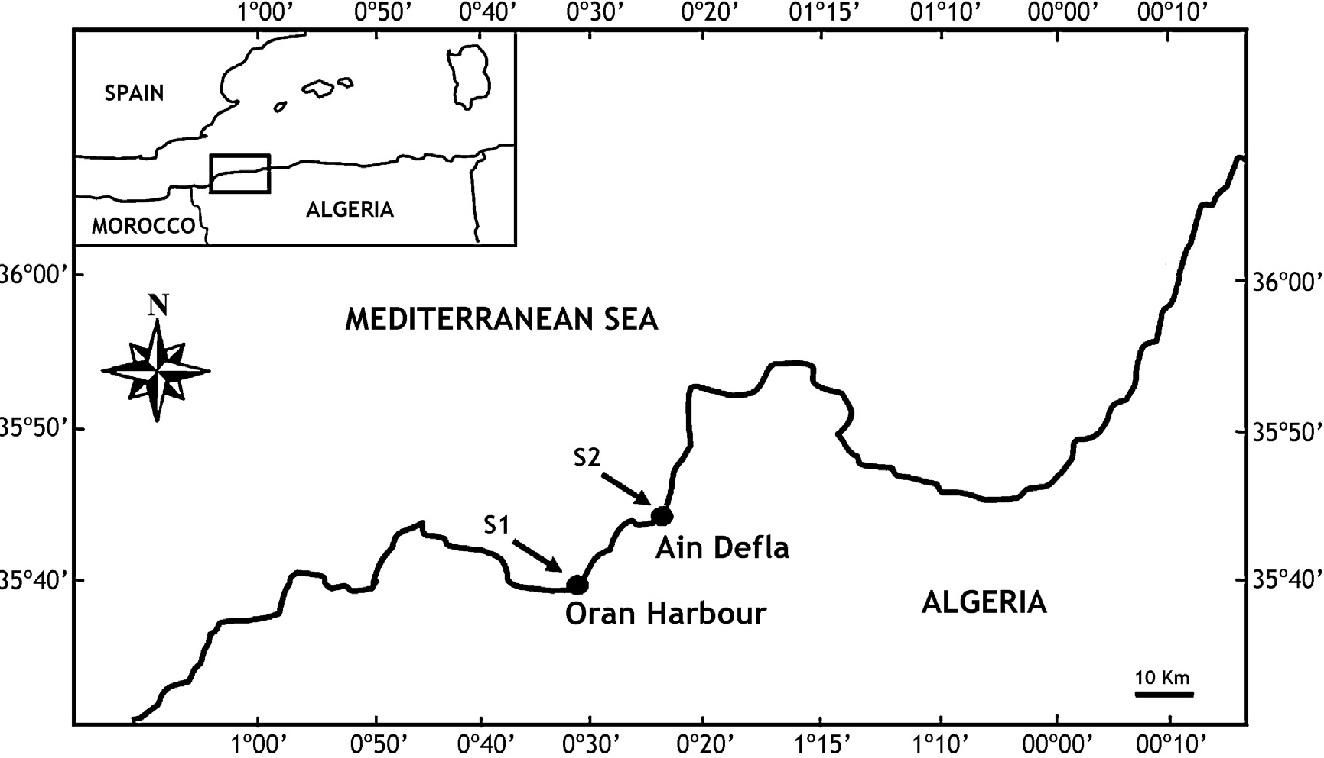
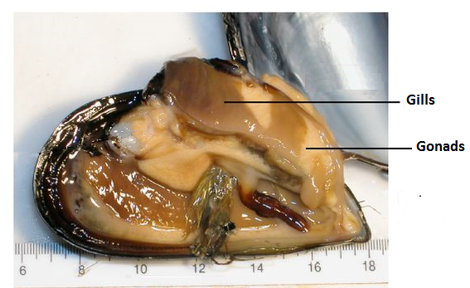
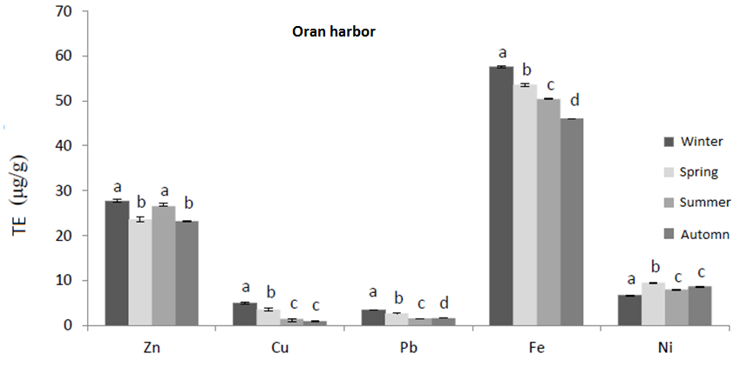
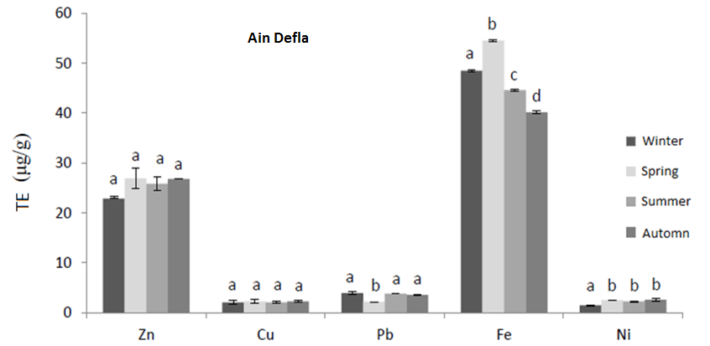
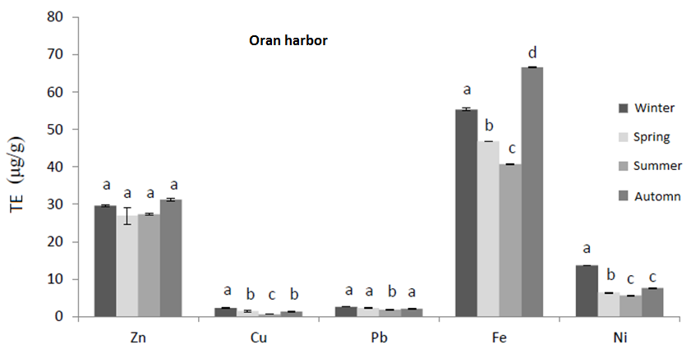
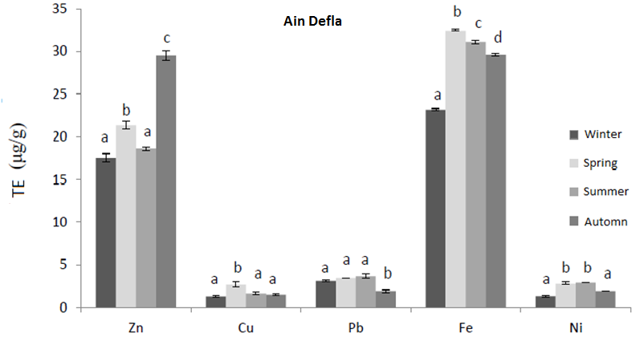
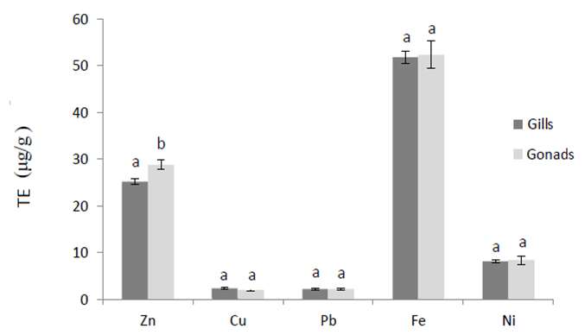
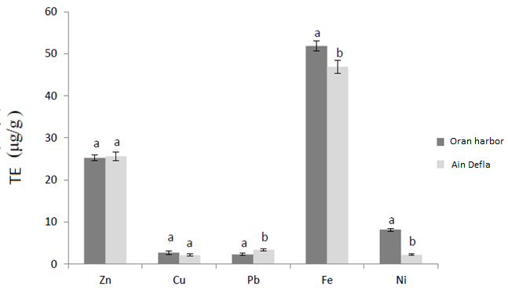
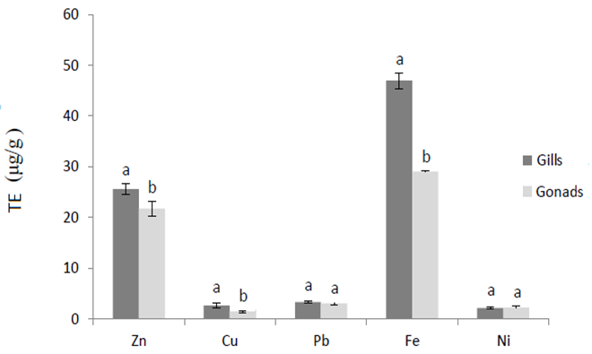
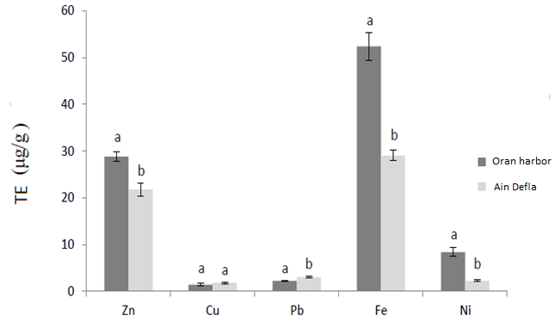
Bioaccumulation of trace metals in Mytilus galloprovincialis from the Algerian west coast
Y.L. Rouabhi ^{1,2,}*, Z. Boutiba ², O. Rouane-hacene ², H. Benkrama ², Ph. Grosjean ¹, J. Richir ^{1,3}
¹ Numerical Ecology of Aquatic Systems, University of Mons (UMons), Pentagone 3D08, 7000 Mons - BELGIUM
² Laboratoire Réseau de Surveillance Environnementale (LRSE), University of Oran 1-Ahmed Ben Bella, Oran, Algeria
³ Laboratory of Oceanology, MARE Centre, University of LIEGE, B6c, 4000 Liege, Sart Tilman, Belgium
* rouabhi-leila@hotmail.fr
1. INTRODUCTION
Algeria has a 1 622 km long coastal strip where a large proportion of the population and the main economic and industrial activities of the country are concentrated. Its coastal fringe therefore suffers from various degradations. In particular, the Bay of Oran (Fig. 1) is housing industrial, commercial, fishing and recreational activities, where 80 % of domestic and industrial wastewaters are not purified before being discharged into the sea.
Algeria has contracted to the Barcelona Convention that aims to reduce pollution in the Mediterranean (UNEP, 1997). However, monitoring surveys aiming to assess the state of contaminantion of Algerian coastal waters are limited (eg. 1, 2).
2. OBJECTIVES
The aim of this work was to biomonitor the metallic contamination of western Algeria coastal waters using Mytilus galloprovincialis gills and gonads (Fig. 2) as indicator tissues, and to assess the seasonal variability of metal levels in those tissues.
Fig. 1. (above) Geographical location of the sampling sites on the western coast of Algeria: Oran Harbor (Site 1), Ain Defla (Site 2).
Fig. 2. (left) Mytilus galloprovincialis anatomy.
3. MATERIAL & METHODS
Mussels were sampled from the highly polluted Oran harbor (S1) and from Ain Defla (S2), a site distant enough from Oran and presumed to be little contaminated (Fig. 1). Samples were collected at the four seasons of year 2010: February (winter), May (spring), August (summer) and November (autumn), in both sites. Gonads and gills were dissected from frozen (n = 30) mussels, lyophilized and digested in hot acid according to the method of Aminot and Chaussepied (1983). Trace metals (Zn, Cu, Ni, Fe and Pb) were measured by atomic absorption spectroscopy (Perkin Elmer AAnalyst-100 - Version 1.10).
Fig. 3. Seasonal variations in trace metal concentrations in mussel gills
Fig. 4. Seasonal variations in trace metal concentrations in mussel gonads
4. RESULTS AND DISCUSSION
Each metal followed a seasonal trend, showing concentration peaks during winter and spring for gills and autumn for gonads (Figs. 3, 4). Metal concentrations differed between organs. In mussels from Ain Defla, Fe, Zn and Cu were more accumulated in gills (46.91 ± 1.60 µg/g, 25.6 ± 1.07 µg/g, 2.68 ± 0.50 µg/g, respectively) compared to gonads (29.06 ± 1.07 µg/g, 21,76 ± 1,46 ppm µg/g, 1.44 ± 0.20 ppm, respectively). However, in mussels from Oran Harbor only Zn concentrations differed between organs, with higher levels in gonads (Figs. 5, 6). Oran harbor was globally more contaminated than Ain Defla, especially for Fe, Zn and Ni. However, Pb levels were higher at Ain Defla with concentrations up to 3.35 ± 0.25 µg/g in gills (Figs. 7, 8).
Fig. 5. Annual variations in trace metal concentrations in mussel organs collected at Oran harbor.
Fig. 7. Annual variations in trace metal concentrations in mussel gills as a function of sites.
5. CONCLUSIONS
This study demonstrated the need to biomonitor the metallic contamination of Algerian coastal waters. Such monitoring surveys, relying on organisms, will require consensual sampling and analytical protocols to avoid hazardous conclusions due to tissue speciation and accumulation seasonality.
Fig. 6. Annual variations in trace metal concentrations in mussel organs collected at Ain Defla.
Fig. 8. Annual variations in trace metal concentrations in mussel gonads as a function of sites.
REFERENCES
(1) Grimes, S. et al (2010). Ecological quality status of the soft-bottom communities on the Algerian coast: general patterns and diagnosis. Mar. Pollut. Bull. 60 (11), 1969-1977. (2) Rouane-Hacene, O et al (2008). Evaluation of organochlorinated compounds in Hake (Merluccius merluccius L., 1758) from Algerian western coast. In: International Conference on Modelling & Monitoring of Marine Pollution, INOC-INCO, Kish Island , Iran, Decembre 2008.

