Slide 1



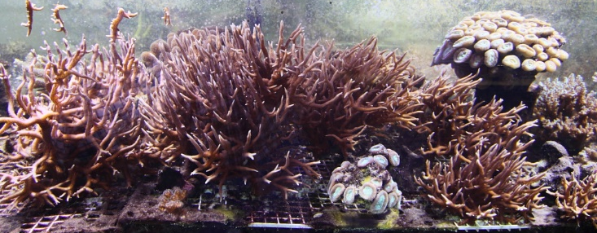
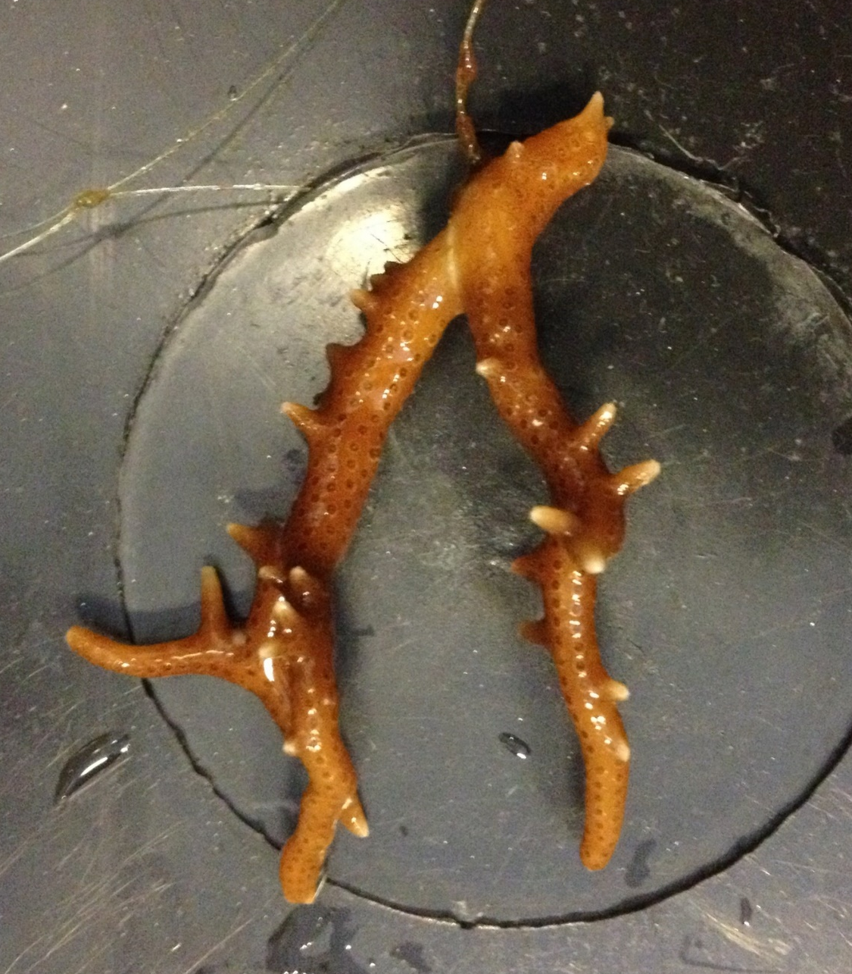
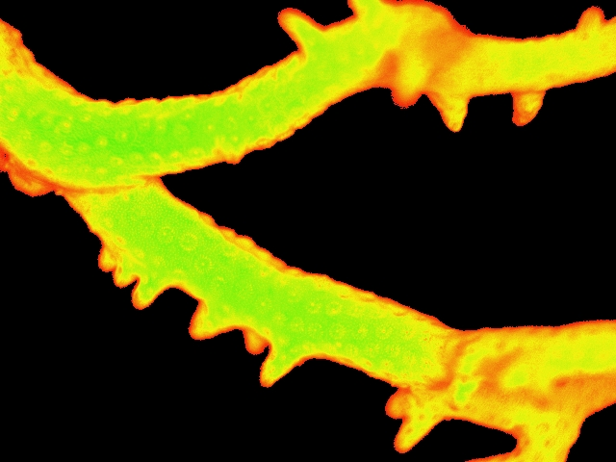
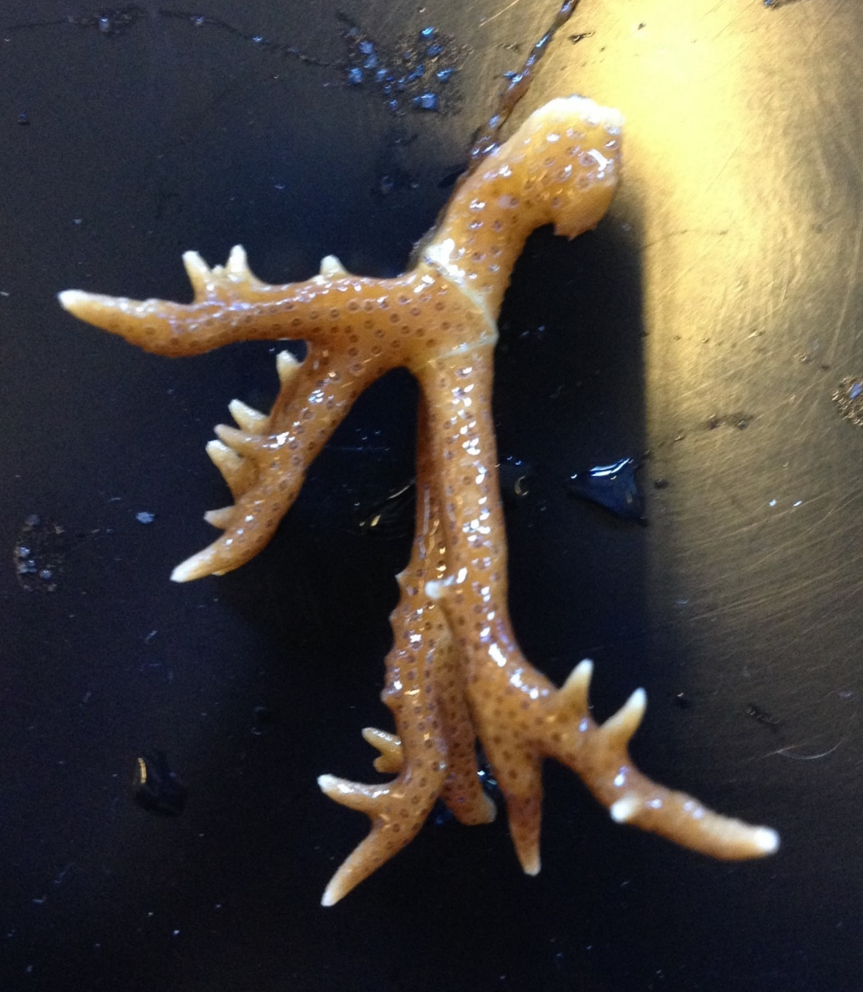
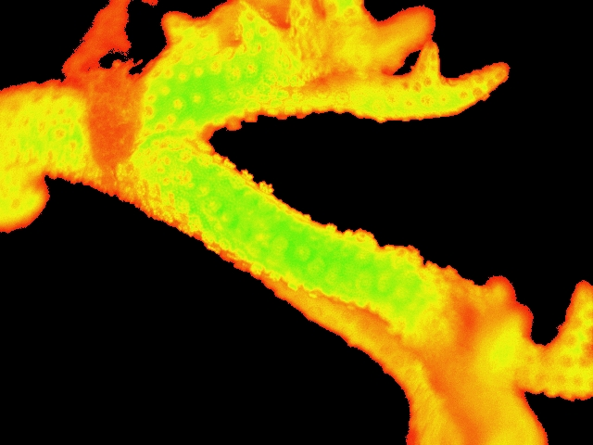
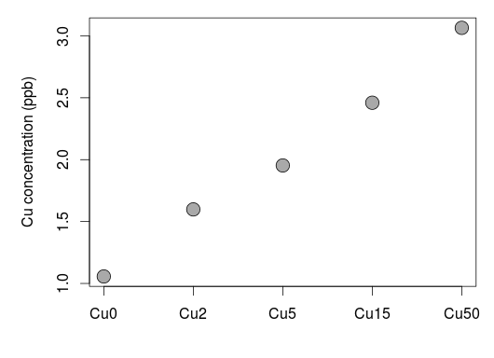
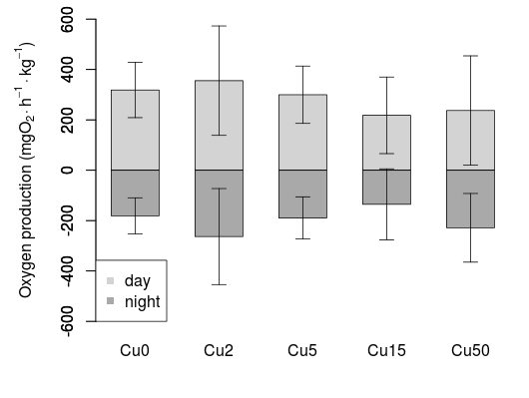
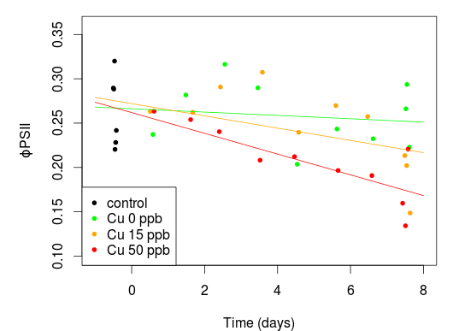
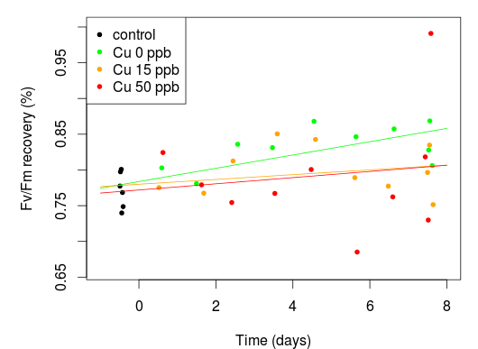
Copper toxicity on coral holobiont photosynthetic processes
N. Georges^{1,#,}*, J. Richir^{1, 3,#}, A. Batigny¹, A.V. Borges², W. Champenois², S. Gobert³, S. Roberty⁴, Ph. Grosjean¹
# First co-authors
* nadege.georges@student.umons.ac.be
¹Numerical Ecology of Aquatic Systems, University of Mons, Pentagone 3D, 6, Avenue du Champ de Mars, 7000 Mons, Belgium
²Chemical Oceanography Unit, MARE Centre, University of Liège, B5A, 4000 Liège, Sart Tilman, Belgium
³Laboratory of Oceanology, MARE Centre, University of Liège, B6C, 4000 Liège, Sart Tilman, Belgium
⁴InBioS – Animal Physiology, University of Liège, 4 Chemin de la Vallée, 4000 Liège, Sart Tilman, Belgium
Introduction
Corals are particularly sensitive to anthropogenic disturbances including exposure to metals. Copper (Cu), an essential micronutrient, might become toxic when present at high environmental levels. Cu remains an aquatic contaminant of concern, notably because of its recent re-use as biocide in metal-based antifouling paints. However, the essentiality vs toxicity of Cu on coral ecophysiological processes is poorly studied. This work aimed to investigate the impact of increasing Cu concentrations on the photosynthetic activity of the scleractinian coral holobiont Seriatopora hystrix (Fig. 1).
Fig. 1. S. hystrix colonies in EcoNum mesocosm.
Material and methods
Nubbins of S. hystrix (Fig. 2) were exposed for 8 days in 1 L intermittent respirometers to 5 nominal Cu concentrations: 0 – 2 – 5 – 15 – 50 ppb.
Respirometers were maintained at 25.0 ± 0.2°C with successive open/close cycles of 30 min. A 12/12 hours day-night light regime was applied with constant daylight intensity of 200 µmol photons.m⁻².s⁻¹. Water renewal rate during the 30 min. open cycles was 15 mL.min⁻¹. Nutrients were analysed with a SEAL AA3 HR autoanalyzer and total alkalinity was determined by acid titration. Salinity was 34.6 ± 0.1.
The photosynthetic performances of coral endosymbionts were assessed daily with a fluorescence imaging system (Walz Imaging PAM).
Bioavailable Cu in experimental respirometers was measured throughout the use of DGT devices. Accumulated Cu in DGT Chelex 100 binding phase was eluted in 1.0 mol.L⁻¹ HNO₃. Eluates were analysed by ICP-MS.
Table 1. Mean chemical properties of water within respirometers (n = 32, except for pH_{tot}: n = 36) and in the water stock tank (n = 7). All parameters except pH_{tot} are in µmol.kg-sol⁻¹. TN = total nitrogen.
 | NO₃⁻ | NH₄⁺ | NO₂⁻ | TN | PO₄³⁻ | TA | pH_{tot}
water stock | 2.43 | 0.86 | 0.20 | 42.8 | 0.97 | 2292 | -
Cu0 | 0.19 | 1.31 | 0.03 | 42.1 | 2.28 | 2119 | 7.49
Cu2 | 0.63 | 1.05 | 0.06 | 40.7 | 2.43 | 2211 | 7.54
Cu5 | 0.14 | 1.44 | 0.05 | 42.7 | 2.40 | 2204 | 7.49
Cu15 | 1.07 | 1.53 | 0.07 | 42.4 | 2.01 | 2203 | 7.51
Cu50 | 4.15 | 2.62 | 0.13 | 48.7 | 1.77 | 2244 | 7.54
Fig. 2. Nubbins of S. hystrix after 8 days of exposure to 2 ppb (top) and 15 ppb (bottom) Cu treatments. Right images are colour-scaled fluorescence pictures from the Imaging PAM.
A
B
Results
Orthophosphates, total alkalinity and pH_{tot} averaged for the 8-days experiment were similar between respirometers, contrary to nitrogen compounds more concentrated in the 15 ppb and mainly 50 ppb treatments (table 1).
Cu bioavailable concentrations in resin eluates ranged between 11 and 1163 ppb according to the treatment (Fig. 3A).
At the end of the exposure period, the effective photochemical quantum yield (ɸPSII) of coral nubbins had decreased by 41% and 54%, respectively, in the 15 ppb and 50 ppb treatments (Fig. 3C). In contrast, the maximal photochemical quantum yield (F_{V}/F_{M}) percentage recovery following the 13 min. dark recovery period remained more similar between treatments (Fig. 3D).
The analysis of nubbin primary productivity contrasted with the above observations. The mean daily oxygen production showed only a low trend towards decrease with increasing Cu concentrations (Fig. 3B).
Cu exposure affected the symbiosis between the coral host and its endosymbionts. Nubbins of the 15 ppb treatment lightened from day 6 (Fig. 2), whilst nubbins exposed to the 50 ppb treatment lightened from day 3 and started to bleach from day 6.
C
D
Fig. 3. A) Mean bioavailable Cu concentrations (n = 3) in resin eluates (logarithmic scale). B) Day and night mean ± sd oxygen production per hour, averaged for the 8-days experiment (n = 16 in average) and normalized by kg of coral holobiont. C) Mean ɸPSII (5 AOI) after 10 min. exposure to 248 PAR. D) Mean F_{V}/F_{M} percentage recovery (5 AOI) at the end of the 13 min. dark recovery period, compared to the initial F_{V}/F_{M}. Lines on graphs C and D are linear general trends.
Discussion and conclusion
Cu was toxic to S. hystrix nubbins at relevant environmental concentrations. From 15 ppb treatment, Cu caused a decrease of coral endosymbiont photosynthesis. This decrease was initiated with the photoinhibition of the photosystem II of zooxanthellae (decrease of ɸPSII, Fig. 3C) and very likely resulted in an oxidative stress ending with the death or the expulsion of the algae, as highlighted by the holobiont partial decolouration and bleaching (Fig. 2). The relatively low trend of decreased oxygen production (Fig. 3B) could result in counterpart from an improved access to light of the remaining endosymbionts, their photosynthesis, although diminished, remaining effective (Fig. 3D). Cu also affected the coral holobiont’s ability to metabolize nitrogen compounds by lowering their consumption and/or increase the release of organic material from nubbins (Table 1). In conclusion, since Cu affected S. hystrix within 8 days from relevant environmental concentrations, the exposure of coral holobionts to toxic metals has to be considered as an additional stressor to, e.g., ocean acidification or elevated temperature, which may disturb their ecophysiology and lead to their bleaching.

