Slide 1
The added value of new GNSS to monitor the ionosphere
R. Warnant¹, C. Deprez¹, L. Van de Vyvere²
¹University of Liege, Liege, Belgium.
²M3 System, Wavre, Belgium.
International Association of Geodesy – Commission 4
Symposium on Positioning and Navigation
September 4-7 2016, Wroclaw (Poland).

Slide 2
Monitoring TEC for geodetic applications
For the last 25 years, GPS L1/L2 code and phase pseudoranges have been used to monitor the ionosphere Total Electron Content (TEC).
Both absolute TEC and Rate of TEC change are crucial parameters for the mitigation of the ionospheric effects on GNSS applications.
Nevertheless, GPS L1/L2 TEC reconstruction suffers from different shortcomings.
We investigate if new/modernized GNSS can bring improvements in:
  Reconstructed TEC precision (not accuracy).
  The monitoring of local variability in TEC (Travelling Ionospheric Disturbances)

Slide 3
Absolute TEC 1
Absolute Slant TEC can be reconstructed from code and/or phase geometry-free combinations :
Code/phase GF
at frequencies
f_{k} and f_{l}
InterFrequency
rec. and
sat. biases
Slant TEC
Multipath
Noise
Phase ambiguity

Slide 4
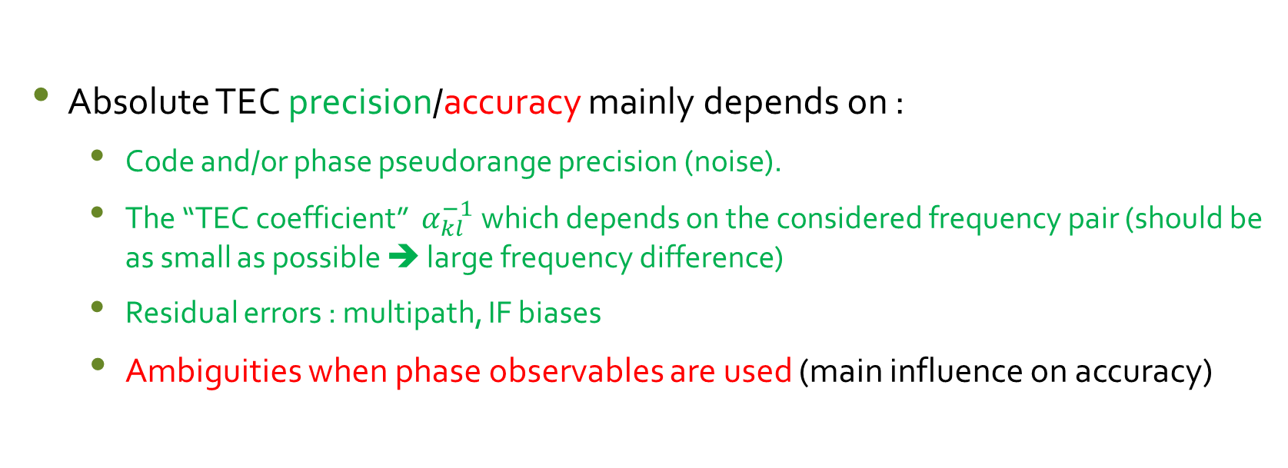
Absolute TEC 2
Absolute TEC precision/accuracy mainly depends on :
  Code and/or phase pseudorange precision (noise).
  The “TEC coefficient” $α_{kl}^{−1}$ which depends on the considered frequency pair (should be as small as possible ➔ large frequency difference)
  Residual errors : multipath, IF biases
  Ambiguities when phase observables are used (main influence on accuracy)

Slide 5
Rate of TEC change 1
Between epoch change in slant TEC can be used to monitor local variability in TEC due to moving structures.
Can be mapped to vertical and/or normalized (to 1 minute interval).
This combination removes biases (constant part of IF delays, ambiguities) but it still depends on noise and on between epoch variation of TEC, multipath and IF biases (usually considered as negligible).

Slide 6
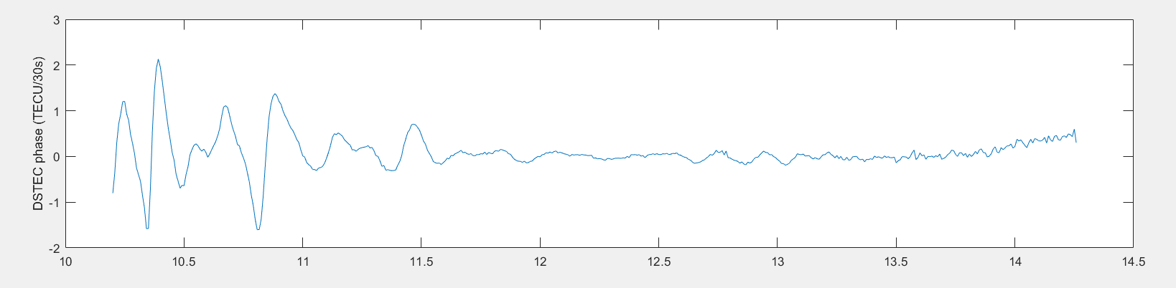
Rate of TEC change 2
Local variability in TEC at European mid-latitudes (Belgium):
  Mainly due Travelling Ionospheric Disturbances (affect precise positioning).
  GPS-based detection of moving structures (TIDs) is « biased » by the fact that ionospheric points have a velocity wrt the ionosphere due to satellite orbital motion.

Slide 7
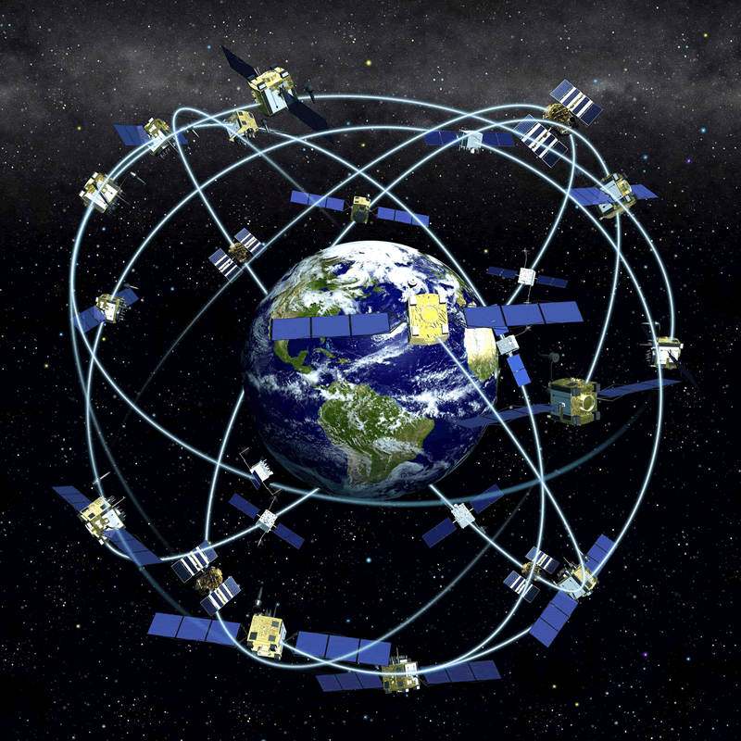
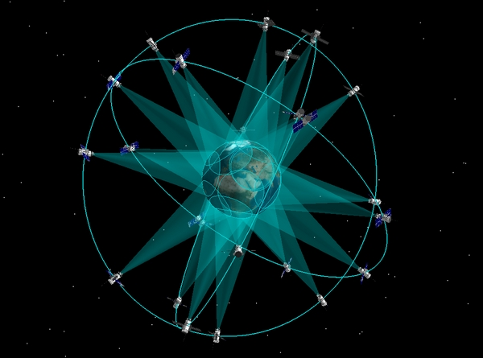
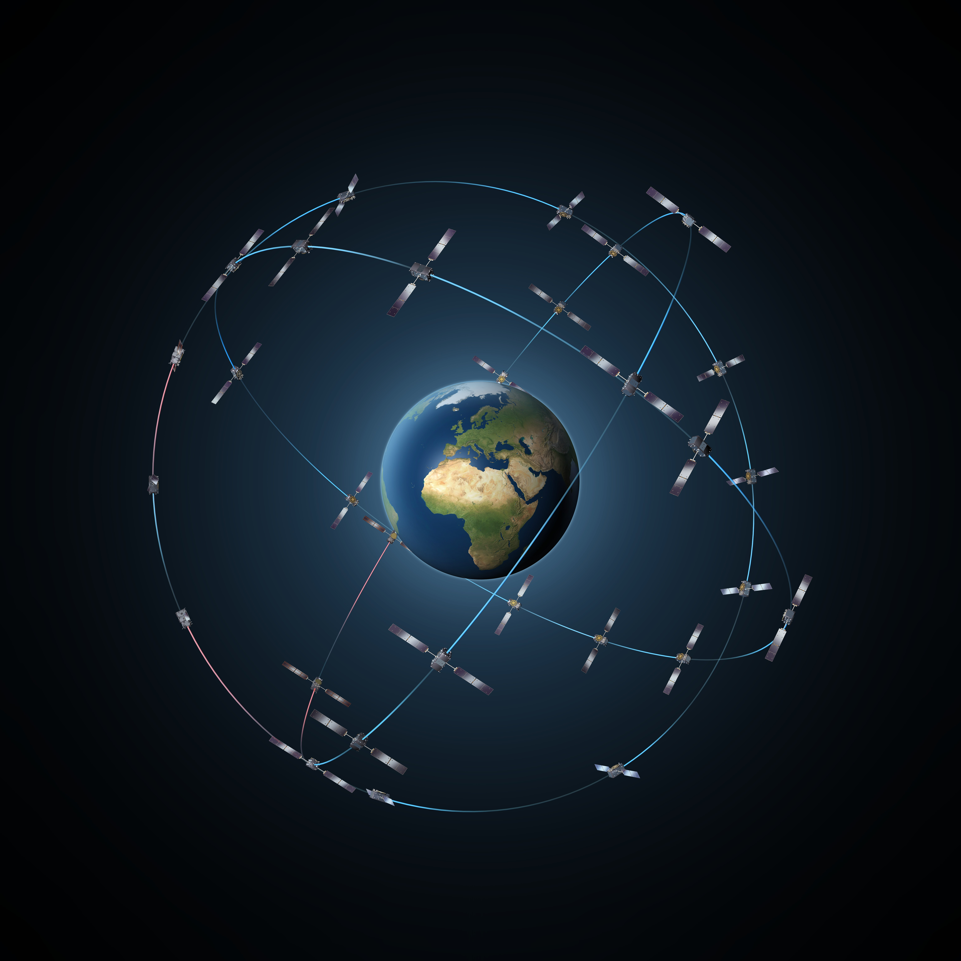
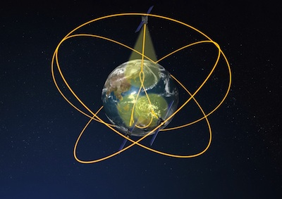




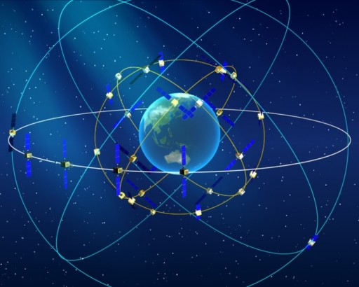
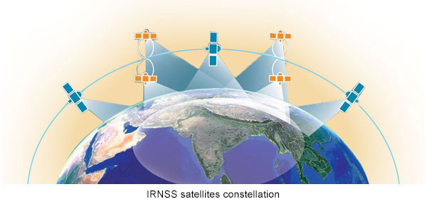
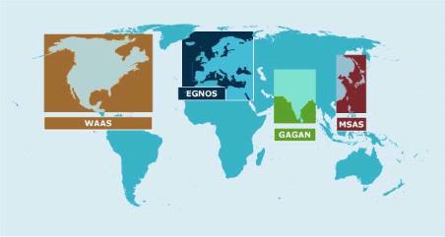


New/modernized GNSS 1
GPS
GLONASS
Galileo
QZSS
Beidou
NAVIC
SBAS

Slide 8
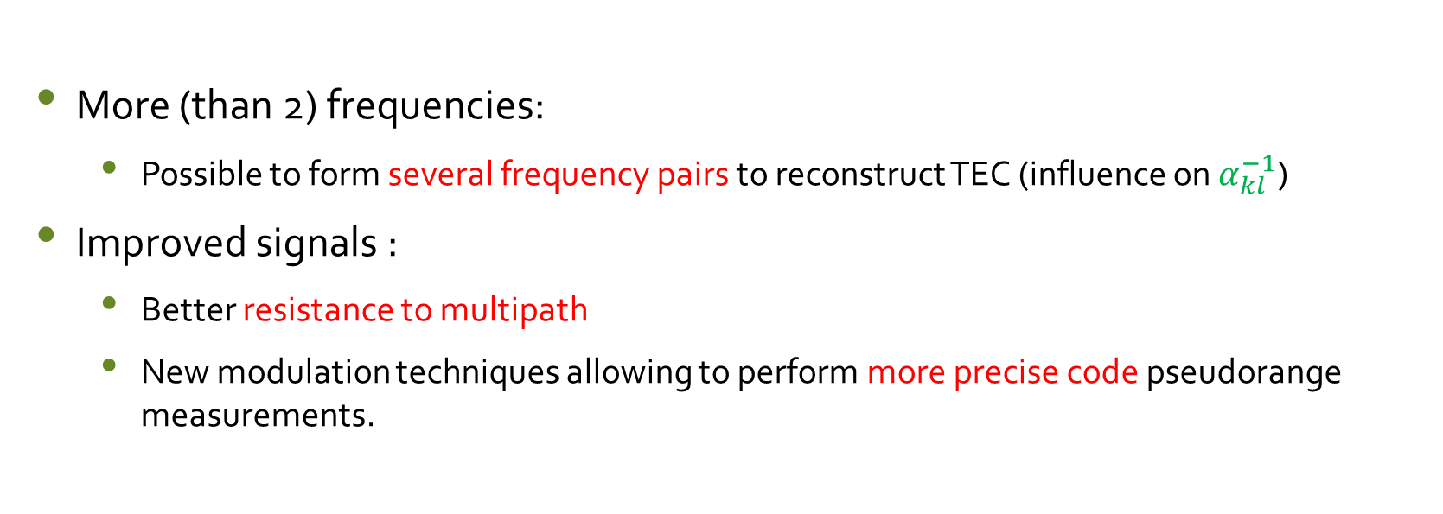
New/modernized GNSS 2
More (than 2) frequencies:
  Possible to form several frequency pairs to reconstruct TEC (influence on $α_{kl}^{−1}$)
Improved signals :
  Better resistance to multipath
  New modulation techniques allowing to perform more precise code pseudorange measurements.

Slide 9
New/modernized GNSS 3
Availability of (dual or triple frequency) geostationary navigation satellites
  SBAS (2F): EGNOS, GAGAN, WAAS.
  Beidou (3F): C01 to C05.
As GEO satellites have a negligible velocity wrt respect to the ionosphere, they could be interesting for the study of local variability in TEC.
Availability of new generation receivers and antennas which already bring improvement in the “standard” GPS L1/L2 case.

Slide 10
Multi GNSS/multi-frequency TEC precision

Slide 11
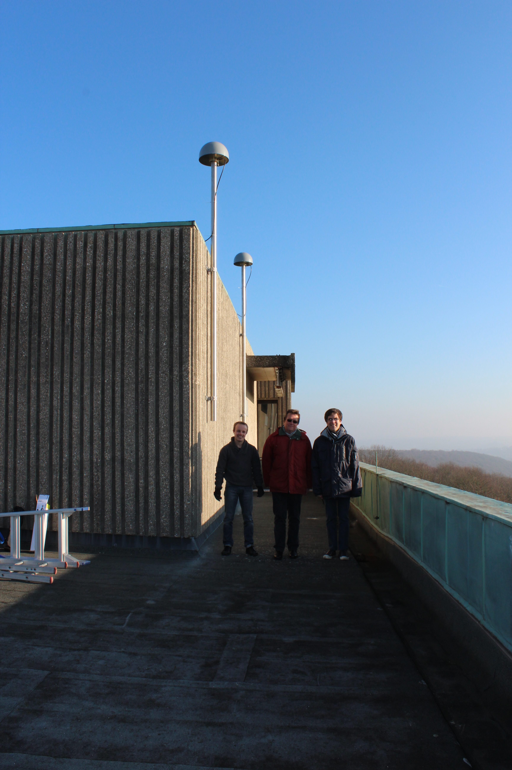
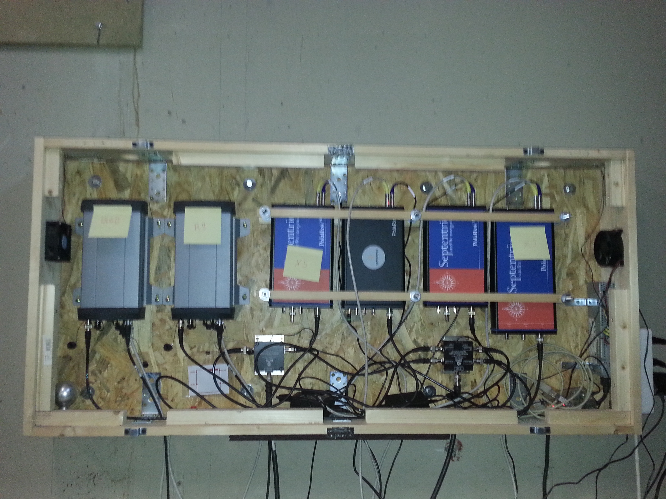
GNSS equipment
Located in Liege (Belgium).
2 Trimble GNSS choke ring antennas on a short baseline (5,352 m).
6 multi-GNSS/multi-frequency receivers :
  2 Trimble NetR9 receivers
  2 Septentrio PolaRx4 receivers
  1 Septentrio PolaRxS scintillation receiver
  1 Septentrio PolaRx5 (new model).
Equipment used to perform zero and short baseline tests for positioning and ionosphere monitoring.

Slide 12
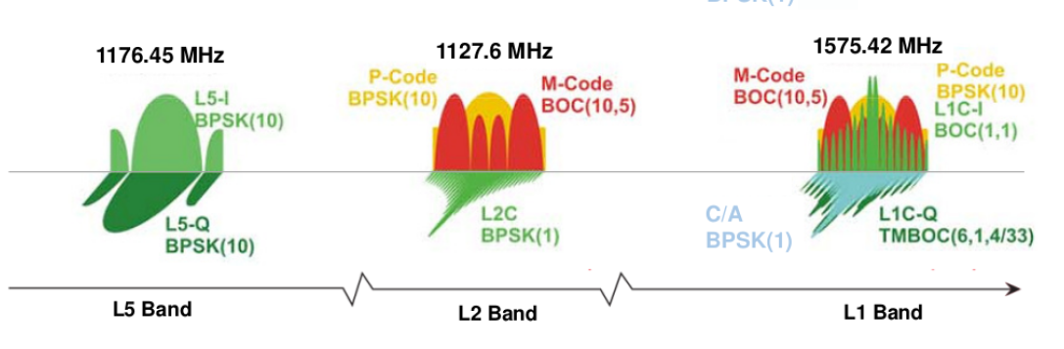
GNSS signals : GPS
L5
L2
L1

Slide 13
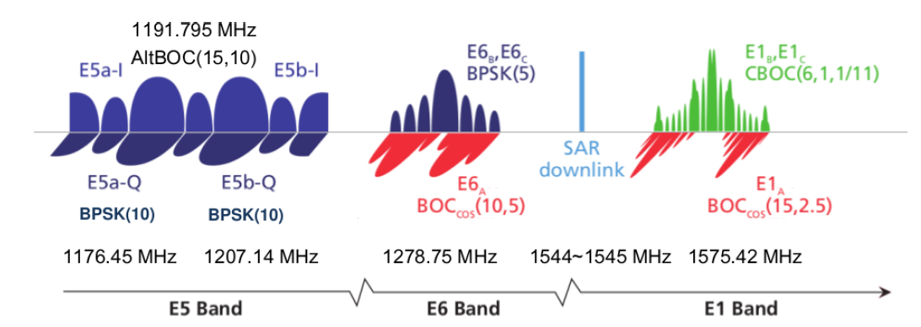
GNSS signals : Galileo
E5a
E5
E5b
E6
E1
Only available with PolaRx5

Slide 14
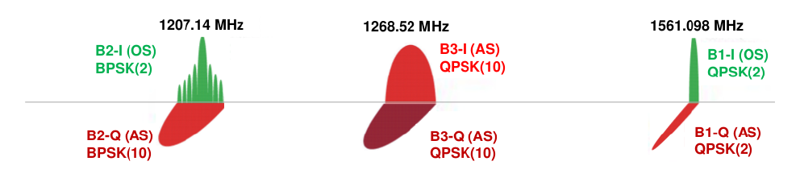
GNSS signals : Beidou (phase II)
B2
B3
B1
Only available on NetR9 and PolaRx5

Slide 15
Different TEC coefficients
Given the same code/phase precision, a larger frequency difference gives a smaller TEC coefficient and therefore a better TEC precision.
TEC coefficients
Galileo |  |  |  | GPS |  |  | Beidou
E1-E5a | E1-E5b | E1-E5 | E1-E6 | L1-L2 | L1-L5 | L2-L5 | B1-B2 | B1-B3
7,764 | 8,757 | 8,24 | 11,893 | 9,52 | 7,764 | 42,089 | 8,993 | 11,754

Slide 16
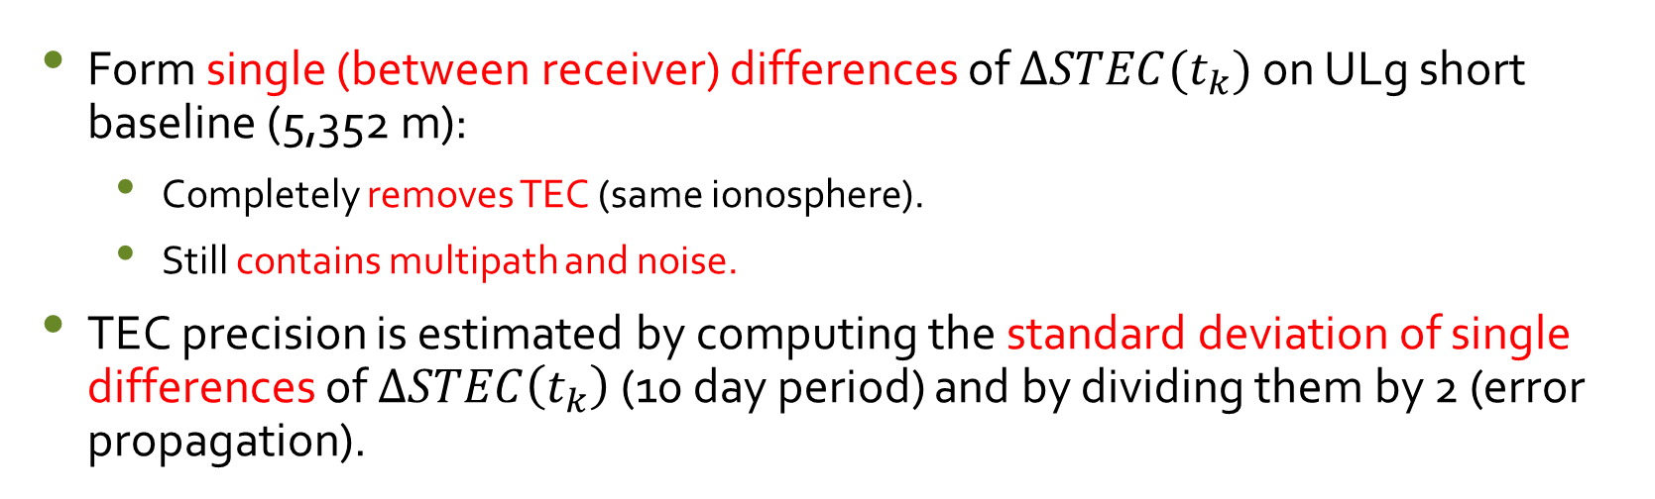
Methodology to asses TEC precision
Compute Slant TEC change from epoch to epoch (30 s interval)
Form single (between receiver) differences of $∆STEC(t_{k})$ on ULg short baseline (5,352 m):
  Completely removes TEC (same ionosphere).
  Still contains multipath and noise.
TEC precision is estimated by computing the standard deviation of single differences of $∆STEC\left(t_{k}\right)$ (10 day period) and by dividing them by 2 (error propagation).

Slide 17
Results: code (multipath filter off - mask 10°)
Strong improvement in code TEC precision with Galileo (in particular E1/E5) wrt the “standard” GPS L1/L2.

Slide 18
Results: code (multipath filter on - mask 20°)
Galileo E1/E5 combination has a precision better than 1 TECU above 20° elevation (Septentrio PolaRx4).

Slide 19
Results: Phase (multipath filter off - mask 10°)

Slide 20
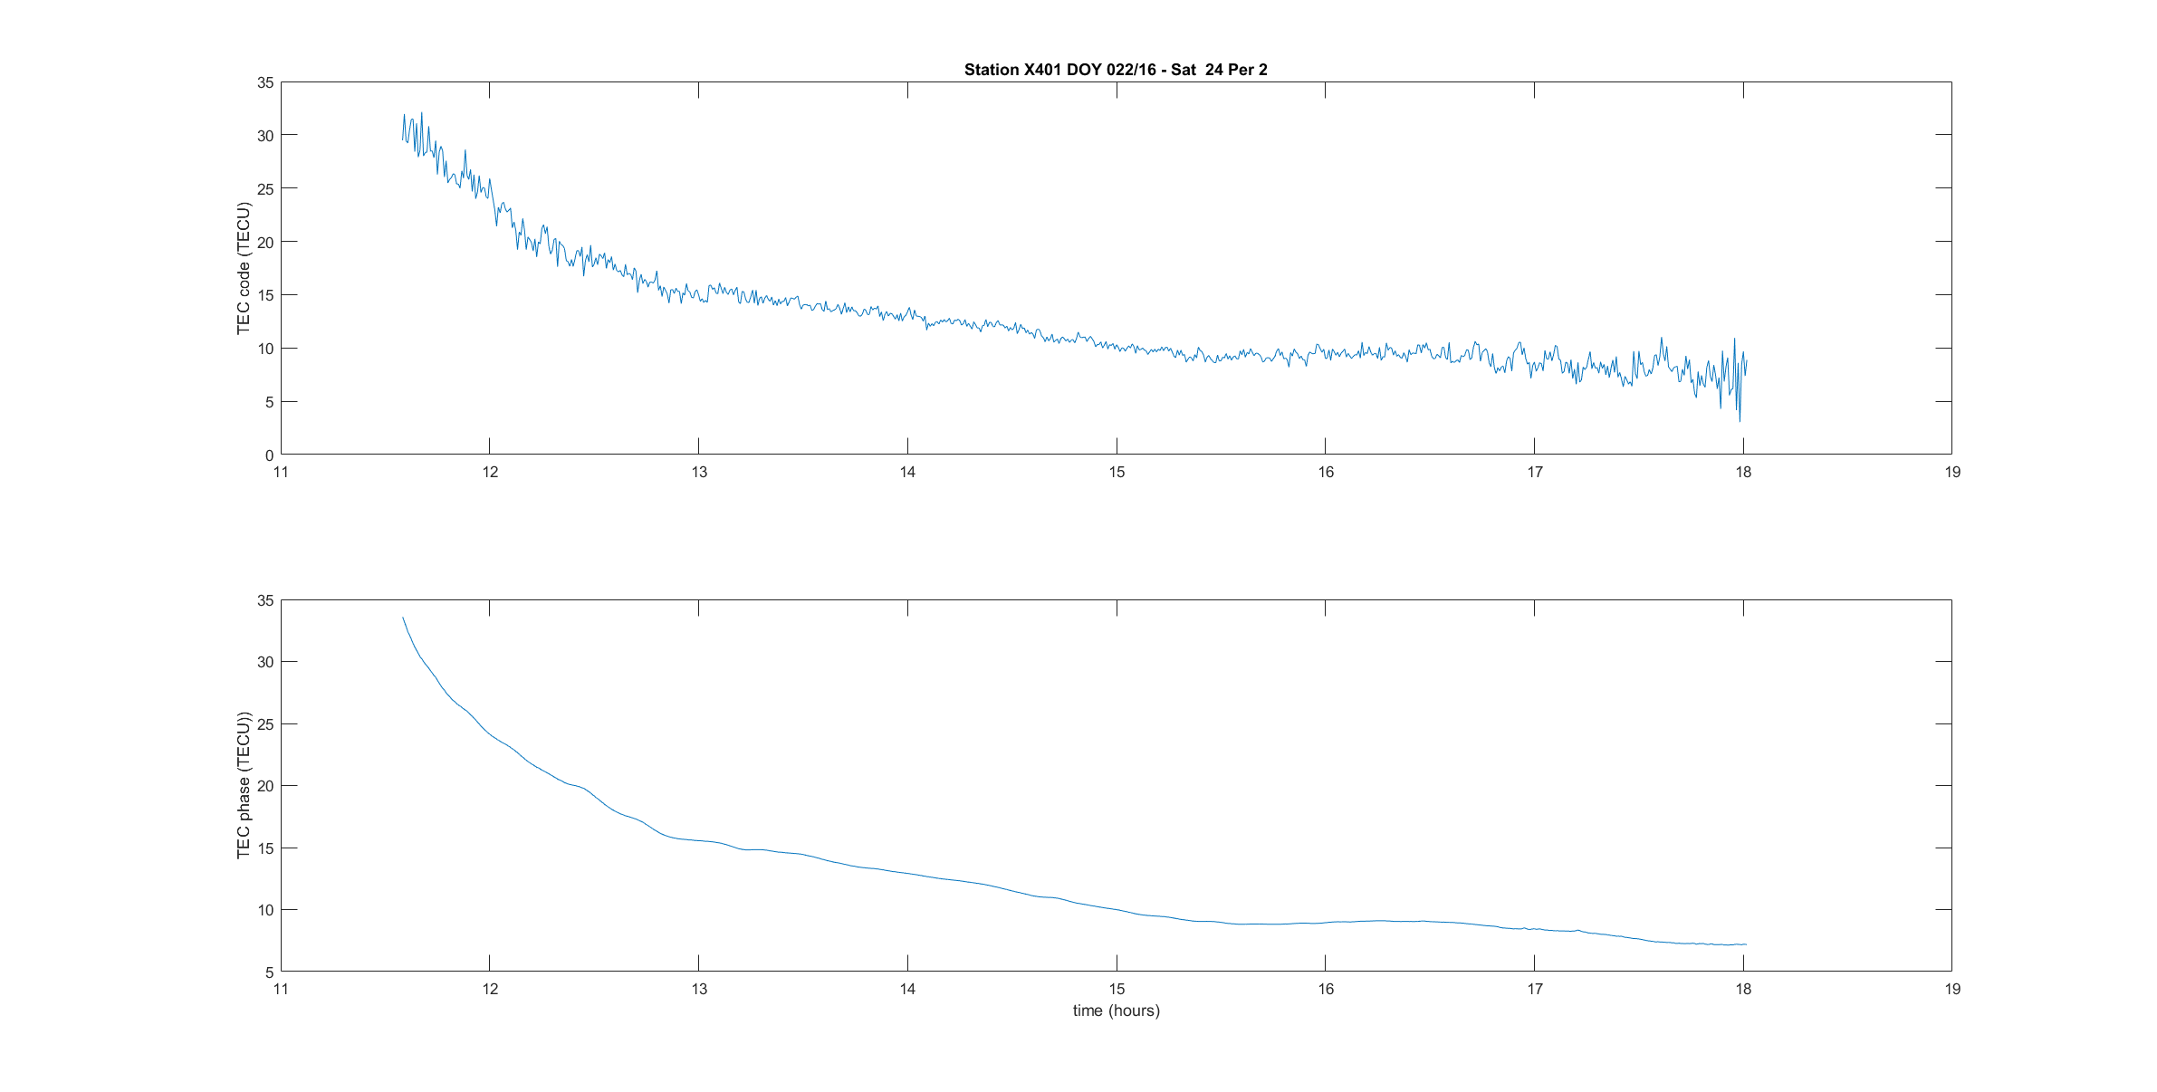
Galileo E1-E5 Slant TEC (code versus phase)
TEC could directly be obtained from code measurements :
  No phase ambiguity to compute.
  No problem with cycle slips, in particular during disturbed ionosphere conditions.

Slide 21
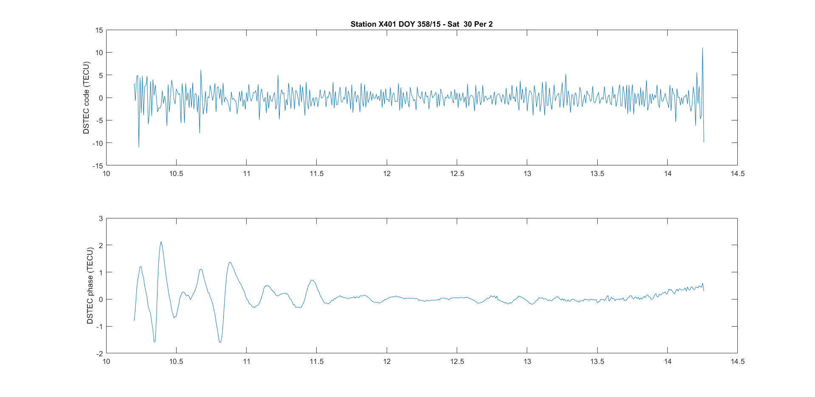
Galileo E1-E5 RoTEC (code versus phase)
Nevertheless, a strong TID cannot be extracted from code noise.

Slide 22
GEO satellites for ionosphere monitoring

Slide 23
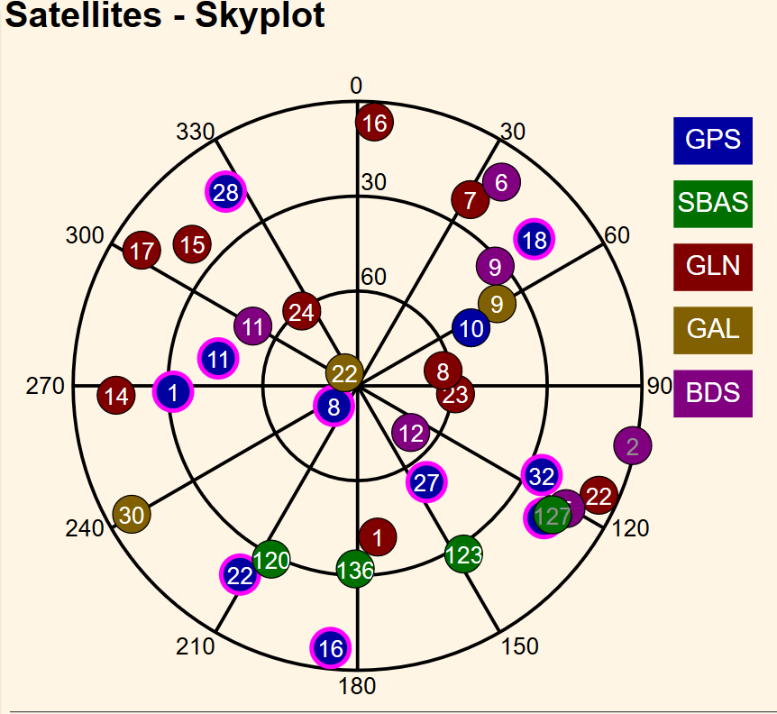
GEO at European mid-latitude (Liege, Belgium)
Beidou
  C02 (1°-2°)
  C05 (15°)
SBAS
  GAGAN (India)
    S127 (16°)
  EGNOS (Europe)
    S123 (27°)
    S136 (32°)
C02
C05
GAGAN S127
EGNOS S123 and S136

Slide 24
Beidou GEO
In Liege (Belgium), Beidou GEO satellites C05 (15°) and C02 (1-2°) can be tracked by all Septentrio receivers.
C05 data are continuous (in average less than 1 cycle slip a day).
  ➔ Phase ambiguity often remains the same during several days.
C02 data are usually continuous during several hours (up to 24 hours).
Our Trimble NetR9 receivers only track C05 but data are unusable due to many cycle slips.

Slide 25
Beidou GEO (Liege): Precision (phase)
Given phase TEC accuracy (C05: 0,023 TECU) and (C02: 0,045 TECU), both satellites can be used to monitor slant TEC or local variability in TEC.

Slide 26
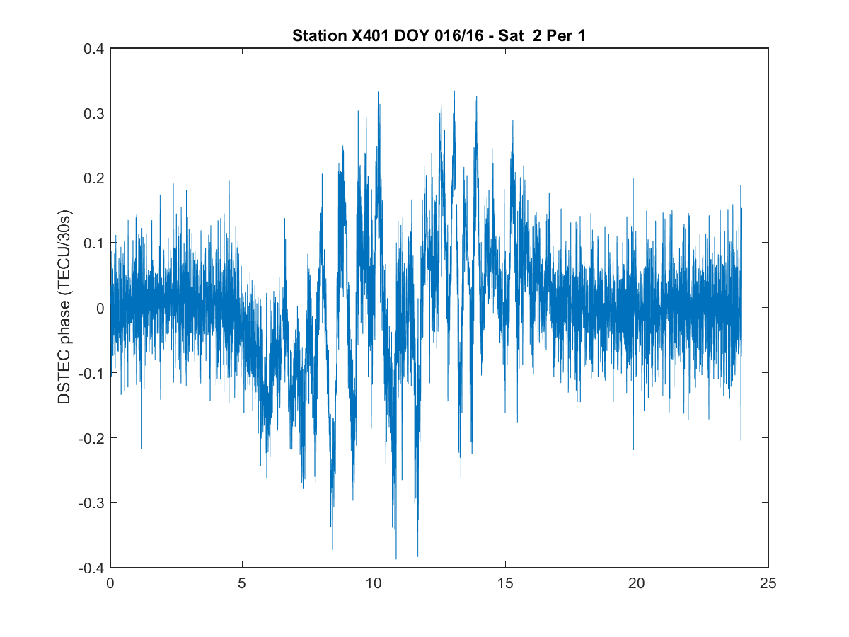
Beidou GEO : $∆STEC$ Phase 1

Slide 27
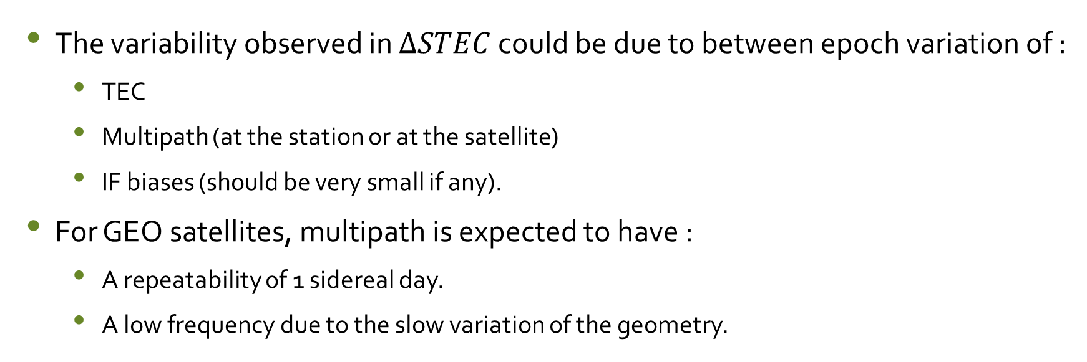
Beidou GEO : $∆STEC$ Phase 2
The variability observed in $∆STEC$ could be due to between epoch variation of :
  TEC
  Multipath (at the station or at the satellite)
  IF biases (should be very small if any).
For GEO satellites, multipath is expected to have :
  A repeatability of 1 sidereal day.
  A low frequency due to the slow variation of the geometry.

Slide 28
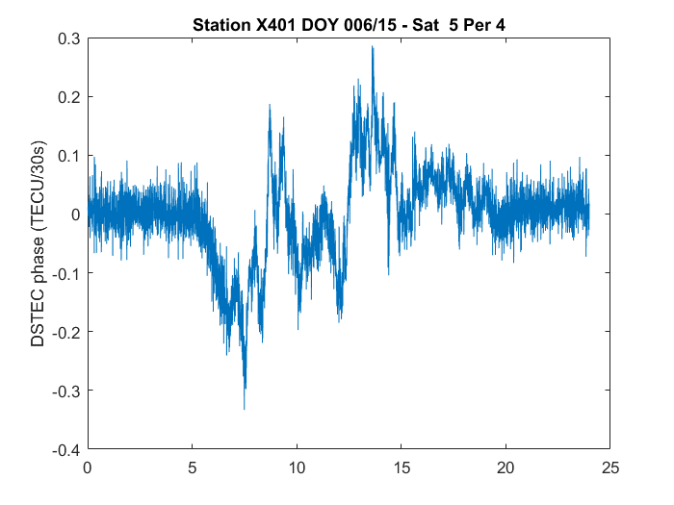
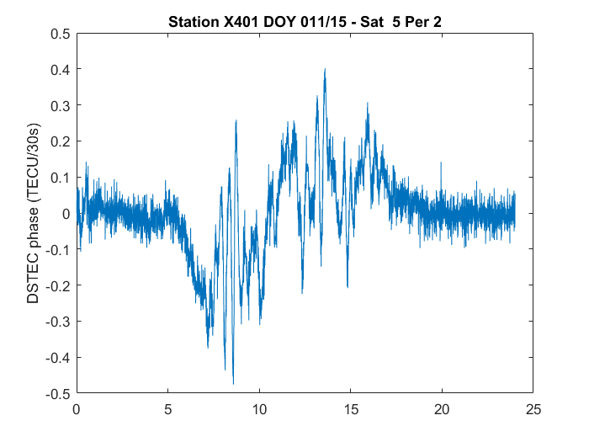
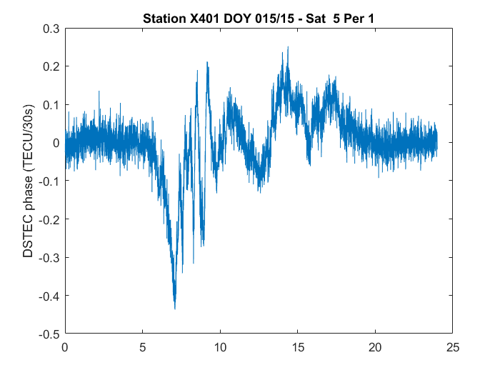
No daily repeatability

Slide 29
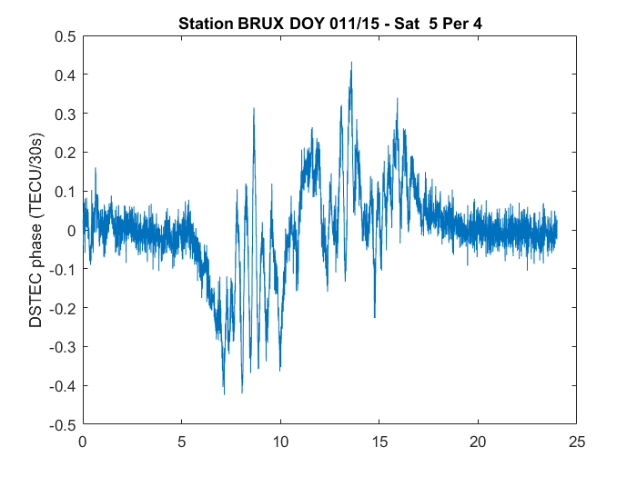
Similar signal for Liege and Brussels (about 100 km baseline)

Slide 30
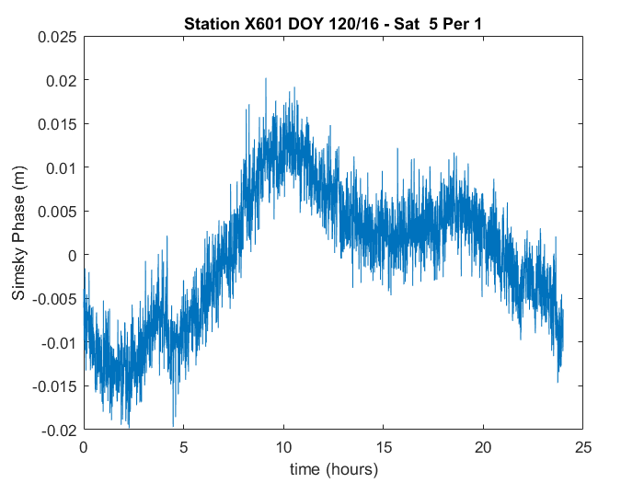
Simsky 3F combination

Slide 31
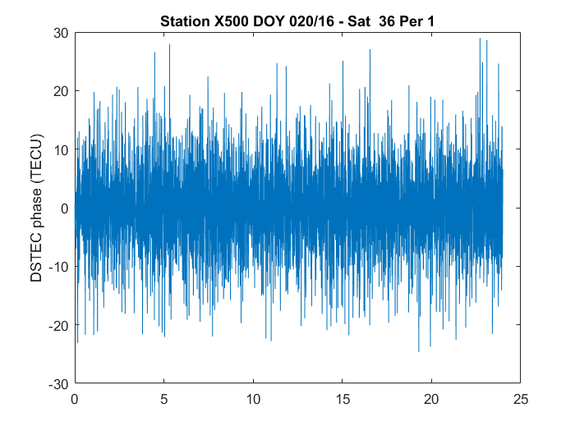
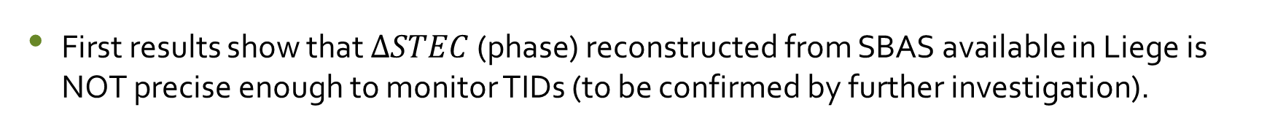
SBAS (Liege)
First results show that $∆STEC$ (phase) reconstructed from SBAS available in Liege is NOT precise enough to monitor TIDs (to be confirmed by further investigation).
DSTEC (TCU/30s)

Slide 32
Conclusions
New/modernized GNSS combined with last generation receivers/antennas bring improvement in code and phase TEC accuracy (larger frequency difference, more precise code and phase observables more resistant to multipath).
In particular, Code TEC precision is better than 1 TECU (above 20° elevation, multipath filter on, Septentrio PolaRx4) when using Galileo E1 and E5.
  Code only TEC reconstruction becomes an option.
  Not possible to detect even strong TIDs.
In Liege, TEC reconstructed with
  Available SBAS is NOT precise enough to study local variability in TEC (to be confirmed);
  Beidou GEO provide a valuable tool to study “moving structures” in TEC.

Slide 33
Thanks for your attention !

