Slide 1
Monitoring the ionosphere using new GNSS
R. Warnant¹, C. Deprez¹, G. Wautelet², L. Van de Vyvere³
¹University of Liege, Liege, Belgium.
²GRGS, Toulouse, France.
³M3 System, Wavre, Belgium.
International Beacon Satellite Symposium 2016
27 June - 1 July 2016, Trieste (Italy).

Slide 2
Monitoring TEC for geodetic applications
For the last 25 years, TEC has been reconstructed from GPS L1/L2 code and phase pseudoranges in order to correct ionospheric effects on positioning applications.
Absolute positioning is influenced by absolute TEC and “regular” gradients.
Differential and relative positioning are influenced by regular gradients and also local variability in TEC (the latter mainly degrading precise applications).
GPS-based TEC monitoring data suffers from different shortcomings.

Slide 3
Present shortcomings 1
Absolute TEC accuracy is limited to 2-5 TECU:
Depends on code and phase pseudoranges precision.
The use of code levelling to compute phase ambiguities degrades TEC accuracy due to low code precision (main limitation).
Limited spatial resolution:
Depends on the number of satellites in view.
In Liege, the number of GPS satellites in view ranges from 8 to 15 (average 11).
A proper modeling of local variability in TEC requires increased spatial resolution.

Slide 4
Present shortcomings 2
Monitoring of local variability in TEC at European mid-latitudes (Belgium):
Mainly due Travelling Ionospheric Disturbances.
Also detected during geomagnetic storms.
Depends on phase pseudorange precision.
Requires good spatial resolution.
The detection of moving structures (TIDs) is « biased » by the fact that ionospheric points have a velocity wrt the ionosphere due to satellite orbital motion.

Slide 5
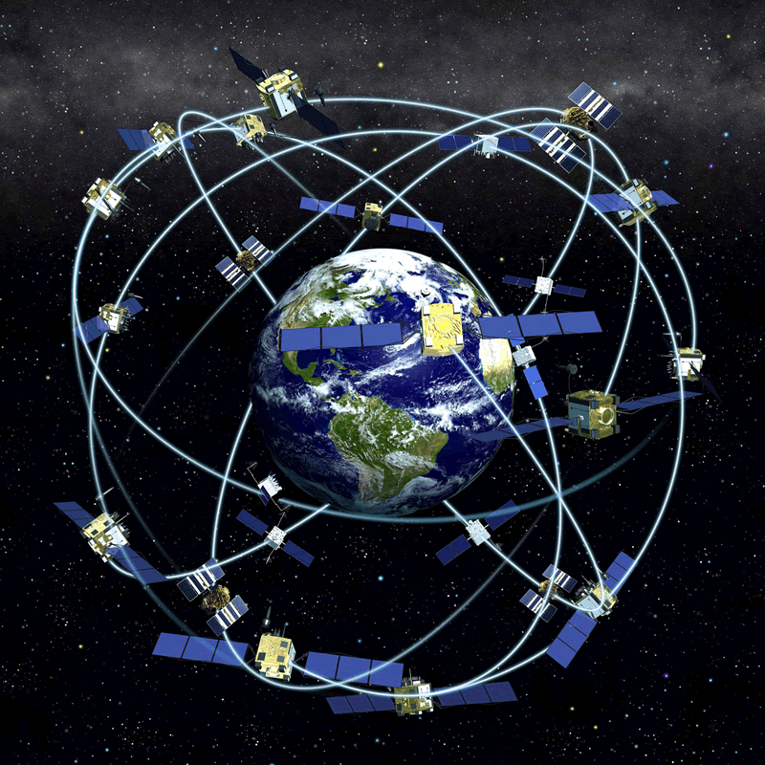
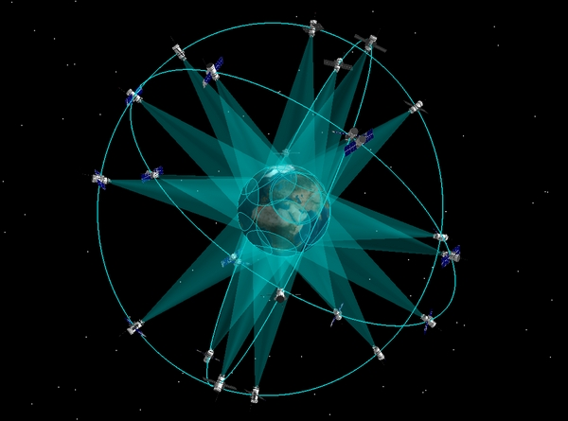
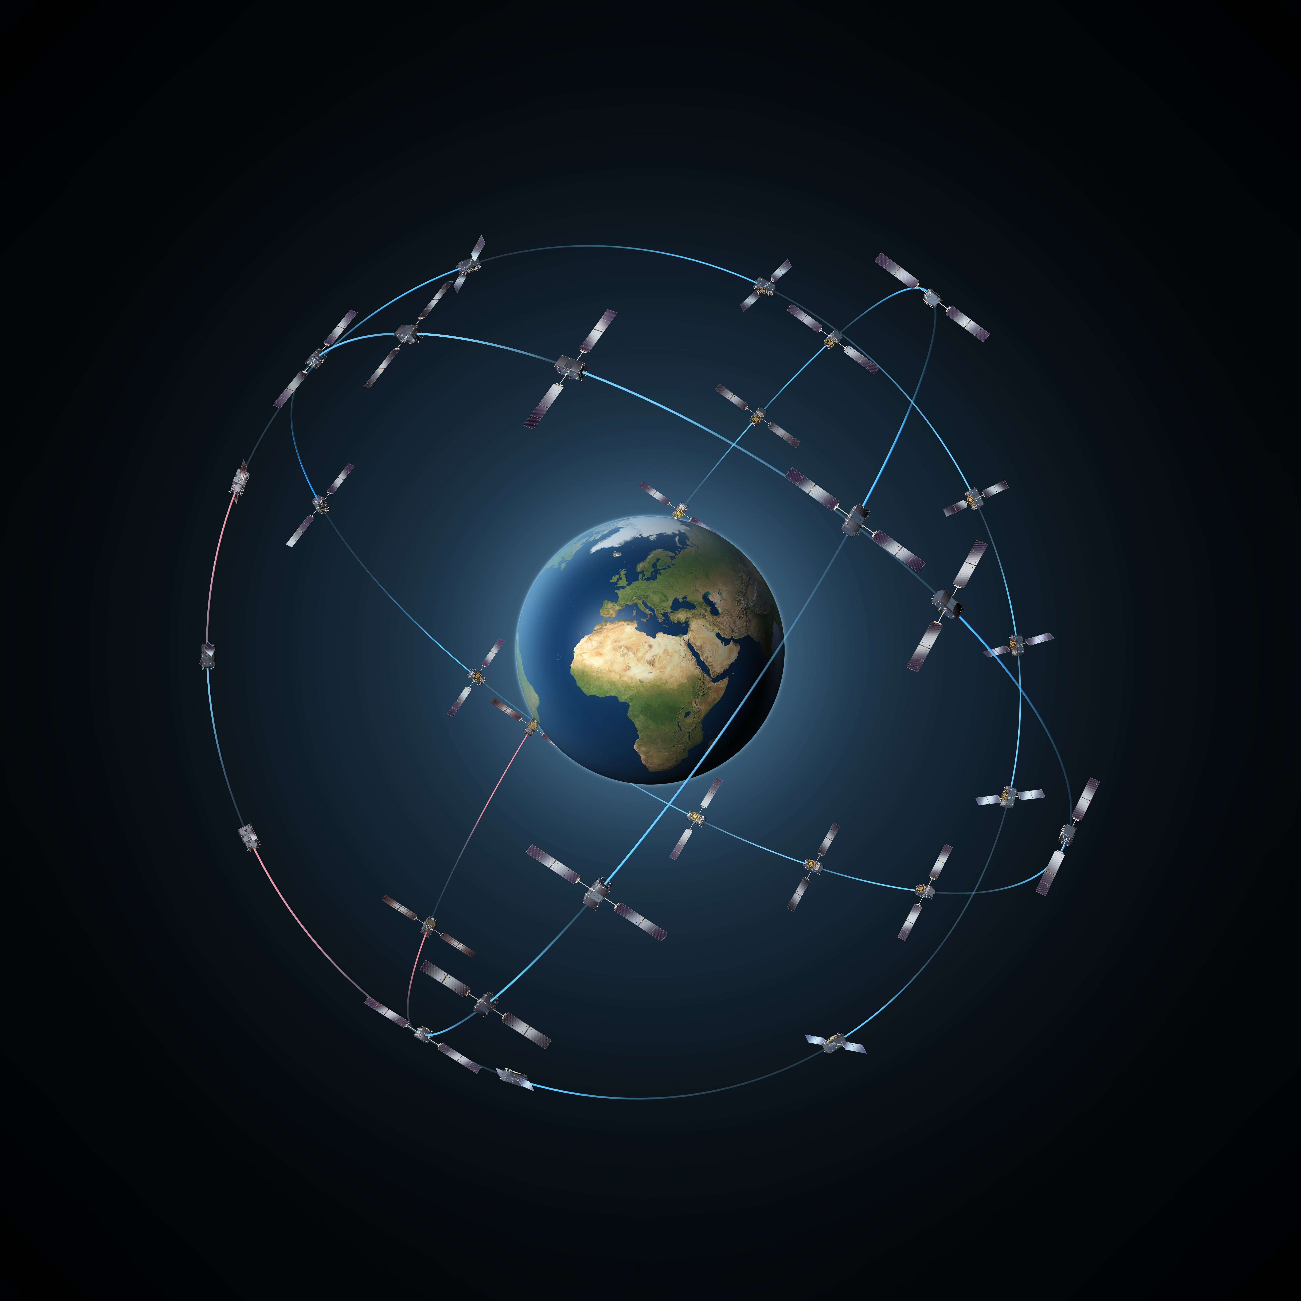
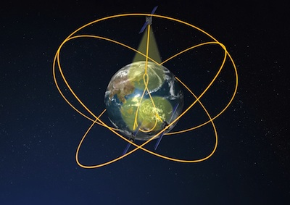
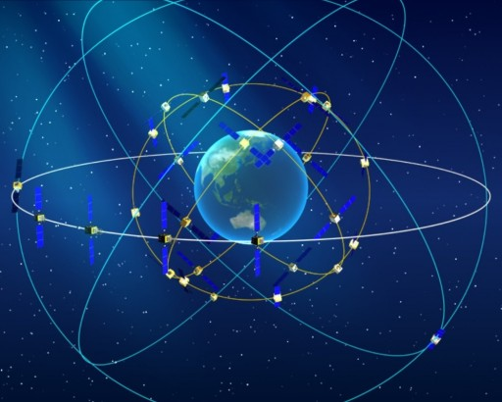
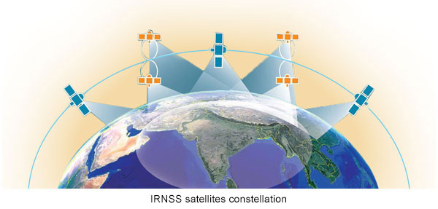
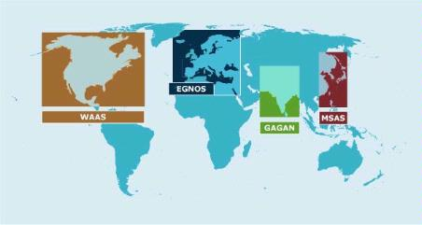
New/modernized GNSS 1
GPS
GLONASS
Galileo
QZSS
Beidou
NAVIC
SBAS

Slide 6
New/modernized GNSS 2
More (than 2) frequencies:
Possible to form several frequency pairs to reconstruct TEC
Development of improved ambiguity computation (even resolution ?) techniques.
Improved signals :
Better resistance to multipath
New modulation techniques allowing to perform more precise code pseudorange measurements.
More satellites:
The combined use of al the available GNSS provides better redundancy and improved spatial resolution.

Slide 7
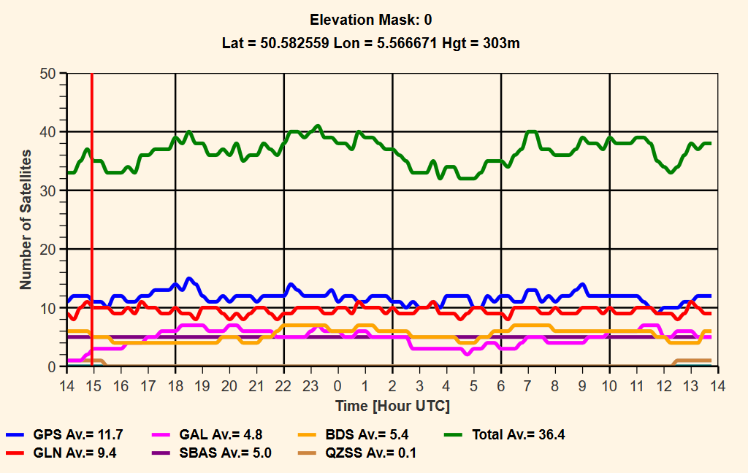
New/modernized GNSS 3
Number of GNSS satellites in view (up to 40) in Liege (Belgium)

Slide 8
New/modernized GNSS 4
Different types of orbits:
Medium Earth Orbits (MEO)
Geostationary Orbits (GEO)
Inclined Geosynchronous Orbits (IGSO)
GEO orbits have a negligible velocity wrt respect to the ionosphere.
Therefore, GEO satellites have a particular interest for the study of local variability in TEC.

Slide 9
Multi GNSS/multi-frequency TEC precision

Slide 10
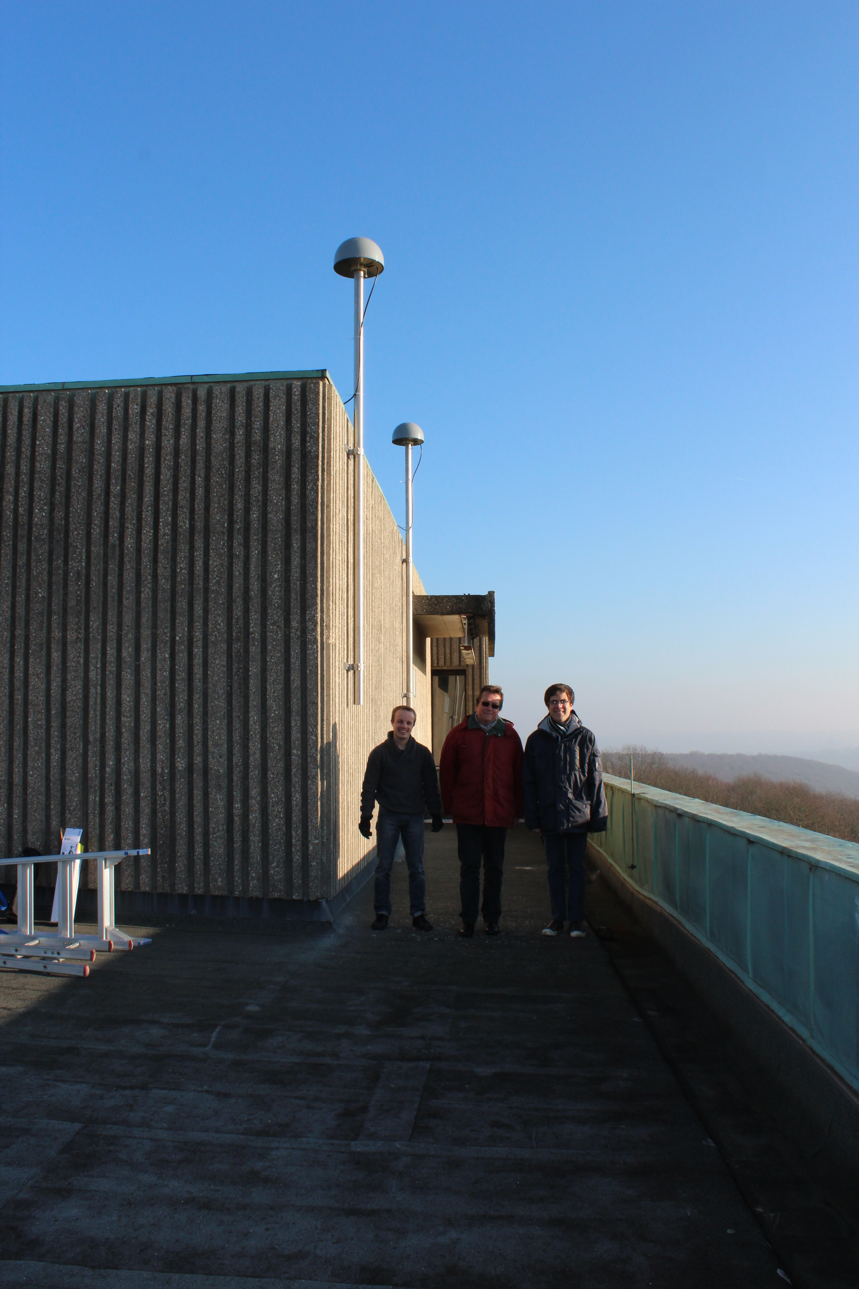
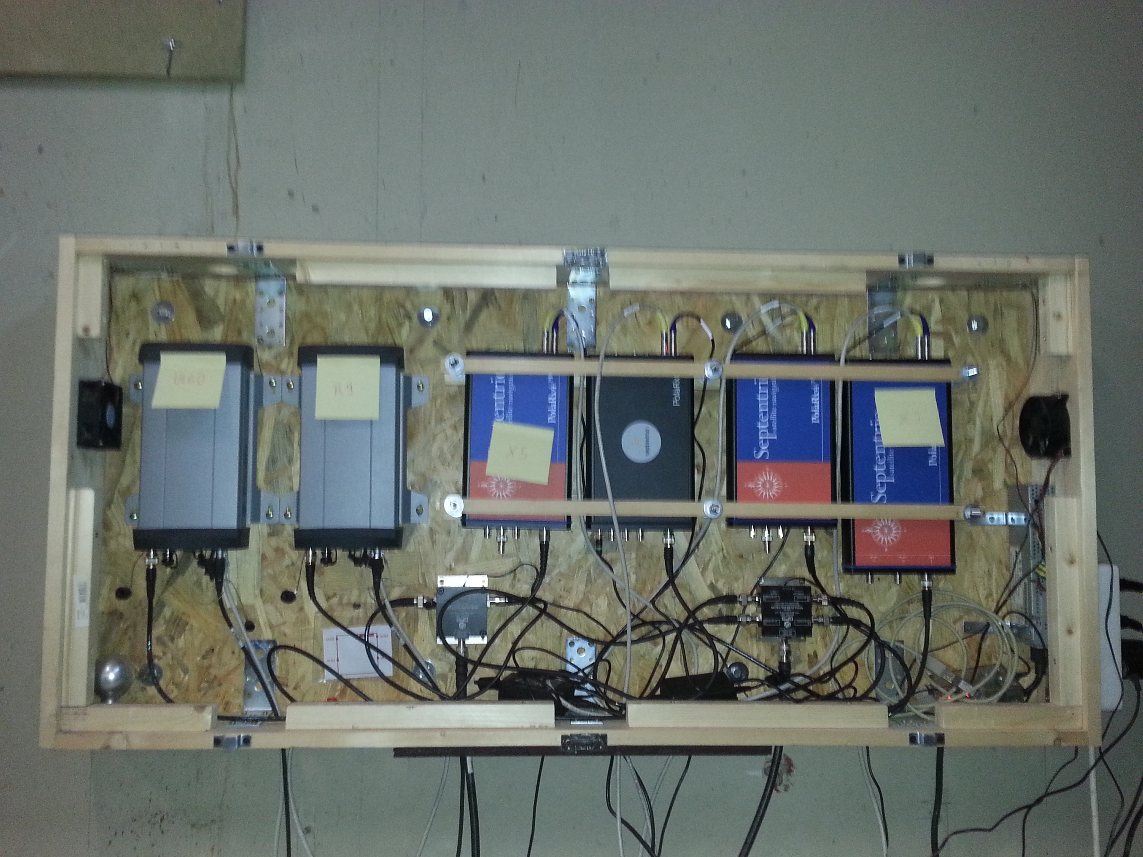
GNSS equipment
Located in Liege (Belgium).
2 Trimble GNSS choke ring antenna’s on a short baseline (5,352 m).
6 multi-GNSS/multi-frequency receivers :
2 Trimble NetR9 receivers
2 Septentrio PolaRx4 receivers
1 Septentrio PolaRxS scintillation receiver
1 Septentrio PolaRx5 (new model).
Equipment used to perform zero and short baseline tests for positioning and ionosphere monitoring.

Slide 11
GNSS signals : GPS
L5
L2
L1

Slide 12
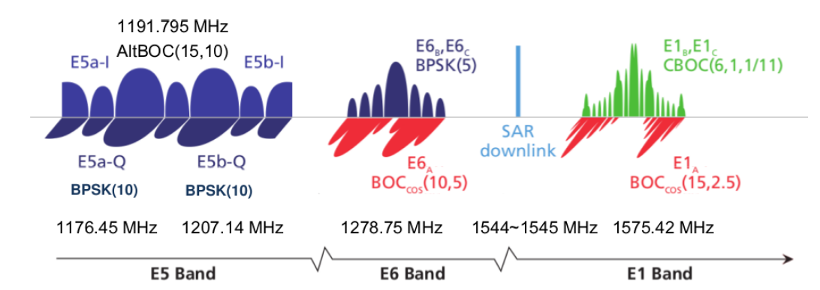
GNSS signals : Galileo
E5a
E5
E5b
E6
E1
Only available with PolaRx5

Slide 13
GNSS signals : Beidou
B2
B3
B1
Only available on NetR9 and PolaRx5

Slide 14
Multi-GNSS/frequency TEC precision 1
For satellite “i” and receiver “p”, the code geometry free (GF) combination between frequency f_{k} and f_{l} :
Codes at frequency
f_{k} and f_{l}
Slant TEC
InterFrequency
rec. and
sat. biases
Multipath
Noise

Slide 15
Multi-GNSS/frequency TEC precision 2
Reconstructed TEC precision mainly depends on :
Code pseudorange (P_{k},P_{l}) precision.
Multipath.
IF biases variability (one usually assume that they are stable over short time periods).
The “TEC coefficient” : $α_{kl}^{−1}$
Same demonstration can be done for phase pseudoranges which contain an additional term: the phase ambiguity.

Slide 16
Multi-GNSS/frequency TEC precision 3
Given the same code precision, a larger frequency difference gives a smaller TEC coefficient and therefore a better TEC precision.
TEC coefficients
Galileo |  |  |  | GPS |  |  | Beidou
E1-E5a | E1-E5b | E1-E5 | E1-E6 | L1-L2 | L1-L5 | L2-L5 | B1-B2 | B1-B3
7,764 | 8,757 | 8,24 | 11,893 | 9,52 | 7,764 | 42,089 | 8,993 | 11,754

Slide 17
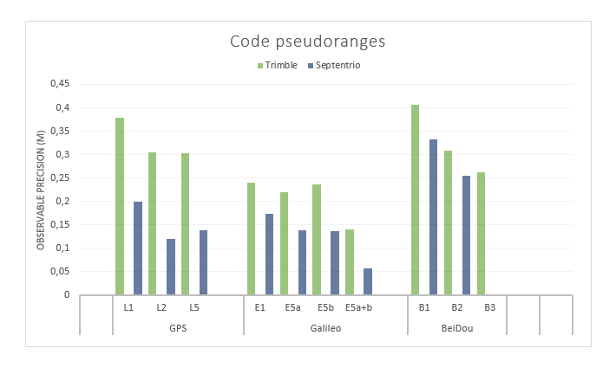
Multi-GNSS/frequency TEC precision 4
Code pseudorange precision (large differences between frequencies/receivers !)

Slide 18
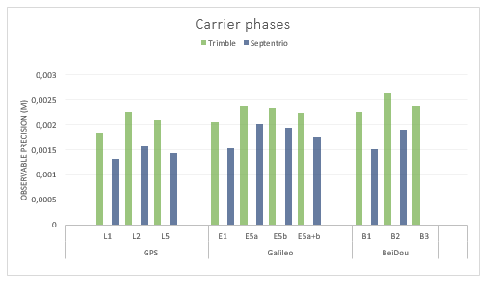
Multi-GNSS/frequency TEC precision 5
Phase pseudorange precision: small differences between frequencies/receivers

Slide 19
Methodology to asses TEC precision 1
Compute Slant TEC change from epoch to epoch (30 s interval) without normalization:
Removes biases (constant part of IF delays, ambiguities)
Still depends on noise and on between epoch variation of TEC and multipath
Form single (between receiver) differences of $∆STEC(t_{k})$ on ULg short baseline (5,352 m):
Completely removes TEC (same ionosphere).
Still contains multipath and noise.

Slide 20
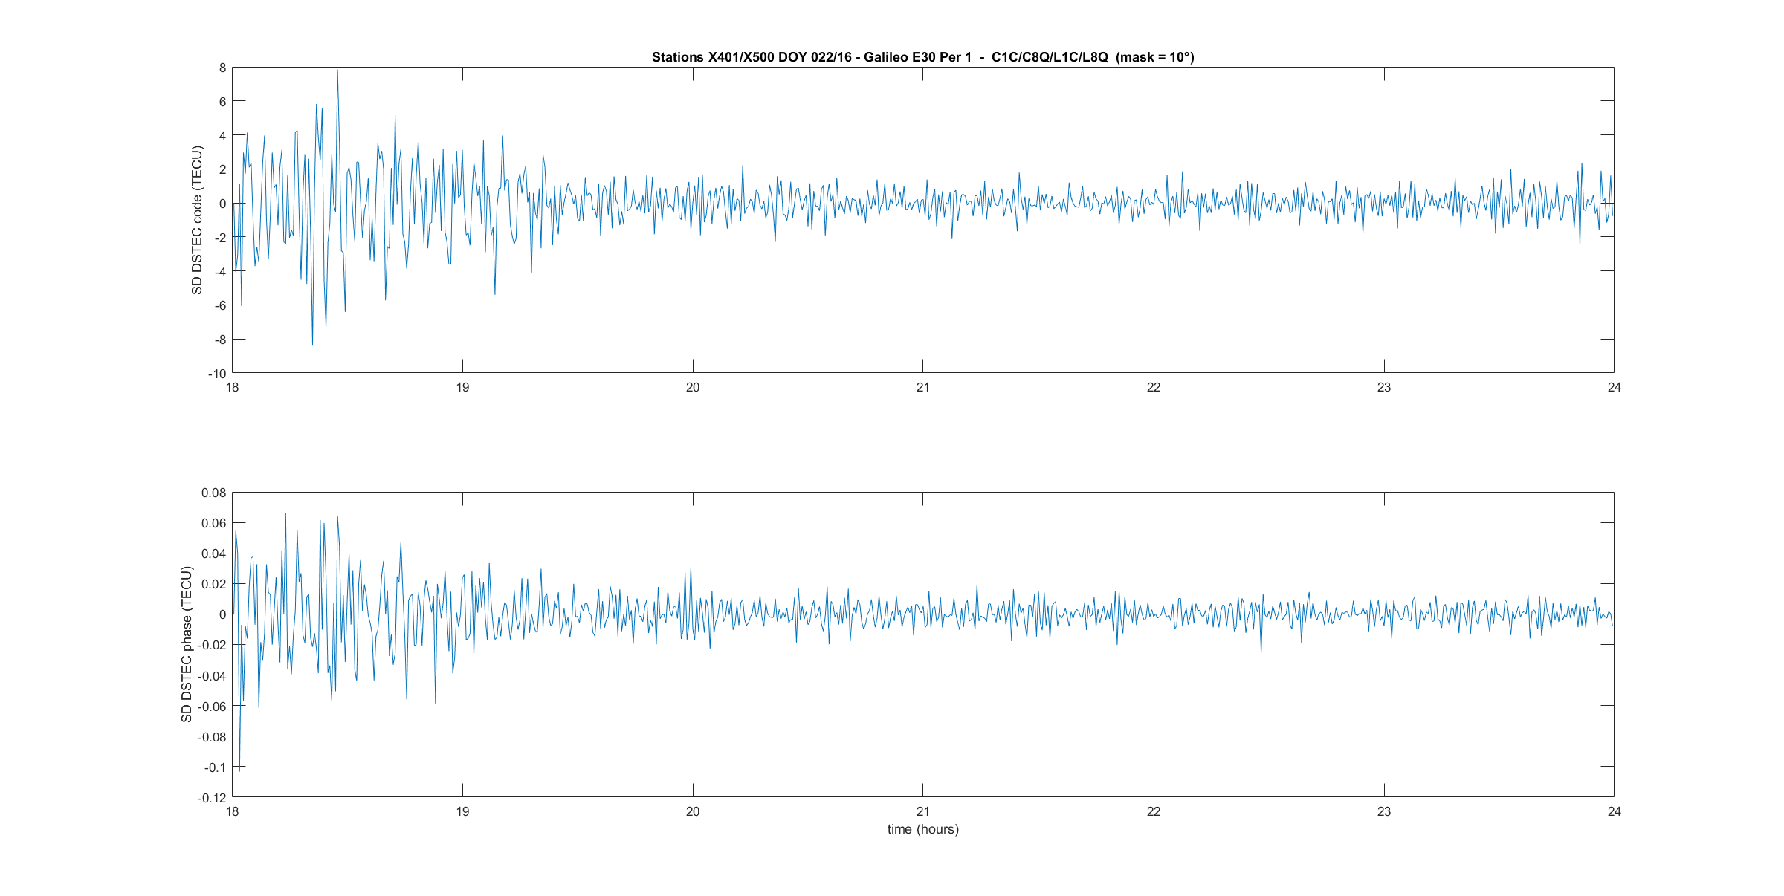
Methodology to asses TEC precision 2
TEC precision is estimated by computing the standard deviation of single differences of $∆STEC\left(t_{k}\right)$ and by dividing them by 2 (error propagation).

Slide 21
Results: code (multipath filter off - mask 10°)

Slide 22
Results: Phase (multipath filter off - mask 10°)

Slide 23
Results: code (multipath filter on - mask 20°)

Slide 24
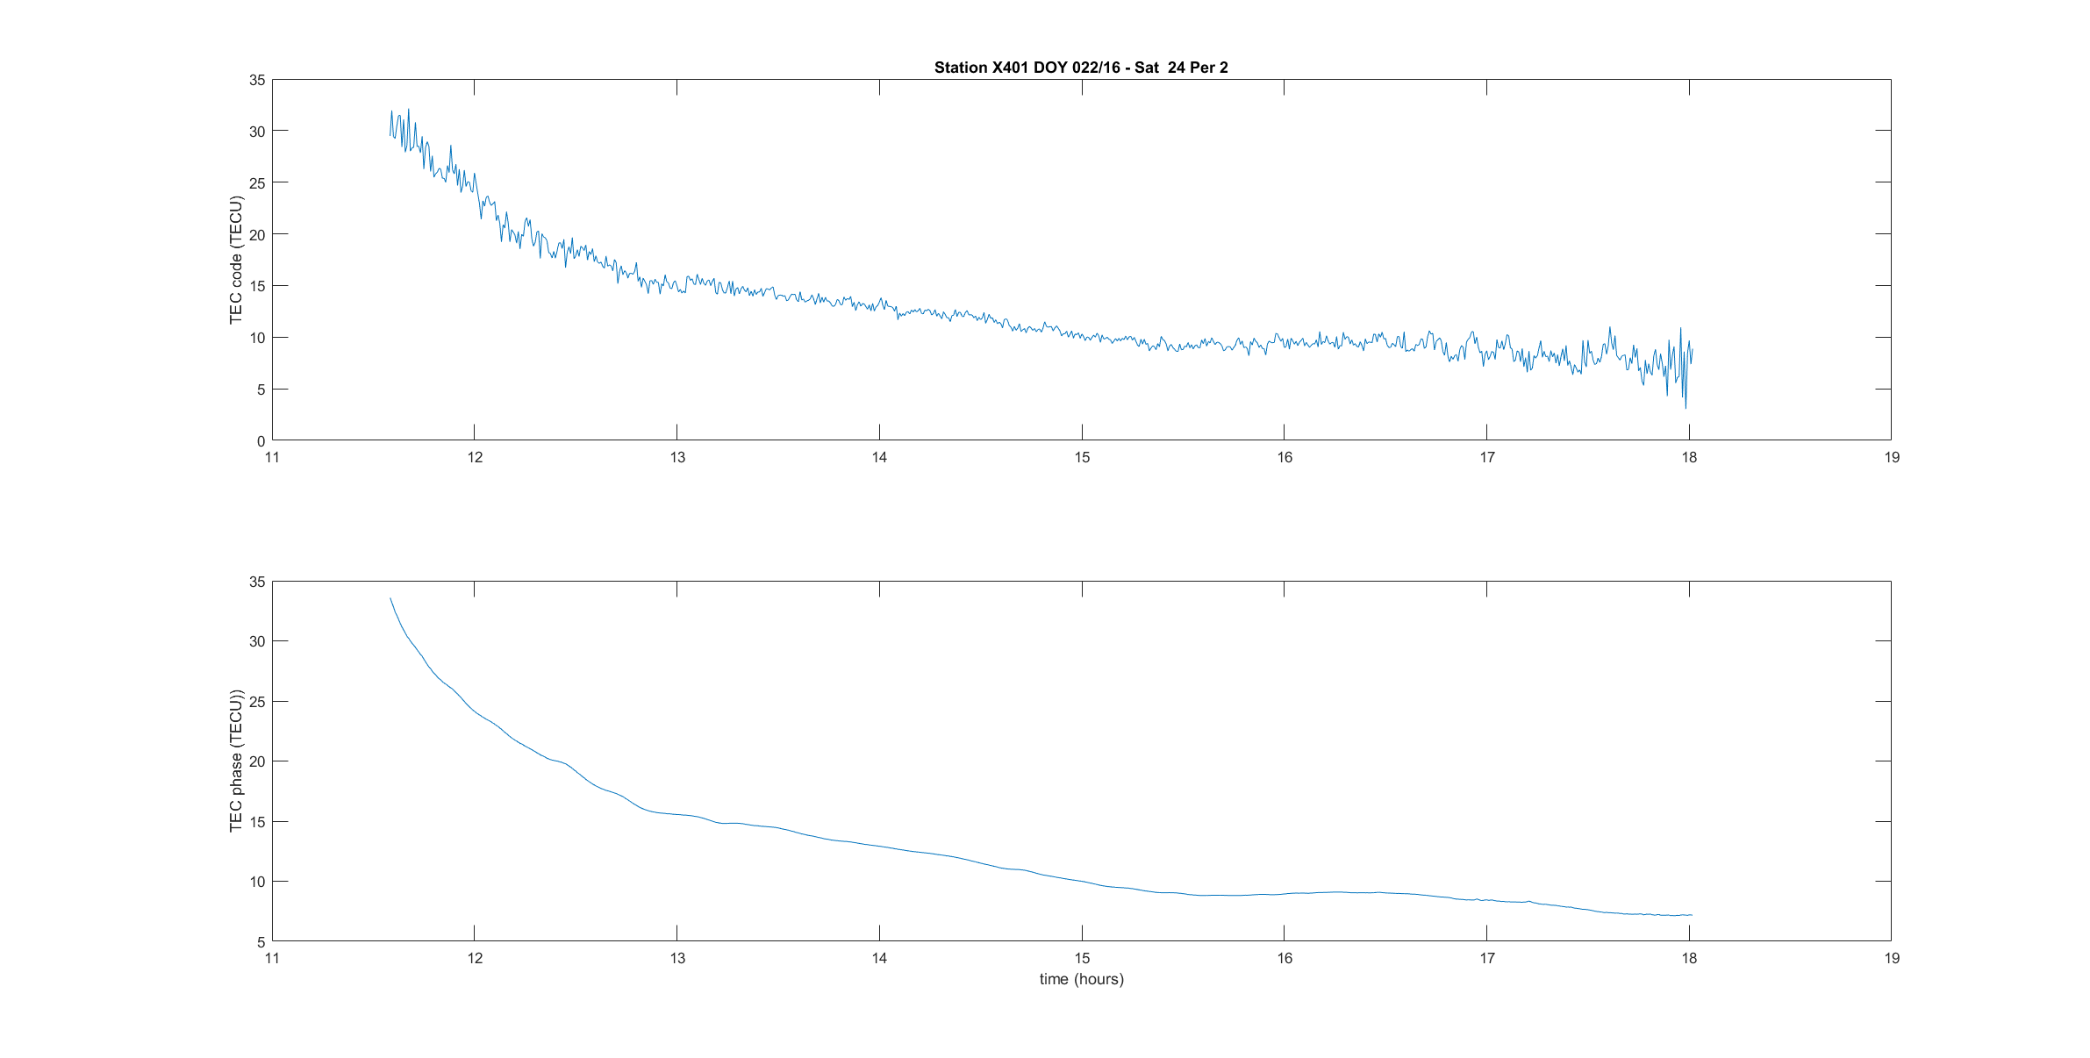
Slant TEC Galileo E1-E5 code versus phase

Slide 25
Multi-GNSS/frequency TEC: Summary 1
Strong improvement in code TEC precision with Galileo wrt the “standard” GPS L1/L2.
Galileo E1/E5 combination has a precision better than 1 TECU above 20° elevation (Septentrio PolaRx4).
This will bring improvement in code-phase leveling.
➔ Better TEC accuracy.
Depending on application requirement, TEC could directly be obtained from code measurements.
➔ No phase ambiguity to compute
➔ No problem with cycle slips, in particular during disturbed ionosphere conditions.

Slide 26
Multi-GNSS/frequency TEC: Summary 2
As far as phase TEC accuracy is concerned, for Septentrio receivers, TEC precision has similar accuracy levels of about 0,012 TECU (mask 10°) for the different combinations/GNSS.
For Trimble receivers, Galileo provides the best accuracy (0,008 TECU).

Slide 27
GEO satellites for ionosphere monitoring

Slide 28
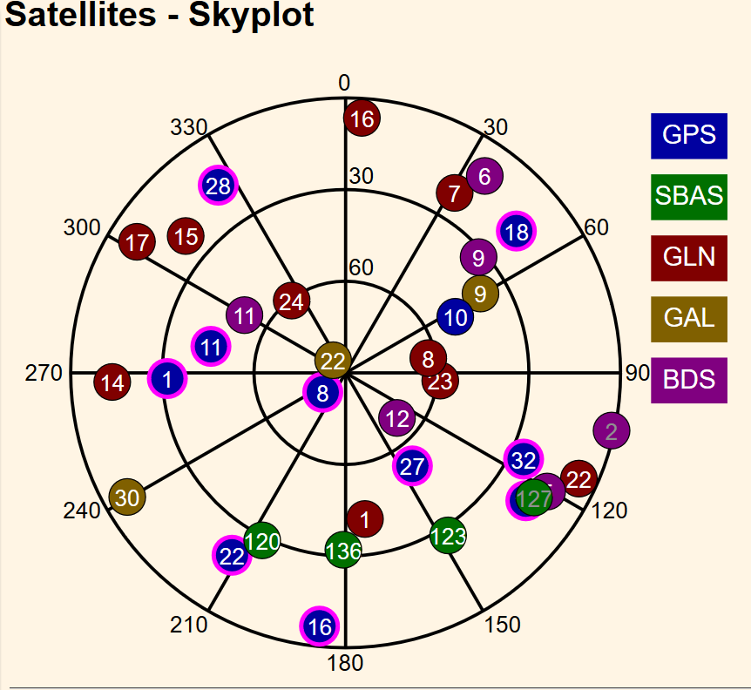
GEO at European mid-latitude (Liège, Belgium)
Beidou
C02 (1°-2°)
C05 (15°)
SBAS
GAGAN (India)
S127 (16°)
EGNOS (Europe)
S123 (27°)
S136 (32°)
NAVIC
I06 (29°)
Only single frequency available yet (with PolaRx5).
C02
C05
GAGAN S127
EGNOS S123 and S136

Slide 29
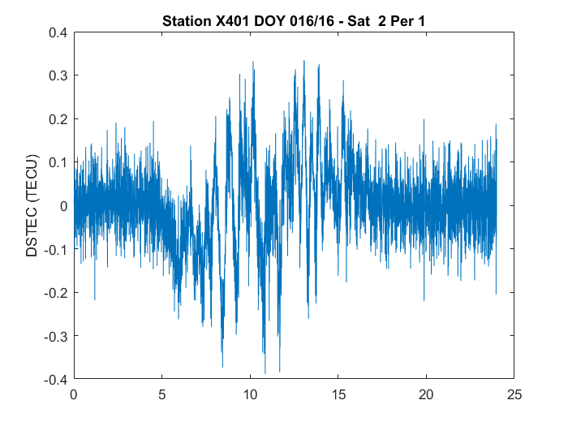
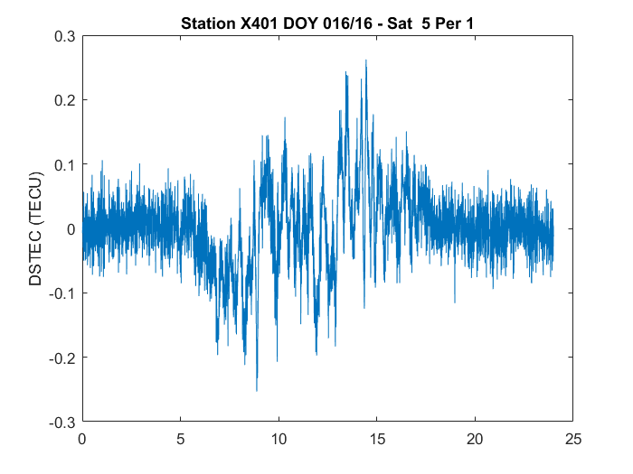
Beidou GEO : $∆STEC$ Phase

Slide 30
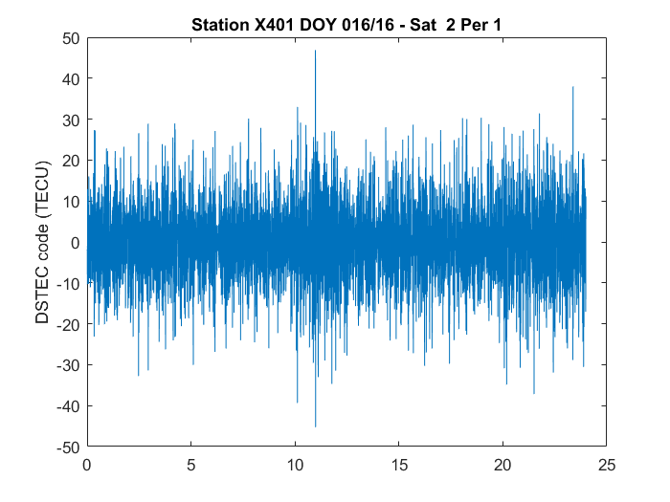
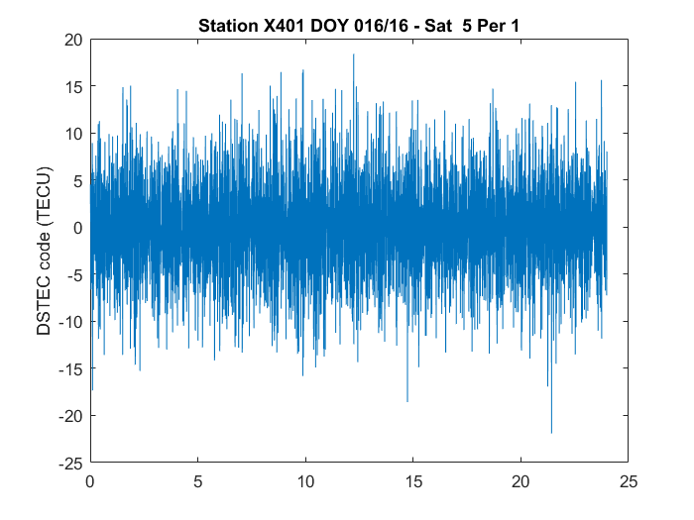
Beidou GEO : $∆STEC$ Code

Slide 31
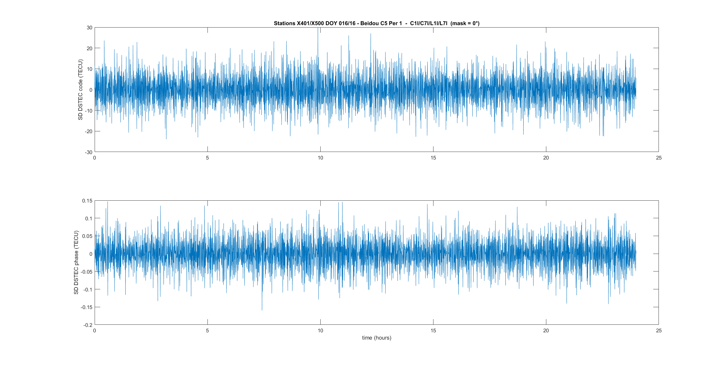
Beidou GEO: SD of $∆STEC$ (C05)

Slide 32
Beidou GEO: accuracy

Slide 33
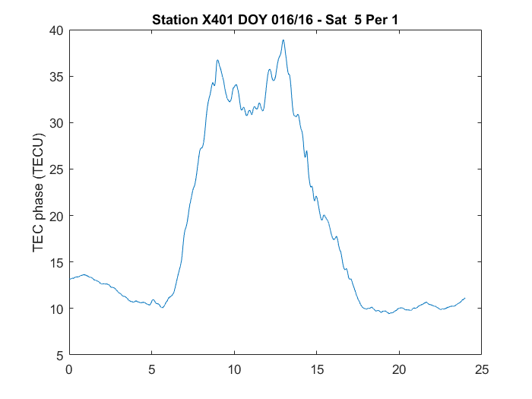
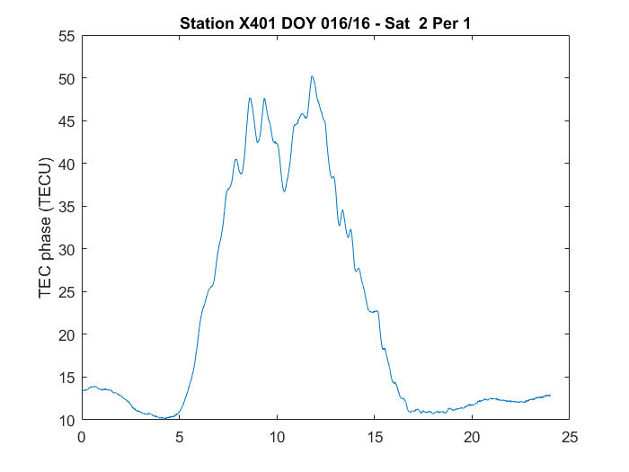
Beidou GEO: Slant phase TEC

Slide 34
Beidou GEO: Summary 1
In Liege (Belgium), Beidou GEO satellites C05 (15°) and C02 (1-2°) can be tracked by all Septentrio receivers.
C05 data are continuous (in average less than 1 cycle slip a day).
➔ Phase ambiguity often remains the same during several days.
C02 data are usually continuous during several hours (up to 24 hours).
Given phase TEC accuracy (C05: 0,023 TECU) and (C02: 0,045 TECU), both satellites could be used to monitor TEC or local variability in TEC.

Slide 35
Beidou GEO: Summary 2
Code leveling could be degraded by code noise but ambiguities are usually computed on much longer time periods.
Further investigations are necessary to interpret the variability observed in $∆STEC$
Multipath, Ionosphere, variability in IF biases.
Our Trimble NetR9 receivers only track C05 but data are unusable due to cycle slips.

Slide 36
Thanks for your attention !

