Slide 1
GNSS: Principle, applications and opportunities.
René Warnant
Professeur à l’Université de Liège
Business and Technology Club : “Les Technologies aérospatiales”
CSL, 5 décembre 2016.

Slide 2
Definition

Slide 3
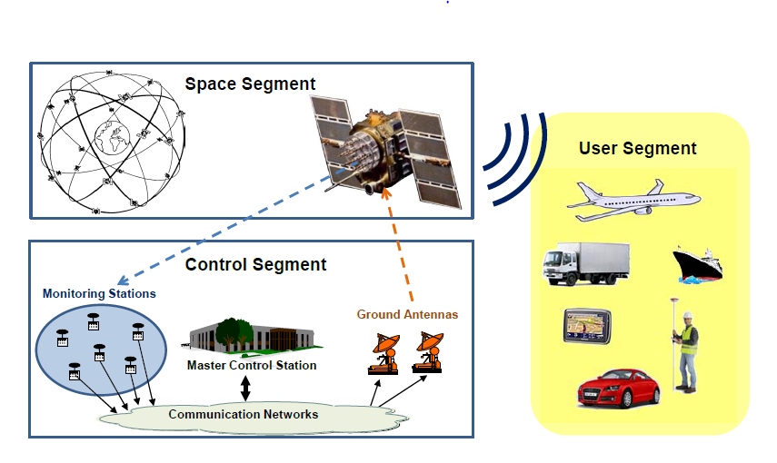
GNSS : Definition
GNSS = Global Navigation Satellite System
Goals :
Real time navigation i.e. to measure the user position (and velocity) in real time.
Anywhere on Earth
Under any weather conditions
Precise timing (clock synchronisation)
Composed of 3 segments
Space segment
Control segment
User segment

Slide 4
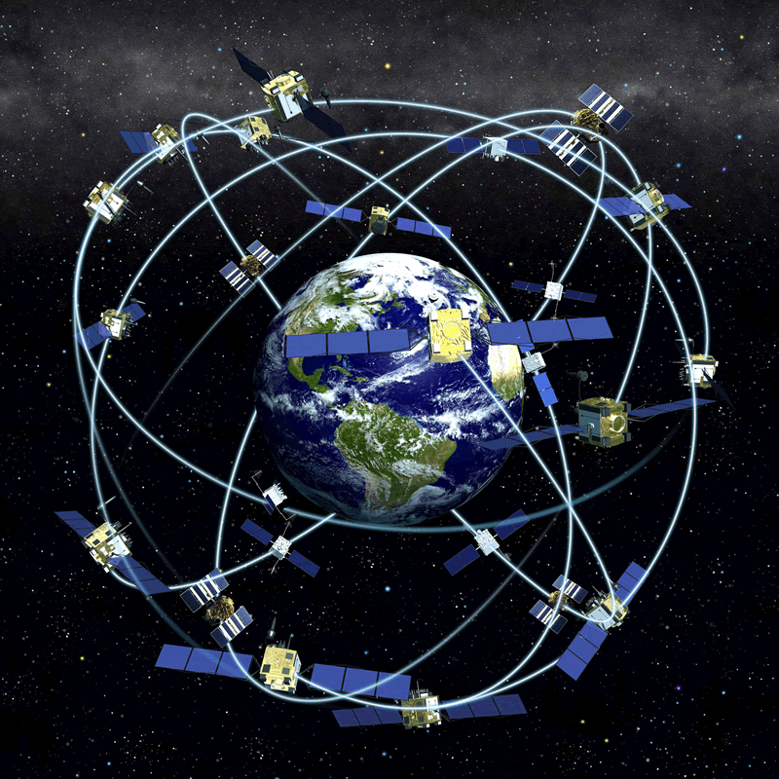
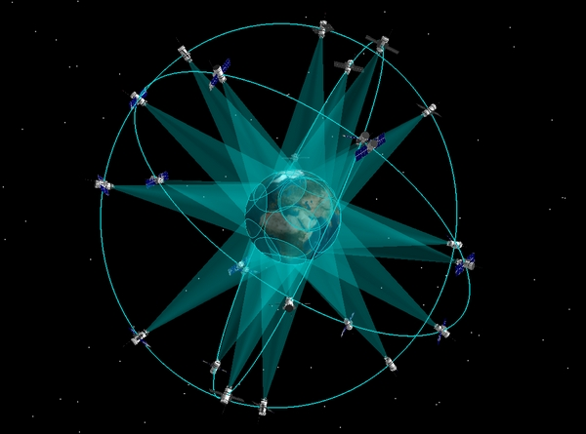
Main GNSS 1
GPS (USA)
First GNSS, operational since 1994
32 satellites
GLONASS (Russia)
Operational since 2012
24 satellites

Slide 5
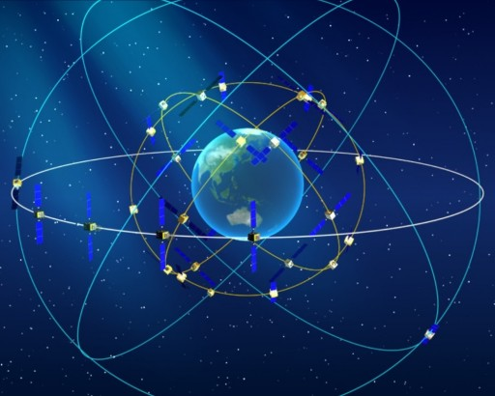
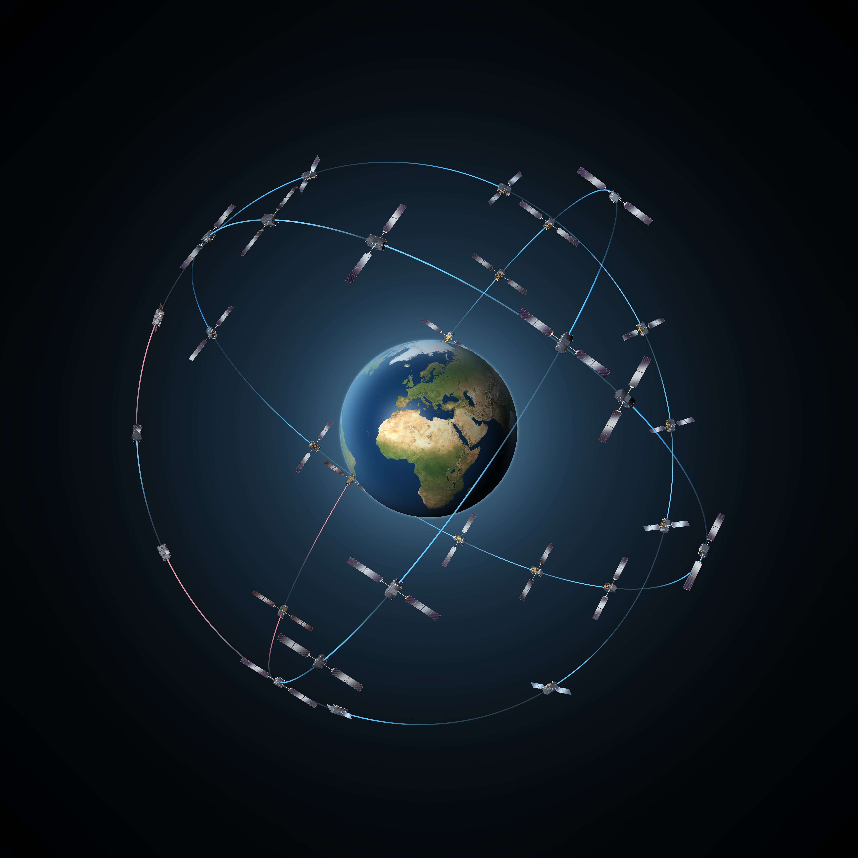
Main GNSS 2
Beidou (China)
Not yet operational
13 satellites + 5 under commissioning
Galileo (Europe)
Now pre-operational.
A constellation of 30 satellites (24 + 6 spare) in MEO orbits by 2020.
At the present time : 18 satellites in orbit
4 satellites to be launched in 2017, 4 in 2018 and 4 in 2020.

Slide 6
Principle

Slide 7
TOA ranging 1
GNSS use the concept of Time of Arrival (TOA) ranging (also called Time of Flight (TOF) ranging).
The idea is measure the time it takes for a signal transmitted by an emitter to reach a receiver.
The emitter (foghorn, radio beacon, satellite, …) is at a known location and emits the signal at a conventional (known) time.
From the known time of emission and the measured time of arrival, the propagation time is computed.

Slide 8
TOA ranging 2
The emitter-to-receiver distance is obtained by multiplying the travel time by the signal speed (speed of sound, speed of light).
By measuring the propagation time of the signal broadcast by multiple emitters, the receiver position can be determined.
The emitter and receiver clocks should be “perfectly” synchronized.

Slide 9
3D Navigation with GNSS 1
GNSS satellites are equipped with very precise clocks which are synchronized with a reference time scale.
They emit electromagnetic signals at “reference times”.
GNSS receivers are also equipped with clocks and measure the signal propagation time (i.e. the time it takes for the signal to reach the receiver).
In a vacuum, electromagnetic wave speed is c.
In a first step, we neglect the presence of the atmosphere and we assume that the receiver and satellite clocks are perfectly synchronized.
Then, the satellite-to-receiver distance “R” is obtained by multiplying the propagation time by the speed of light.

Slide 10
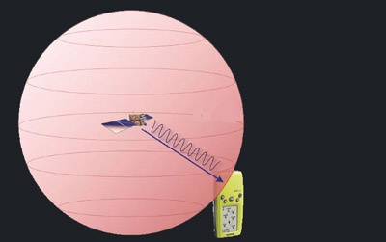
3D Navigation with GNSS 2
GNSS satellite position is known at any time thanks to the navigation message.
If only one satellite (one receiver-to-satellite distance) is available, the receiver is somewhere on the surface of a sphere with radius “R” centered on the (known) satellite position.

Slide 11
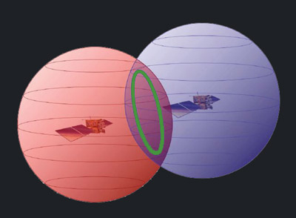
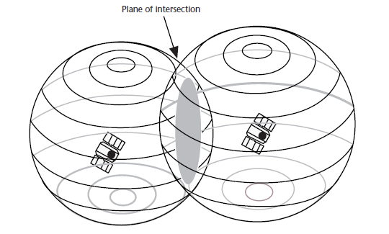
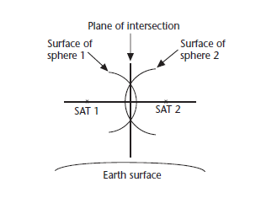
3D Navigation with GNSS 3
If 2 satellites are available, the user is somewhere on a circle at the intersection of 2 spheres.
A closer look: the intersection is the perimeter of the shaded area (called plane of intersection)

Slide 12
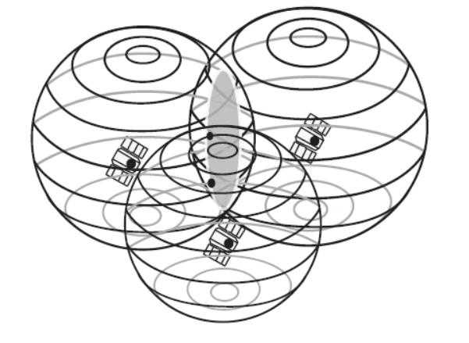
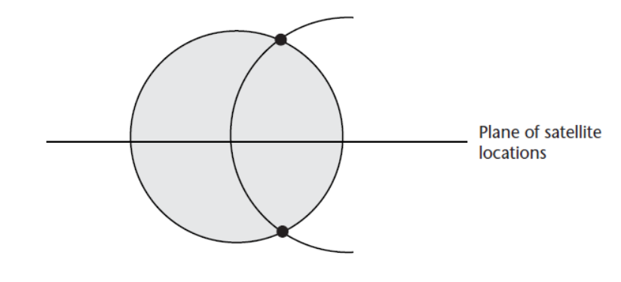
3D Navigation with GNSS 4
If 3 satellites are available, there are 2 possible intersection points.
Circle of intersection
of the first 2 spheres
Third sphere
➔ 2 intersection points

Slide 13
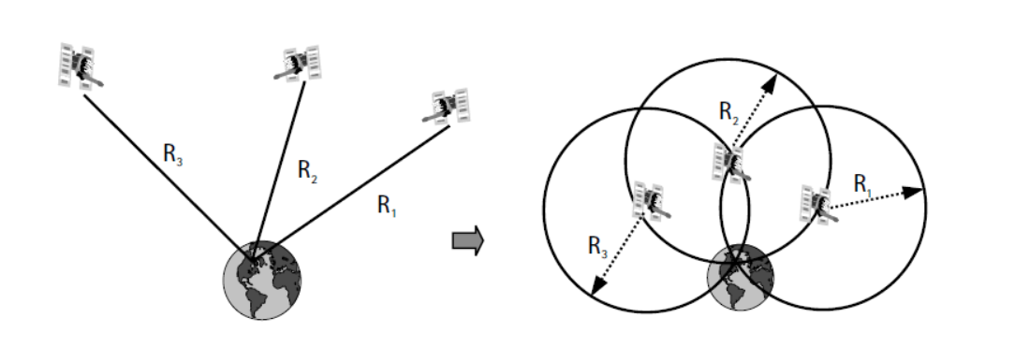
3D Navigation with GNSS 5
Usually, for users on or close to the Earth’s surface, only one solution (the lower intersection) is “possible” (i.e. is close to the Earth surface).
In the case of airborne/spaceborne receivers, ancillary information might be necessary (a priori information on the user position or additional measurement).

Slide 14
3D Navigation with GNSS 6
Each GNSS has its own reference time scale.
Receiver and satellite clocks are not perfectly synchronized with this reference time scale.
The resulting error on range measurements is called (receiver and satellite) clock error.
Due to clock errors, GNSS range measurements are called “pseudoranges”.
Satellite clock error can be mitigated using a model contained in the navigation message.

Slide 15
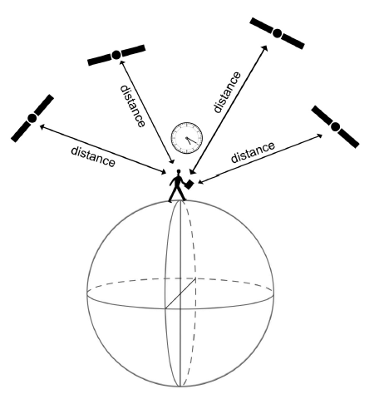
3D Navigation with GNSS 7
In practice, the receiver clock error Δtrec must be estimated as an unknown in addition to the 3D user position (X_{user}, Y_{user}, Z_{user})
Then, it is necessary to have at least 4 satellites giving the user with 4 pseudorange measurements to solve the 4 unknowns.

Slide 16
The importance of GNSS clocks
The measured signal propagation time is multiplied by the speed of light c (about 3 10⁸ m/s in the vacuum) to obtain the receiver-to-satellite range.
In the same way, the error on time measurement has to be multiplied by c to compute the corresponding range error.
For example, a (small) clock error of 1 µs (= 10⁻⁶ s) will result in a 300 m equivalent range error.
For this reason, the availability of precise clocks is crucial for GNSS.

Slide 17
GNSS observables

Slide 18
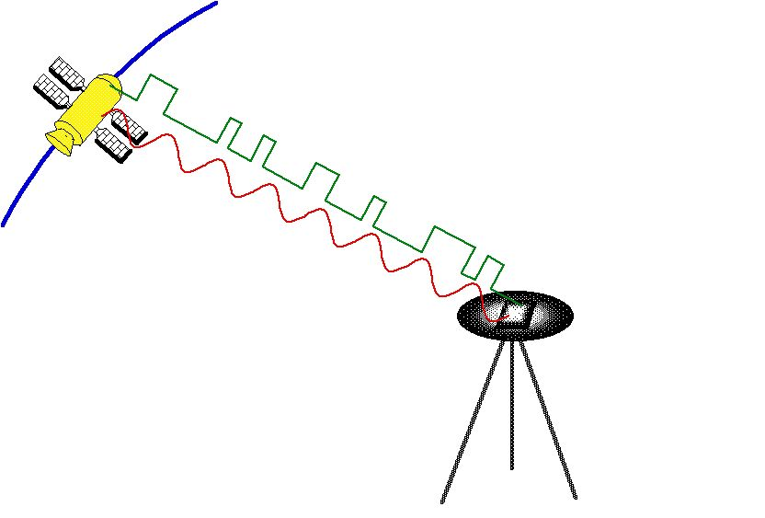
GNSS observables 1
GNSS can measure the satellite-to receiver distance by measuring the time of propagation of :
A PRN code
A carrier wave (monochromatic signal)

Slide 19
GNSS observables 2
Code pseudorange measurements have a precision (1 σ) of about 0,40 m.
Phase pseudorange measurements have a precision of about 0,002 m but are ambiguous:
The satellite-to-receiver distance is measured with an unknown integer number of wavelengths (N).
This number is called the initial ambiguity
$$D=\left(N+φ\right) λ$$

Slide 20
Main error sources

Slide 21
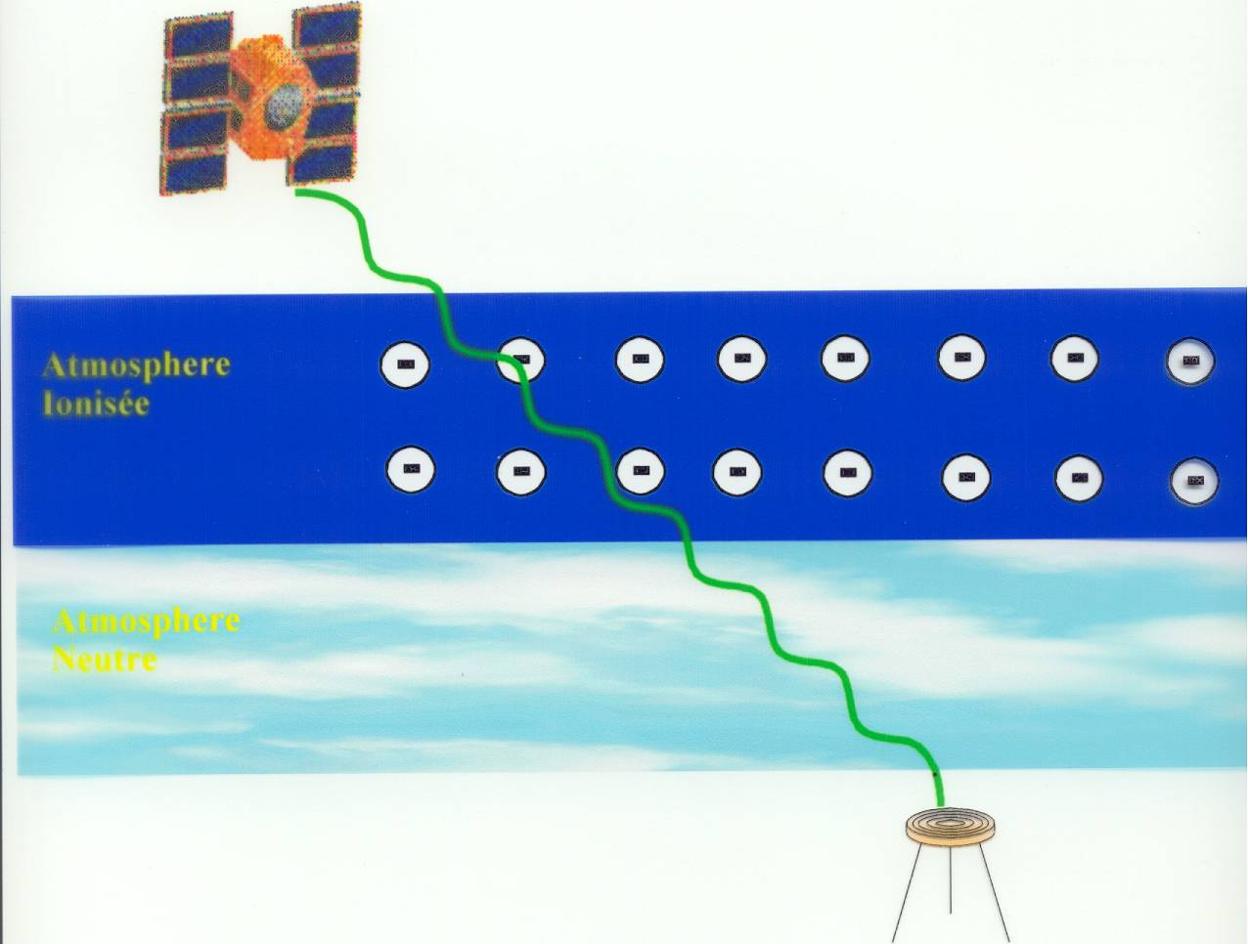
Atmospheric effects
The main effects of the atmosphere on GNSS propagation is to modify GNSS signal velocity
Therefore, it affects the measurement of the receiver-to-satellite distance:
$$c∆T→v∆T$$
As far as refraction is concerned, two atmospheric layers can be distinguished.
Neutral atmosphere
Ionized atmosphere (ionosphere)

Slide 22
Tropospheric error
Neutral atmosphere extends from the Earth surface to about 50 km.
Encompasses the troposphere and the stratosphere.
Tropospheric error refers to the effect of the neutral atmosphere on pseudorange measurements.
Depends on pressure, temperature and humidity on the satellite-to-receiver path.
Usually ranges between 2,25 m and 2,60 m at vertical.
Depends on satellite elevation (e=10° ➔ factor 6 larger than at vertical).

Slide 23
Ionospheric error
The ionosphere is the ionized part of the atmosphere.
Composed of ions and free electrons.
Extends from about 60 km to more than 2000 km (in theory to the “infinite”).
The ionospheric error is the effect of the ionosphere on pseudorange measurements
Depends on the number of free electrons on the satellite-to-receiver path
Ranges from 0,16 m to 32 m at vertical on GPS L1.
Up to 3 times larger at low elevation than at vertical.

Slide 24
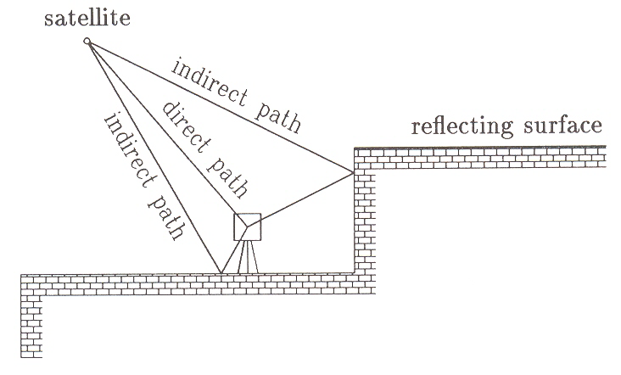
Multipath
Multipath occurs when, in addition to the direct signal, reflected signals reach the antenna.
This effect results in errors on both code- and carrier-based measurement of the receiver-to-satellite distance.
It is different for code and phase measurements and depends on the signal frequency.

Slide 25
Fields of application

Slide 26
Positioning 1
Different positioning modes can be distinguished.
Code- or phase-based positioning:
Code or phase observables are both a measure of receiver-to-satellite distance.
Code-based positioning usually gives an accuracy of a few meters using cheap receivers and simple data processing techniques as code measurements are not ambiguous.
Phase-based positioning gives an accuracy ranging from a few decimetres to a few millimetres:
Phase measurements are more precise but they are ambiguous.
It is mandatory to solve ambiguities before computing precise positions.
The ambiguity resolution requires more sophisticated data processing techniques.
Receivers able to make phase measurements are more expensive.
Code and phase observable can also be “mixed” in the data processing procedures.

Slide 27
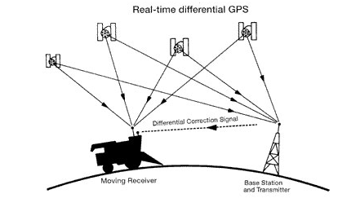
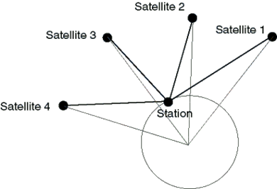
Positioning 2
Absolute, differential or relative positioning:
Absolute positioning:
A standalone receiver computes its absolute position in the ECEF reference frame using only its own GNSS measurements (code and/or phase).
Single Point Positioning (SPP) = code-based absolute positioning.
Precise Point Positioning (PPP) = phase-based absolute positioning.
Differential positioning: it is a special case of absolute positioning; a standalone receiver computes its absolute position in the ECEF reference frame using its own GNSS measurements AND so-called differential corrections coming from reference stations.

Slide 28
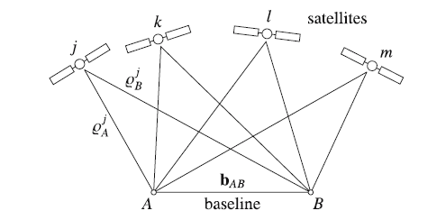
Positioning 3
Absolute, differential or relative positioning:
Relative positioning:
The receiver (station B with unknown position ) processes its own GNSS measurements together with the GNSS measurements collected by a reference station (station A whose position in the ECEF frame is known).
The baseline vector between the receiver and the reference station is obtained from “mixed” data processing ( = station A + station B together).
Then, using the known reference station position and the computed baseline, the receiver’s absolute position can be obtained.
$$\vec{R_{B}}$$
$$\vec{R_{A}}$$
$$\vec{b_{AB}}$$

Slide 29
Positioning 4
Real time or post processing:
Real time: the user needs to compute his position immediately after the code/phase measurements have been made.
Post processing: the user collects data during a given time interval and stores the data which are processed with a delay wrt the time of measurement.
Static or kinematic:
Static: receiver with fixed coordinates.
Kinematic: moving receiver.
Kinematic positioning versus dynamic positioning: In dynamic positioning, accelerations are measured in order to reconstruct the user’s trajectory. In kinematic positioning with GNSS, the successive positions of the user are measured at a high rate so that the trajectory can be reconstructed.

Slide 30
Positioning 5
In fact, a continuous spectrum of positioning applications with precision ranging from 1 mm to 10 m.
Examples:
Mass market = car navigation: Real time absolute kinematic positioning with code measurements (accuracy between 5 and 10 m during favourable conditions).
Surveyors: Real time differential kinematic positioning with code and phase measurements (accuracy of a few centimetres).
Geophysicists/Geodesists : Post processed static relative positioning with code and phase measurements (accuracy of a few millimetres).

Slide 31
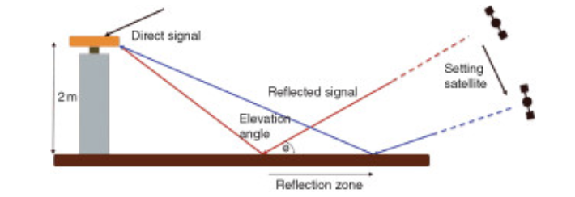
Remote sensing
GNSS code and phase pseudoranges can be used to reconstruct information about (no specific receiver/data necessary) :
Neutral atmosphere (Integrated Water Vapour Content, …)
Ionosphere (Total Electron Content, …)
Reflecting surface (soil, vegetation coverage, sea level, snow depth, …)

Slide 32
GNSS applications
The only limitation to GNSS applications is the imagination of users.

Slide 33
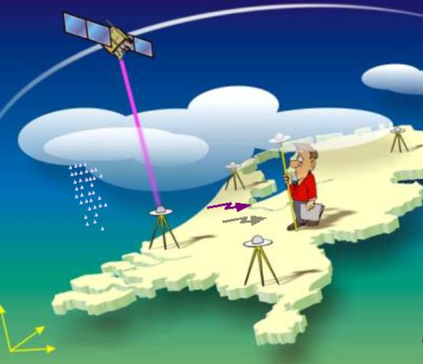
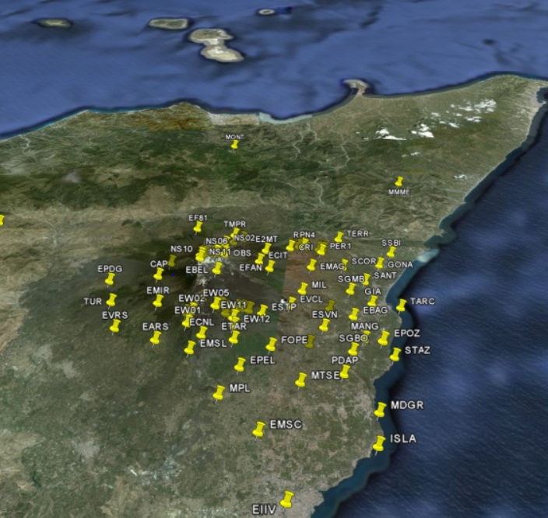
Fields of applications 1
Geoscience
Precise monitoring of ground deformation at global, regional and local scales.
Reconstruction of water vapour content for applications in meteorology or climatology.

Slide 34
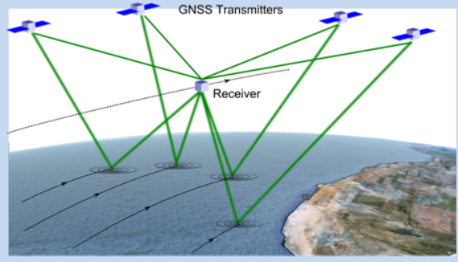
Fields of applications 2
Geoscience
Monitoring of Space Weather and ionosphere (signature of tsunamis and earthquakes).
Monitoring of oceans, sea level, tides, tsunamis.
Monitoring of land coverage (soil moisture, vegetation coverage, ice sheet, …)

Slide 35
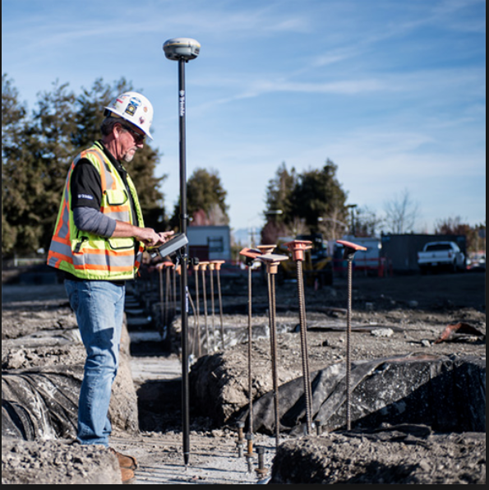
Fields of applications 3
Surveying and mapping
Roads, buildings, fields, geodetic networks and maps, …

Slide 36
Fields of applications 4
Location based services
Tourism, culture, gaming, shopping, hiking, …
Transport
Autonomous driving and flying (UAV’s), fleet management, traffic management, aviation, key lock for transport of dangerous goods, …
Emergency, security and humanitarian services
Locate missing persons, stolen objects, Search and Rescue, …
Internet of Things
Connected objects require more and more precise positioning, velocity and timing information.

Slide 37
Fields of applications 5
Precise timing
Science (compare precise clock readings)
Energy (synchronisation of power grids)
Communications (network management, calibration of frequency standards, …)
Finance (certified time-tagging of transactions, …)
Civil engineering
Monitoring of buildings, bridges, …

Slide 38
Perspectives

Slide 39
Evolutions 1
5 years ago: GPS was the only operational GNSS.
32 satellites
2 carrier frequencies
2 codes
Since then, development of new/modernized GNSS
More satellites.
More signals (more frequencies (carriers), more codes)
More sophisticated signals
Improved accuracy (mainly) for code and phase measurements.
Better resistance to different degradations.
Encrypted signals (Galileo)

Slide 40
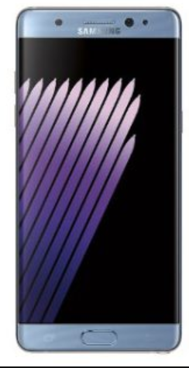
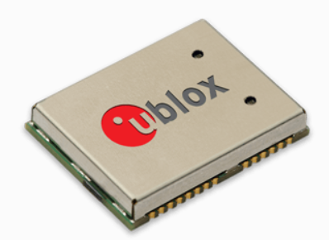
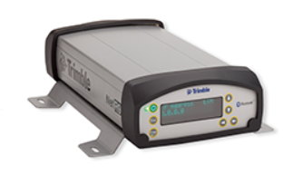
Evolutions 2
Development of cheap(er) multi-GNSS (still single frequency) receivers

Slide 41
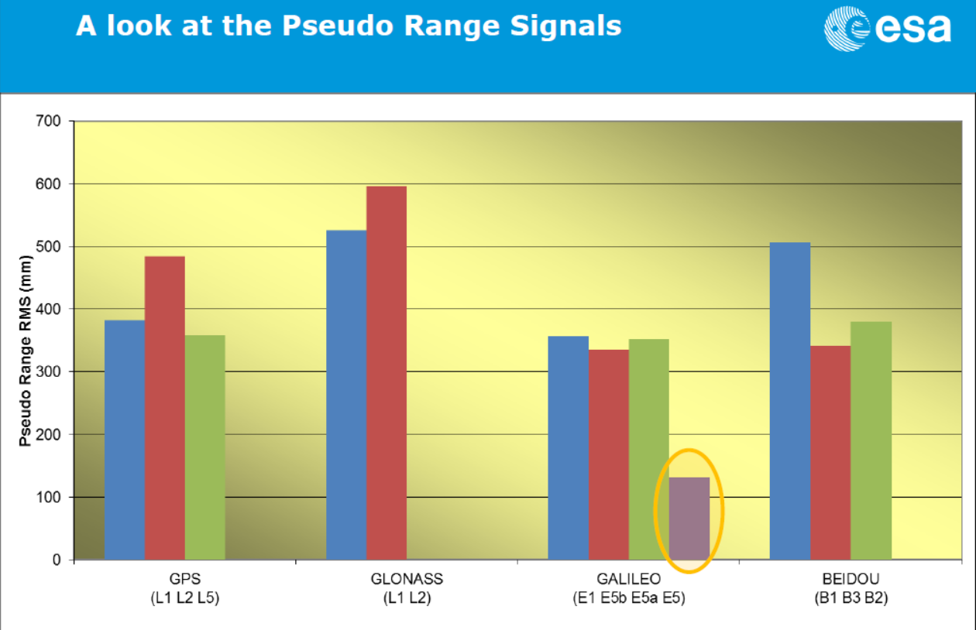
Code pseudorange accuracy
Springer et al., 2013

Slide 42
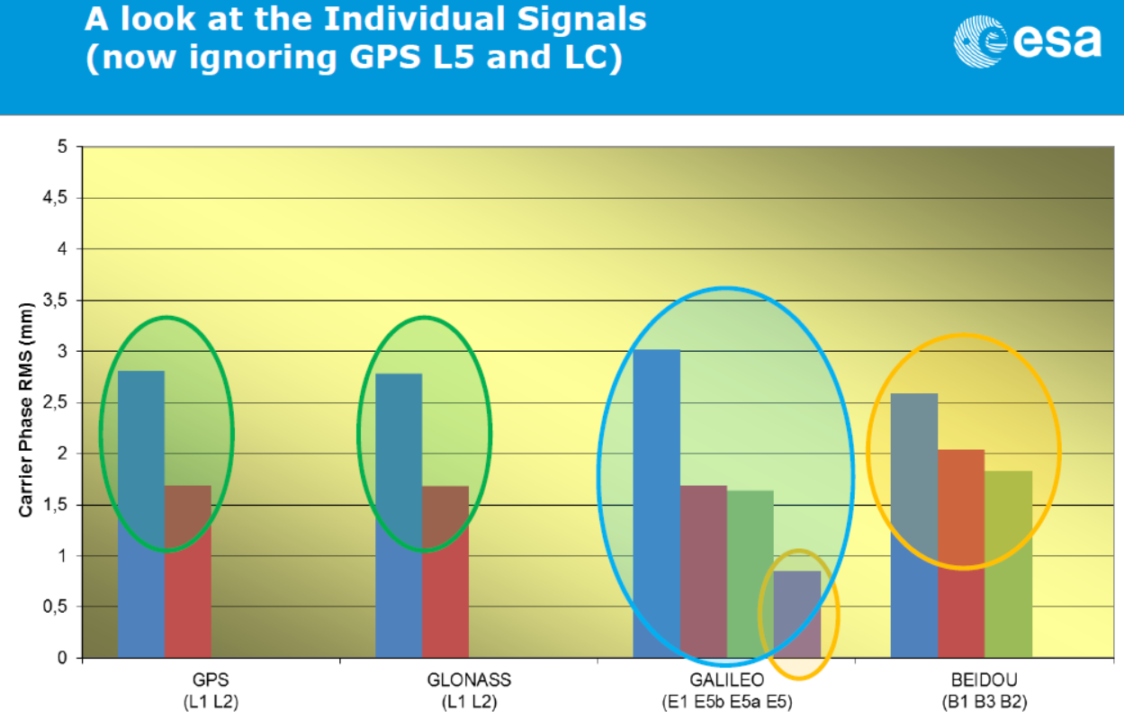
Phase pseudorange accuracy
Springer et al., 2013

Slide 43
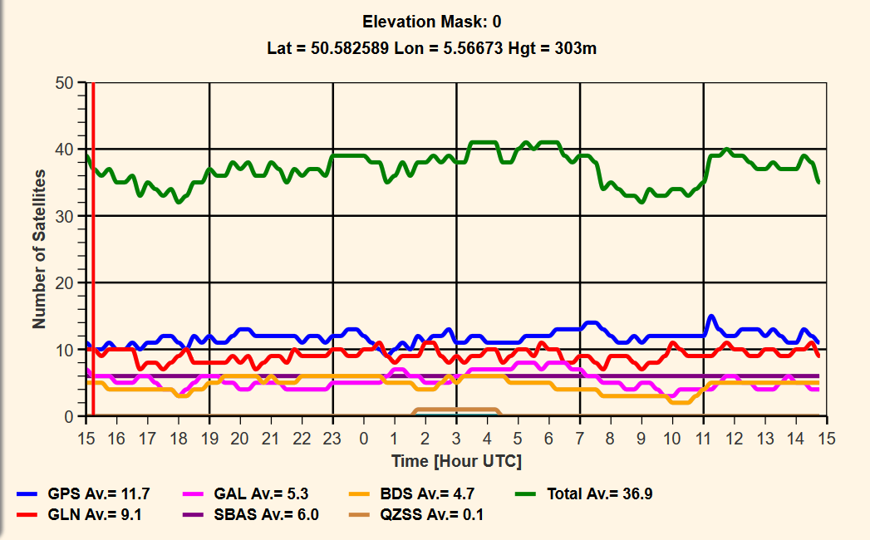
More satellites 1

Slide 44
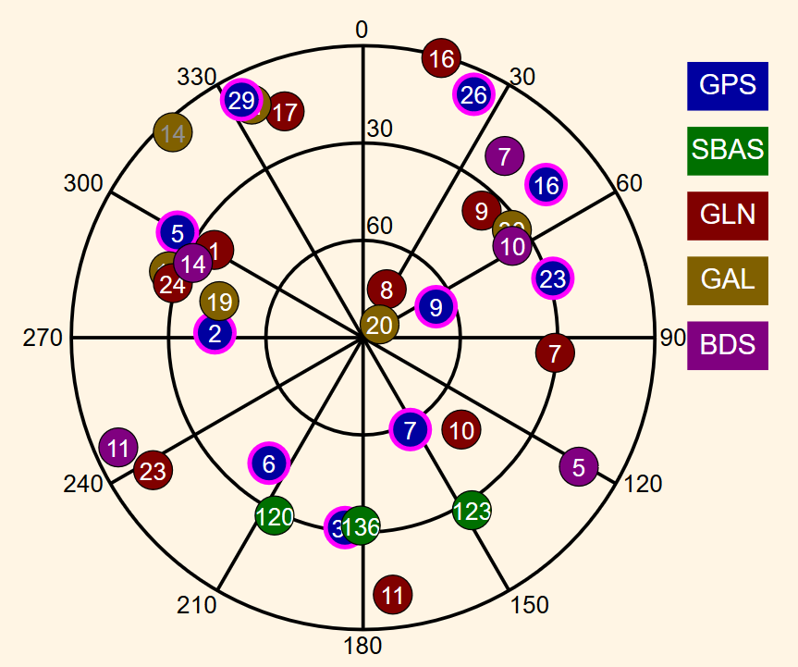
More satellites 2

Slide 45
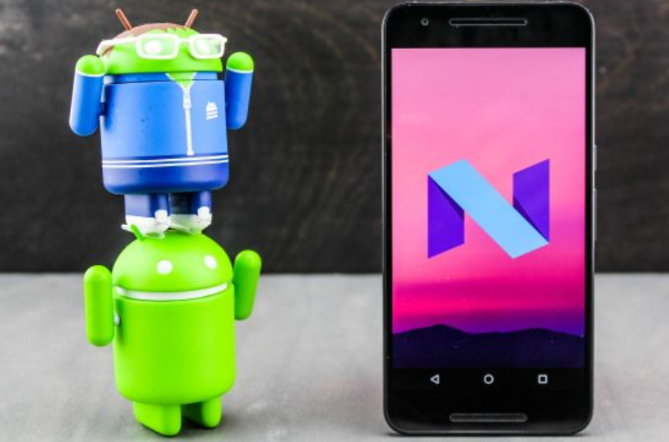
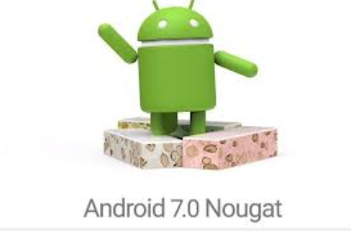
Added value
Improved precision, reliability and integrity even under harsh environments.
Added value for most existing applications.
Development of new application types.
…
Higher precision levels with cheap devices and low volume of external data
10 m ➔ few dm ➔ even few cm ?
! Raw data now available from Android 7 devices !

Slide 46
Keywords for the future are :
Smartphone technology, Galileo and multi-GNSS

