Slide 1
GNSS: Principle, limitations and perspectives.
René Warnant
Professeur à l’Université de Liège
Colloque national de l’Ordre Belge des Géomètres-Experts
Wépion, 6 décembre 2016.

Slide 2
Basics about GNSS

Slide 3
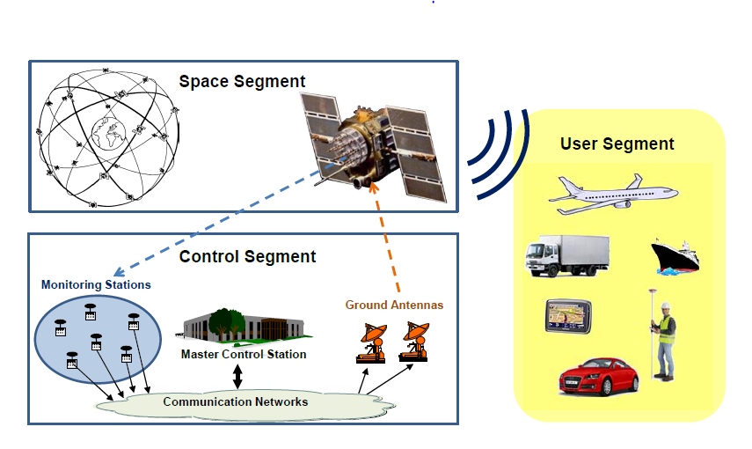
GNSS : Definition
GNSS = Global Navigation Satellite System
Goals :
Real time navigation i.e. to measure the user position (and velocity) in real time.
Anywhere on Earth
Under any weather conditions
Precise timing (clock synchronisation)
Composed of 3 segments
Space segment
Control segment
User segment

Slide 4
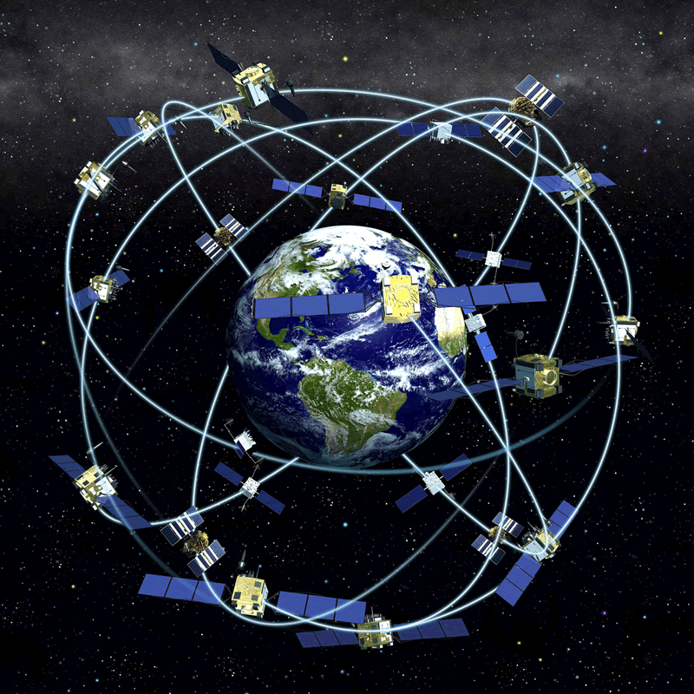
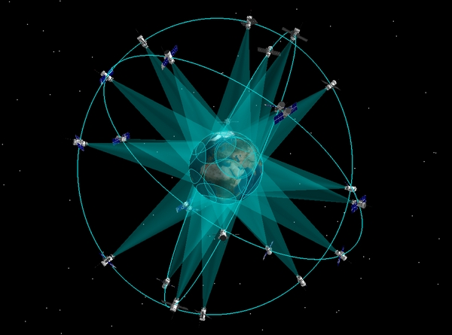
Main GNSS 1
GPS (USA)
First GNSS, operational since 1994
32 satellites
GLONASS (Russia)
Operational since 2012
24 satellites

Slide 5
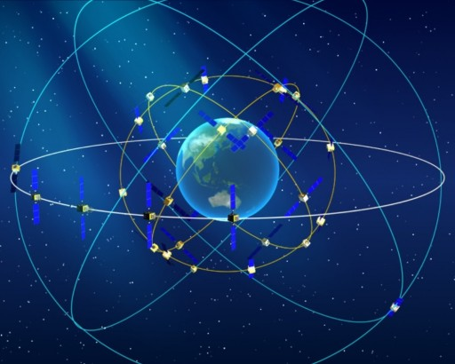
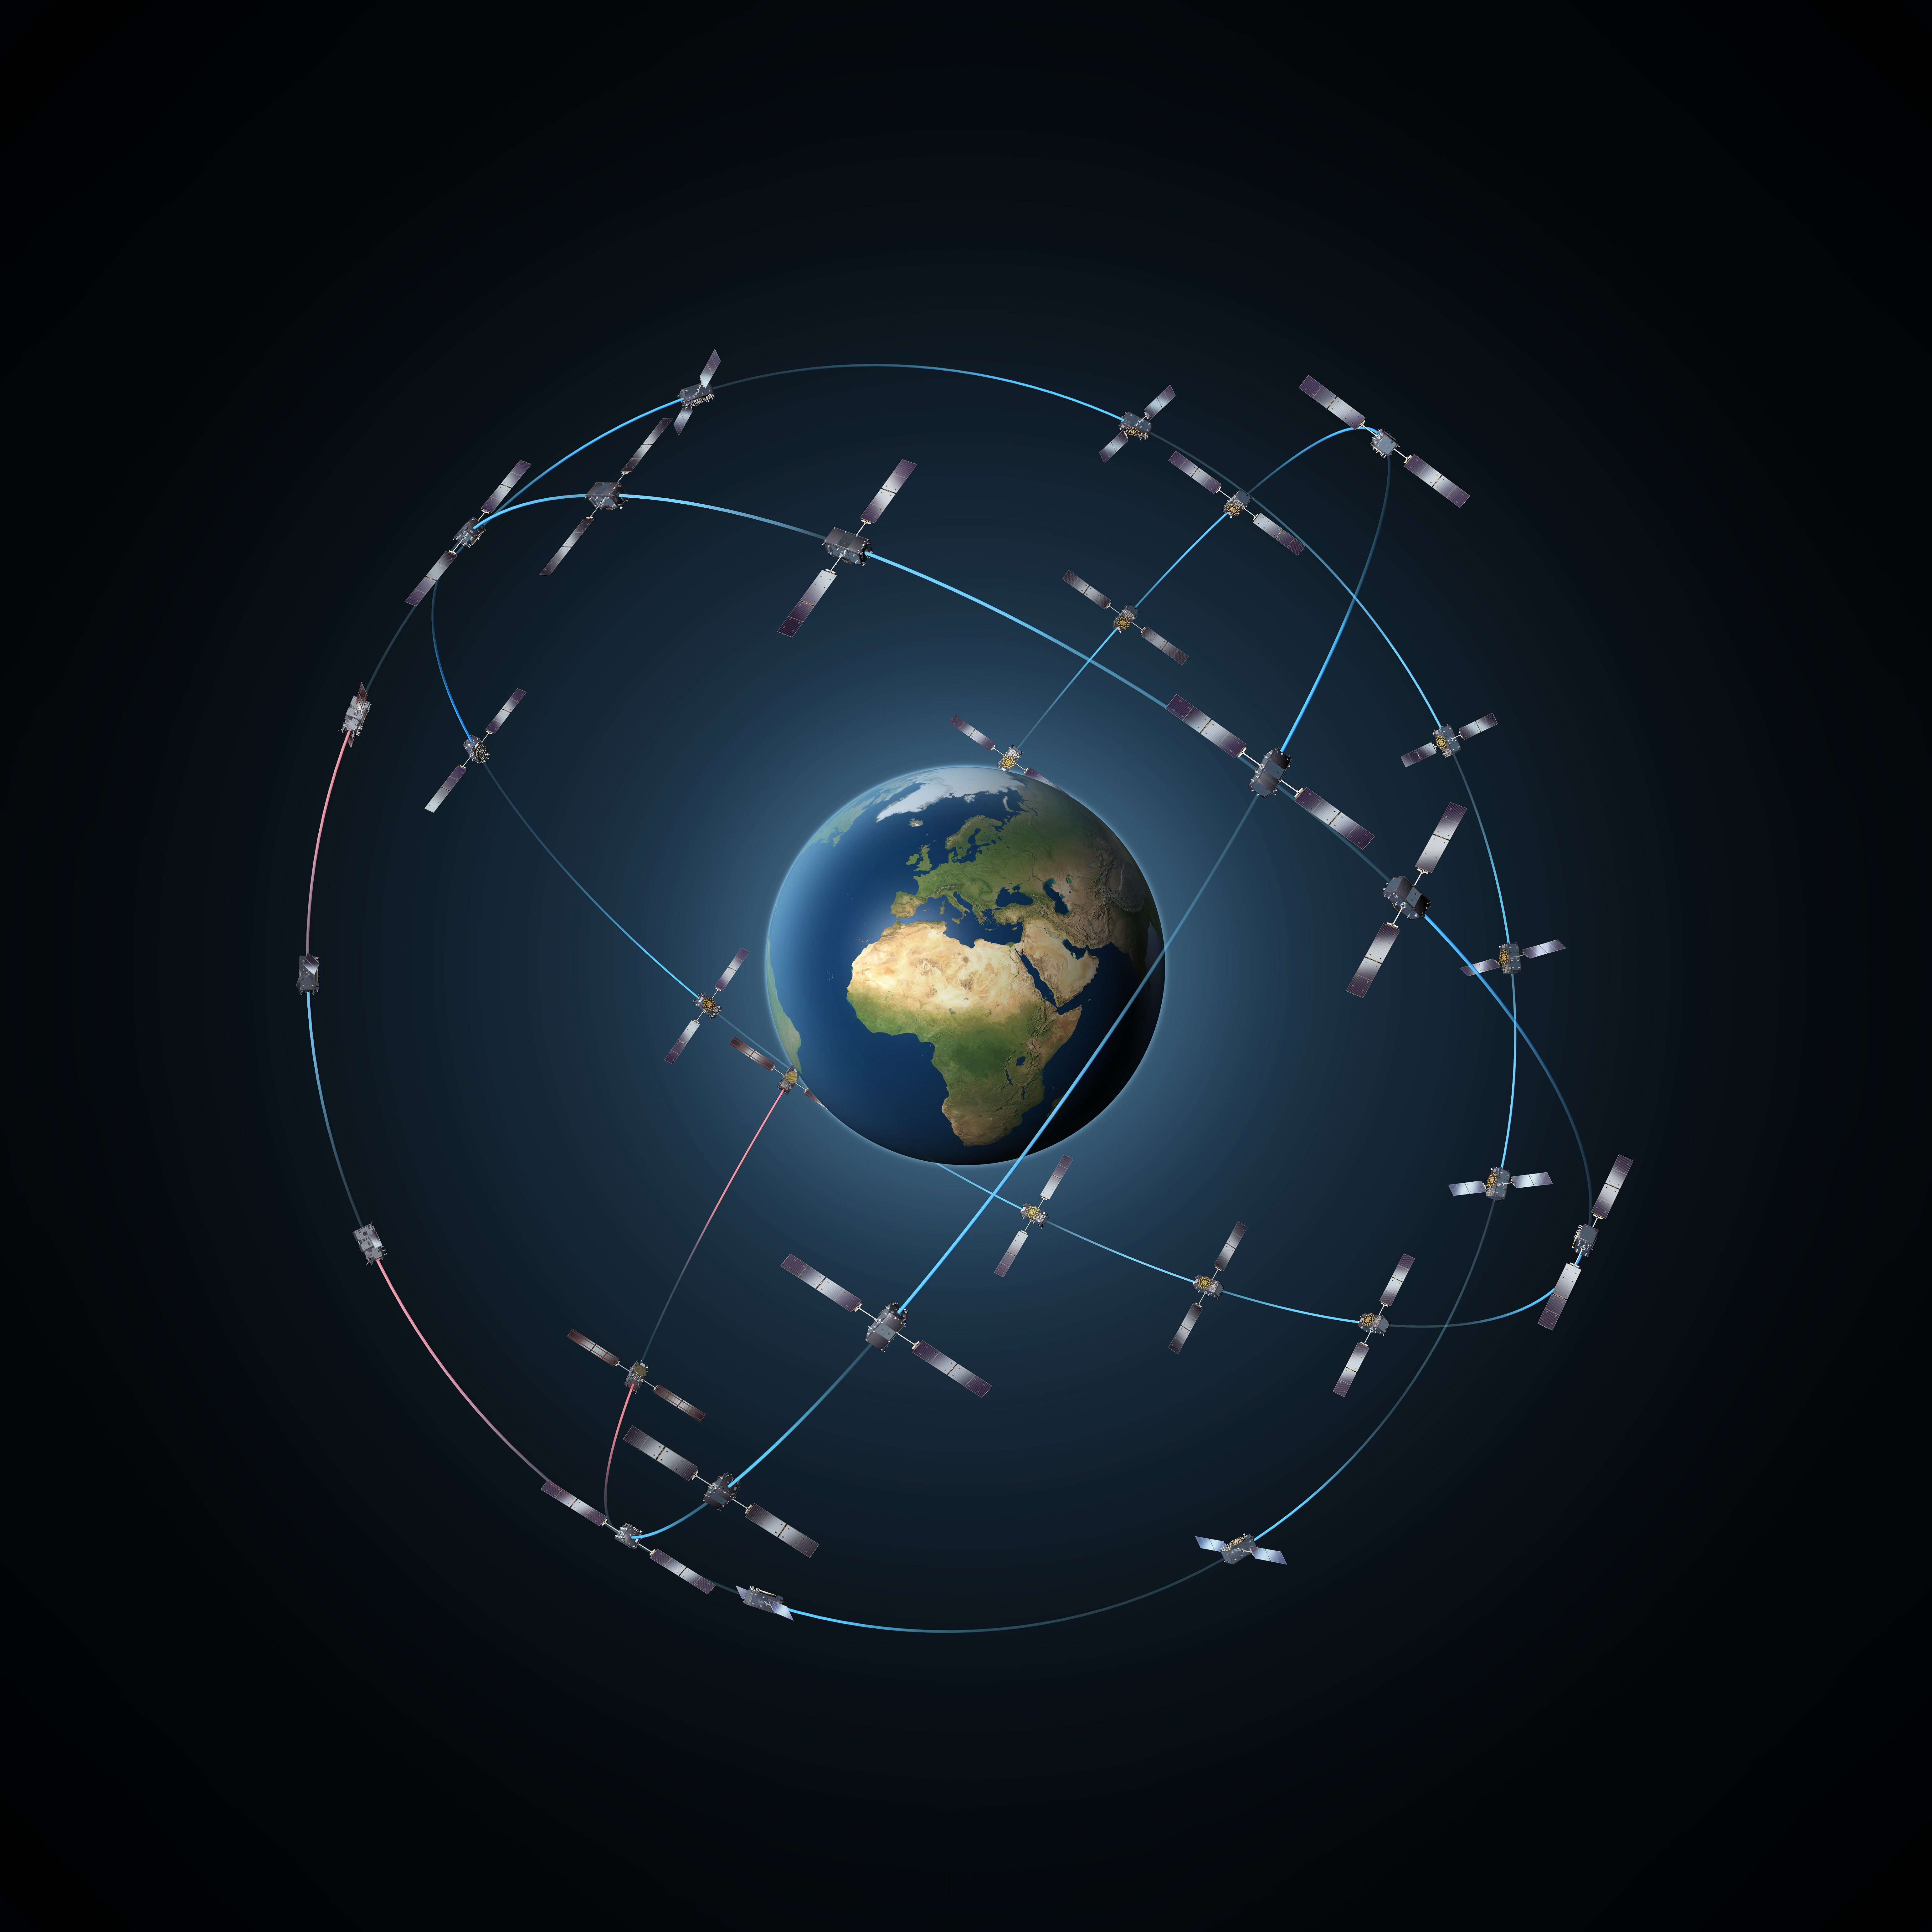
Main GNSS 2
Beidou (China)
Not yet operational
13 satellites + 5 under commissioning
Galileo (Europe)
Now pre-operational.
A constellation of 30 satellites (24 + 6 spare) in MEO orbits by 2020.
At the present time : 18 satellites in orbit
4 satellites to be launched in 2017, 4 in 2018 and 4 in 2020.

Slide 6
Navigation based on Time of Arrival ranging

Slide 7
TOA ranging 1
GNSS use the concept of Time of Arrival (TOA) ranging (also called Time of Flight (TOF) ranging).
The idea is measure the time it takes for a signal transmitted by an emitter to reach a receiver.
The emitter (foghorn, radio beacon, satellite, …) is at a known location and emits the signal at a conventional (known) time.
From the known time of emission and the measured time of arrival, the propagation time is computed.

Slide 8
TOA ranging 2
The emitter-to-receiver distance is obtained by multiplying the travel time by the signal speed (speed of sound, speed of light).
By measuring the propagation time of the signal broadcast by multiple emitters, the receiver position can be determined.
In a first step, we apply this principle to 2D navigation (intuitive approach) and then, we consider GNSS-based 3D navigation.

Slide 9
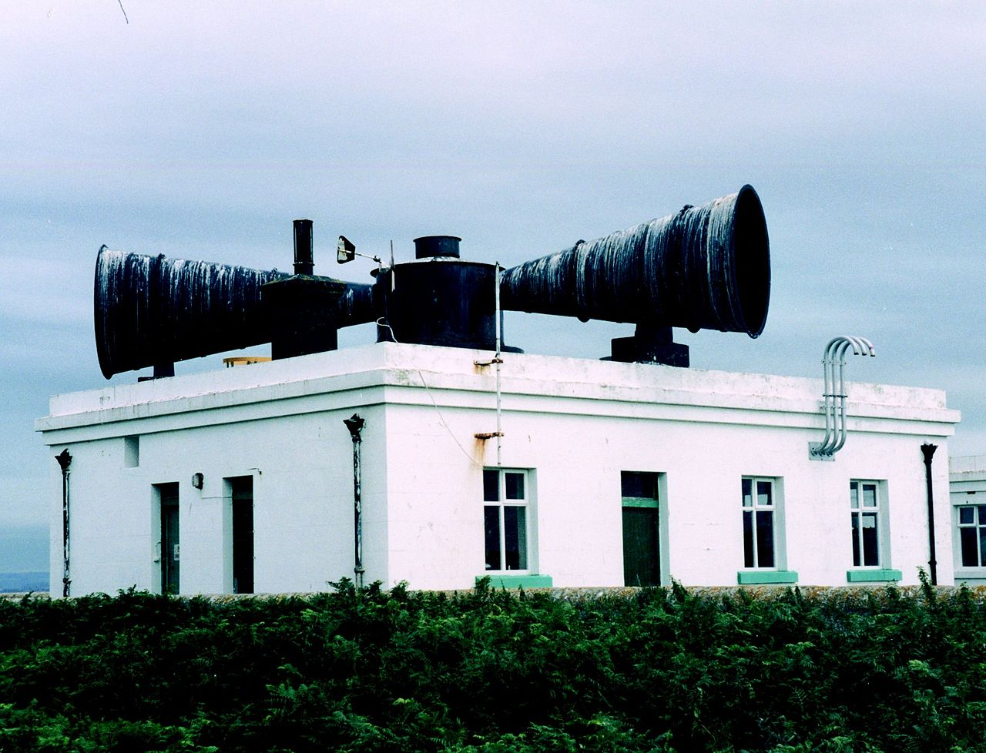
2D Navigation with acoustic signals 1
For hundreds of years, lighthouses have been operating so-called “foghorns” to inform mariners about their position in case of fog.
The lighthouse (known location) emits an acoustic signal (horn, bell, siren, …) at a conventional time (say precisely at the minute mark).
The ship is equipped with a precise clock which is synchronized with the lighthouse clock.

Slide 10
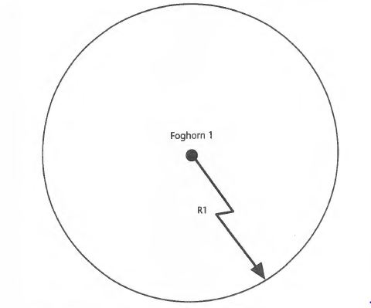
2D Navigation with acoustic signals 2
The signal propagation time = time of reception – time of emission
The lighthouse-to-ship distance (denoted as R1) is obtained by multiplying the propagation time by sound speed (about 335 m/s).
Thus, the mariner knows that the ship is somewhere on a circle with radius R1 centered about the lighthouse (denoted as foghorn1).

Slide 11
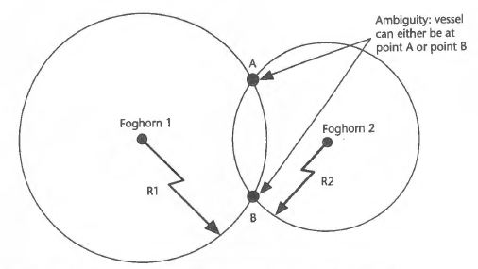
2D Navigation with acoustic signals 3
If 2 lighthouses are available, the ship is at one of the intersections of the 2 range circles.
Two possible solutions (A or B).

Slide 12
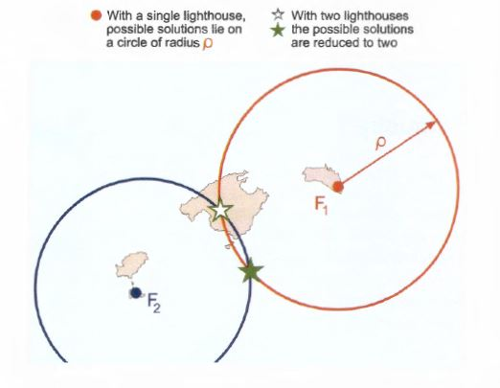
2D Navigation with acoustic signals 4
The ambiguity can be resolved based on a priori information:
The mariner has approximate knowledge of the ship’s position.
One of the solution is “impossible” due, for example, to the fact that is not located on the sea.

Slide 13
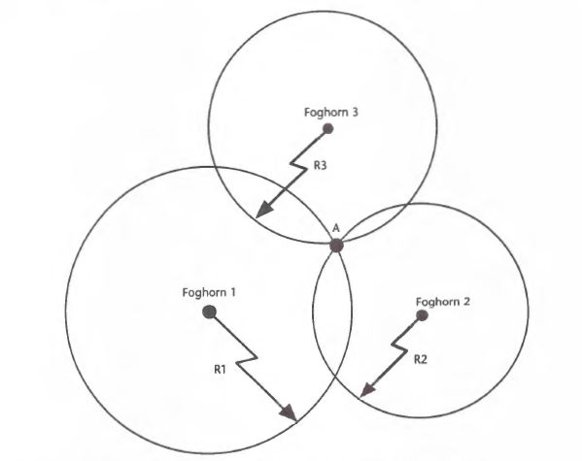
2D Navigation with acoustic signals 5
The ambiguity can be resolved if a third lighthouse is available

Slide 14
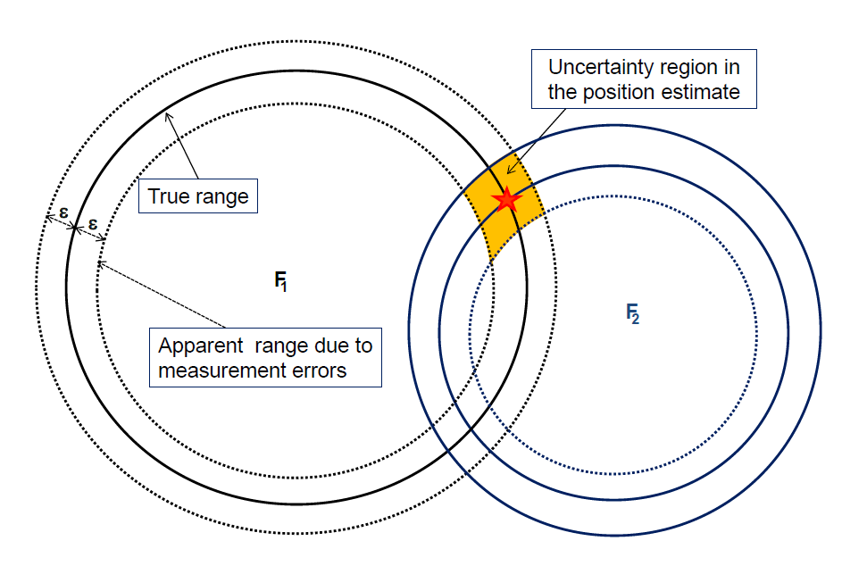
2D Navigation with acoustic signals 6
Due to synchronisation errors between the lighthouse and ship clocks, there is an uncertainty ± ε on the measured range.
As a consequence, there is an uncertainty (in orange) on the ship position.
Apparent range
True range

Slide 15
2D Navigation with acoustic signals 7
For a given (fixed) uncertainty on the range measurement ± ε, the resulting error on the ship position depends on the emitter “geometry”.

Slide 16
3D Navigation with GNSS 1
GNSS satellites are equipped with very precise clocks which are synchronized with a reference time scale (similar to lighthouses).
They emit electromagnetic signals at “reference times” (to be developed later).
GNSS receivers are also equipped with clocks and measure the signal propagation time (i.e. the time it takes for the signal to reach the receiver).
In a vacuum, electromagnetic wave speed is c.
In a first step, we neglect the presence of the atmosphere and we assume that the receiver and satellite clocks are perfectly synchronized.
Then, the satellite-to-receiver distance “R” is obtained by multiplying the propagation time by the speed of light.

Slide 17
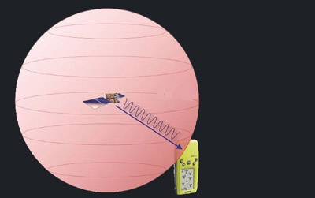
3D Navigation with GNSS 2
GNSS satellite position is known at any time thanks to the navigation message.
If only one satellite (one receiver-to-satellite distance) is available, the receiver is somewhere on the surface of a sphere with radius “R” centered on the (known) satellite position.

Slide 18
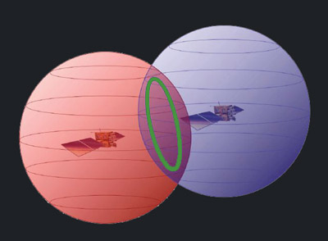
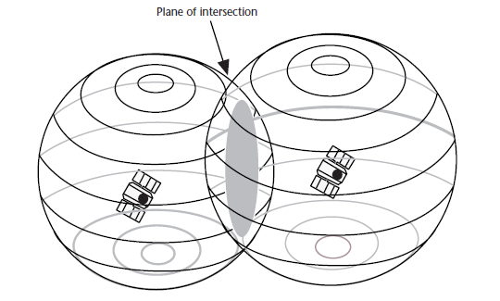
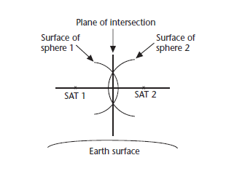
3D Navigation with GNSS 3
If 2 satellites are available, the user is somewhere on a circle at the intersection of 2 spheres.
A closer look: the intersection is the perimeter of the shaded area (called plane of intersection)

Slide 19
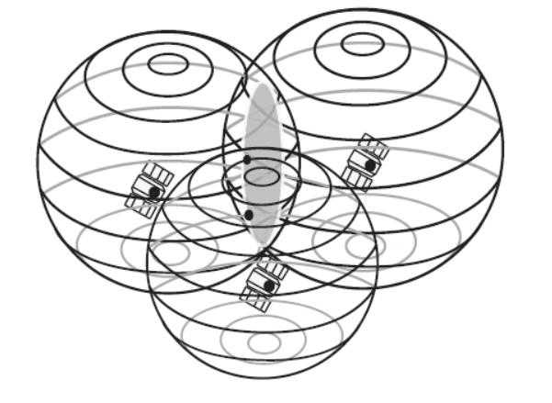
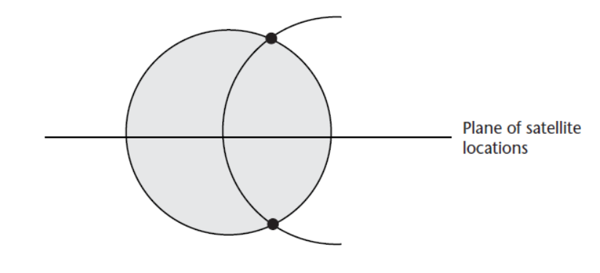
3D Navigation with GNSS 4
If 3 satellites are available, there are 2 possible intersection points.
Circle of intersection
of the first 2 spheres
Third sphere
➔ 2 intersection points

Slide 20
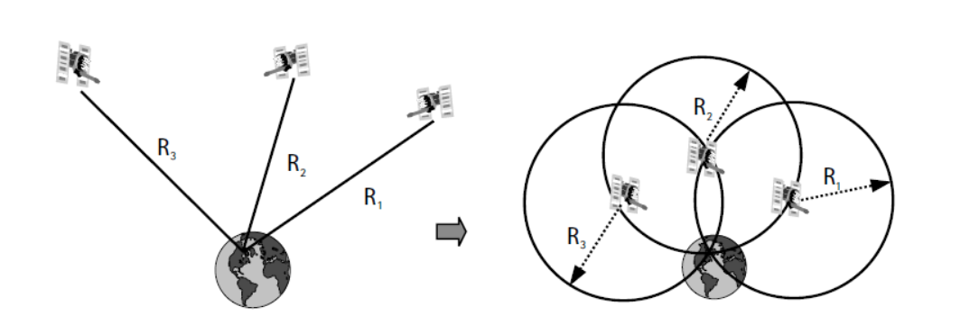
3D Navigation with GNSS 5
Usually, for users on or close to the Earth’s surface, only one solution (the lower intersection) is “possible” (i.e. is close to the Earth surface).
In the case of airborne/spaceborne receivers, ancillary information might be necessary (a priori information on the user position or additional measurement).

Slide 21
3D Navigation with GNSS 6
Each GNSS has its own reference time scale.
Receiver and satellite clocks are not perfectly synchronized with this reference time scale.
The resulting error on range measurements is called (receiver and satellite) clock error.
Due to clock errors, GNSS range measurements are called “pseudoranges”.
Satellite clock error can be mitigated using a model contained in the navigation message.

Slide 22
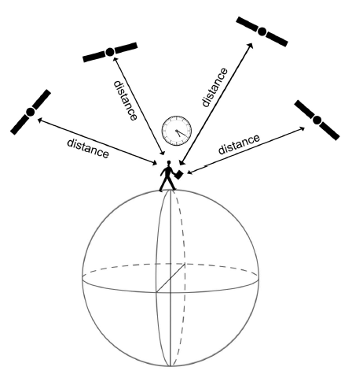
3D Navigation with GNSS 7
In practice, the receiver clock error Δtrec must be estimated as an unknown in addition to the 3D user position (X_{user}, Y_{user}, Z_{user})
Then, it is necessary to have at least 4 satellites giving the user with 4 pseudorange measurements to solve the 4 unknowns.

Slide 23
The importance of GNSS clocks
The measured signal propagation time is multiplied by the speed of light c (about 3 10⁸ m/s in the vacuum) to obtain the receiver-to-satellite range.
In the same way, the error on time measurement has to be multiplied by c to compute the corresponding range error.
For example, a (small) clock error of 1 µs (= 10⁻⁶ s) will result in a 300 m equivalent range error.
For this reason, the availability of precise clocks is crucial for GNSS.

Slide 24
GNSS signals

Slide 25
GNSS signals: Ranging codes
Ranging code = sequence of a well defined number of “chips” (0 or 1) during a well defined time interval.
Example : GPS C/A Code = sequence of 1023 chips at a frequency of 1.023 MHz during a 1 ms period.
Are used to measure the receiver-to-satellite distance called “code pseudorange”

Slide 26
GNSS signals: Navigation message
Information about the satellites
Satellite “health” : Is the satellite working correctly ?
Satellite orbits : contains information allowing to compute satellite positions in real time
Satellite clock error : contains a model which allows computing the synchronisation error of satellite clocks with respect to the considered GNSS reference time scale.
Ionospheric activity (not for all GNSS): contains a model for the mitigation of the ionospheric error.

Slide 27
GNSS signals: Carrier frequency
Monochromatic electromagnetic wave (only 1 frequency) which is used to “carry” the GNSS codes and navigation messages from the satellite to the receiver.
In practice, carrier frequencies are also used to measure the receiver-to-satellite distance called “phase pseudorange”

Slide 28
GNSS observables

Slide 29
Code pseudorange observable 1
GNSS satellites emit codes which are generated based on known algorithms: at a given GNSS time corresponds a well-defined code sate.
GNSS receivers are able to generate a code replica based on the same principle.
In the case receiver and satellite clocks are perfectly synchronized with the considered GNSS time scale, receiver and satellite codes are identical for a given time.
The code emitted by the satellite at the time of emission t^{i} reaches the receiver at the time of reception t_{p}.

Slide 30
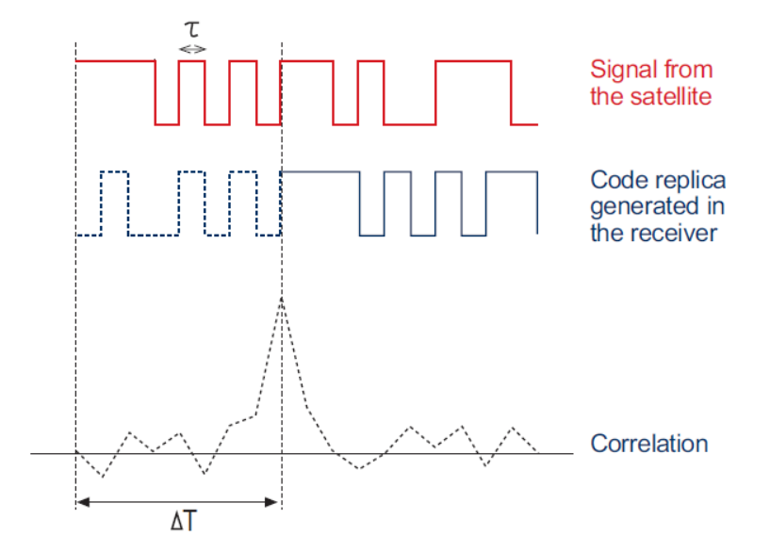
Code pseudorange observable 2
There is a time delay ΔT between the code replica generated by the receiver and the code emitted by the satellite at time t^{i} and arriving at the receiver at time t_{p}.
ΔT represents the code time of propagation from the satellite to the receiver.
The receiver is able to measure ΔT using cross-correlation:
The receiver shifts its code replica until correlation with the code coming from the satellite is maximum i. e. when the time shift is equal to ΔT.

Slide 31
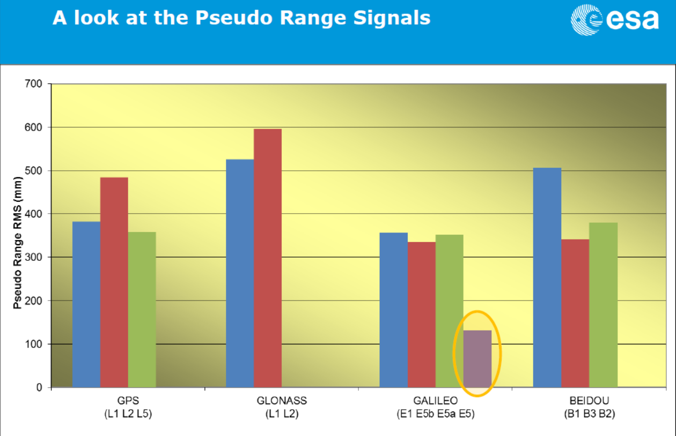
Code pseudorange accuracy
Usually, one considers that the accuracy is of the order of one hundredth of the wavelength even if modern modulation techniques allow to reach much better precision levels.
Springer et al., 2013

Slide 32
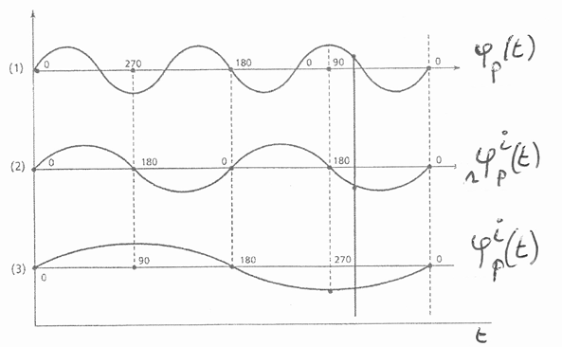
Phase pseudorange observable 1
As for codes, GNSS receivers can generate a replica of the satellite carrier.
Again, if clocks are perfectly synchronized, the receiver carrier replica is perfectly in phase with the carrier emitted by the satellite.
The carrier beat phase measurement is the phase difference between the receiver carrier replica and the carrier emitted by the satellite at time t^{i} and arriving at the receiver at time t_{p.}
Phase of the receiver carrier replica at time t
Phase of the carrier emitted by the satellite at
time t_{e} and arriving at the receiver at time t.
Carrier beat phase measurement at time t.

Slide 33
Phase pseudorange observable 2
The carrier beat phase depends on the signal time of propagation and as a consequence on the receiver-to-satellite distance:
Multiplied by the signal wavelength, the carrier beat phase gives the receiver-to-satellite distance.
Given a receiver-to-satellite distance of about 20 000 km and a wavelength of about 20 cm, the carrier beat phase is of the order of 10⁸ cycles.
Phase measurements are always ambiguous:
Fractional part of the beat phase can be measured.
The integer part remains unknown: it is called Initial ambiguity.

Slide 34
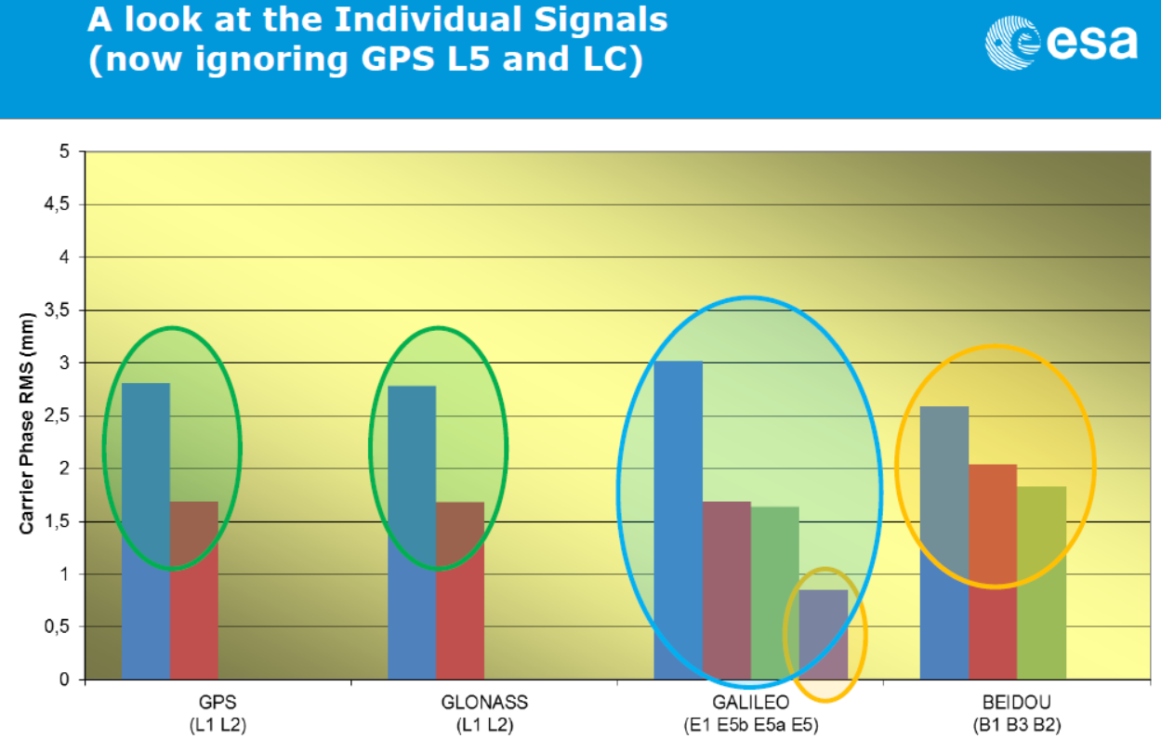
Phase pseudorange accuracy
Springer et al., 2013

Slide 35
GNSS observables: summary
Both code and phase pseudorange observables allow to measure the time of code and carrier propagation from satellite to receiver:
Phase pseudorange observable is precise but ambiguous.
Code pseudorange observable is less precise but is not ambiguous.

Slide 36
Main error sources

Slide 37
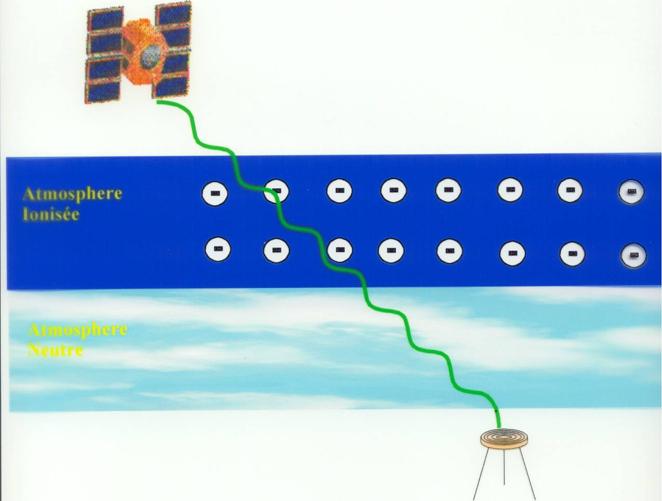
Atmospheric effects
The main effects of the atmosphere on GNSS propagation is to modify GNSS signal velocity
Therefore, it affects the measurement of the receiver-to-satellite distance:
$$c∆T→v∆T$$
As far as refraction is concerned, two atmospheric layers can be distinguished.
Neutral atmosphere
Ionized atmosphere (ionosphere)

Slide 38
Tropospheric error
Neutral atmosphere extends from the Earth surface to about 50 km.
Encompasses the troposphere and the stratosphere.
Tropospheric error refers to the effect of the neutral atmosphere on pseudorange measurements.
Depends on pressure, temperature and humidity on the satellite-to-receiver path.
Usually ranges between 2,25 m and 2,60 m at vertical.
Depends on satellite elevation (e=10° ➔ factor 6 larger than at vertical).

Slide 39
Ionospheric error
The ionosphere is the ionized part of the atmosphere.
Composed of ions and free electrons.
Extends from about 60 km to more than 2000 km (in theory to the “infinite”).
The ionospheric error is the effect of the ionosphere on pseudorange measurements
Depends on the number of free electrons on the satellite-to-receiver path
Ranges from 0,16 m to 32 m at vertical on GPS L1.
Up to 3 times larger at low elevation than at vertical.

Slide 40
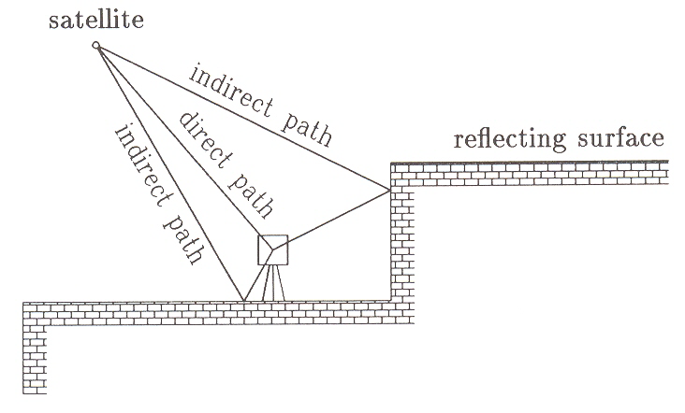
Multipath 1
Multipath occurs when, in addition to the direct signal, reflected signals reach the antenna.
This effect results in errors on both code- and carrier-based measurement of the receiver-to-satellite distance.
It is different for code and phase measurements and depends on the signal frequency.

Slide 41
Multipath 2
Code multipath :
Usually about 1-2 m.
Depends on chip (wave)length.
Theoretical maximum effect is 150 m for GPS C/A code and 15 m for GPS P code.
Phase multipath:
Usually 1-2 cm.
Theoretical maximum effect is one fourth of wavelength (about 5 cm depending on the considered carrier).
Multipath is more frequent at low elevation as the geometry is more favourable to reflection.

Slide 42
Updated modelling of the observables 1
Based on the different error sources influencing the signal time of propagation, the code observable model become :
k stands for signal frequency
Receiver “p” to satellite “i”
geometric distance
Ionospheric
error
Multipath
error
Measurement noise
Tropospheric
error

Slide 43
Updated modelling of the observables 2
Updated phase observable model :

Slide 44
Positioning modes

Slide 45
Different positioning modes 1
Different positioning modes can be distinguished.
Code- or phase-based positioning:
Code or phase observables are both a measure of receiver-to-satellite distance.
Code-based positioning usually gives an accuracy of a few meters using cheap receivers and simple data processing techniques as code measurements are not ambiguous.
Phase-based positioning gives an accuracy ranging from a few decimetres to a few millimetres:
Phase measurements are more precise but they are ambiguous.
It is mandatory to solve ambiguities before computing precise positions.
The ambiguity resolution requires more sophisticated data processing techniques.
Receivers able to make phase measurements are more expensive.
Code and phase observable can also be “mixed” in the data processing procedures.

Slide 46
Different positioning modes 2
Real time or post processing:
Real time: the user needs to compute his position immediately after the code/phase measurements have been made.
Post processing: the user collects data during a given time interval and stores the data which are processed with a delay wrt the time of measurement.
Static or kinematic:
Static: receiver with fixed coordinates.
Kinematic: moving receiver.
Absolute, differential or relative.

Slide 47
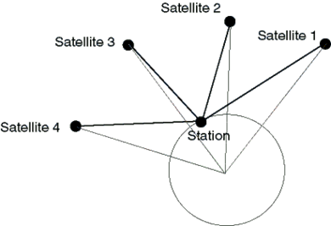
Absolute positioning
A standalone receiver computes its absolute position using only its own GNSS measurements (code and/or phase).
Single Point Positioning (SPP) = code-based absolute positioning.
Precise Point Positioning (PPP) = phase-based absolute positioning.

Slide 48
Single Point Positioning
Originally, GPS has been designed to perform Single Point Positioning (SPP).
SPP uses code measurements to perform absolute positioning, in real time or in post processing, in kinematic or static mode.
The ionospheric and tropospheric errors are corrected using models.
Usually, the receiver coordinates and clock error are computed from code pseudorange measurements using the least square technique.
It is the “mass-market” positioning technique.
In the case of GPS position accuracy usually ranges from 5 m to 10 m in real time.

Slide 49
Single Point Positioning accuracy 1
The 4 unknowns are computed based on code pseudorange measurements which are “indirect measurements” .
In this case, the precision of the computed unknowns is obtained by applying error propagation to the observation model.
In practice, the relationship between individual code pseudorange accuracy $σ_{obs}$ and the position accuracy $σ_{pos}$ is given by:

Slide 50
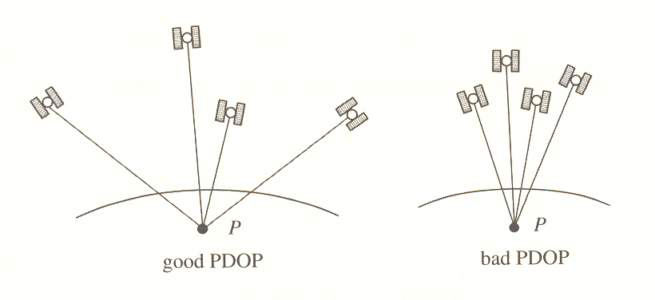
Single Point Positioning accuracy 2
In practice, the PDOP depends on satellite geometry (i.e. satellite distribution in the user’s sky).
PDOP can be geometrically interpreted as being inversely proportional to the volume of the tetrahedron formed by the 4 receiver-to-satellite directions:
Larger volume ➔ smaller PDOP ➔ better position accuracy.
Limited visibility (urban canon ➔ Bad PDOP)

Slide 51
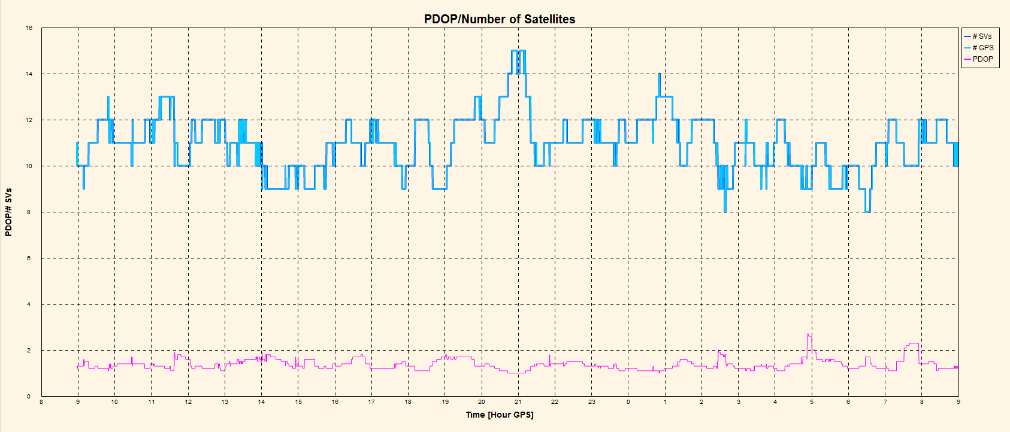
Single Point Positioning accuracy 3
PDOP and number of observed GPS satellites in Liège (open sky):

Slide 52
Precise Point Positioning
Basically, Precise Point Positioning (PPP) is based in the same principle as SPP except that phase pseudoranges are used instead of code pseudoranges.
As compared to SPP, the use of ambiguous phase measurements brings additional unknowns (1 unknown per observed satellite).
SPP requires “external” information (limited volume) about satellite orbit and clocks.
Rather long initialization phase (ambiguity resolution) : about 1 hour
Accuracy: few cm (static) – dm (kinematic).

Slide 53
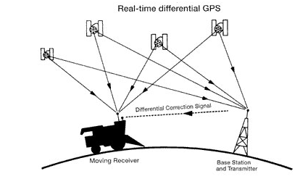
Differential Positioning 1
Differential positioning also called DGNSS is a special case of absolute positioning.
It relies on the availability of reference station(s) or even networks of reference stations whose positions are accurately known.
The user determines his position based on the measurements collected by his receiver (code or/and phase pseudoranges) in addition to so-called differential corrections provided by one or several reference stations.
Differential corrections allows to improve the accuracy of the computed positions.

Slide 54
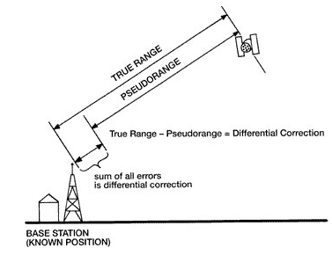
Differential Positioning 2
Measurement-domain approach:
Satellite coordinates can be obtained from broadcast ephemeris and reference station coordinates are know.
Therefore, the reference station can compute the “reference” receiver-to-satellite distance.
This reference distance is compared to receiver-to-satellite distances measured by code and phase pseudoranges at the reference station.
Reference range

Slide 55
Differential Positioning 3
Measurement-domain approach:
The difference between measured pseudorange and reference range (= differential range correction) which is due to errors (ionosphere, troposphere, …) is transmitted to the rover receiver which can correct its own code and phase pseudoranges.
This approach is valid as long as reference station and rover receiver are affected by the same errors.
In practice, the validity of differential corrections decreases with increasing distance between reference station and rover receiver.
Only one reference station is necessary: it is called Local Area Differential GNSS (LADGNSS).

Slide 56
Differential Positioning 4
Space-state approach:
A network of reference stations is used to derive models of different errors over the whole network which are transmitted to the users.
For example, a model of ionospheric vertical delays can be computed at grid points above the network.
It is the most effective and sophisticated approach which allows to apply DGNSS on longer distances.
It is called Wide Area Differential GNSS (WADGNSS)

Slide 57
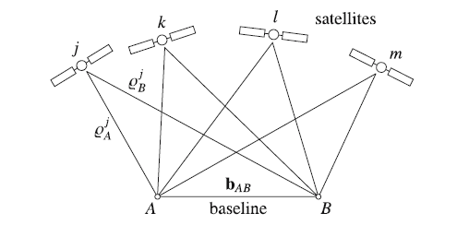
Relative positioning 1
The receiver (station B with unknown position ) processes its own GNSS measurements together with the GNSS measurements collected by a reference station (station A whose position is known).
The baseline vector between the receiver and the reference station is obtained from “mixed” data processing ( = station A + station B together).
Then, using the known reference station position and the computed baseline, the receiver’s absolute position can be obtained.
$$\vec{R_{B}}$$
$$\vec{R_{A}}$$
$$\vec{b_{AB}}$$

Slide 58
Relative positioning 2
The basic observable used in relative positioning is the double difference of phase measurements.
Double differences (DD) are differences of 4 phase measurements (2 receivers/2 satellites).
Double differences remove:
Satellite and receiver clock errors
The common part of the atmospheric errors (depends on baseline length)

Slide 59
Influence of residual errors
Multipath is a local effect: therefore, its influence does not depend on baseline length.
Under normal circumstances, the residual ionospheric effect can be considered as negligible on distances up to 10-15 km.
Nevertheless, different types of ionospheric disturbances can be the origin of local variability in the ionosphere TEC even on short distances (a few km).
On short baselines, the tropospheric residual error is usually negligible: in general, the tropospheric error variability is much smaller than the ionospheric error variability.
Nevertheless, the passage of a weather front, a violent storm, … can be the origin of increased local variability in water vapour which can give rise to non negligible tropospheric residual errors.

Slide 60
Real Time Kinematics (RTK) 1
RTK is the surveyor’s preferred positioning technique.
It is a kinematic positioning technique which provides an accuracy of a few cm in real time.
It requires a network of reference stations et can work both in differential and in relative mode.
The relative mode require a “heavier” data transfer from the reference station to the user as the reference station measurements are processed together with the user measurements (double differences).

Slide 61
Real Time Kinematics (RTK) 2
Nevertheless, the relative mode gives the best accuracy mainly due to the fact that, the receiver clock error does not influence double differences while it must be estimated (= 1 additional unknown) in differential mode.
In practice, users can start to measure positions after a short (static) initialization phase during which ambiguities are solved to the correct integer.

Slide 62
Perspectives

Slide 63
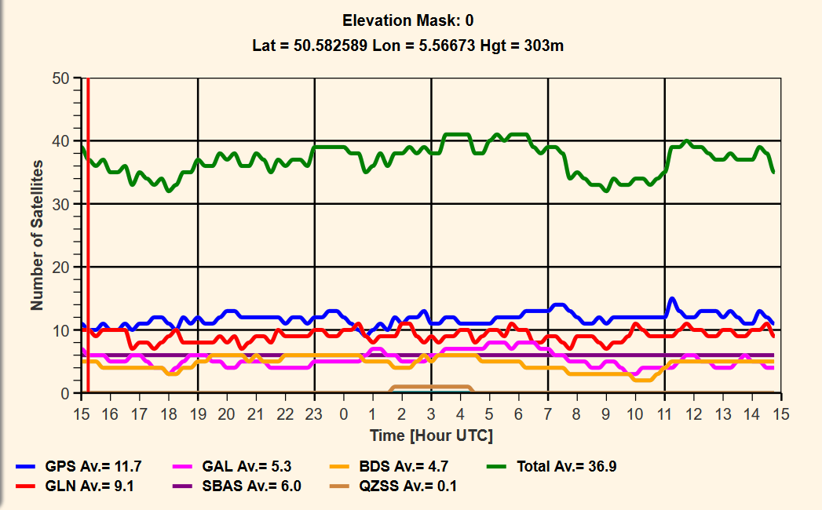
The future 1
More satellites (up to 40), more frequencies, more precise signals (Galileo).

Slide 64
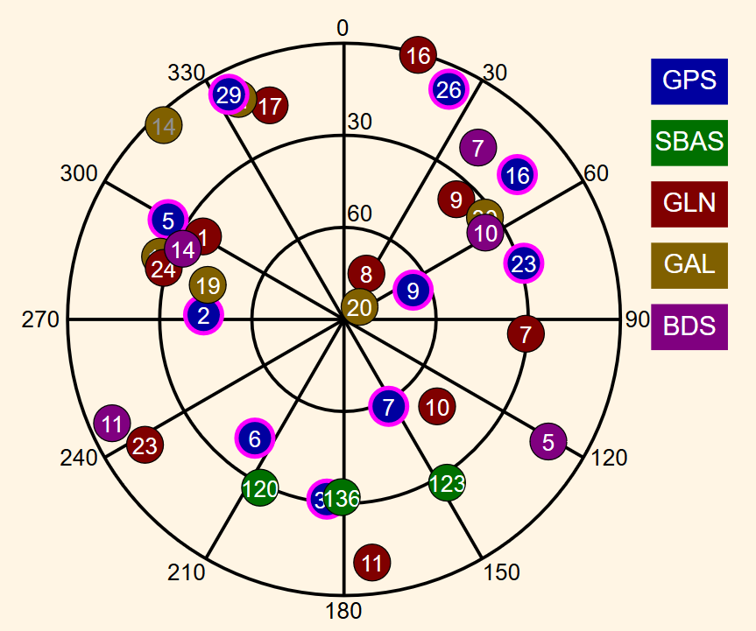
The future 2

Slide 65
The future 3
The combination of all available satellites and observables brings better accuracy and integrity in particular in difficult environments.
Ambiguities solved on an epoch-to-epoch basis.
Better geometry even if more limited visibility.
Better redundancy.
Precise positioning (dm, cm ?) will soon become available on cheaper device
Tomorrow, will you ever be able to make precise RTK using your smartphone ?

