Slide 1
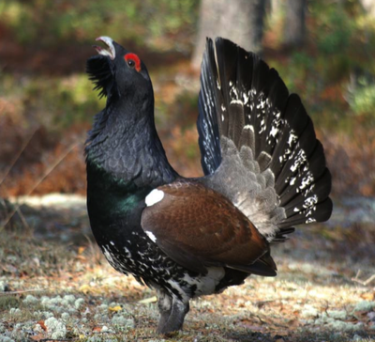
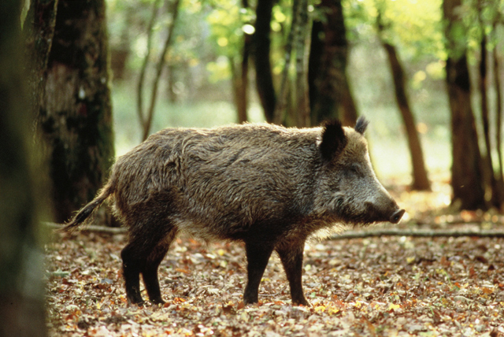

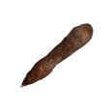


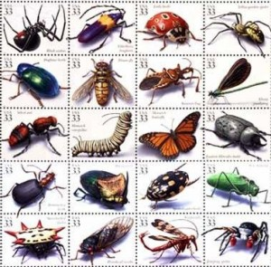
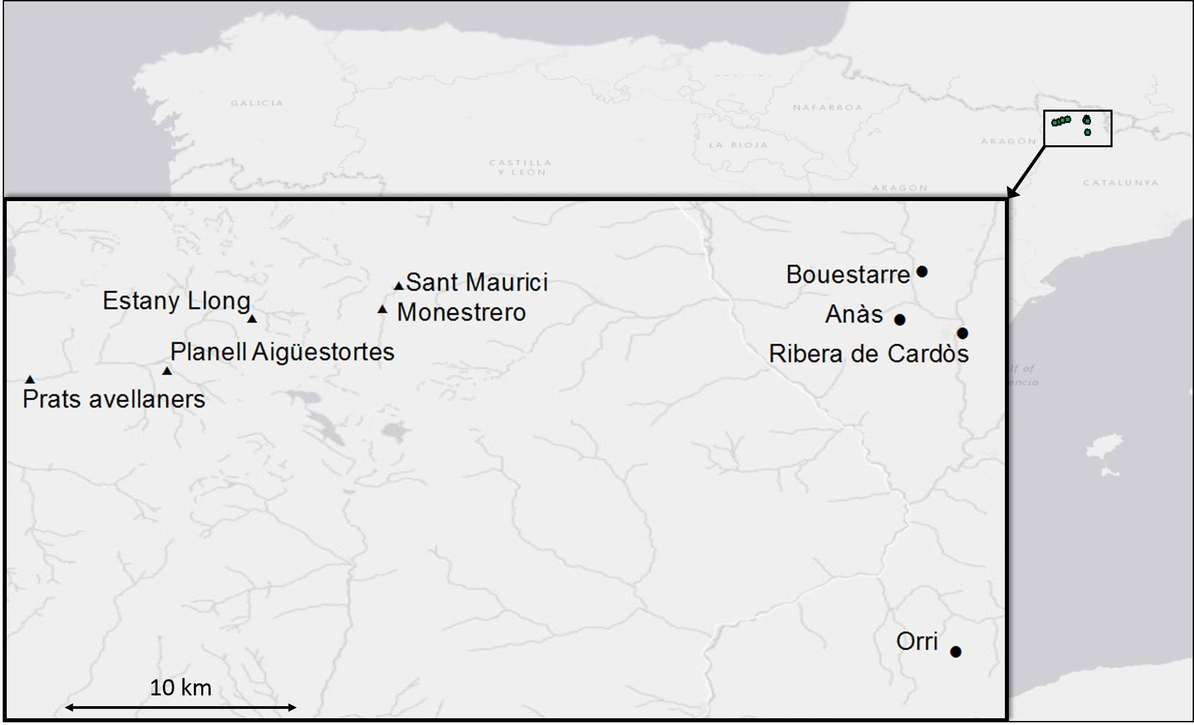
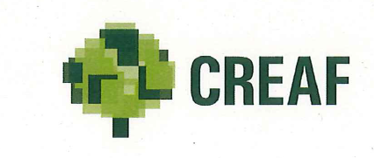
Using Next Generation Sequencing to characterize species diets: a study case with the wild boar in the Spanish Pyrenees.
Mouton A^{1,2}, Andre A², Espelta J.M³, Baurain D⁴, Michaux JR²
¹ Department of Ecology and Evolutionary Biology, UCLA, Los Angeles, usa
² Department of Life Science, Botanic Institute, Conservation Genetics Laboratory, ULG,Liege, Belgium
³ CREAF, Center for Ecology Research and Forestry, 08193 Cerdanyola del Valles, Spain
⁴ Department of Life Science, Botanic Institute, unit of Eukaryotic Phylogenomics, ULG,Liege, Belgium
urbancarnivores.com
INTRODUCTION
Dna metabarcoding represents a powerful and non invasive tool to answer questions regarding ecological questions.
In the Spanish Pyrenees, the wild boar populations are growing and might cause damages to ecosystems and agricultural landscapes, particularly in high altitude habitats recently colonised by this species given the climate changes.
They might be responsible for the rapid decline of the endangered capercaillie (Tetrao urogallus) and other species nesting on the ground.
OBJECTIVE
Using a metabarcoding approach and faecal samples, the aim of this study was to analyze the diet of the wild boar populations in high altitude habitats from the Spanish Pyrenees
More information about the prey diet of the wild boar populations in high altitude might help wildlife managers to apply concrete management measures .
www.eea.europa.eu
?
?
Larousse.fr
…
MATERIALS & METHODS
81 faecal samples extracted using the DNA Stool Mini Kit in the Parc Nacional d’Aiguestortes i Estany de Sant Maurici ( ) and Parc Natural de l’Alt Pirineu ( ) (Fig 1)
Paired-end sequencing of small fragment of COI (140bp) (Miseq protocols :16S Metagenomic Sequencing Library Preparation)
Sequence analyses and taxon assignation:
  Sequence reference database applying the programs ecoPCR implemented in OBITools on the whole set of EMBL sequences and the NCBI taxonomy
  Quality control, filtering and annotating with packages OBITools (http://www.prabi.grenoble.fr/trac/OBITools)
  Assignation of the samples with the Ecotag command (assigns sequences to a taxon based on sequence similarity from the reference database)
RESULTS
Fig 1 Sampling distribution
Reference database (Ecopcr):
56198 sequences =>12193 unique sequences
1554 families- 331 orders- 29 phyla (Fig 2)
Samples results:
- Some fecal samples were discarded due to low DNA concentrations and to low quality of the reads during the filtering analyses.
- Several samples belonged to other species than Sus scrofa such as Capreolus capreolus,Cervus elaphus, Ovis aries.
- A high percentage of the samples was assigned to « root » or « bilateria » => probably due to the very low quality of DNA (highly degraded samples)
- No evidence of the capercaillie DNA in the analysed fecal samples but presence of many insect species confirming the omnivorous diet of the wild boar.
Arthropoda(21%)
Fig 2 proportion of phyla in the ecopcr database
Chordata (76%)
PRELIMINARY CONCLUSIONS
ACKNOWLEDGMENTS
The present study evidenced the existence of a large set of prey species on the Spanish Pyrenean wild boar diet, confirming its omnivorous diet. However, at the exception of one bird species (Turdus merula) observed in one single sample, no vertebrate species were evidenced in the analysed fecal samples.
This results would be explained by the following reasons :
- The sampling was too low to detect vertebrate preys, suggesting that they are rare on the diet of these wild boar populations;
The DNA conserved in the fecal samples was too degraded to identify all the prey species;
The used bioinformatic tools (EcoPCR) would be too conservative => necessity to integrate another dabatase (BOLD) in order to get a better assignation for the samples;
- As Sus scrofa is omnivorous, the use of a barcode specific to plants will allow understanding more precisely the wild boar diet and the ratio between animal and plant food.

