Slide 1
EDX PROGNOSIS Of Focal Neuropathies
FC Wang

Slide 2
Electrodiagnostic studies (EDX)
To define the location
To grade the severity To exclude other lesions
To predict recovery

Slide 3
Why EDX prognosis is useful ?
To make treatment option recommendations
Severe radial nerve injury unlikely to recover => tendon transfers = good early option
Good prognosis => conservative treatment
To modify the workplace and equipment
to change occupation
If the neuropathy is unlikely to recover

Slide 4
How to predict outcome from a nerve injury ?
The pathophysiology of the nerve lesion
Axon loss versus demyelination
Nodopathies (a new concept)
The distance from the injury site to the muscle The variability between nerves
Distance : short versus long nerves
Intraneural architecture
Blood supply
Motor function requirements
Functional segment localization
Importance of the sensation role in functional recovery
Aberrant reinnervation as a limiting factor

Slide 5
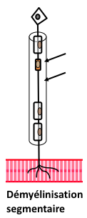
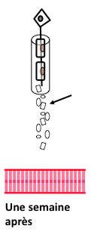
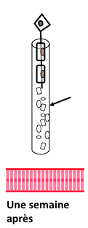
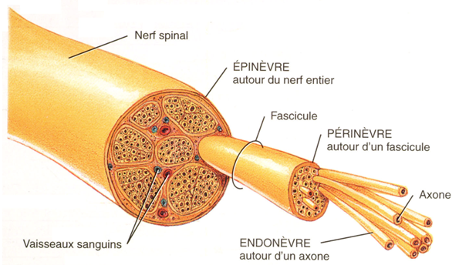
The pathophysiology of the nerve lesion
Neurapraxia : GOOD PROGNOSIS: 2 - 3 months
Neurotmesis : POOR PROGNOSIS Axonotmesis : VARIABLE PROGNOSIS : depending upon the ability of axons to regrow
Root avulsion : DOES NOT RECOVER

Slide 6
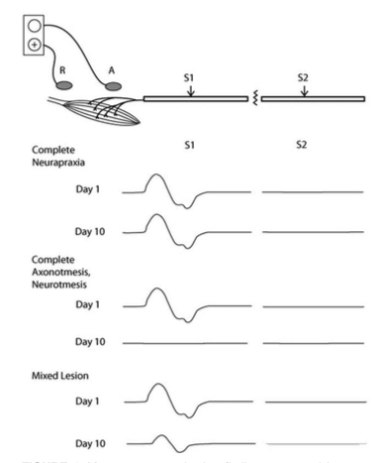
The pathophysiology of the nerve lesion
Neurapraxia : Day 1, with stim. distal to the site of nerve injury : => CMAP normal
Complete Neurotmesis/Axonotmesis : Day 1, with stim. distal to the site of nerve injury : => CMAP normal
Mixed Lesion : Day 1, with stim. distal to the site of nerve injury : => CMAP normal

Slide 7
The pathophysiology of the nerve lesion
Neurapraxia : Day 10, with stim. distal to the site of nerve injury : => CMAP normal
Complete Neurotmesis/Axonotmesis : Day 10, with stim. distal to the site of nerve injury : => CMAP absent
Mixed Lesion :
Day 10, with stim. distal to the site of nerve injury : => CMAP reduced in amplitude
Root avulsion : Day 12 => distal SNAP normal fibrillations in paraspinal muscles

Slide 8
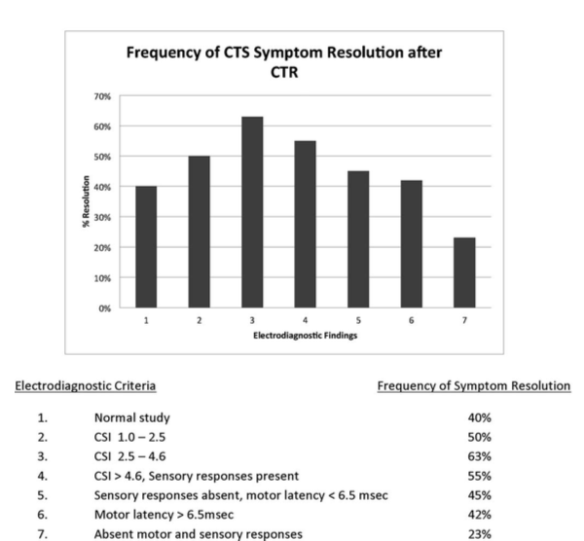
The pathophysiology of the nerve lesion
Degree of Demyelination : little impact on PROGNOSIS except in CTS : better outcome after surgery with moderate NCS abnormalities (vs mild or severe) Bland, 2001
Degree of Axon Loss : large impact on PROGNOSIS: GOOD if minimal, POOR if > 90%

Slide 9
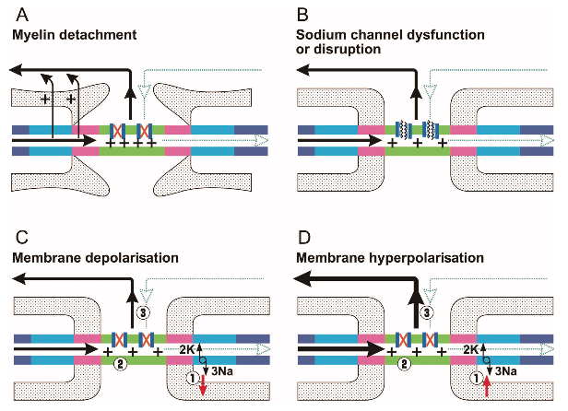
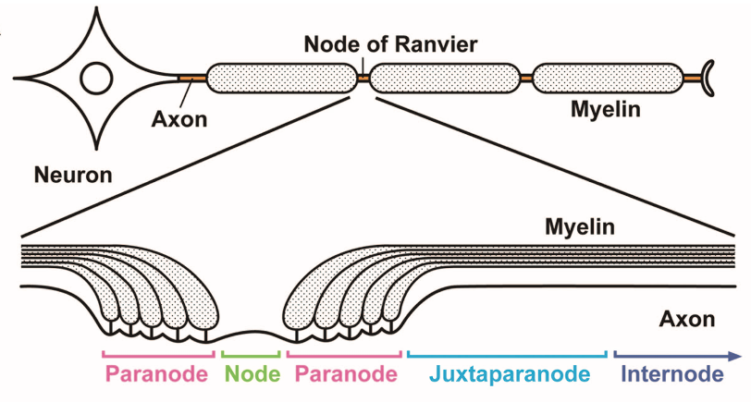
The pathophysiology of the nerve lesion
Nodopathies (a new concept) : MMN, CIP, ischemic neuropathy, subtypes of GBS … 1 pathophysiological continuum from transitory nerve CB to axonal degeneration 2 the CB may be due to - paranodal myelin detachment - node lengthening - dysfunction or disruption of Na+ channels - altered homeostasis of water and ions - abnormal polarisation of the axolemma (Na+/K+ pump)

Slide 10
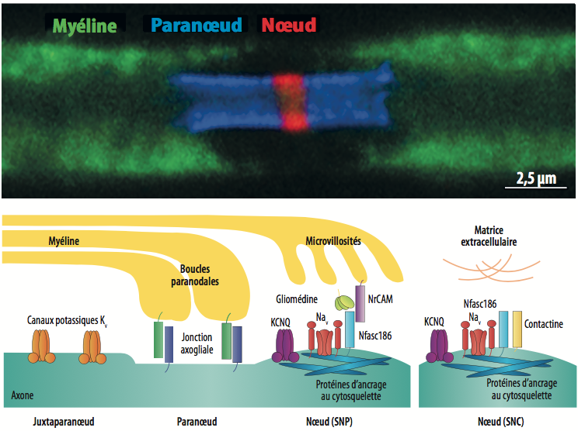
The pathophysiology of the nerve lesion
Nodopathies (a new concept) : MMN, CIP, ischaemic neuropathy, subtypes of GBS … 3 the CB may be promtly reversible => GOOD PROGNOSIS 4 axonal degeneration eventually follows the CB => LESS GOOD PROGNOSIS

Slide 11
Distance to the muscle
For complete motor axonal injury : - axons can traverse the segment of injury in 8-15 days - axons regenerate at a rate of 1-5 mm/day (faster proximally and in younger individuals) - muscle fibers cannot survive for more than 20-24 months - thus, whenever the denervated muscle fibers lie > 60 cm from the injury site, reinnervation cannot occur by proximodistal regeneration
There is no time limit for sensory nerve fiber regeneration

Slide 12
Variability between nerves
Intraneural architecture : many small fascicles separated by generous amount of soft tissue: GOOD PROGNOSIS : tibial nerve > fibular nerve
Blood supply : Important : GOOD PROGNOSIS : tibial nerve > fibular nerve

Slide 13
Variability between nerves
Motor function requirements : Global/Intense >< Fine/Precise: GOOD PROGNOSIS : femoral nerve > facial nerve
Functional segment localization : Proximal >< Distal GOOD PROGNOSIS : fibular at the fibula > ulnar at the elbow
Importance of the sensation role: Minimal >< Crucial GOOD PROGNOSIS : deep fibular nerve > median nerve
Aberrant regeneration can be a limiting factor in recovery : facial nerve +++

Slide 14
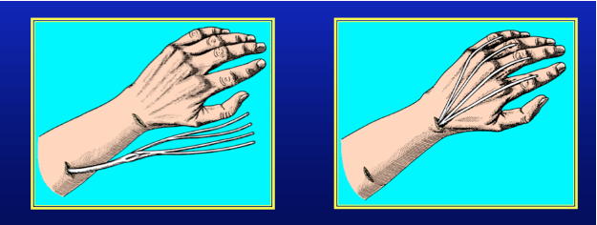
Palliative surgery
For some nerves there are good treatment options
GOOD PROGNOSIS : radial nerve (tendon transfers) > complete ulnar or median nerve lesion upper plexus lesion > lower plexus lesion

Slide 15
NCS : the good timing
< 10 days postinjury : Can overestimate the number of viable axons: incomplete degeneration
> 3-6 months postinjury: Can also overestimate the number of preserved axons : axonal sprouting
10 days > good timing > 1 month: Stimulation distal and proximal to the nerve injury site: neurapraxia
Stimulation distal to the nerve injury site and comparison with the unaffected side: axon loss

Slide 16
EMG
Spontaneous Activity: Absence after 1 month: GOOD PROGNOSIS, even in the case of complete paralysis Presence after > 1 year in a completely denervated muscle: GOOD PROGNOSIS: muscular reinnervation is always possible
Needle EMG Recruitment: Rough indication of the degree of axon preservation The presence of MUAP recruitment in muscles immediately distal to the injury site is an element of GOOD prognosis However, recruitment is difficult to quantify and is usually recorded on a subjective ordinal scale. Moreover, conduction block may also be responsible for poor or absent recruitment

Slide 17
Generally useful prognostic measures (> Day 12 -> Month 2)
PROGNOSIS | Good | Poor
EMG (recruitment distal to lesion) | Mildly reduced or normal | Discrete or absent
Distal CMAP amplitude Conduction block | Mildly reduced or normal Present | Absent Absent
Distal SNAP (for injuries distal to DRG) Distal SNAP (for root avulsions) | Present | Absent Present

Slide 18
Specific Nerve Injuries : CTS
PROGNOSIS (outcome post surgery) | Good | Poor
Sensory NCS | Present SNAP and moderate slowing | Normal study or mild slowing Absent SNAP
Motor DL | < 6.5 ms | Absent CMAP

Slide 19
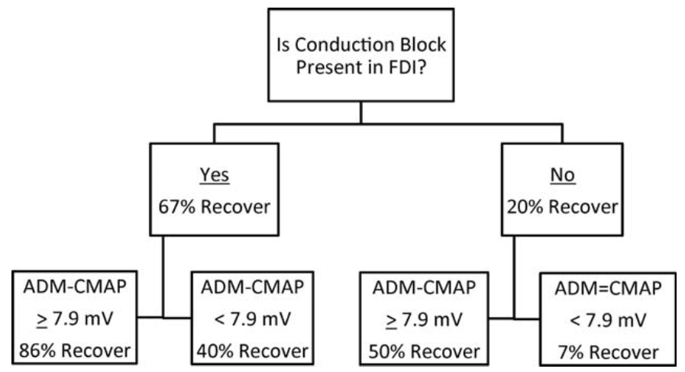
Specific Nerve Injuries : UNE

Slide 20
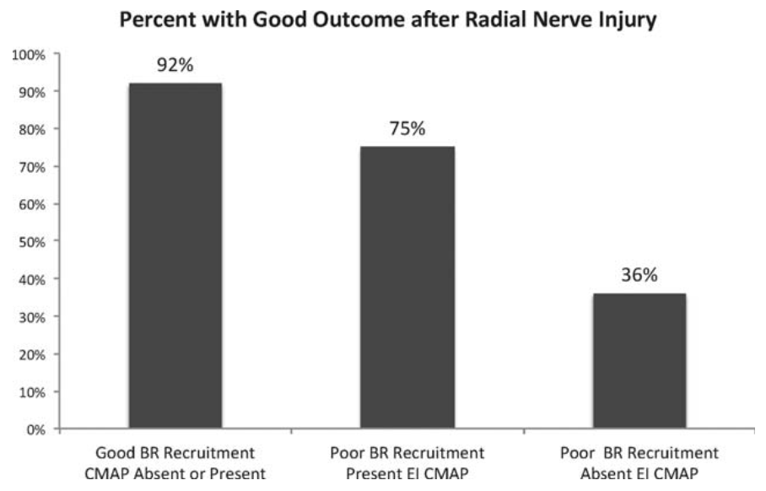
Specific Nerve Injuries : Radial Nerve Injury

Slide 21
Specific Nerve Injuries : Bell Palsy
PROGNOSIS | Good | Poor
CMAP (ENG) | > 30% of contralateral side | < 10% of contralateral side
Blink reflex | Present | Absent
Fibrillations |  | ++ in Young -> synkinesis

Slide 22
Upper versus lower brachial plexus lesion
 | Upper plexus | Lower plexus
Prognosis | Good | Poor
Pathophysiology | Neurapraxia | Axonotmesis/neurotmesis/avulsion
Injury site localisation | Extraforaminal | Preganglionic root
Distance to muscles | < 60 cm | > 60 cm
Motor function requirements | Global/intense | Fine/precise
Good treatment options | + | -

Slide 23
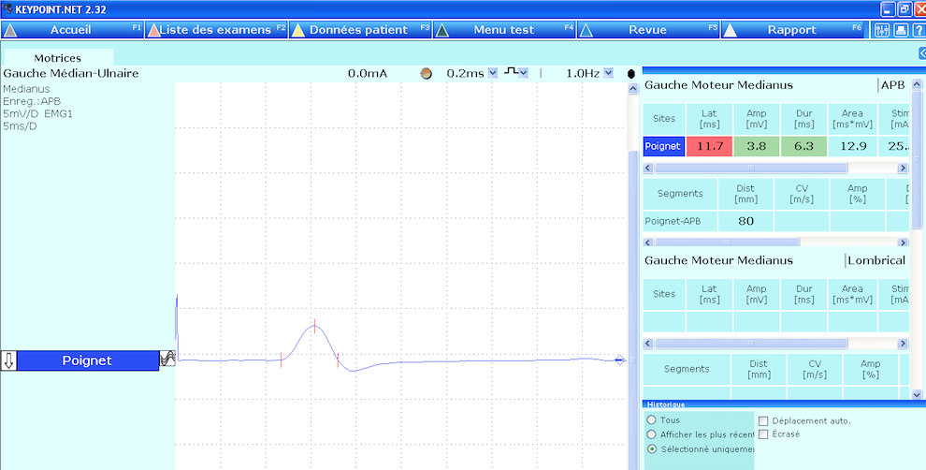
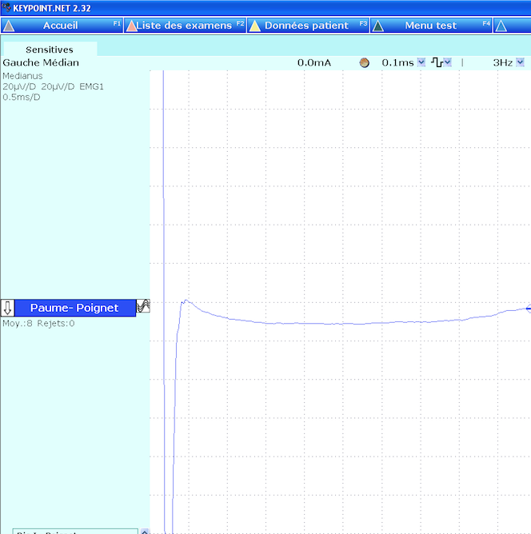
76 yo CTS
Median motor latency : 11,7 ms
Median sensory SNAP : absent
GOOD or POOR PROGNOSIS ?
GOOD or POOR OUTCOME (after surgery) ?

Slide 24
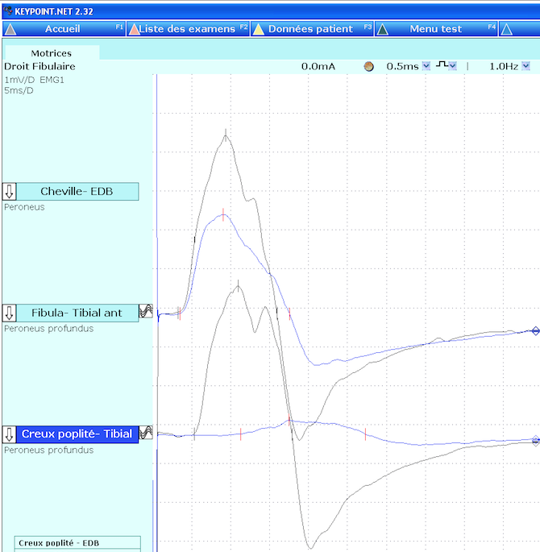
68 yo Fibular neuropathy at the fibula head
Motor NCS at day 10
CB : 85%
Motor axonal loss : 40%
GOOD or POOR PROGNOSIS ?

Slide 25
1 month later
CB : 50%
Motor axonal loss : 40%

Slide 26
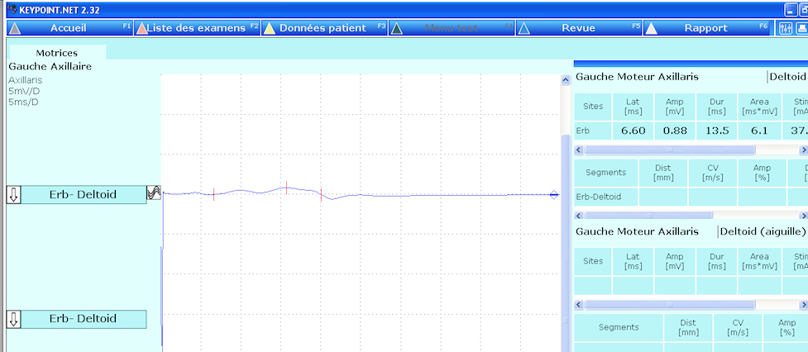
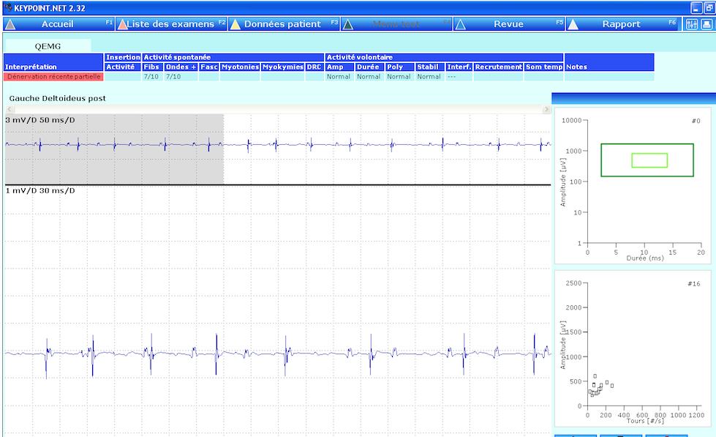
51 yo Shoulder trauma 6 weeks ago
Deltoid CMAP : 0,9 mV (Erb stim)
Fibrillations : 7/10
GOOD or POOR PROGNOSIS ?
We don’t know because Erb stimulation is above the nerve injury site

Slide 27
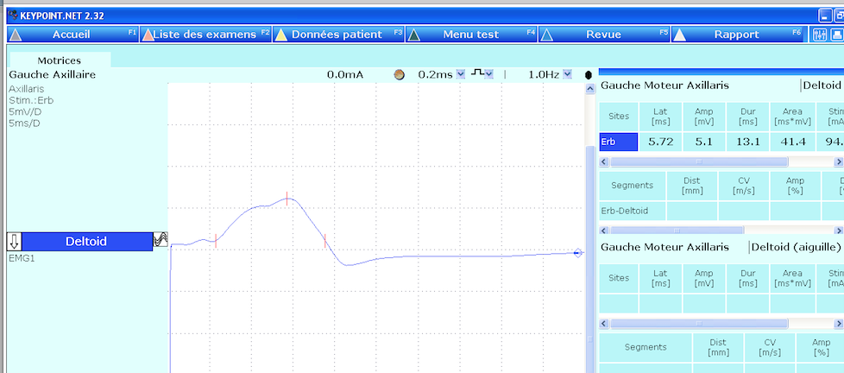
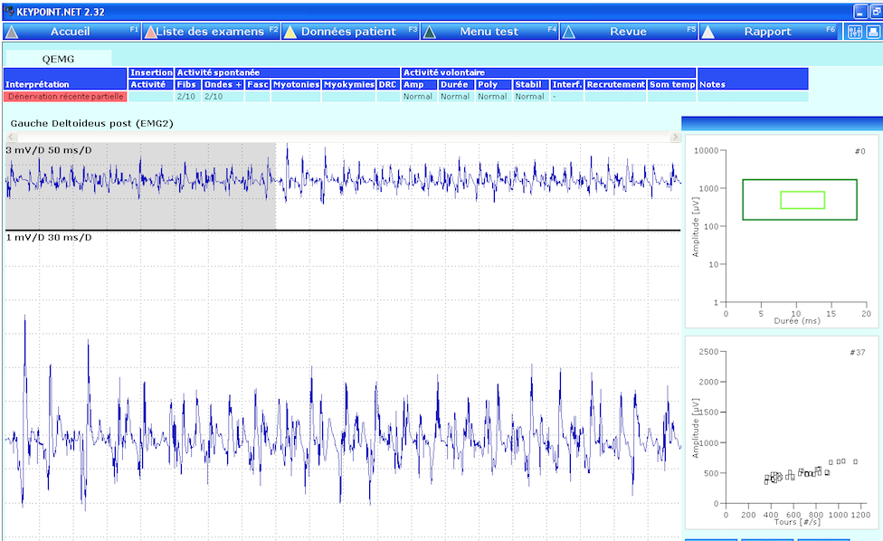
6 weeks later
GOOD OUTCOME

