Slide 1
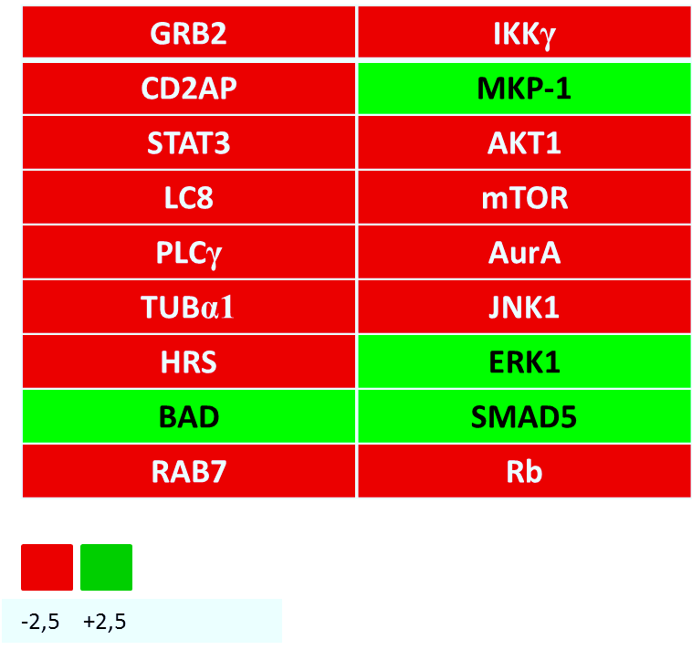
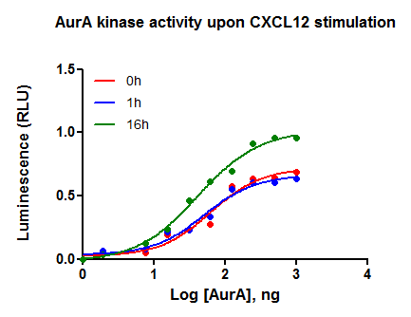
Implication of AurA kinase in the CXCL12-dependent
glioblastoma cell chemotaxis
G I G A
Willems, E.¹, Dedobbeleer, M.¹, Lombard, A.^{1,3}, Chevigné, A.⁶, Goffart, N.^{4,5} and Rogister B.^{1,2}
¹Laboratory of Nervous System Diseases and Therapy, GIGA-Neuroscience, University of Liège, Liège, Belgium, ²Department of Neurology, CHU and University of Liège, Liège, Belgium, ³Department of Neurosurgery, CHU and University of Liège, Liège, Belgium, ⁴Department of Human Genetics, GIGA-Cancer, University of Liège, Liège, Belgium, ⁵The T&P Bohnenn Laboratory for Neuro-Oncology, Department of Neurosurgery, UMC Utrecht, Utrecht, The Netherlands, ⁶Laboratory of Retrovirology, Center of Public Health Research, Luxembourg, Luxembourg
- Introduction -
Despite great improvements in therapies of glioblastoma (GBM), the median survival does not exceed 12-15 months. The main obstacle for the cure of GBM is the systematic recurrence of the tumor after standard treatments (i.e. surgery, radiotherapy and chemotherapy). A major advance in the understanding of GBM recurrences is the identification of glioblastoma-initiating cells (GIC). GIC are able to self-renew, to initiate new tumors in mice and to develop resistance mechanisms to standard treatments. Using orthotopic xenografts of human GBM cells in the mice striatum, we have showed that GIC can specifically migrate out of the tumor and invade the subventricular zones (SVZ) in response to the local production of the CXCL12 chemokine. SVZ, located along the ependymal layer on lateral ventricle wall, are stem cells niches crucial for the regulation of adult neurogenesis. The hypothesis is that GIC migrate in the SVZ to benefit from the SVZ environment allowing them to survive and to resist standard treatments. In this work, we identified a new actor of the CXCL12 pathway by the phosphoproteome analysis of U87MG cells stimulated with CXCL12: the mitotic kinase Aurora A (AurA) whose activity seems crucial for the CXCL12-dependent chemotaxis of GBM cells
- Results -
1. CXCL12 controls the activity of AurA in GBM cells
2. AurA promotes the CXCL12-dependent GBM cells chemotaxis
(a)
(c)
**
(a)
***
***
(c)
**
***
***
***
(b)
U87MG
GBM1
(d)
(b)
**
(d)
P-AurA
AurA
Actine
0h 1h 16h ALS 0h 1h 16h ALS
***
***
***
***
**
Figure 1 (a) Phosphoproteome analysis by mass spectrometry of U87MG cells after 0h or 1h of CXCL12 stimulation. AurA was found to be significantly dephosphorylated after 1h of CXCL12 stimulation (b) Immunostaining and (c) western-blotting of P-AurA/AurA in U87MG and GBM1 cell lines after 0h, 1h or 16h of CXCL12 stimulation and AMD3100 (CXCR4 inhibitor) and U0126 (ERK inhibitor) treatments. AurA phosphorylation decreases at 1h and increases significantly at 16h of CXCL12 stimulation in both U87MG and GBM1 cells. Cell treatment with ALS (alisertib), a specific P-AurA inhibitor, was used as negative control (d) ADP-Glo kinase assay measuring the enzymatic activity of AurA in U87MG cells after 0h, 1h or 16h of CXCL12 stimulation. AurA kinase activity increases after 16h of CXCL12 stimulation.
Figure 2 Chemotaxis assay using Boyden chamber assays (a) The increase in migration of U87MG and GBM1 cells in response to CXCL12 is reduced upon ALS treatment. MMC (mitomycin C) was used as control of proliferation (b) The increase in migration of U87MG cells extracted from the tumor mass or from the subventricular zone of our mouse model in response to CXCL12 is reduced upon ALS treatment. The percentage of U87MG^{SVZ} migrating cells is significantly higher than the U87MGTM cells (c) The increase of U87MG migrating cells in response to CXCL12 is reduced upon U0126 treatment (d) The increase in migration of U87MG cells in response to CXCL12 is significant in U87MG expressing the CXCR4 receptor (U87MG^{WT}, U87MG^{R4+/R7-}), but not in U87MG^{R4-/R7+}. ALS treatment also reduced the migration of CXCR4-overexpressing cells.
3. AurA inhibition promotes GBM cell adherence and inhibits mesenchymal markers expression dependently of CXCL12
(a)
(b)
Figure 3 (a) Adherence assay of U87MG and GBM1 cells in response to CXCL12 and/or ALS treatments. Adherence of ALS-treated cells is significantly increased after CXCL12 stimulation (b) Quantitative RT-PCR analysis of the expression of the mesenchymal markers vimentin and n-cadherin in U87MG and GBM1 cells. Expression of mesenchymal markers in U87MG and GBM1 cells is significantly increased upon CXCL12 stimulation and repressed with ALS treatment
*
**
***
***
**
**
**
*
*
*
*
- Conclusions and perspectives -
In summary, we identified a new actor of the CXCL12 pathway in GBM cells: the AurA kinase, which is phosphorylated and activated by the CXCL12 chemokine. AurA contributes to the CXCL12-dependent chemotaxis of U87MG and GBM1 GBM cells. Moreover, U87MG^{SVZ} cells migrate more in response to CXCL12 than U87MGTM cells. We showed that the CXCL12-dependent regulation of AurA and its impact on cell migration rely on the activity of the CXCR4 receptor and the MAPK pathway. In addition, AurA inhibition promotes GBM cell adherence and inhibits mesenchymal markers expression in a CXCL12-dependent manner. Next purposes are (i) to study the role of AurA in our GBM xenograft mice model set up to study the SVZ-directed migration and (ii) to study the role of the CXCL12-AurA pathway in the stemness and the therapeutic resistance of GBM. We aim to determine the exact role of AurA in GBM tumor recurrence in order to evaluate the potential of AurA as a therapeutic target in GBM.

