Slide 1

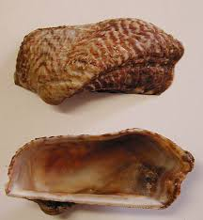
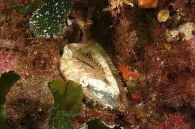
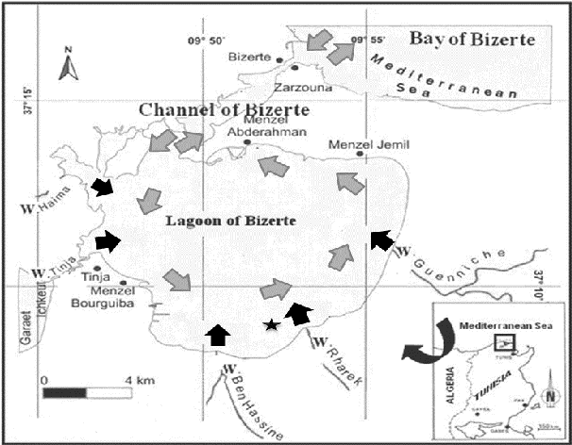



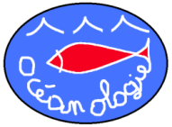
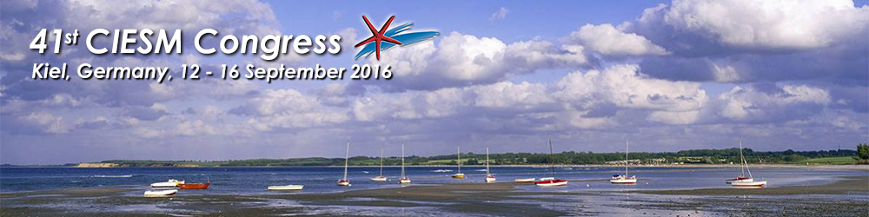
TRACE METALS IN SOFT TISSUE OF MARINE BIVALVE NOAH’S ARK (Arca noae) FROM BIZERTE LAGOON (NORTHERN TUNISIA) Feriel GHRIBI¹ *, Jonathan RICHIR² , Dhouha BOUSSOUFA¹ , M’hamed El CAFSI¹ & Sylvie GOBERT²
¹Unit of Physiology and Aquatic Environment, University of Tunis El Manar
²Laboratory of Oceanology - MARE Centre - University of LIEGE - B6C - 4000 LIEGE - Sart Tilman - Belgium
ferielghribi@yahoo.fr
INTRODUCTION
The Bizerte lagoon is one of the most studied coastal areas in Tunisia, and is used for shellfish production since 1964 [1]. It inhabits a wide diversity of marine invertebrates, among them the valuable shellfish Noah’s ark (Arca noae). But like any benthic invertebrates, that mollusk may accumulate trace elements (TEs) whether essential or not, which cause toxic effects above threshold levels. This study aimed to monitor the bioaccumulation of five Traces metals (Zn, Fe, Cu, Cd, and Pb) in A. noae flesh. The Objective of this study is to assess the nutritional quality of this bivalve and to promote its consumption as marine resource in Tunisia. To the best of our knowledge, this is the first work to monitor the bioaccumulation of trace metals on the soft tissue of Tunisian A. noae.
Fig. 1 Arca noae
MATERIALS & METHODS
Ten mature specimens of Arca noae (Fig. 1) (46.23-65.08 mm) were collected monthly from Bizerte Lagoon (Fig. 2) at a depth of 3 meters by scuba diving from October 2013 to September 2014. The sampling site is located far from urban and industrial sources of pollution but remained influenced by agricultural inputs [2]. The concentrations of Zinc (Zn), Iron (Fe), Copper (Cu), Cadmium (Cd) and Lead (Pb) were measured in the mollusk flesh by inductively coupled plasma mass spectrometry (ICP-MS).
Fig. 2 Bizerte Lagoon Sampling site
RESULTS & DISCUSSION
Fresh water Sea water
***
***
***
***
***
Trace element (TEs) concentrations in mg/Kg wet weight decreased in the following order: Zn > Fe > Cu > Pb > Cd (Fig. 3).
Essential (e.g. Zn, Fe) trace elements were accumulated at higher levels than non essential toxic ones (e.g. Pb, Cd) (Fig. 3).
Significant differences (p < 0.05) were observed between mean seasonal TEs concentrations in A. noae flesh. The highest values of all trace elements were recorded during summer 2014 and autumn 2014 (warmer compared to autumn 2013) and the lowest ones during winter 2014 (Fig.3, 4).
The winter period in Bizerte Lagoon is characterized by the increase of provision in rainwaters washing out the agricultural bordering lands and enriching the lagoon on various pollutants (pesticides and chemical) [3]
We assume that the strong surface water currents specific to Bizerte lagoon rapidly diluted and exported TEs brought through water runoff and river discharge that were consequently not bioaccumulated at higher levels in A. noae flesh.
The food standards for bivalves set by the FAO [4] are 10.0-30.0, 40.0-100.0, 2.0 and 1.0-6.0 mg kg_{ww}⁻¹ for Cu, Zn, Cd and Pb, respectively. The derived wet weight based-concentrations of all metals in Arca noae from the present study were well below their respective food standards.
Fig. 3. Seasonal trace element (TEs) concentrations (mean ± SD, in mg kgww-1; n=10) in A. noae flesh sampled from Bizerte Lagoon.
Fig. 4. Principal component analysis (PCA) based on trace elements levels in the soft tissue of A. noae.
CONCLUSIONS
REFERENCES
The levels of all trace metals analyzed in Arca noae are below maximum admissible level which makes this species a healthy and safe food for human consumption.
This result is very encouraging from an economic point of view to enable future commercial exploitation of A. noae in our country.
1- Beji, O., 2000. Les ressources vivantes exportables du lac de Bizerte: Etat actuel et potentialités (première partie). Bull. Inst. Nat. Sci. Tech. Mer Salammbô 27, 45–60. 2- Barhoumi B, LeMenach K , C lérandeau C, Ben Ameur W, Budzinski H, Driss MR, Cachot J. 2014 Assessment of pollution in the Bizerte lagoon (Tunisia) by the combined use of chemical and biochemical markers in mussels, Mytilus galloprovincialis Mar Pollut Bull 84: 379-390. 3- Kamel, N., Bourgeot, T., Banni, M., Chalghaf, M., Devin, S., Minier, M., Boussetta, H. 2014. Effects of increasing temperature on biomarker responses ans accumulation of hazardous substances in rope mussels (Mytilus gallopranvinciallis) from Bizerte lagoon. Env Sci Poll., Vol. 21, Issue 9, pp. 6108-6123. 4- FAO. 1983. Compilation of legal limits for hazardous substances in fish and fishery products. FAO fishery circular vol. no. 464, pp. 5-100.

