Slide 1
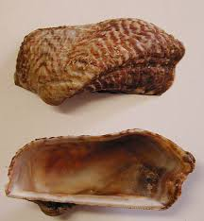
TRACE METALS IN SOFT TISSUE OF MARINE BIVALVE NOAH’S ARK (Arca noae) FROM BIZERTE LAGOON (NORTHERN TUNISIA)
F. Ghribi *, J. Richir , D. Boussoufa , M. El Cafsi and S. Gobert
Is the edible marine bivalve Arca noae a healthy and safe food for human consumption?
Our study aimed to monitor the bioaccumulation of 5 Traces metals (Zn, Fe, Cu, Cd, and Pb)
Arcidae
Epifaunal / fixed on rocky grounds
Mediterranean sea / Black sea / Atlantic ocean
Northern and southernTunisian coasts
Important commercial value in Croatia and Italy
Our Objective is to assess the nutritional quality of this bivalve and to promote its consumption as marine resource in Tunisia.

Slide 2
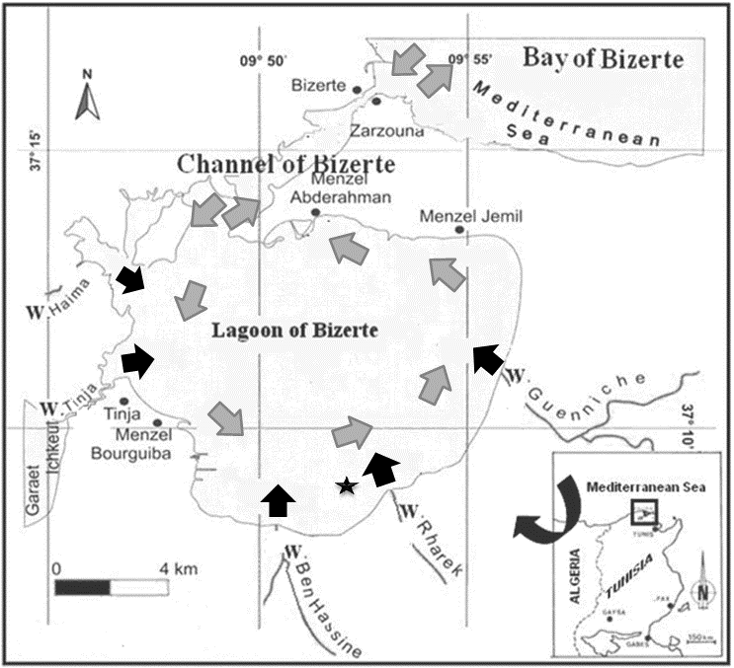

- Essential (e.g. Zn) TEs were accumulated at higher levels than non essential toxic ones (e.g. Pb, Cd).
- Significant differences (p < 0.05) were observed between mean seasonal TEs concentrations in A. noae flesh
-The highest values of all trace elements were recorded during summer 2014 and autumn 2014 (warmer compared to autumn 2013) and the lowest ones during winter 2014
sampling site is located far from urban and industrial sources of pollution but remained influenced by agricultural inputs.
 | Autumn 2013 | Winter 2014 | Spring 2014 |  | Summer 2014 | Autumn 2014
Zn | 37,44ª±4.52 | 42,02ª±5.32 | 42,23^{b}±4.61 |  | 42,41^{b}±3.79 | 75,02^{c}±20.12
Fe | 36,81^{b}±8.688 | 33,20^{b}±5.819 |  | 30,06^{b}±2.504 | 45,73^{c}±17.48 | 46,94^{c}±0.00
Cu | 1,06^{b}±0.19 | 0,97ª±0.08 |  | 1,26^{c}±0.17 | 1,56^{c}±0.14 | 1,12^{b}±1.16
Cd | 0,14ª±0.00 | 0,20^{b}±0.03 |  | 0,21^{b}±0.03 | 0,23^{b}±0.05 | 0,31^{c}±0.42
Pb | 0,29^{b}±0.17 | 0,13ª±0.01 |  | 0,28^{b}±0.26 | 0,48^{c}±0.43 | 0,40^{c}±0.44
Fresh water Sea water
Zn > Fe > Cu > Pb > Cd

Slide 3




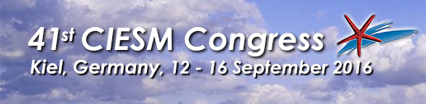
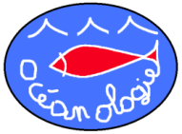
Conclusion
All metals in A. noae from the present study were well below the food safety standards set for bivalves by the Food and Agricultural Organization ( FAO)
This result is very encouraging from an economic point of view to enable future commercial exploitation of A. noae in our country

