Slide 1
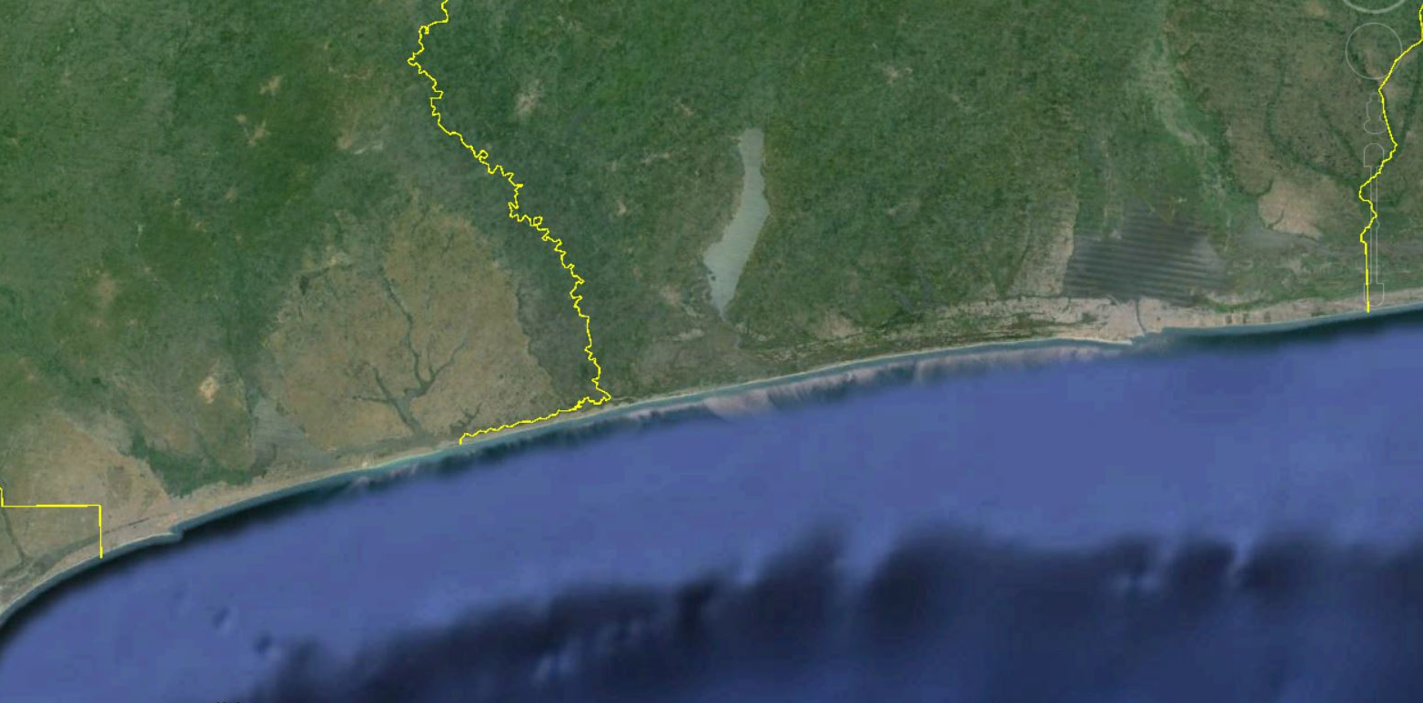
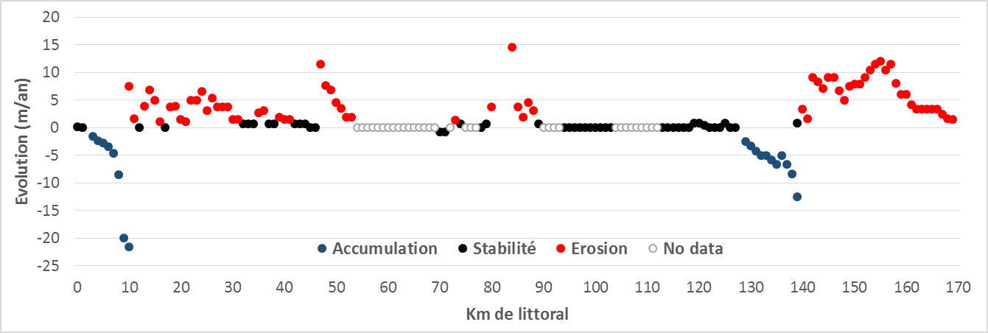
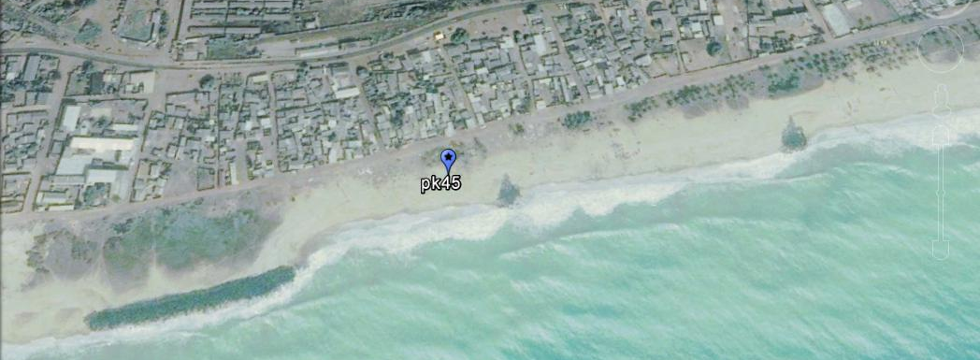
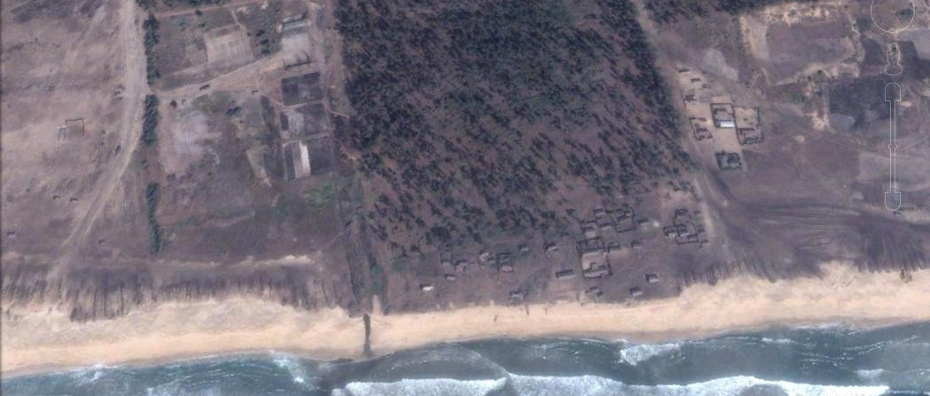
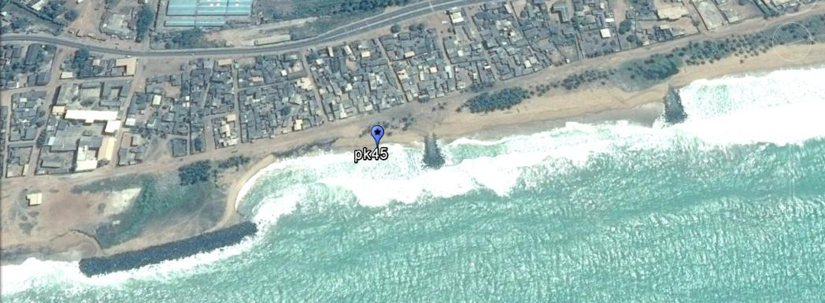
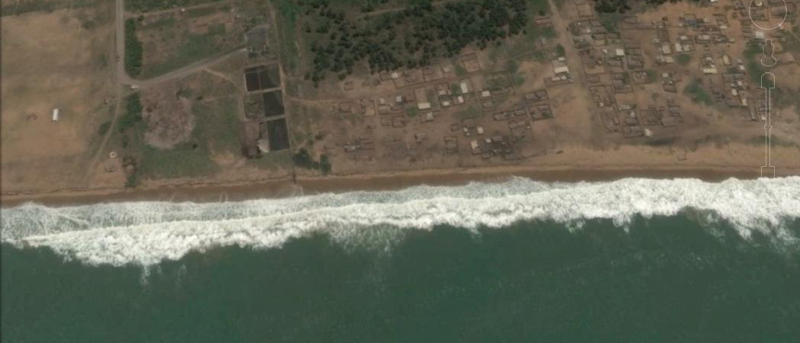
Recent evolution of the coastline in the Gulf of Guinea. Example of Togo and Benin (2000-2015)
Pierre OZER ¹ , Yvon-Carmen HOUNTONDJI ² , Florence DE LONGUEVILLE ³
¹ Département des Sciences et Gestion de l’Environnement / Hugo Observatory, Université de Liège, Belgium, pozer@ulg.ac.be
² Département Aménagement et Gestion des Ressources Naturelles, Université de Parakou, Benin
³ Département de Géographie, Université de Namur, Belgium
Introduction
The land-sea interface is an extremely fragile environment. On a global scale, coastlines are threatened by a multitude of factors sometimes natural and mostly anthropogenic. Thus, in addition to the disruptions to coastal areas by port facilities, dams, sediment sampling on the beach or urban sprawl, there are the consequences of climate change, including rising sea levels.
Objective
Assessing recent trends (between 2000 and 2015) of the coastline in Togo and Benin where more localized studies show that sandy beaches are experiencing major changes (accretion or erosion) in recent decades.
Where?
Method
Coastal dynamics is analyzed using very high spatial resolution images available in open access on Google Earth; the coast is studied by section of 1 km on a coastline of 170 km (pk1 to pk170) by calculating the average change in meter per year since 2000.
TOGO
BENIN
Cotonou
NIGERIA
Lomé
GHANA
50 km
Results
v
v
Population dynamics
v
TOGO
Lomé
TOGO
BENIN
Cotonou
BENIN
v
GHANA
TOGO
NIGERIA
2002
2002
2002
2015
2014
Relative stability (change <1m / year) of the coastline following the construction of coastal protection works (pk 45).
2014
Beach accretion (+260 m between 2002 and 2015) upstream of the harbor of Lomé.
Beach erosion (-120 m between 2002 and 2014) 12 km downstream of the harbor of Cotonou.
Conclusion
Analysis of coastal Togo and Benin shows that only 34% of the coastlines (often protected) are stable and that accretion is recorded only upstream of harbor infrastructures (14%). Elsewhere, coastlines undergo erosive processes (52%) exceeding annual average retreats of 10 m / year. In such conditions, villages have disappeared during the past decade and a large number of people have been displaced.

