Slide 1
Successional trajectories of cyanobacterial communities following glacier retreat in Svalbard (High Arctic)
Igor S Pessi, E Pushkareva, Y Lara, F Borderie, A Wilmotte & J Elster
Centre For Protein Engineering, University Of Liège
Centre For Polar Ecology, České Budějovice, Czech Republic

Slide 2
The study of glacier forefields
Glaciers are retreating
Little Ice Age (ca. 1850–1900 AD)
Exposure of new habitats
Colonization by pioneering (micro)organisms
Spatial gradient
Space-for-time substitution or chronosequence approach
Primary succession studies

Slide 3
Primary succession in glacier forefields
…but comparatively little is known about the earlier successional stages
Plant succession has been
studied for more than one century…

Slide 4
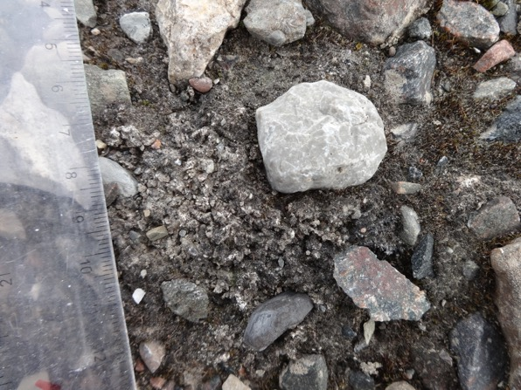
The earlier stages: microbial succession
Low nutrient content and vegetation
Soil biomass and nutrient cycling activity are dominated by microorganisms
Cyanobacteria are common pioneers
Photosynthetic and N-fixing capabilities
Biological soil crusts
Cyanobacteria, other bacteria, eukaryotic microalgae, fungi and lichens
EPS stabilizes the soil surface

Slide 5
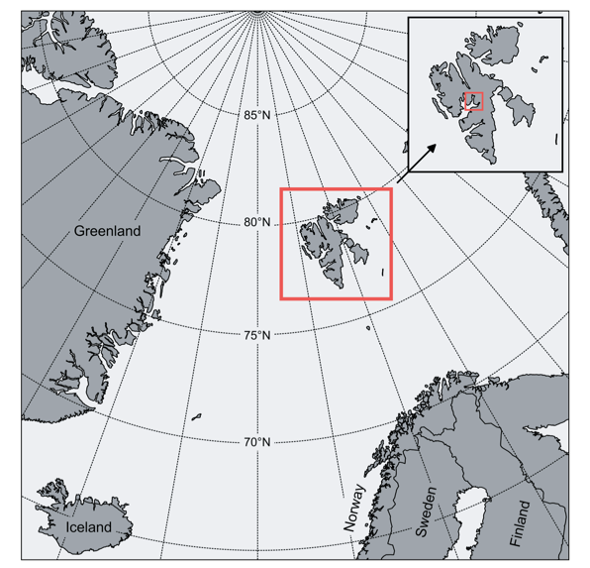
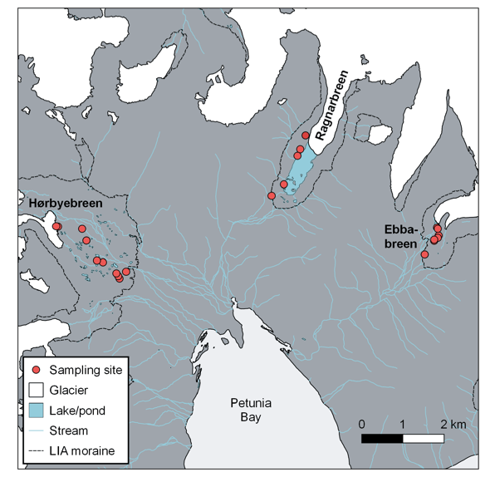
Petunia Bay, Svalbard, High Arctic
100 years of glacier retreat

Slide 6
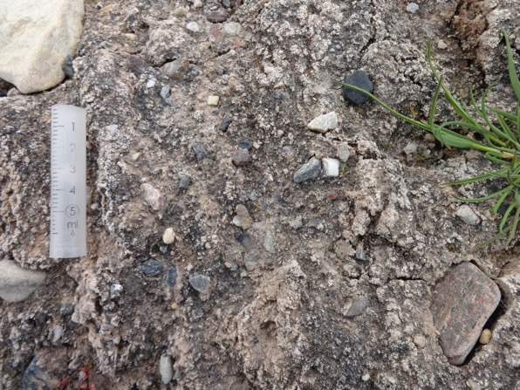
Poorly developed biocrusts

Slide 7
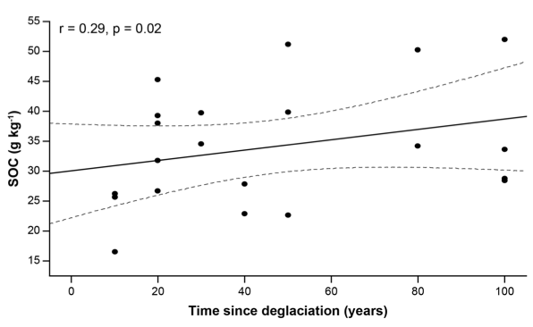
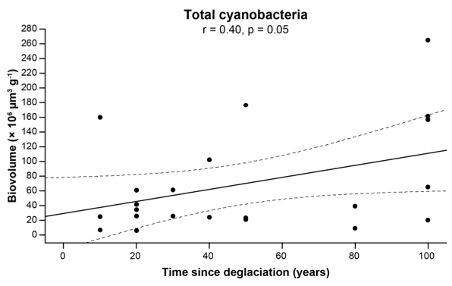
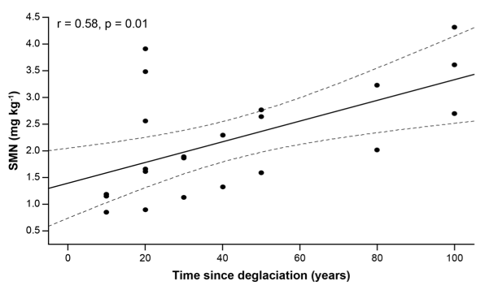
Nutrients and cyanobacterial abundance increase with time
Biovolume
(Epifluorescence microscopy)

Slide 8
Nutrients and cyanobacterial abundance increase with time
Cyanobacterial role in organic matter accumulation has been previously suggested
Microbial communities are also maintained by nutrients from allochtonous sources
e.g. through aerial deposition, runoff from the glacier surface and ancient organic pools
No direct measurement of photosynthetic and nitrogen fixation activities
Association remains elusive and should be regarded as putative

Slide 9
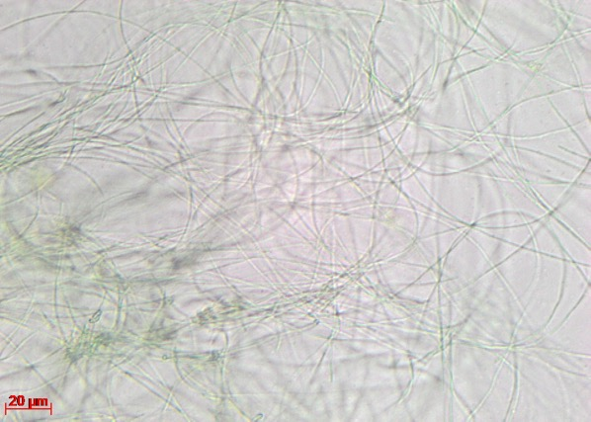
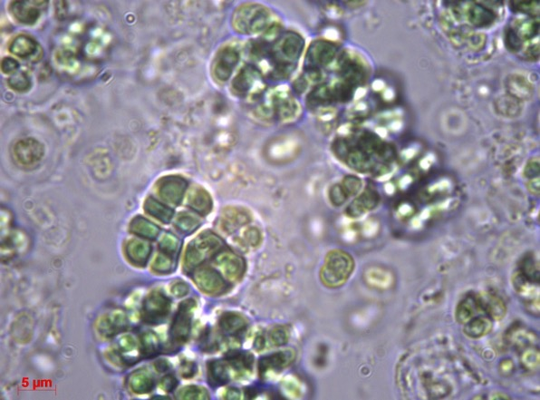
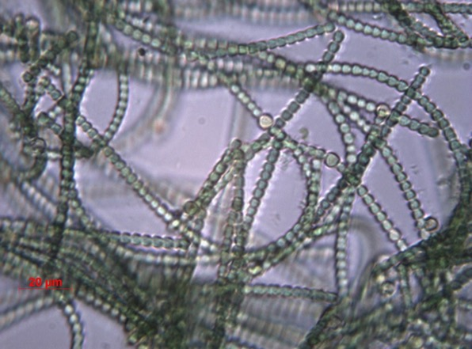
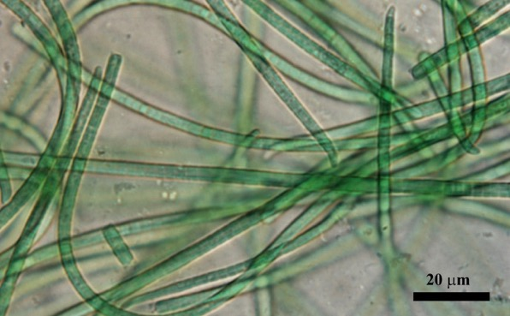
Cyanobacterial community composition: 454 pyrosequencing
148 OTUs (97.5%)
Pseudanabaenales (96): Leptolyngbya, Pseudanabaena
Chroococcales (13): Chroococcidiopsis
Oscillatoriales (7): Phormidium, Microcoleus
Synechococcales (6)
Nostocales (5): Nostoc
Gloeobacterales (3)

Slide 10
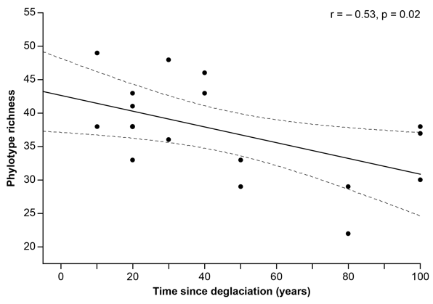
OTU richness decreases with time

Slide 11
OTU richness decreases with time
Consistent with previous findings for other polar and alpine chronosequences
Competitive exclusion associated with increasing cyanobacterial abundance
Similarly to plant communities
Early successional soils
Low nutrient content and high levels of physical disturbance
Small cyanobacterial populations
Higher cyanobacterial richness
Later successional stages
Increased soil stability and nutrient levels
Higher population sizes
Intensified competition
Local extinction of several taxa

Slide 12
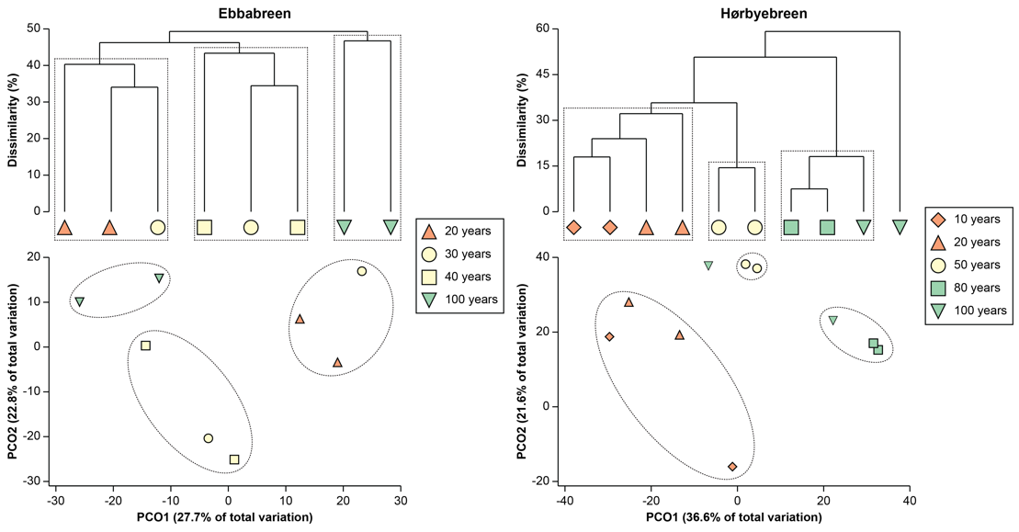
Community structure shifts with time

Slide 13
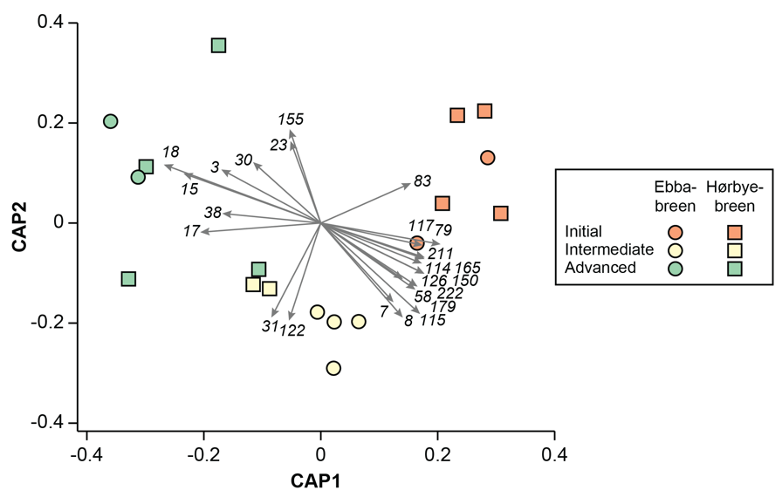
SOME PHYLOTYPES were specific to a particular successional stage

Slide 14
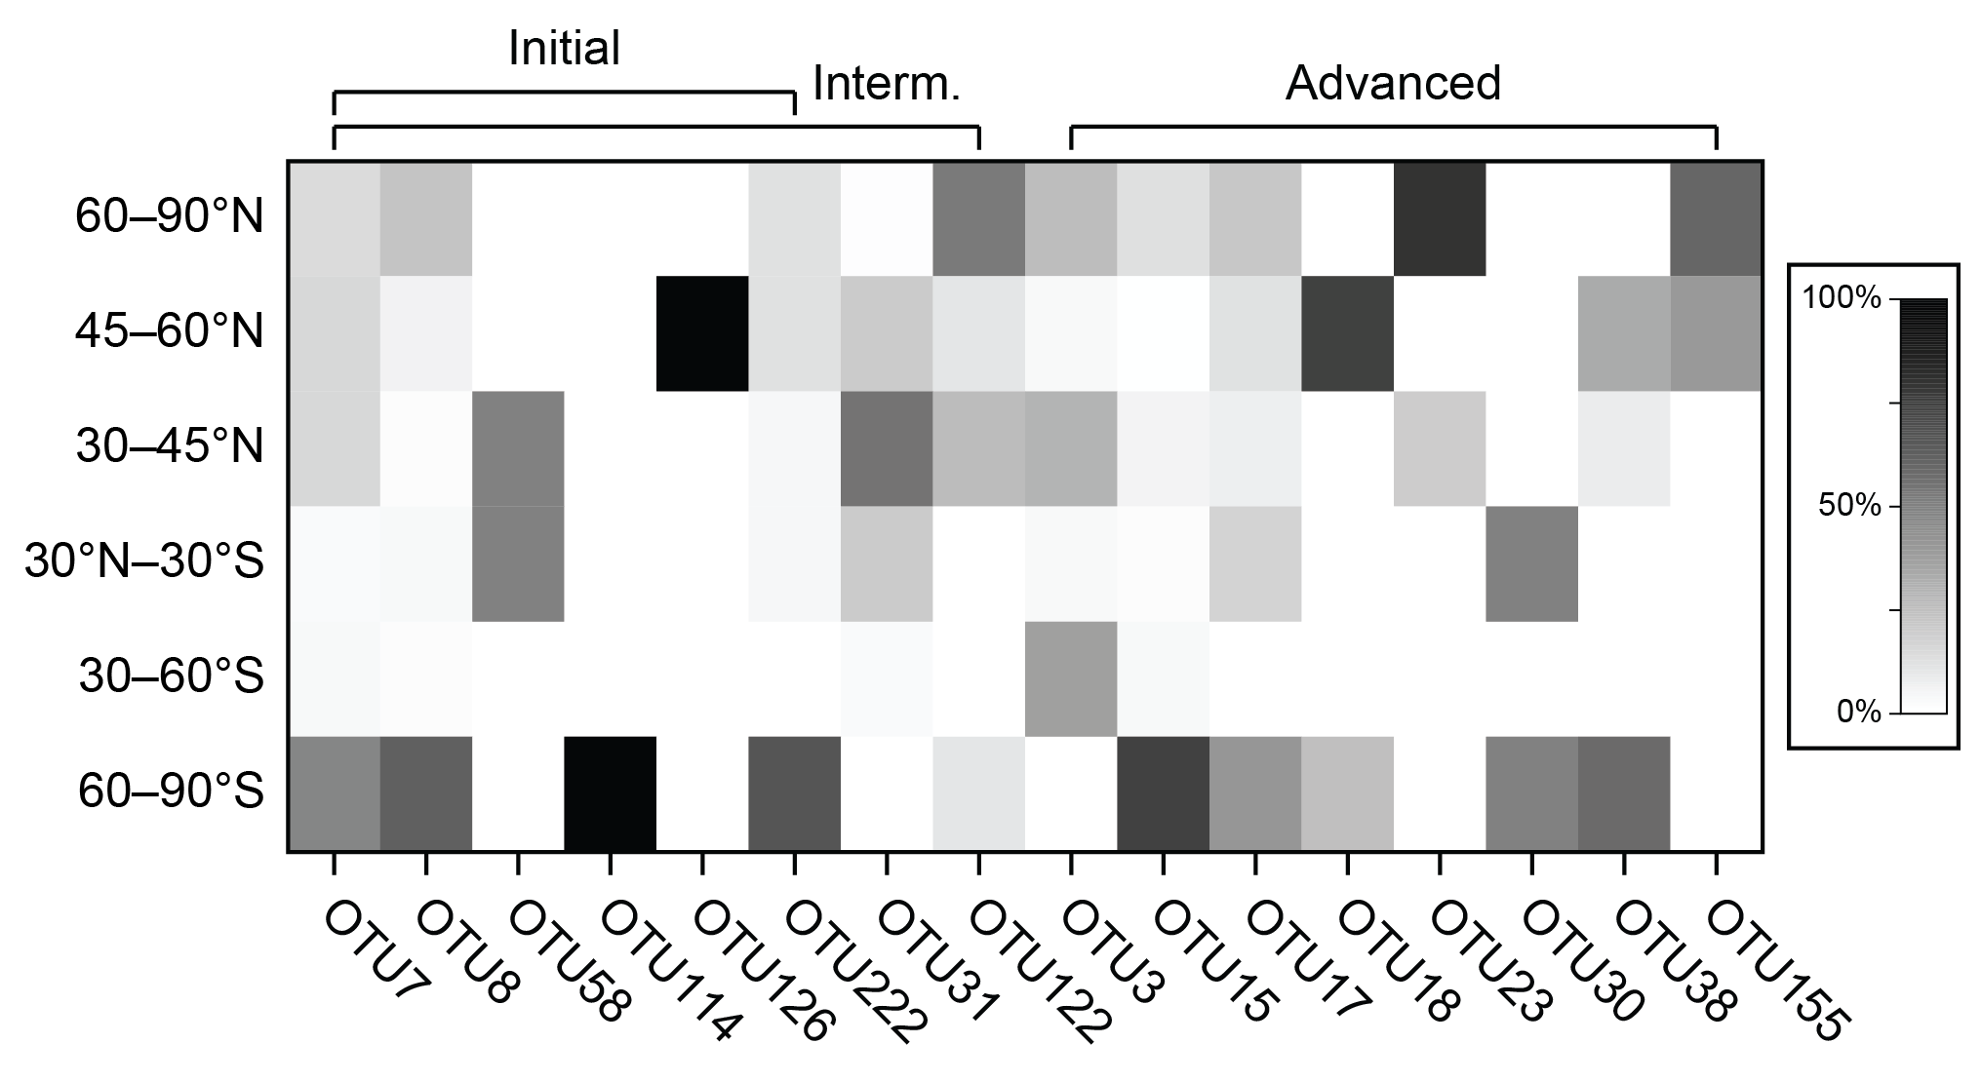
Initial colonizers are mainly related polar cyanobacteria

Slide 15
Initial colonizers are mainly related polar cyanobacteria
Initial colonization mainly performed by microorganisms from nearby glacial environments
1. Glacial systems harbour complex microbial communities
Cryoconite holes on the glacier surface
Nearby freshwater ecosystems
Subglacial environments
2. Structurally and physiologically adapted
Able to withstand the harsh environmental conditions
3. Low levels of competition due to small populations

Slide 16
Advanced communities include more widely dispersed genotypes

Slide 17
Advanced communities include more widely dispersed genotypes
Pioneering microorganisms are usually cosmopolitan?
More widely dispersed → Higher chances of colonizing remote habitats
Harsh environmental conditions likely preclude cosmopolitan taxa
e.g. frequent physical disturbances, low nutrient content, and poor soil stability
Modification of the microclimatic conditions by pioneers
UV-screening pigments, extracellular polymeric substances
Increased soil stability, protection against physical damage and nutrient content
Establishment of more widely distributed taxa in later successional stages

Slide 18
Conclusions
Harsh environmental conditions
Initial colonization accomplished by cyanobacteria transported from nearby glacial environments
Modification of the microenvironment
Establishment of cosmopolitan cyanobacteria in later successional stages
Milder microclimatic conditions and larger population sizes
Local extinction of several taxa
Pioneering cyanobacteria are replaced by more widely distributed, mesophilic taxa

Slide 19
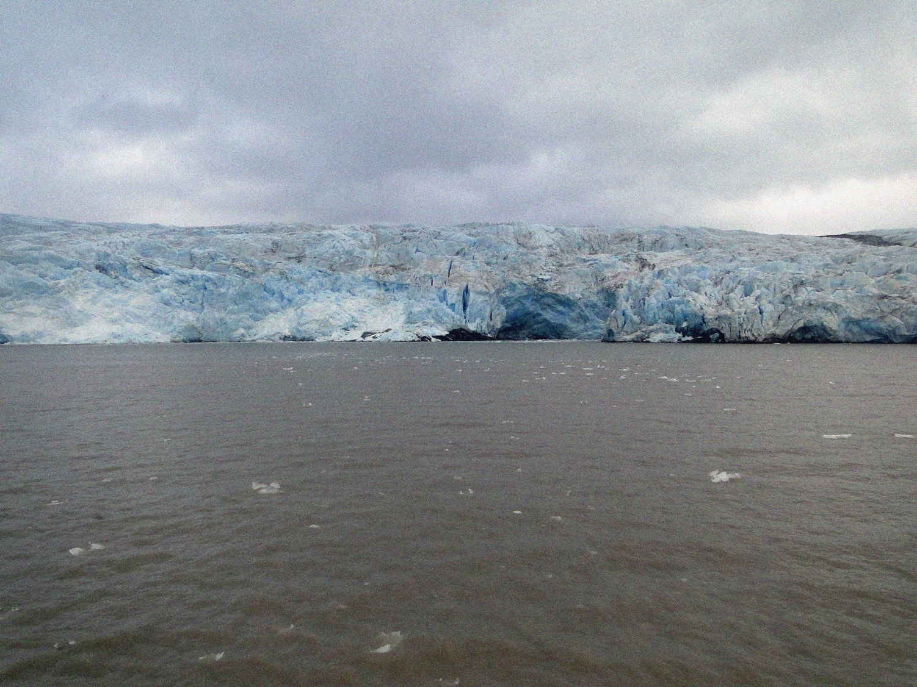
Thank you ispessi@ulg.ac.be http://www.ccambio.ulg.ac.be

