Slide 1
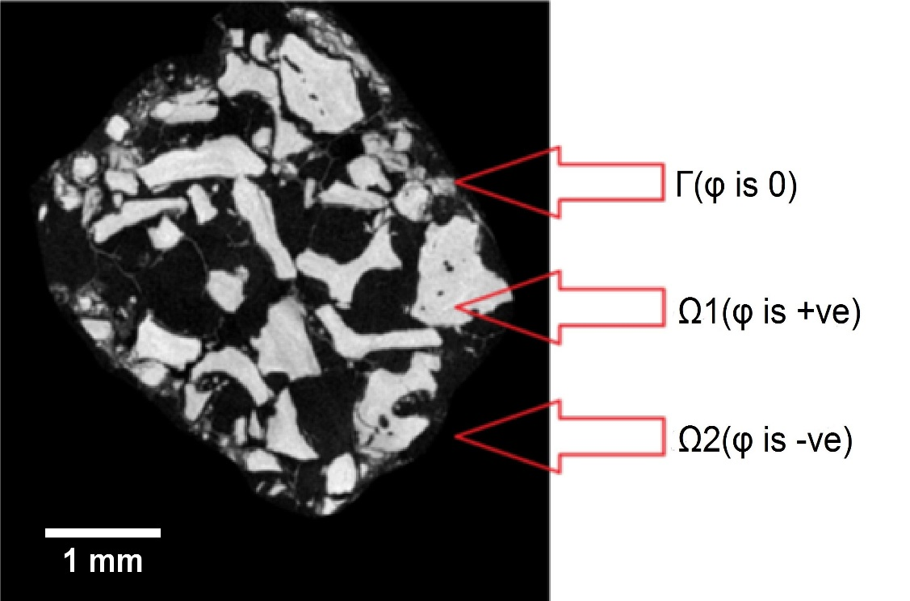
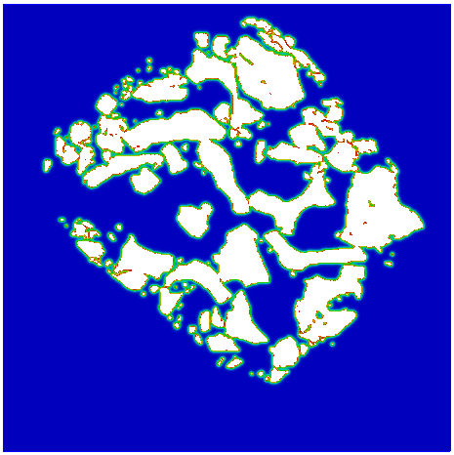
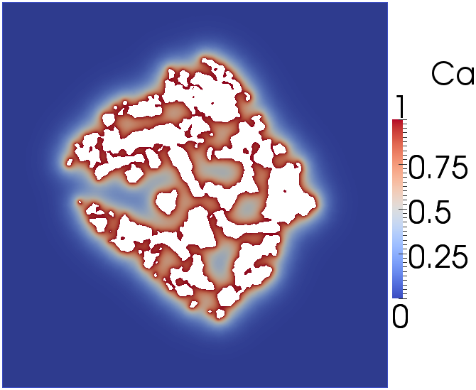
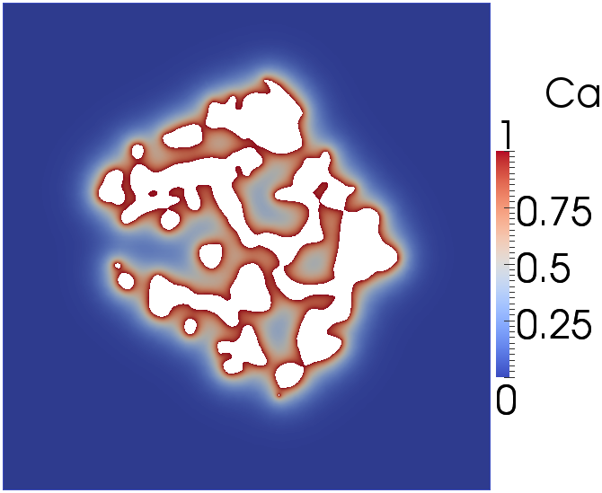
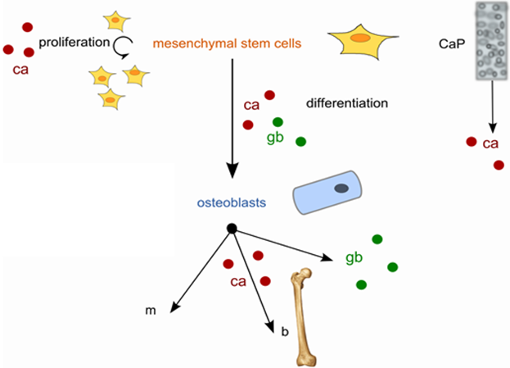
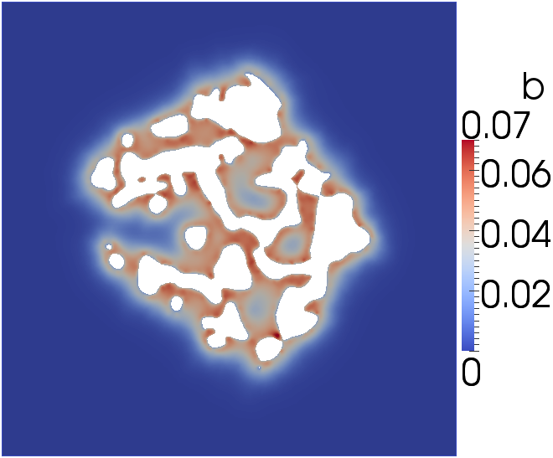
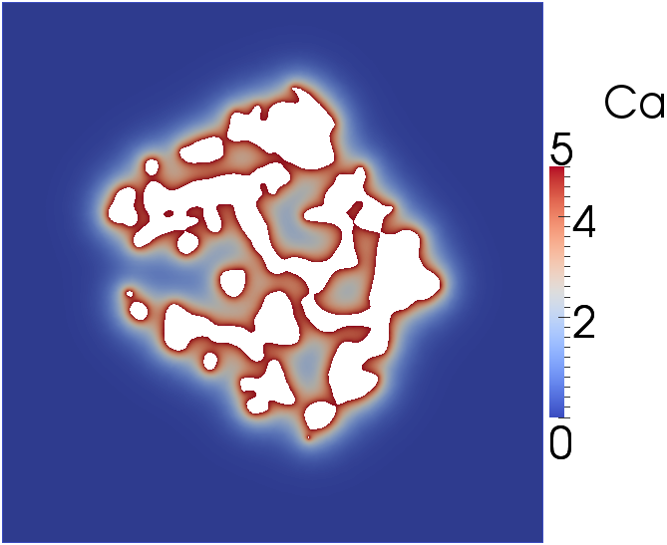
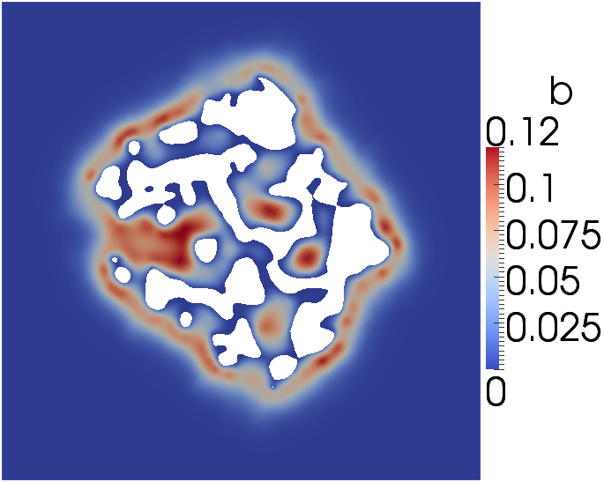
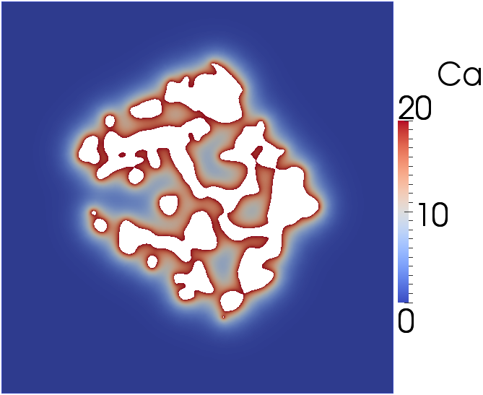
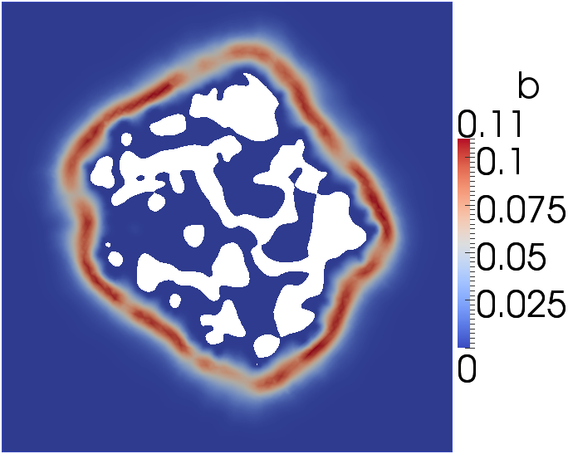
Investigating cell-carrier combinations for bone formation using a mathematical model
V. Manhas^{1,3,5}, Y. Guyot^{1,5}, Y.C. Chai^{2,5}, G. Kerckhofs^{1,4,5}, A. Carlier^{1,3,5}, J. Schrooten^{4,5} and L. Geris^{1,3,5}
¹Biomechanics Research Unit, University of Liège, Liège, Belgium; ²Tissue Engineering Laboratory, Skeletal Biology and Engineering Research Center,
KU Leuven, Belgium; ³Department of Mechanical Engineering, Division of Biomechanics Section, KU Leuven, Belgium; ⁴Department of Metallurgy
and Materials Engineering, KU Leuven, Belgium; ⁵Prometheus, Division of Skeletal Tissue Engineering, KU Leuven, Belgium
INTRODUCTION
In tissue engineering (TE) applications, scaffolds act as carriers for cells and growth factors that restore functionality of an organ.
Since 1960s, calcium phosphate (CaP) has proven to be an excellent bone substitute material [1].
However, complexity of in vitro and in vivo behavior of these scaffolds has not been elucidated completely.
Computational models can help us to understand this complexity, allowing improvement in scaffold design.
The aim of this study is to computationally determine the local Ca²⁺ concentrations of different clinical grade CaP scaffold types and subsequently represent its effect on in vivo bone regeneration.
MATERIALS & METHODS
Model is developed as part of design and manufacturing strategy to investigate cell-carrier combinations for optimum bone formation.
Both, level-set equation and linear/non-linear PDEs are implemented in FreeFEM++, a free C++ based finite element solver.
Nanofocus X-ray computed tomography (nanoCT) images are obtained to extract scaffold geometries (fig.1A).
Scaffold morphology is then defined in finite element (FE) domain (fig.1B).
Level-set method (LSM), a numerical technique is used to track scaffold shape during bone formation process (fig. 3).
A
B
Figure 1: A. NanoCT image of CaP granules in the scaffold and B. Scaffold morphology defined in FE domain (right)
MODEL SETUP
RESULTS
DISCUSSION
A previously developed model of calcium driven bone regeneration (Carlier et al 2011) has been altered to account for novel insights. The equations describe densities of cells (mesenchymal stem cells (MSCs) and osteoblasts), osteogenic growth factors, collagen matrix, mineralization and calcium concentration.
The local growth factor density and Ca²⁺ concentration in the system influence the behaviour of cells (proliferation, differentiation, diffusion and apoptosis). The growth factors are produced by both MSCs and osteoblasts whereas production of collagen matrix is dependent only on osteoblasts. The bone formation is dependent on osteoblasts & local calcium concentration (see figure 2).
At the start of the simulation, there are MSCs ${(c}_{m, ini}={10}^{6}cells/ml),$growth factors ${(g}_{b, ini}=1.5 µg/ml)$ and collagen matrix ${(m}_{ini}=0.001 g/ml).$ For Ca²⁺ , various physiological values ranging from low to high are used.
Model reproduces sequential events observed experimentally (not shown here) during bone regeneration: (a) proliferation, (b) differentiation, (c) collagen production & (d) mineralization.
Model also simulates influence of local Ca²⁺ on bone regeneration (fig. 4 A,B,C).
Day 0
Day 56
Figure 3: Shrinking of the scaffold during bone formation process
A. Ca low
Bone formation
CONCLUSION
Proposed model is an interesting computational tool to investigate interactions between CaP based biomaterials and osteogenic cells.
However, dedicated in vivo and in vitro experiments are ongoing in our lab to validate in silico results.
Figure 2: Schematic overview of the model
B. Ca medium
Bone formation
REFERENCES
C. Ca high
Bone formation
[1] Carlier et al, Acta Biomaterialia, 7:3573-3585, 2011.
CONTACT DETAILS
Varun Manhas / Liesbet Geris
Biomechanics Research Unit, University of Liege
liesbet.geris@ulg.ac.be
Figure 4: A. Bone formation when Ca is low, B. Bone formation when Ca is medium, C. Bone formation when Ca is high
This work is part of Prometheus, the KU Leuven R&D Division of Skeletal Tissue Engineering (http://www.kuleuven.be/prometheus).
The research leading to these results has received funding from the European Research Council under the European Union's Seventh Framework Programme (FP/2007-2013) / ERC Grant Agreements n. 279100; from the Belgian National Fund for Scientific Research (FNRS) Grant FRFC 2.4564.12 and from the special research fund of the KU Leuven (GOA/13/016).

