Slide 1
NEW Trade partnerships, digital technologies and culture : the FADING OUT of the CULTURAL EXCEPTION?
Antonios Vlassis
Scientific Research Fund (Belgium) – Center for International Relations Studies, University of Liege

Slide 2
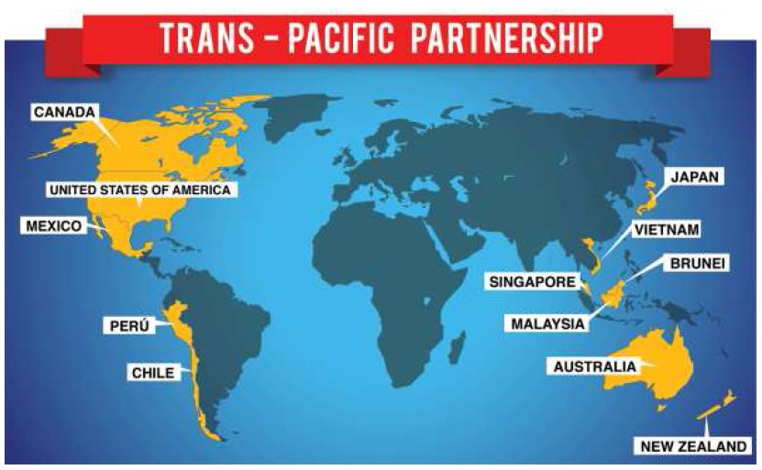
Trade partnerships and culture
Since 2013 negotiations on the Transatlantic Trade Investment Partnership (TTIP) between US and European Union, 15th negotiation round
Transpacific Partnership (TPP) among 12 of the Pacific Rim countries, signed in February 2016
« Partenariat transpacifique : bombe sur la culture », Le Devoir, 06 June 2016
« Paris impose l’exception culturelle à Bruxelles », Le Monde, 20 June 2013.
Between TPP and TTIP : Different approaches about the treatment of the cultural sector ?
If yes, for which reasons ?

Slide 3
1. International regime on cultural industries: interests and norms
Since 1990s :
General Agreement on Trade in Services-WTO
North-American Trade Agreement
Negotiations on Multilateral Agreement on Investment (OECD)
US administration, MPAA, Japan (…) # France, Canada, culture organisations of professionals (…)
Liberalisation of audiovisual-cultural sector # cultural exception
Global mobilization in favour of the diversity of cultural expressions
Convention on diversity of cultural expressions, UNESCO, 2005
Recognition of the specificity of cultural goods and services and of the importance of cultural policies for the protection and promotion of cultural diversity.

Slide 4
1. International regime on cultural industries : the digital technologies
Since mid-2000s : the new reality of the digital technologies
Broad changes on production, distribution, consumption of the cultural content.
The dynamic of 5D :
Dematerialization, Disintermediation, Decompartmentalization, Delinearization, Deterritorialisation
US administration : the financial and regulatory mechanisms on cultural sector are obsolete in the digital context.
Undisputed fact : the big transformation of the cultural sector due to the digital technologies
Controversial situation : how to deal with the effects, what should be the objectives of the cultural policies and what should be the regulatory and financial tools of the public authorities in this context?

Slide 5
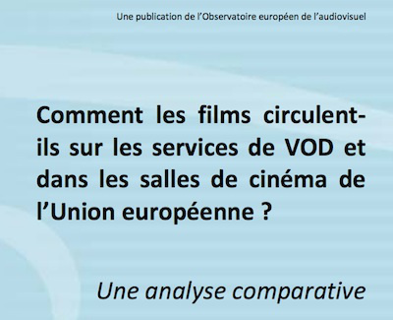
2. Culture in TPP and TTIP : asymmetrical regionalization in audiovisual services
Through the TTIP and TPP, formalization of asymmetrical relationships in terms of cultural industries
US: substantial trade surplus in terms of audiovisual services
UK, Australia, Germany, the Netherlands, Canada : 55% of total US exports in audiovisual services in 2012
Film markets dominated by Hollywood ; the only exceptions : France and Japan
Circulation of films on VOD services :
EU films travel less well on VOD than US films: on average EU films are available in 2.8 countries, US films in 6.8 countries.
47% of EU films released between 2005 and 2014 in EU cinemas were available on at least one VOD service
87% of US films released between 2005 and 2014 in EU cinemas were available on at least one VOD service.
80% of EU films are available in three countries or less, suggesting a three-country VOD distribution for EU films. 80% of US films are available in 11 countries or fewer.

Slide 6
2. Culture in TPP and TTIP : asymmetrical regionalization in audiovisual services
(in USD billions) | 2008 | 2009 | 2010 | 2011 | 2012
Exports | 13,2 | 13,7 | 13,6 | 14,5 | 16,2
Imports | 1,7 | 1,9 | 1,6 | 2,0 | 2,6
Balance of trade | 11,4 | 11,6 | 12,0 | 12,5 | 13,5
 | 2013 | 2014 | 2015
Australia | 3,5 | 2,4 | 7,2
Germany | 26,2 | 26,7 | 27,5
Mexico | 12,1 | 10,0 | 6,1
Chile | 8,1 | 2,8 | 3,8
France | 33,8 | 44,4 | 35,5
Spain | 13,9 | 25,5 | 19,2
Singapor | 4 | 4 | -
Poland | 20,4 | 27,5 | 18,7
Peru | 11,7 | 9,7 | 7,0
Malaisia | 13,2 | 10,2 | 6,6
Japan | 60,6 | 58,3 | 55,4
Italia | 31,0 | 27,8 | 21,3
US | 94,6 | 95,0 | 98,1
(revenues in USD billions | 2009 | 2013
Apple i Tunes | 4 | 16
Amazon | 7.6 | 13
YouTube | 0.5 | 5.6
Netflix | 1.6 | 4.3

Slide 7
2. Culture in TPP and TTIP : divergent approaches
TPP and culture
Extensive reservations in order to adopt and maintain policies about the cultural sector
BUT regarding the digital cultural services, the TPP undermines the 2005 CDCE
Canada cannot “adopt (a) discriminatory requirements on service suppliers or investors to make financial contributions for Canadian content development and (b) measures restricting the access to on-line foreign audiovisual content”
Japan : “broadcasting does not include on-demand services including such services supplied over the internet”
Chapter “Electronic commerce” : no special reservations to the digital cultural services, the definition of the “digital products” could lead to confusion and uncertainty.
“Digital product means a computer programme, text, video, image, sound recording or other product that is digitally encoded, produced for commercial sale or distribution, and that can be transmitted electronically”
The capacity of the countries with respect to promoting local content and regulating online audiovisual services is considerably weakened.

Slide 8
2. Culture in TPP and TTIP : divergent approaches
TTIP and culture
EU Negotiating mandate for a TTIP with US (2013) : « the Agreement will not affect the capacity of the Union and its Member States to implement policies and measures to take account of developments in the cultural sector in particular in the digital environment ».
European Parliament’s Resolution on the negotiations for a Trade in Services Agreement (February 2016): « to ensure, in line with Article 167(4) TFEU and with the UNESCO CDCE, by means of a horizontal and legally binding clause applicable to the whole agreement, that the parties preserve their right to adopt and maintain any measure with respect to the protection or promotion of cultural and linguistic diversity, irrespective of the technology or distribution platform used both online and offline ».

Slide 9
3. TTIP and TPP: Configuration of actors
Three factors :
A. Intergovernmental; B. inter-institutional; C. societal
Intergovernmental factor
Since 1990s, ambivalent position of participants to TPP in terms of ‘culture-trade’
WTO: 7 countries taking some commitments in the audiovisual sector
7 countries are Parties to the CDCE
Canada: political reversal about the CDCE and change of strategy about the cultural exception
TPP: major break in the treatment of the cultural goods and services in the trade agreements
France and several EU countries: intransigent position about an horizontal cultural exception dealing with traditional and digital cultural goods and services.

Slide 10
3. TTIP and TPP: Configuration of actors
Inter-institutional factor : the European Parliament as a kind of institutional guardian
Cultural exception: a red line for the EP and one condition for the future ratification of the TTIP
Reform on the Audiovisual Media Services Directive: the Parliament’s draft report (September 2016) suggests to rise to 30%, as opposed to 20% in the text of the European Commission, the rate of European works in the catalogues of VOD providers.
The cultural exception has not given rise to discussions within the national parliaments of the TPP countries

Slide 11
3. TTIP and TPP: Configuration of actors
Societal factor
European Coalitions for Cultural Diversity: very active exerting pressure to French government, European Parliament and European Commission; in favour of an horizontal cultural exception applicable to the whole agreement and dealing with linear and no linear audiovisual services.
Priorities: respect of the CDCE, protection of the cultural exception in EU trade negotiations, modernize creation funding in order to integrate new internet players, reduced taxation systems for cultural goods, with no differentiation on the nature of these goods (digital or physical).
The five coalitions for cultural diversity from the TPP countries : no common position about the treatment of cultural goods and services
Canadian Coalition for Cultural Diversity: in favour of a “chapter by chapter” cultural exception
No clear position about the place of digital cultural services in the TPP
Official comments of the Canadian Coalition for Cultural Diversity regarding Canada’s participation in the TPP (2012): no mention to the digital cultural services

