Slide 1
From resource to process efficiency.
-
Educating a new generation of engineers
Prof. Dr. Ir. Eric Pirard
Rosalia Fiorentino

Slide 2

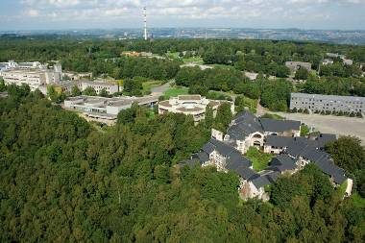
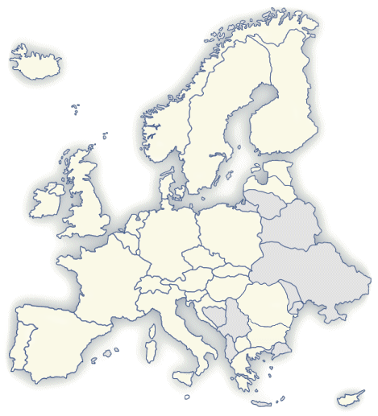
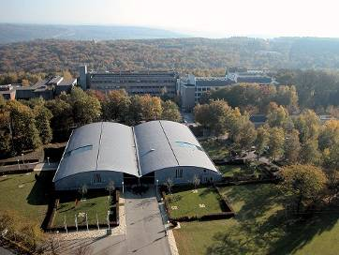
University of Liège
A heart beating for Europe
Liège - A millenary city
Less than 300km from:
London, Frankfurt,
Paris, Amsterdam,...
Cradle of mining &
metallurgy in Europe
23400 students
2200 PhD students
500 professors
One of the largest network of spin-off companies in Belgium
Notes:
Superimpose Australia

Slide 3
Geo-Engineers
Liège, Nancy 1900
  Improve (create?) the dialogue between geologists and mining engineers
Interface between geosciences and engineering
  Understand – Prevent – Manage – Beneficiate – Recycle – Protect
Liège, Nancy,… 2000
  “Not an engineer, nor a geologist…”
    Perfect background to adress (non-biological) environmental issues
    Focus on water protection / soil remediation / waste management / …
GEOTECHNICS
ENVIRONMENT
HYDROGEOLOGY
OIL & GAS
NUMERICAL
GEOLOGY
MINERAL RESOURCES

Slide 4

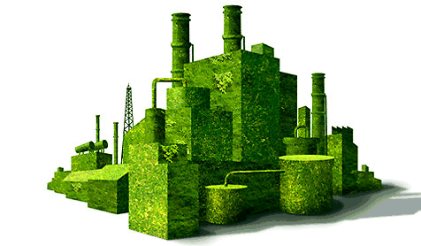



Geo-Engineers
Towards resource engineering
EXTRACTION & CONCENTRATION
Fragmentation/Sorting
PRODUCTION
Materials/Design
GEO-RESOURCES
Exploration/Evaluation
ECO-RESOURCES
Collect/Storage
Mines
Urban Mines

Slide 5
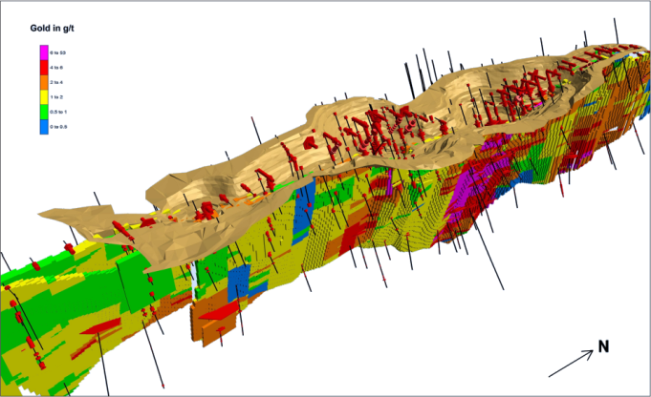
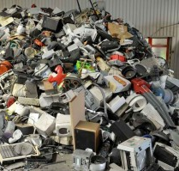
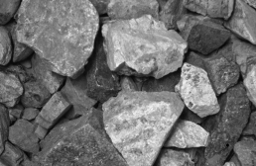
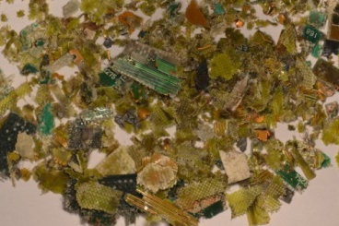
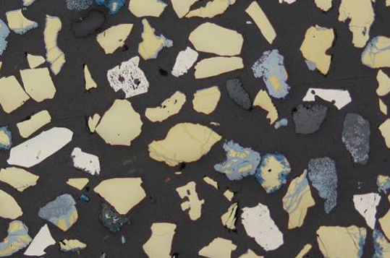
Geo-Engineers
Towards resource engineering
  Exploration
    Ore deposits, Landfills, Urban Mines,…
  Resource Estimation
    Grade, Tonnage, Kriging (spatial variability),…
  Characterization
    Mineralogy, small-scale testing,…
  Processing
    Comminution, Separation, Flotation, Leaching,…
  Simulation
    Particle tracking
    Process optimization

Slide 6
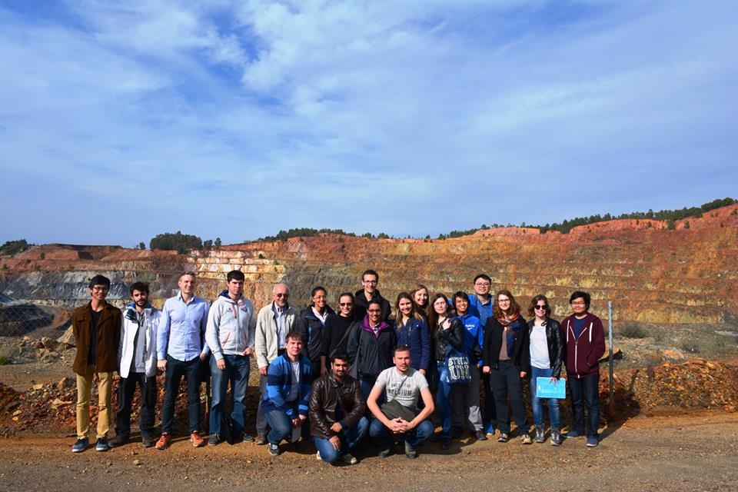

Geo-Engineers
Internationalisation
EMerald Master in Georesources Engineering
  2 Yr Innovative Education in Geometallurgy
  Full English program
  Simple mobility scheme
  Worldwide network of associated universities
www.em-georesources.eu

Slide 8
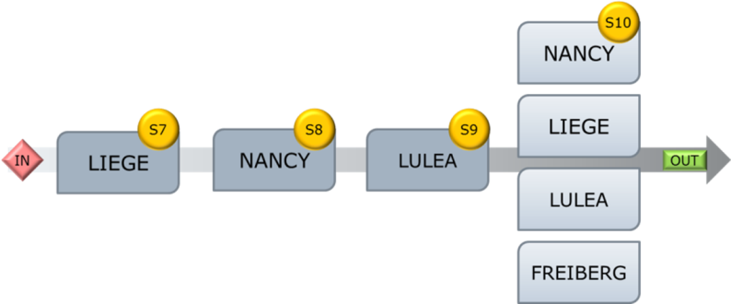
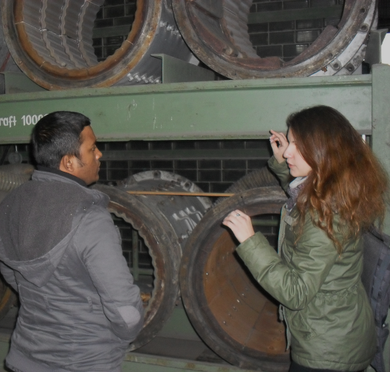
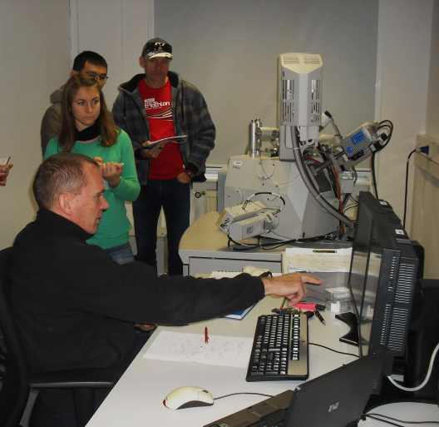
EMerald
Georesources Engineering
Engineering skills
  Characterization techniques (20 ECTS)
  Processing (35 ECTS)
  Modelling (25 ECTS)
  Management (15 ECTS)
  Internship + Master thesis(30 ECTS)
Interpersonal skills
  Semestrial mobility (1! group)
  Multicultural environment
  Group dynamics (projects)
  Communication skills

Slide 9
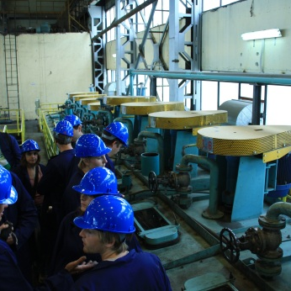
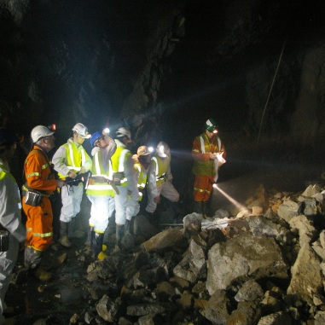
EMerald
Georesources Engineering
Strategic Advisory Board
      Senior representatives from industry
        Imerys, LKAB, Aurubis, Lhoist,…
      Academics from partner universities worldwide
        U Queensland; U CapeTown; U Chile; UFMG Belo Horizonte;…
  Mission
    Validate curriculum
    Support in organising / finding
      Seminars
      Field trips
      Internships
      Master theses

Slide 10
EMerald
Georesources Engineering
Seminars
      Health and Safety issues at industrial operations (Imerys)
      Corporate Social Responsibility (Umicore)
      Bankable Feasibility Study, theory and practical exercise (Technip)
      Legislative aspects of mining / recycling
      Environmental remediation of mining operations
Project work
  Teams of 4
  Analyze a mining operation
    Technical (resource / process)
    Social Acceptance / Corporate Social Responsibility
    Environmental Issues (water / tailings / reactants / …)
    Economic (production / taxes / financial structure / …)
  Written report + 10’ pitch
Development of a mining project in Greenland
Opening of a mine in densely populated areas
Reclaiming of landfills

Slide 11
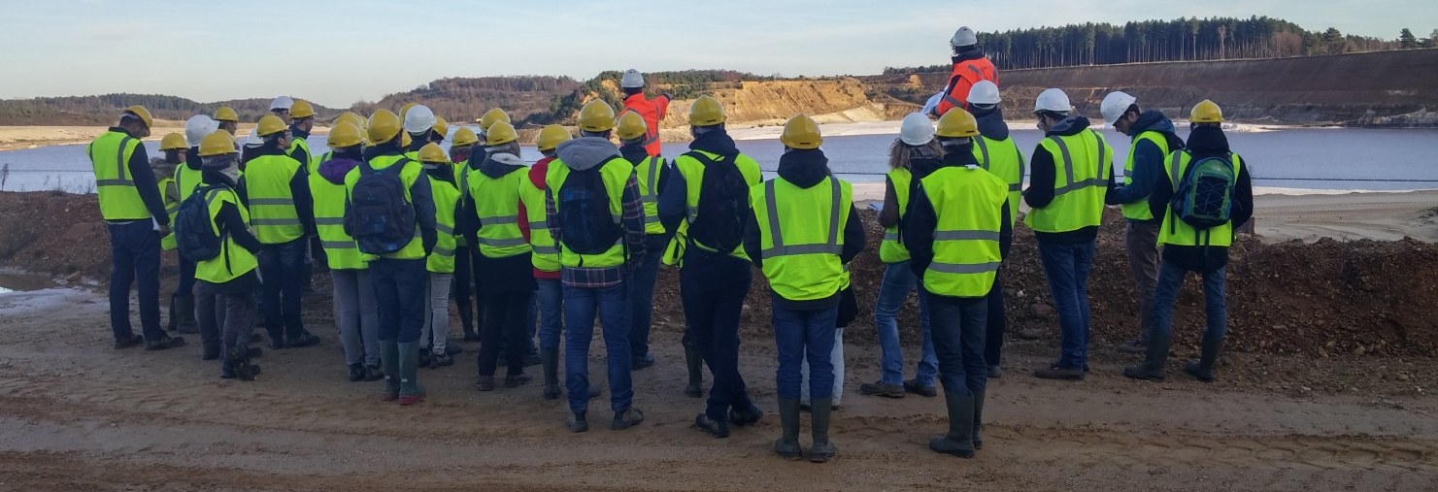
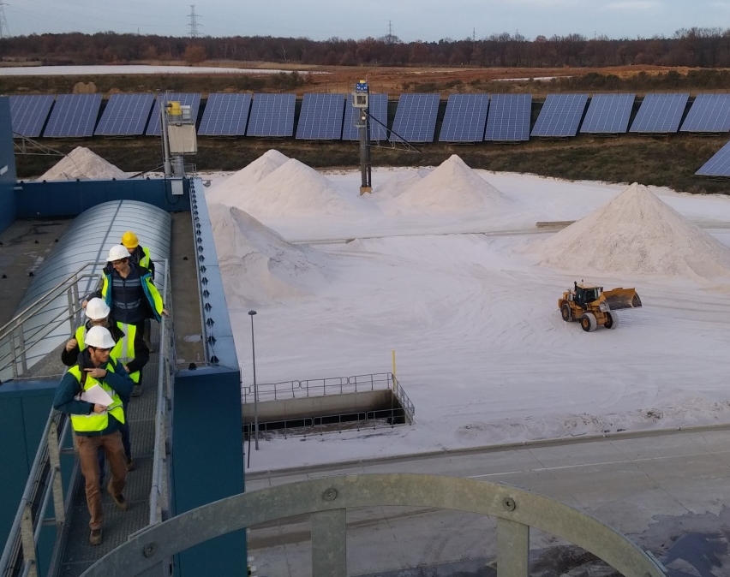
EMerald
Georesources Engineering
One day site visits
  Sibelco, Imerys, Umicore, Lhoist,…
    Focus on process efficiency and environmental impact

Slide 12
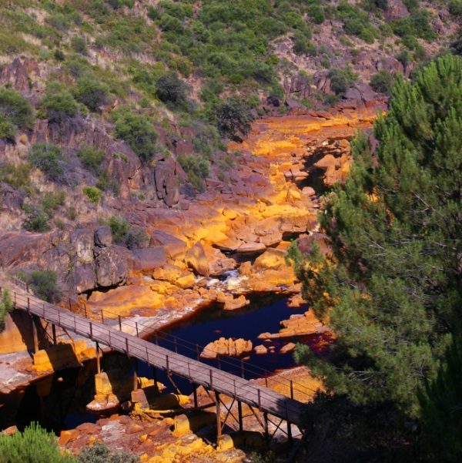
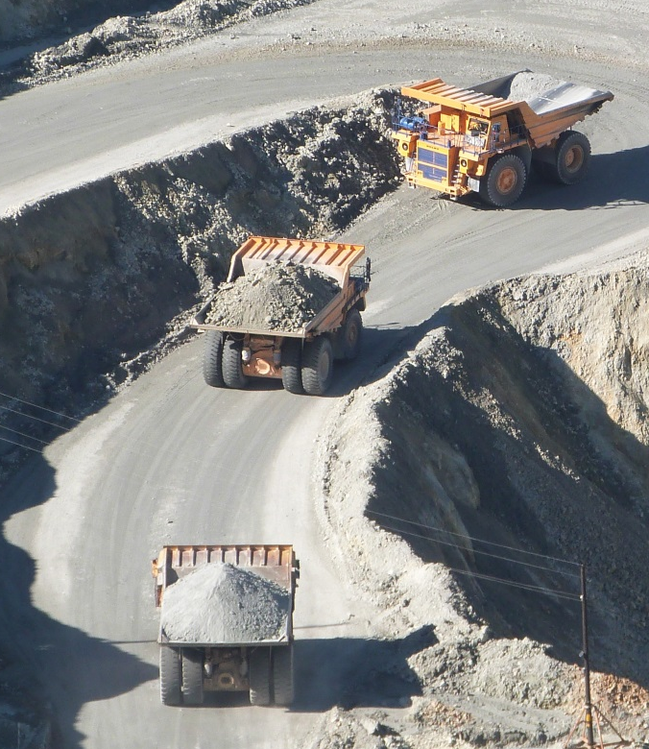
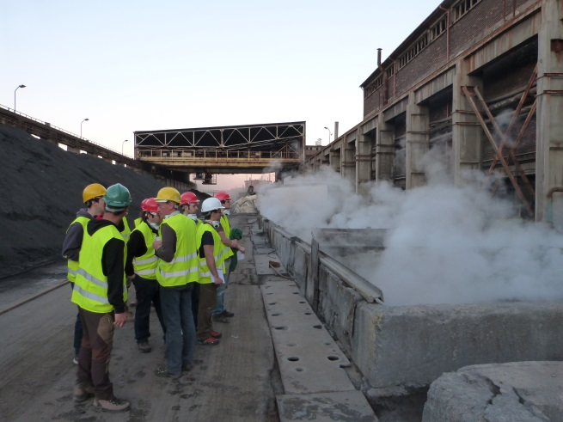
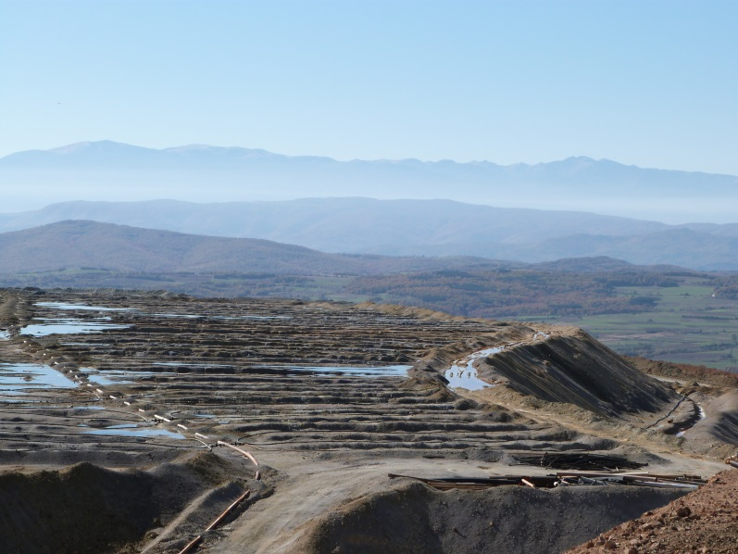
EMerald
Georesources Engineering
Field trips
  Poland 2013; Spain 2014; Bulgaria 2015;…
    Regional resource management
    Environmental remediation
    Communication and social acceptance

Slide 13
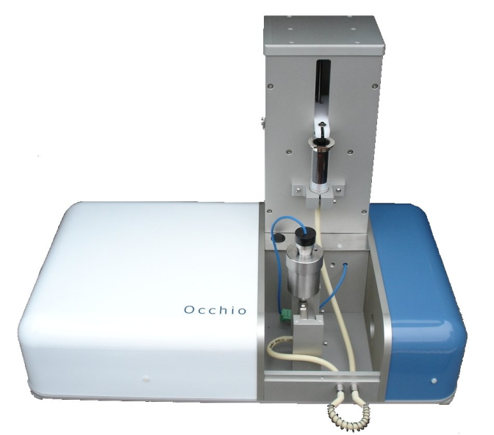
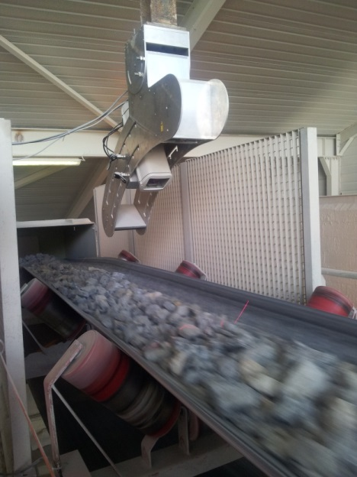
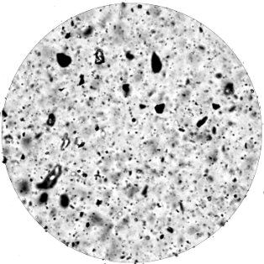
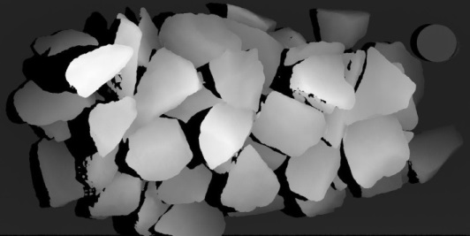
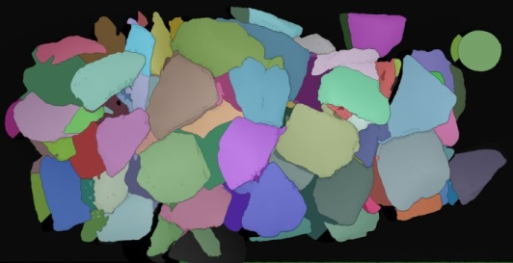
EMerald
Georesources Engineering
Internships & Master theses
  With industrial partner
    Innovation “process optimization”
    Economic, environmental and societal benefits
Flow cell

Slide 14
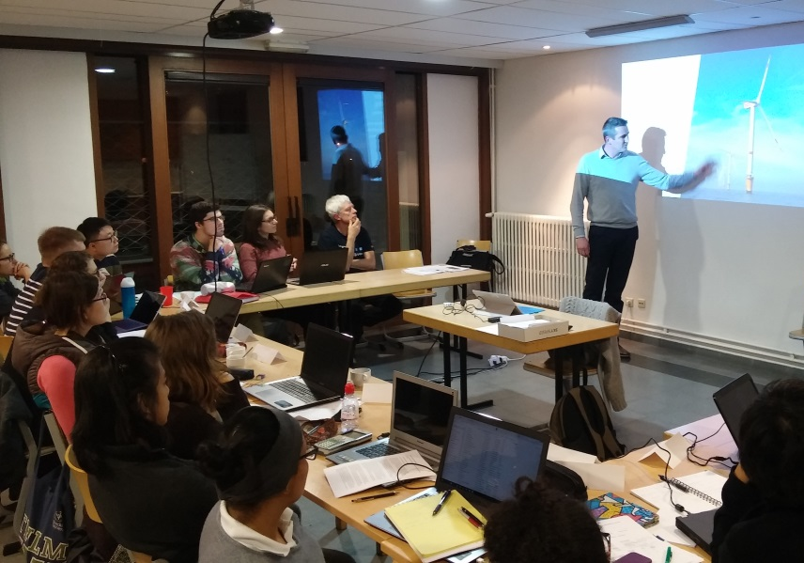
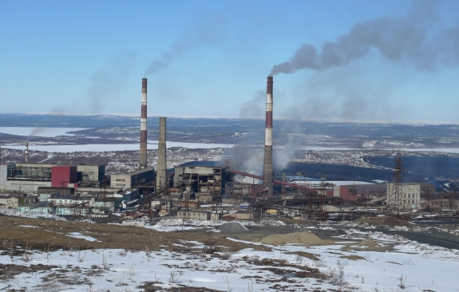
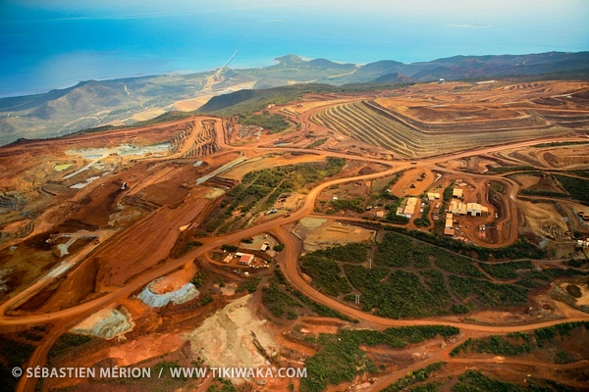
EMerald
Georesources Engineering
Business Winter School
  Testimonials by young entrepreneurs
  Business Model Canvas exercises
  Lifecycle analysis from “cradle to grave”
  Questioning sustainability of resource use
NORILSK (RUS) 1,5% Ni
Ni Sulphides
Underground mining
Arctic circle
Pyrometallurgy
TIEBAGHI (N CAL) 1,5% Ni
Ni Silicates
Tropical Ecosystem (reefs)
Open Pit Mining
Pressure Acid Leaching

