Slide 1
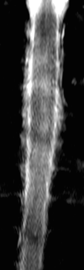
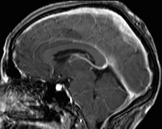
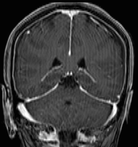
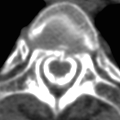
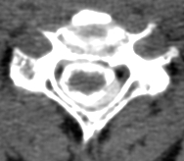
Neurosurgery and Spontaneous Intracranial Hypotension
AL. Salado, F. Scholtes,, S. Delstanche A. Fumal, M. Tebache, JL. Pépin, A. Maertens de Noorhout. CHU Sart Tilman, Université de Liège, Belgique.
BACKGROUND
Spontaneous intracranial hypotension (SIH):
Caused by unexplained cerebrospinal fluid (CSF) leak
Less common and less well know than idiopathic intracranial hypertension
CASE REPORT
Clinical presentation
60 year-old-woman
Within 1 week:
  Orthostatic headache, photophobia, nausea, and neck stiffness
  Without fever
Neurological examination: normal
Cervico dorsal MRI
Suspected a CSF leak
Epidural fluid sleeve extended along the cervico dorsal column
Fig 2: Cervico dorsal MRI :
Epidural fluid sleeve between dura mater and the bone limits of the intervertebral channel (red arrow)
Brain CT
normal
Myelography
Rarely performed in this context because it may worsen intracranial hypotension ²
Localises CSF leak
Cerebral MRI
Signs suggestive of intracranial hypotension ¹ (Fig. 1)
A
B
A
B
Fig 1: Cerebral MRI : A: Cerebral involvement. B: Pachymeningitis et Subdural effusion (red arrow).
Fig 3: Myelography : A: T0: localised the CSF leak in front of the spinal cord at D2-D3 (arrow). B: T30: Extravasations of the contrast within the epidural space D2 to D5 (red arrow).
DIAGNOSIS of SIH ^{3,5}
A. CSF leakage shown by imaging, or
B. Signs of intracranial hypotension MRI and at least one of the following additional arguments:
1- CSF hypotension at lumbar puncture (≤ 60mmH2O)
2- Meningeal diverticula
3- Symptom regression secondary to epidural blood patch, or
C. Orthostatic headache and at least one of the 3 additional arguments already cited in “B”
+
NOT: iatrogenic or post traumatic CSF leakage
TREATMENT
77% of patients are relieved by 2 bloods patches ²
Surgical treatment ^{4,6} if:
- repeated blood patches fail
- breach is identifiable
- reasonably accessible to surgery
- after multidisciplinary discussion
Ligature of the dura-mater diverticula with aneurysm clips
Placement of a muscle pledget on the leak
Rarely direct suture of the dura mater
Références
Aspect IRM de hypotension intracrânienne: diagnostic et impact thérapeutique, S. Soize, Université Paris Descartes
Le colmatage sanguin péridural (blood patch): au delà de la céphalée post ponction dure mérienne, A. Fabrizi, Anesthésiologie Conférences scientifiques, 2010, Volume 8, Numéro 5
A case of spontaneous intracrânien hypotension: from Menière like syndrome to cerebral involvement, N. Fontaine, European Annals of Otothinolaryngology, 2012, 129, 153-156
Prise en charge de la brèche dural, P. Zetlaoui, DAR Bicêtre, SFAR 2012
Docteur j’ai mal à la tête, J. Behr, Neuroradiodiagnostic et imagerie vasculaire, CHU de Besançon
Spontaneous spinal cerebrospinal fluid leaks, WI Schievink, Department of Neurosurgery, Cedars-Sinai medical center, Los Angeles, CA, USA

