Slide 1
Genomic study of multiple myeloma based on aCGH and NGS
Blood cancer of mature plasma cells
Normoploid profile (del(13), del(17)(p), t(4;14))
>>>BAD prognosis
Hyperdiploid profile (trisomy of odd chromosomes)
>>>GOOD prognosis
Unreliable classification !!
Genomic abnormalities
High resolution SNP-aCGH
Punctual mutations
High throughput exome sequencing
Clinical data
Subclassification of multiple myeloma
Notes:
I will present briefly the results of my project intitled ,,,. Mmis a ,,, patients can be divide in 2 based on genomic prfile,,, but unrealiable because many ,,,
In this study we try to detect ,,,,on a cohort of 95 patients and this data link with,,,

Slide 2
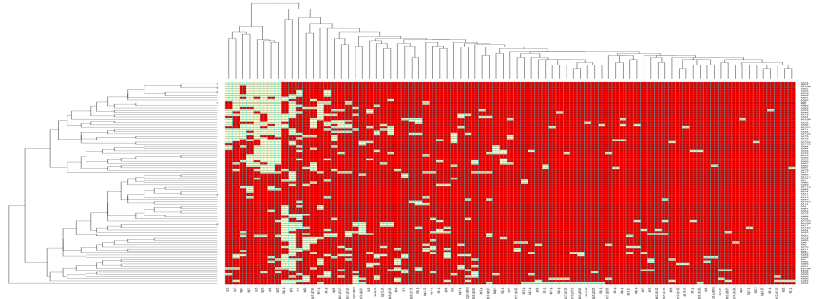
Genomic study of multiple myeloma based on aCGH and NGS
Xi
Xa
Xa
45% of the patients show X chromosome alteration
AR
Xi deletion
XIAP
BCORL1
IRAK
IKBKG
…
Loss of heterozygosity on Xq region
Notes:
results obtain by cgh are represented by this heatmap which show in ble box patient,,, and in orange box patients ,,, but we also detected many alte with unknown prognosis impact it s the case for,,,
If we look at NGS data we can see here for these 2 patients with partial deletion that the kept region is characterized by a loh, it mean that we are not in this condition but rather in ,,,
Based on these observations we ask the question QUID about the genes in the conserved region sometimes implicated in apoptosis or in cell prolif? To answer this question we performed a screening of theirexpression. The results are available on my poster and i invite you to come and have a discussion about that.

