Slide 1


Is there a place for Bone Turnover markers in renal osteodystrophy?
Pierre DELANAYE, MD, PhD
Nephrology Dialysis Transplantation
CHU-Sart Tilman
University of Liège
BELGIUM

Slide 2
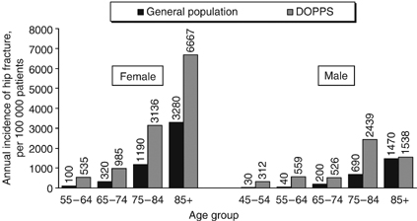
Incidence of hip fracture in dialysis patients versus the general population
Jadoul M, KI ,2006, p1358
Notes:
Moe dans JASN EVOLVe: 10 à 52% des patients dialyses ont eu une ou des fractures
FR: age, femme, psychortrope, malnutrition

Slide 3
N=34579
Notes:
Quand ajusté la mortalité reste plus haute (data not shown) et c’est vrai que c’est le non ajusté qui compte ici…
USRD: risue mortalit” 2,7x plus haut
Remarque: durée d’hospi: 7 jours aux USA et plus de 30 au Japon

Slide 4
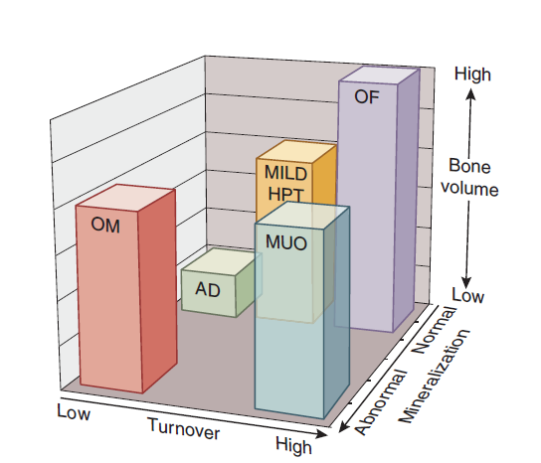
Bone health in CKD patient
(turnover versus volume versus mineralization)
Moorthi N, Kidney Int, 2013, p886

Slide 5
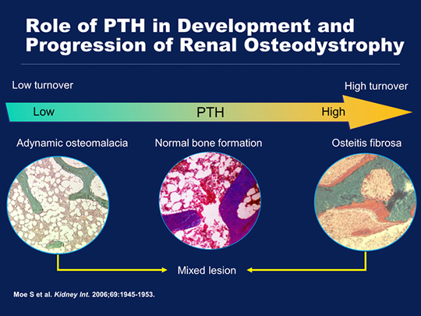

Slide 6
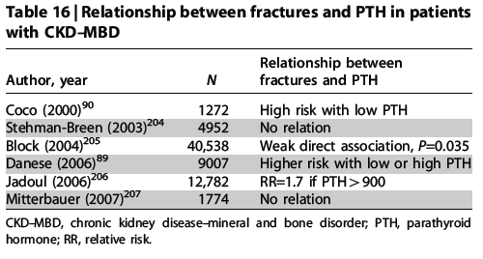
PTH and fracture
Association PTH-fracture in dialysis patients
Idem in Iimori S, NDT, 2012 (n=485)
Goldsmith D, AJKD, 2009, p1002
Notes:
Goldsmith = métanalyse de 5 études (très hétérogènes) high PTH associé à fracture
Ostéodensitométrie en dialyse n’est pas non plus franchement (en tout cas pas aussi franchement) associée aux fractures en dialyse

Slide 7
Diagnostic

Slide 8
KDIGO Guidelines
August 2009

Slide 9
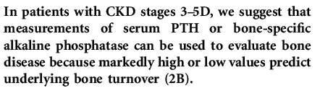
Bone biomarker: focus on bone turnover

Slide 10

PTH target: 150 – 300 pg/mL
Allegro intact PTH
Am J Kidney Dis. 2003 Oct;42(4 Suppl 3):S1-201.
K/DOQI clinical practice guidelines for bone metabolism and disease in chronic kidney disease.
National Kidney Foundation

Slide 11
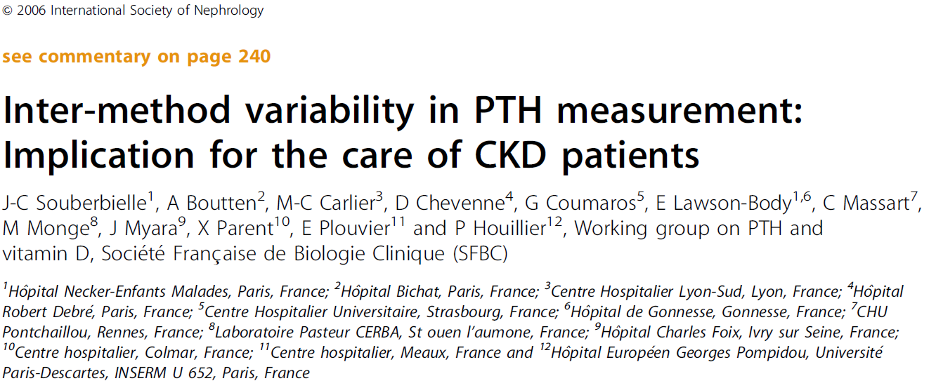
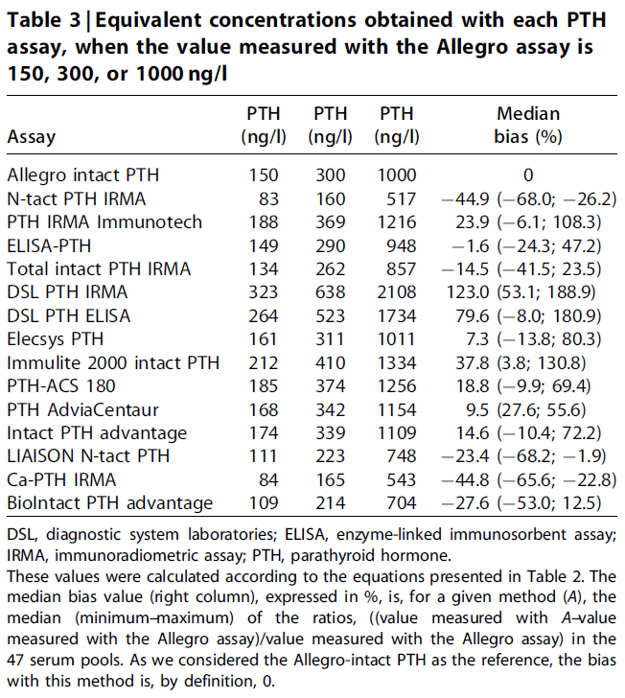

Slide 12
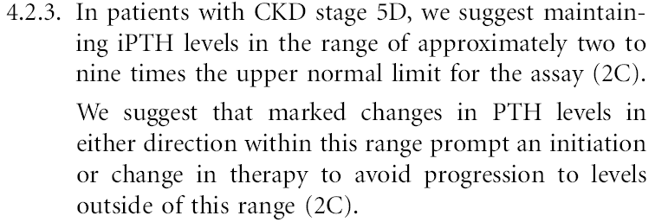
KDIGO Guidelines
August 2009
Importance of the « normal » upper value

Slide 13
Reference values for PTH
Exclude all potential causes of secondary hyperparathyroidism!
Inclusion of patients with:
Normal GFR
Normal 25(OH)D concentration
Normal Ca and Phosphates concentrations
Have the manufacturers followed these recommendations for establishing their reference values?
Souberbielle JC, Clin Chem, 2005

Slide 14
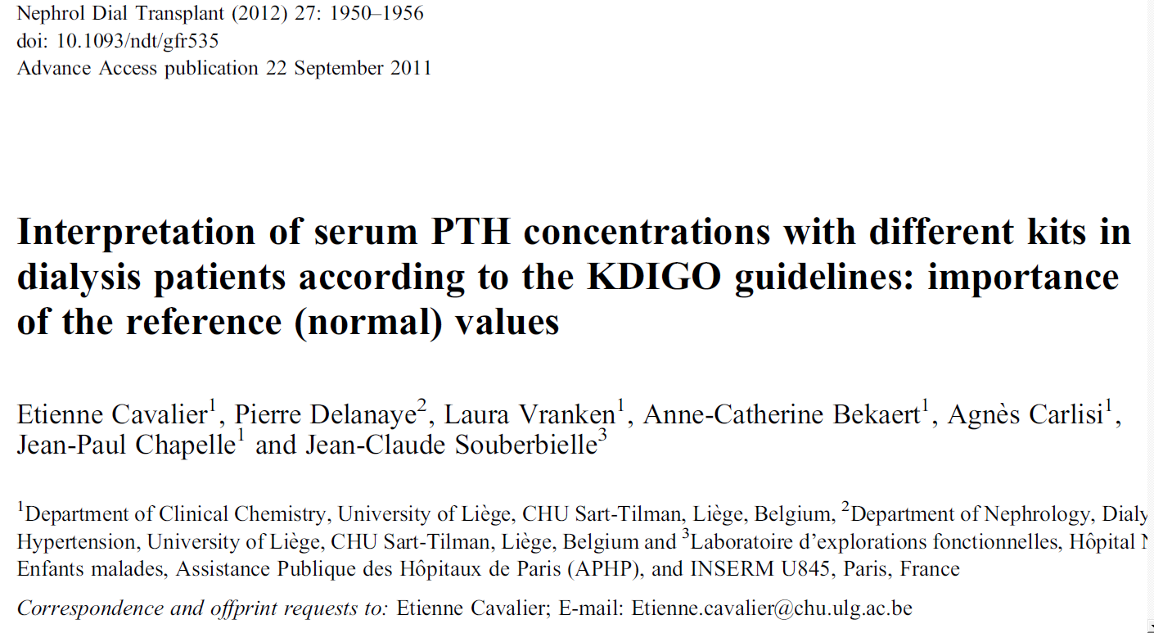

Slide 15
n=240
Methods | Reference range (Manufacturer) (pg/ml) | Lower and Upper Reference limits (95% Confidence – Interval) obtained in our reference population (pg/mL)
2nd generation assays
Abbott Architect | 15.0 - 68.3 | 16.3 - 64.7
Beckman Access | 12 - 88 | 10.1 - 47.4
DiaSorin N-tact IRMA | 13 – 54 | 7.2 - 35.7
DiaSorin Liaison N-tact | 17.3 - 72.9 | 21.3 - 68.2
Ortho Vitros | 7.5 - 53.5 | 10.8 - 47.5
Roche Elecsys | 15 - 65 | 13.7 - 50.2
Scantibodies Total intact PTH | 14 - 66 | 7.8 - 49.7
Siemens Immulite | 12 - 65 | 5.4 - 57.1
3rd generation assays
DiaSorin Liaison 1-84 | 5.5 - 38.4 | 4.6 - 25.8
Scantibodies Ca-PTH IRMA | 5 - 39 | 6.8 - 30.8

Slide 16
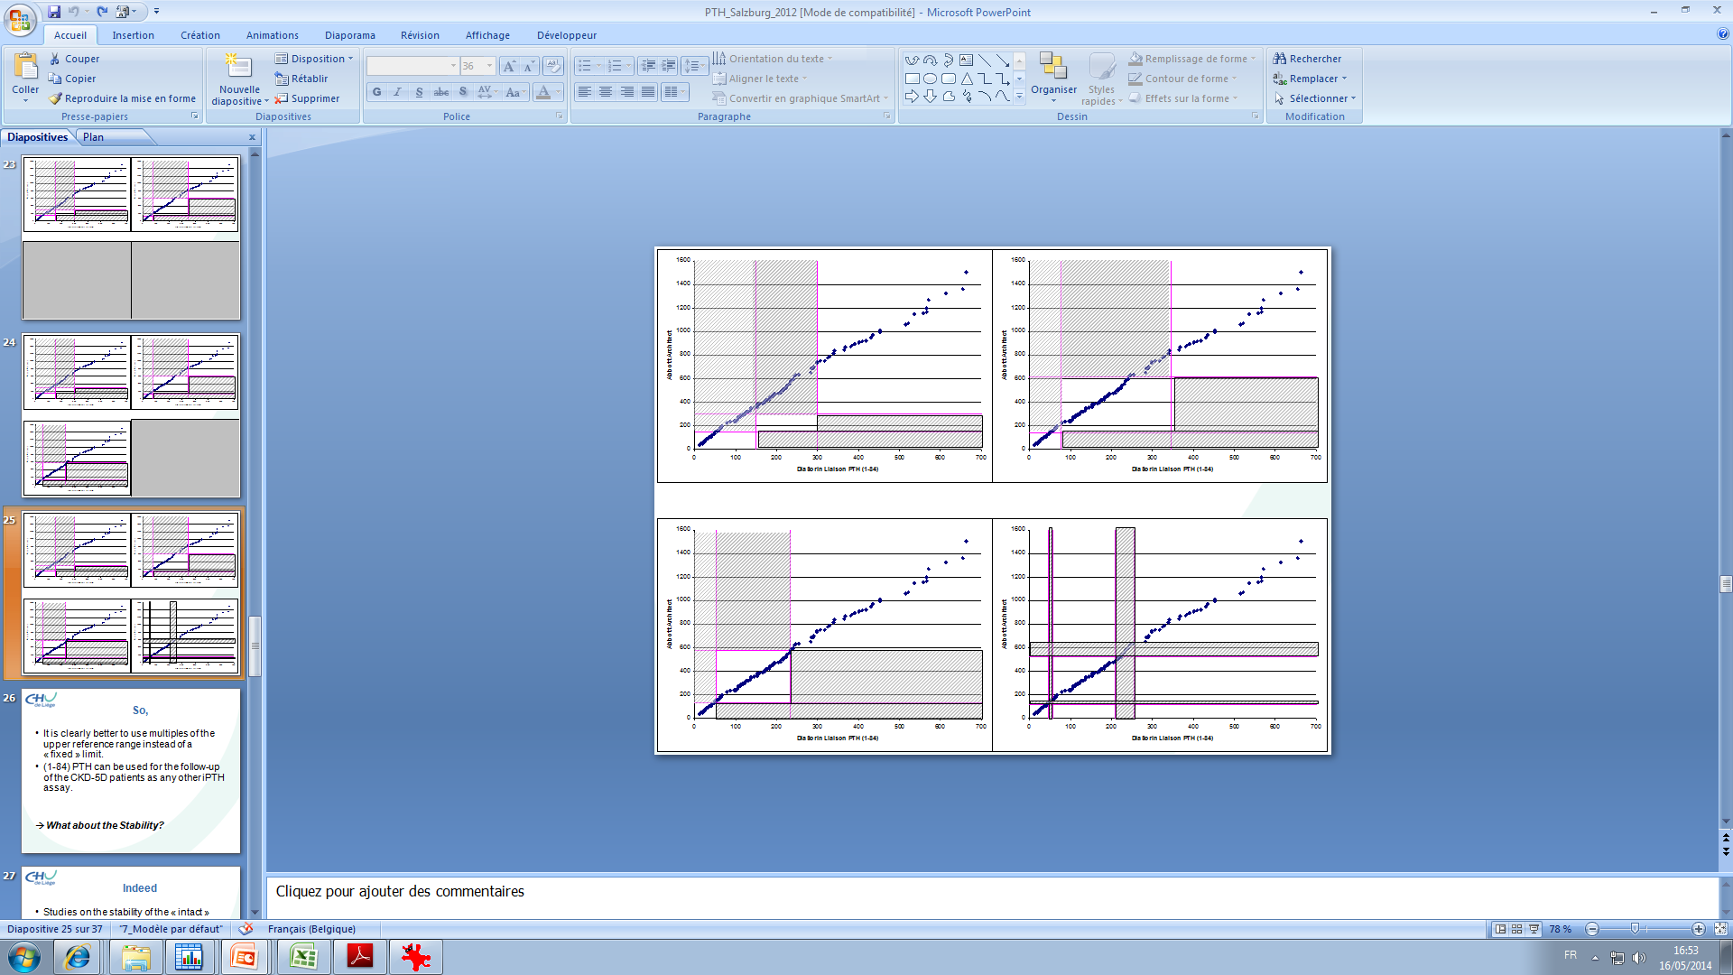
Impact on the concordance between assays
n=149

Slide 17
PTH in dialyzed patients?
  ☑ PTH is not a true bone biomarker
  High PTH values associated with high bone turnover
  Low PTH values associated with low bone turnover
  A grey zone…

Slide 18
Bone biomarker: focus on bone turnover

Slide 19
BALP: Why?
Clinical arguments
« True » bone biomarker (produced by osteoblasts, role in mineralization)
Concentrations are not influenced by renal function
Association between BALP and PTH in CKD patients
Association with fracture risk
Associated with BTR
Critical difference
Delanaye P, NDT, 2014, p997

Slide 20
BALP: Clinical limitations
High values when fracture, metastases, Paget and osteomalacia...
No clear threshold: between 10 and 20 µg/L proposed as target values but no consensus in the guidelines.

Slide 21
BALP: analytical limitations
Interference in hepatic diseases
Not available in all countries (costly)
No standardization between assays

Slide 22

Nothing is perfect…

Slide 23
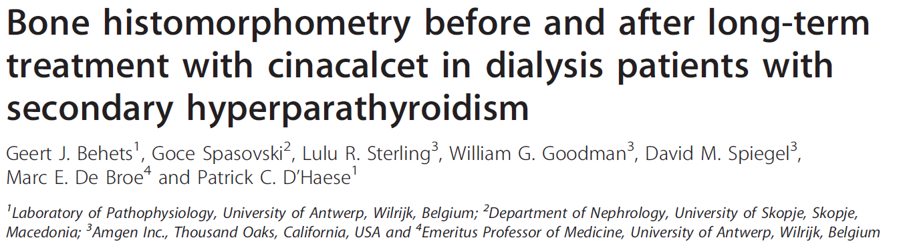

+ 18 y, dialyzed
Biopsy
PTH>300 pg/mL (Advia Centaur)
BALP>20,9 ng/mL (Tandem)
Calcium > 8,4 mg/dL
Included if high BFR
17% (25/146) of patients with PTH>300 pg/mL (Advia Centaur) and BALP>21 ng/mL were excluded because normal BFR (at least no adynamic bone)

Slide 24
Am J Kidney Dis. 2016 Apr;67(4):559-66
492 dialysis patients
Brazil, Turkey, Portugal, Venezuela
Cross-sectional
Notes:
1993-2007 à -20°C….

Slide 25
Scantibodies: Third generation
6-32 pg/mL
TRANSVERSAL !
Notes:
PTH= Roche elecsys
bALP= Quidel

Slide 26
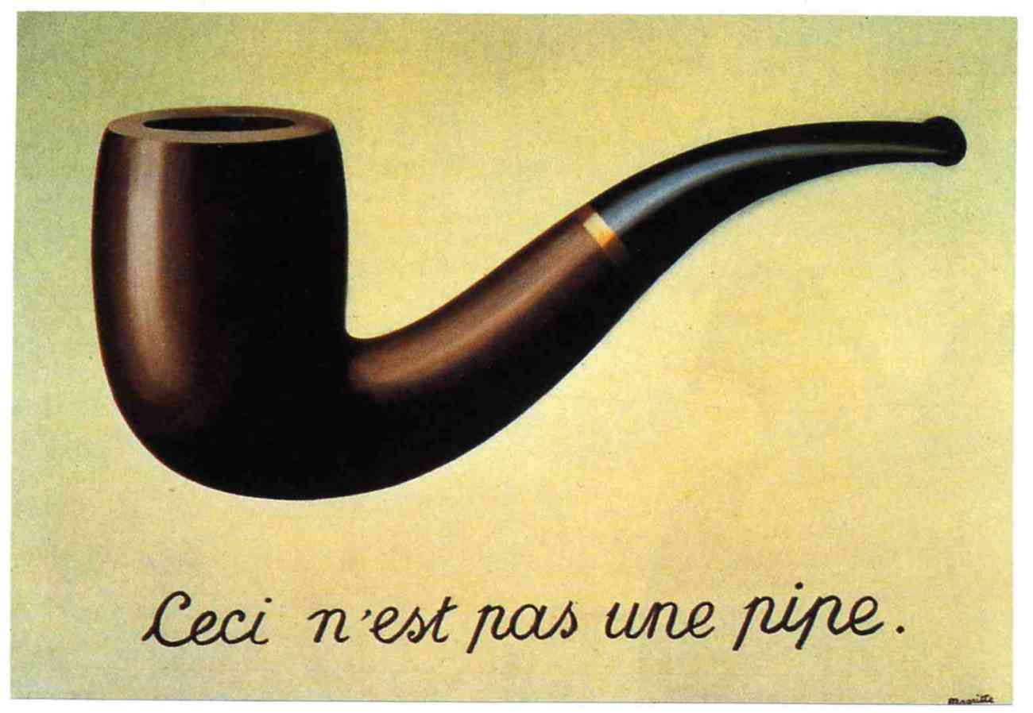
So, what ?

Slide 27
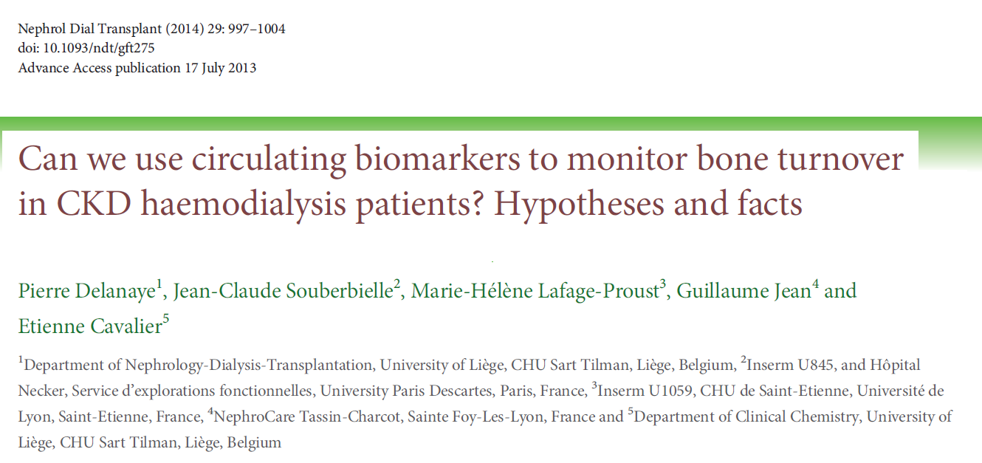
“New” bone biomarkers in CKD-MBD
TRAP-5B: tartrate-resistant acid phosphatase 5B, bone resorption marker
CTX: Beta-CrossLaps, fragments formed as a result of the degradation of type I collagen
P1NP: amino-terminal propeptide of type 1 procollagen, produced in equimolar amounts with the collagen deposited in the tissue
Osteocalcin: Osteocalcin is captured in the bone matrix during bone formation processAnd then is released during bone resorption
Sclerostin

Slide 28
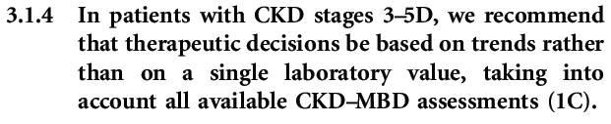

Slide 29
+ 18 y, dialyzed
Biopsy
PTH>300 pg/mL (Advia Centaur)
BALP>20,9 ng/mL (Tandem)
Calcium > 8,4 mg/dL
Included if high BFR

Slide 30
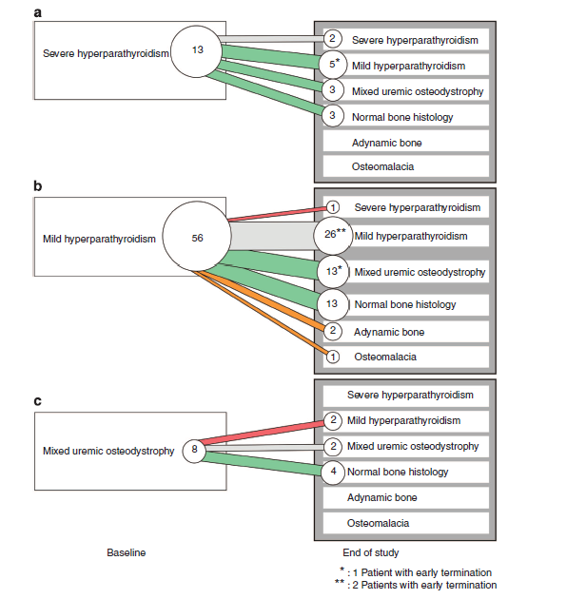
20 patients who normalized their bone biopsy have normalized their PTH and BALP levels, as well
Notes:
Sur les 77: 51% à baseline traité par vitamine D active et 78% à 1 an
Dose de 15.9 µg/sem à 21.8/sem
On n’est pas sur à 100% que l’effet bénéfique sur l’os n’est pas du à la vitamine D (mais bon) (Au moins deux petites études sur qqs patients de Brickman et Andress qui montraient un role bénéfique de la vitamine D sur l’hisptologie)
Pas de groupe contrôle non plus
Les deux os adynamiques ont aussi un ePTH qui va diminuer à moins de 1(celui avec ostéomalacie avec hypophosphatémie d’origine ?)

Slide 31
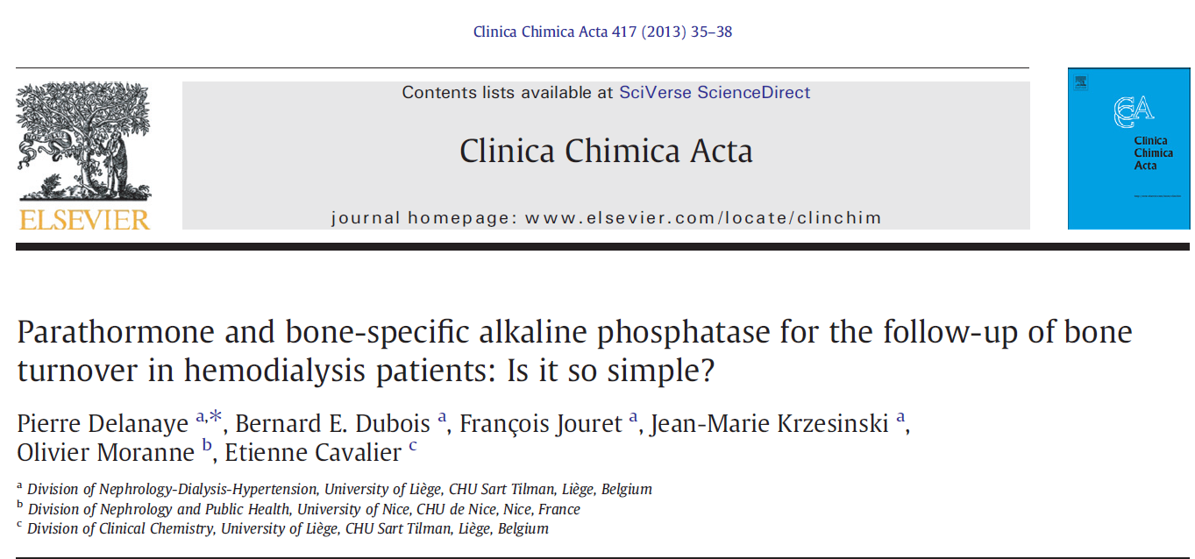
Trends

Slide 32
Follow up
Association between PTH-BALP
Determination of ΔPTH and ΔBALP
6 weeks
N=77

Slide 33
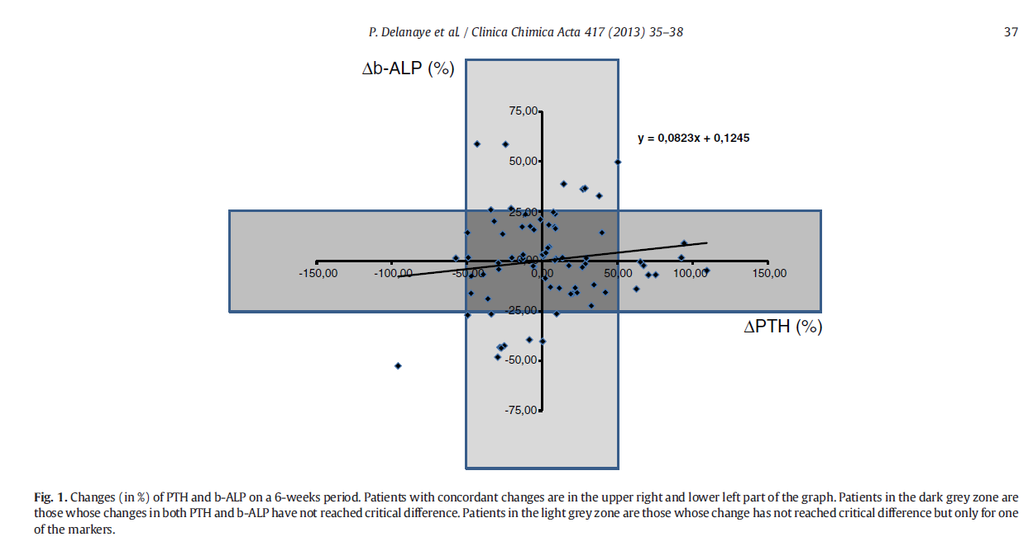
Follow up 6 semaines

Slide 34
Delanaye P and Cavalier E, ASN, San Diego, 2016

Slide 36
Cavalier E, AJKD, 2013

Slide 37
Conclusions
Is there a place? Yes, for sure…(bone biopsy)
Not so simple…
Trends and critical difference
Monitoring of therapy (?)
Collaboration between clinicians and biologists
Beyond bone turnover
Notes:
PBO: new KDIGO: oui si impact un éventuel traitement (ex BMD très basse)

Slide 38
Thank you

Slide 39
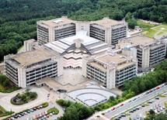
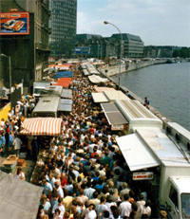


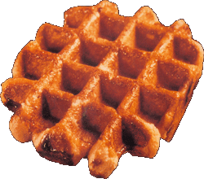
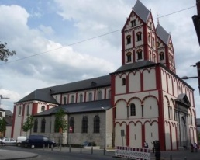
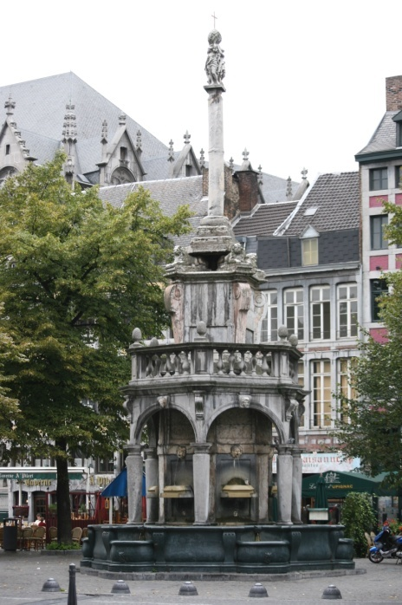

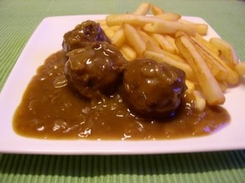
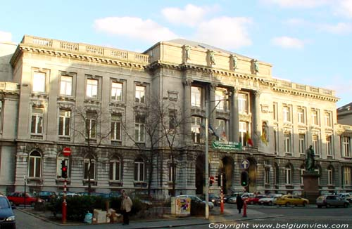
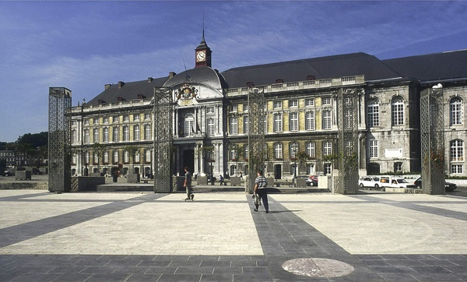


Enjoy Liège !

