Slide 1
Male and female behaviors, attitudes and moods at the light of their historical opportunities and capabilities
Claire Gavray
University of Liege

Slide 2
Approaching crime and crime control from a gendered perspective is highly relevant : crime and penalty are historically among the most gendered fields in the society, predominantly inhabited by men (Jon 2007,Tomsen 2008).

Slide 3
Gender refers here to the social construction of masculine/ feminine poles, of the separate and hierarchical rights, roles, statutes, qualities, competences, tastes, psycho-social attitudes of women and men.
It is a dynamic process which depends of the historical context in evolution, which can evolve in terms of form and intensity

Slide 4
Our question : Which effects of gender on teens’ depression and violence ?
French speaking Belgian ISRD 3 data
representative sampling of 472 girls and 578 boys of middle of secondary school
Same mean age in each gender group : 15 years

Slide 5
Violent acting
List of investigated behaviors : graffiti, vandalism, extortion, carrying a weapon, group fighting, beaten someone or an animal;
More boys than girls admit having experienced at least one violent behavior of the available list, ever and over the last year (sign <0.000)
Ever : 27 % of girls and 45 % of boys
During the last 12 months: respectively 18 % and 32 %.
Note that 93 % of girls and 82 % of boys experimented 1 single type of violent act last year.

Slide 6
.
ANOVA
male > code 1= boys SD =5.83 code 0= girls SD= 5.18

Slide 7
List of variables referring to bad experiences and feelings in several spheres
Attending general education or not Feeling of belonging to a highly deprived household Feeling that the police does not treat young people with respect Great importance given to peers’ recognition / admiration Not able to trust anyone in his neighborhood Feeling less supported by his teachers compared to other classmates
Feeling that school is not fulfilling its mission of emancipation and opportunities’ equalization Ever been victimized by someone (attacked, racketed) Ever been injured by someone so that he/she had to go to the doctor Ever been threatened because of his skin color, social or national origin Ever being hit, corrected by his / her parent (s)
Having experienced the death or serious illness of a parent Having experienced the excessive consumption of alcohol and drugs from his/her parent (s) Have experienced serious quarrels between his/her parents Mother absent in the household Father absent in the household

Slide 8
Violence /girls | R2 | F | p
Not in general education | .05 | 19.03 | <.0001
Parent(s) with problems of consumption | .04 | 16.45 | <.0001
Ever been injured by someone | .03 | 12.37 | <.001
Serious quarrels between parents | .01 | 5.84 | <.05
Ever been threatened because of his skin color, social or national origin | .01 | 5.25 | <.05
feeling of belonging to a highly deprived household; | .01 | 4.68 | <.05
Ever being hit, corrected by her parent (s) | .01 | 4.95 | <.05

Slide 9
Violence /boys | Partial R2 | F | p
Feeling that the police does not treat young people with respect | .05 | 22.15 | <.0001
Great importance given to peers’ recognition / admiration | .03 | 12.44 | <.001
Not in general education | .02 | 7.62 | <.01
Impression that school is not fulfilling its mission of emancipation and opportunities’ equalization | .01 | 5.32 | <.05

Slide 10
Depression/boys | R2 partiel | F | p
Serious quarrels between parents | .06 | 25.99 | <.0001
Having being hit by his parents | .03 | 15.51 | <.0001
Not in general education | .02 | 7.39 | <.01
Not able to trust anyone in his neighborhood | .01 | 6.51 | <.05
Ever been injured | .01 | 5.30 | <.05
feeling less supported by his teachers compared to other classmates | .001 | 4.37 | <.05

Slide 11
Depression/girls | Partial R2 | F | p
Number of different violent behavior of the list ever experienced. | .04 | 15.67 | <.0001
Serious quarrels between parents | .02 | 8.02 | <.01
Ever been threatened because of his skin color, social or national origin | .02 | 6.12 | <.05
Mother absent in the household | .01 | 5.14 | <.05
Great importance given to peers’ recognition / admiration | .01 | 5.86 | <.05
Parent(s) with problems of consumption | .01 | 5.47 | <.05

Slide 12
A same need for boys and girls to react to bad experiences and feelings of discrimination > not two different brains
Gender influences - type of roots of depression and violence
- type of stakes and reactions
‘Depression versus violence’
Two different paths, somewhere still hierarchized, among male teens
A interconnected path in female group

Slide 13
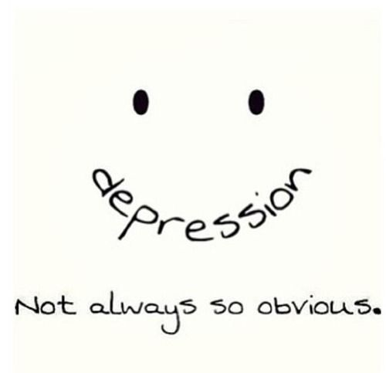

Slide 14
Gender historical opportunities and individual capabilities are active in the process
> confirmation of the interest
of the theory of societal vulnerability
of the theory of recognition / contempt
of the concept of ‘capabilities’

Slide 15

interesting for researchers and fieldworkers to adopt gender glasses ! And this from an early age !

